Slide 1
Social Networking for Research Communities Using Tagging and Shared Bookmarks: a Web 2.0 Application
Marlon Pierce, Geoffrey Fox, Joshua Rosen, Siddharth Maini, and Jong Youl Choi
Community Grids Lab, Indiana University

Slide 2
Motivation
MSI-CIEC is an NSF funded project to engage researchers at minority-serving institutions in modern cyberinfrastructure
“Minority Serving Institution-Cyberinfrastructure Empowerment Consortium”
See http://www.msi-ciec.org/eduwiki for more info.
As part of MSI-CIEC, we wanted to pursue social networking and other Web 2.0 approaches.
Enable MSI researchers to find others with similar research interests.

Slide 3
Tagging and Social Bookmarking
This was pioneered by sites such as http://del.ico.us
Connotea and CiteULike extend and specialize this for scientific journals.
Idea is to put your bookmarks of interesting URLs on a remote, Web accessible database rather than within your browser.
They can be shared
URLs are tagged with keywords
Everything has an RSS feed
Tags, users, user+tag combos, groups, and so on.

Slide 4
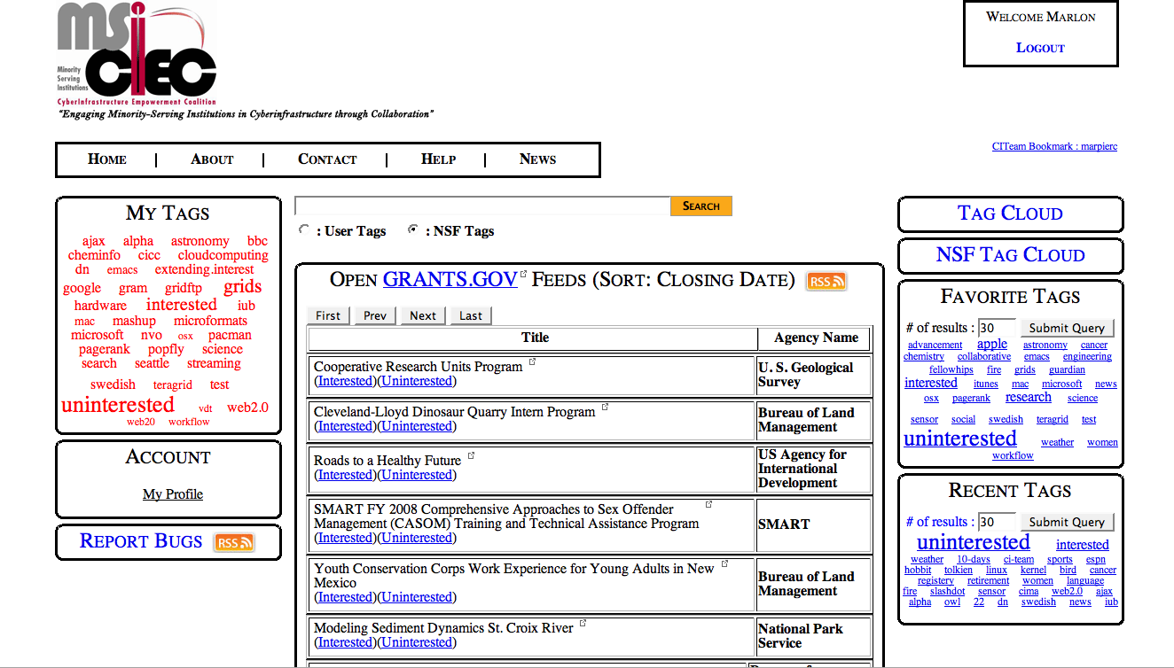
Tag Clouds
Click-Taggable Grants.gov RSS Feed

Slide 5
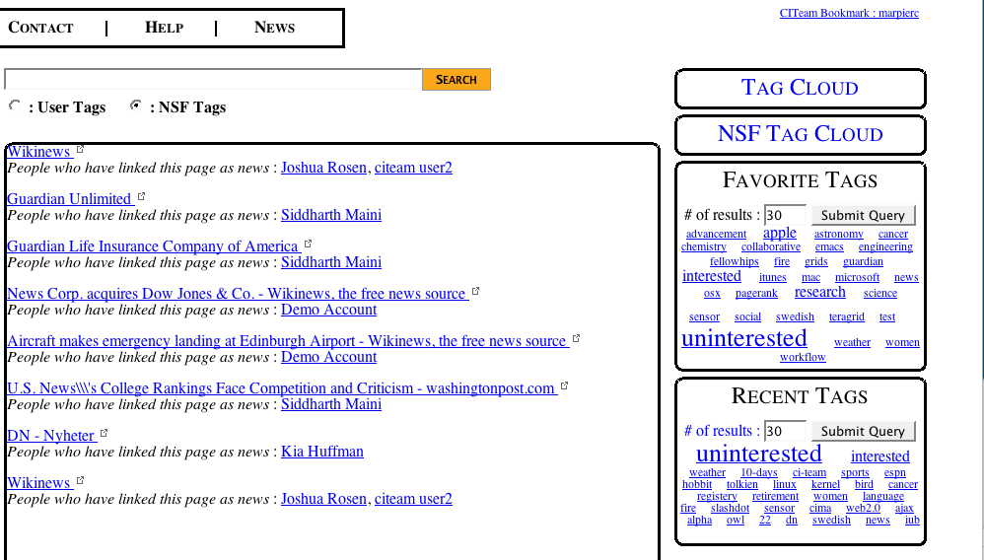
Click a tag and see all associated links.

Slide 6
Sweet Spots for Research Communities?
Most social bookmarking sites have much less profiling and social networking capabilities than Facebook, MySpace, etc.
You can find my bookmarks on del.icio.us but not much else about me.
NSF already has many rich sources of data that can be converted into tags and imported.
Previously funded research: division, directorate, project, investigators, etc.
We also import people and create profiles.
TeraGrid projects and allocations.
RSS feeds of funding opportunities

Slide 7
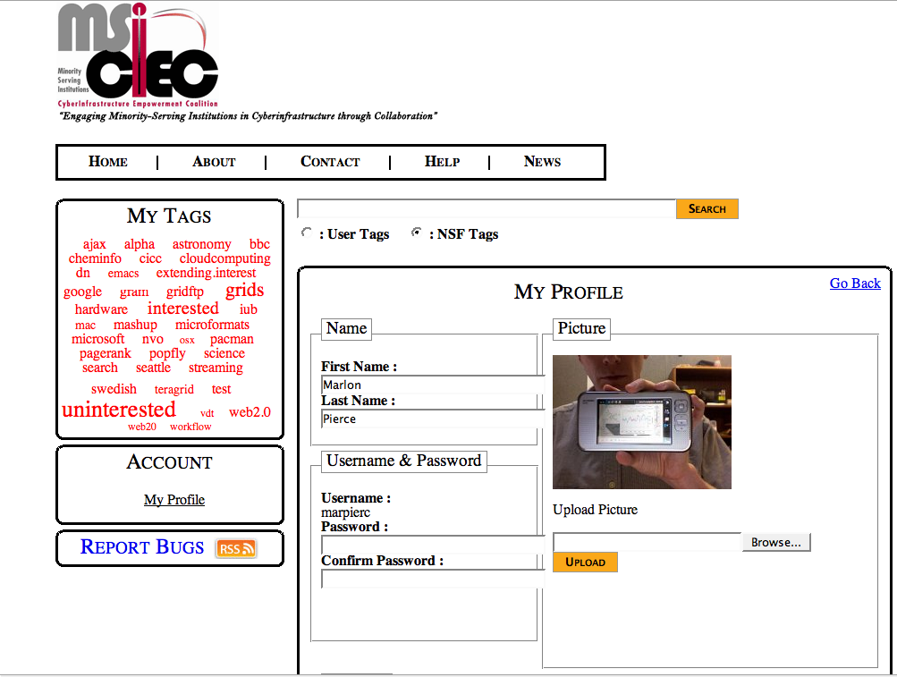
User profiles allow you to describe yourself.
Collaborators, awards, and tag profiles are automatically generated.

Slide 8
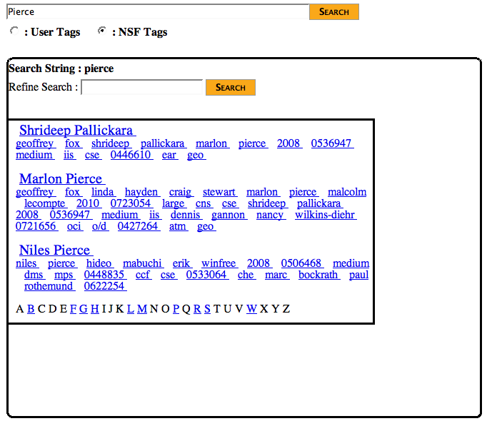
NSF search tags include
Researcher name
Directorate
Award number
Size of award
Year of award
TeraGrid allocation
Search NSF Tags to find matches
We can span multiple databases with tags.

Slide 9
Click Tagging and Grants.gov Feed
There are many useful RSS feeds that we can embed into the portal.
NSF’s “Research Opportunities” feed.
Let’s make it easy to tag these things so you can find collaborators.
Display feeds in the portal
“Interested” and “Uninterested” tags can be assigned in one click.
You can add other tags later.
Why no Grants.gov feed?
Let’s make one with OpenKapow’s Robomaker

Slide 10
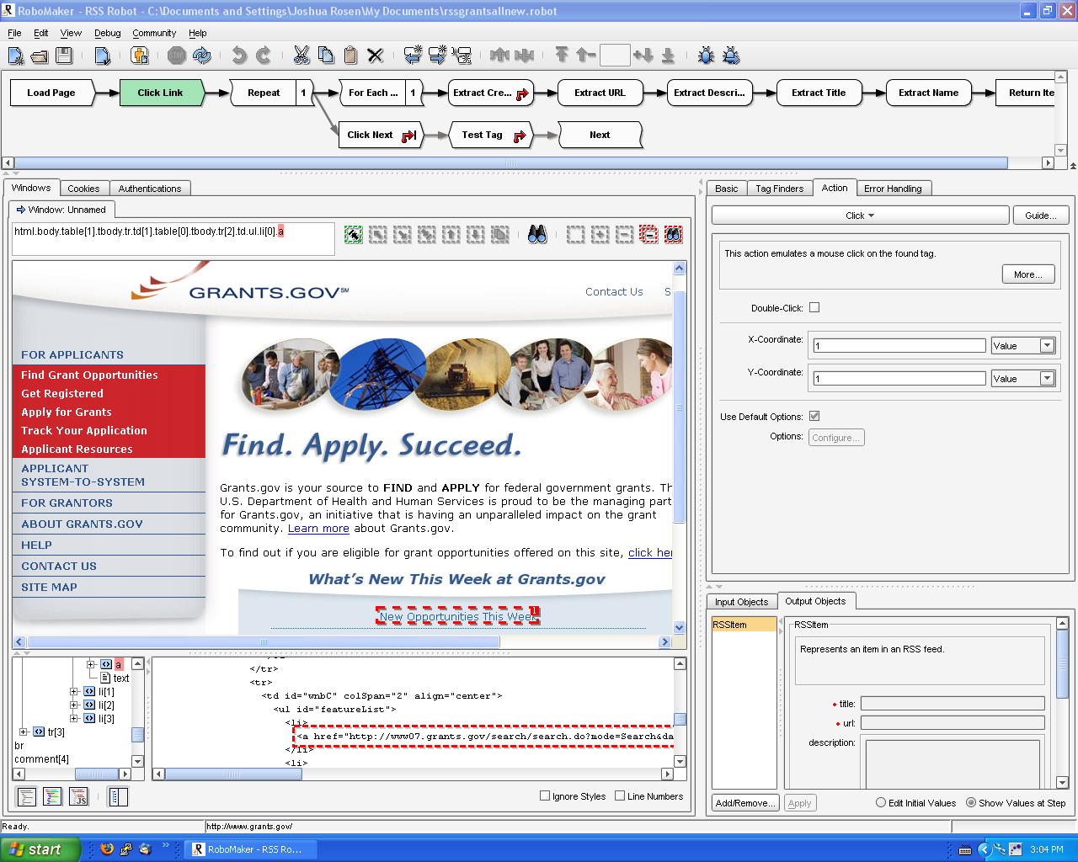
Your algorithm is displayed above.
You can interact with a page
Or with the code directly

Slide 11
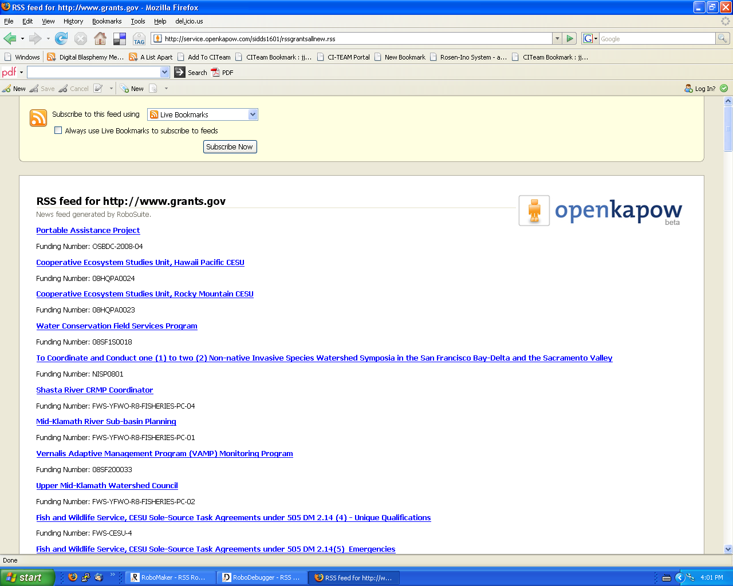
Your RSS feed will be available
from OpenKapow.

Slide 12
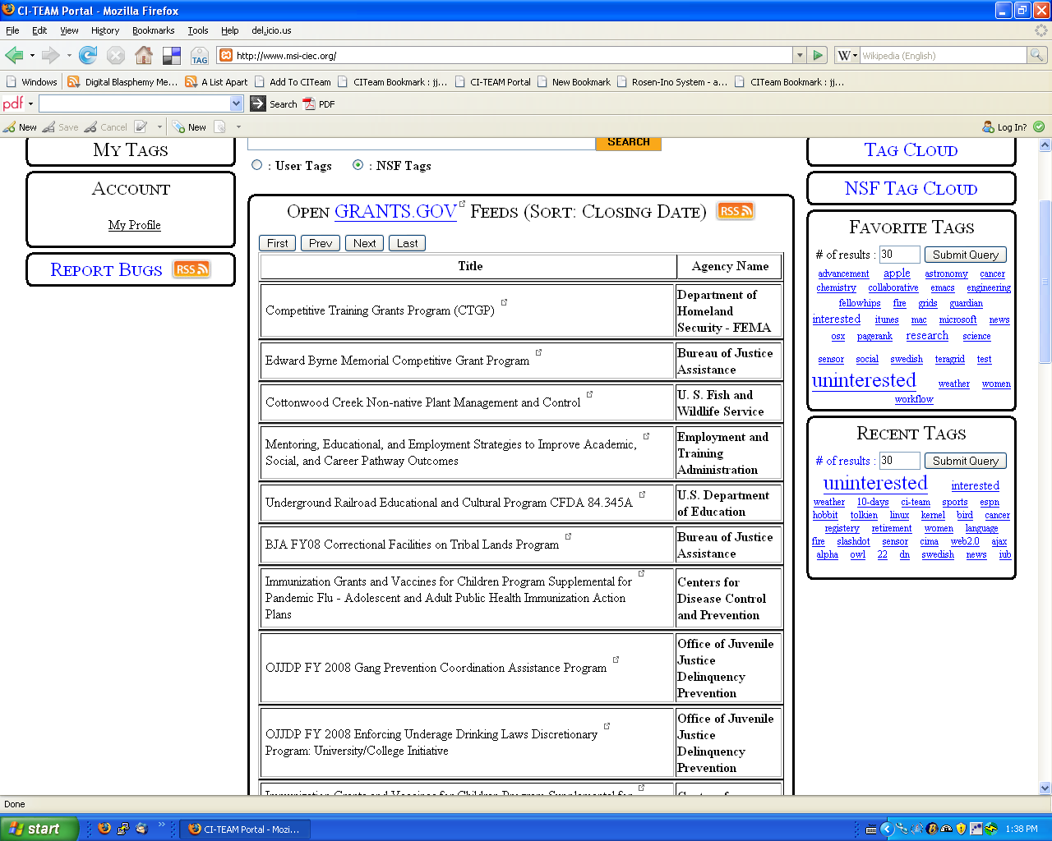
Grants.gov rss feed shown on main page of portal

Slide 13
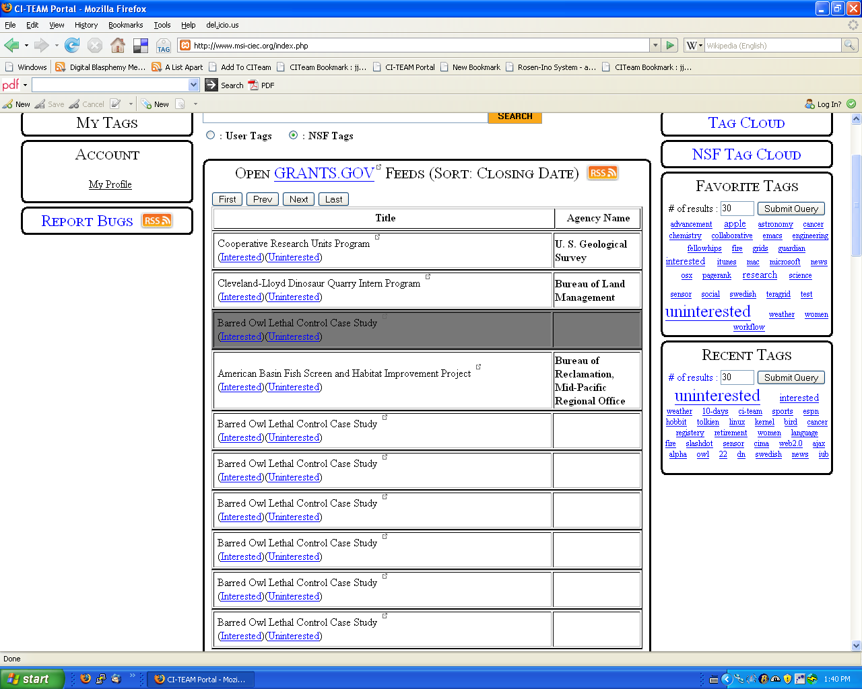
When logged in, click-tags allow you to mark interesting links with a single click

Slide 14
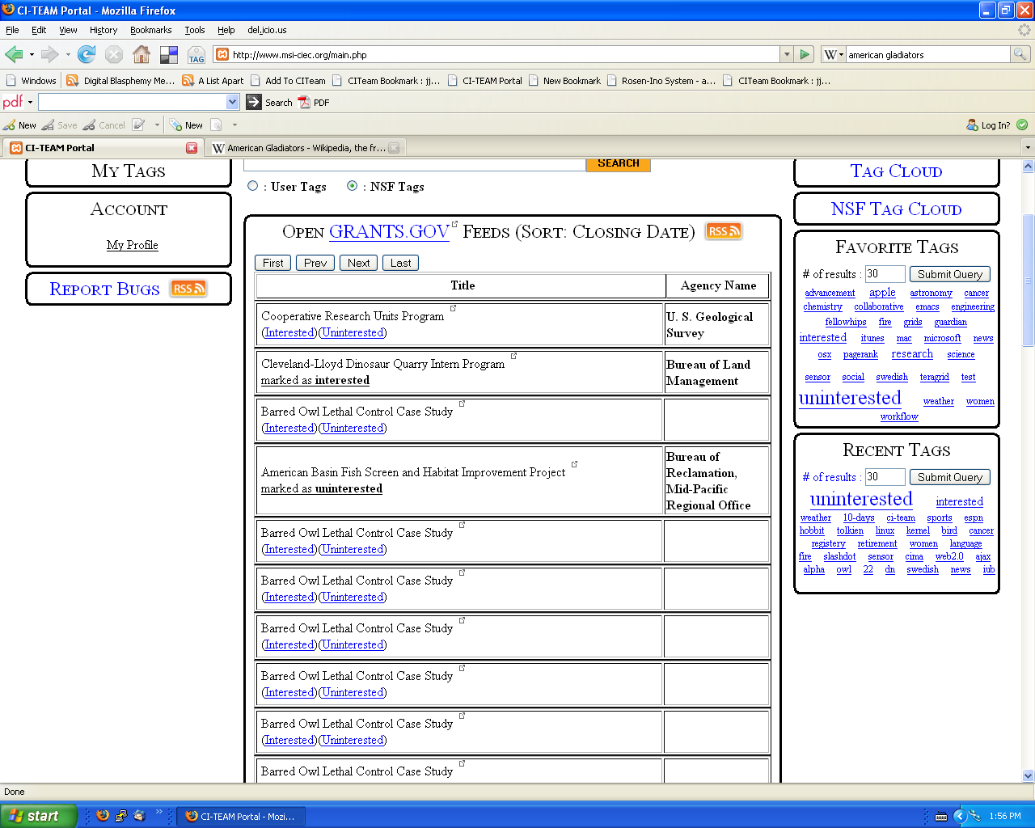
Click tag will show any tags that have been clicked.

Slide 15
Research Opportunities
Social bookmarks create folksonomies.
People, Web site profiles are defined by their associated tags
Users, URLs, and tags define graphs.
Similar to graphs in RDF, OWL based ontologies.
Difference is that these are
NOT predefined, but emerge and evolve from use.
Are suitable for analysis through graph and matrix analysis rather than description logics.
For example, you can build simple recommendation systems using linear algebra
Convert tag graph into matrix.
Find eigenvectors, keep only largest
Calculate dot products for tags.
We are systematically reviewing various techniques for this analysis.

Slide 16
More Information
Portal: http://www.msi-ciec.org
Accounts are open
But it would be more useful for us if you give us feedback (bug reports and feature requests).
Email: mpierce@cs.indiana.edu
See me for demonstrations

