Slide 1
Analysis Tools for
Data Enabled Science
IndexedHBase
6th Workshop on Many-Task Computing on Clouds, Grids, and Supercomputers (MTAGS), Nov. 17, 2013
Judy Qiu
xqiu@indiana.edu
http://SALSAhpc.indiana.edu
School of Informatics and Computing Indiana University

Slide 2
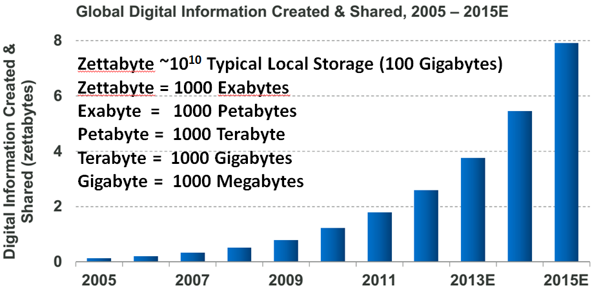
Big Data Challenge
(Source: Helen Sun, Oracle Big Data)

Slide 3
Learning from Big Data Converting raw data to knowledge discovery
Exponential data growth
Continuous analysis of streaming data
A variety of algorithms and data structures
Multi/Manycore and GPU architectures
Thousands of cores in clusters and millions in data centers
Cost and time trade-off
Parallelism is a must to process data in a meaningful length of time

Slide 4
Programming Runtimes
Workflows, Swift, Falkon
Classic Cloud: Queues, Workers
PaaS:
Worker Roles
Hadoop MapReduce
Pig Latin,
Hive
Chapel, X10,
HPF
DAGMan, BOINC
MPI, PVM,
Achieve Higher Throughput
Perform Computations Efficiently
High-level programming models such as MapReduce adopt a data-centered design
Computation starts from data
Support moving computation to data
Shows promising results for data-intensive computing
( Google, Yahoo, Amazon, Microsoft …)
Challenges: traditional MapReduce and classical parallel runtimes cannot solve iterative algorithms efficiently
Hadoop: repeated data access to HDFS, no optimization to (in memory) data caching and (collective) intermediate data transfers
MPI: no natural support of fault tolerance; programming interface is complicated

Slide 5
Applications & Different Interconnection Patterns
(a) Map Only (Pleasingly Parallel) | (b) Classic MapReduce | (c) Iterative MapReduce | (d) Loosely Synchronous
- CAP3 Gene Analysis Smith-Waterman Distances - Document conversion (PDF -> HTML) - Brute force searches in cryptography - Parametric sweeps - PolarGrid MATLAB data analysis | - High Energy Physics (HEP) Histograms - Distributed search - Distributed sorting - Information retrieval - Calculation of Pairwise Distances for sequences (BLAST) | Expectation maximization algorithms Linear Algebra - Data mining, includes K-means clustering Deterministic Annealing Clustering - Multidimensional Scaling (MDS) - PageRank | Many MPI scientific applications utilizing wide variety of communication constructs, including local interactions - Solving Differential Equations and particle dynamics with short range forces
Input
Input
Input
iterations
map
map
map
Pij
reduce
reduce
Output
No Communication
Collective Communication
MPI
Domain of MapReduce and Iterative Extensions

Slide 6
What is Iterative MapReduce
Iterative MapReduce
Mapreduce is a Programming Model instantiating the paradigm of bringing computation to data
Iterative Mapreduce extends Mapreduce programming model and support iterative algorithms for Data Mining and Data Analysis
Portability
Is it possible to use the same computational tools on HPC and Cloud?
Enabling scientists to focus on science not programming distributed systems
Reproducibility
Is it possible to use Cloud Computing for Scalable, Reproducible Experimentation?
Sharing results, data, and software

Slide 7
(Iterative) MapReduce in Context
Support Scientific Simulations (Data Mining and Data Analysis)
Kernels, Genomics, Proteomics, Information Retrieval, Polar Science, Scientific Simulation Data Analysis and Management, Dissimilarity Computation, Clustering, Multidimensional Scaling, Generative Topological Mapping
Applications
Security, Provenance, Portal
Programming Model
Services and Workflow
High Level Language
Runtime
Cross Platform Iterative MapReduce (Collectives, Fault Tolerance, Scheduling)
Storage
Distributed File Systems
Object Store
Data Parallel File System
Linux HPC
Bare-system
Amazon Cloud
Windows Server HPC
Bare-system
Azure Cloud
Grid Appliance
Infrastructure
Virtualization
Virtualization
Hardware
CPU Nodes
GPU Nodes

Slide 8
Apache Data Analysis Open Stack
(Source: Apache Tez)

Slide 9
Data Analysis Tools
MapReduce optimized for iterative computations
Twister: the speedy elephant
Abstractions
In-Memory
Cacheable map/reduce tasks
Data Flow
Iterative
Loop Invariant
Variable data
Thread
Lightweight
Local aggregation
Map-Collective
Communication patterns optimized for large intermediate data transfer
Portability
HPC (Java)
Azure Cloud (C#)
Supercomputer (C++)

Slide 10
Programming Model for Iterative MapReduce
Loop Invariant Data
Loaded only once
Configure()
Cacheable map/reduce tasks
(in memory)
Variable data
Main Program
while(..)
{
runMapReduce(..)
}
Map(Key, Value)
Faster intermediate data transfer mechanism
Reduce (Key, List<Value>)
Combine(Map<Key,Value>)
Combiner operation to collect all reduce outputs
Distinction on loop invariant data and variable data (data flow vs. δ flow)
Cacheable map/reduce tasks (in-memory)
Combine operation

Slide 11
KMeans Clustering Comparison
Hadoop vs. HDInsight vs. Twister4Azure
Shaded part is computation

Slide 12
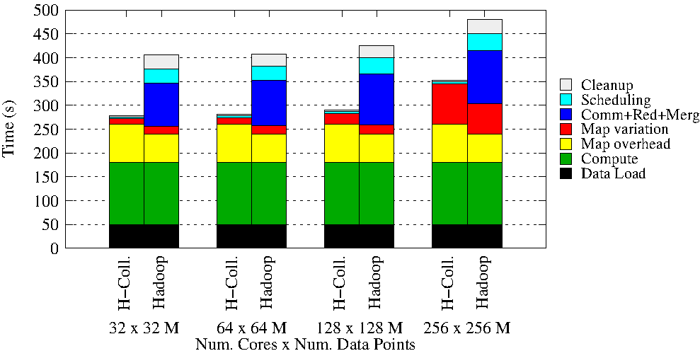
KMeans Weak Scaling Hadoop vs. our new Hadoop-Collective

Slide 13
Case Studies: Data Analysis Algorithms
Support a suite of parallel data-analysis capabilities
Clustering using image data (Computer Vision)
Parallel Inverted Indexing used for HBase (Social Network)
Matrix algebra as needed
Matrix Multiplication
Equation Solving
Eigenvector/value Calculation

Slide 14
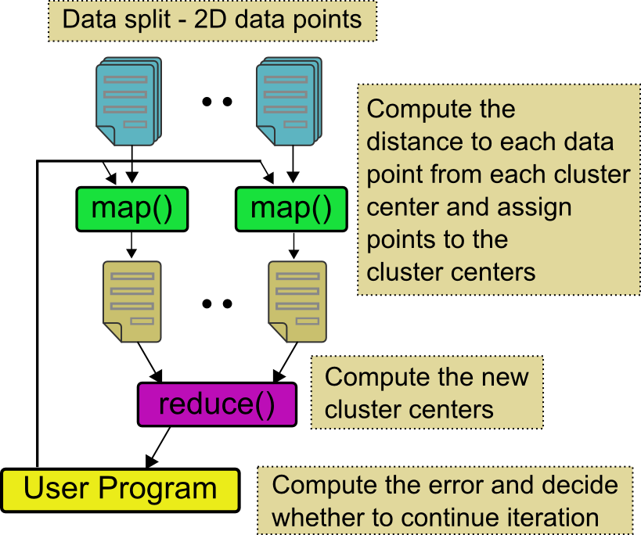
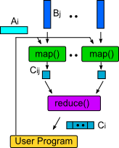
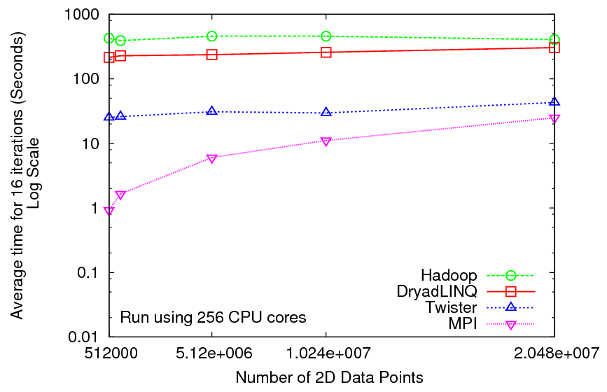
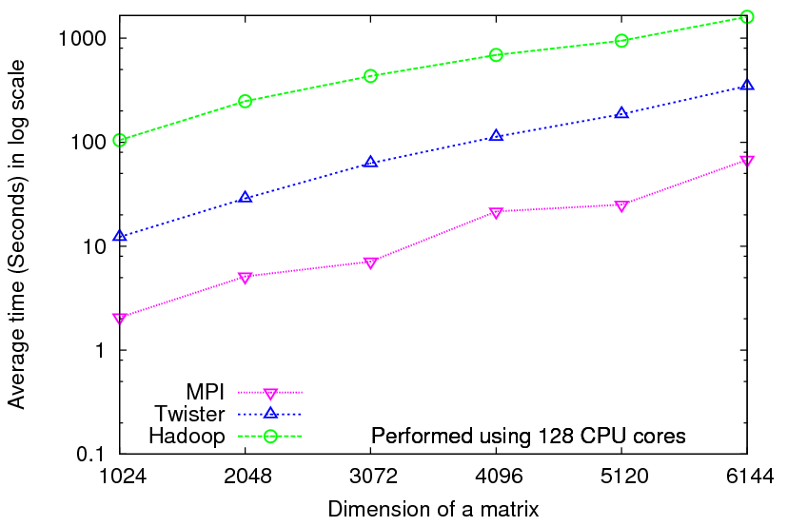
Iterative Computations
K-means
Matrix Multiplication
Performance of K-Means
Parallel Overhead Matrix Multiplication

Slide 15
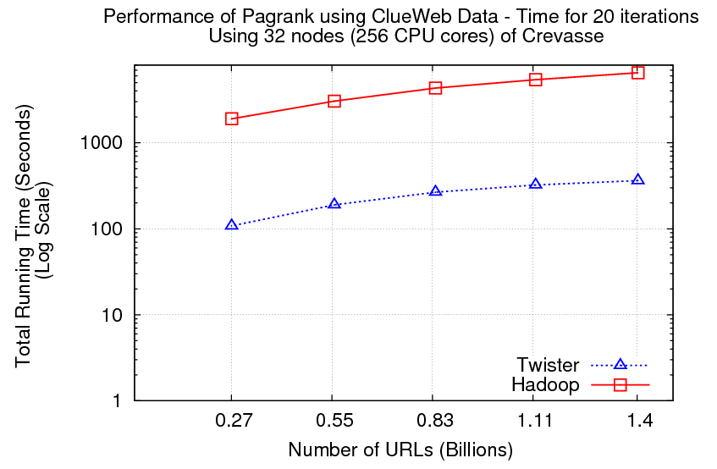
PageRank
Partial Adjacency Matrix
Current
Page ranks (Compressed)
M
Partial
Updates
R
Iterations
C
Partially merged
Updates
Well-known page rank algorithm [1]
Used ClueWeb09 [2] (1TB in size) from CMU
Hadoop loads the web graph in every iteration
Twister keeps the graph in memory
Pregel approach seems natural to graph-based problems
[1] Pagerank Algorithm, http://en.wikipedia.org/wiki/PageRank
[2] ClueWeb09 Data Set, http://boston.lti.cs.cmu.edu/Data/clueweb09/

Slide 16
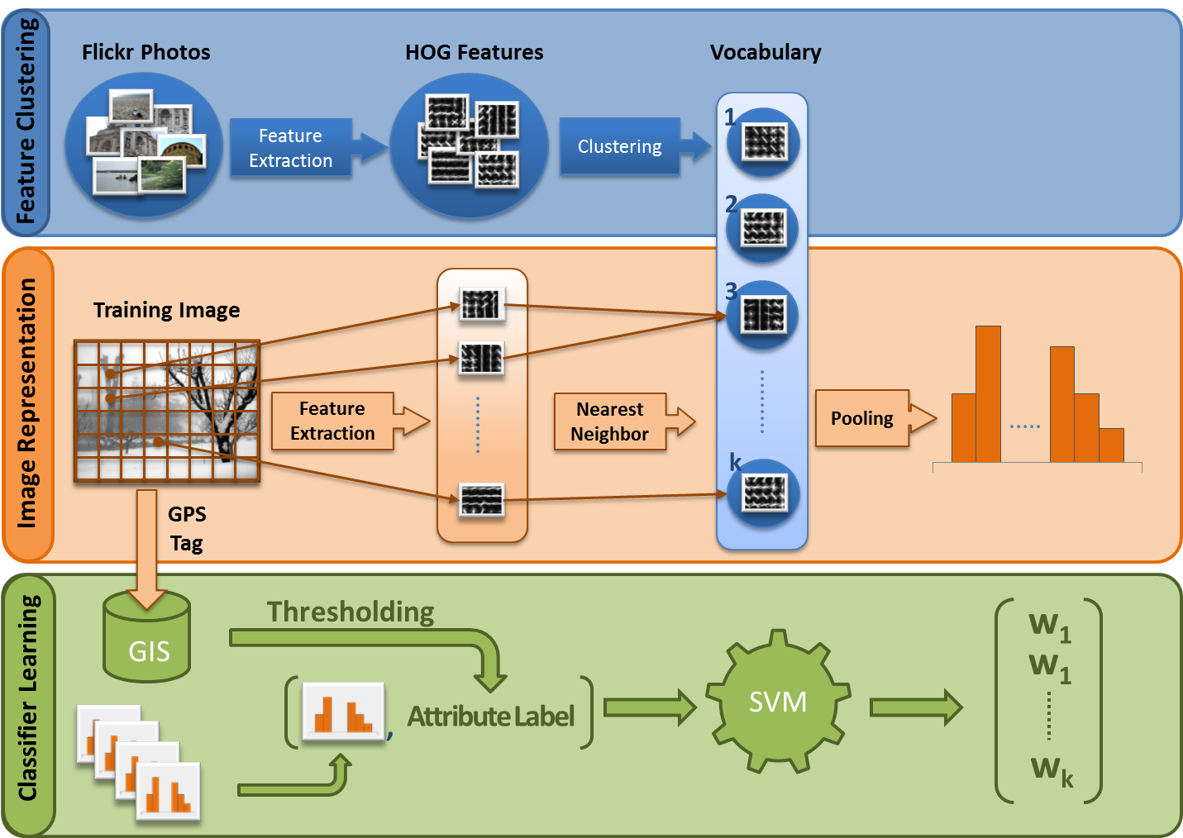
Workflow of the vocabulary learning application in Large-Scale Computer Vision
Collaboration with Prof. David Crandall at Indiana University

Slide 17
High Dimensional Image Data
K-means Clustering algorithm is used to cluster the images with similar features.
Each image is characterized as a data point (vector) with dimensions in the range of 512 ~ 2048. Each value (feature) ranges from 0 to 255.
A full execution of the image clustering application
We successfully cluster 7.42 million vectors into 1 million cluster centers. 10000 map tasks are created on 125 nodes. Each node has 80 tasks, each task caches 742 vectors.
For 1 million centroids, broadcasting data size is about 512 MB. Shuffling data is 20 TB, while the data size after local aggregation is about 250 GB.
Since the total memory size on 125 nodes is 2 TB, we cannot even execute the program unless local aggregation is performed.

Slide 18
Image Clustering Control Flow in Twister
with new local aggregation feature in Map-Collective to drastically reduce intermediate data size
Broadcast from Driver
Worker 1
Worker 2
Worker 3
Map
Map
Map
Local Aggregation
Local Aggregation
Local Aggregation
Shuffle
Reduce
Reduce
Reduce
Combine to Driver
We explore operations such as high performance broadcasting and shuffling, then add them to Twister iterative MapReduce framework. There are different algorithms for broadcasting.
Pipeline (works well for Cloud)
minimum-spanning tree
bidirectional exchange
bucket algorithm

Slide 19
Broadcast Comparison: Twister vs. MPI vs. Spark
At least a factor of 120 on 125 nodes, compared with the simple broadcast algorithm
The new topology-aware chain broadcasting algorithm gives 20% better performance than best C/C++ MPI methods (four times faster than Java MPJ)
A factor of 5 improvement over non-optimized (for topology) pipeline-based method over 150 nodes.

Slide 20
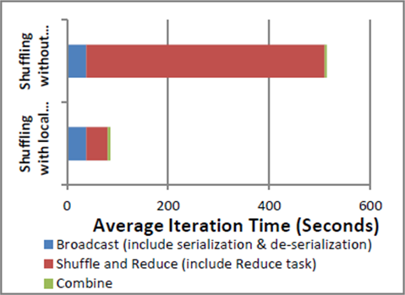
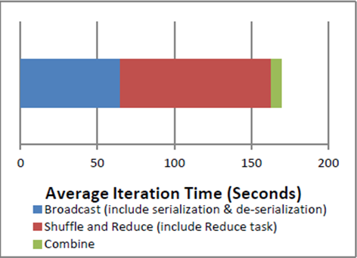
Broadcast Comparison: Local Aggregation
Comparison between shuffling with and without local aggregation
Communication cost per iteration of the image clustering application
Left figure shows the time cost on shuffling is only 10% of the original time
Right figure presents the collective communication cost per iteration, which is 169 seconds (less than 3 minutes).

Slide 21
End-to-End System: IndexedHBase + Twister for social media data analysis

Slide 22
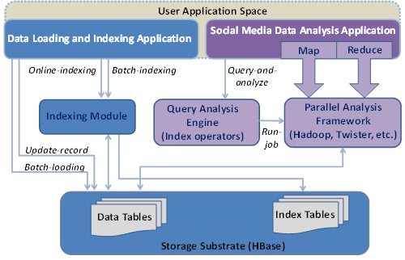
IndexedHBase Architecture for Truthy

Slide 23
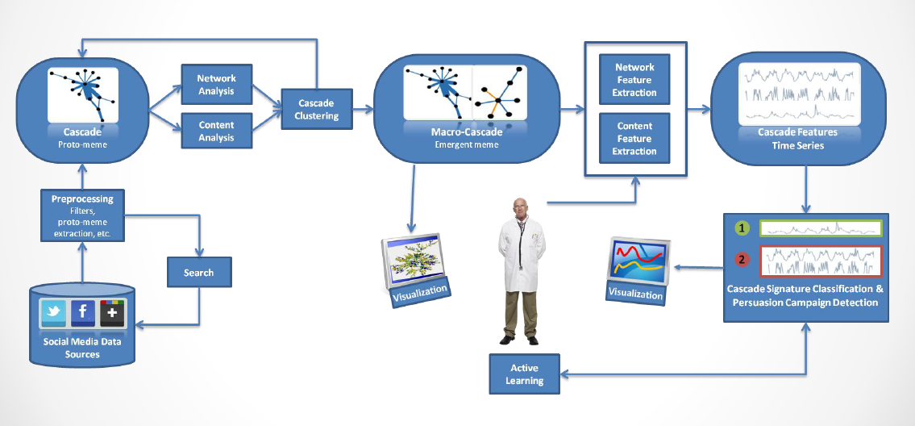
Truthy Online Social Media Studies
Collaboration with Prof. Filippo Menczer at Indiana University
Emilio Ferrara, Summer Workshop on Algorithms and Cyberinfrastructure for large scale optimization/AI, August 8, 2013

Slide 24
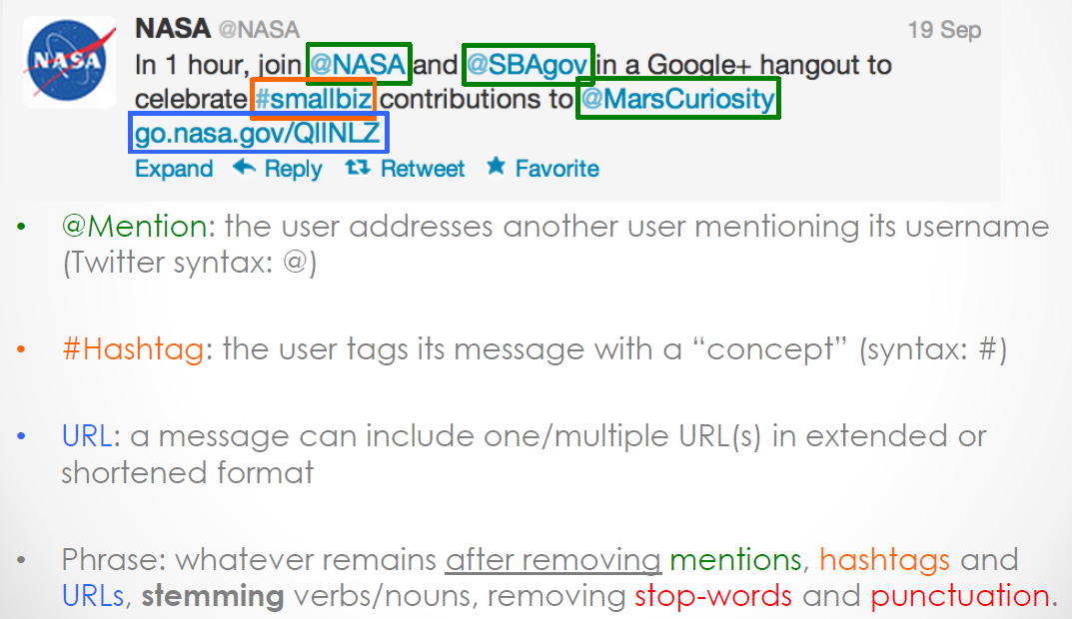
Meme Definition in Truthy
Emilio Ferrara, Summer Workshop on Algorithms and Cyberinfrastructure for large scale optimization/AI, August 8, 2013

Slide 25
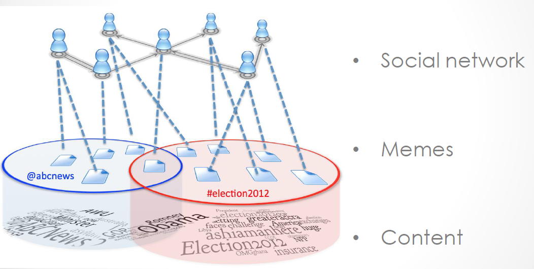
Network, Memes & Content Relations
Emilio Ferrara, Summer Workshop on Algorithms and Cyberinfrastructure for large scale optimization/AI, August 8, 2013

Slide 26
Problems and Challenges
Loading large volume of Twitter Tweet data takes long time
Clustering large volume of Tweets in a streaming scenario, in topic based on their similarity
Tweets text is too sparse for classification and needs to exploit further features:
Network structure
Temporal signature
Meta data

Slide 27
Streaming data loading strategy
Twitter streaming API
Twitter streaming API
Filter by “mod”
Filter by “mod”
Construct data table records
Construct data table records
…
General Customizable Indexer
General Customizable Indexer
Loader 1
Loader N
HBase
Data tables
Index tables

Slide 28
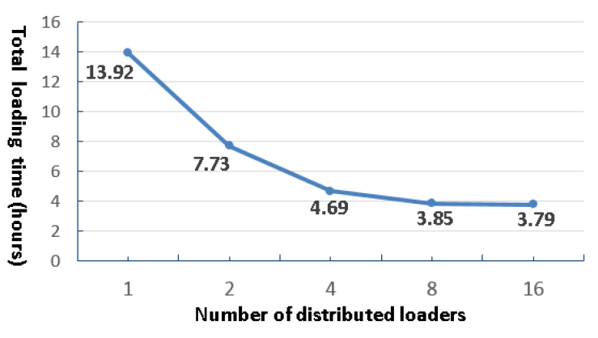
Streaming data loading performance using IndexedHBase

Slide 29
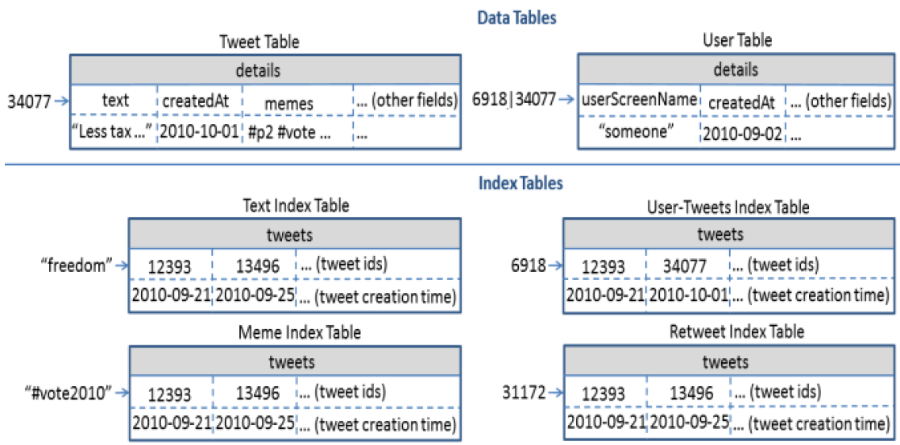
HBase Table for Truthy

Slide 30
Query Evaluation

Slide 31
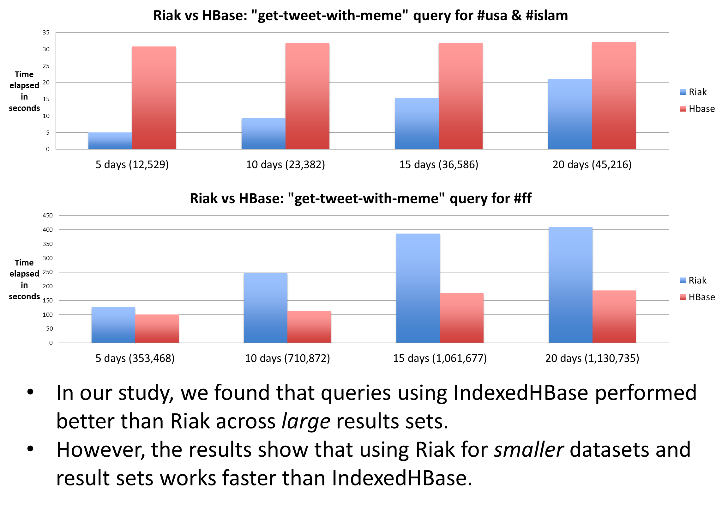
Performance Comparison: Riak vs. IndexedHBase

Slide 32
Testbed setup on FutureGrid
35 nodes on the Alamo cluster
CPU | RAM | Hard Disk | Network
8 * 2.66GHz (Intel Xeon X5550) | 12GB | 500GB | 40Gb InfiniBand
1 node as Hadoop JobTracker, HDFS name node
1 nodes as HBase master
1 node as Zookeeper and ActiveMQ broker
32 nodes as HDFS data nodes, Hadoop TaskTrackers, HBase Region Servers, and Twister Daemons

Slide 33
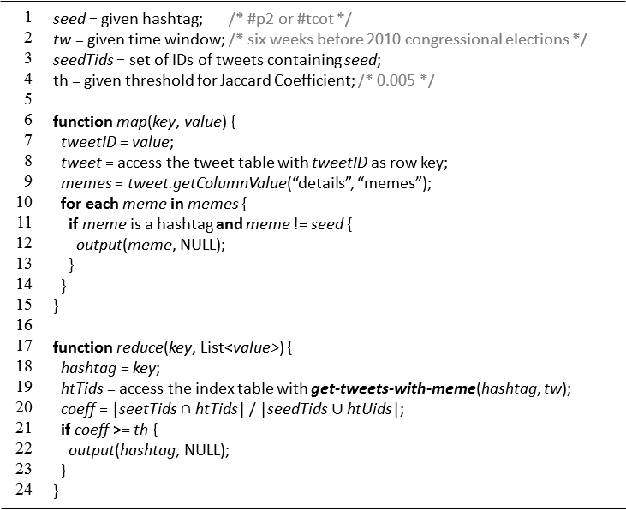
Related hashtag mining from Twitter data set
Jaccard coefficient:
$σ(S,T)=\frac{|S∩T|}{|S∪T|}$. S: set of tweets for seed hashtag; T: set of tweets for target

Slide 34
Related hashtag mining from Twitter data set
2010 Dataset (six weeks before the mid-term elections)
- seed hashtags: #p2 (Progressives 2.0) and #tcot (Top Conservatives on Twitter)
- #p2: 4 mappers processing 109,312 in 190 seconds
- #tcot: 8 mappers processing 189,840 in 128 seconds
- 66 related hashtags mined in total
- Examples: #democrats, #vote2010, #palin, …
2012 Dataset (six weeks before the presidential elections)
- seed hashtags: #p2 and #tcot
- #p2: 7 mappers processing 160,934 in 142 seconds
- #tcot: 13 mappers processing 364,825 in 191 seconds
- 66 related hashtags mined in total
- Examples: #2futures, #mittromney, #nobama, …

Slide 35
Force-directed algorithm for Graph based model
Fruchterman-Reingold algorithm
- “Replusive Force” between nodes
- “Attractive Force” along edges
Iterative computation
Disconnected nodes “push” each other away;
Inter-connected nodes are ‘pulled’ together;
Implementation
Iterative MapReduce on Twister;
Graph adjacency matrix partitioned by nodes.

Slide 36
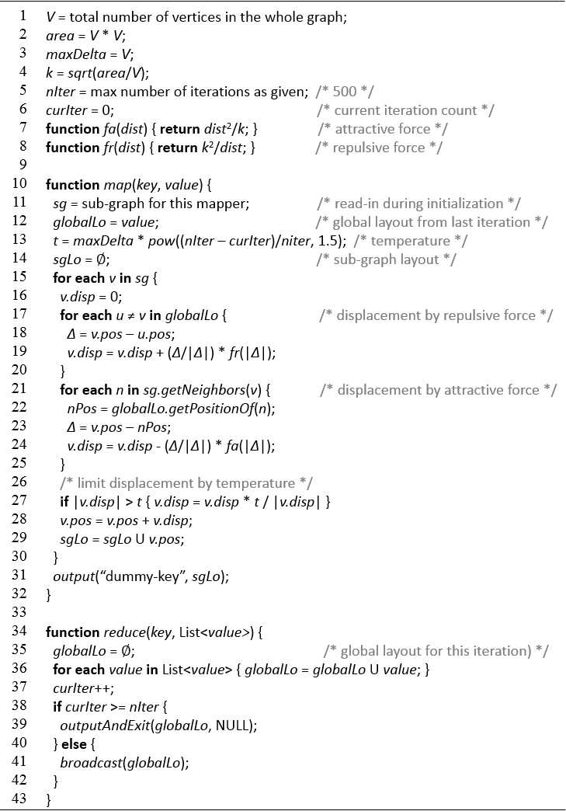
Fruchterman-Reingold algorithm

Slide 37
End-to-End Analysis Workflow
(1) Choosing seed hashtags: #p2 and #tcot
1
(2) Find hashtags related to #p2 and #tcot
2
#p2, #tcot,
#vote, #ucot, …
(3) Query for retweet network using all related hashtags
3
(4) Community detection of retweet network
(5) Visualization preparation: graph layout of retweet network
4
5
(6) Visualization of retweet network
6

Slide 38
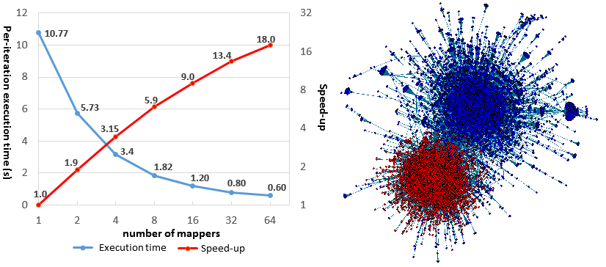
Force-directed algorithm for Graph based model
Results for 2010 retweet network:
- More than 23,000 non-isolated nodes, More than 44,000 edges;
- Sequential Implementation in R: 9.0 seconds per iteration.
Scalability issue:
- Not enough computation in each iteration compared with overhead.

Slide 39
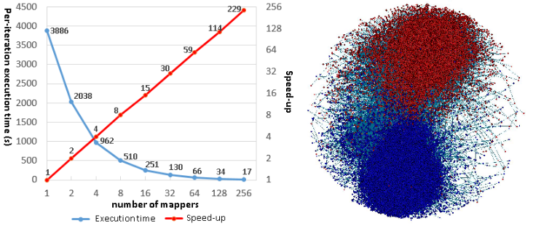
Force-directed algorithm for Graph based model
Results for 2012 retweet network:
- More than 470,000 non-isolated nodes, More than 665,000 edges;
- Sequential Implementation in R: 6043.6 seconds per iteration.
Near-linear scalability:
- Our iterative MR algorithm is especially good at handling large networks.

Slide 40
Acknowledgements
SALSA HPC Group
http://salsahpc.indiana.edu
School of Informatics and Computing
Indiana University

