Slide 1
MapReduce and Data Intensive Applications
XSEDE’12 BOF Session
Judy Qiu
Indiana University
Chicago, IL
July 18th 2012
http://futuregrid.org

Slide 2


Big Data Challenges
250
200
150
100
50
0
90
80
70
60
50
40
30
20
10
0
!
Research
Science Impact
Daily Production
“Behind every click”
38K Servers
170 PB Storage
1M+ Monthly Jobs
Petabytes
Thousands of Servers
Today
2006
2007
2008
2009
2010
Yahoo!
Notes:
Started Developing Hadoop 5 years ago
Prototype of a 20 node cluster
Dedicated team developing Hadoop every since
Focused on supporting Yahoo! needs
Contributing Hadoop to Apache and helping build the community
Started as research projects
Progressed to applied science efforts supporting search and adv products
Then production systems (Ad Targeting, Content optimization)
Now Hadoop usage has spread to all parts of our business
Hadoop is our Big Data infrastructure -- It provides agility with Big Data
50% of enterprises cited recent study said strongly considering Hadoop adoption
Agility cited as the number one reason

Slide 3
Bring Computation to Data
hadoop at
yahoo!
  “Where Science meets Data”
Software
Data Analytics
Content Optimization
Content Enrichment
Big Data Processing
DIMENSIONAL DATA
CONTENT
HADOOP CLUSTERS
Tens of thousands of servers
DATA PIPELINES
APPLIED SCIENCE
User Interest Prediction
Machine learning - search ranking
Machine learning
Yahoo!
Notes:
Hadoop is at the center or our data eco system
Every click, page view, search
Foundation of our ad management & targeting systems
Content Enrichment: (geo location, category)
Customize content for users
Where Science Meets Data
Machine learning - algorithm development
spam detection
ad targeting
predicting user interest and ad inventory
Research on ad effectiveness
Provides Scale for Big Data
Daily: 120TB, 3+PB. Total 70+PB data -- and growing
Web data growing at CAGR of 60% - by 2013 - 667 exabytes (Cisco)

Slide 4
Why MapReduce
Drivers:
  500M+ unique users per month
  Billions of interesting events per day
  Data analysis is key
Need massive scalability
  PB’s of storage, millions of files, 1000’s of nodes
Need to do this cost effectively
  Use commodity hardware
  Share resources among multiple projects
  Provide scale when needed
Need reliable infrastructure
  Must be able to deal with failures – hardware, software, networking
    Failure is expected rather than exceptional
  Transparent to applications
    very expensive to build reliability into each application
The MapReduce platform provides these capabilities

Slide 5
What is MapReduce
MapReduce is a programming model and implementation for processing and generating large data sets
  Focus developer time/effort on salient (unique, distinguished) application requirements.
  Allow common but complex application requirements (e.g., distribution, load balancing, scheduling, failures) to be met by the framework.
  Enhance portability via specialized run-time support for different architectures.
Uses:
  Large/massive amounts of data
  Simple application processing requirements
  Desired portability across variety of execution platforms
Runs on Clouds and HPC environments

Slide 6
(Iterative) MapReduce in Context
Support Scientific Simulations (Data Mining and Data Analysis)
Kernels, Genomics, Proteomics, Information Retrieval, Polar Science, Scientific Simulation Data Analysis and Management, Dissimilarity Computation, Clustering, Multidimensional Scaling, Generative Topological Mapping
Applications
Security, Provenance, Portal
Programming Model
Services and Workflow
High Level Language
Runtime
Cross Platform Iterative MapReduce (Collectives, Fault Tolerance, Scheduling)
Storage
Distributed File Systems
Object Store
Data Parallel File System
Linux HPC
Bare-system
Amazon Cloud
Windows Server HPC
Bare-system
Azure Cloud
Grid Appliance
Infrastructure
Virtualization
Virtualization
Hardware
CPU Nodes
GPU Nodes

Slide 7
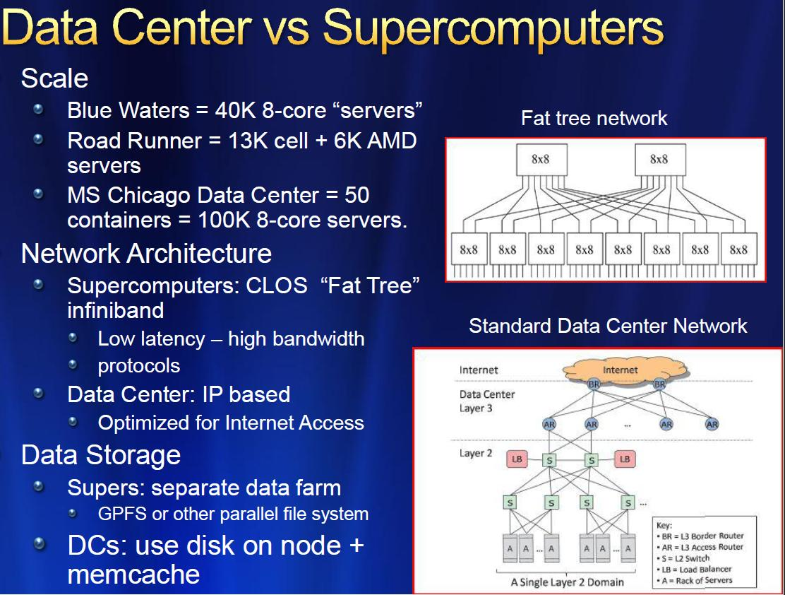
7
(Old)
MICROSOFT

Slide 8
4 Forms of MapReduce
(a) Map Only
(b) Classic MapReduce
(c) Iterative MapReduce
(d) Loosely Synchronous
Input
Input
Iterations
Input
map
map
map
P_{ij}
reduce
reduce
Output
BLAST Analysis
Parametric sweep
Pleasingly Parallel
High Energy Physics (HEP) Histograms
Distributed search
Expectation maximization Clustering e.g. Kmeans
Linear Algebra, Page Rank
Classic MPI
PDE Solvers and particle dynamics
Domain of MapReduce and Iterative Extensions
MPI

Slide 9
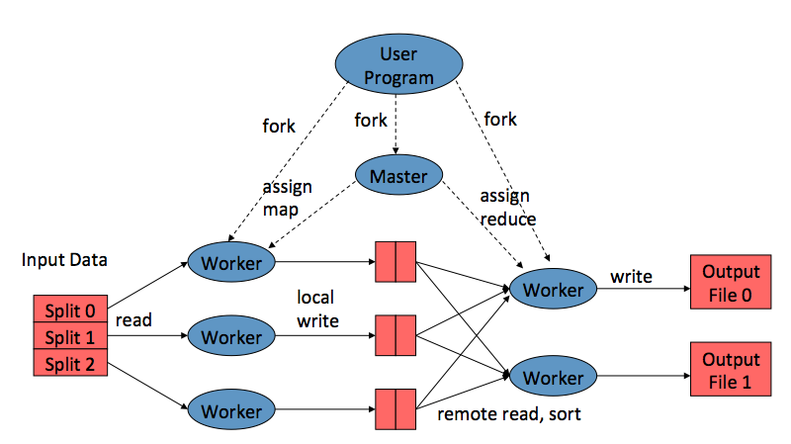
MapReduce Model
Map: produce a list of (key, value) pairs from the input structured as a (key value) pair of a different type
(k1,v1) → list (k2, v2)
Reduce: produce a list of values from an input that consists of a key and a list of values associated with that key
(k2, list(v2)) → list(v2)

Slide 10


Hadoop
Hadoop provides an open source implementation of MapReduce and HDFS.
myHadoop provides a set of scripts to configure and run Hadoop within an HPC environment
  From San Diego Supercomputer Center
  Available on India, Sierra, and Alamo systems within FutureGrid
Log into to india & load myhadoop
user@host:$ ssh user@india.futuregrid.org
[user@i136 ~]$ module load myhadoop
myHadoop version 0.2a loaded
[user@i136 ~]$ echo $MY_HADOOP_HOME
/N/soft/myHadoop

Slide 11
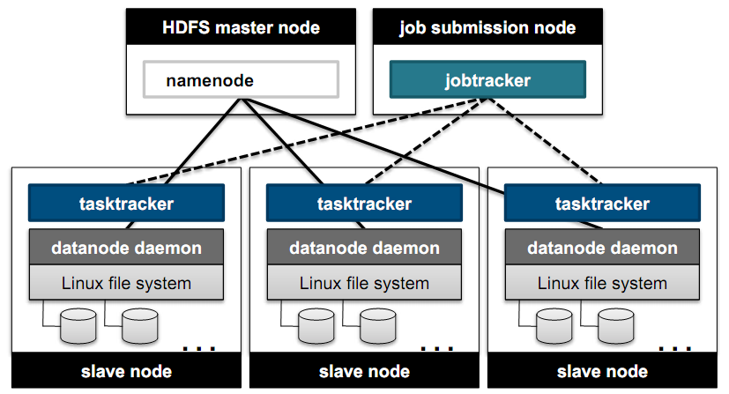
Hadoop Architecture
Hadoop Components
  JobTracker, TaskTracker
  MapTask, ReduceTask
  Fault Tolerance
Storage
Compute

Slide 12
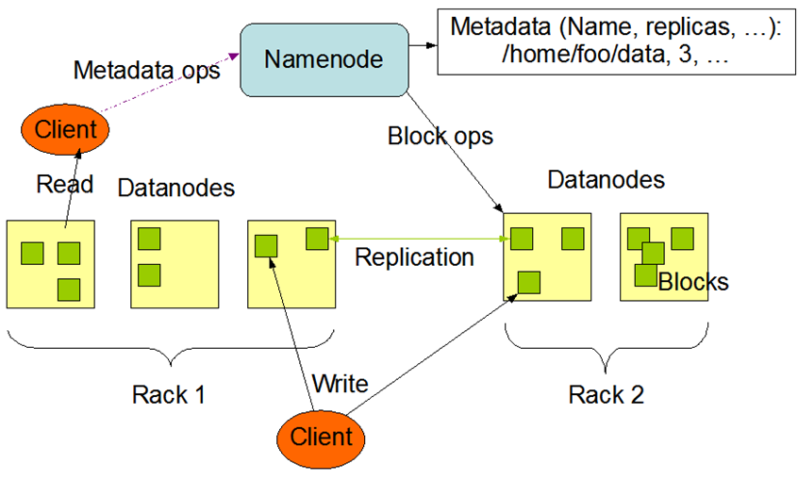
HDFS Architecture

Slide 13





Map Reduce
Programming Model
Moving Computation to Data
Scalable
Fault Tolerance
  Simple programming model
  Excellent fault tolerance
  Moving computations to data
  Works very well for data intensive pleasingly parallel applications
  Ideal for data intensive loosely coupled (including pleasingly parallel “map only”) applications
Notes:
MapReduce provides a easy to use programming model together with very good fault tolerance and scalability for large scale applications. MapReduce model is proving to be Ideal for data intensive pleasingly parallel applications in commodity hardware and in clouds.

Slide 14
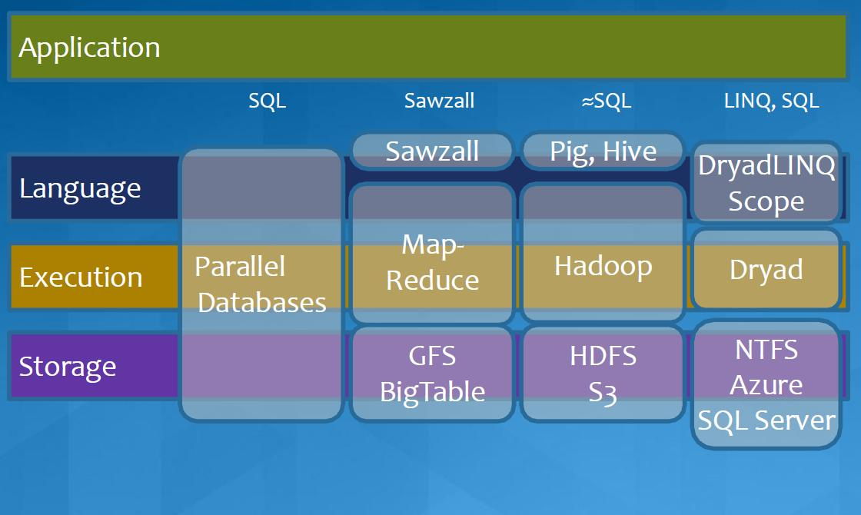
MapReduce in Heterogeneous Environment
MICROSOFT

Slide 15
Iterative MapReduce Frameworks
Twister^{[1]}
  Map->Reduce->Combine->Broadcast
  Long running map tasks (data in memory)
  Centralized driver based, statically scheduled.
Daytona^{[3]}
  Iterative MapReduce on Azure using cloud services
  Architecture similar to Twister
Haloop^{[4]}
  On disk caching, Map/reduce input caching, reduce output caching
  Spark^{[5]}
  Iterative Mapreduce Using Resilient Distributed Dataset to ensure the fault tolerance
  Pregel^{[6]}
  Graph processing from Google
Notes:
iMapReduce, Twister -> single wave..
Iterative MapReduce: Haloop, Twister @IU, Spark
Map-Reduce-Merge: enable processing heterogeneous data sets
MapReduce online: online aggregation, and continuous queries

Slide 16
Others
Mate-EC2^{[6]}
  Local reduction object
Network Levitated Merge^{[7]}
  RDMA/infiniband based shuffle & merge
Asynchronous Algorithms in MapReduce^{[8]}
  Local & global reduce
MapReduce online^{[9]}
  online aggregation, and continuous queries
  Push data from Map to Reduce
Orchestra^{[10]}
  Data transfer improvements for MR
iMapReduce^{[11]}
  Async iterations, One to one map & reduce mapping, automatically joins loop-variant and invariant data
CloudMapReduce^{[12]} & Google AppEngine MapReduce^{[13]}
  MapReduce frameworks utilizing cloud infrastructure services
Notes:
Orchestra : Broadcast and shuffle improvements…

Slide 17





Performance – Kmeans Clustering
Overhead between iterations
First iteration performs the initial data fetch
Task Execution Time Histogram
Number of Executing Map Task Histogram
Scales better than Hadoop on bare metal
Strong Scaling with 128M Data Points
Weak Scaling
Performance with/without
data caching
Speedup gained using data cache
Scaling speedup
Increasing number of iterations

Slide 18
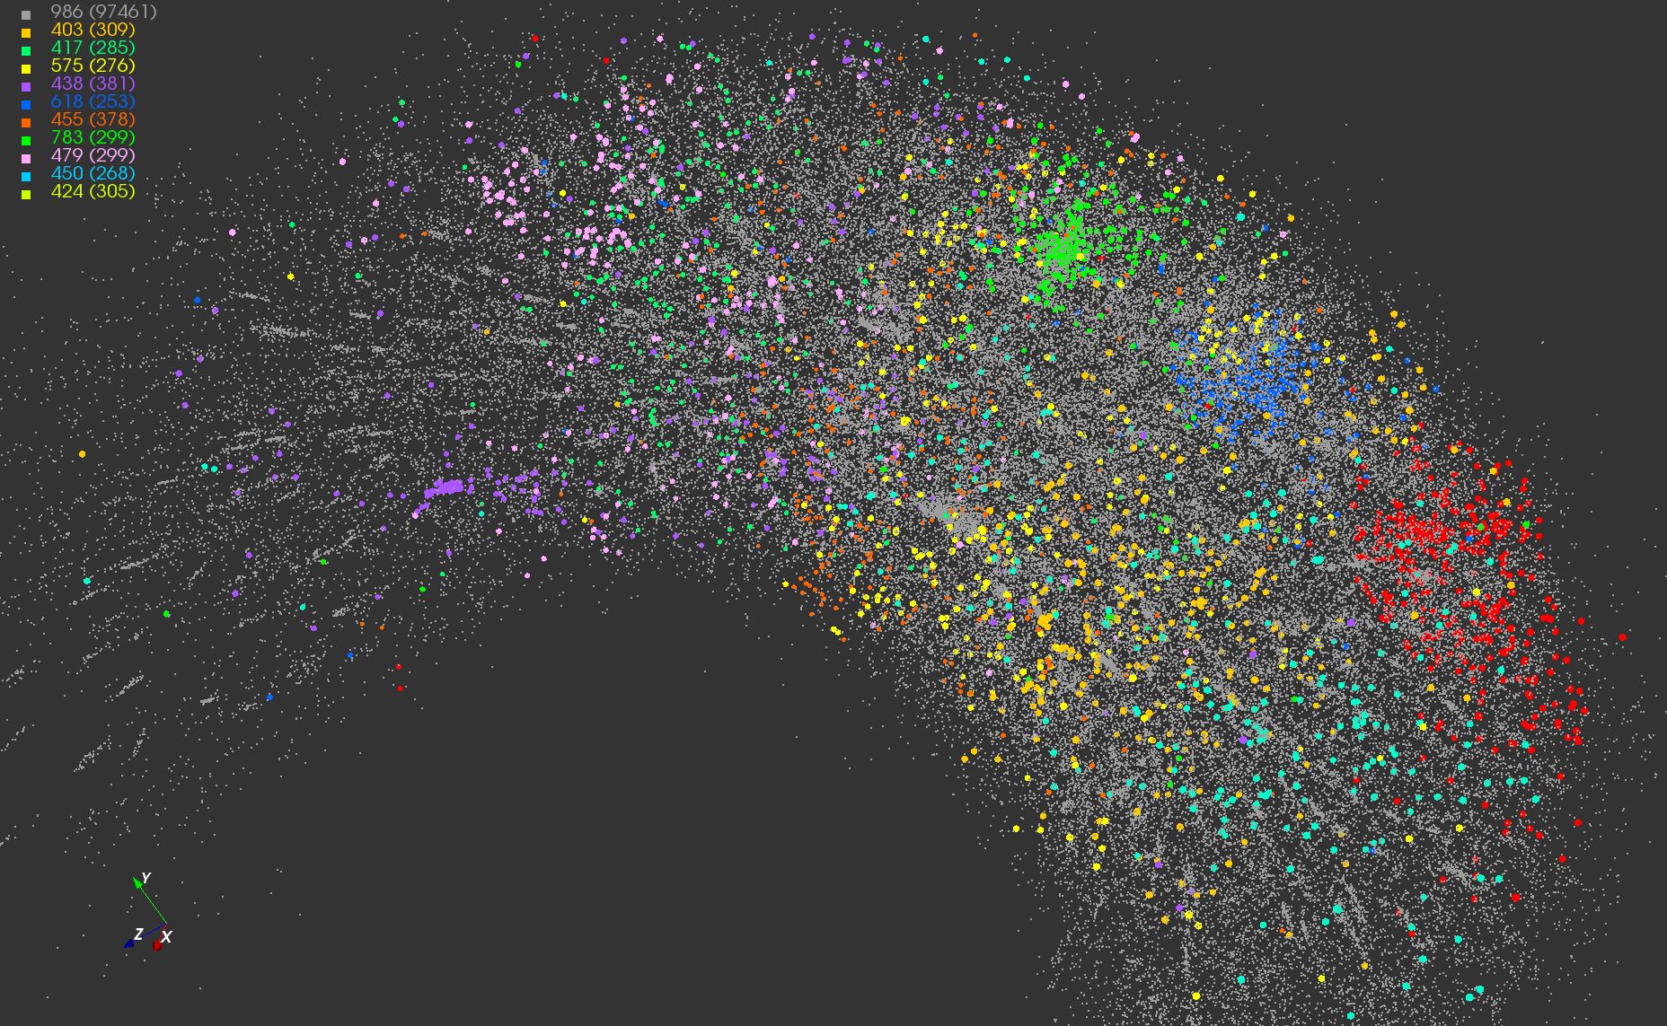
Application #1
Twister-MDS Output
MDS projection of 100,000 protein sequences showing a few experimentally
identified clusters in preliminary work with Seattle Children’s Research Institute

Slide 19
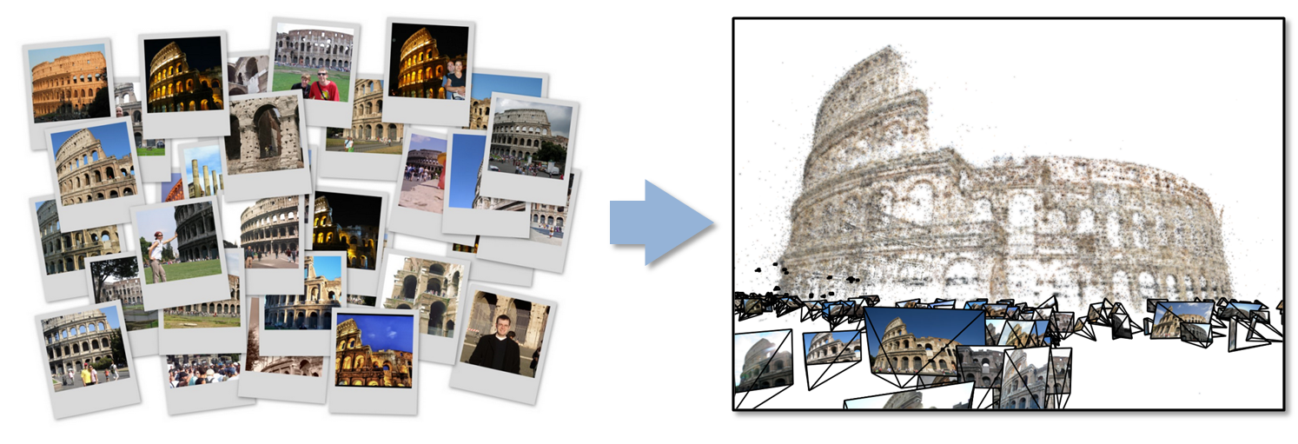
Data Intensive Kmeans Clustering
Application #2
  ─ Image Classification: 1.5 TB; 500 features per image;10k clusters
  1000 Map tasks; 1GB data transfer per Map task

Slide 20
Twister Performance on Kmeans Clustering

Slide 21
Twister on InfiniBand
InfiniBand successes in HPC community
  More than 42% of Top500 clusters use InfiniBand
  Extremely high throughput and low latency
    Up to 40Gb/s between servers and 1μsec latency
  Reduce CPU overhead up to 90%
Cloud community can benefit from InfiniBand
  Accelerated Hadoop (sc11)
  HDFS benchmark tests
RDMA can make Twister faster
  Accelerate static data distribution
  Accelerate data shuffling between mappers and reducer
In collaboration with ORNL on a large InfiniBand cluster
Notes:
Even higher between switches

Slide 22
Issues for this BOF
Is there a demand for MapReduce (as a Service)?
FutureGrid supports small experimental work on conventional (Hadoop) and Iterative (Twister) MapReduce
Is there demand for larger size runs?
Do we need HDFS/Hbase as well?
Do we need Hadoop and/or Twister?
Do we want Cloud and/or HPC implementations?
Is there an XSEDE MapReduce Community?
Covered Tuesday July 31 in Science Cloud Summer School

Slide 23
Questions?

