Slide 1
MapReduce TG11 BOF FutureGrid Team (Geoffrey Fox)
TG11 19 July 2011
Downtown Marriott
Salt Lake City

Slide 2
MapReduce@TeraGrid/XSEDE/FutureGrid
As the computing landscape becomes increasingly data-centric, data-intensive computing environments are poised to transform scientific research. In particular, MapReduce based programming models and run-time systems such as the open-source Hadoop system have increasingly been adopted by researchers with data-intensive problems, in areas including bio-informatics, data mining and analytics, and text processing. While Map/Reduce run-time systems such as Hadoop are currently not supported across all TeraGrid systems (it is available on systems including FutureGrid), there is increased demand for these environments by the science community. This BOF session will provide a forum for discussions with users on challenges and opportunities for the use of MapReduce. It will be moderated by Geoffrey Fox who will start with a short overview of MapReduce and the applications for which it is suitable. These include pleasingly parallel applications and many loosely coupled data analysis problems where we will use genomics, information retrieval and particle physics as examples.
We will discuss the interest of users, the possibility of using Teragrid and commercial clouds, and the type of training that would be useful. The BOF will assume only broad knowledge and will not need or discuss details of technologies like Hadoop, Dryad, Twister, Sector/Sphere (MapReduce variants).

Slide 3
Why MapReduce?
Largest (in data processed) parallel computing platform today as runs information retrieval engines at Google, Yahoo and Bing.
Portable to Clouds and HPC systems
Has been shown to support much data analysis
It is “disk” (basic MapReduce) or “database” (DrayadLINQ) NOT “memory” oriented like MPI; supports “Data-enabled Science”
Fault Tolerant and Flexible
Interesting extensions like Pregel and Twister (Iterative MapReduce)
Spans Pleasingly Parallel, Simple Analysis (make histograms) to main stream parallel data analysis as in parallel linear algebra
Not so good at solving PDE’s

Slide 4
Application Classification: MapReduce and MPI
(a) Map Only
(b) Classic MapReduce
(c) Iterative MapReduce
(d) Loosely Synchronous
Input
Input
Iterations
Input
map
map
map
P_{ij}
reduce
reduce
Output
BLAST Analysis
Smith-Waterman Distances
Parametric sweeps
PolarGrid Matlab data analysis
High Energy Physics (HEP) Histograms
Distributed search
Distributed sorting
Information retrieval
Expectation maximization clustering e.g. Kmeans
Linear Algebra
Multimensional Scaling
Page Rank
Many MPI scientific applications such as solving differential equations and particle dynamics
Domain of MapReduce and Iterative Extensions
MPI

Slide 5
Microsoft Wants to Make It Easy for Academics to Analyze ‘Big Data’
July 18, 2011, 2:04 pm By Josh Fischman
http://chronicle.com/blogs/wiredcampus/microsoft-wants-to-make-it-easy-for-academics-to-analyze-big-data/32265
The enormous amount of data that scholars can generate now can easily overwhelm their desktops and university computing centers. Microsoft Corporation comes riding to the rescue with a new project called Daytona, unveiled at the Microsoft Research Faculty Summit on Monday. Essentially, it’s a tool—a free one—that connects these data to Microsoft’s giant data centers, and lets scholars run ready-made analytic programs on them. It puts the power of cloud computing at every scholar’s fingertips, says Tony Hey, corporate vice president of Microsoft Research Connections, as crunching “Big Data” becomes an essential part of research in health care, education, and the environment.
Researchers don’t need to know how to code for the cloud, for virtual machines, or to write their own software, Mr. Hey says. “What we do needs to be relevant to what academics want,” he says, and what they want is to spend time doing research and not writing computer programs. The idea grew out of academe, he adds, with roots in an open-source computing project led by Geoffrey Fox, a professor at Indiana University who directs the Digital Science Center there.
This is Iterative MapReduce (aka Twister) on Azure; portably runs on HPC at FutureGrid (with Excel front end)

Slide 6
MapReduce
Data Partitions
Map(Key, Value)
A hash function maps the results of the map tasks to reduce tasks
Reduce(Key, List<Value>)
Reduce Outputs
Implementations (Hadoop – Java; Dryad – Windows) support:
Splitting of data with customized file systems
Passing the output of map functions to reduce functions
Sorting the inputs to the reduce function based on the intermediate keys
Quality of service
20 petabytes per day (on an average of 400 machines) processed by Google using MapReduce September 2007

Slide 7
MapReduce: The Map Step
Input
key-value pairs
Intermediate
key-value pairs
k
v
map
k
v
k
v
map
k
v
k
v
…
…
k
v
k
v

Slide 8
The Map (Example)
inputs
tasks (M=3)
partitions (intermediate files) (R=2)
When in the course of human events it …
map
(when,1), (course,1) (human,1) (events,1) (best,1) …
(in,1) (the,1) (of,1) (it,1) (it,1) (was,1) (the,1) (of,1) …
It was the best of times and the worst of times…
Over the past five years, the authors and many…
map
(over,1), (past,1) (five,1) (years,1) (authors,1) (many,1) …
(the,1), (the,1) (and,1) …
This paper evaluates the suitability of the …
map
(this,1) (paper,1) (evaluates,1) (suitability,1) …
(the,1) (of,1) (the,1) …

Slide 9
MapReduce: The Reduce Step
Output
key-value pairs
Intermediate
key-value pairs
Key-value groups
reduce
k
v
k
v
v
v
k
v
reduce
k
v
k
v
v
k
v
group
k
v
…
…
…
k
v
k
v
k
v

Slide 10
The Reduce (Example)
partition (intermediate files) (R=2)
reduce task
(in,1) (the,1) (of,1) (it,1) (it,1) (was,1) (the,1) (of,1) …
sort
run-time function
(the,1), (the,1) (and,1) …
(the,1) (of,1) (the,1) …
(and, (1)) (in,(1)) (it, (1,1)) (the, (1,1,1,1,1,1))
(of, (1,1,1)) (was,(1))
reduce
(and,1) (in,1) (it, 2) (of, 3) (the,6) (was,1)
Note: only one of the two reduce tasks shown

Slide 11
Generalizing Information Retrieval
But you input anything from genome sequences to HEP events as well as documents
You can map them with an arbitrary program
You can reduce with an arbitrary reduction including all of those in MPI_(ALL)REDUCE
In Twister you can iterate this

Slide 12
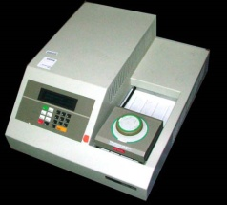
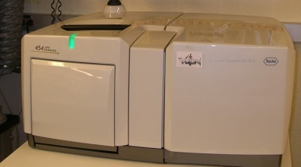
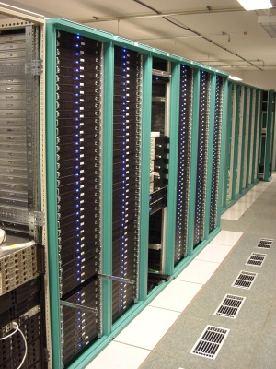
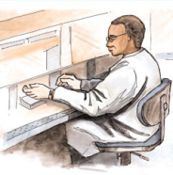
MapReduce “File/Data Repository” Parallelism
Map = (data parallel) computation reading and writing data
Reduce = Collective/Consolidation phase e.g. forming multiple global sums as in histogram
Instruments
MPI or Iterative MapReduce
Map Reduce Map Reduce Map
Communication
Reduce
Portals /Users
Disks
Map₁
Map₂
Map₃

Slide 13
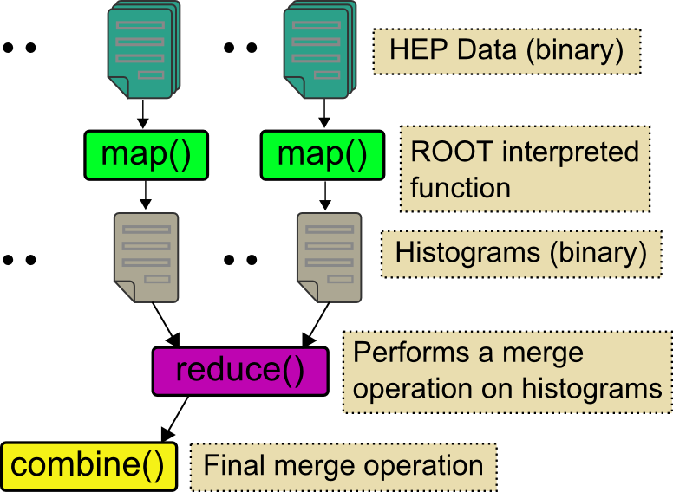
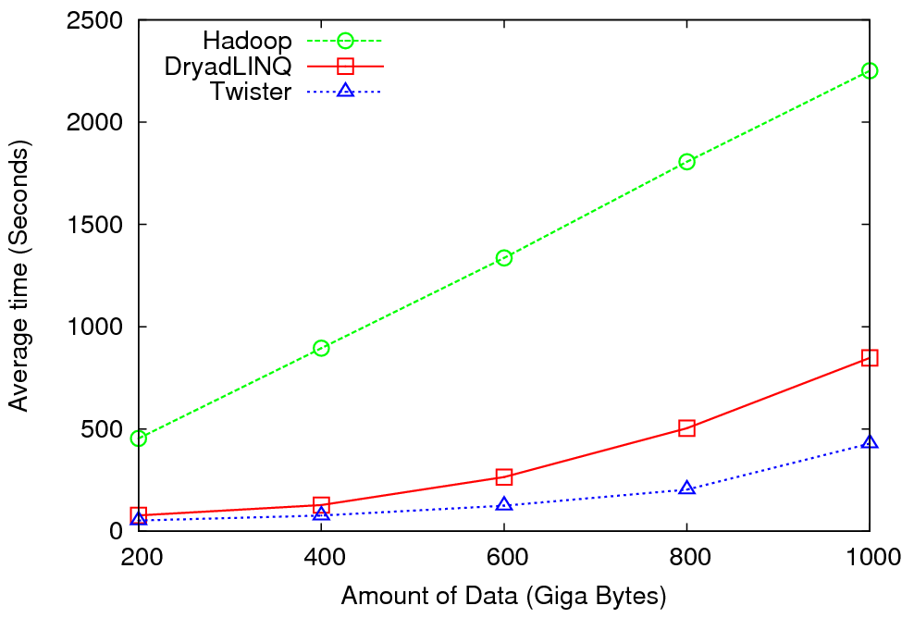
High Energy Physics Data Analysis
An application analyzing data from Large Hadron Collider (1TB but 100 Petabytes eventually)
Input to a map task: <key, value>
key = Some Id value = HEP file Name
Output of a map task: <key, value>
key = random # (0<= num<= max reduce tasks)
value = Histogram as binary data
Input to a reduce task: <key, List<value>>
key = random # (0<= num<= max reduce tasks)
value = List of histogram as binary data
Output from a reduce task: value
value = Histogram file
Combine outputs from reduce tasks to form the final histogram

Slide 14
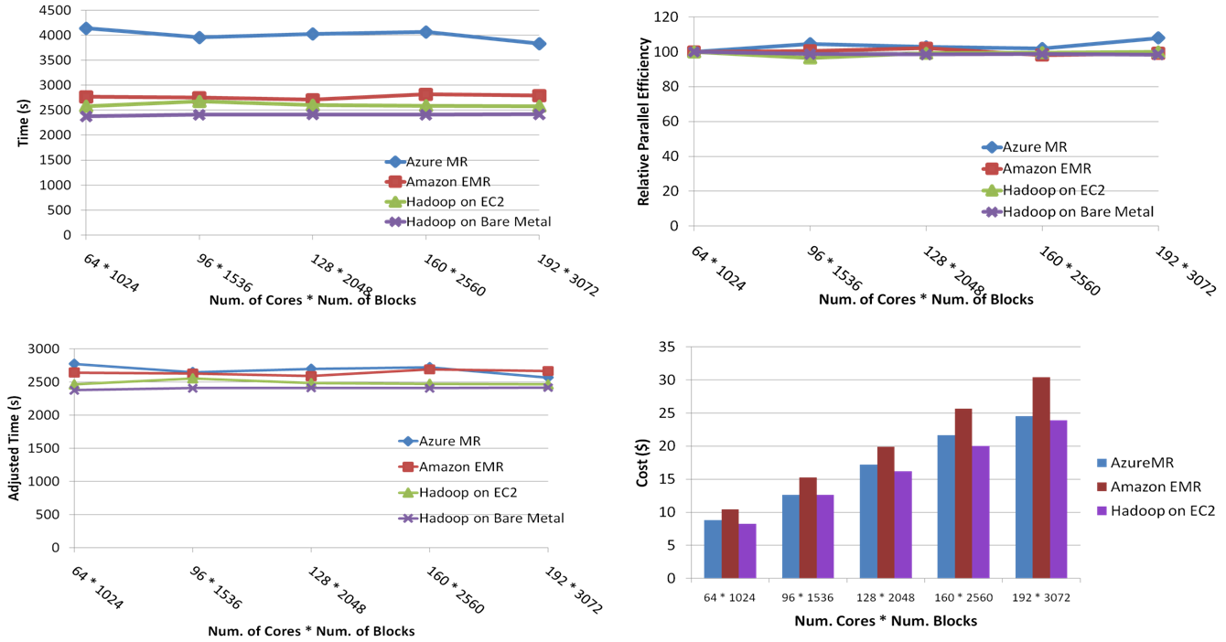
SWG Sequence Alignment Performance
Smith-Waterman-GOTOH to calculate all-pairs dissimilarity
Notes:
~123 million sequence alignments, for under 30$ with zero up front hardware cost,

Slide 15
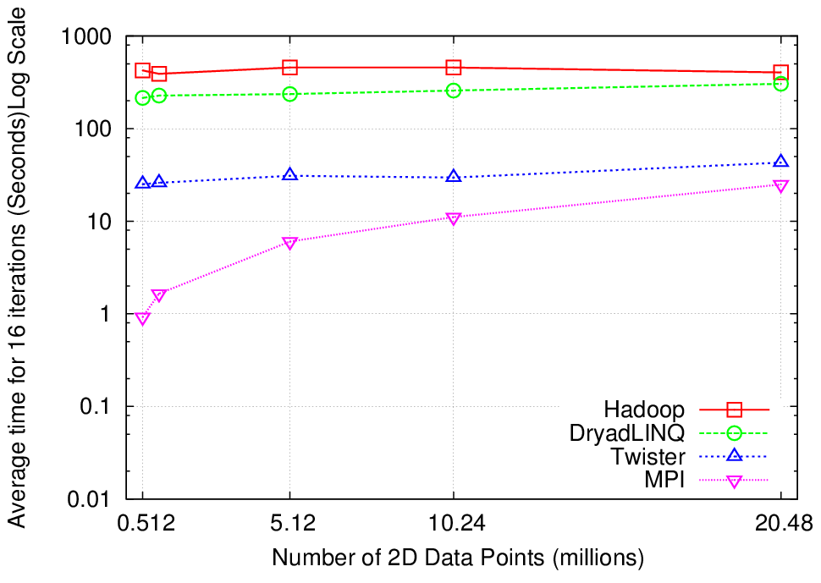
Why Iterative MapReduce? K-Means Clustering
http://www.iterativemapreduce.org/
Compute the distance to each data point from each cluster center and assign points to cluster centers
map
map
Time for 20 iterations
reduce
Compute new cluster
centers
User program
Compute new cluster centers
Iteratively refining operation
Typical MapReduce runtimes incur extremely high overheads
New maps/reducers/vertices in every iteration
File system based communication
Long running tasks and faster communication in Twister enables it to perform close to MPI

Slide 16
Usage Statistics from FutureGrid
Based on User input we focused on
Nimbus (53%)
Eucalyptus (51%)
Hadoop (37%)
HPC (36%)
Eucalyptus: 64(50.8%)
High Performance Computing Environment: 45(35.7%)
Nimbus: 67(53.2%)
Hadoop: 47(37.3%)
MapReduce: 42(33.3%)
Twister: 20(15.9%)
OpenNebula: 14(11.1%)
Genesis II: 21(16.7%)
Common TeraGrid Software Stack: 34(27%)
Unicore 6: 13(10.3%)
gLite: 12(9.5%)
OpenStack: 16(12.7%)

Slide 17
Hadoop on FutureGrid
Goal:
Simplify running Hadoop jobs thru FutureGrid batch queue systems
Allows user customized install of Hadoop
Status and Milestones
Today
myHadoop 0.2a released early this year, deployed to Sierra and India, tutorial available
In future
deploy to Alamo, Hotel, Xray (end of year 2)

Slide 18
Many FutureGrid uses of MapReduce demonstrated in various Tutorials
https://portal.futuregrid.org/tutorials
Running Hadoop as a batch job using MyHadoop
Useful for coordinating many hadoop jobs through the HPC system and queues
Running Hadoop on Eucalyptus
Running hadoop in a virtualized environment
Running Hadoop on the Grid Appliance
Running haddop in a virtualized environment
Benefit from easy setup
Eucalyptus and Twister on FG
Those wanting to use the Twister Iterative MapReduce
Could organize workshops, seminars and/or increase online material.

Slide 19
300+ Students learning about Twister & Hadoop
MapReduce technologies, supported by FutureGrid.
July 26-30, 2010 NCSA Summer School Workshop
http://salsahpc.indiana.edu/tutorial
Washington
University
University of
Minnesota
Michigan
State
Johns
Hopkins
Univ.Illinois
at Chicago
Iowa
Penn
State
IBM Almaden
Research Center
Notre
Dame
University of
California at
Los Angeles
Indiana
University
San Diego
Supercomputer
Center
University of
Texas at El Paso
University of
Arkansas
University
of Florida

Slide 20
ADMI Cloudy View on Computing Workshop June 2011
Concept and Delivery by Jerome Mitchell:
Undergraduate ECSU,
Masters Kansas, PhD (in progress)Indiana
Jerome took two courses from IU in this area Fall 2010 and Spring 2011 on FutureGrid
ADMI: Association of Computer and Information Science/Engineering Departments at Minority Institutions
10 Faculty and Graduate Students from ADMI Universities
Included bootcamp on Mapreduce illustrated with case studies of scientific applications on FutureGrid.
At the conclusion of the workshop, the participants indicated that they would incorporate cloud computing into their courses and/or research.

Slide 21
ADMI Cloudy View on Computing Workshop Participants

Slide 22
Questions?
What is interest in:
Running MapReduce?
Training in MapReduce?
“Special Interest Group” in MapReduce?
Hadoop, DryadLINQ, Twister?
HPC, Amazon, Azure?

