Slide 1
MapReduce on FutureGrid
Andrew Younge
Jerome Mitchell

Slide 2
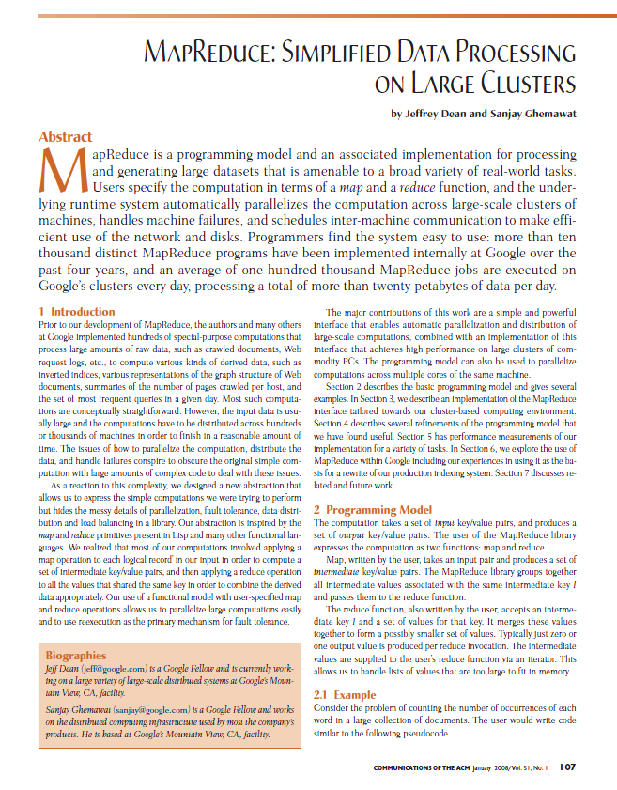
MapReduce

Slide 3
Motivation
Programming model
Purpose
Focus developer time/effort on salient (unique, distinguished) application requirements
Allow common but complex application requirements (e.g., distribution, load balancing, scheduling, failures) to be met by support environment
Enhance portability via specialized run-time support for different architectures

Slide 4
Motivation
Application characteristics
Large/massive amounts of data
Simple application processing requirements
Desired portability across variety of execution platforms
 | Cluster | GPGPU
Architecture | SPMD | SIMD
Granularity | Process | Thread x 100
Partition | File | Sub-array
Bandwidth | Scare | GB/sec x 10
Failures | Common | Uncommon

Slide 5
MapReduce Model
Basic operations
Map: produce a list of (key, value) pairs from the input structured as a (key value) pair of a different type
(k1,v1) → list (k2, v2)
Reduce: produce a list of values from an input that consists of a key and a list of values associated with that key
(k2, list(v2)) → list(v2)

Slide 6
MapReduce: The Map Step
Input
key-value pairs
Intermediate
key-value pairs
k
v
map
k
v
k
v
map
k
v
k
v
…
…
k
v
k
v

Slide 7
The Map (Example)
inputs
tasks (M=3)
partitions (intermediate files) (R=2)
When in the course of human events it …
map
(when,1), (course,1) (human,1) (events,1) (best,1) …
(in,1) (the,1) (of,1) (it,1) (it,1) (was,1) (the,1) (of,1) …
It was the best of times and the worst of times…
Over the past five years, the authors and many…
map
(over,1), (past,1) (five,1) (years,1) (authors,1) (many,1) …
(the,1), (the,1) (and,1) …
This paper evaluates the suitability of the …
map
(this,1) (paper,1) (evaluates,1) (suitability,1) …
(the,1) (of,1) (the,1) …

Slide 8
MapReduce: The Reduce Step
Output
key-value pairs
Intermediate
key-value pairs
Key-value groups
reduce
k
v
k
v
v
v
k
v
reduce
k
v
k
v
v
k
v
group
k
v
…
…
…
k
v
k
v
k
v

Slide 9
The Reduce (Example)
partition (intermediate files) (R=2)
reduce task
(in,1) (the,1) (of,1) (it,1) (it,1) (was,1) (the,1) (of,1) …
sort
run-time function
(the,1), (the,1) (and,1) …
(the,1) (of,1) (the,1) …
(and, (1)) (in,(1)) (it, (1,1)) (the, (1,1,1,1,1,1))
(of, (1,1,1)) (was,(1))
reduce
(and,1) (in,1) (it, 2) (of, 3) (the,6) (was,1)
Note: only one of the two reduce tasks shown

Slide 10
Hadoop Cluster MapReduce Runtime
User
Program
fork
fork
fork
Master
assign
map
assign
reduce
Input Data
Worker
write
Output
File 0
local
write
Worker
Split 0
read
Split 1
Worker
Split 2
Output
File 1
Worker
Worker
remote read, sort

Slide 11
Let’s Not Get Confused …
Google calls it: | Hadoop Equivalent:
MapReduce | Hadoop
GFS | HDFS
Bigtable | HBase
Chubby | Zookeeper

Slide 12
Start a Eucalyptus VM. For Hadoop, please use image “emi-D778156D”.
command: euca-run-instances -k [public key] -t [instance class] [image emi #]
[johnny@i136 johnny-euca]$ euca-run-instances -k johnny -t c1.medium emi-D778156D
RESERVATION r-45F607A9 johnny johnny-default
INSTANCE i-55CE091E emi-D778156D 0.0.0.0 0.0.0.0 pending johnny 2011-02-20T03:59:20.572Z eki-78EF12D2 eri-5BB61255
Please check and wait the instance status become “running”.
[johnny@i136 johnny-euca]$ euca-describe-instances
RESERVATION r-442E080F johnny default
INSTANCE i-46B007AE emi-A89A14B0 149.165.146.207 10.0.5.66 running johnny 0 c1.medium 2011-02-18T22:37:36.772Z india eki-78EF12D2 eri-5BB61255
Copy wordcount assignment onto prepackaged Hadoop virtual machine
[johnny@i136 johnny-euca]$ scp -i johnny.private WordCount.zip root@149.165.146.207:

Slide 13
“149.165.146.207” is the assigned public IP to your VM. At the end, you can login as root user with your created ssh private key (i.e. johnny.private).
[johnny@i136 johnny-euca]$ ssh -i johnny.private root@149.165.146.207
Warning: Permanently added '149.165.146.207' (RSA) to the list of known hosts.
Linux localhost 2.6.27.21-0.1-xen #1 SMP 2009-03-31 14:50:44 +0200 x86_64 GNU/Linux
Ubuntu 10.04 LTS
Welcome to Ubuntu!
* Documentation: https://help.ubuntu.com/
The programs included with the Ubuntu system are free software;
the exact distribution terms for each program are described in the
individual files in /usr/share/doc/*/copyright.
Ubuntu comes with ABSOLUTELY NO WARRANTY, to the extent permitted by
applicable law.
root@localhost:~#

Slide 14
Format hadoop distributed file system
root@localhost:~# hadoop namenode -format
11/07/14 15:03:51 INFO namenode.NameNode: STARTUP_MSG:
/************************************************************
STARTUP_MSG: Starting NameNode
STARTUP_MSG: host = localhost/127.0.0.1
STARTUP_MSG: args = [-format]
STARTUP_MSG: version = 0.20.2
STARTUP_MSG: build = https://svn.apache.org/repos/asf/hadoop/common/branches/branch-0.20 -r 911707; compiled by 'chrisdo' on Fri Feb 19 08:07:34 UTC 2010
************************************************************/
Re-format filesystem in /root/hdfs/name ? (Y or N) Y
11/07/14 15:03:56 INFO namenode.FSNamesystem: fsOwner=root,root
11/07/14 15:03:56 INFO namenode.FSNamesystem: supergroup=supergroup
11/07/14 15:03:56 INFO namenode.FSNamesystem: isPermissionEnabled=true
11/07/14 15:03:56 INFO common.Storage: Image file of size 94 saved in 0 seconds.
11/07/14 15:03:56 INFO common.Storage: Storage directory /root/hdfs/name has been successfully formatted.
11/07/14 15:03:56 INFO namenode.NameNode: SHUTDOWN_MSG:
/************************************************************
SHUTDOWN_MSG: Shutting down NameNode at localhost/127.0.0.1
************************************************************/

Slide 15
Using Hadoop Distributed File Systems (HDFS)
Can access HDFS through various shell commands (see Further Resources slide for link to documentation)
hadoop –put <localsrc> … <dst>
hadoop –get <src> <localdst>
hadoop –ls
hadoop –rm file

Slide 16
Starts all Hadoop daemons, the namenode, datanodes, the jobtracker and tasktrackers root@localhost:~# start-all.sh
starting namenode, logging to /opt/hadoop-0.20.2/bin/../logs/hadoop-root-namenode-localhost.out
localhost: Warning: Permanently added 'localhost' (RSA) to the list of known hosts.
localhost: starting datanode, logging to /opt/hadoop-0.20.2/bin/../logs/hadoop-root-datanode-localhost.out
localhost: starting secondarynamenode, logging to /opt/hadoop-0.20.2/bin/../logs/hadoop-root-secondarynamenode-localhost.out
starting jobtracker, logging to /opt/hadoop-0.20.2/bin/../logs/hadoop-root-jobtracker-localhost.out
localhost: starting tasktracker, logging to /opt/hadoop-0.20.2/bin/../logs/hadoop-root-tasktracker-localhost.out
Validate java processes executing on the master
root@localhost:~# jps
2522 NameNode
2731 SecondaryNameNode
2622 DataNode
2911 TaskTracker
3093 Jps
2804 JobTracker

Slide 17
Execute WordCount program
root@localhost:~/WordCount# hadoop jar ~/WordCount/wordcount.jar WordCount input output
…
11/05/10 15:30:26 INFO mapred.JobClient: map 0% reduce 0%
11/05/10 15:30:38 INFO mapred.JobClient: map 100% reduce 0%
11/05/10 15:30:44 INFO mapred.JobClient: map 100% reduce 100%
…
11/05/10 15:30:46 INFO mapred.JobClient: FILE_BYTES_READ=11334
11/05/10 15:30:46 INFO mapred.JobClient: HDFS_BYTES_READ=1464540
11/05/10 15:30:46 INFO mapred.JobClient: FILE_BYTES_WRITTEN=22700
11/05/10 15:30:46 INFO mapred.JobClient: HDFS_BYTES_WRITTEN=9587
11/05/10 15:30:46 INFO mapred.JobClient: Map-Reduce Framework
11/05/10 15:30:46 INFO mapred.JobClient: Reduce input groups=887
11/05/10 15:30:46 INFO mapred.JobClient: Combine output records=887
11/05/10 15:30:46 INFO mapred.JobClient: Map input records=39600
11/05/10 15:30:46 INFO mapred.JobClient: Reduce shuffle bytes=11334
11/05/10 15:30:46 INFO mapred.JobClient: Reduce output records=887
11/05/10 15:30:46 INFO mapred.JobClient: Spilled Records=1774
11/05/10 15:30:46 INFO mapred.JobClient: Map output bytes=2447412
11/05/10 15:30:46 INFO mapred.JobClient: Combine input records=258720
11/05/10 15:30:46 INFO mapred.JobClient: Map output records=258720
11/05/10 15:30:46 INFO mapred.JobClient: Reduce input records=887

Slide 18
Create a directory, upload input file on HDFS and View the contents
root@localhost:~/WordCount# hadoop fs -mkdir input
root@localhost:~/WordCount# hadoop fs -put ~/WordCount/input.txt input/input.txt
View contents on HDFS
root@localhost:~/WordCount# hadoop fs -ls
Found 1 items
drwxr-xr-x - root supergroup 0 2011-07-14 15:24 /user/root/input
root@localhost:~/WordCount# hadoop fs -ls /user/root/input
Found 1 items
-rw-r--r-- 3 root supergroup 1464540 2011-07-14 15:24 /user/root/input/input.txt

Slide 19
View ouput directory created on HDFS
root@localhost:~/WordCount# hadoop fs -ls
Found 2 items
drwxr-xr-x - root supergroup 0 2011-07-14 15:24 /user/root/input
drwxr-xr-x - root supergroup 0 2011-07-14 15:30 /user/root/output
root@localhost:~/WordCount# hadoop fs -ls /user/root/output
Found 2 items
drwxr-xr-x - root supergroup 0 2011-07-14 15:30 /user/root/output/_logs
-rw-r--r-- 3 root supergroup 9587 2011-07-14 15:30 /user/root/output/part-r-00000
Display the results
root@localhost:~/WordCount# hadoop fs -cat /user/root/output/part-r-00000
"'E's 132
"An' 132
"And 396
"Bring 132
"But 132
"Did 132
….

Slide 20
Let’s Clean Up
Stops all Hadoop daemons
root@localhost:~/WordCount# stop-all.sh
stopping jobtracker
localhost: stopping tasktracker
stopping namenode
localhost: stopping datanode
localhost: stopping secondarynamenode
root@localhost:~/WordCount# exit
Terminate VM
[johnny@i136 ~]$ euca-terminate-instances i-39170654
INSTANCE i-46B007AE

Slide 21
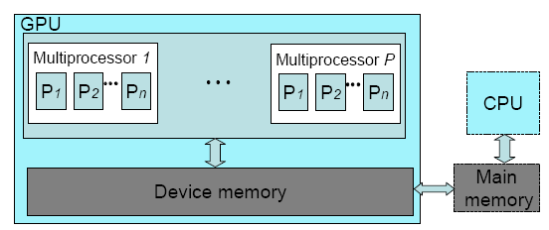
GPU Architecture

Slide 22
MapReduce GPGPU
General Purpose Graphics Processing Unit (GPGPU)
Available as commodity hardware
GPU vs. CPU
Used previously for non-graphics computation in various application domains
Architectural details are vendor-specific
Programming interfaces emerging
Question
Can MapReduce be implemented efficiently on a GPGPU?

Slide 23
“MARS” GPU MapReduce Runtime

Slide 24
Questions

