Slide 1
Early Experience with Cloud Technologies
Microsoft External Research Symposium , March 31 2009, Microsoft Seattle
Geoffrey Fox
gcf@indiana.edu www.infomall.org/salsa
Community Grids Laboratory,
Chair Department of Informatics
School of Informatics
Indiana University

Slide 2
Collaboration in SALSA Project
Microsoft Research
Technology Collaboration
Dryad
Roger Barga
CCR
George Chrysanthakopoulos
DSS
Henrik Frystyk Nielsen
Indiana University
SALSA Team
Geoffrey Fox
Xiaohong Qiu
Scott Beason
Seung-Hee Bae
Jaliya Ekanayake
Jong Youl Choi
Yang Ruan
Others
Application Collaboration
Bioinformatics, CGB
Haiku Tang, Mina Rho, Qufeng Dong
IU Medical School
Gilbert Liu
Demographics (GIS)
Neil Devadasan
Cheminformatics
Rajarshi Guha, David Wild
Physics
CMS group at Caltech (Julian Bunn)
Community Grids Lab
and UITS RT -- PTI
Sangmi Pallickara,
Shrideep Pallickara,
Marlon Pierce

Slide 3
Data Intensive (Science) Applications
1) Data starts on some disk/sensor/instrument
  It needs to be partitioned; often partitioning natural from source of data
2) One runs a filter of some sort extracting data of interest and (re)formatting it
  Pleasingly parallel with often “millions” of jobs
  Communication latencies can be many milliseconds and can involve disks
3) Using same (or map to a new) decomposition, one runs a parallel application that could require iterative steps between communicating processes or could be pleasing parallel
  Communication latencies may be at most some microseconds and involves shared memory or high speed networks
Workflow links 1) 2) 3) with multiple instances of 2) 3)
  Pipeline or more complex graphs
Filters are “Maps” or “Reductions” in MapReduce language

Slide 4
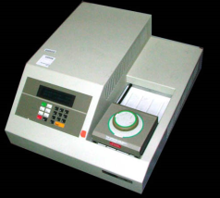

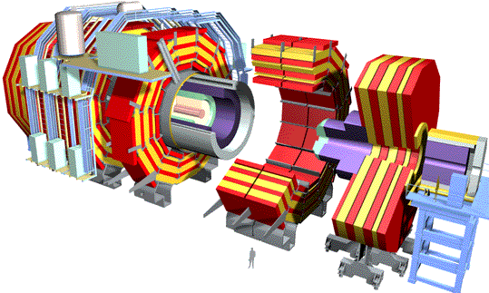




“File/Data Repository” Parallelism
Instruments
Map = (data parallel) computation reading and writing data
Reduce = Collective/Consolidation phase e.g. forming multiple global sums as in histogram
Communication via Messages/Files
Portals
/Users
Disks
Map₁
Map₂
Map₃
Reduce
Computers/Disks

Slide 5
Data Analysis Examples
LHC Particle Physics analysis: File parallel over events
  Filter1: Process raw event data into “events with physics parameters”
  Filter2: Process physics into histograms
  Reduce2: Add together separate histogram counts
  Information retrieval similar parallelism over data files
Bioinformatics - Gene Families: Data parallel over sequences
  Filter1: Calculate similarities (distances) between sequences
  Filter2: Align Sequences (if needed)
  Filter3: Cluster to find families
  Filter 4/Reduce4: Apply Dimension Reduction to 3D
  Filter5: Visualize

Slide 6
Philosophy
Clouds are (by definition) commercially supported approach to large scale computing
  So we should expect Clouds to replace Compute Grids
  Current Grid experience gives a not so positive evaluation of “non-commercial” software solutions
Informational Retrieval is major data intensive commercial application so we can expect technologies from this field (Dryad, Hadoop) to be relevant for related scientific (File/Data parallel) applications
  Need technology to be packaged for general use

Slide 7
MapReduce implemented
by Hadoop using files for communication or CGL-MapReduce using in memory queues as “Enterprise bus” (pub-sub)
H
Y
n
Y
Example: Word Histogram
Start with a set of words
Each map task counts number of occurrences in each data partition
Reduce phase adds these counts
map(key, value)
U
U
S
4n
S
reduce(key, list<value>)
M
4n
M
D
n
D
Dryad supports general dataflow – currently communicate via files; will use queues
X
n
X
U
N
U
N

Slide 8
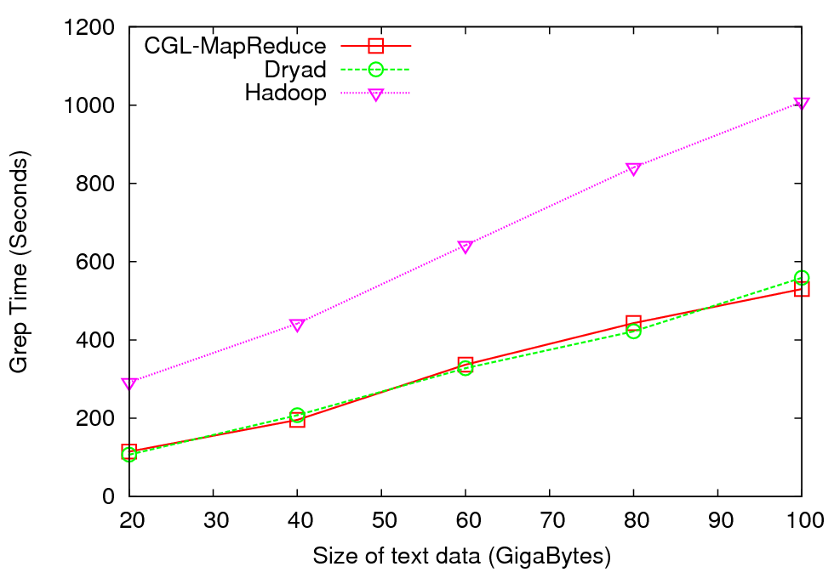
Distributed Grep - Performance
Performs “grep” operation on a collection of documents
Results not normalized for machine performance
CGL-MapReduce and Hadoop both used all the cores of 4 gridfarm nodes while Dryad used only 1 core per node in four nodes of Barcelona.
Abstraction of real Information Retrieval use of Dryad

Slide 9
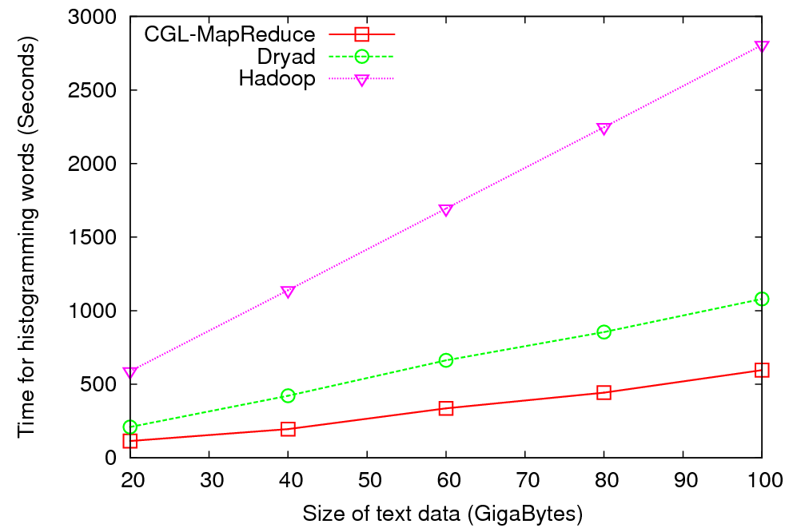
Histogramming of Words- Performance
Perform a “histogramming” operation on a collection of documents
Results not normalized for machine performance
Also, CGL-MapReduce and Hadoop both used all the cores of 4 gridfarm nodes while Dryad used only 1 core per node in four nodes of Barcelona

Slide 10
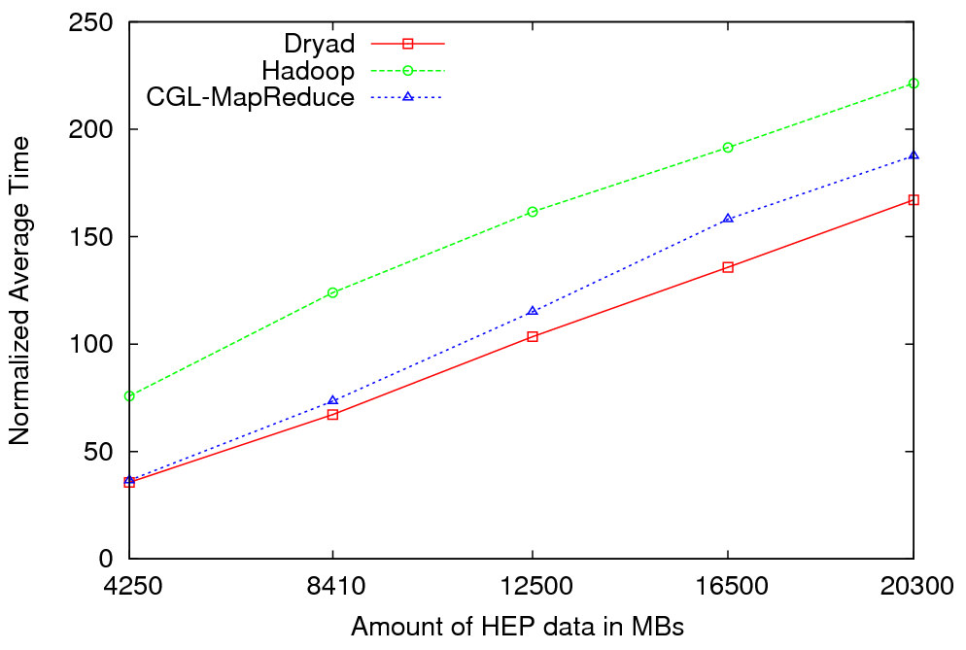

Particle Physics (LHC) Data Analysis
MapReduce for LHC data analysis
LHC data analysis, execution time vs. the volume of data (fixed compute resources)
Root running in distributed fashion allowing analysis to access distributed data – computing next to data
LINQ not optimal for expressing final merge

Slide 11

Reduce Phase of Particle Physics “Find the Higgs” using Dryad
Combine Histograms produced by separate Root “Maps” (of event data to partial histograms) into a single Histogram delivered to Client

Slide 12
Cluster Configuration
Configurations | CGL-MapReduce and Hadoop | Dryad
Number of nodes and processor cores | 4 Nodes => 4x8 =32 processor cores | 4 Nodes => 4x8 =32 processor cores
Processors | Quad Core Intel Xeon E5335 – 2 processors 2000.12 MHz | Quad Core AMD Opteron 2356 – 2 processors 2.29 GHz
Memory | 16GB | 16GB
Operating System | Red Hat Enterprise Linux 4 | Windows Server 2008 (HPC Edition)
Language | Java | C#
Data Placement | Hadoop -> Hadoop Distributed File System (HDFS) CGL-MapReduce -> Shared File System (NFS) | Individual nodes with shared directories
Note: Our current version of Dryad can only run one PN process per node. Therefore we have configured, Hadoop and CGL-MapReduce to use only one parallel task in each node.

Slide 13
Notes on Performance
Speed up = T(1)/T(P) = ε (efficiency ) P
  with P processors
Overhead f = (PT(P)/T(1)-1) = (1/ε -1)
is linear in overheads and usually best way to record results if overhead small
For MPI communication f ∝ ratio of data communicated to calculation complexity = n^{-0.5} for matrix multiplication where n (grain size) matrix elements per node
MPI Communication Overheads decrease in size as problem sizes n increase (edge over area rule)
Dataflow communicates all data – Overhead does not decrease
Scaled Speed up: keep grain size n fixed as P increases
Conventional Speed up: keep Problem size fixed n ∝ 1/P
VMs and Windows Threads have runtime fluctuation /synchronization overheads

Slide 14
Comparison of MPI and Threads on Classic parallel Code
Parallel Overhead
≈ 1-efficiency
= (PT(P)/T(1)-1)
On P processors
= (1/efficiency)-1
24-way
Speedup = 24/(1+f)
16-way
2-way
4-way
8-way
1-way
Speedup 28
MPI 1 2 1 4 2 1 8 4 2 1 16 8 4 2 1 24 12 8 6 4 3 2 1 Processes
CCR 1 1 2 1 2 4 1 2 4 8 1 2 4 8 16 1 2 3 4 6 8 12 24 Threads
4 Intel Six Core Xeon E7450 2.4GHz 48GB Memory 12M L2 Cache
3 Dataset sizes

Slide 15
Performance of Parallel Pairwise Clustering
Scaled Speedup Tests on eight nodes 16-core System
(Different choices of MPI and Threading)
Parallel Overhead
128-way Parallelism
2000 Points
8 nodes
16 MPI Processes per node
1 Thread per process
Runtime Fluctuations/Synchronization (VM, Threads)
+ Communication Time /(n * Calculation Time)
n = Total Points/Number of Execution Units
varies from 10000 to 2000/128 = 16
Communication Time = 0 (Threads)
128-way Parallelism
2000 Points
8 nodes
16 Threads
per process
64-way
96-way
48-way
8-way
16-way
32-way
4000 Points
2-way
4-way
10,000 Points
4x2x1
4x4x3
4x4x6
2x8x8
1x4x2
8x2x8
1x8x1
2x2x2
2x4x1
4x1x2
1x8x2
2x4x2
2x8x1
4x2x2
4x4x1
8x1x2
8x2x1
2x8x2
4x4x2
1x2x2
8x2x2
2x1x2
2x2x1
2x4x6
2x8x3
4x4x8
4x2x6
16x1x8
1x8x8
8x2x4
2x4x8
1x16x2
16x1x2
2x8x4
1x1x1
1x16x3
1x16x8
1x1x2
1x2x1
2x1x1
1x4x1
1x16x1
4x2x8
16x1x4
8x1x8

Slide 16
Performance of Parallel Pairwise Clustering
Scaled Speedup Tests on eight nodes 16-core System
(Different choices of MPI and Threading)
Parallel Overhead
2000 Points
16-way
32-way
4000 Points
Parallel Overhead
8-way
4-way
2-way
64-way
48-way
128-way
10,000 Points
96-way
4x2x1
4x4x3
4x4x6
2x8x8
1x4x2
8x2x8
1x8x1
2x2x2
2x4x1
4x1x2
1x8x2
2x4x2
2x8x1
4x2x2
4x4x1
8x1x2
8x2x1
2x8x2
4x4x2
1x2x2
8x2x2
2x1x2
2x2x1
2x4x6
2x8x3
4x4x8
4x2x6
16x1x8
1x8x8
8x2x4
2x4x8
1x16x2
16x1x2
2x8x4
1x1x1
1x16x3
1x16x8
1x1x2
1x2x1
2x1x1
1x4x1
1x16x1
4x2x8
16x1x4
8x1x8

Slide 17
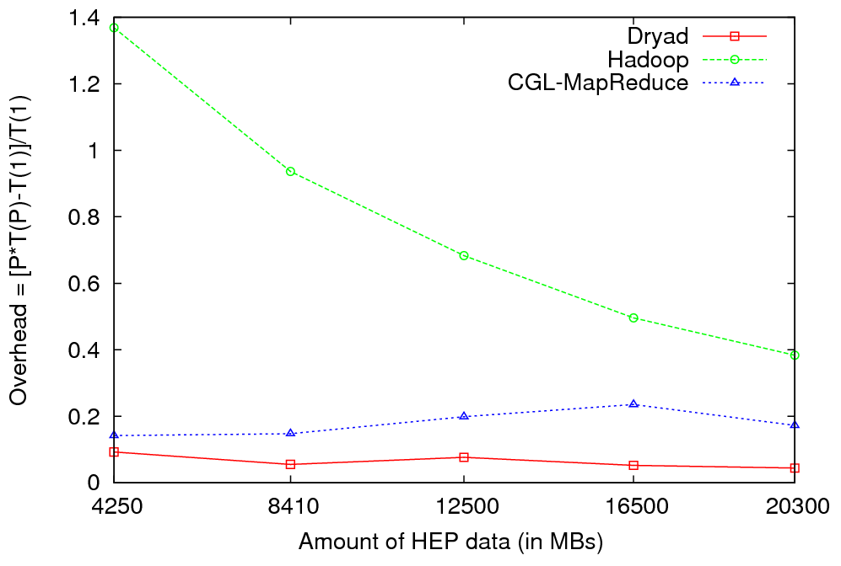
HEP Data Analysis - Overhead
Overhead of Different Runtimes vs. Amount of Data Processed

Slide 18
Some Other File/Data Parallel Examples from Indiana University Biology Dept
EST (Expressed Sequence Tag) Assembly: 2 million mRNA sequences generates 540000 files taking 15 hours on 400 TeraGrid nodes (CAP3 run dominates)
MultiParanoid/InParanoid gene sequence clustering: 476 core years just for Prokaryotes
Population Genomics: (Lynch) Looking at all pairs separated by up to 1000 nucleotides
Sequence-based transcriptome profiling: (Cherbas, Innes) MAQ, SOAP
Systems Microbiology (Brun) BLAST, InterProScan
Metagenomics (Fortenberry, Nelson) Pairwise alignment of 7243 16s sequence data took 12 hours on TeraGrid
All can use Dryad

Slide 19
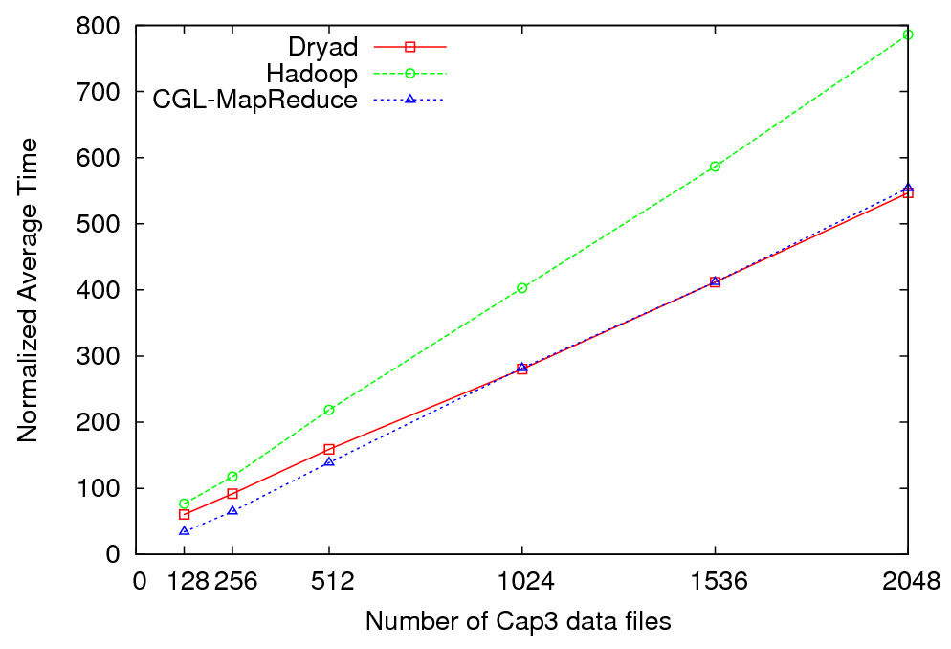
Cap3 Data Analysis - Performance
Normalized Average Time vs. Amount of Data Processed

Slide 20
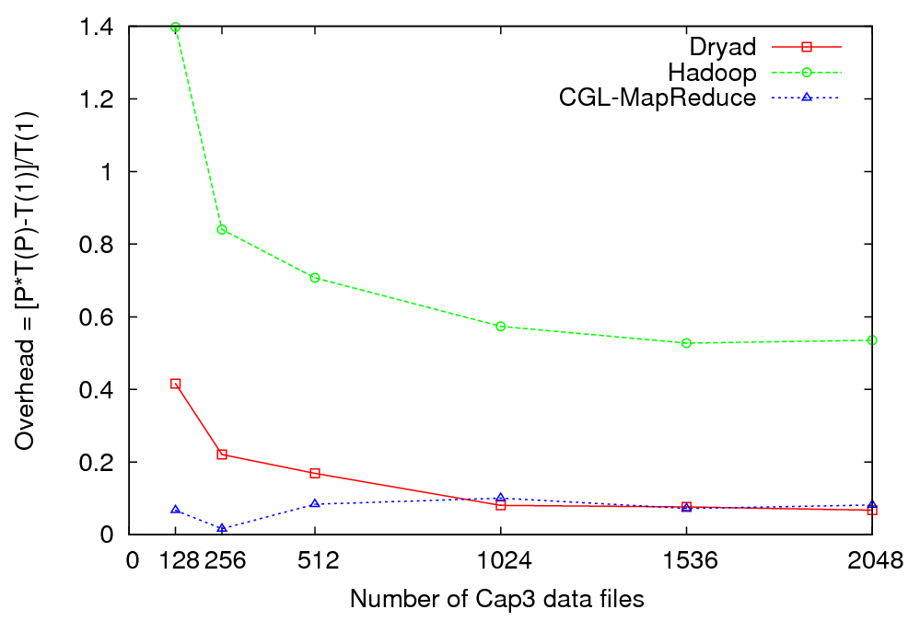
Cap3 Data Analysis - Overhead
Overhead of Different Runtimes vs. Amount of Data Processed

Slide 21
The many forms of MapReduce
MPI, Hadoop, Dryad, (Web or Grid) services, workflow (Taverna .. Mashup .. BPEL), (Enterprise) Service Buses all consist of execution units exchanging messages
They differ in performance, long v short lived processes, communication mechanism, control v data communication, fault tolerance, user interface, flexibility (dynamic v static processes) etc.
As MPI can do all parallel problems, so can Hadoop, Dryad … (famous paper on MapReduce for datamining)
MPI is “data-parallel”, it is actually “memory-parallel” as “owner computes” rule says “computer evolves points in its memory”
Dryad and Hadoop support “File/Repository-parallel” (attach computing to data on disk) which is natural for vast majority of experimental science
Dryad/Hadoop typically transmit all the data between steps (maps) by either queues or files (process lasts as long as map does)
MPI will only transmit needed state changes using rendezvous semantics with long running processes which is higher performance but less dynamic and less fault tolerant

Slide 22
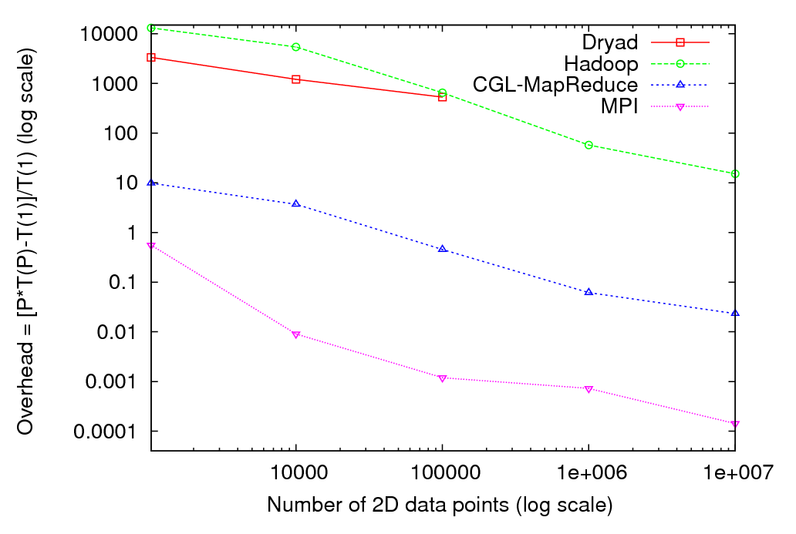
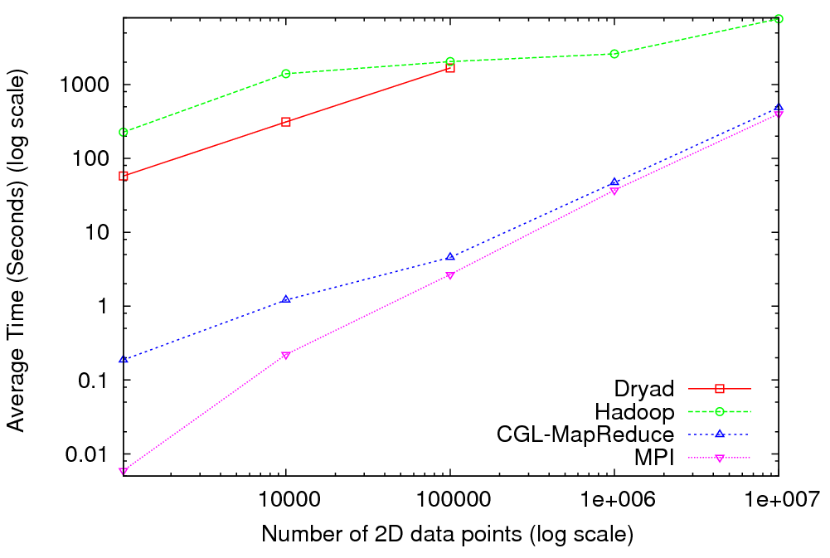
Kmeans Clustering in MapReduce
So Dryad will be better when uses pipes not files as communication
“CGL-MapReduce
Millisecond MPI”
“Microsecond MPI”

Slide 23
MapReduce in MPI.NET(C#)
A couple of Setup calls and one for Reduce ….
Follow a data decomposed MPI calculation (the map) with NO communication by
MPI_communicator.Allreduce<UserDataStructure>(LocalStructure, UserReductionRoutine) with Struct UserDataStructure instance LocalStructure and a general reduction routine ReducedStruct = UserReductionRoutine(Struct1, Struct2)
Or for example MPI_communicator.Allreduce<double>( Histogram, Operation<double>.Add) with Histogram as a double array gives particle physics Root application to summing histograms
Could drive with higher level language which could choose Dryad or MPI depending on needed trade-offs

Slide 24
Data Intensive Cloud Architecture
MPI/GPU Cloud
Instruments
User Data
Linux
Cloud
Windows Cloud
Users
Files
Files
Files
Files
Dryad should manage decomposed data from database/file to Windows cloud (Azure) to Linux Cloud and specialized engines (MPI, GPU …)
Does Dryad replace Workflow? How does it link to MPI-based daatmining?

Slide 25
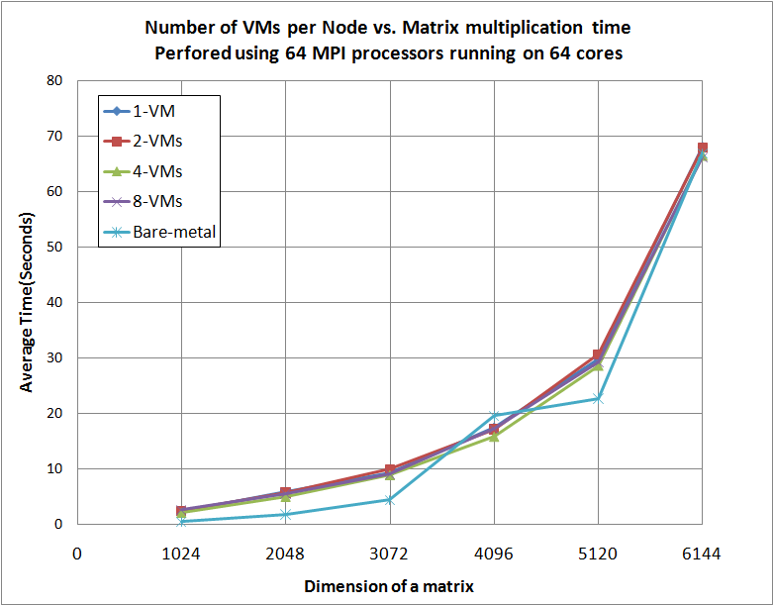
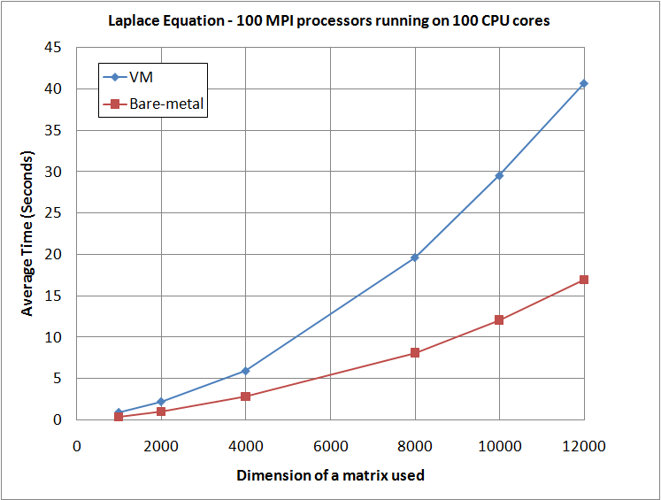
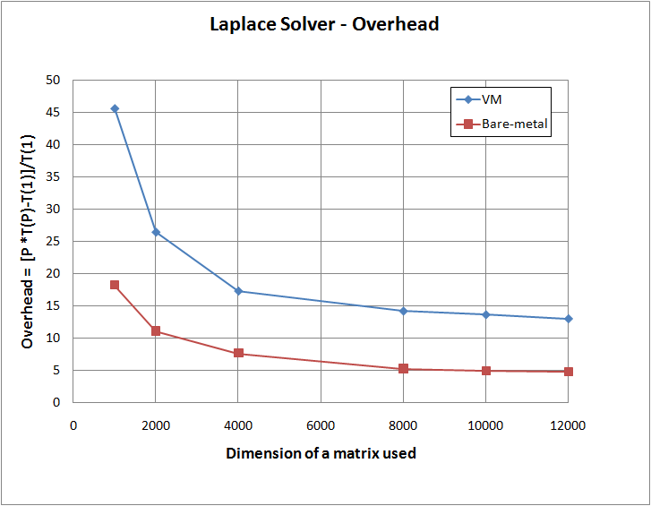
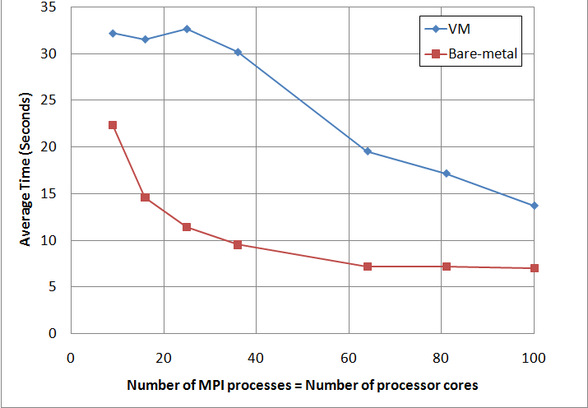
MPI Cloud Overhead
Eucalyptus (Xen) versus “Bare Metal Linux” on communication Intensive trivial problem (2D Laplace) and matrix multiplication
Cloud Overhead ~3 times Bare Metal; OK if communication modest
7200 by 7200 Grid
Grid size in each of 2 dimensions
Grid size in each of 2 dimensions

