Slide 1
Our Objectives
Explore the applicability of Microsoft technologies to real world scientific domains with a focus on data intensive applications
Expect data deluge will demand multicore enabled data analysis/mining
Detailed objectives modified based on input from Microsoft such as interest in CCR, Dryad and TPL
Evaluate and apply these technologies in demonstration systems
Threading: CCR, TPL
Service model and workflow: DSS and Robotics toolkit
MapReduce: Dryad/DryadLINQ compared to Hadoop and Azure
Classical parallelism: Windows HPCS and MPI.NET,
XNA Graphics based visualization
Work performed using C#
Provide feedback to Microsoft
Broader Impact
Papers, presentations, tutorials, classes, workshops, and conferences
Provide our research work as services to collaborators and general science community

Slide 2
Approach
Use interesting applications (working with domain experts) as benchmarks including emerging areas like life sciences and classical applications such as particle physics
Bioinformatics - Cap3, Alu, Metagenomics, PhyloD
Cheminformatics - PubChem
Particle Physics - LHC Monte Carlo
Data Mining kernels - K-means, Deterministic Annealing Clustering, MDS, GTM, Smith-Waterman Gotoh
Evaluation Criterion for Usability and Developer Productivity
Initial learning curve
Effectiveness of continuing development
Comparison with other technologies
Performance on both single systems and clusters

Slide 3
Major Achievements
Analysis of CCR and DSS within SALSA paradigm with very detailed performance work on CCR
Detailed analysis of Dryad and comparison with Hadoop and MPI. Initial comparison with Azure
Comparison of TPL and CCR approaches to parallel threading
Applications to several areas including particle physics and especially life sciences
Demonstration that Windows HPC Clusters can efficiently run large scale data intensive applications
Development of high performance Windows 3D visualization of points from dimension reduction of high dimension datasets to 3D. These are used as Cheminformatics and Bioinformatics dataset browsers
Proposed extensions of MapReduce to perform datamining efficiently
Identification of datamining as important application with new parallel algorithms for Multi Dimensional Scaling MDS, Generative Topographic Mapping GTM, and Clustering for cases where vectors are defined or where one only knows pairwise dissimilarities between dataset points.
Extension of robust fast deterministic annealing to clustering (vector and pairwise), MDS and GTM.

Slide 4
Typical CCR Comparison with TPL
Efficiency = 1 / (1 + Overhead)
Hybrid internal threading/MPI as intra-node model works well on Windows HPC cluster
Within a single node TPL or CCR outperforms MPI for computation intensive applications like clustering of Alu sequences (“all pairs” problem)
TPL outperforms CCR in major applications

Slide 5
Threading versus MPI on node Always MPI between nodes
Clustering by Deterministic Annealing
(Parallel Overhead = [PT(P) – T(1)]/T(1), where T time and P number of parallel units)
MPI
MPI
Parallel Overhead
MPI
Thread
Thread
Thread
Thread
Thread
MPI
MPI
MPI
MPI
Thread
Thread
Parallel Patterns (ThreadsxProcessesxNodes)
Note MPI best at low levels of parallelism
Threading best at Highest levels of parallelism (64 way breakeven)
Uses MPI.Net as a wrapper of MS-MPI

Slide 6
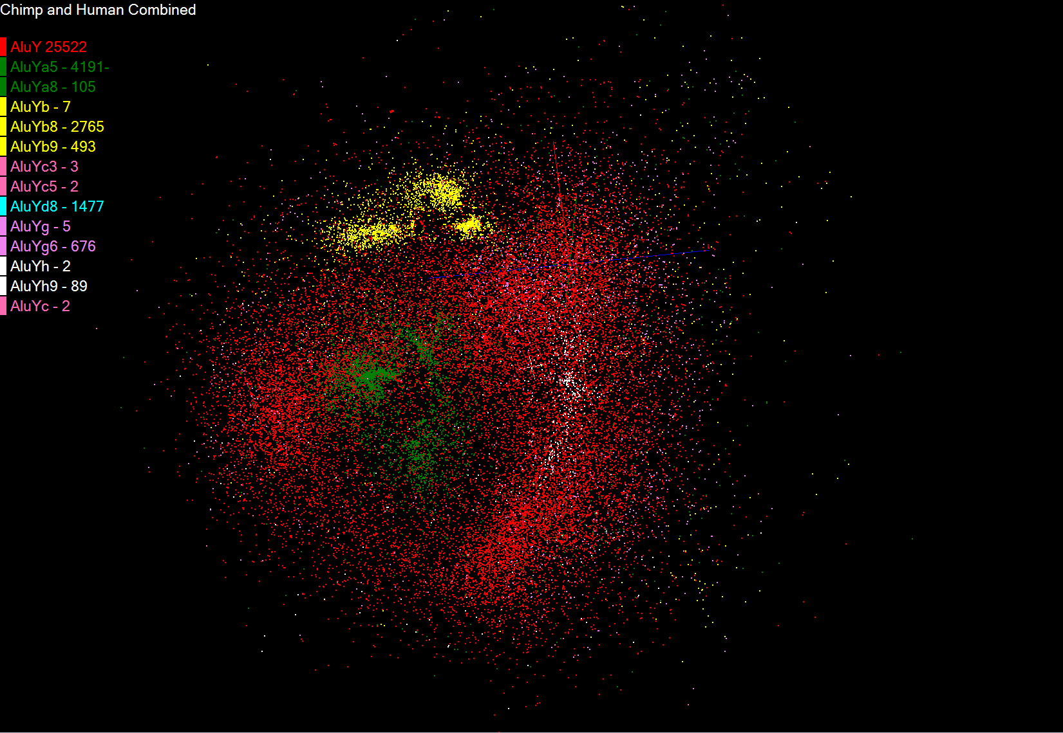
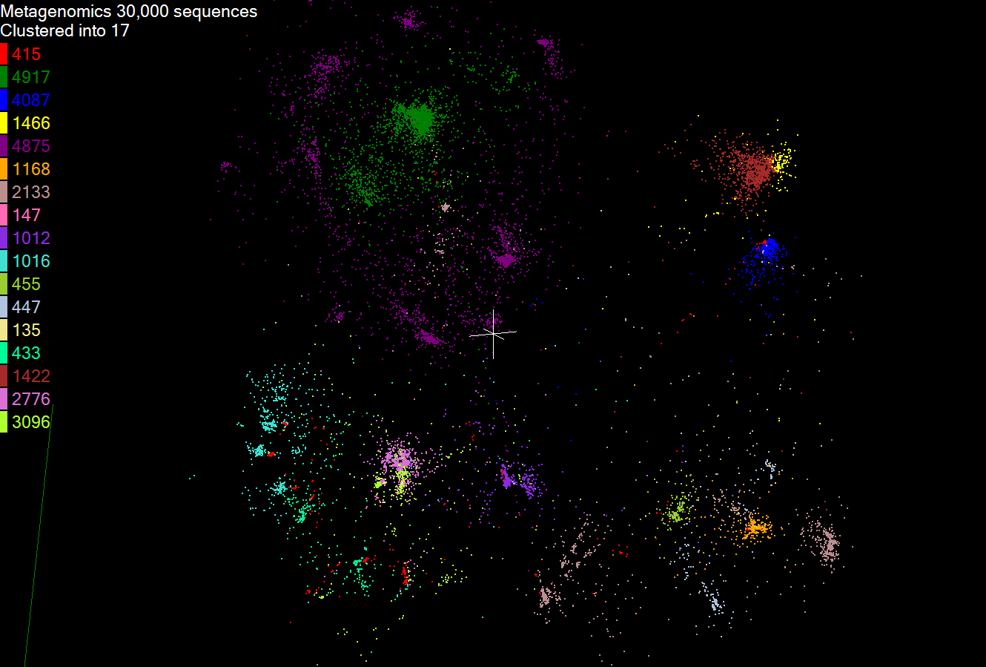
Biology MDS and Clustering Results
Alu Families
This visualizes results of Alu repeats from Chimpanzee and Human Genomes. Young families (green, yellow) are seen as tight clusters. This is projection of MDS dimension reduction to 3D of 35399 repeats – each with about 400 base pairs
Metagenomics
This visualizes results of dimension reduction to 3D of 30000 gene sequences from an environmental sample. The many different genes are classified by clustering algorithm and visualized by MDS dimension reduction

Slide 7
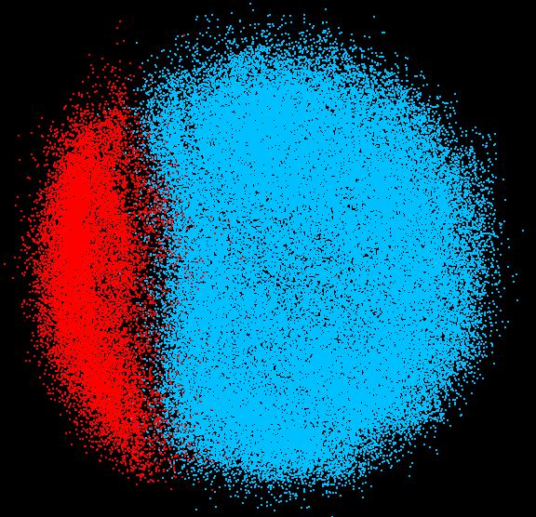
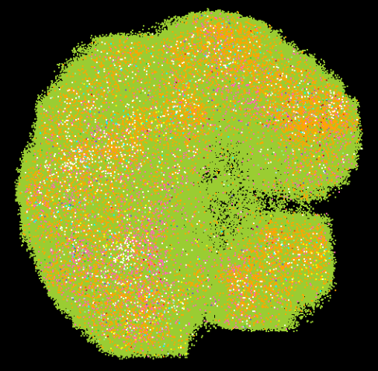
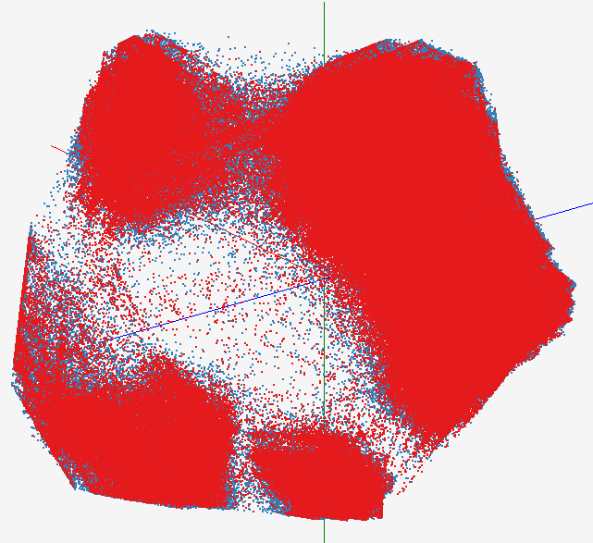
High Performance Data Visualization
Developed parallel MDS and GTM algorithm to visualize large and high-dimensional data
Processed 0.1 million PubChem data having 166 dimensions
Parallel interpolation can process up to 2M PubChem points
GTM with interpolation for 2M PubChem data
2M PubChem data is plotted in 3D with GTM interpolation approach. Red points are 100k sampled data and blue points are 4M interpolated points.
MDS for 100k PubChem data
100k PubChem data having 166 dimensions are visualized in 3D space. Colors represent 2 clusters separated by their structural proximity.
GTM for 930k genes and diseases
Genes (green color) and diseases (others) are plotted in 3D space, aiming at finding cause-and-effect relationships.
[3] PubChem project, http://pubchem.ncbi.nlm.nih.gov/

Slide 8
Applications using Dryad & DryadLINQ
CAP3 [1] - Expressed Sequence Tag assembly to re-construct full-length mRNA
Input files (FASTA)
DryadLINQ
CAP3
CAP3
CAP3
Output files
Perform using DryadLINQ and Apache Hadoop implementations
Single “Select” operation in DryadLINQ
“Map only” operation in Hadoop
[4] X. Huang, A. Madan, “CAP3: A DNA Sequence Assembly Program,” Genome Research, vol. 9, no. 9, pp. 868-877, 1999.

Slide 9
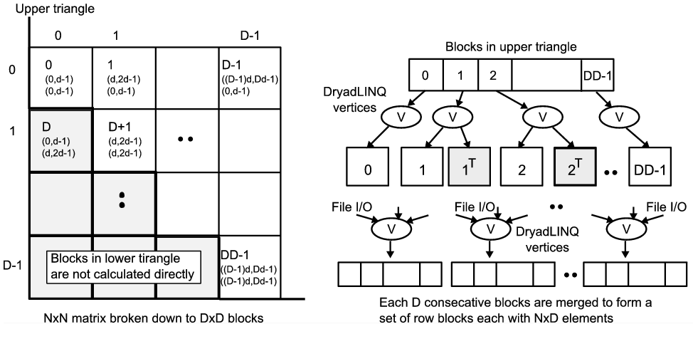
All-PairsUsing DryadLINQ
125 million distances
4 hours & 46 minutes
Calculate Pairwise Distances (Smith Waterman Gotoh)
Calculate pairwise distances for a collection of genes (used for clustering, MDS)
Fine grained tasks in MPI
Coarse grained tasks in DryadLINQ
Performed on 768 cores (Tempest Cluster)
[5] Moretti, C., Bui, H., Hollingsworth, K., Rich, B., Flynn, P., & Thain, D. (2009). All-Pairs: An Abstraction for Data Intensive Computing on Campus Grids. IEEE Transactions on Parallel and Distributed Systems , 21, 21-36.

Slide 10
Hadoop/Dryad Comparison Inhomogeneous Data I
Inhomogeneity of data does not have a significant effect when the sequence lengths are randomly distributed
Dryad with Windows HPCS compared to Hadoop with Linux RHEL on Idataplex (32 nodes)

Slide 11
Hadoop/Dryad Comparison Inhomogeneous Data II
This shows the natural load balancing of Hadoop MR dynamic task assignment using a global pipe line in contrast to the DryadLinq static assignment
Dryad with Windows HPCS compared to Hadoop with Linux RHEL on Idataplex (32 nodes)

Slide 12
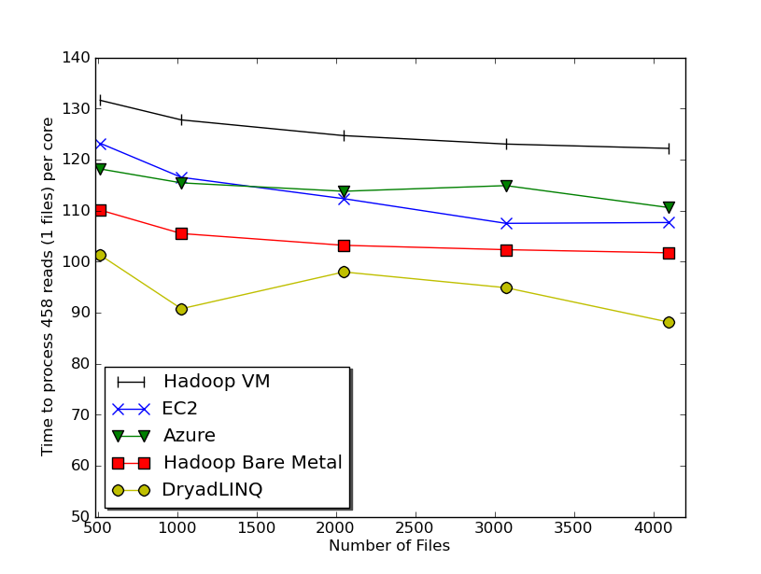
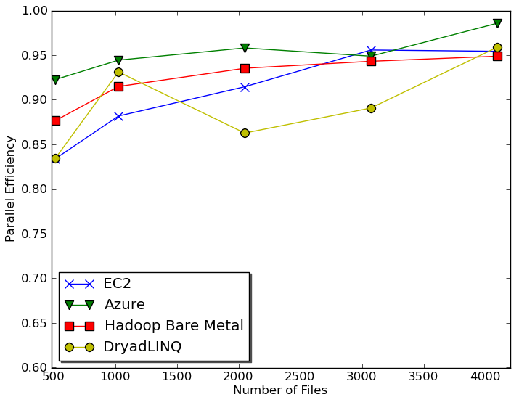
Usability and Performance of Different Cloud Approaches
Cap3 Performance
Cap3 Efficiency
Ease of Use – Dryad/Hadoop are easier than EC2/Azure as higher level models
Lines of code including file copy
Azure : ~300 Hadoop: ~400 Dyrad: ~450 EC2 : ~700
Efficiency = absolute sequential run time / (number of cores * parallel run time)
Hadoop, DryadLINQ - 32 nodes (256 cores IDataPlex)
EC2 - 16 High CPU extra large instances (128 cores)
Azure- 128 small instances (128 cores)

Slide 13
Table 1 : Selected EC2 Instance Types
Instance Type | Memory | EC2 compute units | Actual CPU cores | Cost per hour | Cost per Core per hour
Large (L) | 7.5 GB | 4 | 2 X (~2Ghz) | 0.34$ | 0.17$
Extra Large (XL) | 15 GB | 8 | 4 X (~2Ghz) | 0.68$ | 0.17$
High CPU Extra Large (HCXL) | 7 GB | 20 | 8 X (~2.5Ghz) | 0.68$ | 0.09$
High Memory 4XL (HM4XL) | 68.4 GB | 26 | 8X (~3.25Ghz) | 2.40$ | 0.3$
Tempest@IU | 48GB | n/a | 24 | 1.62$ | 0.07$

Slide 14
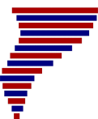
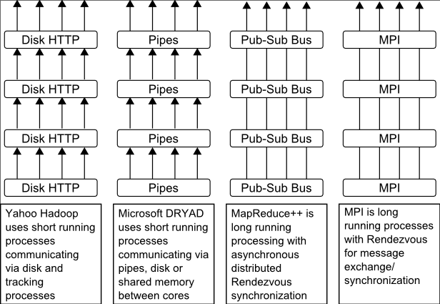
Twister(MapReduce++)
Pub/Sub Broker Network
Map Worker
M
Streaming based communication
Intermediate results are directly transferred from the map tasks to the reduce tasks – eliminates local files
Cacheable map/reduce tasks
Static data remains in memory
Combine phase to combine reductions
User Program is the composer of MapReduce computations
Extends the MapReduce model to iterative computations
Worker Nodes
R
Reduce Worker
D
D
MR
Driver
User
Program
M
M
M
M
D
MRDeamon
R
R
R
R
Data Read/Write
Communication
Data Split
File System
Iterate
Static
data
Configure()
User Program
Map(Key, Value)
δ flow
Reduce (Key, List<Value>)
Combine (Key, List<Value>)
Different synchronization and intercommunication mechanisms used by the parallel runtimes
Close()

Slide 15
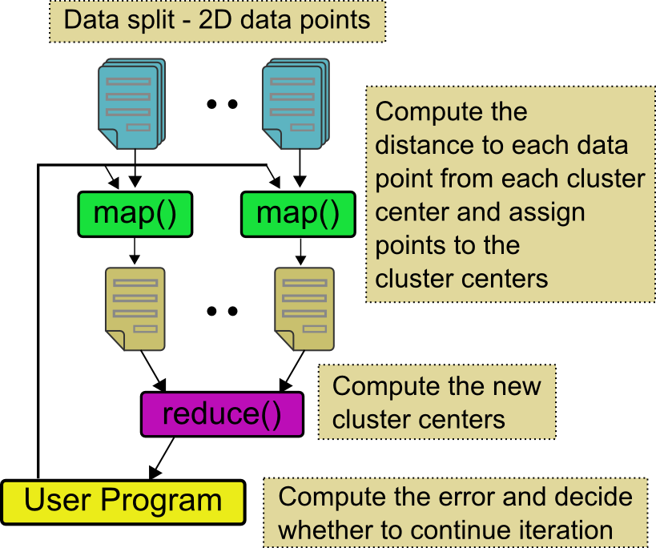
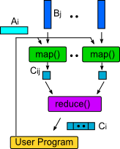
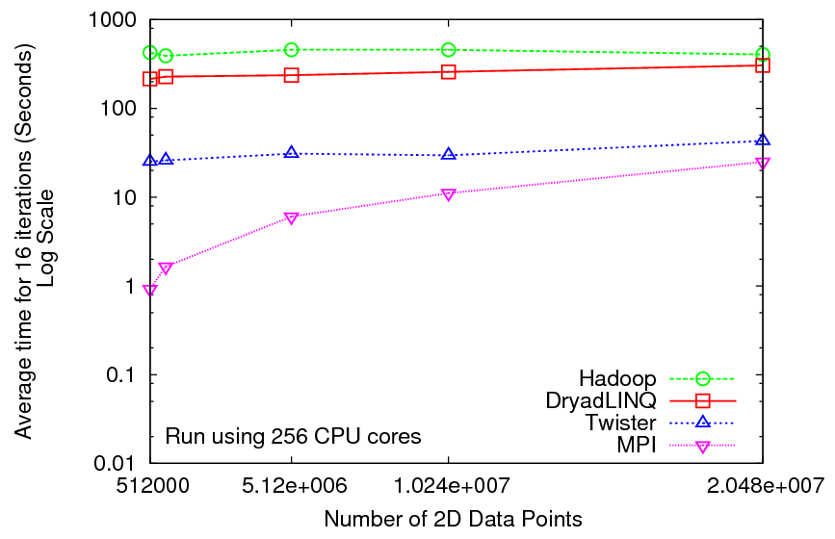
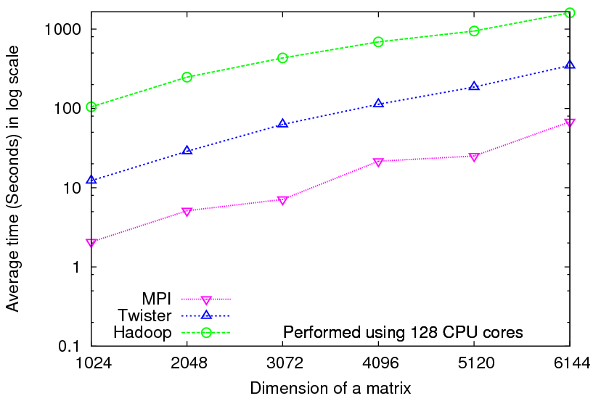
Iterative Computations
K-means
Matrix Multiplication
Performance of K-Means
Parallel Overhead Matrix Multiplication

