Slide 1
Big Data in Research and Education
Symposium on Big Data Science and Engineering
Metropolitan State University, Minneapolis/St. Paul, Minnesota
October 19 2012
Geoffrey Fox
gcf@indiana.edu
Informatics, Computing and Physics
Indiana University Bloomington

Slide 2
Abstract
We discuss the sources of data from biology and medical science to particle physics and astronomy to the Internet with implications for discovery and challenges for analysis.
We describe typical data analysis computer architectures from High Performance Computing to the Cloud.
On education we look at interdisciplinary programs from computational science to flavors of informatics.
The possibility of "data science" as an academic discipline is looked at in detail as is the Program in Informatics at Indiana University.

Slide 3
Topics Covered
Broad Overview: Data Deluge to Clouds
Clouds Grids and HPC
Cloud applications
Analytics and Parallel Computing on Clouds and HPC
Data (Analytics) Architectures
Data Science and Data Analytics
Informatics at Indiana University
FutureGrid
Computing Testbed as a Service
Conclusions

Slide 4
Broad Overview:
Data Deluge to Clouds

Slide 5

Some Trends
  The Data Deluge is clear trend from Commercial (Amazon, e-commerce) , Community (Facebook, Search) and Scientific applications
  Light weight clients from smartphones, tablets to sensors
  Multicore reawakening parallel computing
  Exascale initiatives will continue drive to high end with a simulation orientation
  Clouds with cheaper, greener, easier to use IT for (some) applications
  New jobs associated with new curricula
    Clouds as a distributed system (classic CS courses)
    Data Analytics (Important theme in academia and industry)
    Network/Web Science

Slide 6
Some Data sizes
  ~40 10⁹ Web pages at ~300 kilobytes each = 10 Petabytes
  Youtube 48 hours video uploaded per minute;
    in 2 months in 2010, uploaded more than total NBC ABC CBS
    ~2.5 petabytes per year uploaded?
  LHC 15 petabytes per year
  Radiology 69 petabytes per year
  Square Kilometer Array Telescope will be 100 terabits/second
  Earth Observation becoming ~4 petabytes per year
  Earthquake Science – few terabytes total today
  PolarGrid – 100’s terabytes/year
  Exascale simulation data dumps – terabytes/second

Slide 7
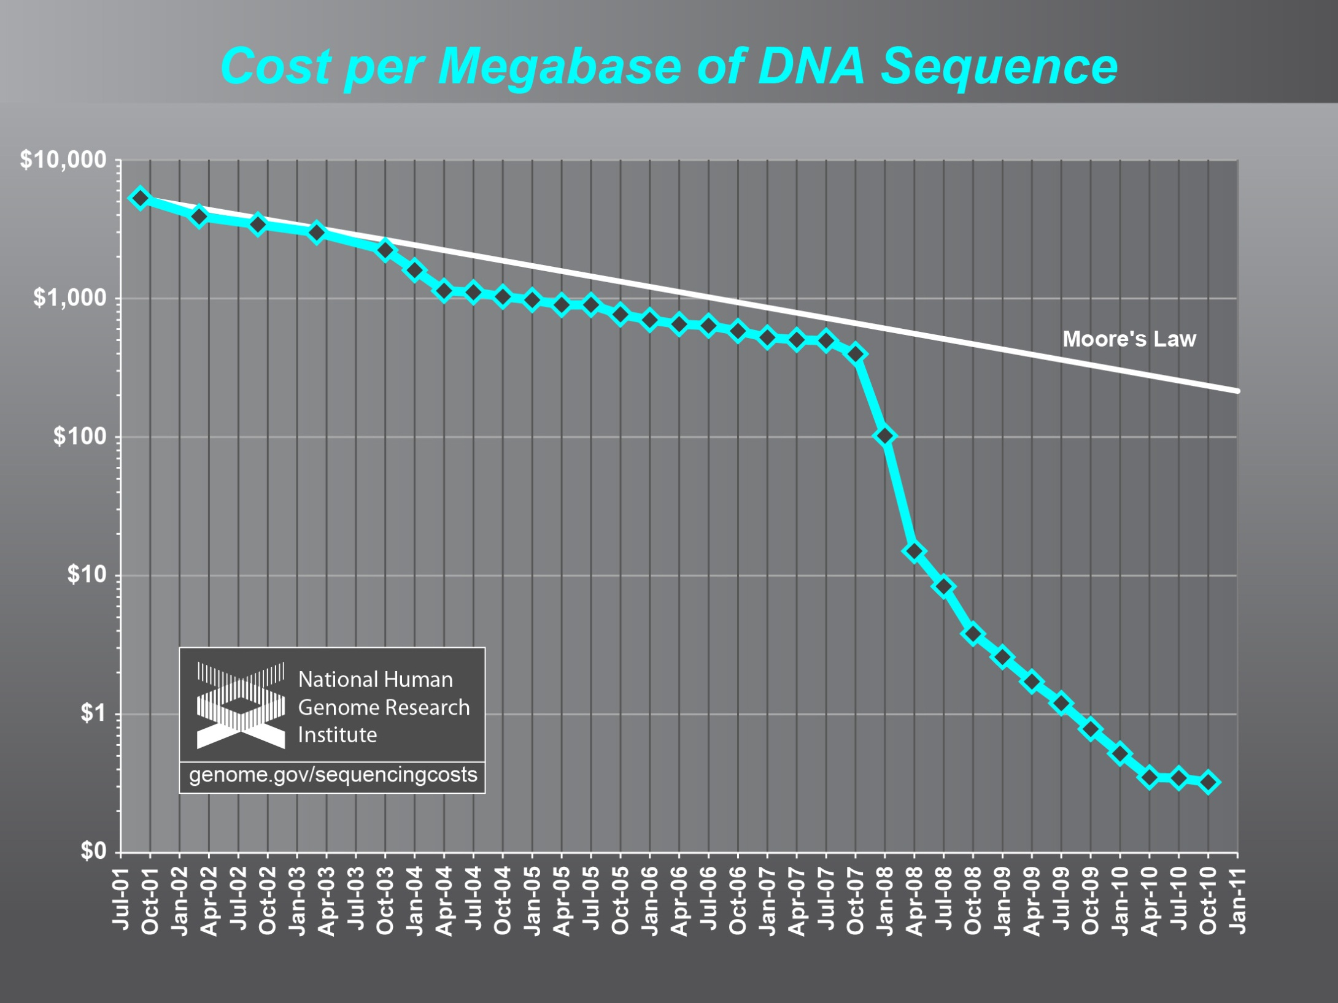
Why need cost effective
Computing!
Full Personal Genomics: 3 petabytes per day

Slide 8
Clouds Offer From different points of view
Features from NIST:
  On-demand service (elastic);
  Broad network access;
  Resource pooling;
  Flexible resource allocation;
  Measured service
Economies of scale in performance and electrical power (Green IT)
Powerful new software models
  Platform as a Service is not an alternative to Infrastructure as a Service – it is instead an incredible valued added
  Amazon is as much PaaS as Azure

Slide 9

Jobs v. Countries

Slide 10

McKinsey Institute on Big Data Jobs
There will be a shortage of talent necessary for organizations to take advantage of big data. By 2018, the United States alone could face a shortage of 140,000 to 190,000 people with deep analytical skills as well as 1.5 million managers and analysts with the know-how to use the analysis of big data to make effective decisions.

Slide 11
Some Sizes in 2010
http://www.mediafire.com/file/zzqna34282frr2f/koomeydatacenterelectuse2011finalversion.pdf
30 million servers worldwide
Google had 900,000 servers (3% total world wide)
Google total power ~200 Megawatts
  < 1% of total power used in data centers (Google more efficient than average – Clouds are Green!)
  ~ 0.01% of total power used on anything world wide
Maybe total clouds are 20% total world server count (a growing fraction)

Slide 12
Some Sizes Cloud v HPC
Top Supercomputer Sequoia Blue Gene Q at LLNL
  16.32 Petaflop/s on the Linpack benchmark using 98,304 CPU compute chips with 1.6 million processor cores and 1.6 Petabyte of memory in 96 racks covering an area of about 3,000 square feet
  7.9 Megawatts power
Largest (cloud) computing data centers
  100,000 servers at ~200 watts per CPU chip
  Up to 30 Megawatts power
So largest supercomputer is around 1-2% performance of total cloud computing systems with Google ~20% total

Slide 13
Clouds Grids and HPC

Slide 14
2 Aspects of Cloud Computing:
Infrastructure and Runtimes
Cloud infrastructure: outsourcing of servers, computing, data, file space, utility computing, etc..
Cloud runtimes or Platform: tools to do data-parallel (and other) computations. Valid on Clouds and traditional clusters
  Apache Hadoop, Google MapReduce, Microsoft Dryad, Bigtable, Chubby and others
  MapReduce designed for information retrieval but is excellent for a wide range of science data analysis applications
  Can also do much traditional parallel computing for data-mining if extended to support iterative operations
  Data Parallel File system as in HDFS and Bigtable

Slide 15
Infrastructure, Platforms, Software as a Service
Software Services are building blocks of applications
The middleware or computing environment
Nimbus, Eucalyptus, OpenStack
OpenNebula
CloudStack

Slide 16
Science Computing Environments
Large Scale Supercomputers – Multicore nodes linked by high performance low latency network
  Increasingly with GPU enhancement
  Suitable for highly parallel simulations
High Throughput Systems such as European Grid Initiative EGI or Open Science Grid OSG typically aimed at pleasingly parallel jobs
  Can use “cycle stealing”
  Classic example is LHC data analysis
Grids federate resources as in EGI/OSG or enable convenient access to multiple backend systems including supercomputers
  Portals make access convenient and
  Workflow integrates multiple processes into a single job
Specialized visualization, shared memory parallelization etc. machines

Slide 17
Clouds HPC and Grids
Synchronization/communication Performance
Grids > Clouds > Classic HPC Systems
Clouds naturally execute effectively Grid workloads but are less clear for closely coupled HPC applications
Classic HPC machines as MPI engines offer highest possible performance on closely coupled problems
    Likely to remain in spite of Amazon cluster offering
Service Oriented Architectures portals and workflow appear to work similarly in both grids and clouds
May be for immediate future, science supported by a mixture of
  Clouds – some practical differences between private and public clouds – size and software
  High Throughput Systems (moving to clouds as convenient)
  Grids for distributed data and access
  Supercomputers (“MPI Engines”) going to exascale

Slide 18
Cloud Applications

Slide 19
What Applications work in Clouds
Pleasingly (moving to modestly) parallel applications of all sorts with roughly independent data or spawning independent simulations
  Long tail of science and integration of distributed sensors
Commercial and Science Data analytics that can use MapReduce (some of such apps) or its iterative variants (most other data analytics apps)
Which science applications are using clouds?
  Venus-C (Azure in Europe): 27 applications not using Scheduler, Workflow or MapReduce (except roll your own)
  50% of applications on FutureGrid are from Life Science
  Locally Lilly corporation is commercial cloud user (for drug discovery)
  Nimbus applications in bioinformatics, high energy physics, nuclear physics, astronomy and ocean sciences

Slide 20
27 Venus-C Azure Applications
Chemistry (3)
• Lead Optimization in Drug Discovery
• Molecular Docking
Civil Protection (1)
• Fire Risk estimation and fire propagation
Biodiversity &
Biology (2)
• Biodiversity maps in marine species
• Gait simulation
Civil Eng. and Arch. (4)
• Structural Analysis
• Building information Management
• Energy Efficiency in Buildings
• Soil structure simulation
Physics (1)
• Simulation of Galaxies configuration
Earth Sciences (1)
• Seismic propagation
Mol, Cell. & Gen. Bio. (7)
• Genomic sequence analysis
• RNA prediction and analysis
• System Biology
• Loci Mapping
• Micro-arrays quality.
ICT (2)
• Logistics and vehicle routing
• Social networks analysis
Medicine (3)
• Intensive Care Units decision support.
• IM Radiotherapy planning.
• Brain Imaging
Mathematics (1)
• Computational Algebra
Mech, Naval & Aero. Eng. (2)
• Vessels monitoring
• Bevel gear manufacturing simulation

Slide 21
Parallelism over Users and Usages
“Long tail of science” can be an important usage mode of clouds.
In some areas like particle physics and astronomy, i.e. “big science”, there are just a few major instruments generating now petascale data driving discovery in a coordinated fashion.
In other areas such as genomics and environmental science, there are many “individual” researchers with distributed collection and analysis of data whose total data and processing needs can match the size of big science.
Clouds can provide scaling convenient resources for this important aspect of science.
Can be map only use of MapReduce if different usages naturally linked e.g. exploring docking of multiple chemicals or alignment of multiple DNA sequences
  Collecting together or summarizing multiple “maps” is a simple Reduction

Slide 22
Internet of Things and the Cloud
It is projected that there will be 24 billion devices on the Internet by 2020. Most will be small sensors that send streams of information into the cloud where it will be processed and integrated with other streams and turned into knowledge that will help our lives in a multitude of small and big ways.
The cloud will become increasing important as a controller of and resource provider for the Internet of Things.
As well as today’s use for smart phone and gaming console support, “Intelligent River” “smart homes” and “ubiquitous cities” build on this vision and we could expect a growth in cloud supported/controlled robotics.
Some of these “things” will be supporting science
Natural parallelism over “things”
“Things” are distributed and so form a Grid

Slide 23
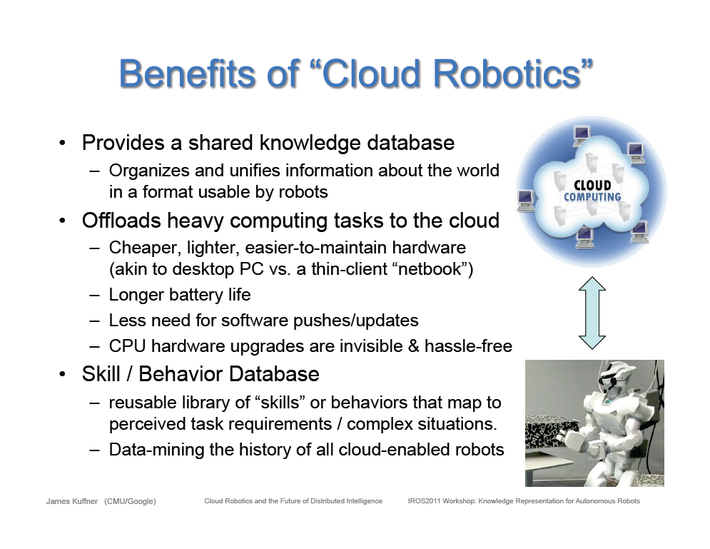
Cloud based robotics from Google

Slide 24
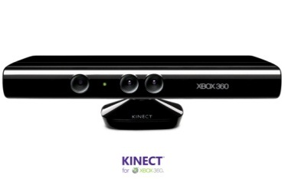








Sensors (Things) as a Service
Output Sensor
Sensors as a Service
Sensor Processing as a Service (could use
MapReduce)
A larger sensor ………
https://sites.google.com/site/opensourceiotcloud/ Open Source Sensor (IoT) Cloud

Slide 25
Analytics and Parallel Computing on Clouds and HPC

Slide 26
Classic Parallel Computing
HPC: Typically SPMD (Single Program Multiple Data) “maps” typically processing particles or mesh points interspersed with multitude of low latency messages supported by specialized networks such as Infiniband and technologies like MPI
  Often run large capability jobs with 100K (going to 1.5M) cores on same job
  National DoE/NSF/NASA facilities run 100% utilization
  Fault fragile and cannot tolerate “outlier maps” taking longer than others
Clouds: MapReduce has asynchronous maps typically processing data points with results saved to disk. Final reduce phase integrates results from different maps
  Fault tolerant and does not require map synchronization
  Map only useful special case
HPC + Clouds: Iterative MapReduce caches results between “MapReduce” steps and supports SPMD parallel computing with large messages as seen in parallel kernels (linear algebra) in clustering and other data mining

Slide 27
4 Forms of MapReduce
(a) Map Only
(b) Classic MapReduce
(c) Iterative MapReduce
(d) Loosely Synchronous
Input
Input
Iterations
Input
map
map
map
P_{ij}
reduce
reduce
Output
BLAST Analysis
Parametric sweep
Pleasingly Parallel
High Energy Physics (HEP) Histograms
Distributed search
Expectation maximization Clustering e.g. Kmeans
Linear Algebra, Page Rank
Classic MPI
PDE Solvers and particle dynamics
Domain of MapReduce and Iterative Extensions
Science Clouds
MPI
Exascale

Slide 28
Commercial “Web 2.0” Cloud Applications
Internet search, Social networking, e-commerce, cloud storage
These are larger systems than used in HPC with huge levels of parallelism coming from
  Processing of lots of users or
  An intrinsically parallel Tweet or Web search
Classic MapReduce is suitable (although Page Rank component of search is parallel linear algebra)
Data Intensive
Do not need microsecond messaging latency

Slide 29
Data Analytics Futures?
PETSc and ScaLAPACK and similar libraries very important in supporting parallel simulations
Need equivalent Data Analytics libraries
Include datamining (Clustering, SVM, HMM, Bayesian Nets …), image processing, information retrieval including hidden factor analysis (LDA), global inference, dimension reduction
  Many libraries/toolkits (R, Matlab) and web sites (BLAST) but typically not aimed at scalable high performance algorithms
Should support clouds and HPC; MPI and MapReduce
  Iterative MapReduce an interesting runtime; Hadoop has many limitations
Need a coordinated Academic Business Government Collaboration to build robust algorithms that scale well
  Crosses Science, Business Network Science, Social Science
Propose to build community to define & implement
SPIDAL or Scalable Parallel Interoperable Data Analytics Library

Slide 30
Data Architectures

Slide 31
Clouds as Support for Data Repositories?
The data deluge needs cost effective computing
  Clouds are by definition cheapest
  Need data and computing co-located
Shared resources essential (to be cost effective and large)
  Can’t have every scientists downloading petabytes to personal cluster
Need to reconcile distributed (initial source of ) data with shared analysis
  Can move data to (discipline specific) clouds
  How do you deal with multi-disciplinary studies
Data repositories of future will have cheap data and elastic cloud analysis support?
  Hosted free if data can be used commercially?

Slide 32
Architecture of Data Repositories?
Traditionally governments set up repositories for data associated with particular missions
  For example EOSDIS (Earth Observation), GenBank (Genomics), NSIDC (Polar science), IPAC (Infrared astronomy)
  LHC/OSG computing grids for particle physics
This is complicated by volume of data deluge, distributed instruments as in gene sequencers (maybe centralize?) and need for intense computing like Blast
  i.e. repositories need lots of computing?

Slide 33
Traditional File System?
S
Data
C
C
C
C
S
C
C
C
C
Archive
Data
S
C
C
C
C
Data
C
C
C
C
S
Data
Compute Cluster
Storage Nodes
Typically a shared file system (Lustre, NFS …) used to support high performance computing
Big advantages in flexible computing on shared data but doesn’t “bring computing to data”
Object stores similar structure (separate data and compute) to this

Slide 34
Data Parallel File System?
Block1
Replicate each block
File1
Block2
……
Breakup
BlockN
C
C
C
C
Data
Data
Data
Data
C
C
C
C
Data
Data
Data
Data
C
C
C
C
Data
Data
Data
Data
C
C
C
C
Data
Data
Data
Data
Block1
File1
Block2
……
Breakup
Replicate each block
BlockN
No archival storage and computing brought to data

Slide 35
What is Data Analytics and
Data Science?

Slide 36
Data Analytics/Science
Broad Range of Topics from Policy to new algorithms
Enables X-Informatics where several X’s defined especially in Life Sciences
  Medical, Bio, Chem, Health, Pathology, Astro, Social, Business, Security, Crisis, Intelligence Informatics defined (more or less)
  Could invent Life Style (e.g. IT for Facebook), Radar …. Informatics
  Physics Informatics ought to exist but doesn’t
Plenty of Jobs and broader range of possibilities than computational science but similar issues
  What type of degree (Certificate, track, “real” degree)
  What type of program (department, interdisciplinary group supporting education and research program)

Slide 37
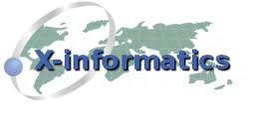

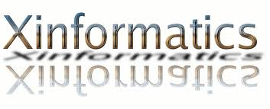



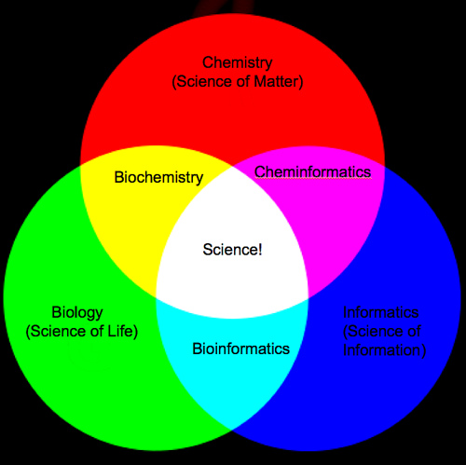
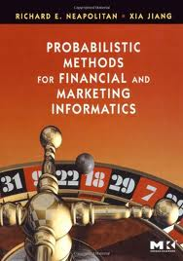
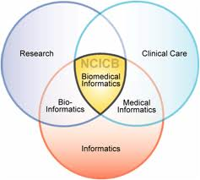
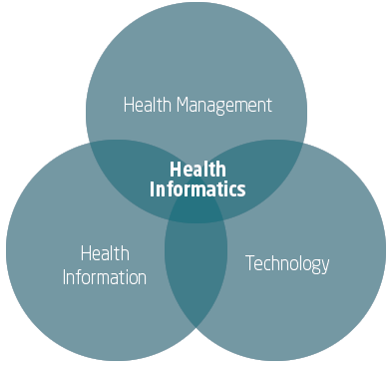
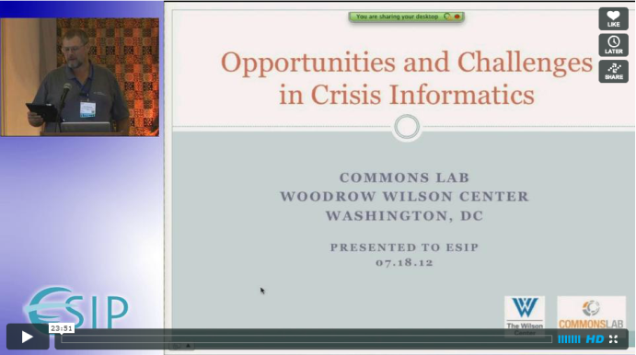
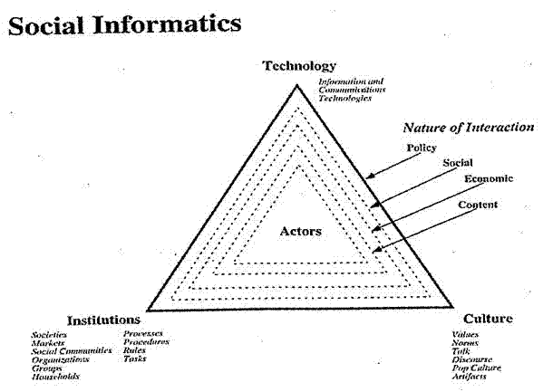
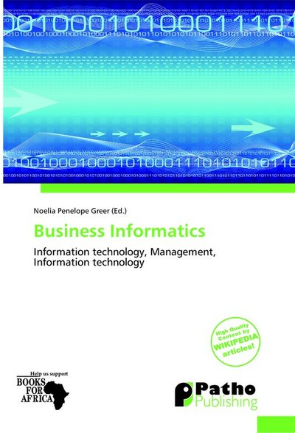
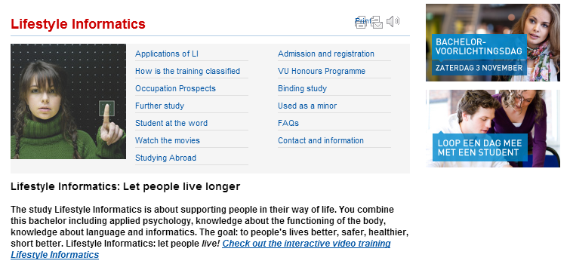

Slide 38
Computational Science
Interdisciplinary field between computer science and applications with primary focus on simulation areas
Very successful as a research area
  XSEDE and Exascale systems enable
Several academic programs but these have been less successful as
  No consensus as to curricula and jobs (don’t appoint faculty in computational science; do appoint to DoE labs)
  Field relatively small
Started around 1990
Note Computational Chemistry is typical part of Computational Science (and chemistry) whereas Cheminformatics is part of Informatics and data science
  Here Computational Chemistry much larger than Cheminformatics but
  Typically data side larger than simulations

Slide 39
Data Science is also Information/Knowledge/Wisdom/Decision Science?

Slide 40
Data Science General Remarks I
An immature (exciting) field: No agreement as to what is data analytics and what tools/computers needed
  Databases or NOSQL?
  Shared repositories or bring computing to data
  What is repository architecture?
Sources: Data from observation or simulation
Different terms: Data analysis, Datamining, Data analytics., machine learning, Information visualization, Data Science
Fields: Computer Science, Informatics, Library and Information Science, Statistics, Application Fields including Business
Approaches: Big data (cell phone interactions) v. Little data (Ethnography, surveys, interviews)
Includes: Security, Provenance, Metadata, Data Management, Curation

Slide 41
Data Science General Remarks II
Tools: Regression analysis; biostatistics; neural nets; Bayesian nets; support vector machines; classification; clustering; dimension reduction; artificial intelligence; semantic web
Some data in metric spaces; others very high dimension or none
Patient records growing fast (70PB pathology)
Complex graphs from internet studying communities/linkages
Large Hadron Collider analysis mainly histogramming – all can be done with MapReduce (larger use than MPI)
Commercial: Google, Bing largest data analytics in world
Time Series: Earthquakes, Tweets, Stock Market (Pattern Informatics)
Image Processing from climate simulations to NASA to DoD to Radiology (Radar and Pathology Informatics – same library)
Financial decision support; marketing; fraud detection; automatic preference detection (map users to books, films)

Slide 42
School | Program | On-Campus | Online | Degrees
Undergraduate
George Mason University | Computational and Data Sciences: the combination of applied math, real world CS skills, data acquisition and analysis, and scientific modeling | Yes | No | B.S.
Illinois Institute of Technology | CS Specialization in Data Science CIS specialization in Data Science |  |  | B.S.
Oxford University | Data and Systems Analysis | ? | Yes | Adv. Diploma
Masters
Bentley University | Marketing Analytics: knowledge and skills that marketing professionals need for a rapidly evolving, data-focused, global business environment. | Yes | ? | M.S.
Carnegie Mellon | MISM Business Intelligence and Data Analytics: an elite set of graduates cross-trained in business process analysis and skilled in predictive modeling, GIS mapping, analytical reporting, segmentation analysis, and data visualization. | Yes |  | M.S. 9 courses
Carnegie Mellon | Very Large Information Systems: train technologists to (a) develop the layers of technology involved in the next generation of massive IS deployments (b) analyze the data these systems generate
DePaul University | Predictive Analytics: analyze large datasets and develop modeling solutions for decision making, an understanding of the fundamental principles of marketing and CRM | Yes | ? | MS.
Georgia Southern University | Comp Sci with concentration in Data and Know. Systems: covers speech and vision recognition systems, expert systems, data storage systems, and IR systems, such as online search engines | No | Yes | M.S. 30 cr
Survey from
Howard Rosenbaum SLIS IU

Slide 43
Illinois Institute of Technology | CS specialization in Data Analytics: intended for learning how to discover patterns in large amounts of data in information systems and how to use these to draw conclusions. | Yes | ? | Masters 4 courses
Louisiana State University businessanalytics.lsu.edu/ | Business Analytics: designed to meet the growing demand for professionals with skills in specialized methods of predictive analytics 36 cr | Yes | No | M.S. 36 cr
Michigan State University | Business Analytics: courses in business strategy, data mining, applied statistics, project management, marketing technologies, communications and ethics | Yes | No | M.S.
North Carolina State University: Institute for Advanced Analytics | Analytics: designed to equip individuals to derive insights from a vast quantity and variety of data | Yes | No | M.S.: 30 cr.
Northwestern University | Predictive Analytics: a comprehensive and applied curriculum exploring data science, IT and business of analytics | Yes | Yes | M.S.
New York University | Business Analytics: unlocks predictive potential of data analysis to improve financial performance, strategic management and operational efficiency | Yes | No | M.S. 1 yr
Stevens Institute of Technology | Business Intel. & Analytics: offers the most advanced curriculum available for leveraging quant methods and evidence-based decision making for optimal business performance | Yes | Yes | M.S.: 36 cr.
University of Cincinnati | Business Analytics: combines operations research and applied stats, using applied math and computer applications, in a business environment | Yes | No | M.S.
University of San Francisco | Analytics: provides students with skills necessary to develop techniques and processes for data-driven decision-making — the key to effective business strategies | Yes | No | M.S.

Slide 44
Certificate
iSchool @ Syracuse | Data Science: for those with background or experience in science, stats, research, and/or IT interested in interdiscip work managing big data using IT tools | Yes | ? | Grad Cert. 5 courses
Rice University | Big Data Summer Institute: organized to address a growing demand for skills that will help individuals and corporations make sense of huge data sets | Yes | No | Cert.
Stanford University | Data Mining and Applications: introduces important new ideas in data mining and machine learning, explains them in a statistical framework, and describes their applications to business, science, and technology | No | Yes | Grad Cert.
University of California San Diego | Data Mining: designed to provide individuals in business and scientific communities with the skills necessary to design, build, verify and test predictive data models | No | Yes | Grad Cert. 6 courses
University of Washington | Data Science: Develop the computer science, mathematics and analytical skills in the context of practical application needed to enter the field of data science | Yes | Yes | Cert.
Ph.D
George Mason University | Computational Sci and Informatics: role of computation in sci, math, and engineering, | Yes | No | Ph.D.
IU SoIC | Informatics | Yes | No | Ph.D

Slide 45
Informatics at Indiana University

Slide 46
Informatics at Indiana University
School of Informatics and Computing
  Computer Science
  Informatics
  Information and Library Science (new DILS was SLIS)
Undergraduates: Informatics ~3x Computer Science
  Mean UG Hiring Salaries
  Informatics $54K; CS $56.25K
  Masters hiring $70K
  125 different employers 2011-2012
Graduates: CS ~2x Informatics
DILS Graduate only, MLS main degree

Slide 47
Original Informatics Faculty at IU
Security largely moving to Computer Science
Bioinformatics moving to Computer Science
Cheminformatics
Health Informatics
Music Informatics moving to Computer Science
Complex Networks and Systems now =largest
Human Computer Interaction Design now =largest
Social Informatics
Move partly as CS rated; Informatics not
Illustrates difficulties with degrees/departments with new names

Slide 48
Largely Applied Computer Science
Cyberinfrastructure and High Performance Computing largely in Computer Science
Data, Databases and Search in Computer Science
Image Processing/ Computer Vision in Informatics
Ubiquitous Computing Interested in adding
Robotics in Informatics
Visualization and Computer Graphics Retired in CS
These are fields you will find in many computer science departments but are focused on using computers

Slide 49
Largely Core Computer Science
Computer Architecture
Computer Networking
Programming Languages and Compilers
Artificial Intelligence, Artificial Life and Cognitive Science
Computation Theory and Logic
Quantum Computing
These are traditional important fields of Computer Science providing ideas and tools used in Informatics and Applied Computer Science

Slide 50
Informatics Job Titles
Account Service Provider
Analyst
Application Consultant
Application Developer
Assoc. IT Business analyst
Associate IT Developer
Associate Software Engineer
Automation Engineer
Business Analyst
Business Intelligence
Business Systems Analyst
Catapult Rotational Program
Computer Consultant
Computer Support Specialist
Consultant
Corporate Development Program Analyst
Data Analytics Consultant
Database and Systems Manager
Delivery Consultant
Designer
Director of Information Systems
Engineer
Information Management Leadership Program
Information Technology Security Consultant
IT Business Process Specialist
IT Early Development Program
Java Programmer
Junior Consultant
Junior Software Engineer
Lead Network Engineer
Logistics Management Specialist
Market Analyst

Slide 51
Informatics Job Titles
Marketing Representative
Mobile Developer
Network Engineer
Programmer
Project Manager
Quality Assurance Analyst
Research Programmer
Security and Privacy Consultant
Social Media Mgr & Community Mgmt
Software Analyst
Software Consultant
Software Developer
Software Development Engineer
Software Development Engineer in Test (SDET)
Software Engineer
Support Analyst
Support Engineer
System Administrator
System integration Analyst
Systems Architect
Systems Engineer
Systems/Data Analyst
Tech Analyst
Tech Consultant
Tech Leadership Dev Program
UI Designer
User Interface Software Engineer
UX Designer
UX Researcher
Velocity Software Engineer
Velocity Systems Consultant
Web Designer
Web Developer

Slide 52
Undergraduate Cognates
Biology
Business
Chemistry
Cognitive Science
Communication and Culture
Computer Science
Economics
Fine Arts (2 options)
Geography
Human-Centered Computing
Information Technology
Journalism
Linguistics
Mathematics
Medical Sciences
Music
Philosophy of Mind and Cognition
Pre-health Professions
Psychology
Public and Environmental Affairs (5 options)
Public Health
Security
Telecommunications (3 options)

Slide 53
Data Science at Indiana University
Currently Masters in CS, Informatics, HCI, Bioinformatics, Security Informatics and will add Information and Library Science (ILS)
Propose to add a Masters in Data Science (~30 cr.) with courses covering CS, Informatics, ILS
  Data Lifecycle (~ILS)
  Data Analysis (~CS)
  Data Management (~CS and ILS)
  Applications (X Informatics) (~Informatics)
Also minor/certificates
Number of courses in each category being debated
  Existing programs would like their courses required
  i.e. as always political and technical issues in decisions

Slide 54
Massive Open Online Courses (MOOC)
MOOC’s are very “hot” these days with Udacity and Coursera as start-ups
Over 100,000 participants but concept valid at smaller sizes
Relevant to Data Science as this is a new field with few courses at most universities
Technology to make MOOC’s
  Drupal mooc (unclear it’s real)
  Google Open Source Course Builder is lightweight LMS (learning management system) released September 12 rescuing us from Sakai
At least one MOOC model is collection of short prerecorded segments (talking head over PowerPoint)

Slide 55
I400 X-Informatics (MOOC)
General overview of “use of IT” (data analysis) in “all fields” starting with data deluge and pipeline
Observation→Data→Information→Knowledge→Wisdom
Go through many applications from life/medical science to “finding Higgs” and business informatics
Describe cyberinfrastructure needed with visualization, security, provenance, portals, services and workflow
Lab sessions built on virtualized infrastructure (appliances)
Describe and illustrate key algorithms histograms, clustering, Support Vector Machines, Dimension Reduction, Hidden Markov Models and Image processing

Slide 56
FutureGrid

Slide 57
FutureGrid key Concepts I
FutureGrid is an international testbed modeled on Grid5000
  September 21 2012: 260 Projects, ~1360 users
Supporting international Computer Science and Computational Science research in cloud, grid and parallel computing (HPC)
The FutureGrid testbed provides to its users:
  A flexible development and testing platform for middleware and application users looking at interoperability, functionality, performance or evaluation
  FutureGrid is user-customizable, accessed interactively and supports Grid, Cloud and HPC software with and without VM’s
  A rich education and teaching platform for classes
See G. Fox, G. von Laszewski, J. Diaz, K. Keahey, J. Fortes, R. Figueiredo, S. Smallen, W. Smith, A. Grimshaw, FutureGrid - a reconfigurable testbed for Cloud, HPC and Grid Computing, Bookchapter – draft

Slide 58

FutureGrid key Concepts II
Rather than loading images onto VM’s, FutureGrid supports Cloud, Grid and Parallel computing environments by provisioning software as needed onto “bare-metal” using Moab/xCAT (need to generalize)
  Image library for MPI, OpenMP, MapReduce (Hadoop, (Dryad), Twister), gLite, Unicore, Globus, Xen, ScaleMP (distributed Shared Memory), Nimbus, Eucalyptus, OpenNebula, KVM, Windows …..
  Either statically or dynamically
Growth comes from users depositing novel images in library
FutureGrid has ~4400 distributed cores with a dedicated network and a Spirent XGEM network fault and delay generator
Image1
Image2
…
ImageN
Choose
Load
Run

Slide 59

FutureGrid Grid supports Cloud Grid HPC Computing Testbed as a Service (aaS)
12TF Disk rich + GPU 512 cores
NID: Network Impairment Device
Private
Public
FG Network
59

Slide 60
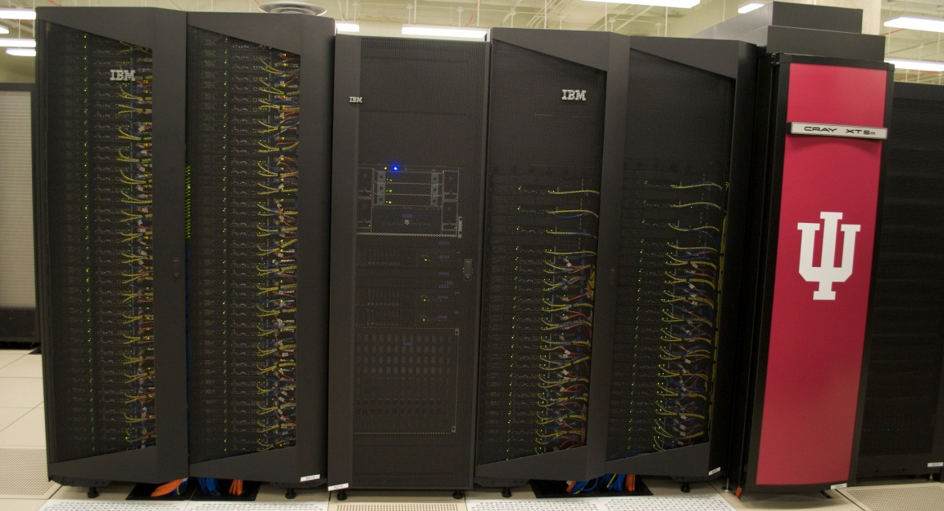
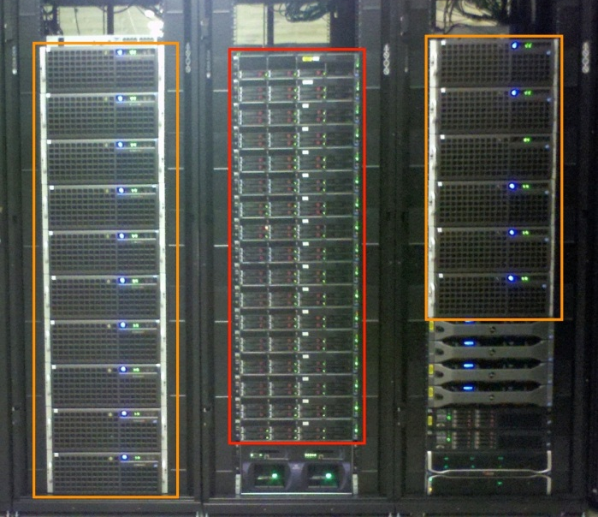
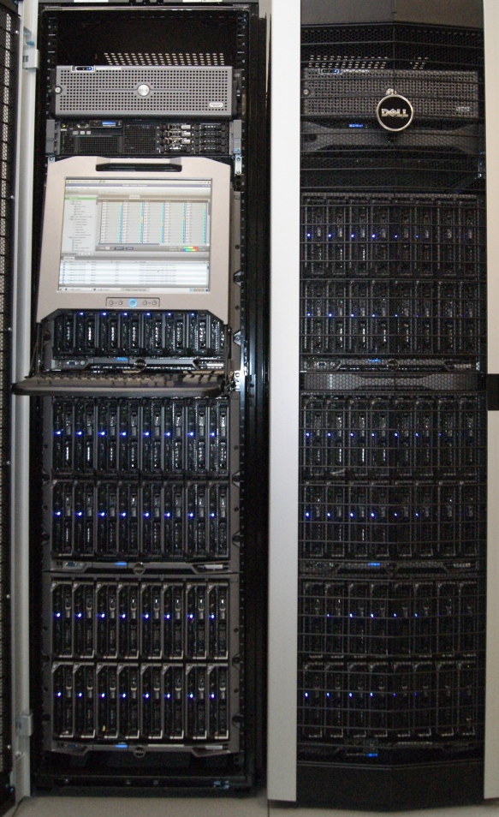
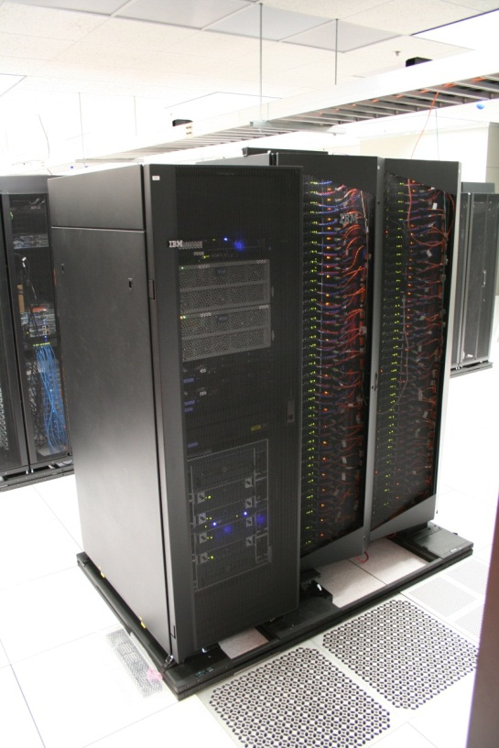
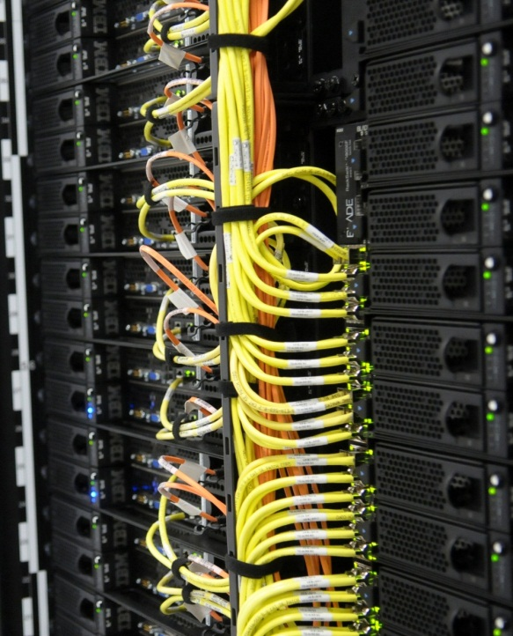
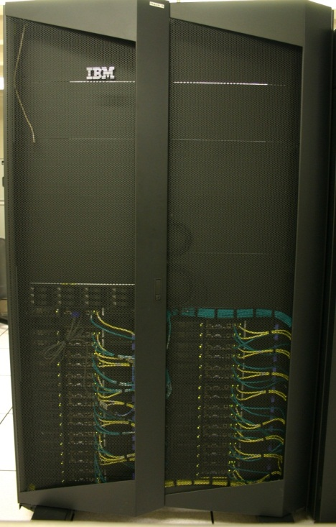
FutureGrid Distributed Testbed-aaS
Bravo Delta (IU)
India (IBM) and Xray (Cray) (IU)
Hotel (Chicago)
Foxtrot (UF)
Sierra (SDSC)
Alamo (TACC)

Slide 61
Compute Hardware
Name | System type | # CPUs | # Cores | TFLOPS | Total RAM (GB) | Secondary Storage (TB) | Site | Status
india | IBM iDataPlex | 256 | 1024 | 11 | 3072 | 180 | IU | Operational
alamo | Dell PowerEdge | 192 | 768 | 8 | 1152 | 30 | TACC | Operational
hotel | IBM iDataPlex | 168 | 672 | 7 | 2016 | 120 | UC | Operational
sierra | IBM iDataPlex | 168 | 672 | 7 | 2688 | 96 | SDSC | Operational
xray | Cray XT5m | 168 | 672 | 6 | 1344 | 180 | IU | Operational
foxtrot | IBM iDataPlex | 64 | 256 | 2 | 768 | 24 | UF | Operational
Bravo | Large Disk & memory | 32 | 128 | 1.5 | 3072 (192GB per node) | 192 (12 TB per Server) | IU | Operational
Delta | Large Disk & memory With Tesla GPU’s | 32 CPU 32 GPU’s | 192+ 14336 GPU | ? 9 | 1536 (192GB per node) | 192 (12 TB per Server) | IU | Operational
Echo (ScaleMP) | Large Disk & Memory | 32 CPU | 192 | 2 | 6144 | 192 | IU | On Order
Lima | SSD | 16 | 128 | 1.3 | 512 | 3.8 (SSD) 8 (disk) | SDSC | On Order

Slide 62
FutureGrid Partners
Indiana University (Architecture, core software, Support)
San Diego Supercomputer Center at University of California San Diego (INCA, Monitoring)
University of Chicago/Argonne National Labs (Nimbus)
University of Florida (ViNE, Education and Outreach)
University of Southern California Information Sciences (Pegasus to manage experiments)
University of Tennessee Knoxville (Benchmarking)
University of Texas at Austin/Texas Advanced Computing Center (Portal)
University of Virginia (OGF, XSEDE Software stack)
Center for Information Services and GWT-TUD from Technische Universtität Dresden. (VAMPIR)
Red institutions have FutureGrid hardware

Slide 63
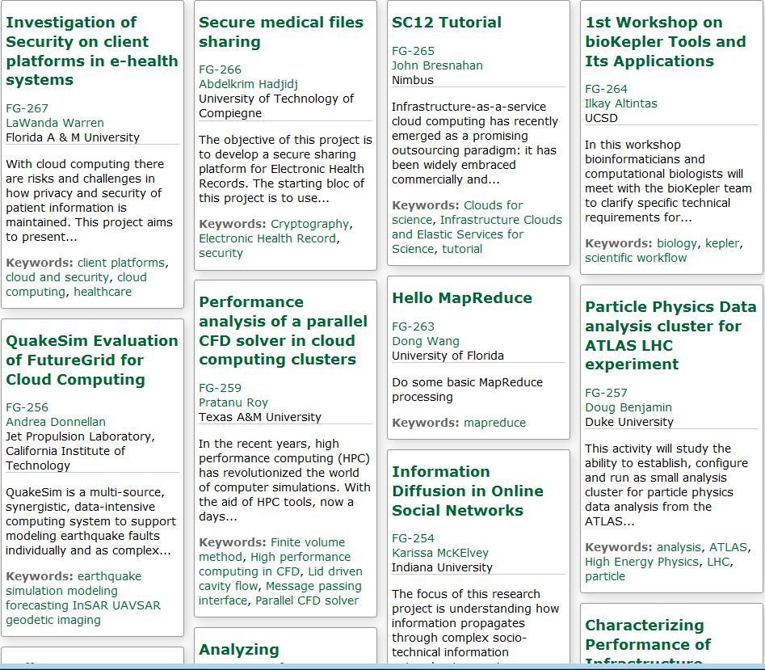
Recent Projects

Slide 64
4 Use Types for FutureGrid TestbedaaS
260 approved projects (1360 users) September 21 2012
  USA, China, India, Pakistan, lots of European countries
  Industry, Government, Academia
Training Education and Outreach (10%)
  Semester and short events; interesting outreach to HBCU
Computer science and Middleware (59%)
  Core CS and Cyberinfrastructure; Interoperability (2%) for Grids and Clouds; Open Grid Forum OGF Standards
Computer Systems Evaluation (29%)
  XSEDE (TIS, TAS), OSG, EGI; Campuses
New Domain Science applications (26%)
  Life science highlighted (14%), Non Life Science (12%)
  Generalize to building Research Computing-aaS
Fractions are as of July 15 2012 add to > 100%

Slide 65
Computing
Testbed as a Service

Slide 66
FutureGrid offers
Computing Testbed as a Service
FutureGrid Uses
Testbed-aaS Tools
Provisioning
Image Management
IaaS Interoperability
IaaS tools
Expt management
Dynamic Network
Devops
Research
Computing
aaS
Custom Images
Courses
Consulting
Portals
Archival Storage
System e.g. SQL, GlobusOnline
Applications e.g. Amber, Blast
SaaS
FutureGrid Usages
Computer Science
Applications and understanding Science Clouds
Technology Evaluation including XSEDE testing
Education and Training
Cloud e.g. MapReduce
HPC e.g. PETSc, SAGA
Computer Science e.g. Languages, Sensor nets
PaaS
Hypervisor
Bare Metal
Operating System
Virtual Clusters, Networks
IaaS

Slide 67
Research Computing as a Service
Traditional Computer Center has a variety of capabilities supporting (scientific computing/scholarly research) users.
  Could also call this Computational Science as a Service
IaaS, PaaS and SaaS are lower level parts of these capabilities but commercial clouds do not include
  Developing roles/appliances for particular users
  Supplying custom SaaS aimed at user communities
  Community Portals
  Integration across disparate resources for data and compute (i.e. grids)
  Data transfer and network link services
  Archival storage, preservation, visualization
  Consulting on use of particular appliances and SaaS i.e. on particular software components
  Debugging and other problem solving
  Administrative issues such as (local) accounting
This allows us to develop a new model of a computer center where commercial companies operate base hardware/software
A combination of XSEDE, Internet2 and computer center supply 1) to 9)?

Slide 68
Expanding Resources in FutureGrid
We have a core set of resources but need to keep up to date and expand in size
Natural is to build large systems and support large experiments by federating hardware from several sources
  Requirement is that partners in federation agree on and develop together TestbedaaS
Infrastructure includes networks, devices, edge (client) equipment

Slide 69
Conclusion

Slide 70
Conclusions
Does Cloud + MPI Engine for computing + grids for data cover all?
  Merge high throughput computing and cloud concepts?
Need interoperable data analytics libraries for HPC and Clouds that address new robustness and scaling challenges of big data
Can we characterize data analytics applications?
  I said modest size and kernels need reduction operations and are often full matrix linear algebra (true?)
Is Research Computing as a Service interesting?
CTaaS (Computing Testbed as a Service) and Federated resources
More employment opportunities in clouds than HPC and Grids and in data than simulation; so cloud and data related activities popular with students
International activity to discuss data science education
  Agree on curricula; is such a degree attractive?

