Slide 1
SALSA Group’s Collaborations with Microsoft
SALSA Group
http://salsahpc.indiana.edu
Principal Investigator Geoffrey Fox
Project Lead Judy Qiu
Scott Beason, Jaliya Ekanayake, Thilina Gunarathne, Jong Youl Choi, Seung-Hee Bae,
Yang Ruan, Hui Li, Bingjing Zhang, Saliya Ekanayake, Stephen Wu
Community Grids Laboratory
Digital Science Center
Pervasive Technology Institute
Indiana University

Slide 2
Our Objectives
Explore the applicability of Microsoft technologies to real world scientific domains with a focus on data intensive applications
Expect data deluge will demand multicore enabled data analysis/mining
Detailed objectives modified based on input from Microsoft such as interest in CCR, Dryad and TPL
Evaluate and apply these technologies in demonstration systems
Threading: CCR, TPL
Service model and workflow: DSS and Robotics toolkit
MapReduce: Dryad/DryadLINQ compared to Hadoop and Azure
Classical parallelism: Windows HPCS and MPI.NET,
XNA Graphics based visualization
Work performed using C#
Provide feedback to Microsoft
Broader Impact
Papers, presentations, tutorials, classes, workshops, and conferences
Provide our research work as services to collaborators and general science community

Slide 3
Approach
Use interesting applications (working with domain experts) as benchmarks including emerging areas like life sciences and classical applications such as particle physics
Bioinformatics - Cap3, Alu, Metagenomics, PhyloD
Cheminformatics - PubChem
Particle Physics - LHC Monte Carlo
Data Mining kernels - K-means, Deterministic Annealing Clustering, MDS, GTM, Smith-Waterman Gotoh
Evaluation Criterion for Usability and Developer Productivity
Initial learning curve
Effectiveness of continuing development
Comparison with other technologies
Performance on both single systems and clusters

Slide 4
Overview of Multicore SALSA Project at IU
The term SALSA or Service Aggregated Linked Sequential Activities, describes our approach to multicore computing where we used services as modules to capture key functionalities implemented with multicore threading.
This will be expanded as a proposed approach to parallel computing where one produces libraries of parallelized components and combines them with a generalized service integration (workflow) model
We have adopted a multi-paradigm runtime (MPR) approach to support key parallel models with focus on MapReduce, MPI collective messaging, asynchronous threading, coarse grain functional parallelism or workflow.
We have developed innovative data mining algorithms emphasizing robustness essential for data intensive applications. Parallel algorithms have been developed for shared memory threading, tightly coupled clusters and distributed environments. These have been demonstrated in kernel and real applications.

Slide 5
Major Achievements
Analysis of CCR and DSS within SALSA paradigm with very detailed performance work on CCR
Detailed analysis of Dryad and comparison with Hadoop and MPI. Initial comparison with Azure
Comparison of TPL and CCR approaches to parallel threading
Applications to several areas including particle physics and especially life sciences
Demonstration that Windows HPC Clusters can efficiently run large scale data intensive applications
Development of high performance Windows 3D visualization of points from dimension reduction of high dimension datasets to 3D. These are used as Cheminformatics and Bioinformatics dataset browsers
Proposed extensions of MapReduce to perform datamining efficiently
Identification of datamining as important application with new parallel algorithms for Multi Dimensional Scaling MDS, Generative Topographic Mapping GTM, and Clustering for cases where vectors are defined or where one only knows pairwise dissimilarities between dataset points.
Extension of robust fast deterministic annealing to clustering (vector and pairwise), MDS and GTM.

Slide 6
Broader Impact
Major Reports delivered to Microsoft on
CCR/DSS
Dryad
TPL comparison with CCR (short)
Strong publication record (book chapters, journal papers, conference papers, presentations, technical reports) about TPL/CCR, Dryad , and Windows HPC.
Promoted engagement of undergraduate students in new programming models using Dryad and TPL/CCR through class, REU, MSI program.
To provide training on MapReduce (Dryad and Hadoop) for Big Data for Science to graduate students of 24 institutes worldwide through NCSA virtual summer school 2010.
Organization of the Multicore workshop at CCGrid 2010, the Computation Life Sciences workshop at HPDC 2010, and the International Cloud Computing Conference 2010.

Slide 7
Typical CCR Comparison with TPL
Efficiency = 1 / (1 + Overhead)
Hybrid internal threading/MPI as intra-node model works well on Windows HPC cluster
Within a single node TPL or CCR outperforms MPI for computation intensive applications like clustering of Alu sequences (“all pairs” problem)
TPL outperforms CCR in major applications

Slide 8
Threading versus MPI on node Always MPI between nodes
Clustering by Deterministic Annealing
(Parallel Overhead = [PT(P) – T(1)]/T(1), where T time and P number of parallel units)
MPI
MPI
Parallel Overhead
MPI
Thread
Thread
Thread
Thread
Thread
MPI
MPI
MPI
MPI
Thread
Thread
Parallel Patterns (ThreadsxProcessesxNodes)
Note MPI best at low levels of parallelism
Threading best at Highest levels of parallelism (64 way breakeven)
Uses MPI.Net as a wrapper of MS-MPI

Slide 9
Typical CCR Performance Measurement
Performance of CCR vs MPI for MPI Exchange Communication
Machine | OS | Runtime | Grains | Parallelism | MPI Latency
Intel8 (8 core, Intel Xeon CPU, E5345, 2.33 Ghz, 8MB cache, 8GB memory) (in 2 chips) | Redhat | MPJE(Java) | Process | 8 | 181
 |  | MPICH2 (C) | Process | 8 | 40.0
 |  | MPICH2:Fast | Process | 8 | 39.3
 |  | Nemesis | Process | 8 | 4.21
Intel8 (8 core, Intel Xeon CPU, E5345, 2.33 Ghz, 8MB cache, 8GB memory) | Fedora | MPJE | Process | 8 | 157
 |  | mpiJava | Process | 8 | 111
 |  | MPICH2 | Process | 8 | 64.2
Intel8 (8 core, Intel Xeon CPU, x5355, 2.66 Ghz, 8 MB cache, 4GB memory) | Vista | MPJE | Process | 8 | 170
 | Fedora | MPJE | Process | 8 | 142
 | Fedora | mpiJava | Process | 8 | 100
 | Vista | CCR (C#) | Thread | 8 | 20.2
AMD4 (4 core, AMD Opteron CPU, 2.19 Ghz, processor 275, 4MB cache, 4GB memory) | XP | MPJE | Process | 4 | 185
 | Redhat | MPJE | Process | 4 | 152
 |  | mpiJava | Process | 4 | 99.4
 |  | MPICH2 | Process | 4 | 39.3
 | XP | CCR | Thread | 4 | 16.3
Intel4 (4 core, Intel Xeon CPU, 2.80GHz, 4MB cache, 4GB memory) | XP | CCR | Thread | 4 | 25.8
MPI Exchange Latency in µs (20-30 µs computation between messaging)
CCR outperforms Java always and even standard C except for optimized Nemesis

Slide 10
Dimension Reduction Algorithms
Multidimensional Scaling (MDS) [1]
Given the proximity information among points.
Optimization problem to find mapping in target dimension of the given data based on pairwise proximity information while minimize the objective function.
Objective functions: STRESS (1) or SSTRESS (2)
Only needs pairwise distances δ_{ij} between original points (typically not Euclidean)
d_{ij}(X) is Euclidean distance between mapped (3D) points
Generative Topographic Mapping (GTM) [2]
Find optimal K-representations for the given data (in 3D), known as K-cluster problem (NP-hard)
Original algorithm use EM method for optimization
Deterministic Annealing algorithm can be used for finding a global solution
Objective functions is to maximize log-likelihood:
[1] I. Borg and P. J. Groenen. Modern Multidimensional Scaling: Theory and Applications. Springer, New York, NY, U.S.A., 2005.
[2] C. Bishop, M. Svens´en, and C. Williams. GTM: The generative topographic mapping. Neural computation, 10(1):215–234, 1998.

Slide 11
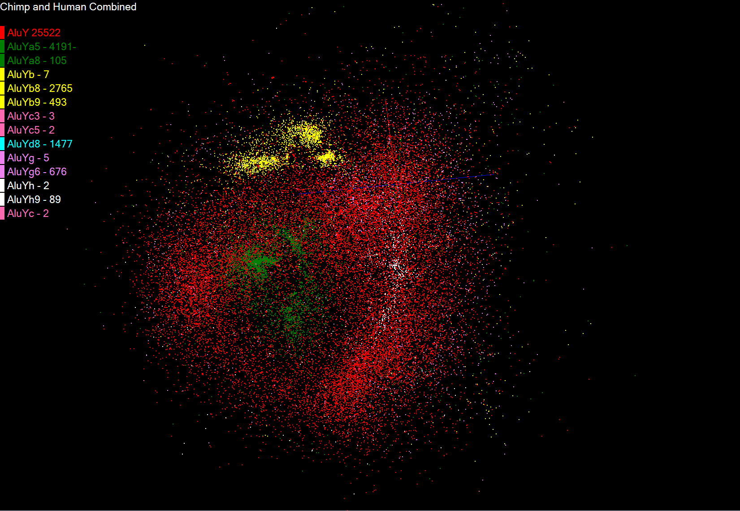
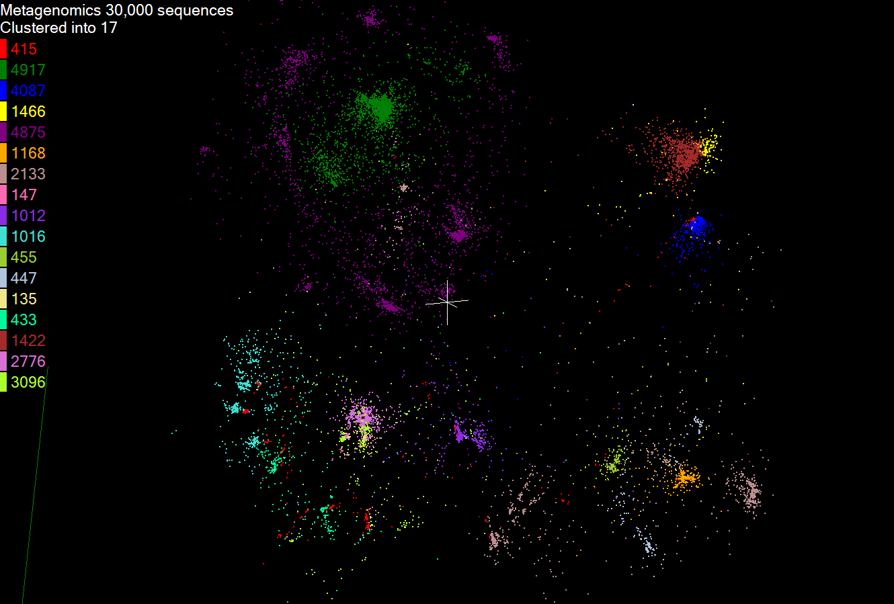
Biology MDS and Clustering Results
Alu Families
This visualizes results of Alu repeats from Chimpanzee and Human Genomes. Young families (green, yellow) are seen as tight clusters. This is projection of MDS dimension reduction to 3D of 35399 repeats – each with about 400 base pairs
Metagenomics
This visualizes results of dimension reduction to 3D of 30000 gene sequences from an environmental sample. The many different genes are classified by clustering algorithm and visualized by MDS dimension reduction

Slide 12
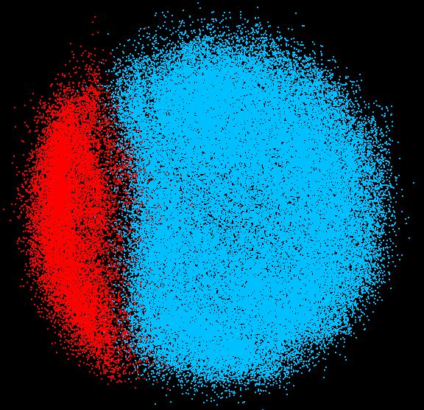
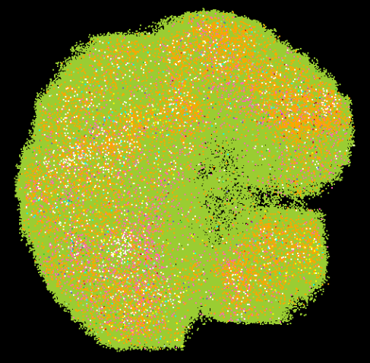
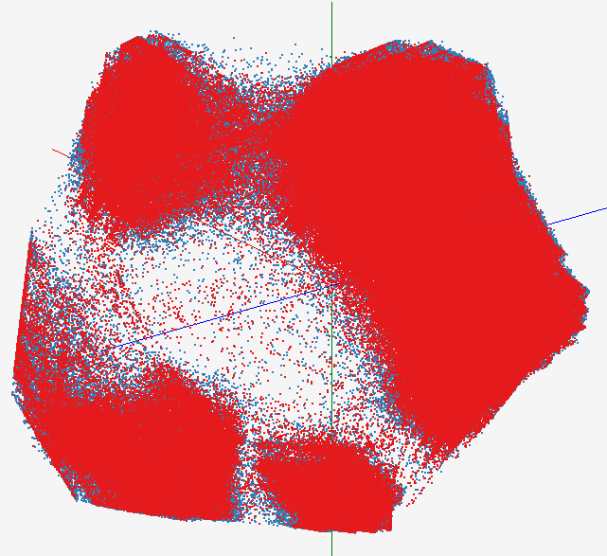
High Performance Data Visualization
Developed parallel MDS and GTM algorithm to visualize large and high-dimensional data
Processed 0.1 million PubChem data having 166 dimensions
Parallel interpolation can process up to 2M PubChem points
GTM with interpolation for 2M PubChem data
2M PubChem data is plotted in 3D with GTM interpolation approach. Red points are 100k sampled data and blue points are 4M interpolated points.
MDS for 100k PubChem data
100k PubChem data having 166 dimensions are visualized in 3D space. Colors represent 2 clusters separated by their structural proximity.
GTM for 930k genes and diseases
Genes (green color) and diseases (others) are plotted in 3D space, aiming at finding cause-and-effect relationships.
[3] PubChem project, http://pubchem.ncbi.nlm.nih.gov/

Slide 13
Applications using Dryad & DryadLINQ (1)
CAP3 [1] - Expressed Sequence Tag assembly to re-construct full-length mRNA
Input files (FASTA)
DryadLINQ
CAP3
CAP3
CAP3
Output files
Perform using DryadLINQ and Apache Hadoop implementations
Single “Select” operation in DryadLINQ
“Map only” operation in Hadoop
[4] X. Huang, A. Madan, “CAP3: A DNA Sequence Assembly Program,” Genome Research, vol. 9, no. 9, pp. 868-877, 1999.

Slide 14
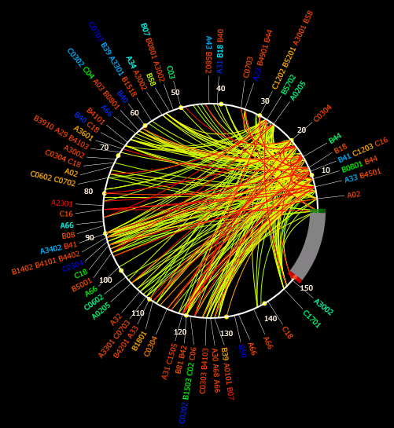
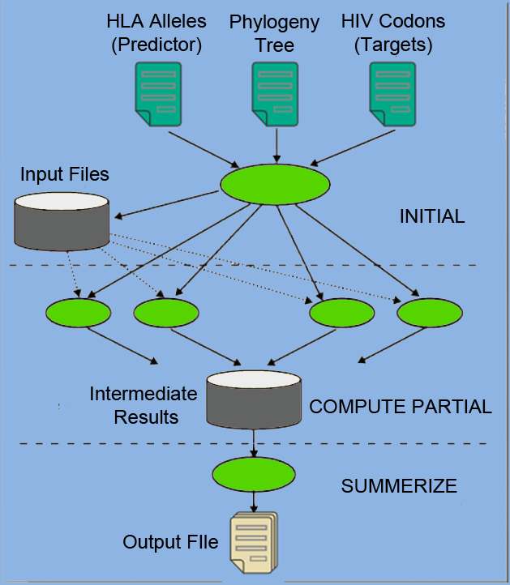
Applications using Dryad & DryadLINQ (2)
PhyloD [2] project from Microsoft Research
Output of PhyloD shows the associations
Derive associations between HLA alleles and HIV codons and between codons themselves
Scalability of DryadLINQ PhyloD Application
[5] Microsoft Computational Biology Web Tools, http://research.microsoft.com/en-us/um/redmond/projects/MSCompBio/

Slide 15
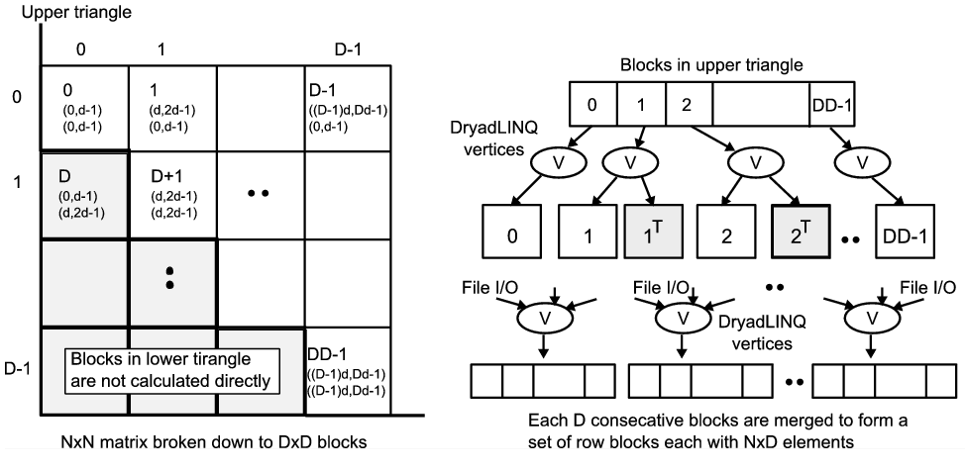
All-Pairs[3] Using DryadLINQ
125 million distances
4 hours & 46 minutes
Calculate Pairwise Distances (Smith Waterman Gotoh)
Calculate pairwise distances for a collection of genes (used for clustering, MDS)
Fine grained tasks in MPI
Coarse grained tasks in DryadLINQ
Performed on 768 cores (Tempest Cluster)
[5] Moretti, C., Bui, H., Hollingsworth, K., Rich, B., Flynn, P., & Thain, D. (2009). All-Pairs: An Abstraction for Data Intensive Computing on Campus Grids. IEEE Transactions on Parallel and Distributed Systems , 21, 21-36.

Slide 16
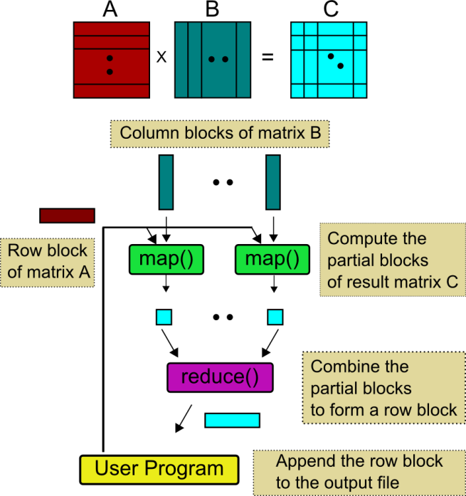
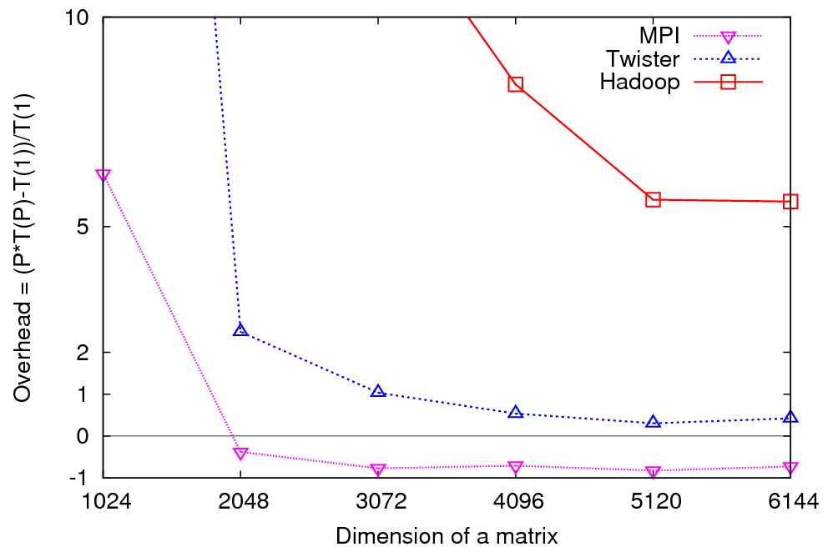
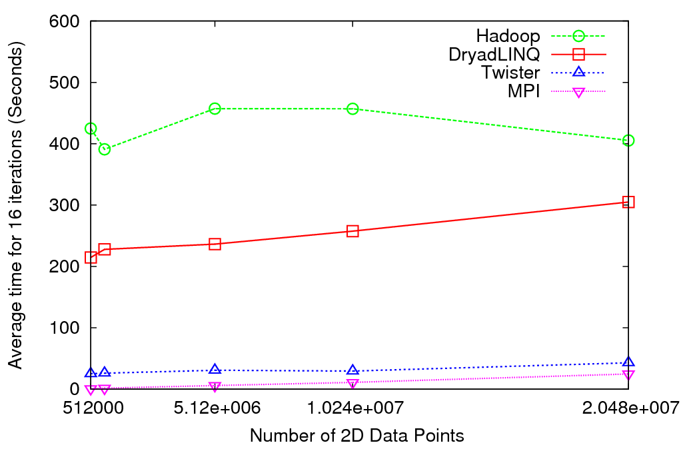
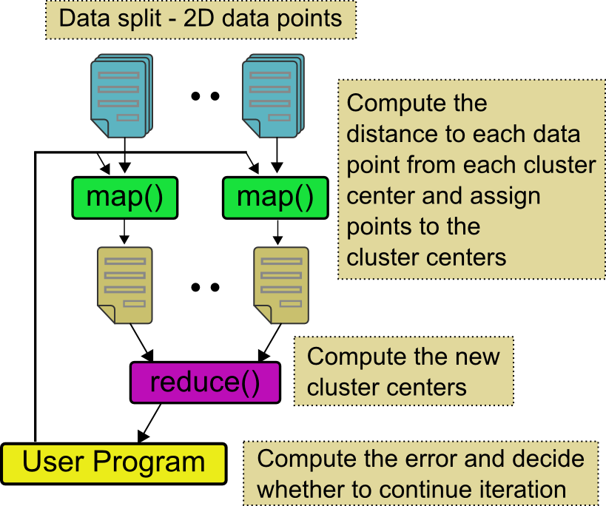
Matrix Multiplication & K-Means Clustering Using Cloud Technologies
Matrix Multiplication
K-Means clustering on 2D vector data
Matrix multiplication in MapReduce model
DryadLINQ and Hadoop, show higher overheads
Twister (MapReduce++) implementation performs closely with MPI
Parallel Overhead
Matrix Multiplication
K-Means Clustering
Average Time
K-means Clustering

Slide 17
Dryad & DryadLINQ
Higher Jumpstart cost
User needs to be familiar with LINQ constructs
Higher continuing development efficiency
Minimal parallel thinking
Easy querying on structured data (e.g. Select, Join etc..)
Many scientific applications using DryadLINQ including a High Energy Physics data analysis
Comparable performance with Apache Hadoop
Smith Waterman Gotoh 250 million sequence alignments, performed comparatively or better than Hadoop & MPI
Applications with complex communication topologies are harder to implement

Slide 18
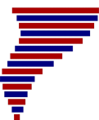
Application Classes
Old classification of Parallel software/hardware
in terms of 5 (becoming 6) “Application architecture” Structures)
1 | Synchronous | Lockstep Operation as in SIMD architectures
2 | Loosely Synchronous | Iterative Compute-Communication stages with independent compute (map) operations for each CPU. Heart of most MPI jobs | MPP
3 | Asynchronous | Compute Chess; Combinatorial Search often supported by dynamic threads | MPP
4 | Pleasingly Parallel | Each component independent – in 1988, Fox estimated at 20% of total number of applications | Grids
5 | Metaproblems | Coarse grain (asynchronous) combinations of classes 1)-4). The preserve of workflow. | Grids
6 | MapReduce++ | It describes file(database) to file(database) operations which has subcategories including. Pleasingly Parallel Map Only Map followed by reductions Iterative “Map followed by reductions” – Extension of Current Technologies that supports much linear algebra and datamining | Clouds Hadoop/ Dryad Twister
Notes:
CGL-MapReduce is an example of MapReduce++ -- supports MapReduce model with iteration (data stays in memory and communication via streams not files)

Slide 19
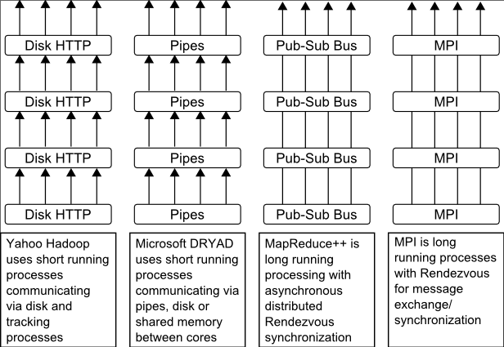
Twister(MapReduce++)
Pub/Sub Broker Network
Map Worker
M
Streaming based communication
Intermediate results are directly transferred from the map tasks to the reduce tasks – eliminates local files
Cacheable map/reduce tasks
Static data remains in memory
Combine phase to combine reductions
User Program is the composer of MapReduce computations
Extends the MapReduce model to iterative computations
Worker Nodes
R
Reduce Worker
D
D
MR
Driver
User
Program
M
M
M
M
D
MRDeamon
R
R
R
R
Data Read/Write
Communication
Data Split
File System
Iterate
Static
data
Configure()
User Program
Map(Key, Value)
δ flow
Reduce (Key, List<Value>)
Combine (Key, List<Value>)
Different synchronization and intercommunication mechanisms used by the parallel runtimes
Close()

Slide 20
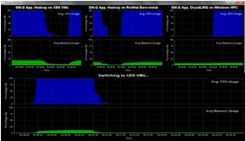
Dynamic Virtual Clusters
Dynamic Cluster Architecture
Monitoring & Control Infrastructure
Monitoring Infrastructure
Monitoring Interface
Pub/Sub Broker Network
SW-G Using Hadoop
SW-G Using Hadoop
SW-G Using DryadLINQ
Linux
Bare-system
Linux on Xen
Windows Server 2008 Bare-system
Virtual/Physical Clusters
Summarizer
XCAT Infrastructure
XCAT Infrastructure
Switcher
iDataplex Bare-metal Nodes
(32 nodes)
iDataplex Bare-metal Nodes
Switchable clusters on the same hardware (~5 minutes between different OS such as Linux+Xen to Windows+HPCS)
Support for virtual clusters
SW-G : Smith Waterman Gotoh Dissimilarity Computation as an pleasingly parallel problem suitable for MapReduce style applications

Slide 21
SALSA HPC Dynamic Virtual Clusters Demo
At top, these 3 clusters are switching applications on fixed environment. Takes ~30 Seconds.
At bottom, this cluster is switching between Environments – Linux; Linux +Xen; Windows + HPCS. Takes about ~7 minutes.
It demonstrates the concept of Science on Clouds using a FutureGrid cluster.

