Slide 1
North Dakota Tribal Colleges
Cyberinfrastructure Day
Overview
United Tribes Technical College
April 17 2009
Geoffrey Fox
Computer Science, Informatics, Physics
Chair Informatics Department
Director Community Grids Laboratory and Digital Science Center
Indiana University Bloomington IN 47404
gcf@indiana.edu
http://www.infomall.org

Slide 2
e-moreorlessanything
‘e-Science is about global collaboration in key areas of science, and the next generation of infrastructure that will enable it.’ from inventor of term John Taylor Director General of Research Councils UK, Office of Science and Technology
e-Science is about developing tools and technologies that allow scientists to do ‘faster, better or different’ research
Similarly e-Business captures the emerging view of corporations as dynamic virtual organizations linking employees, customers and stakeholders across the world.
This generalizes to e-moreorlessanything including e-NMAI, e-SocialScience, e-HavingFun and e-Education
A deluge of data of unprecedented and inevitable size must be managed and understood.
People (virtual organizations), computers, data (including sensors and instruments) must be linked via hardware and software networks
2
Notes:
2

Slide 3
What is Cyberinfrastructure
Cyberinfrastructure is (from NSF) infrastructure that supports distributed research and learning (e-Science, e-Research, e-Education)
  Links data, people, computers
Exploits Internet technology (Web2.0 and Clouds) adding (via Grid technology) management, security, supercomputers etc.
It has two aspects: parallel – low latency (microseconds) between nodes and distributed – highish latency (milliseconds) between nodes
Parallel needed to get high performance on individual large simulations, data analysis etc.; must decompose problem
Distributed aspect integrates already distinct components – especially natural for data (as in biology databases etc.)
3
Notes:
3

Slide 4
Gartner 2008 Technology Hype Curve
Clouds, Microblogs and Green IT appear
Basic Web Services, Wikis and SOA
becoming mainstream

Slide 5
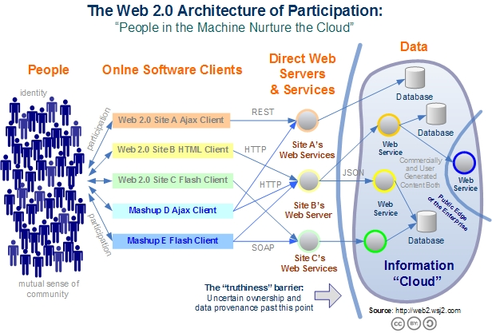
Web 2.0 Systems illustrate Cyberinfrastructure
Captures the incredible development of interactive Web sites enabling people to create and collaborate

Slide 6
Relevance of Web 2.0
Web 2.0 can help e-Research in many ways
Its tools (web sites) can enhance scientific collaboration, i.e. effectively support virtual organizations, in different ways from grids
The popularity of Web 2.0 can provide high quality technologies and software that (due to large commercial investment) can be very useful in e-Research and preferable to complex Grid or Web Service solutions
The usability and participatory nature of Web 2.0 can bring science and its informatics to a broader audience
Cyberinfrastructure is research analogue of major commercial initiatives e.g. to important job opportunities for students!
Web 2.0 is major commercial use of computers and “Google/Amazon” farms spurred cloud computing
  Same computer answering your Google query can do bioinformatics
  Can be accessed from a web page with a credit card i.e. as a Service

Slide 7
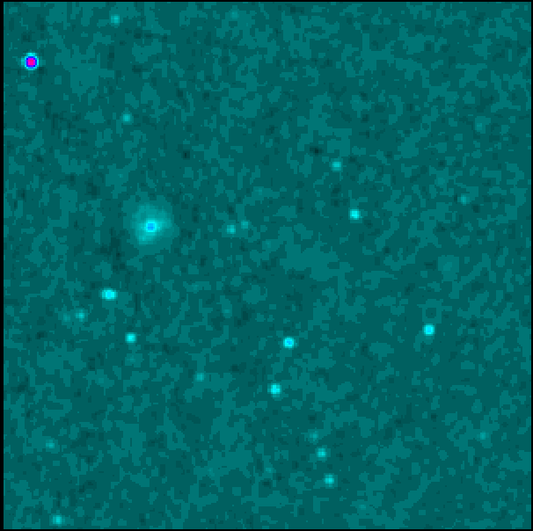

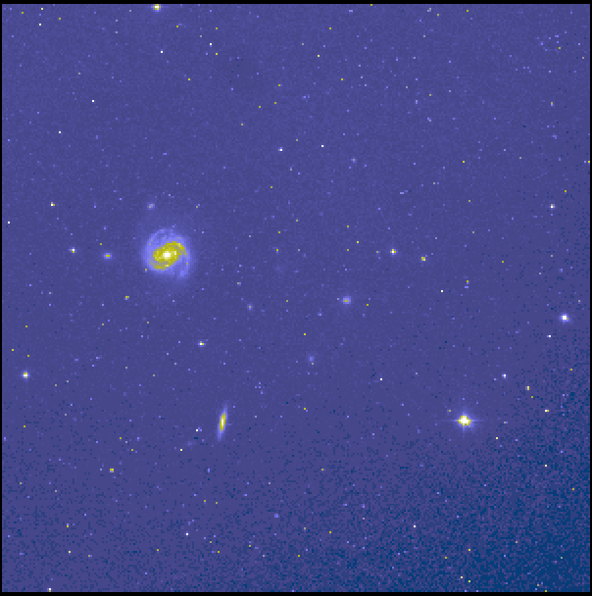
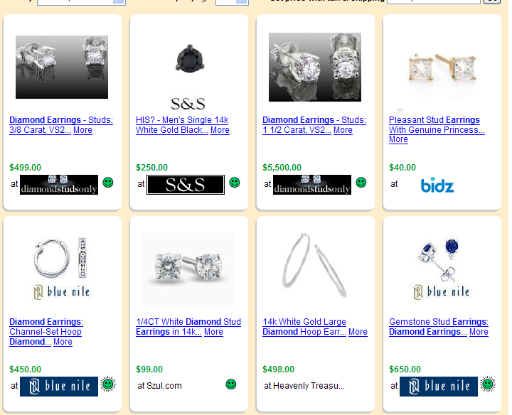
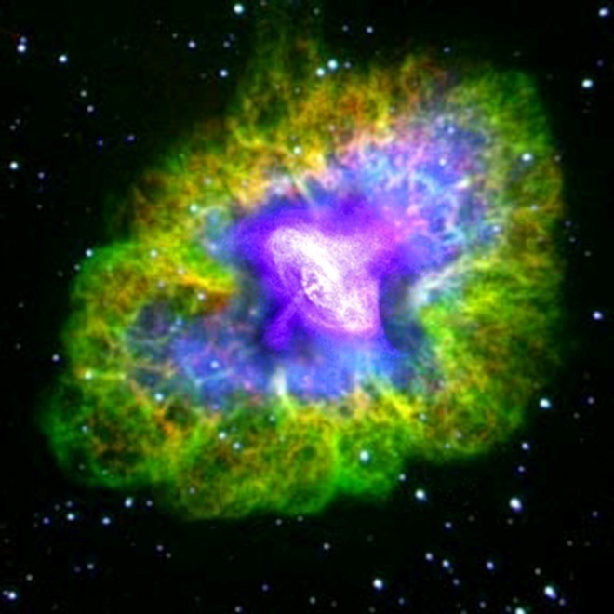
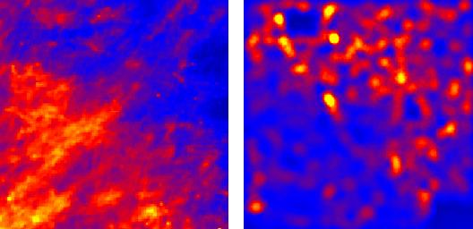
Virtual Observatory in Astronomy uses
Cyberinfrastructure to Integrate Experiments
Radio
Far-Infrared
Visible
Comparison Shopping is Internet analogy to Integrated Astronomy using similar technology
Dust Map
Visible + X-ray
Galaxy Density Map

Slide 8


Clouds as Cost Effective Data Centers
Exploit the Internet by allowing one to build giant data centers with 100,000’s of computers; ~ 200-1000 to a shipping container
“Microsoft will cram between 150 and 220 shipping containers filled with data center gear into a new 500,000 square foot Chicago facility. This move marks the most significant, public use of the shipping container systems popularized by the likes of Sun Microsystems and Rackable Systems to date.”

Slide 9

Clouds hide Complexity
Build portals around all computing capability
SaaS: Software as a Service
IaaS: Infrastructure as a Service or HaaS: Hardware as a Service
PaaS: Platform as a Service delivers SaaS on IaaS
Cyberinfrastructure is “Research as a Service”
2 Google warehouses of computers on the banks of the Columbia River, in The Dalles, Oregon
Such centers use 20MW-200MW
(Future) each
150 watts per core
Save money from large size, positioning with cheap power and access with Internet

Slide 10
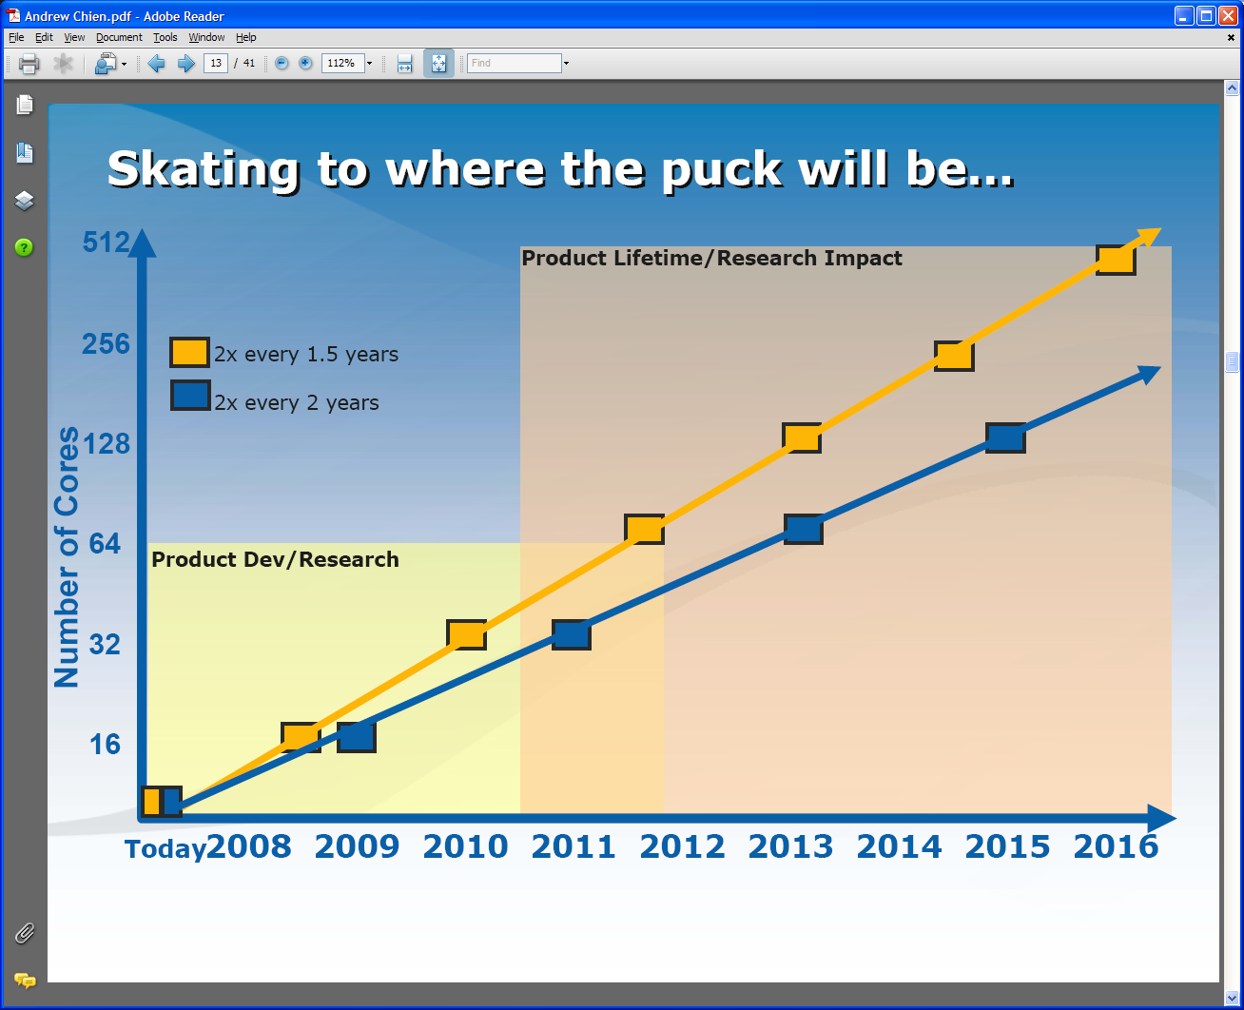
Intel’s Projection for Multicore
Technology might support:
2010: 16—64 cores 200GF—1 TF
2013: 64—256 cores 500GF– 4 TF
2016: 256--1024 cores 2 TF– 20 TF

Slide 11
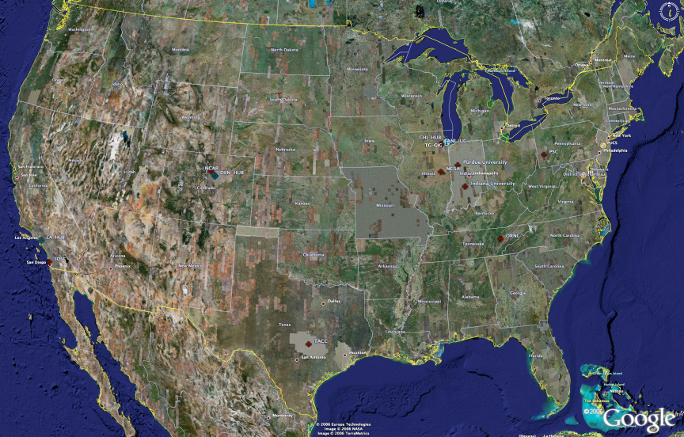
TeraGrid High Performance Computing Systems 2007-8
UC/ANL
PSC
PU
NCAR
NCSA
IU
2008
(~1PF)
ORNL
Tennessee
SDSC
(504TF)
LONI/LSU
TACC
Computational Resources
(size approximate - not to scale)
Slide Courtesy Tommy Minyard, TACC

Slide 12
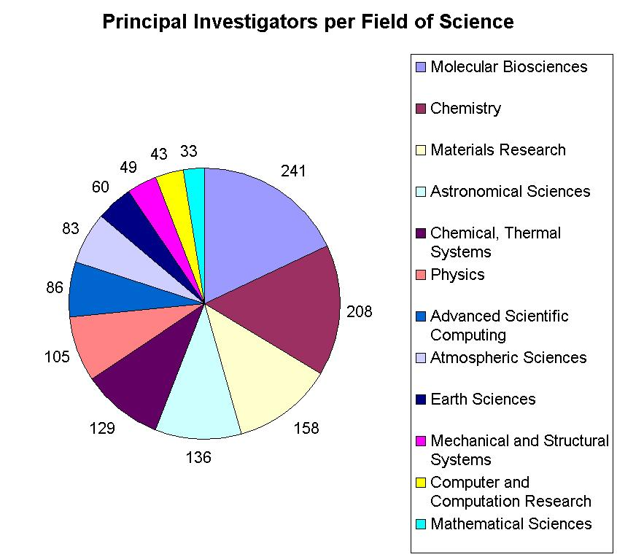

Resources for many disciplines!
> 40,000 processors in aggregate
Resource availability grew during 2008 at unprecedented rates

Slide 13
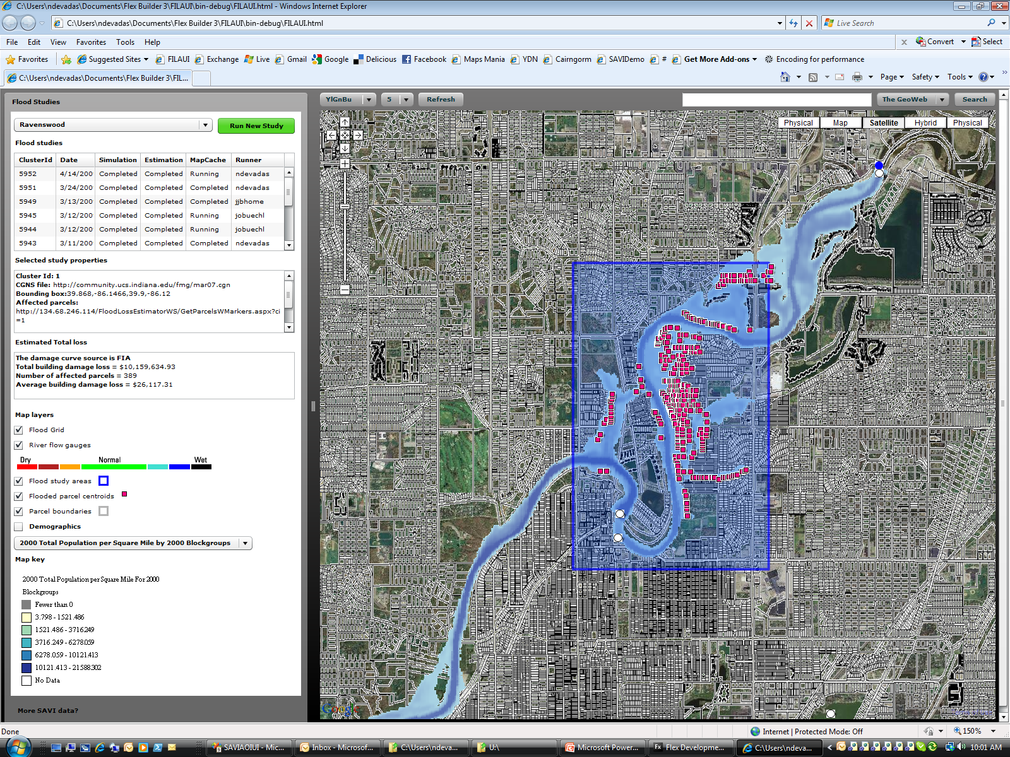
USGS Flood and Loss estimation tools as Cyberinfrastructure
Notes:
What you see is the gui that invokes the service workflow and chart the outputs by clicking the “Run New Study” button. Service chain consists of 7 compound and stand alone web services. The gui hide behind the complexities and service chaining happens behind the scene. We will use BEPEL workflow, though right now I am programmatically chaining. I am planning to use windows workflow foundation some time later. (You can find the services list in the ppt). The core flood model we use is FastMech. It consumes real-time flow gauge data. It outputs the flood depth grid. Depth grid is used to determin the building under flood and calculated looses using Hasus Damage curved, which are based on FIA (Federal Insurance Agency) damage curves.
About the gui, the top left dropdown shows the pre calibrated models for river reaches. We currently have only one model for Ravenswood area.
Flood studies grid control lists model runs and statuses of service completions. Selected study properties box show the initial conditions and inputs that model requires.
Estimated total loss lists the the type of damage curve used to calculate the losses and costs and affected number of buildings.
You also see a map key. And as a supplement to undertand the demographic of the study area, I also included SAVI demographic data.
Right pane shows the map with parcels, areal images, the flood grid and the flooded buildings. And if selectecd you will also see the demographics layers.

Slide 14
Services in Flood Cyberinfrastructure

Slide 15
Service name | Description | Status | Possible improvements
Real time data import service | This service extracts information needed by the Mesh generation service from the result CGNS file generated by the Flood simulation service. | Completed
Input process service | This service incorporates the above initial conditions into the input CGNS file. | Completed
Flood simulation service | This service runs FaSTMECH simulation model on a given input CGNS file by submitting the computation job to a condor queueing system on an IU Gateway hosting VM. | Completed | Interface with other IU/TG computing resources.
Output process service | This service imports real time USGS and NWS water data into necessary initial conditions for flood simulation computing. (discharge and elevation) | Completed
Notes:
FloodGrid is a collection of services:
* Some built by Neil
* Some built by us
* Some third party services (flood gauges online that are run by the National Weather Service and/or USGS)
So services enabled both distributed development (including third party) and distributed computing. The services can be composed using mash-ups (as Neil did) or you can put them together with workflow composers.
The computing problem itself isn't really that big (takes a few minutes to do the calculation on Quarry). Potentially a larger problem (a much larger finite element grid) would need to use this a supercomputer. One could also imagine loosely coupled scenarios.
Note the problem with this system is that the flood code itself isn't very stable for arbitrary inputs.

Slide 16
Mesh generation service | This service consumes the output file from FastMECH and generate a flood depth ascii mesh file. This service also transform the data from UTM 16 coordinate to geographic coordinates. Mesh cells are generated by using nearest neighbor clustering techniques. | Completed | Could use a different clustering technique.
Loss calculation service for building damage | This service consumes parcel assessment data and the overlay on top of the grid and intersect the flooded parcels. After that it uses building assessment information and flood depth information from the mesh and calculate the losses per Federal Insurance Agency (FIA) flood loss curves. | Completed | Add more information for reporting purposes.
Map tile cache service | This service consumes the mesh file and generates flood map for visualization. In this process the mesh coordinates are transformed to World Mercator coordinate system | Completed
Notes:
Flood depth and overlay analysis done by a custom application I wrote. I made the decision not to use ArcGIS or any existing GiS technologies. The reason I went in this route is to scale the app on demand, and also the GIS related problem was not that complicated. It is just a simple overlay of points on a grid. FastMech also uses its own geographic tools. All maps are based on Google technology and flood dept grid image is created by a custom program and follows Google tiling methodology.
Note also Neil is tapping into Hazus-MH.
I was too quick. Also, to cache demographic and parcel maps I use a stack of open source libraries such as OGR tools, Net Topology Suite, sharp map and sharp GIS.
I am planning to develop an application to expose the grid data in a OGC compliant Web Coverage Service (WCS) for interoperability purposes.

Slide 17
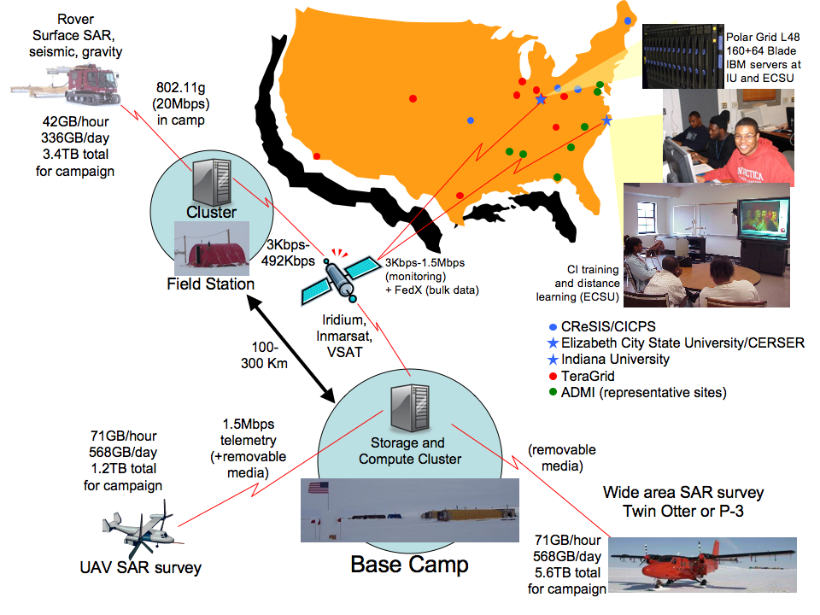

Slide 18
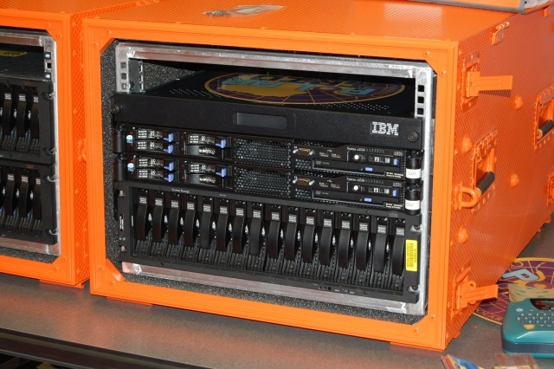
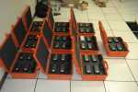
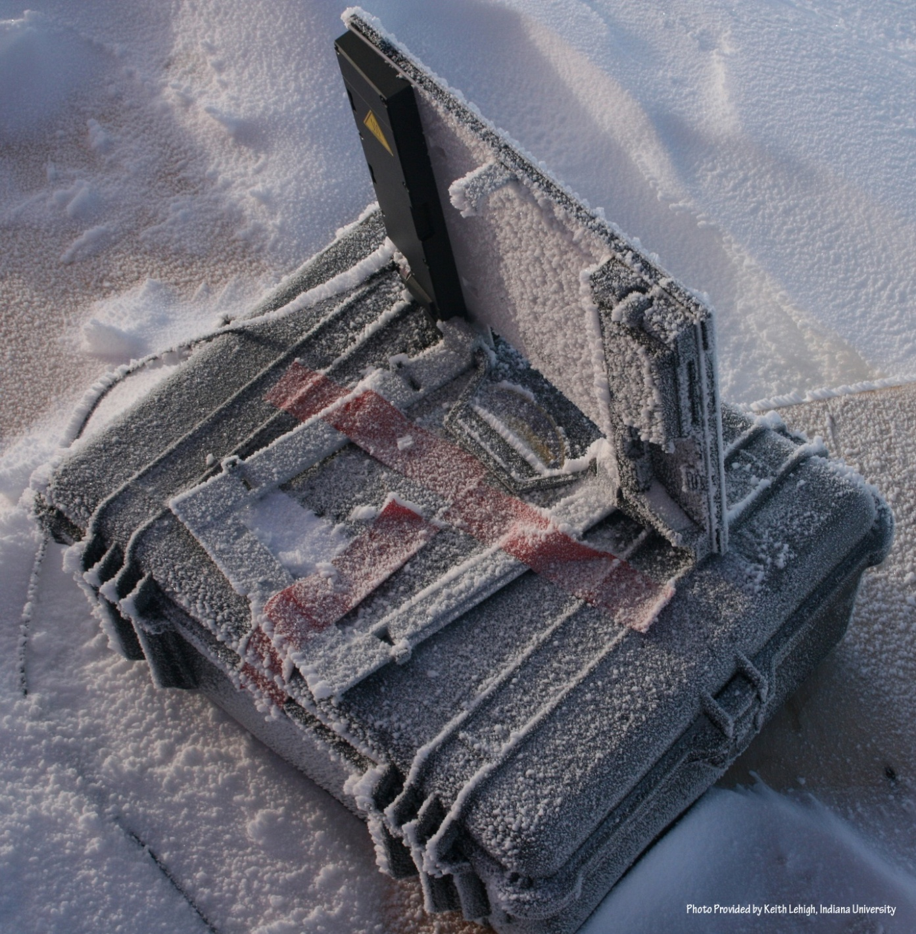
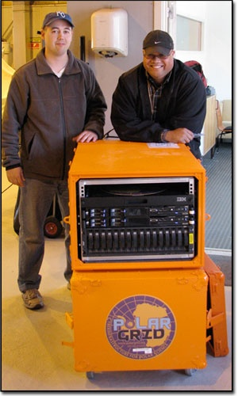
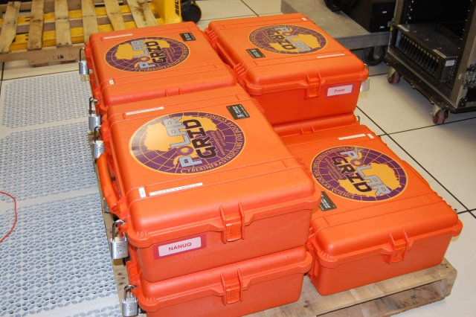

Polar Grid goes to Greenland

Slide 19
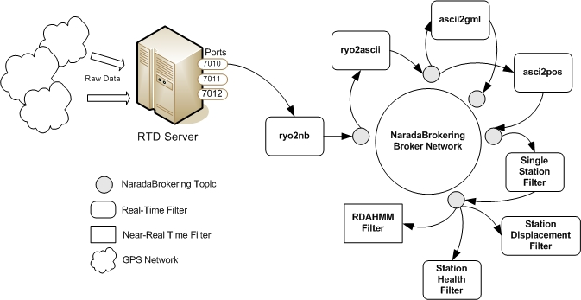
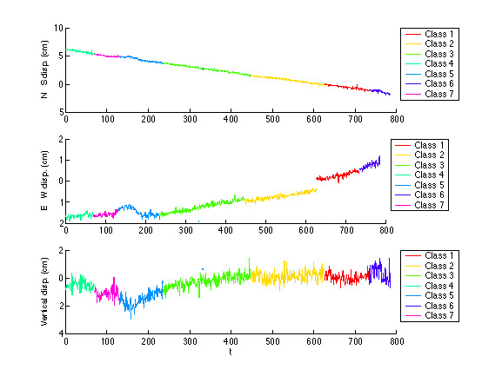
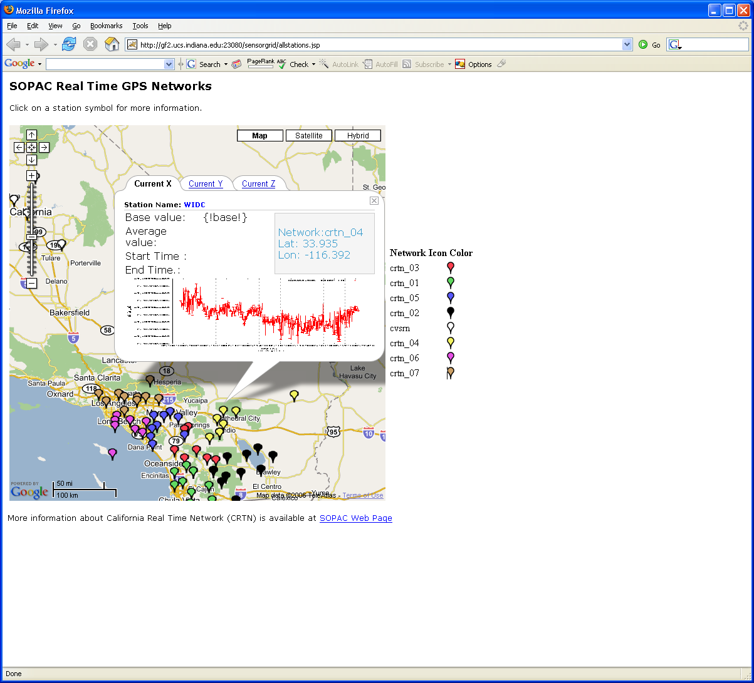
Grid Workflow Datamining in Earth Science
Work with Scripps Institute
Cyberinfrastructure links GPS stations to Earthquake detection tools
NASA GPS
Earthquake
Streaming Data
Support
Archival
Transformations
Data Checking
Hidden Markov
Datamining (JPL)
Real Time
Display (GIS)
19
Notes:
19

Slide 20
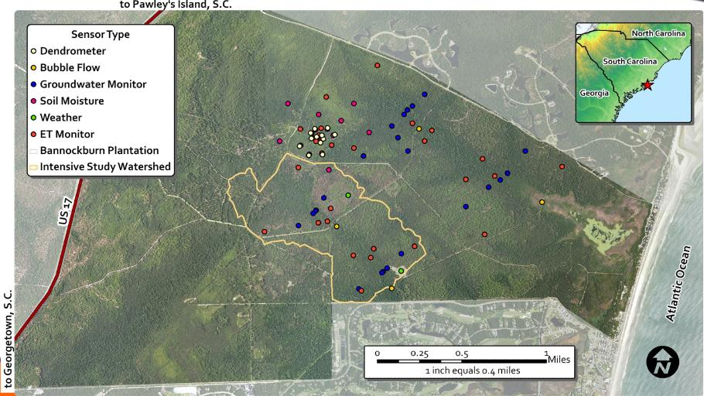
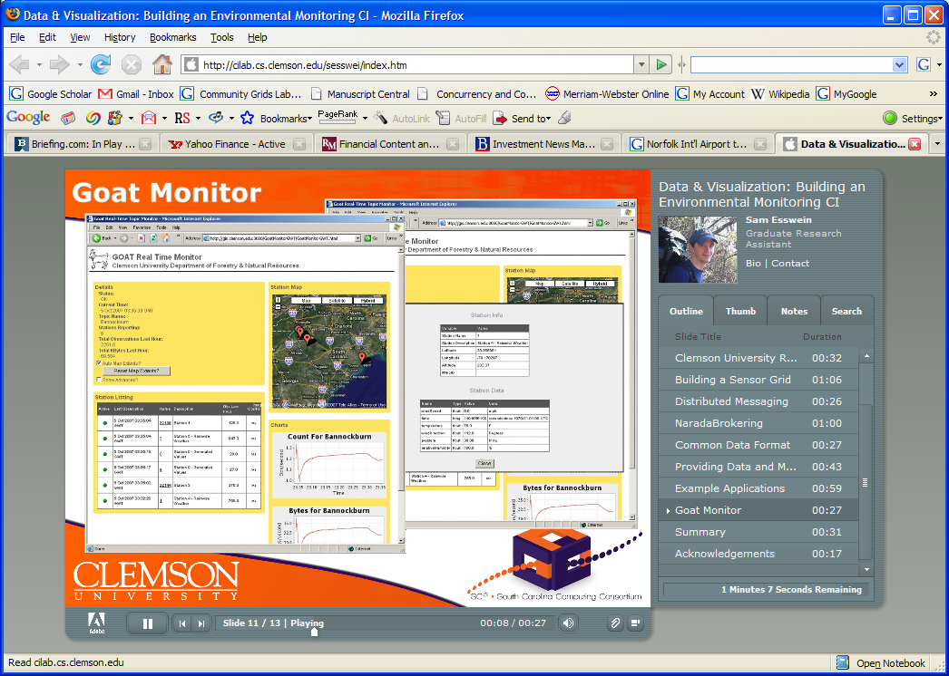
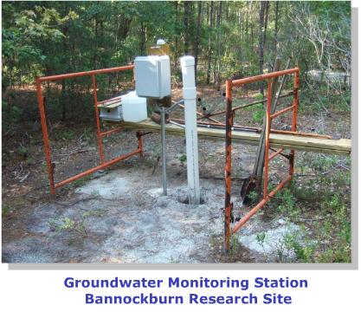
Environmental Monitoring Cyberinfrastructure at Clemson

Slide 21
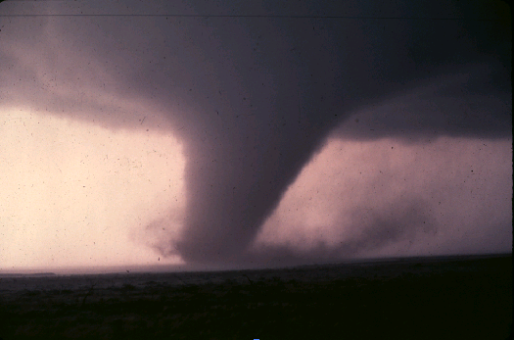
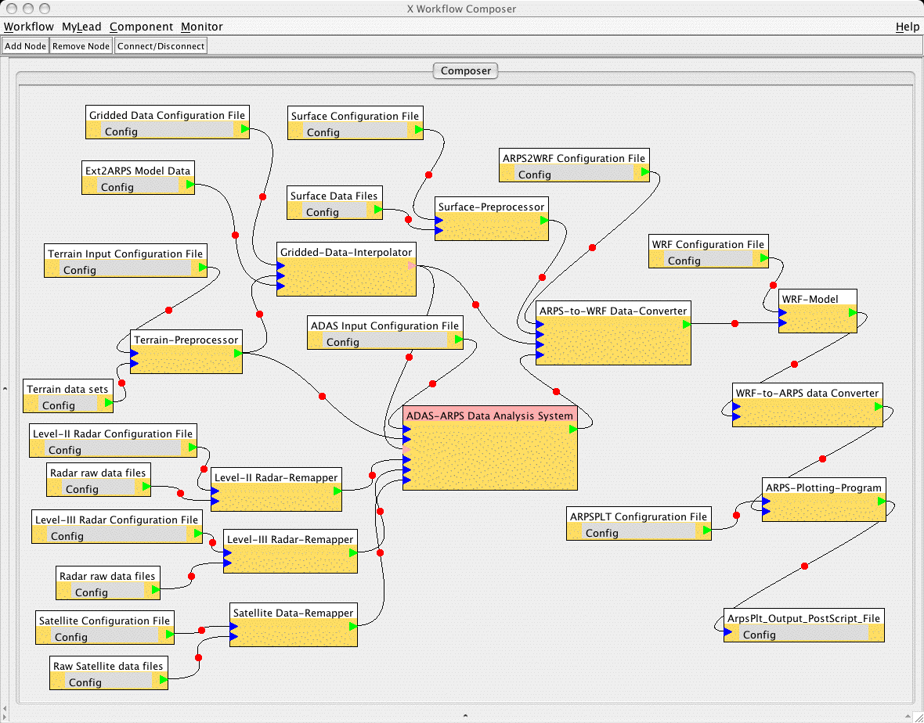
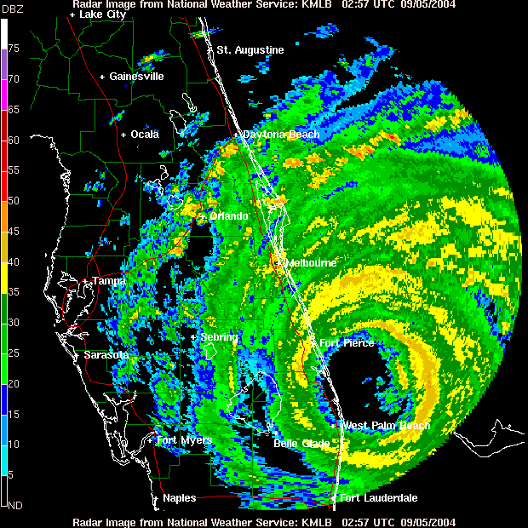
Cyberinfrastructure for Tornado Forecasting in Earth Science
Grid services triggered by abnormal events and controlled by workflow process real time data from radar and high resolution simulations for tornado forecasts
Typical graphical interface to service composition

Slide 22
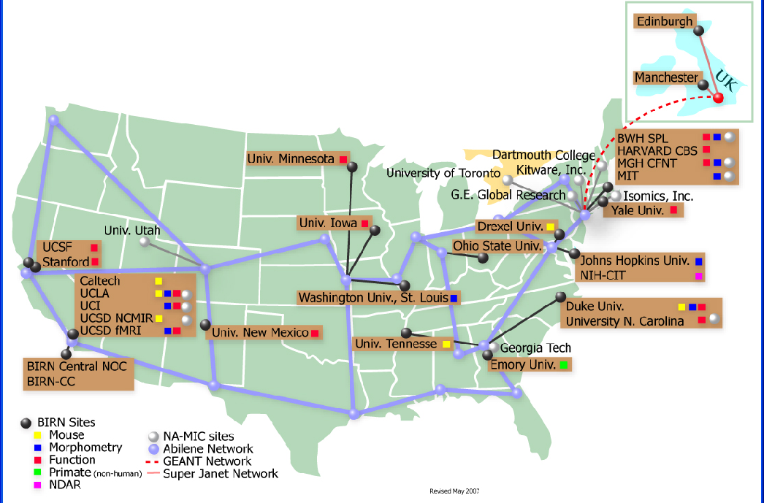
BIRN Bioinformatics Research Network

Slide 23
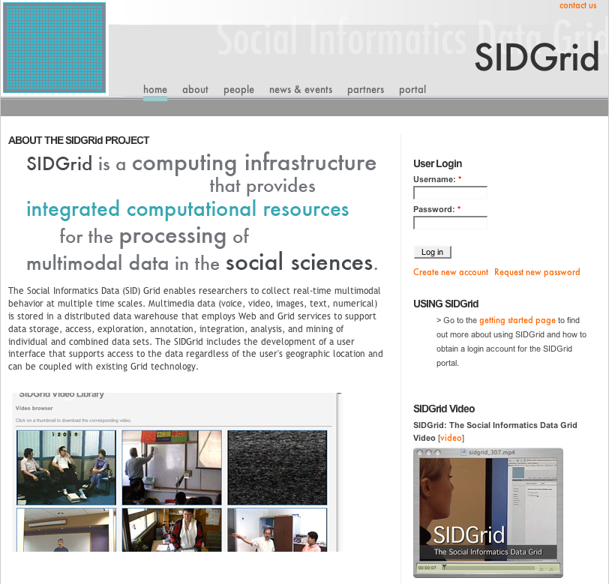
U. Chicago SIDGrid (sidgrid.ci.uchicago.edu)

Slide 24
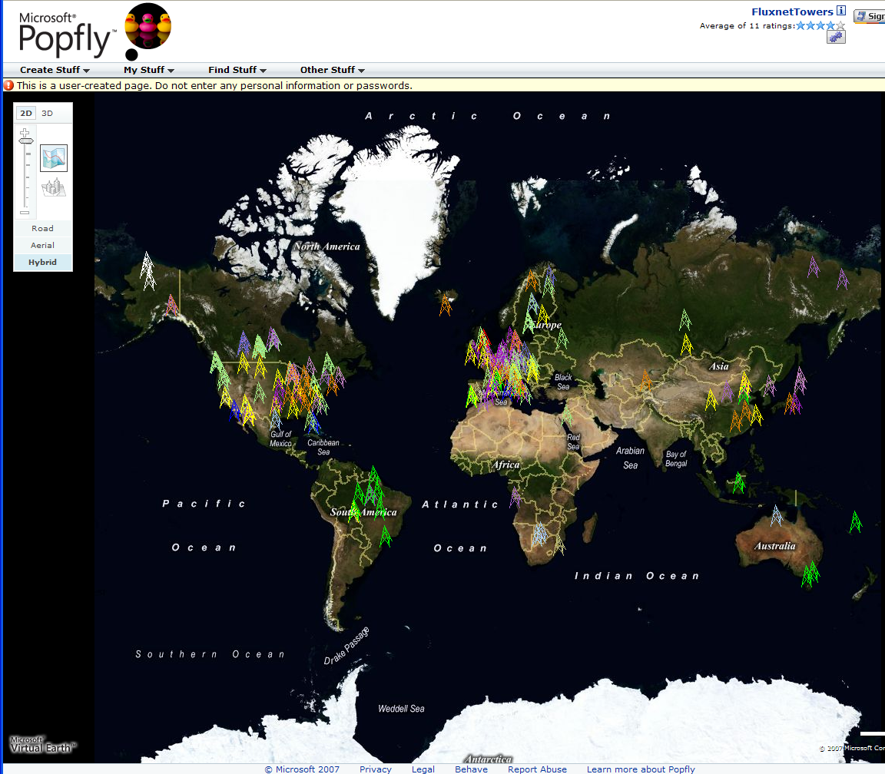
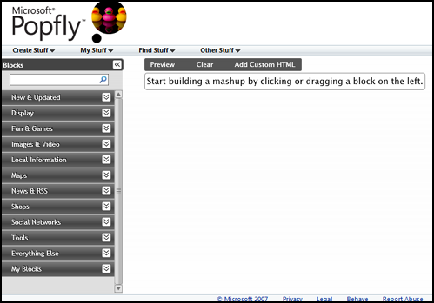
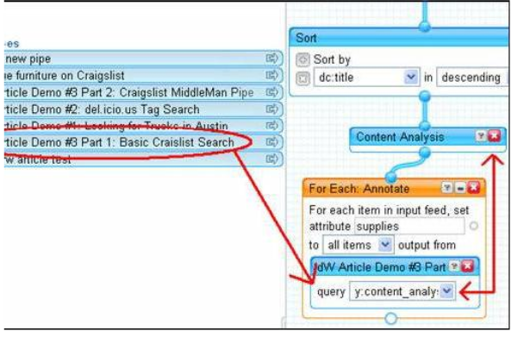
Major Companies entering mashup area
Web 2.0 Mashups (same as workflow in Grids) are likely to drive composition (programming) tools for Grids, Clouds and web
Recently we see Mashup tools like Yahoo Pipes and Microsoft Popfly which have familiar graphical interfaces
Currently only simple examples but tools could become powerful
Yahoo Pipes

Slide 25
Sensor Grids Can be Fun
Note sensors are any time dependent source of information and a fixed source of information is just a broken sensor
  SAR Satellites
  Environmental Monitors
  Nokia N800 pocket computers
  RFID tags and readers
  GPS Sensors
  Lego Robots
  RSS Feeds
  Audio/video: web-cams
  Presentation of teacher in distance education
  Text chats of students
  Cell phones

Slide 26

The Sensors on the Fun Grid
Laptop for PowerPoint
2 Robots used
Lego Robot GPS Nokia N800 RFID Tag RFID Reader

Slide 28
The People in Cyberinfrastructure
Web 2.0 can enhance scientific collaboration, i.e. effectively support virtual organizations, in different ways from grids
I expect more resources like MyExperiment from UK, SciVee from SDSC and Connotea from Nature that offer Flickr, YouTube, Facebook, Second Life type capabilities optimized for science
The usability and participatory nature of Web 2.0 can bring science and its informatics to a broader audience
In particular distance collaborative aspects of such Cyberinfrastructure can level playing field; you do not have to be at Harvard etc. to succeed
  e.g. ECSU in CReSIS NSF Science and Technology Center
  Navajo Tech can access TeraGrid Science Gateways

Slide 29
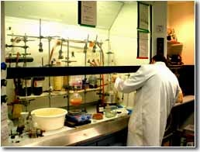
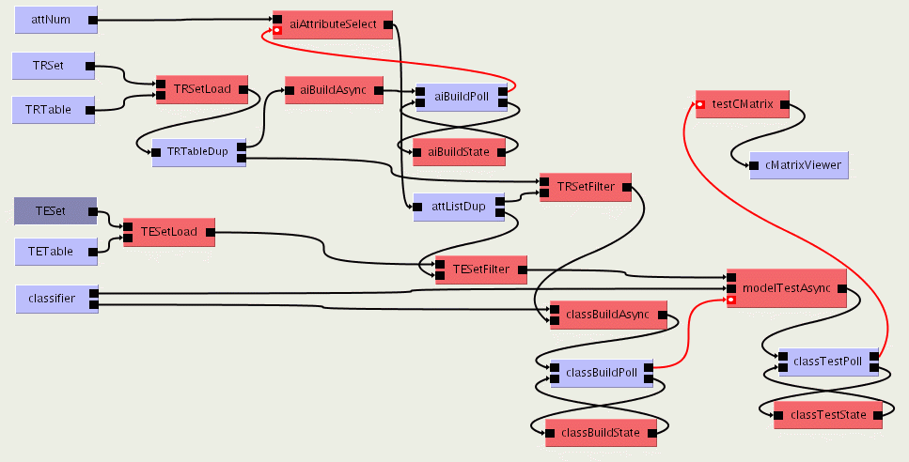

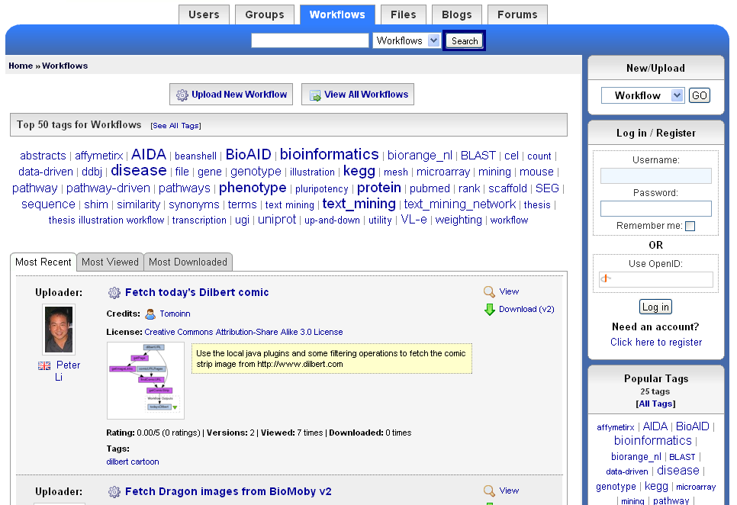
The social process of science 2.0
Virtual Learning Environment
Role of Libraries
and Publishers?
Undergraduate Students
Digital Libraries
scientists
Graduate Students
Reprints
Peer-Reviewed Journal & Conference Papers
experimentation
Technical Reports
Preprints & Metadata
Local
Web
Repositories
Certified Experimental Results & Analyses
Data, Metadata Provenance Workflows
Ontologies

Slide 30
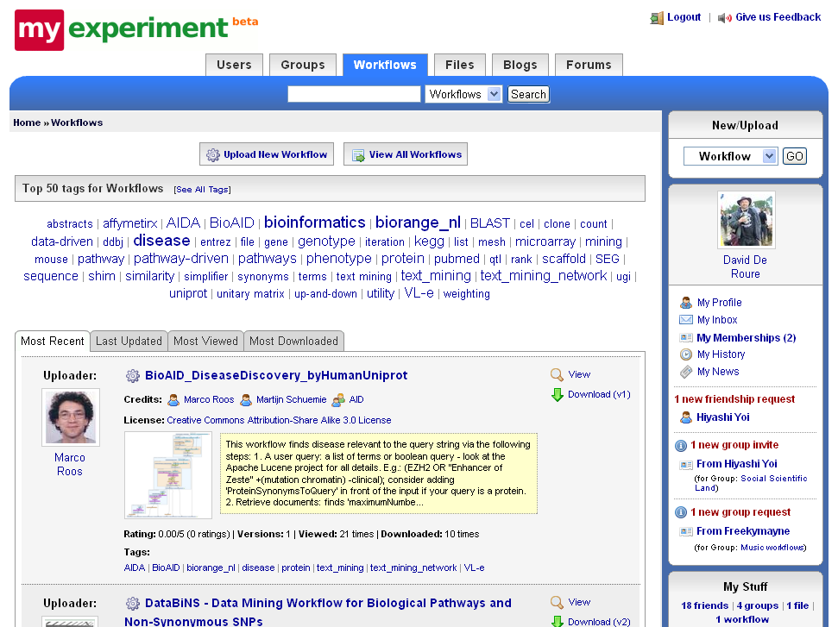

Slide 31
Some critical Concepts as text I
Computational thinking is set up as e-Research and often characterized by a Data Deluge from sensors, instruments, simulation results and the Internet. Curating and managing this data involves digital library technology and possible new roles for libraries. Interdisciplinary Collaboration across continents and fields implies virtual organizations that are built using Web 2.0 technology. VO’s link people, computers and data.
Portals or Gateways provide access to computational and data set up as Cyberinfrastructure or e-Infrastructure made up of multiple Services
Intense computation on individual problems involves Parallel Computing linking computers with high performance networks that are packaged as Clusters and/or Supercomputers. Performance improvements now come from Multicore architectures implying parallel computing important for commodity applications and machines.

Slide 32
Some critical Concepts as text II
Cyberinfrastructure also involves distributed systems supporting data and people that are naturally distributed as well as pleasingly parallel computations. Grids were initial technology approach but these failed to get commercial support and in many cases being replaced by Clouds.
Clouds are highly cost-effective user friendly approaches to large (~100,000 node) data centers originally pioneered by Web 2.0 applications. They tend to use Virtualization technology
These developments have implications for Education as well as Research but there is less agreement and success with education as with research. This reflects differences between different fields (e.g. roles of courses and lab work) and problem in teaching rich curricula and still graduating students expeditiously

