Slide 1
Overview of Cyberinfrastructure
Northeastern Illinois University
Cyberinfrastructure Day
August 17 2010
Geoffrey Fox
gcf@indiana.edu
http://www.infomall.org http://www.futuregrid.org
Director, Digital Science Center, Pervasive Technology Institute
Associate Dean for Research and Graduate Studies, School of Informatics and Computing
Indiana University Bloomington
Notes:
SALSA is
Service Aggregated Linked Sequential Activities

Slide 2
What is Cyberinfrastructure
Cyberinfrastructure is (from NSF) infrastructure that supports distributed research and learning (e-Science, e-Research, e-Education)
  Links data, people, computers
Exploits Internet technology (Web2.0 and Clouds) adding (via Grid technology) management, security, supercomputers etc.
It has two aspects: parallel – low latency (microseconds) between nodes and distributed – highish latency (milliseconds) between nodes
Parallel needed to get high performance on individual large simulations, data analysis etc.; must decompose problem
Distributed aspect integrates already distinct components – especially natural for data (as in biology databases etc.)
2
Notes:
2

Slide 3
e-moreorlessanything
‘e-Science is about global collaboration in key areas of science, and the next generation of infrastructure that will enable it.’ from inventor of term John Taylor Director General of Research Councils UK, Office of Science and Technology
e-Science is about developing tools and technologies that allow scientists to do ‘faster, better or different’ research
Similarly e-Business captures the emerging view of corporations as dynamic virtual organizations linking employees, customers and stakeholders across the world.
This generalizes to e-moreorlessanything including e-DigitalLibrary, e-SocialScience, e-HavingFun and e-Education
A deluge of data of unprecedented and inevitable size must be managed and understood.
People (virtual organizations), computers, data (including sensors and instruments) must be linked via hardware and software networks
3
Notes:
3

Slide 4
Important Trends
Data Deluge in all fields of science
  And areas outside science
Multicore implies parallel computing important again
  Performance from extra cores – not extra clock speed
  GPU enhanced systems can give big power boost
Clouds – new commercially supported data center model replacing compute grids (and your general purpose computer center)
Light weight clients: Sensors, Smartphones and tablets accessing and supported by backend services in cloud
Commercial efforts moving much faster than academia in both innovation and deployment

Slide 5
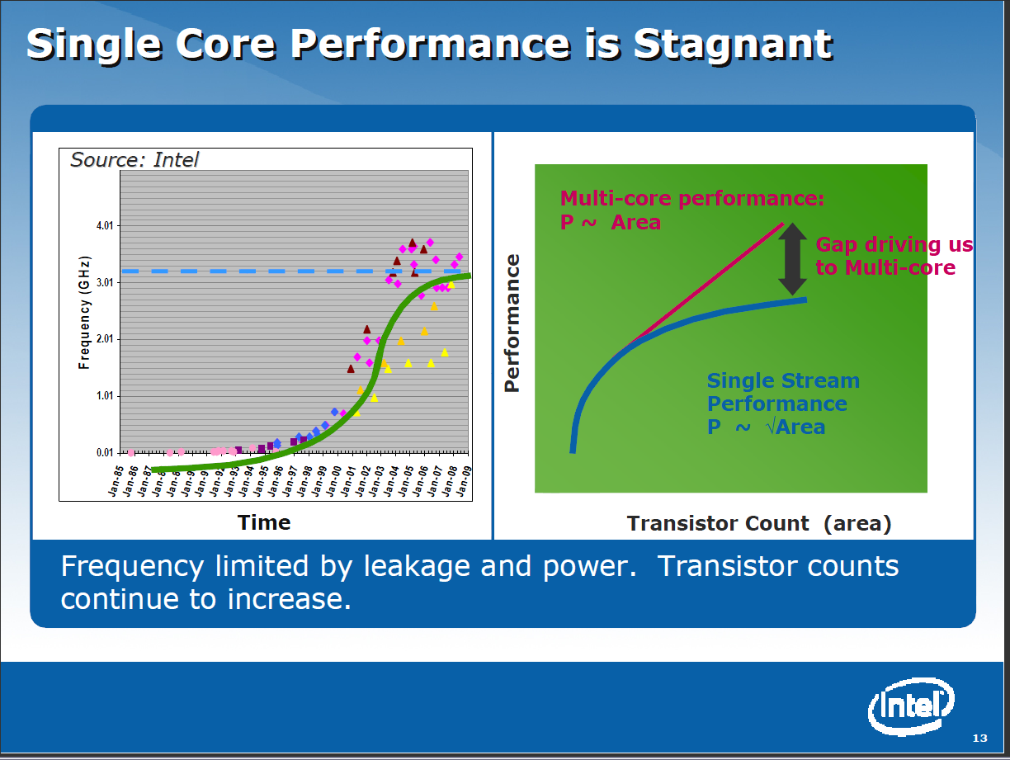

Slide 6

Gartner 2009 Hype Curve
Clouds, Web2.0
Service Oriented Architectures
Social Software Suites
Social Network Analysis

Slide 7



Data Centers Clouds & economies of scale I
Range in size from “edge” facilities to megascale.
Economies of scale
  Approximate costs for a small size center (1K servers) and a larger, 50K server center.
2 Google warehouses of computers on the banks of the Columbia River, in The Dalles, Oregon
Such centers use 20MW-200MW
(Future) each with 150 watts per CPU
Save money from large size, positioning with cheap power and access with Internet
Technology | Cost in small-sized Data Center | Cost in Large Data Center | Ratio
Network | $95 per Mbps/ month | $13 per Mbps/ month | 7.1
Storage | $2.20 per GB/ month | $0.40 per GB/ month | 5.7
Administration | ~140 servers/ Administrator | >1000 Servers/ Administrator | 7.1
Each data center is
11.5 times
the size of a football field

Slide 8


Data Centers, Clouds
& economies of scale II
Builds giant data centers with 100,000’s of computers;
~ 200-1000 to a shipping container with Internet access
“Microsoft will cram between 150 and 220 shipping containers filled with data center gear into a new 500,000 square foot Chicago facility. This move marks the most significant, public use of the shipping container systems popularized by the likes of Sun Microsystems and Rackable Systems to date.”

Slide 9
















X as a Service
SaaS: Software as a Service imply software capabilities (programs) have a service (messaging) interface
  Applying systematically reduces system complexity to being linear in number of components
  Access via messaging rather than by installing in /usr/bin
IaaS: Infrastructure as a Service or HaaS: Hardware as a Service – get your computer time with a credit card and with a Web interface
PaaS: Platform as a Service is IaaS plus core software capabilities on which you build SaaS
Cyberinfrastructure is “Research as a Service”
SensaaS is Sensors (Instruments) as a Service (cf. Data as a Service)
Other Services
Clients

Slide 10
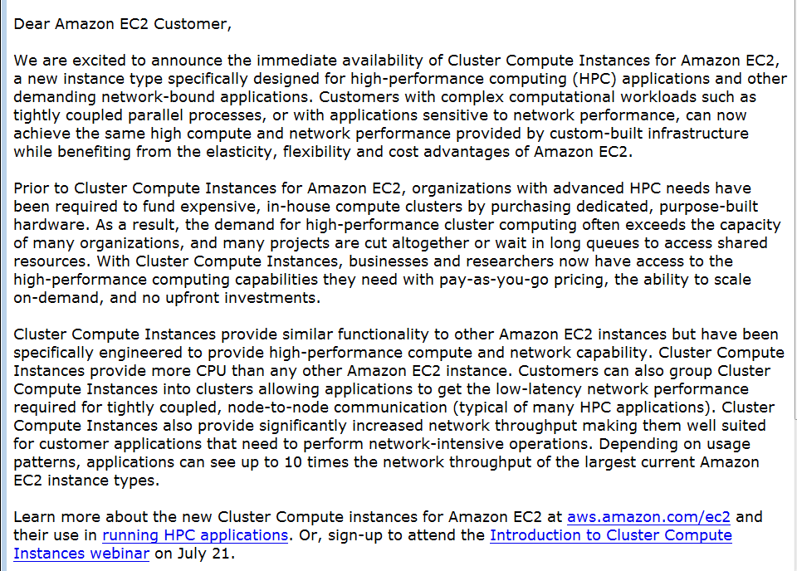
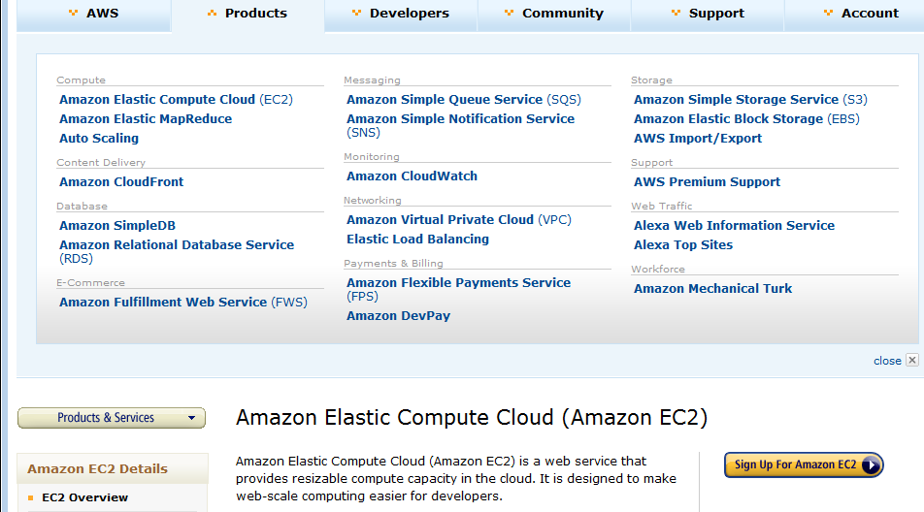
Amazon offers a lot!
The Cluster Compute Instances use hardware-assisted (HVM) virtualization instead of the paravirtualization used by the other instance types and requires booting from EBS, so you will need to create a new AMI in order to use them. We suggest that you use our Centos-based AMI as a base for your own AMIs for optimal performance. See the EC2 User Guide or the EC2 Developer Guide for more information.
The only way to know if this is a genuine HPC setup is to benchmark it, and we've just finished doing so. We ran the gold-standard High Performance Linpack benchmark on 880 Cluster Compute instances (7040 cores) and measured the overall performance at 41.82 TeraFLOPS using Intel's MPI (Message Passing Interface) and MKL (Math Kernel Library) libraries, along with their compiler suite. This result places us at position 146 on the Top500 list of supercomputers. The input file for the benchmark is here and the output file is here.

Slide 11
Philosophy of
Clouds and Grids
Clouds are (by definition) commercially supported approach to large scale computing
  So we should expect Clouds to replace Compute Grids
  Current Grid technology involves “non-commercial” software solutions which are hard to evolve/sustain
  Maybe Clouds ~4% IT expenditure 2008 growing to 14% in 2012 (IDC Estimate)
Public Clouds are broadly accessible resources like Amazon and Microsoft Azure – powerful but not easy to customize and perhaps data trust/privacy issues
Private Clouds run similar software and mechanisms but on “your own computers” (not clear if still elastic)
  Platform features such as Queues, Tables, Databases limited
Services still are correct architecture with either REST (Web 2.0) or Web Services
Clusters are still critical concept

Slide 12
Grids MPI and Clouds
+ and -
Grids are useful for managing distributed systems
  Pioneered service model for Science
  Developed importance of Workflow
  Performance issues – communication latency – intrinsic to distributed systems
  Can never run differential equation based simulations or most datamining in parallel
Clouds can execute any job class that was good for Grids plus
  More attractive due to platform plus elastic on-demand model
  Currently have performance limitations due to poor affinity (locality) for compute-compute (MPI) and Compute-data
  These limitations are not “inevitable” and should gradually improve as in July 13 Amazon Cluster announcement
  Will never be best for most sophisticated differential equation based simulations
Classic Supercomputers (MPI Engines) run communication demanding differential equation based simulations

Slide 13
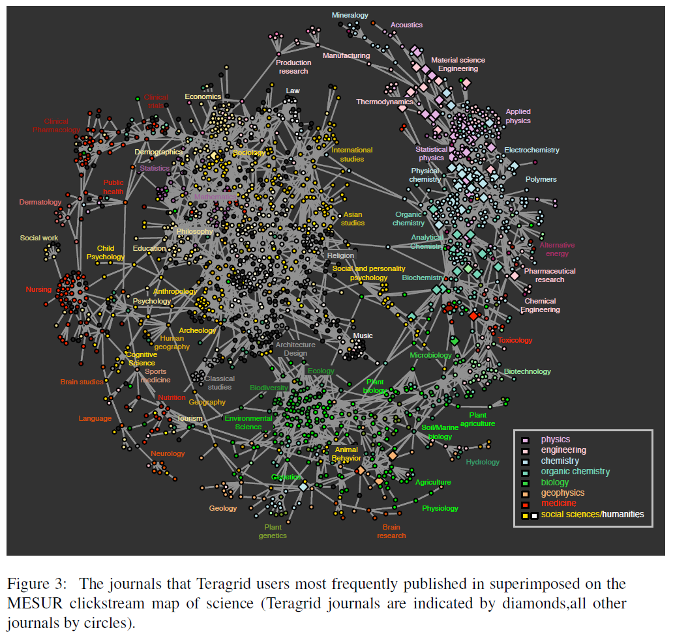
TeraGrid
User Areas

Slide 14
FutureGrid key Concepts I
FutureGrid provides a testbed with a wide variety of computing services to its users
  Supporting users developing new applications and new middleware using Cloud, Grid and Parallel computing (Hypervisors – Xen, KVM, ScaleMP, Linux, Windows, Nimbus, Eucalyptus, Hadoop, Globus, Unicore, MPI, OpenMP …)
  Software supported by FutureGrid or users
  ~5000 dedicated cores distributed across country
The FutureGrid testbed provides to its users:
  A rich development and testing platform for middleware and application users looking at interoperability, functionality and performance
  Each use of FutureGrid is an experiment that is reproducible
  A rich education and teaching platform for advanced cyberinfrastructure classes
  Ability to collaborate with the US industry on research projects

Slide 15
FutureGrid key Concepts II
Cloud infrastructure supports loading of general images on Hypervisors like Xen; FutureGrid dynamically provisions software as needed onto “bare-metal” using Moab/xCAT based environment
Key early user oriented milestones:
  June 2010 Initial users
  October 2010-January 2011 Increasing not so early users allocated by FutureGrid
  October 2011 FutureGrid allocatable via TeraGrid process
To apply for FutureGrid access or get help, go to homepage www.futuregrid.org. Alternatively for help send email to help@futuregrid.org. You should receive an automated reply to email within minutes, and contact clearly from a live human no later than next (U.S.) business day after sending an email message. Please send email to PI gcf@indiana.edu if problems

Slide 16
FutureGrid Partners
Indiana University (Architecture, core software, Support)
  Collaboration between research and infrastructure groups
Purdue University (HTC Hardware)
San Diego Supercomputer Center at University of California San Diego (INCA, Monitoring)
University of Chicago/Argonne National Labs (Nimbus)
University of Florida (ViNE, Education and Outreach)
University of Southern California Information Sciences (Pegasus to manage experiments)
University of Tennessee Knoxville (Benchmarking)
University of Texas at Austin/Texas Advanced Computing Center (Portal)
University of Virginia (OGF, Advisory Board and allocation)
Center for Information Services and GWT-TUD from Technische Universtität Dresden. (VAMPIR)
Red institutions have FutureGrid hardware

Slide 17
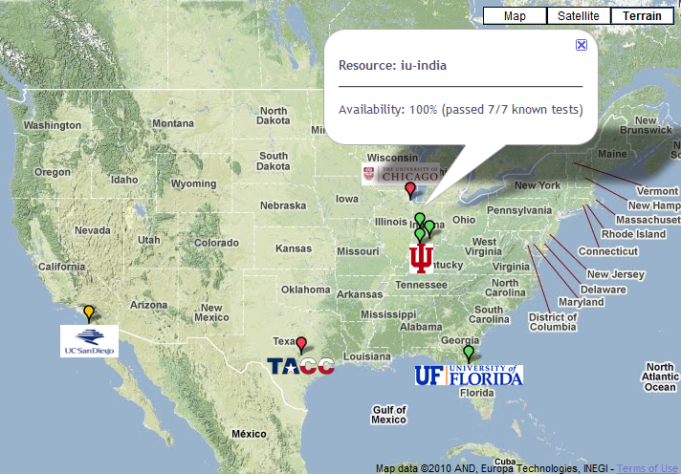

FutureGrid: a Grid/Cloud Testbed
Operational: IU Cray operational; IU , UCSD, UF & UC IBM iDataPlex operational
Network, NID operational
TACC Dell running acceptance tests – ready ~September 1
NID: Network Impairment Device
Private
Public
FG Network

Slide 18
Some Current FutureGrid early uses
Investigate metascheduling approaches on Cray and iDataPlex
Deploy Genesis II and Unicore end points on Cray and iDataPlex clusters
Develop new Nimbus cloud capabilities
Prototype applications (BLAST) across multiple FutureGrid clusters and Grid’5000
Compare Amazon, Azure with FutureGrid hardware running Linux, Linux on Xen or Windows for data intensive applications
Test ScaleMP software shared memory for genome assembly
Develop Genetic algorithms on Hadoop for optimization
Attach power monitoring equipment to iDataPlex nodes to study power use versus use characteristics
Industry (Columbus IN) running CFD codes to study combustion strategies to maximize energy efficiency
Support evaluation needed by XD TIS and TAS services
Investigate performance of Kepler workflow engine
Study scalability of SAGA in difference latency scenarios
Test and evaluate new algorithms for phylogenetics/systematics research in CIPRES portal
Investigate performance overheads of clouds in parallel and distributed environments
Support tutorials and classes in cloud, grid and parallel computing (IU, Florida, LSU)
~12 active/finished users out of ~32 early user applicants

Slide 19
Education on FutureGrid
Build up tutorials on supported software
Support development of curricula requiring privileges and systems destruction capabilities that are hard to grant on conventional TeraGrid
Offer suite of appliances (customized VM based images) supporting online laboratories
Supporting ~200 students in Virtual Summer School on “Big Data” July 26-30 with set of certified images – first offering of FutureGrid 101 Class; TeraGrid ‘10 “Cloud technologies, data-intensive science and the TG”; CloudCom conference tutorials Nov 30-Dec 3 2010
Experimental class use fall semester at Indiana, Florida and LSU

Slide 20


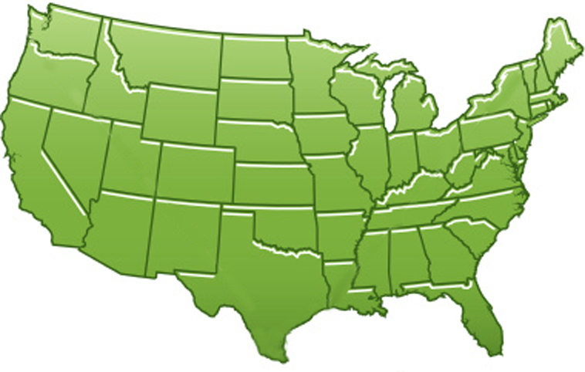















300+ Students learning about Twister & Hadoop
MapReduce technologies, supported by FutureGrid.
July 26-30, 2010 NCSA Summer School Workshop
http://salsahpc.indiana.edu/tutorial
Washington
University
University of
Minnesota
Michigan
State
Johns
Hopkins
Univ.Illinois
at Chicago
Iowa
State
Penn
State
IBM Almaden
Research Center
Notre
Dame
University of
California at
Los Angeles
Indiana
University
San Diego
Supercomputer
Center
University of
Texas at El Paso
University of
Arkansas
University
of Florida

Slide 21

200 papers submitted to main track; 4 days of tutorials

