Slide 1
Looking at Use Case 19, 20 Genomics
1st JTC 1 SGBD Meeting
SDSC San Diego March 19 2014
Judy Qiu
Shantenu Jha (Rutgers)
Geoffrey Fox
gcf@indiana.edu
http://www.infomall.org
School of Informatics and Computing
Digital Science Center
Indiana University Bloomington

Slide 2
We are sort of working on Use Cases with HPC-ABDS
Use Case 10 Internet of Things: Yarn, Storm, ActiveMQ
Use Case 19, 20 Genomics. Hadoop, Iterative MapReduce, MPI, Much better analytics than Mahout
Use Case 26 Deep Learning. High performance distributed GPU (optimized collectives) with Python front end (planned)
Variant of Use Case 26, 27 Image classification using Kmeans: Iterative MapReduce
Use Case 28 Twitter with optimized index for Hbase, Hadoop and Iterative MapReduce
Use Case 30 Network Science. MPI and Giraph for network structure and dynamics (planned)
Use Case 39 Particle Physics. Iterative MapReduce (wrote proposal)
Use Case 43 Radar Image Analysis. Hadoop for multiple individual images moving to Iterative MapReduce for global integration over “all” images
Use Case 44 Radar Images. Running on Amazon

Slide 3
DACIDR for Gene Analysis (Use Case 19,20)
Deterministic Annealing Clustering and Interpolative Dimension Reduction Method (DACIDR)
Use Hadoop for pleasingly parallel applications, and Twister (replacing by Yarn) for iterative MapReduce applications
Sequences – Cluster → Centers
Add Existing data and find Phylogenetic Tree
Pairwise Clustering
All-Pair Sequence Alignment
Streaming
Visualization
Multidimensional Scaling
Simplified Flow Chart of DACIDR

Slide 4
Started Project ~3.5 years ago
http://salsahpc.indiana.edu/millionseq/fungi2/fungi2_index.html
Note we found two subtle errors (in retrospect incorrect parameter/heuristic used at stage of analysis) so computationally intense part of project with many steps ran through two or three times.
Our biology collaborators had never done this type of analysis and this required many discussions at various times
We are about to start a new analysis of new data with a factor of 5 more data.
Looking for a large enough computer! Note many steps taken as lacked computer resources

Slide 5
Comments on Method
Use a mix of O(N²) and O(N) methods to save initial time
100K² < 446K²
Divide full sample into distinct regions for second phase – again to reduce computational intensity
Always visualize results so a lot of “manual workflow”
Visualization finds errors(!) and improves heuristic steps such as hierarchical clustering and center determination
Jobs ran on up to 768 cores with all analytics parallelized
Lots of metadata for intermediate results

Slide 6
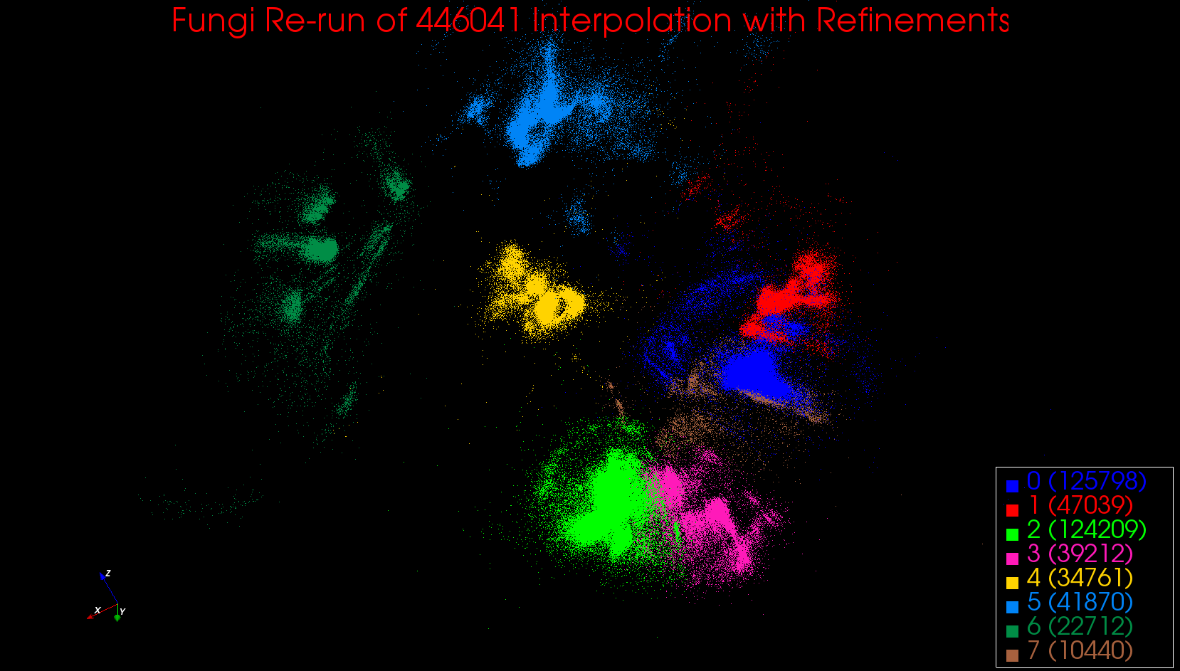
100K with Megaregions

Slide 7
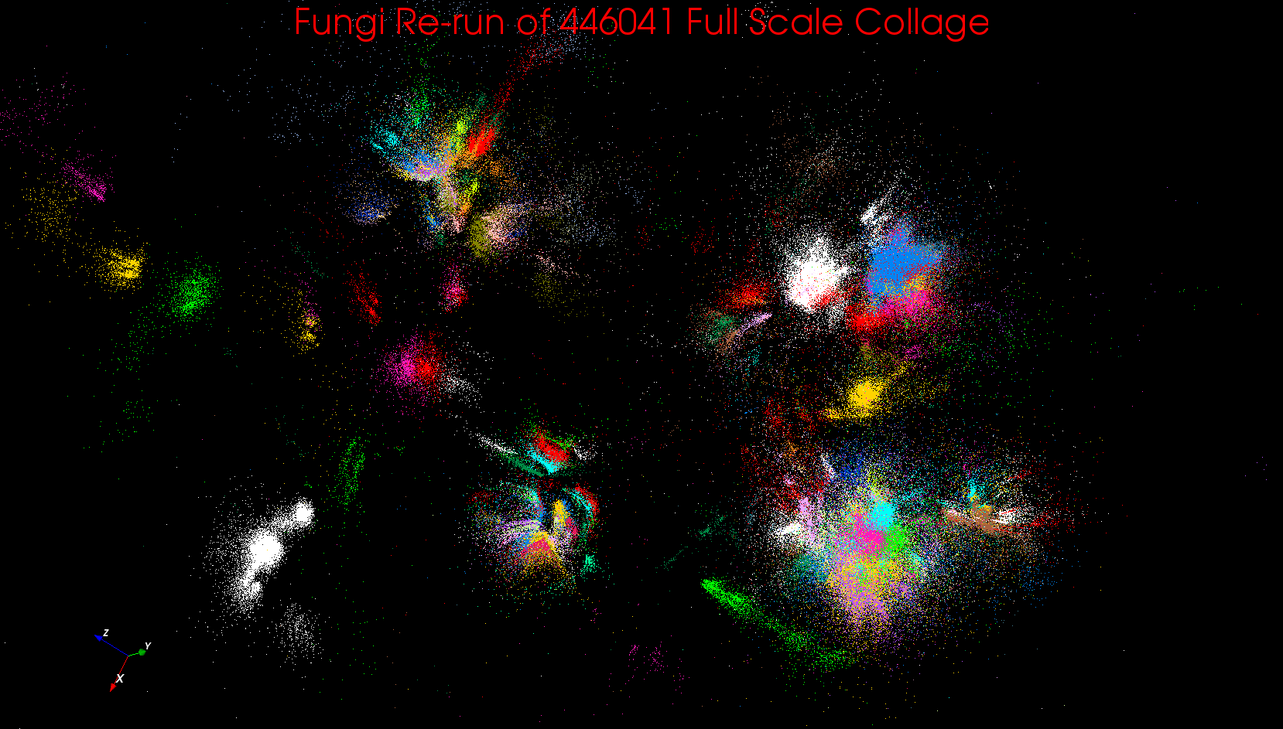
Full 446K Clustered

Slide 8
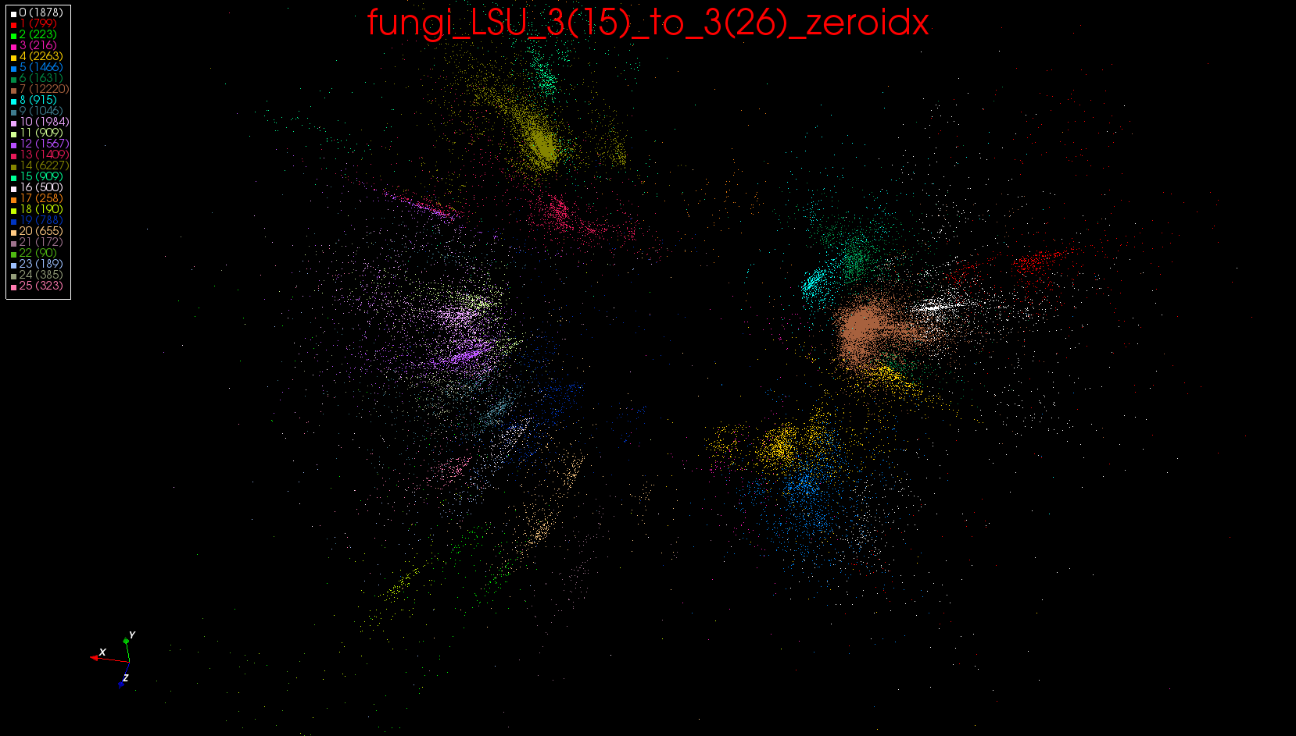
Megaregion 0 126K Sequences

Slide 9
Process (on web page) Part 1
Pick 100K random sample from unique sequences with lengths greater than 200 -- allreads_uniques_gt200_440641_random_100k_0.txt
The remaining is called out-sample sequences
Run pairwise local sequence alignment (Smith-Waterman) on 1.
Run DA(Deterministic Annealing)-SMACOF on 3. O(N²)
Run Deterministic Annealing pairwise clustering on 3.
Produce plot from 4. and 5.
Refine 6. for spatially compact Mega-regions
Assign out-sample sequences in 2. to Mega-regions of 7. based on a nearest neighbour approach O(N)
Extract sequences for each such Mega-region from full unique sequence set

Slide 10
Process (on web page) Part 2
10) For each Mega-region sequence set (mega regions size is from 10K to 125K)
Run pairwise local sequence alignment (Smith-Waterman)
Run DA(Deterministic Annealing)-SMACOF on 10.1
Run MDSasChisq in SMACOF mode on 10.1 with sample points of the region fixed to locations from 4
Run Deterministic Annealing pairwise clustering on 10.1
Produce plot from 10.2 and 10.3
While refinements necessary for 10.5
Extract distances for necessary sub clusters
Run Deterministic Annealing pairwise clustering on 10.5.1
Merge results of 10.5.2 with 10.3
Produce plot from 10.2 and 10.5.3
Go to 10.5
Produce final region specific plot from 10.2 and 10.6
Produce final region specific fixed run plot from 10.3 and 10.6
Classify clusters into three groups (see cluster status) for clusters in 10.7
Find cluster centers for each clean cluster in MDSs of 10.7 and 10.8

Slide 11
Last Step
Take 126 Centers of Clusters.
Combine with existing data and compare using MDS on ~2500 sequences
Biologists choose subset of existing data and refine sequence using Multiple Sequence alignment (which is viable on ~1000 sequences)
Final result is Phylogenetic Tree comparing different methods

Slide 12
Technologies used in analysis
Twister Iterative MapReduce
MPI.NET
Dimension Reduction with Deterministic Annealing SMACOF
Dimension Reduction by χ² (later replaced by a method below)
New WDA-SMACOF outperforming previous methods
Dimension Reduction by Interpolation
Clustering by Deterministic Annealing Pairwise Techniques including center determination
Smith Waterman Gotoh Distance Computation
.NET Bio (formerly Microsoft Biology Foundation)
Phylogram determination
RAxML standard package to find phylogenetic trees

Slide 13
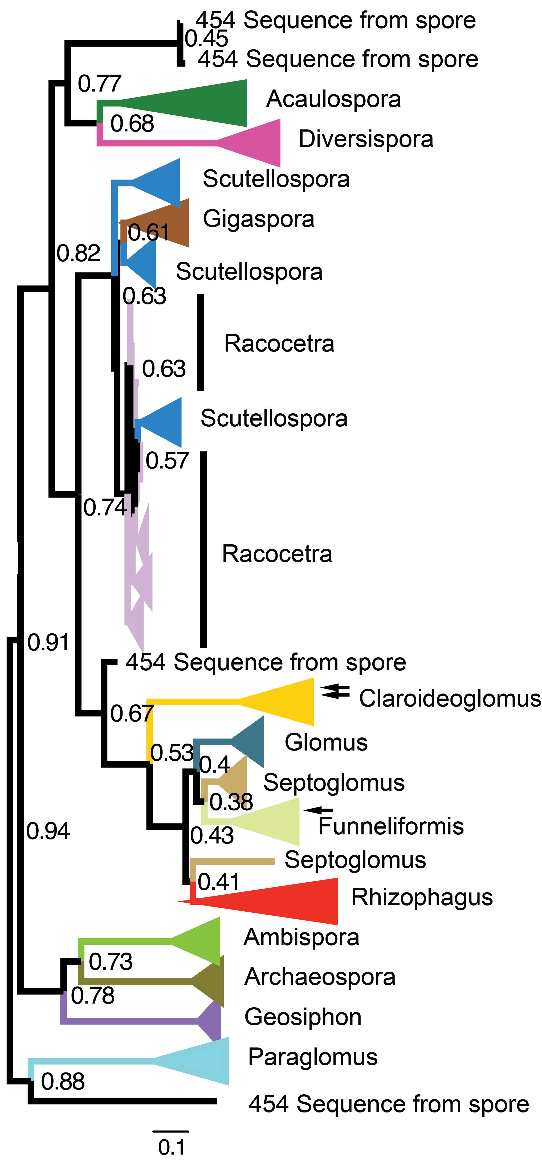
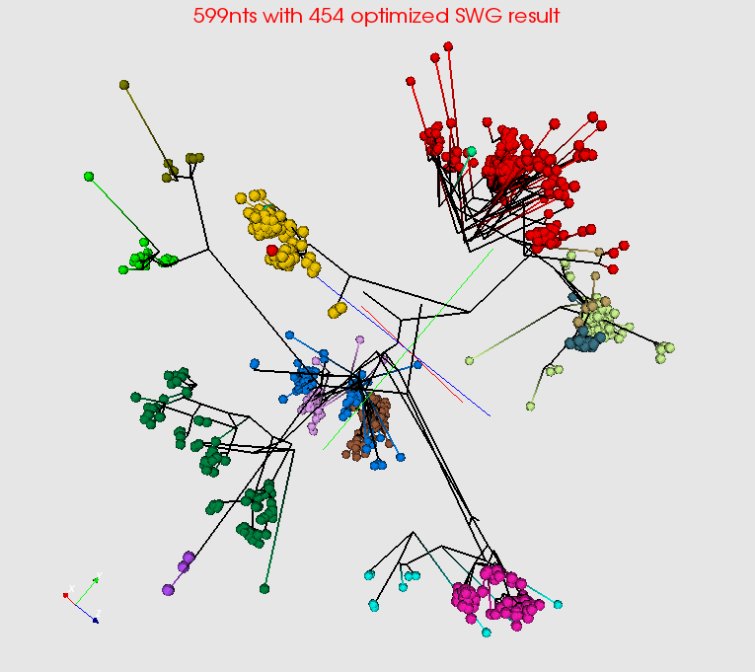
Summarize a million Fungi Sequences Spherical Phylogram Visualization
Spherical Phylogram from new MDS method visualized in PlotViz
RAxML result visualized in FigTree.

Slide 14
Technology Innovations
Better Clustering
Better Center Determination
New 3D Phylograms
Better MDS

