Slide 1
The State of Big Data: Use Cases and the Ogre patterns
NIST Big Data Public Working Group
IEEE Big Data Workshop
October 27, 2014
Geoffrey Fox, Digital Science Center, Indiana University, gcf@Indiana.edu

Slide 2
Requirements and Use Case Subgroup
The focus is to form a community of interest from industry, academia, and government, with the goal of developing a consensus list of Big Data requirements across all stakeholders. This includes gathering and understanding various use cases from diversified application domains.
Tasks
Gather use case input from all stakeholders 51
Get Big Data requirements from use cases. (35 General; 437 Specific)
Analyze/prioritize a list of challenging general requirements that may delay or prevent adoption of Big Data deployment
Work with Reference Architecture to validate requirements and reference architecture
Develop a set of general patterns capturing the “essence” of use cases (Agreed plan at September 30, 2013. Became the Ogres)

Slide 3

Use Case Template
26 fields completed for 51 areas
Government Operation: 4
Commercial: 8
Defense: 3
Healthcare and Life Sciences: 10
Deep Learning and Social Media: 6
The Ecosystem for Research: 4
Astronomy and Physics: 5
Earth, Environmental and Polar Science: 10
Energy: 1

Slide 4
51 Detailed Use Cases: Contributed July-September 2013
http://bigdatawg.nist.gov/usecases.php, 26 Features for each use case
Government Operation(4): National Archives and Records Administration, Census Bureau
Commercial(8): Finance in Cloud, Cloud Backup, Mendeley (Citations), Netflix, Web Search, Digital Materials, Cargo shipping (as in UPS)
Defense(3): Sensors, Image surveillance, Situation Assessment
Healthcare and Life Sciences(10): Medical records, Graph and Probabilistic analysis, Pathology, Bioimaging, Genomics, Epidemiology, People Activity models, Biodiversity
Deep Learning and Social Media(6): Driving Car, Geolocate images/cameras, Twitter, Crowd Sourcing, Network Science, NIST benchmark datasets
The Ecosystem for Research(4): Metadata, Collaboration, Translation, Light source data
Astronomy and Physics(5): Sky Surveys including comparison to simulation, Large Hadron Collider at CERN, Belle II Accelerator in Japan
Earth, Environmental and Polar Science(10): Radar Scattering in Atmosphere, Earthquake, Ocean, Earth Observation, Ice sheet Radar scattering, Earth radar mapping, Climate simulation datasets, Atmospheric turbulence identification, Subsurface Biogeochemistry (microbes to watersheds), AmeriFlux and FLUXNET gas sensors
Energy(1): Smart grid

Slide 5
Patterns (Ogres) modelled on 13 Berkeley Dwarfs
Dense Linear Algebra
Sparse Linear Algebra
Spectral Methods
N-Body Methods
Structured Grids
Unstructured Grids
MapReduce
Combinational Logic
Graph Traversal
Dynamic Programming
Backtrack and Branch-and-Bound
Graphical Models
Finite State Machines
The Berkeley dwarfs and NAS Parallel Benchmarks are perhaps two best known approaches to characterizing Parallel Computing Uses Cases / Kernels / Patterns
Note dwarfs somewhat inconsistent as for example MapReduce is a programming model and spectral method is a numerical method.
No single comparison criterion and so need multiple facets!

Slide 6
7 Computational Giants of NRC Massive Data Analysis Report
G1: Basic Statistics (termed MRStat later as suitable for simple MapReduce implementation)
G2: Generalized N-Body Problems
G3: Graph-Theoretic Computations
G4: Linear Algebraic Computations
G5: Optimizations e.g. Linear Programming
G6: Integration (Called GML Global Machine Learning Later)
G7: Alignment Problems e.g. BLAST

Slide 7
Features of 51 Use Cases I
PP (26) “All” Pleasingly Parallel or Map Only
MR (18) Classic MapReduce MR (add MRStat below for full count)
MRStat (7) Simple version of MR where key computations are simple reduction as found in statistical averages such as histograms and averages
MRIter (23) Iterative MapReduce or MPI (Spark, Twister)
Graph (9) Complex graph data structure needed in analysis
Fusion (11) Integrate diverse data to aid discovery/decision making; could involve sophisticated algorithms or could just be a portal
Streaming (41) data comes in incrementally and is processed this way
Classify (30) Classification: divide data into categories
S/Q (12) Index, Search and Query

Slide 8
Features of 51 Use Cases II
CF (4) Collaborative Filtering for recommender engines
LML (36) Local Machine Learning (Independent for each parallel entity) – application could have GML as well
GML (23) Global Machine Learning: Deep Learning, Clustering, LDA, PLSI, MDS,
  Large Scale Optimizations as in Variational Bayes, MCMC, Lifted Belief Propagation, Stochastic Gradient Descent, L-BFGS, Levenberg-Marquardt . Can call EGO or Exascale Global Optimization with scalable parallel algorithm
Workflow (51) Universal
GIS (16) Geotagged data and often displayed in ESRI, Microsoft Virtual Earth, Google Earth, GeoServer etc.
HPC (5) Classic large-scale simulation of cosmos, materials, etc. generating (visualization) data
Agent (2) Simulations of models of data-defined macroscopic entities represented as agents

Slide 9
First set of Ogre Facets
Facets I: The features just discussed (PP, MR, MRStat, MRIter, Graph, Fusion, Streaming (DDDAS), Classify, S/Q, CF, LML, GML, Workflow, GIS, HPC, Agents)
Facets II: Some broad features familiar from past like
BSP (Bulk Synchronous Processing) or not?
SPMD (Single Program Multiple Data) or not?
Iterative or not?
Regular or Irregular?
Static or dynamic?,
communication/compute and I-O/compute ratios
Data abstraction (array, key-value, pixels, graph…)

Slide 10
Data Processing Facet: Illustrated by Typical Science Case

Slide 11
Core Analytics Facet I
Map-Only
  Pleasingly parallel - Local Machine Learning
MapReduce: Search/Query/Index
  Summarizing statistics as in LHC Data analysis (histograms) (G1)
  Recommender Systems (Collaborative Filtering)
  Linear Classifiers (Bayes, Random Forests)
Alignment and Streaming (G7)
  Genomic Alignment, Incremental Classifiers
Global Analytics: Nonlinear Solvers (structure depends on objective function) (G5,G6)
  Stochastic Gradient Descent SGD and approximations to Newton’s Method
  Levenberg-Marquardt solver

Slide 12
Core Analytics Facet II
Global Analytics: Map-Collective (See Mahout, MLlib) (G2,G4,G6)
  Often use matrix-matrix,-vector operations, solvers (conjugate gradient)
  Clustering (many methods), Mixture Models, LDA (Latent Dirichlet Allocation), PLSI (Probabilistic Latent Semantic Indexing)
  SVM and Logistic Regression
  Outlier Detection (several approaches)
  PageRank, (find leading eigenvector of sparse matrix)
  SVD (Singular Value Decomposition)
  MDS (Multidimensional Scaling)
  Learning Neural Networks (Deep Learning)
  Hidden Markov Models
Graph Analytics (G3)
  Structure and Simulation (Communities, subgraphs/motifs, diameter, maximal cliques, connected components, Betweenness centrality, shortest path)
Linear/Quadratic Programming, Combinatorial Optimization, Branch and Bound (G5)

Slide 13
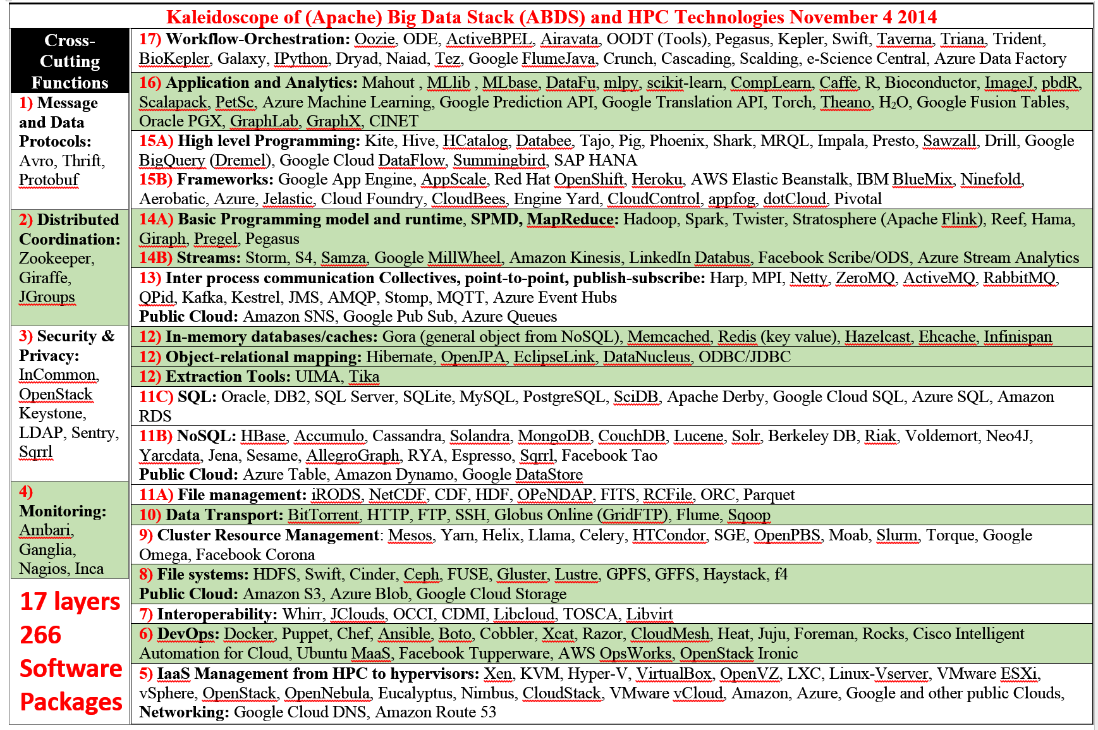
Map Use cases to HPC-ABDS Software Model

