Slide 1
NIST Big Data Public Working Group NBD-PWG
Based on September 30, 2013 Presentations at one day workshop at NIST
Leaders of activity
Wo Chang, NIST (Should present but shut down)
Robert Marcus, ET-Strategies
Chaitanya Baru, UC San Diego
Note web site http://bigdatawg.nist.gov/ is shut down and I relied on incomplete documentation (Geoffrey Fox)

Slide 2
NBD-PWG Charter
Launch Date: June 26, 2013; Public Meeting with interim deliverables: September, 30, 2013; Edit and send out for comment Nov-Dec 2013
The focus of the (NBD-PWG) is to form a community of interest from industry, academia, and government, with the goal of developing a consensus definitions, taxonomies, secure reference architectures, and technology roadmap. The aim is to create vendor-neutral, technology and infrastructure agnostic deliverables to enable big data stakeholders to pick-and-choose best analytics tools for their processing and visualization requirements on the most suitable computing platforms and clusters while allowing value-added from big data service providers and flow of data between the stakeholders in a cohesive and secure manner.
Note identify common/best practice; includes but not limited to discussing standards (S in NIST)

Slide 3
NBD-PWG Subgroups & Co-Chairs
Requirements and Use Cases SG
Geoffrey Fox, Indiana U.; Joe Paiva, VA; Tsegereda Beyene, Cisco
Definitions and Taxonomies SG
Nancy Grady, SAIC; Natasha Balac, SDSC; Eugene Luster, R2AD
Reference Architecture SG
Orit Levin, Microsoft; James Ketner, AT&T; Don Krapohl, Augmented Intelligence
Security and Privacy SG
Arnab Roy, CSA/Fujitsu Nancy Landreville, U. MD Akhil Manchanda, GE
Technology Roadmap SG
Carl Buffington, Vistronix; Dan McClary, Oracle; David Boyd, Data Tactic

Slide 4
Requirements and Use Case Subgroup
The focus is to form a community of interest from industry, academia, and government, with the goal of developing a consensus list of Big Data requirements across all stakeholders. This includes gathering and understanding various use cases from diversified application domains.
Tasks
Gather use case input from all stakeholders
Derive Big Data requirements from each use case.
Analyze/prioritize a list of challenging general requirements that may delay or prevent adoption of Big Data deployment
Work with Reference Architecture to validate requirements and reference architecture
Develop a set of general patterns capturing the “essence” of use cases (to do)

Slide 5
Use Case Template
26 fields completed for 51 areas
Government Operation: 4
Commercial: 8
Defense: 3
Healthcare and Life Sciences: 10
Deep Learning and Social Media: 6
The Ecosystem for Research: 4
Astronomy and Physics: 5
Earth, Environmental and Polar Science: 10
Energy: 1

Slide 6
51 Detailed Use Cases: Many TB’s to Many PB’s
Government Operation: National Archives and Records Administration, Census Bureau
Commercial: Finance in Cloud, Cloud Backup, Mendeley (Citations), Netflix, Web Search, Digital Materials, Cargo shipping (as in UPS)
Defense: Sensors, Image surveillance, Situation Assessment
Healthcare and Life Sciences: Medical records, Graph and Probabilistic analysis, Pathology, Bioimaging, Genomics, Epidemiology, People Activity models, Biodiversity
Deep Learning and Social Media: Driving Car, Geolocate images, Twitter, Crowd Sourcing, Network Science, NIST benchmark datasets
The Ecosystem for Research: Metadata, Collaboration, Language Translation, Light source experiments
Astronomy and Physics: Sky Surveys compared to simulation, Large Hadron Collider at CERN, Belle Accelerator II in Japan
Earth, Environmental and Polar Science: Radar Scattering in Atmosphere, Earthquake, Ocean, Earth Observation, Ice sheet Radar scattering, Earth radar mapping, Climate simulation datasets, Atmospheric turbulence identification, Subsurface Biogeochemistry (microbes to watersheds), AmeriFlux and FLUXNET gas sensors
Energy: Smart grid
Next step involves matching extracted requirements and reference architecture
Alternatively develop a set of general patterns capturing the “essence” of use cases

Slide 7
Definitions and Taxonomies Subgroup
The focus is to gain a better understanding of the principles of Big Data. It is important to develop a consensus-based common language and vocabulary terms used in Big Data across stakeholders from industry, academia, and government. In addition, it is also critical to identify essential actors with roles and responsibility, and subdivide them into components and sub-components on how they interact/ relate with each other according to their similarities and differences.
Tasks
For Definitions: Compile terms used from all stakeholders regarding the meaning of Big Data from various standard bodies, domain applications, and diversified operational environments.
For Taxonomies: Identify key actors with their roles and responsibilities from all stakeholders, categorize them into components and subcomponents based on their similarities and differences

Slide 8
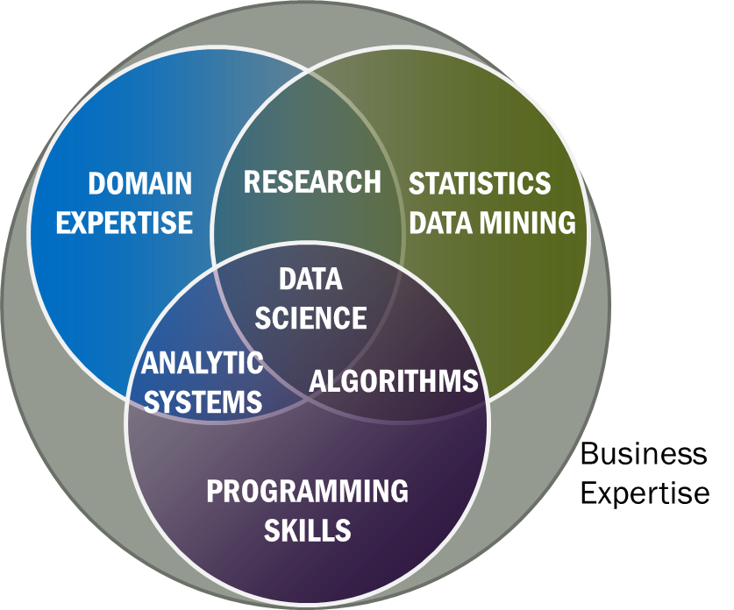
Data Science Definition (Big Data less consensus)
Data Science is the extraction of actionable knowledge directly from data through a process of discovery, hypothesis, and analytical hypothesis analysis.
A Data Scientist is a practitioner who has sufficient knowledge of the overlapping regimes of expertise in business needs, domain knowledge, analytical skills and programming expertise to manage the end-to-end scientific method process through each stage in the big data lifecycle.
Big Data refers to digital data volume, velocity and/or variety whose management requires scalability across coupled horizontal resources
Notes:
Big Data refers to digital data volume, velocity and/or variety whose management requires scalability across coupled horizontal resources
Data Science is the extraction of actionable knowledge directly from data through a process of discovery, hypothesis, and analytical hypothesis analysis.
A Data Scientist is a practitioner who has sufficient knowledge of the overlapping regimes of expertise in business needs, domain knowledge, analytical skills and programming expertise to manage the end-to-end scientific method process through each stage in the big data lifecycle.

Slide 9
Reference Architecture Subgroup
The focus is to form a community of interest from industry, academia, and government, with the goal of developing a consensus-based approach to orchestrate vendor-neutral, technology and infrastructure agnostic for analytics tools and computing environments. The goal is to enable Big Data stakeholders to pick-and-choose technology-agnostic analytics tools for processing and visualization in any computing platform and cluster while allowing value-added from Big Data service providers and the flow of the data between the stakeholders in a cohesive and secure manner.
Tasks
Gather and study available Big Data architectures representing various stakeholders, different data types,’ use cases, and document the architectures using the Big Data taxonomies model based upon the identified actors with their roles and responsibilities.
Ensure that the developed Big Data reference architecture and the Security and Privacy Reference Architecture correspond and complement each other.

Slide 10
List Of Surveyed Architectures
Vendor-neutral and technology-agnostic proposals
Bob Marcus ET-Strategies
Orit Levin Microsoft
Gary Mazzaferro AlloyCloud
Yuri Demchenko University of Amsterdam
Vendors’ Architectures
IBM
Oracle
Booz Allen Hamilton
EMC
SAP
9sight
LexusNexis

Slide 11
INFORMATION VALUE CHAIN
System Orchestrator
Big Data Application Provider
Analytics
Data Provider
Curation
Visualization
Data Consumer
DATA
DATA
SW
Collection
Access
SW
DATA
SW
Big Data Framework Provider
Processing Frameworks (analytic tools, etc.)
IT VALUE CHAIN
Horizontally Scalable
Vertically Scalable
Security & Privacy
Platforms (databases, etc.)
Management
Horizontally Scalable
Vertically Scalable
Infrastructures
Horizontally Scalable (VM clusters)
Vertically Scalable
Physical and Virtual Resources (networking, computing, etc.)

Slide 12
Security and Privacy Subgroup
The focus is to form a community of interest from industry, academia, and government, with the goal of developing a consensus secure reference architecture to handle security and privacy issues across all stakeholders. This includes gaining an understanding of what standards are available or under development, as well as identifies which key organizations are working on these standards.
Tasks
Gather input from all stakeholders regarding security and privacy concerns in Big Data processing, storage, and services.
Analyze/prioritize a list of challenging security and privacy requirements from ~10 special use cases that may delay or prevent adoption of Big Data deployment
Develop a Security and Privacy Reference Architecture that supplements the general Big Data Reference Architecture

Slide 13
CSA (Cloud Security Alliance) BDWG: Top Ten Big Data Security and Privacy Challenges
Secure computations in distributed programming frameworks
Security best practices for non-relational datastores
Secure data storage and transactions logs
End-point input validation/filtering
Real time security monitoring
Scalable and composable privacy-preserving data mining and analytics
Cryptographically enforced access control and secure communication
Granular access control
Granular audits
Data provenance

Slide 14
Top 10 S&P Challenges: Classification
Infrastructure security
Secure Computations in Distributed Programming Frameworks
Security Best Practices for Non-Relational Data Stores
Data Privacy
Privacy Preserving Data Mining and Analytics
Cryptographically Enforced Data Centric Security
Granular Access Control
Data Management
Secure Data Storage and Transaction Logs
Granular Audits
Data Provenance
Integrity and Reactive Security
End-point validation and filtering
Real time Security Monitoring

Slide 15
Use Cases
Retail/Marketing
Modern Day Consumerism
Nielsen Homescan
Web Traffic Analysis
Healthcare
Health Information Exchange
Genetic Privacy
Pharma Clinical Trial Data Sharing
Cyber-security
Government
Military
Education

Slide 16
Technology Roadmap Subgroup
The focus is to form a community of interest from industry, academia, and government, with the goal of developing a consensus vision with recommendations on how Big Data should move forward by performing a good gap analysis through the materials gathered from all other NBD subgroups. This includes setting standardization and adoption priorities through an understanding of what standards are available or under development as part of the recommendations.
Tasks
Gather input from NBD subgroups and study the taxonomies for the actors’ roles and responsibility, use cases and requirements, and secure reference architecture.
Gain understanding of what standards are available or under development for Big Data
Perform a thorough gap analysis and document the findings
Identify what possible barriers may delay or prevent adoption of Big Data
Document vision and recommendations

Slide 17
Some Identified Features
Feature | Roles | Readiness | Ref Architecture Mapping
Storage Framework | TBD | TBD | Capabilities
Processing Framework | TBD | TBD | Capabilities
Resource Managers Framework | TBD | TBD | Capabilities
Infrastructure Framework | TBD | TBD | Capabilities
Information Framework | TBD | TBD | Data Services
Standards Integration Framework | TBD | TBD | Data Services
Applications Framework | TBD | TBD | Capabilities
Business Operations | TBD | TBD | Vertical Orchestrator
09.30.2013
Technology Roadmap

Slide 18
Interaction Between Subgroups
Requirements & Use Cases
❶
Reference Architecture
Technology Roadmap
❸
❷
Security & Privacy
❶
❷
❷
Definitions & Taxonomies
Due to time constraints, activities were carried out in parallel.

