Slide 1
OAuth Security for Gateways
Zhenhua (Gerald) Guo and Marlon Pierce
Indiana University

Slide 2
OAuth and Gateways
OAuth is a security protocol for Web applications.
Security for REST and XML-RPC services.
Three-legged OAuth
  Human-application-application security
  Security flaw, currently being revised
  http://oauth.net/advisories/2009-1
Two-legged OAuth
  Application-to-application security with no human interactions.

Slide 3
OAuth in the Wild
Provider | Description
Twitter | Twitter allows you to access private data through OAuth as an alternative to standard HTTP Authentication
Google | 2-legged OAuth is used by Open Social’s REST/RPC API. Allows gadgets in different containers to exchange data (Orkut <--> LinkedIn, for example).
Ma.gnolia | Social bookmarking service, now defunct. OAuth was co-developed by these guys.
Flickr | Password protected services can be accessed via OAuth instead.
Drupal | Used for Drupal-to-Drupal interoperability

Slide 4
Delegation through Authentication
User: this is the human
Service Provider: a Web service that provides access to the User’s data.
Consumer: a Web application needing access to the User’s data on the Service Provider
The basic idea is that the User delegates authority to the Consumer to access his/her personal data on the Service Provider.

Slide 5
Parameter Name | Description
oauth_consumer_key | Consumer uses this to prove identity to the Server.
oauth_token | Request and access tokens (optional).
oauth_signature_method | Method (like HMAC-SHA1) used to sign the request.
oauth_signature | Contains a hash or signing of the request parameters using the consumer’s private key or a shared secret.
oauth_timestamp | The time of the invocation.
oauth_nonce | A random string that allows the service provider to verify that the invocation is unique to stop replay attacks.
oauth_version | The protocol version number.
You can send these in HTTP Authorization Headers, in HTTP POST, or in HTTP GET

Slide 6
OAuth REST Example URL
http://sandbox.orkut.com/social/rest/people/08354253340777199997/@self
?oauth_consumer_key=orkut.com%3A623061448914
&oauth_nonce=1231537930162003000
&oauth_timestamp=1231537930
&oauth_signature=0h%2FU49KtBplnmnc%2BhDKsDxFPR9%3D
&oauth_signature_method=HMACSHA1
&oauth_token=
&xoauth_requestor_id=03067092798963641994&oauth_version=1.0
That is, the API is all about generating, invoking, and managing the response of the above URL.
The example is taken from two-legged OAuth. The optional token parameter is blank.

Slide 7
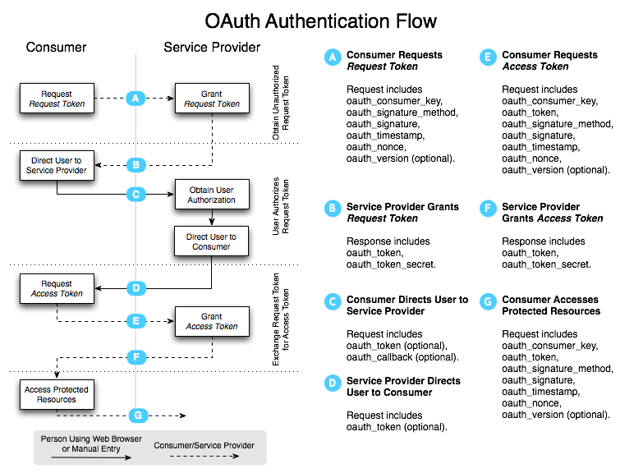
3-Legged, from http://oauth.net/core/1.0/

Slide 8
Getting Tutorial Examples

Slide 9
Tutorial Example Code
We provide example Consumer and Service Provider codes.
  In Java
The Consumer example can also work with third party applications (Twitter).
The Service Provider example supports both 2- and 3-legged OAuth.

Slide 10
Building the Examples
Check out from OGCE SourceForge SVN
  svn checkout https://ogce.svn.sourceforge.net/svnroot/ogce/incubator/OGCE-OAuth
Build with Apache Maven 2
  cd OGCE-Oauth
  mvn clean install
Fire up the server:
  ./portal_deploy/apache-tomcat-5.5.20/bin/startup.sh

Slide 11
Creating a Public/Private Key Pair
You’ll need a key pair for the Service Provider demo.
  Openssl tools won’t work with Java very easily.
  Use Java’s keytool instead.
Use something like this:
  keytool -genkey -keyalg RSA -keysize 1024 -alias oauth-demo -dname "cn=156-56-104-143.dhcp-bl.indiana.edu, ou=OGCE, o=OAuth, c=US”
  The “cn” value must be the DN of your server.
Next export the public key.
  keytool -alias oauth-demo-rsa -export -rfc -file mycert.pem
Finally export the private key with the convenient code (keytool won’t do this).
  java ExportPrivateKey $HOME/.keystore JKS changeit oauth-demo-rsa mykey.pem

Slide 12
A Quick FAQ
Can I use this code?
  Yes, feel free. But give us credit.
What do I need for my development environment?
  Computer with Java 1.5 or greater and a real domain name/IP.
Can I use http://localhost:8080 in my URLs?
  No, you need to use your computers’s full DN for both the consumer and server pieces.
Is there extensive, professionally written documentation with artistically appealing pictures somewhere?
  Not yet.

Slide 13
Using Demo OAuth Consumer with Twitter

Slide 14
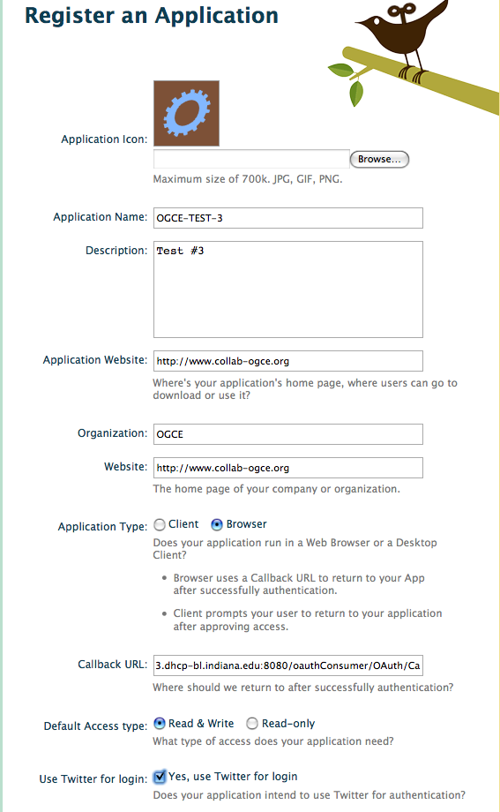
Provide some descriptive metadata about yourself
Callback URL should point to your callback service. It must be a DN (not IP). For example:
http://your.service/oauthConsumer/Oauth/Callback

Slide 15
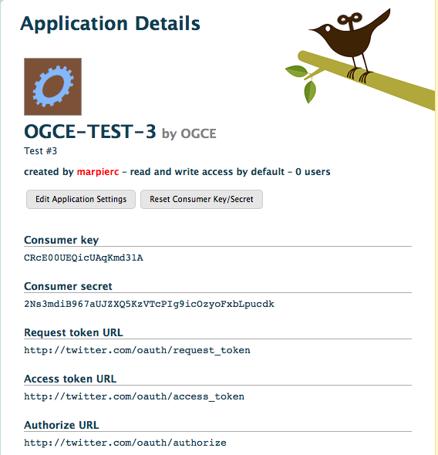
You’ll need this to use the Twitter service from the Consumer interface.
Note you should not normally put secret keys in power point slides. This one has been disabled.

Slide 16
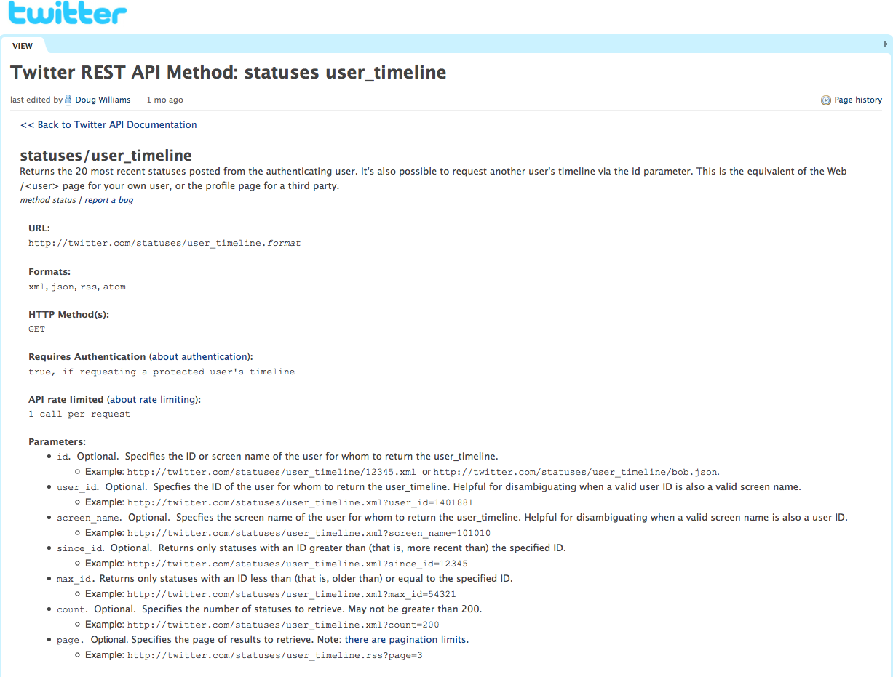
This is one example service. See more at
http://apiwiki.twitter.com/Twitter-API-Documentation

Slide 17
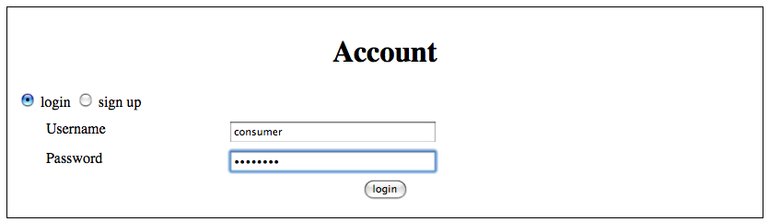
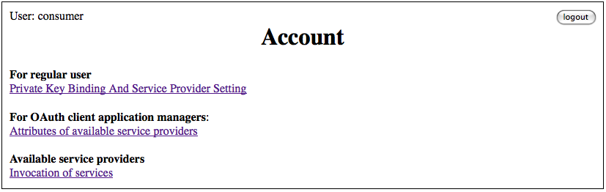
Log in to the Consumer interface to get to the Account management interface

Slide 18
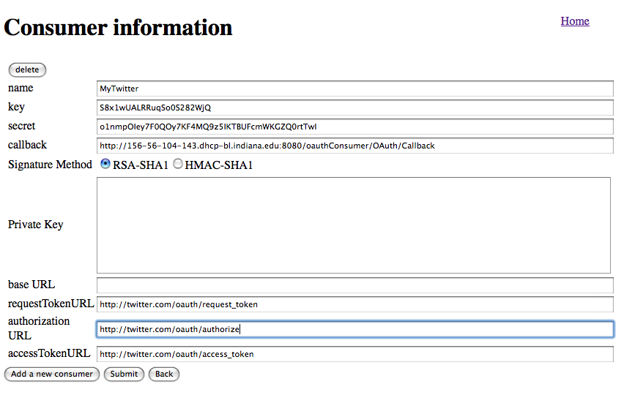
Add a consumer. The key, secret, and URLs all come from Twitter’s “Application Details” page.

Slide 19
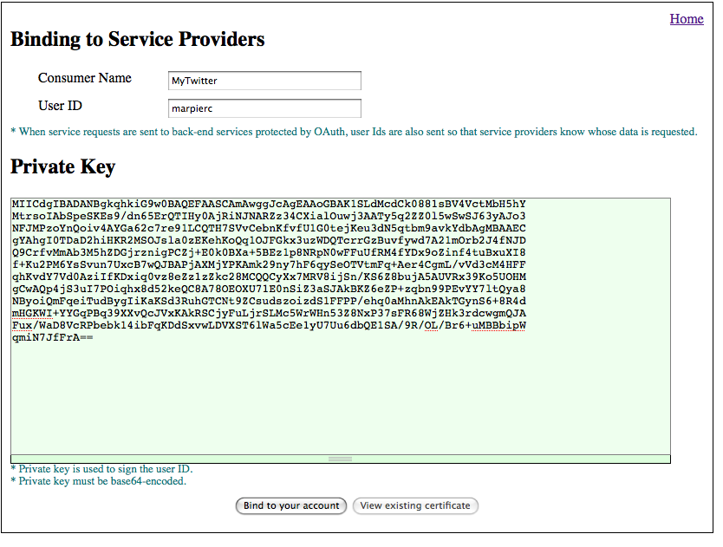
Bind a private key to your account on the consumer. This is a demo implementation detail.

Slide 20
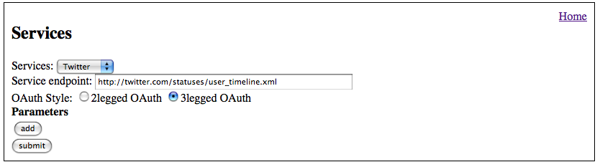
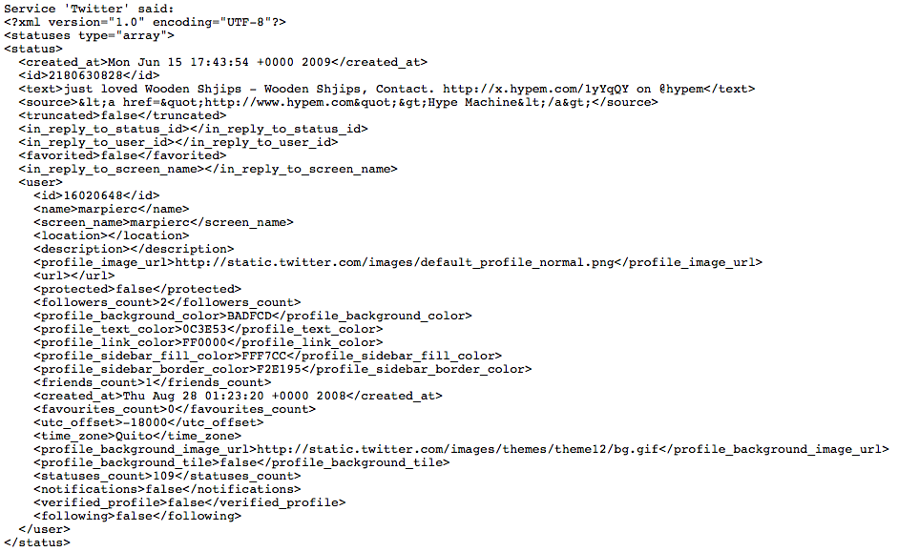
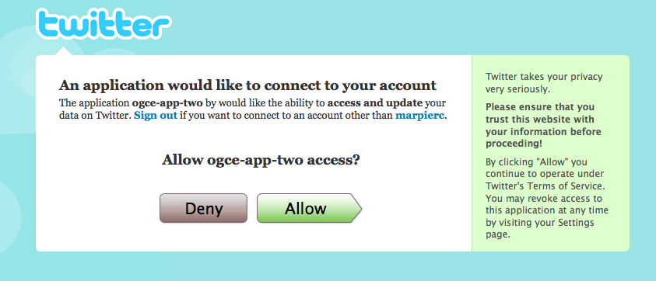
Redirected for authorization
Retrieve illegible XML.

Slide 21
Using the Service Provider Interface

Slide 22
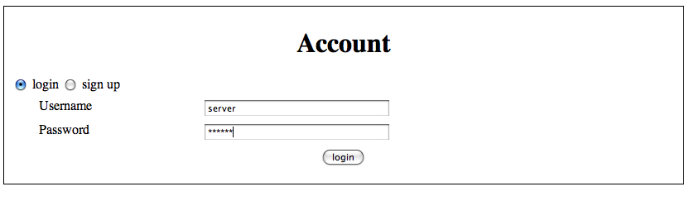
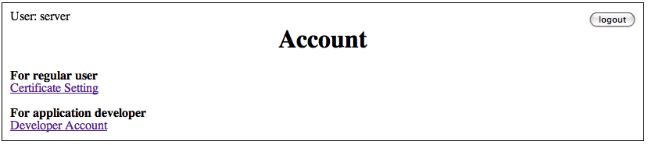
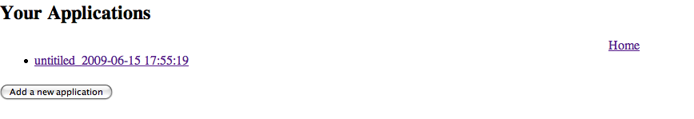
Log in to the server.
Choose “Developer Account”
Add or edit an existing application

Slide 23
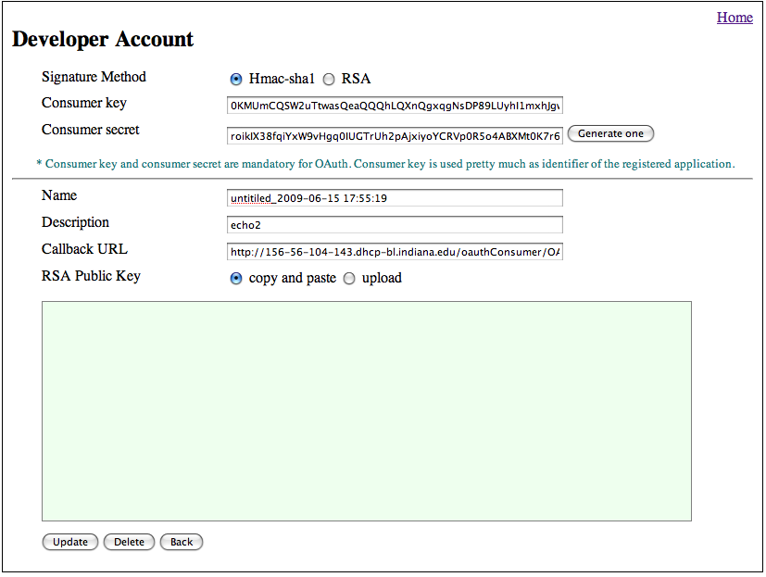
Register a service. This is equivalent to the Twitter registration process.

Slide 24
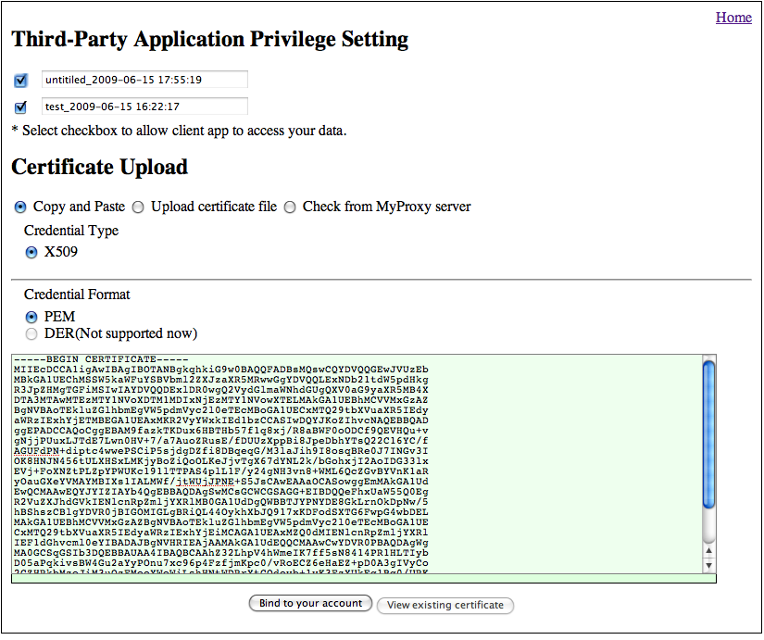
Set privileges for a given user.

Slide 25
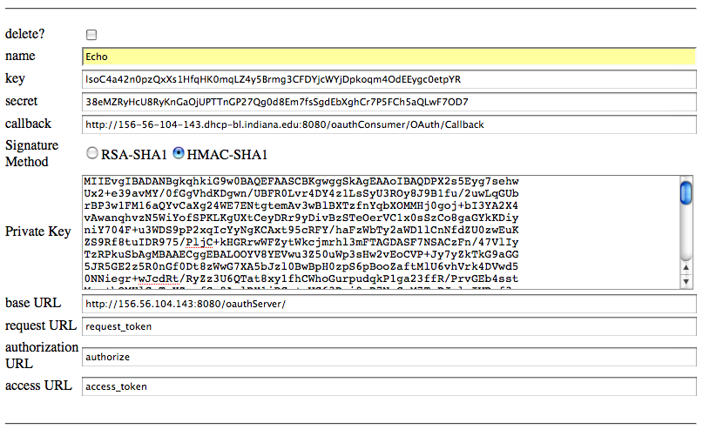
As Consumer, now add the Echo Service. We did the same thing earlier for Twitter service.

Slide 26
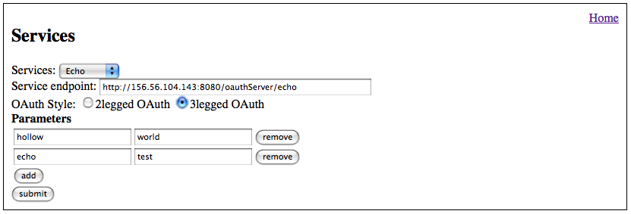
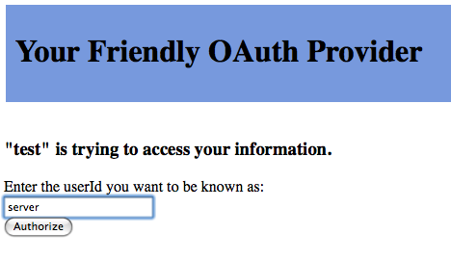

Invoke the service from the client,
Authorize the client,
Gaze upon the output.

