Slide 1
OGCE Components for Enhancing UltraScan Job Management.
Suresh Marru,Raminder Singh, Marlon Pierce

Slide 2
OGCE Tools for Science Workflows
We will go through the steps to use OGCE tools to wrap, register, and run real TeraGrid applications (Gaussian, CHARMM) as a workflow using OGCE tools. Packaged, downloadable software.

Slide 3
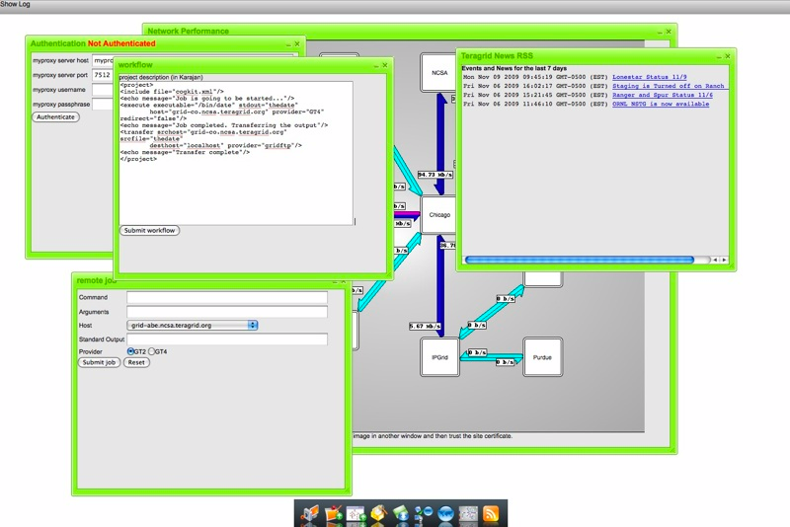
OGCE’s Cyberaide JavaScript provides a Grid abstraction layer for developing mashups and gadgets. Downloadable, packaged software.

Slide 4
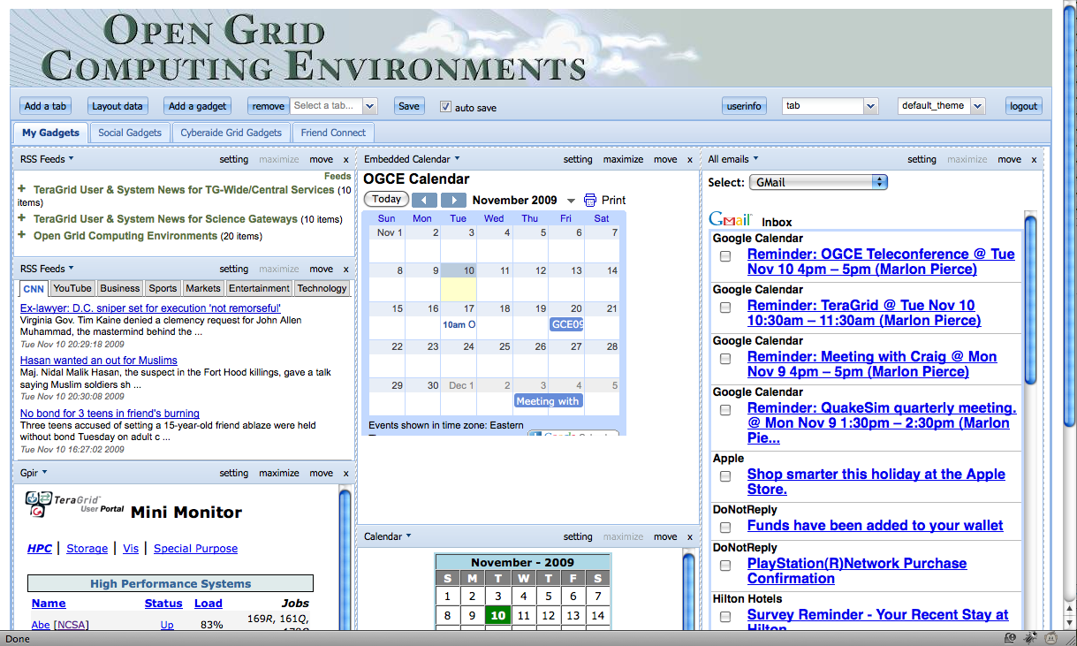
The OGCE Gadget Container allows you to build portals out of public and private Google Open Social gadgets. Supports HTTPS. Downloadable, packaged software.

Slide 5
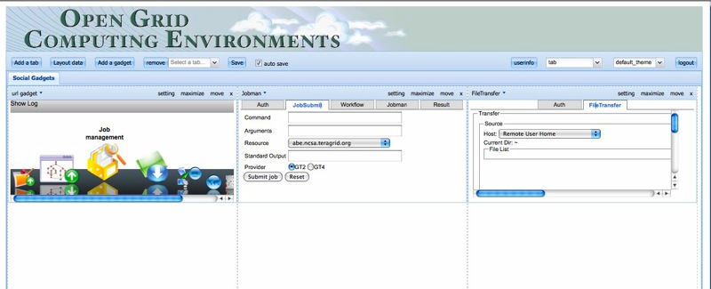
OGCE Grid Mash Up Tools and Gadgets
You can also build secure gadgets for accessing TeraGrid resources using Cyberaide and deploy them into the OGCE Gadget Container.

Slide 6
User Interactions
Web Portal
XBaya GUI
Other Clients
XBaya Core
Event Bus
Middleware Services
Workflow Engine (ODE)
Dynamic Service Creator
XRegistry
Generic Service Factory
Transient Application Services
XMCCat Metadata Catalog
Compute & Data Resources
Computational Cloud
Computational Grids
Local Lab Resources
OGCE Gateway Stack

Slide 7
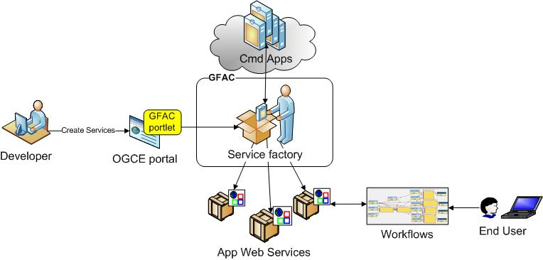
Generic Application Service Factory

Slide 8
Workflow Architecture

Slide 9
More Information
Web Site and Contact Information
http://www.collab-ogce.org
RSS News Feed and blog
http://collab-ogce.blogspot.com
SC09 Demo Portal Site
https://gf18.ucs.indiana.edu:7443/ishindig-webapp

