Slide 1
Building Science Gateways and Managing Workflows with the Open Grid Computing Environment Toolkit
Marlon Pierce, Suresh Marru, Zhenhua Guo, Fugang Wang, Rion Dooley, Wenjun Wu, Gregor von Laszewksi, and the OGCE Team
Tues., November 17
10:00 a.m. – 12:00 p.m.

Slide 2
OGCE Tools for Science Workflows
We will go through the steps to use OGCE tools to wrap, register, and run real TeraGrid applications (Gaussian, CHARMM) as a workflow using OGCE tools. Packaged, downloadable software.

Slide 3
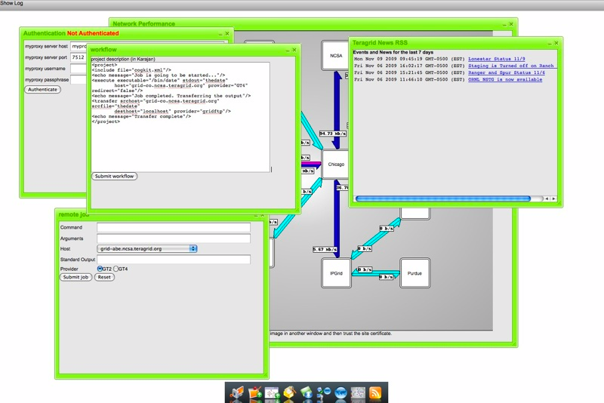
OGCE’s Cyberaide JavaScript provides a Grid abstraction layer for developing mashups and gadgets. Downloadable, packaged software.

Slide 4
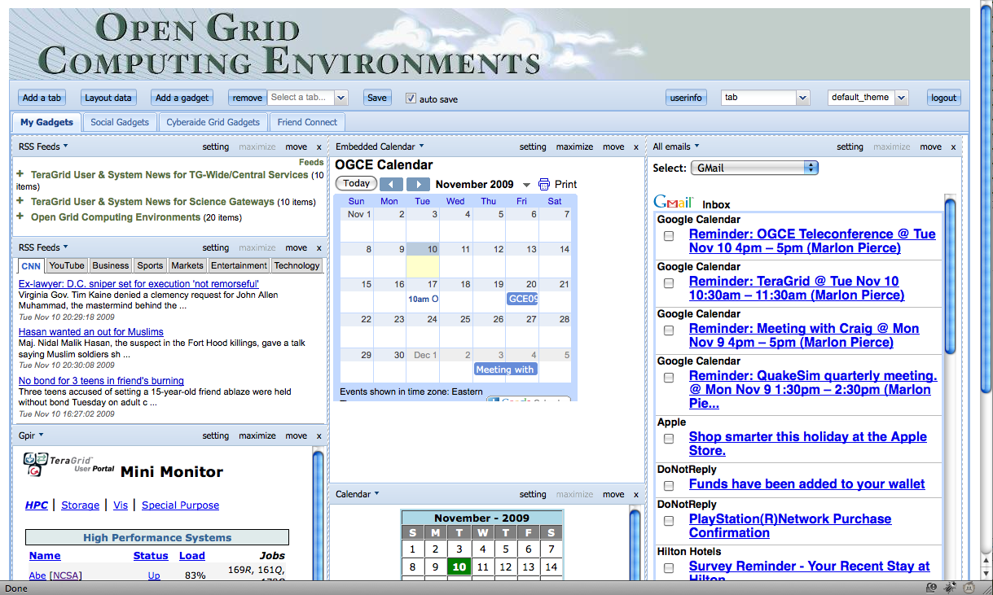
The OGCE Gadget Container allows you to build portals out of public and private Google Open Social gadgets. Supports HTTPS. Downloadable, packaged software.

Slide 5
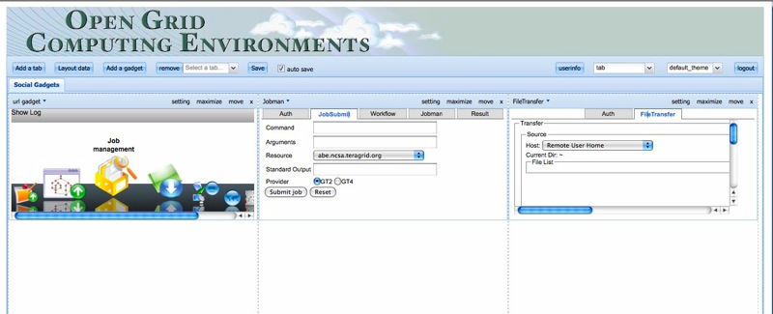
OGCE Grid Mash Up Tools and Gadgets
You can also build secure gadgets for accessing TeraGrid resources using Cyberaide and deploy them into the OGCE Gadget Container.

Slide 6
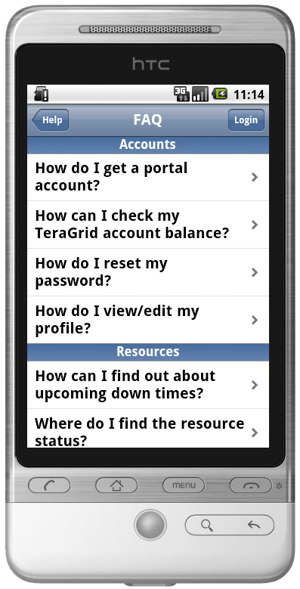
Mobile TeraGrid User Portal
The Mobile TGUP is a streamlined mobile version of the TGUP. It is designed to keep you “in the know while you’re on the go.”
Optimized for the iPhone, available on any smart phone.
Features include:
User job information & notifications
TeraGrid news items
TeraGrid resource status
User allocation information and balances
Direct contact mechanisms for the TeraGrid Help Desk
User profile information and updating

Slide 7
More Information
Web Site and Contact Information
http://www.collab-ogce.org
Links to demonstrated software
http://www.collab-ogce.org/ogce/index.php/Workflow
http://www.collab-ogce.org/ogce/index.php/OGCE_Gadget_Container
http://www.collab-ogce.org/ogce/index.php/JavaScript_COG
RSS News Feed and blog
http://collab-ogce.blogspot.com

Slide 8
Cyberaide JavaScript API

Slide 9
Authentication
How to authenticate through the Cyberaide JavaScript API? // construct an authenticator object for authentication // using myproxy // make sure to use the attributes keys specified here. var auth = org.cyberaide.js.jsAuthenticator(url); auth.setAttribute("host", "myproxy.teragrid.org"); auth.setAttribute("port", 7512); auth.setAttribute("user", ’YOURTGUSERNAME'); auth.setAttribute("password", ’YOURPASSWORD'); // currently only 'myproxy' is supported auth.setProvider("myproxy");

Slide 10
Authentication (cont.)
// construct cyberaide object by pointing to the Agent // service's url // Your call through the Cyberaide API will be // mediated to this Web service // Refer to the installation instruction for the ‘url’. // If you followed each step, the url should be like this var url = "../axis2/services/AgentService”; var cyberaide = new org.cyberaide.js.jsUtil(url); // invoke authentication function cyberaide.authenticate(auth, authResponse); // authResponse is the callback function handler

Slide 11
Authentication (cont.)
/* * the authenticate callback function */ function authResponse(ret) { if(ret){ //authenticated successfully! //put your code here } else{ //authentication failed //put your code here } }

