Slide 1
OGCE Overview: Portals, Services, Workflows, Gadgets, and Tags
Marlon Pierce (IU), Suresh Marru (IU), Raminder Singh (IU), Chathura Herath (IU), Gregor von Laszewski (RIT), Fungang Wang (RIT), Mary Thomas (SDSU), Nancy Wilkins-Diehr (SDSC), Jeff Sale (SDSC), Maytal Dahan (TACC), Rion Dooley (TACC), and Wenjun Wu (UC)
Funding: NSF SDCI, TeraGrid RP and GIG (synergistic)

Slide 2
Links for More Information
Website: http://www.collab-ogce.org
News/RSS/Blog: http://collab-ogce.blogspot.com
Email: discuss@ogce.org
SVN Code Repository: http://ogce.svn.sourceforge.net/viewvc/ogce/
And get tar.gz’s
Source Forge: http://sourceforge.net/projects/ogce

Slide 3
Project | Description | Status
Grid Portal | Packaged, one step installation of Grid portlets into Tomcat+Gridsphere | Stable, V2.5 for TG09
Axis Services | One step install of Resource Discovery and Prediction Services. More services to come. | Stable, V1.0 for TG09.
Workflow Suite | Support for scientific workflows, based on LEAD tools. Suresh will describe next. | Dev. Release for TG09
GTLAB | JSF Tag Libraries for building Grid portlets and gadgets | Dev. Release for TG09
JavaScript COG (Cyberaide) | JavaScript libraries for building Grid gateways. | Dev. Preview for TG09
Gadgets, Open Social Portals | Open Social containers, gadgets, OAuth, OpenID | SVN, will build
Incubator projects | Pylons portals, metascheduling services, bio-gadgets, etc. | SVN if you dare

Slide 4
OGCE and Gateways
We develop and package software for use by TeraGrid Science Gateways and other resources
BioVLAB use OGCE tools to run on Amazon
A lot of this comes from active Gateways.
Information Services (GPIR, QBETS): TeraGrid User Portal
Workflow tools: LEAD
Resource Discovery Service, File Browser Applet: TGUP, GridChem
Gadgets, Open Social Containers: SIDGrid, OLSG
We contribute codes back to these projects.
Gateways
OGCE
Software

Slide 5
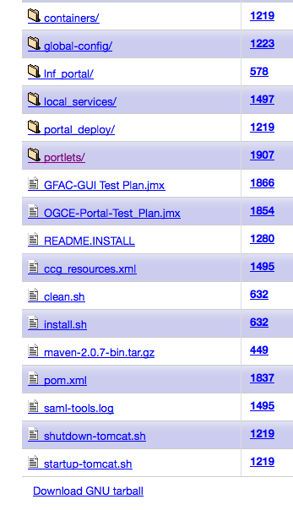
Grid Portal Software
Java-based
Code managed by Source Forge SVN.
Get it by anonymous SVN checkout
Download the Tar: http://ogce.svn.sourceforge.net/viewvc/ogce/tags/ogce-portal-only-2.5-release.tar.gz
One-line build: mvn clean install.
Download has everything you need except Java.

Slide 6
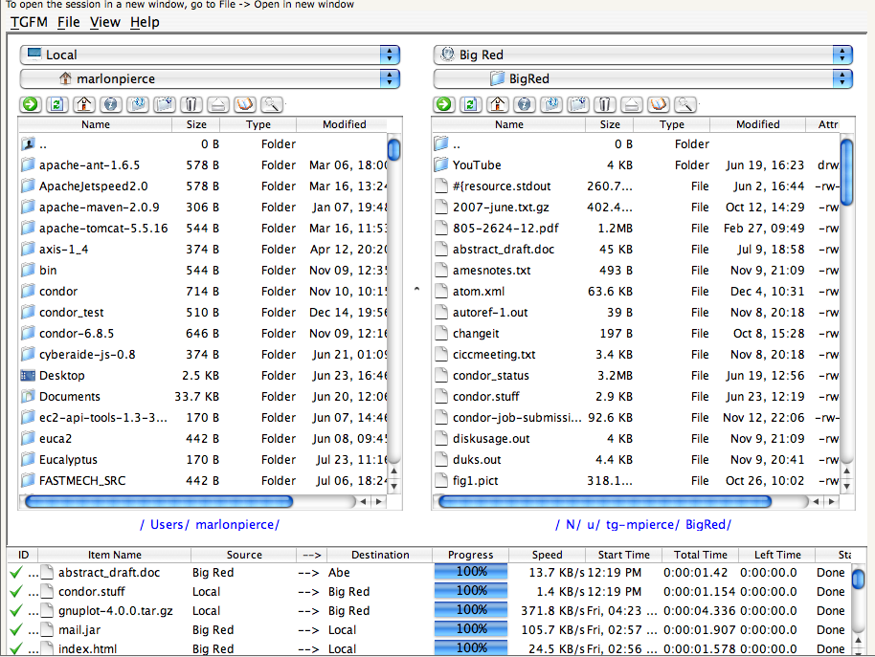
File browser front end from OGCE portal download

Slide 7
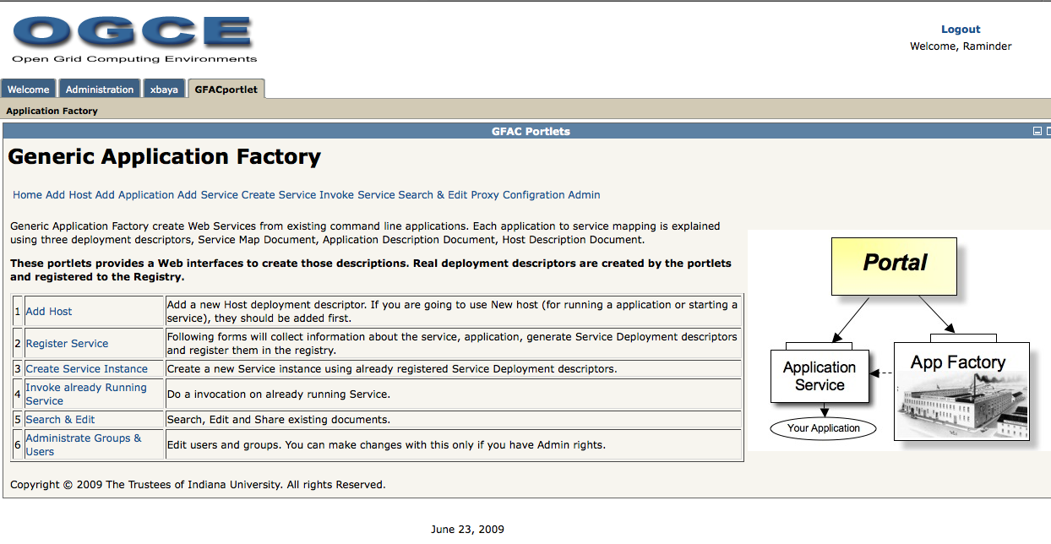
Workflow: GFAC and XBaya

Slide 8
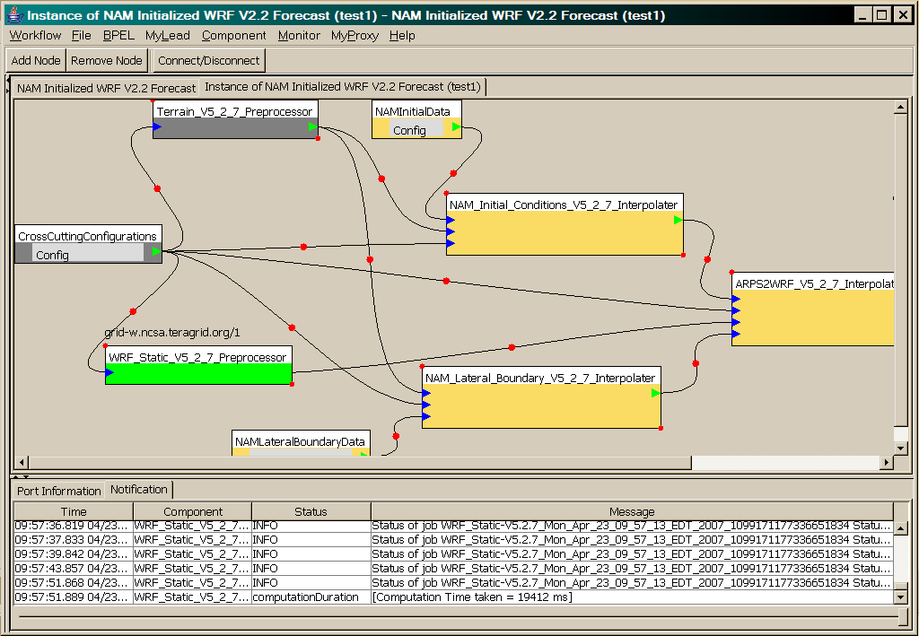
LEAD: A Weather Forecasting Workflow
WRF-Static running on Tungsten

Slide 9
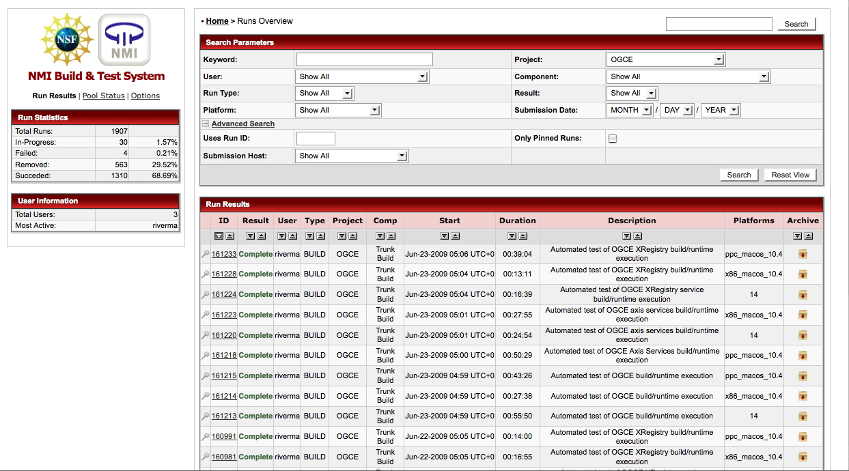
Nightly builds on 14 linux, Mac PPC, and Mac X86

Slide 10
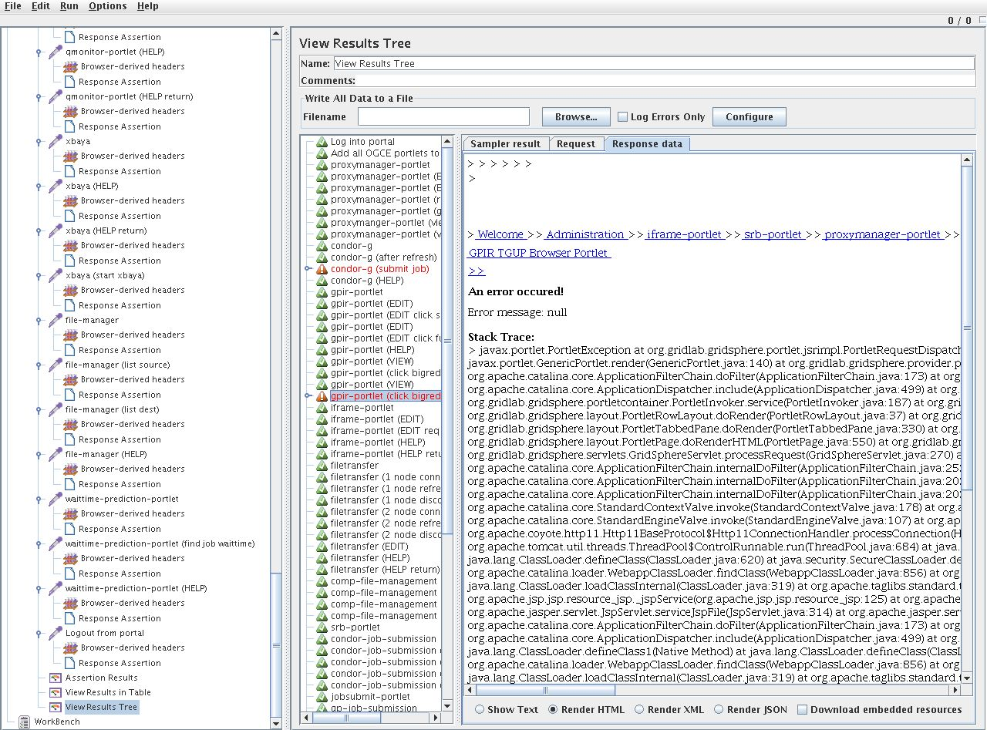
JMeter test suite

Slide 11
Some OGCE Services
Information Web Services and build framework

Slide 12
Resource Discovery Service
Extracted from the TeraGrid User Portal
Contributed by Rion Dooley, TACC
Axis2 Web service
Integrates information from INCA, GPIR services.
What machines are in my Grid
Which ones are actually running?
Works with TeraGrid deployed services, but you can use it with your own information service installations.

Slide 13
Resource Prediction Service (RPS)
Predicts an optimal set of resources for running scientific applications
Predicts a set of resources on which the sum of data transfer time, queue wait time and compute time for the application will be minimum
Data transfer time: Uses input data size and NWS info
Queue wait time: Uses QBETS info
Compute time: Uses application performance info
Axis2 web service with a MySQL backend
RPS is a subset of the Fault Tolerance and Recovery service used in LEAD and VGrADS

Slide 14
Packaging Services
Everything builds with one command
mvn clean install
We use Apache Maven 2 for builds.
Structured, modular builds and consistent layouts
Build a single module:
mvn clean install –f somemod/pom.xml
We include Apache Tomcat in the download, so all you need is Java and MySQL.
Suitable also for the NMI build and test system.
Want the Javadoc? mvn javadoc:javadoc

Slide 15
Upcoming Services
XMC-CAT metadata cataloging service with JSDL sample implementation.
Swarm Web Service for mass job submission and management.
http://escience2008.iu.edu/sessions/SWARM.shtml
GPIR Web Service for information on your Grid. This is being repackaged; older packaged version (but same code) is already available.
GFAC and XRegistry services
Available now using XSUL Web service engine

Slide 16
OGCE and Web 2.0

Slide 17
Enterprise Approach | Web 2.0 Approach
JSR 168 Portlets | Google Gadgets, Widgets, badges
Server-side integration and processing | AJAX, client-side integration and processing, JavaScript
SOAP | RSS, Atom, JSON
WSDL | REST (GET, PUT, DELETE, POST)
Portlet Containers | Open Social Containers (Orkut, LinkedIn, Shindig); Facebook; StartPages
User Centric Gateways | Social Networking Portals
Workflow managers (Taverna, Kepler, XBaya, etc) | Mash-ups
WS-Eventing, WS-Notification, Enterprise Messaging | Blogging and Micro-blogging with REST, RSS/Atom, and JSON messages (Blogger, Twitter)
Semantic Web: RDF, OWL, ontologies | Microformats, folksonomies

Slide 18
OGCE Strategies for Web 2.0
Java COG --> JavaScript COG (Cyberaide)
JavaScript can be integrated with many different frameworks: PHP, JSP, JSF, RoR, etc
Integration with JSON-REST style services.
Enable mashups, integrate with Jquery, etc.
Portlets--> Google and Open Social Gadgets
JSR 168 Containers-->Open Social Containers
Orkut, LinkedIn, MySpace, etc
Apache Shindig, Sakai 3, other open source
Web Services --> REST Services

Slide 19
Authentication
How to authenticate through the Cyberaide JavaScript API? // construct an authenticator object for authentication // using myproxy // make sure to use the attributes keys specified here. var auth = org.cyberaide.js.jsAuthenticator(url); auth.setAttribute("host", "myproxy.teragrid.org"); auth.setAttribute("port", 7512); auth.setAttribute("user", ’YOURTGUSERNAME'); auth.setAttribute("password", ’YOURPASSWORD'); // currently only 'myproxy' is supported auth.setProvider("myproxy");

Slide 20
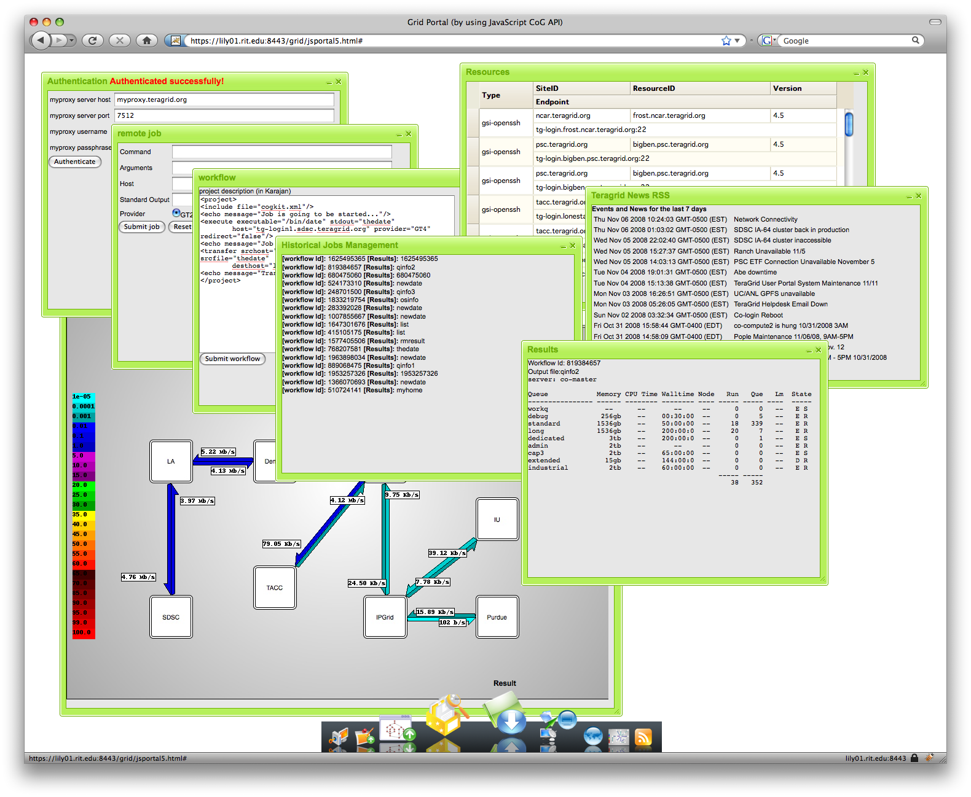
Cyberaide JavaScript API Summary
Authentication
Job and Workflow Submission
Job Monitoring
File management
Listing, upload, download, third party transfer, etc.
Graphical components

Slide 21
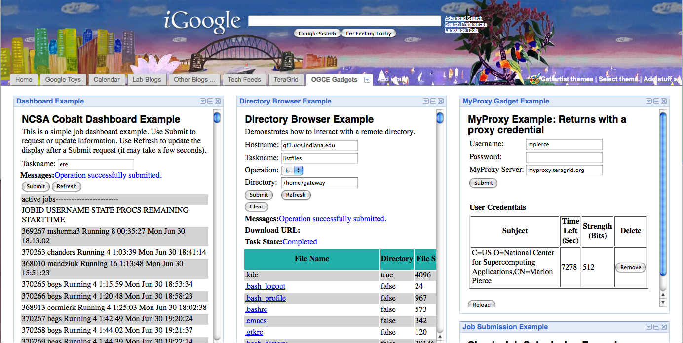
Example OGCE Google Gadgets: MOAB dashboard, remote directory browser, and proxy management. Built with GTLAB.

Slide 22
TeraGrid Gadgets using the OpenSocial APIs
http://www.google.com/ig/directory
Six teragrid gadgets have been published
Slide courtesy of Wenjun Wu and
Thomas Uram

Slide 23
TeraGrid Gadgets on iGoogle
Search for “TeraGrid” in iGoogle Gadget Directory
Add two TeraGrid gadgets here
Open Life Sciences Gateway gadgets
Slide courtesy of Wenjun Wu and
Thomas Uram

Slide 24
Pilot Open Social Project: SIDGrid Gadget Container Integration (W.Wu)
Built on top of Shindig
OAuth Security
Container-Gadget JSON-RPC Communication

Slide 25
TeraGrid REST Information Services
/profiles | GET – list all user profiles PUT – unused POST – add a new user profile DELETE – unused
/profiles/id | GET – get user profile details PUT – update user profile POST – unused DELETE – delete user profile
/resources | GET – list all resources PUT – unused POST – add resource DELETE – unused
/resources/id | GET – get resource details PUT – update resource information POST - unused DELETE – delete resource
/accounts | GET – list all accounts PUT – unused POST – add account DELETE - unused
/accounts/id | GET – get account details PUT – update account details POST - unused DELETE – delete account
Slide courtesy of Rion Dooley

Slide 26
Putting It All Back Together
Time to put it all together again.
Working Grid gadgets and mash-up examples.
Running in an open social container
Coupled with Axis and REST information services
Continued support for workflows
Expect this at SC09

