Slide 1
Remarks on MOOC’s
Open Grid Forum BOF
July 24 OGF38B at XSEDE13 San Diego
Geoffrey Fox
gcf@indiana.edu
Informatics, Computing and Physics
Indiana University Bloomington

Slide 2
OGF BOF Goals
MOOC's are likely to have profound implications for education if only by waking the sleeping giant to reconsider some teaching and costing models.
MOOC's have new open source software (EdX and Google Course Builder) challenging older proprietary (Blackboard) and open systems (Moodle, Sakai).
They are also suggesting open source credentials like eBadges and Openbadges.
MOOC's also provide new ways for organizations to describe their capabilities; maybe all software should be packaged with a MOOC describing how to use.
We will discuss the implications of this for OGF such as standards and software best practices for MOOC's and the best way to organize the community for developing interoperable tools in this area

Slide 3
Massive Open Online Courses (MOOC)
MOOC’s are very “hot” these days with Udacity and Coursera as start-ups; perhaps over 100,000 participants
Relevant to Data Science (where IU is preparing a MOOC) as this is a new field with few courses at most universities
Typical model is collection of short prerecorded segments (talking head over PowerPoint) of length 3-15 minutes
These “lesson objects” can be viewed as “songs”
Google Course Builder (python open source) builds customizable MOOC’s as “playlists” of “songs”
Tells you to capture all material as “lesson objects”
We are aiming to build a repository of many “songs”; used in many ways – tutorials, classes …

Slide 4
http://x-informatics.appspot.com/course

Slide 5
Twelve ~10 minutes lesson objects in this lecture
IU wants us to close caption if use in real course

Slide 8
Customizable MOOC’s I
We could teach one class to 100,000 students or 2,000 classes to 50 students
The 2,000 class choice has 2 useful features
One can use the usual (electronic) mentoring/grading technology
One can customize each of 2,000 classes for a particular audience given their level and interests
One can even allow student to customize – that’s what one does in making play lists in iTunes
Both models can be supported by a repository of lesson objects (3-15 minute video segments) in the cloud
The teacher can choose from existing lesson objects and add their own to produce a new customized course with new lessons contributed back to repository

Slide 9
Cloud MOOC Repository
http://iucloudsummerschool.appspot.com/preview

Slide 10
Customizable MOOC’s II
The 3-15 minute Video over PowerPoint of MOOC lesson object’s is easy to re-use
Qiu (IU)and Hayden (ECSU Elizabeth City State University) will customize a module
Starting with Qiu’s cloud computing course at IU
Adding material on use of Cloud Computing in Remote Sensing (area covered by ECSU course)
This is a model for adding cloud curricula material to diverse set of universities
Defining how to support computing labs associated with MOOC’s with FutureGrid or appliances + Virtual Box
Appliances scale as download to student’s client
Virtual machines essential

Slide 11
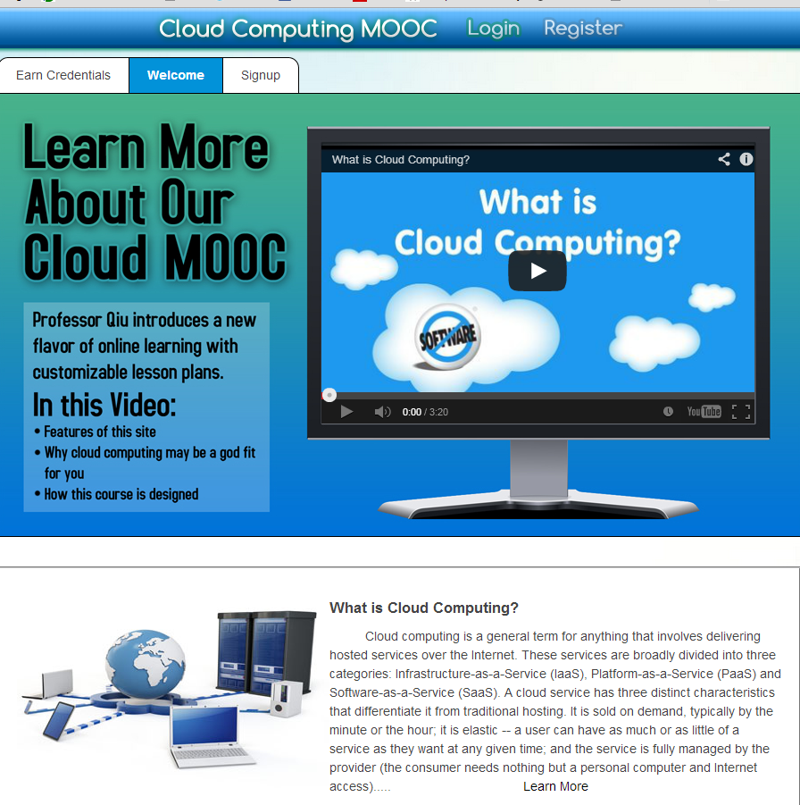
Can of course build many different interfaces
Songs stored on YouTube
Songs prepared with Adobe Presenter on Laptop

Slide 12
Two limits where MOOC’s are Compelling
High volume courses (CS/Ph/Chem/Bio101…) where scalability of MOOC’s make them attractive to reach a lot of students
Niche areas where there is some student interest but either no faculty expertise or not enough students to justify traditional courses
Offer to many institutions simultaneously

Slide 13
Hermit’s Cave Virtual University
I proposed in 1999 misjudging pace of online education: One can place faculty in their favorite location (e.g. remote cave) and universities provide structure to give “credentials” while faculty teach
Maybe some populate repository; others actually deliver courses
Note Google Course Builder has no need for local resources except for faculty client (laptop) – entire course stored in the cloud
So we can radically change university system with a major cross institution virtual education and as well research component
Enabled by cloud plus high performance reliable networking
Lets set up community to define and build the virtual university MOOC repository and other needed activities

Slide 14
Mentoring / Grading
We should aim at simplicity; attractive at moment is a mix of multi-topic forum plus more interactive Hangouts or equivalent (5-12 people)
https://www.youtube.com/watch?v=M3jcSCA9_hM

Slide 15
This is all very simple
Correct but that’s good
Internet successes are from simple ideas done very well
MOOC’s are a very old idea
http://www.old-npac.org/users/gcf/cps615intro96/index.html does a playlist on audio + PowerPoint in 1996
But they didn’t work well before due to network
In general MOOC’s less sophisticated than much online education?

