Slide 1
Parallel Computing and Multicore 2008: Tutorial
ECMS Multiconference HPCS 2008
Nicosia Cyprus
June 5 2008
Geoffrey Fox
School of Informatics, Community Grids Laboratory
Indiana University, Bloomington IN
gcf@indiana.edu
http://grids.ucs.indiana.edu/ptliupages/presentations/PC08Tutorial_HPCS_June5-08.pptx
http://grids.ucs.indiana.edu/ptliupages/presentations/MCPerformanceJune5-08.pptx

Slide 2
Introduction
This tutorial does not assume huge expertise in parallel computing but mixes introduction to parallel computing with an introduction to multicore
Multicore includes both “traditional” architectures like those from Intel and AMD (Xeon and Opteron) and specialized chips (NVIDIA/AMD Graphics, Cell and FPGA ….)
Always it is claimed that we should drop “conventional approaches” and realize huge advantage of “specialized” approaches
  Historically software and sustainability issues have made specialized machines have limited impact
  I expect this to continue especially as conventional approach already gives us more computing power than we can absorb
We will assume that we are interested in “good” performance on 32-1024 cores and we will call this scalable parallelism
  Current machines have fewer cores than this and so today’s results not clearly significant

Slide 3

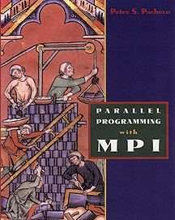
Some Books
No good book or even especially good review talk on multicore. There are some rather dated books on parallel computing
The Sourcebook of Parallel Computing, Edited by Jack Dongarra, Ian Foster, Geoffrey Fox, William Gropp, Ken Kennedy, Linda Torczon, Andy White, October 2002, 760 pages, ISBN 1-55860-871-0, Morgan Kaufmann Publishers. http://www.mkp.com/books_catalog/catalog.asp?ISBN=1-55860-871-0
If you want to use parallel machines one of many
possibilities is: Parallel Programming with MPI, Peter S. Pacheco, Morgan Kaufmann, 1996. Book web page: http://fawlty.cs.usfca.edu/mpi/

Slide 4
Some Internet Resources
See http://www.connotea.org/user/crmc for references -- select tag oldies for venerable links; tags like MPI Applications Compiler Meeting have obvious significance
http://www.infomall.org/salsa for my recent work including publications
My tutorial on parallel computing
http://grids.ucs.indiana.edu/ptliupages/presentations/PC2007/index.html
Many workshops (see Connotea) and talks on multicore
  Importance and inevitability well covered
  Wide variety of talks propounding different software models but few incorporate lessons from HPC /Scientific Computing
  Little quantitative study of multicore and whether results “intrinsic” or due to immature implementations

Slide 5
Classical Parallel Programming and Performance Analysis

Slide 6
Potential in a Vacuum Filled Rectangular Box
Consider the world’s simplest problem
Find the electrostatic potential inside a box whose sides are at a given potential
Set up a 16 by 16 Grid on which potential defined and which must satisfy Laplace’s Equation

Slide 7
Basic Sequential Algorithm
Initialize the internal 14 by 14 mesh to anything you like and then apply for ever!
This Complex System is just a 2D mesh with nearest neighbor connections
φ_{Up}
φ_{New}
φ_{Right}
φ_{Left}
φ_{Down}
φ _{New} = (φ _{Left} + φ _{Right} + φ _{Up} + φ _{Down} ) / 4

Slide 8
Update on the Mesh
14 by 14
Internal
Mesh

Slide 9
Parallelism is Straightforward
If one has 16 processors, then decompose geometrical area into 16 equal parts
Each Processor updates 9 12 or 16 grid points independently

Slide 10
Communication is Needed
Updating edge points in any processor requires communication of values from neighboring processor
For instance, the processor holding green points requires red points

Slide 11
Distributed Memory
Distributed memory systems have shared memory nodes (today multicore) linked by a messaging network
Core
Core
Core
Core
Cache
Cache
Cache
Cache
Cache
Cache
Cache
Cache
L2 Cache
L2 Cache
L2 Cache
L2 Cache
L3 Cache
L3 Cache
L3 Cache
L3 Cache
Main
Memory
Main
Memory
Main
Memory
Main
Memory
Dataflow
Dataflow
Interconnection Network
“Deltaflow” or Events

Slide 12
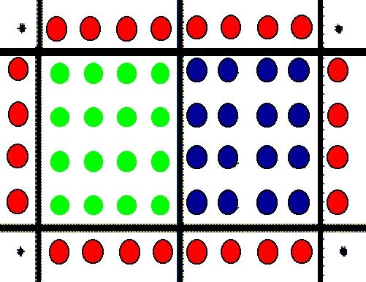
Communication on Shared
Memory Architecture
On a shared Memory Machine a CPU is responsible for processing a decomposed chunk of data but not for storing it
Nature of parallelism is identical to that for distributed memory machines but communication implicit as “just” access memory

Slide 13
Cache and Distributed Memory Analogues
Dataflow performance sensitive to CPU operation per data point – often maximized by preserving locality
Good use of cache often achieved by blocking data of problem and cycling through blocks
  At any one time one (out of 105 in diagram) block being “updated”
Deltaflow performance depends on CPU operations
per edge compared to CPU operations per grain
  One puts one block on each of 105 CPU’s of parallel computer and updates simultaneously
  This works “more often” than cache optimization as works in case with low CPU update count per data point but these algorithms also have low edge/grain size ratios
Core
Cache
Cache
L2 Cache
L3 Cache
Main Memory

Slide 14
Communication Must be Reduced
4 by 4 regions in each processor
  16 Green (Compute) and 16 Red (Communicate) Points
8 by 8 regions in each processor
  64 Green and “just” 32 Red Points
Communication is an edge effect
Give each processor plenty of memory and increase region in each machine
Large Problems Parallelize Best

Slide 15
Performance Analysis Parameters
This will only depend on 3 parameters
n which is grain size -- amount of problem stored on each processor (bounded by local memory)
t_{float} which is typical time to do one calculation on one node
t_{comm} which is typical time to communicate one word between two nodes
Most importance omission here is communication latency
Time to communicate = t_{latency}+ (Num Words)t_{comm}
Memory n
Memory n
Node A
Node B
t_{comm}
CPU t_{float}
CPU t_{float}

Slide 16
Analytical analysis of Load Imbalance
Consider N by N array of grid points on P Processors where √P is an integer and they are arranged in a √P by √P topology
Suppose N is exactly divisible by √P and a general processor has a grain size n = N²/P grid points
Sequential time T₁ = (N-2)² t_{calc}
Parallel Time T_{P} = n t_{calc}
Speedup S = T₁/T_{P} = P (1 - 2/N)² = P(1 - 2/√(nP) )²
S tends to P as N gets large at fixed P
This expresses analytically intuitive idea that load imbalance due to boundary effects and will go away for large N

Slide 17
General Analytical Form of Communication Overhead for Jacobi
Consider N grid points in P processors with grain size n = N²/P
Sequential Time T₁ = 4N² t_{float}
Parallel Time T_{P} = 4 n t_{float} + 4 √n t_{comm}
Speed up S = P (1 - 2/N)² / (1 + t_{comm}/(√n t_{float}) )
Both overheads decrease like 1/√n as n increases
This ignores communication latency but is otherwise accurate
Speed up is reduced from P by both overheads
Load Imbalance Communication Overhead

Slide 18
Summary of Laplace Speed Up
T_{P} is execution time on P processors
  T₁ is sequential time
Efficiency ε = Speed Up S / P (Number of Processors)
Overhead f_{comm} = (P T_{P} - T₁) / T₁ = 1/ ε - 1
As T_{P} linear in f_{comm}, overhead effects tend to be additive
In 2D Jacobi example
f_{comm} = t_{comm}/(√n t_{float})
√n becomes n^{1/d} in d dimensions witH
f_{comm} = constant t_{comm}/(n^{1/d} t_{float})
While efficiency takes approximate form
ε ≈ 1 - t_{comm}/(√n t_{float}) valid when overhead is small
As expected efficiency is < 1 corresponding to speedup being < P

Slide 19
Key General Features
Problems have associated datasets
Parallelism is gotten by decomposing dataset into parts and writing program to simulate/calculate each part
  This differs in geometry and boundary conditions from (sequential) code for full program
  Each part runs as a separate thread or process on separate cores
One uses SPMD Single Program Multiple Data paradigm with each core running same code but at any given time, programs are executing different instructions
The different parts synchronize every now and then e.g. in Jacobi iteration method at the end of each iteration

Slide 20
Hardware

Slide 21
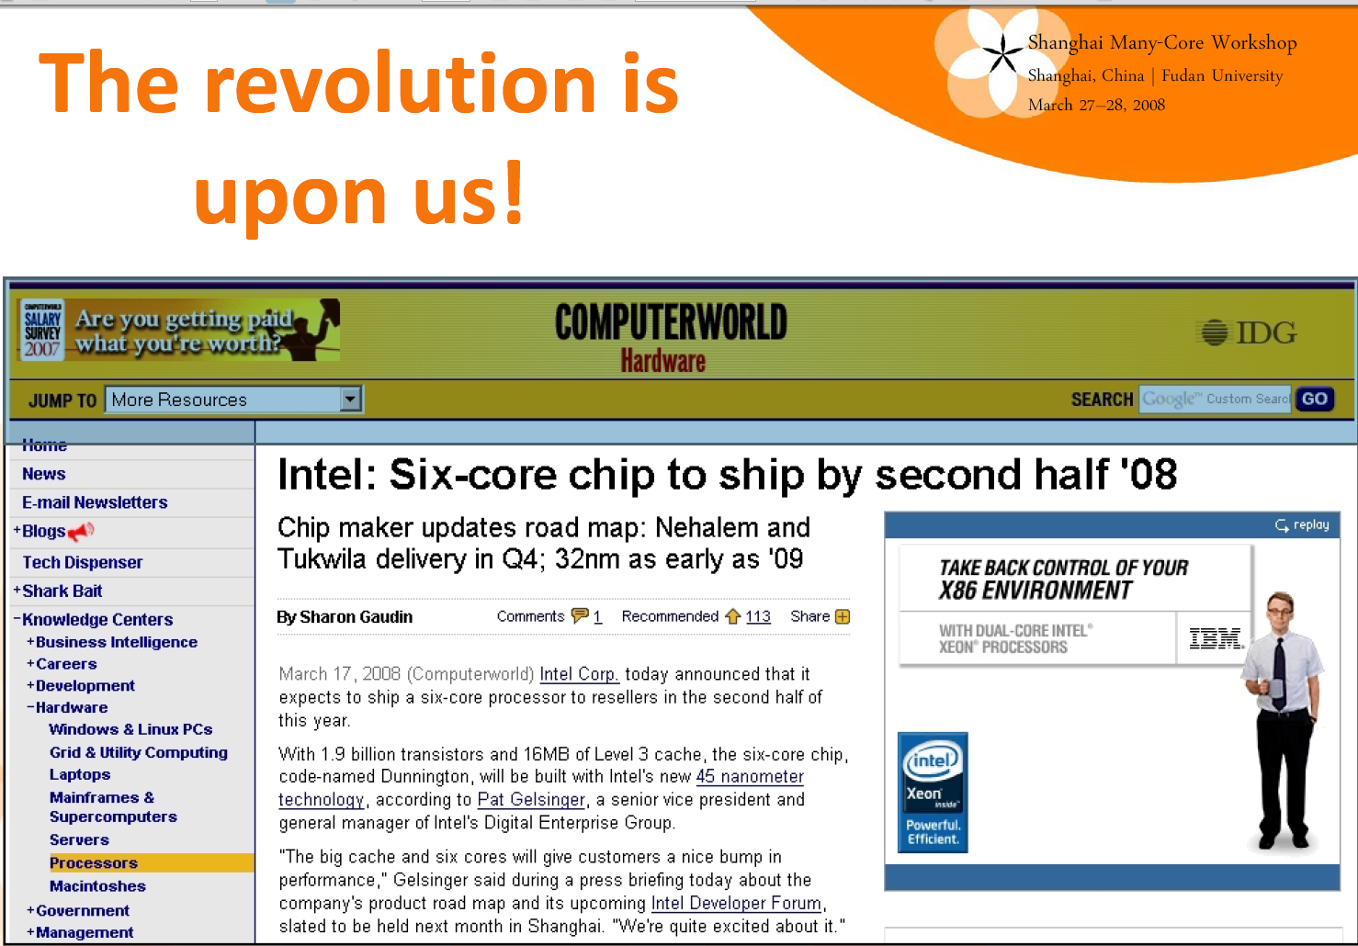
Mark K. Smith, Gelato

Slide 22
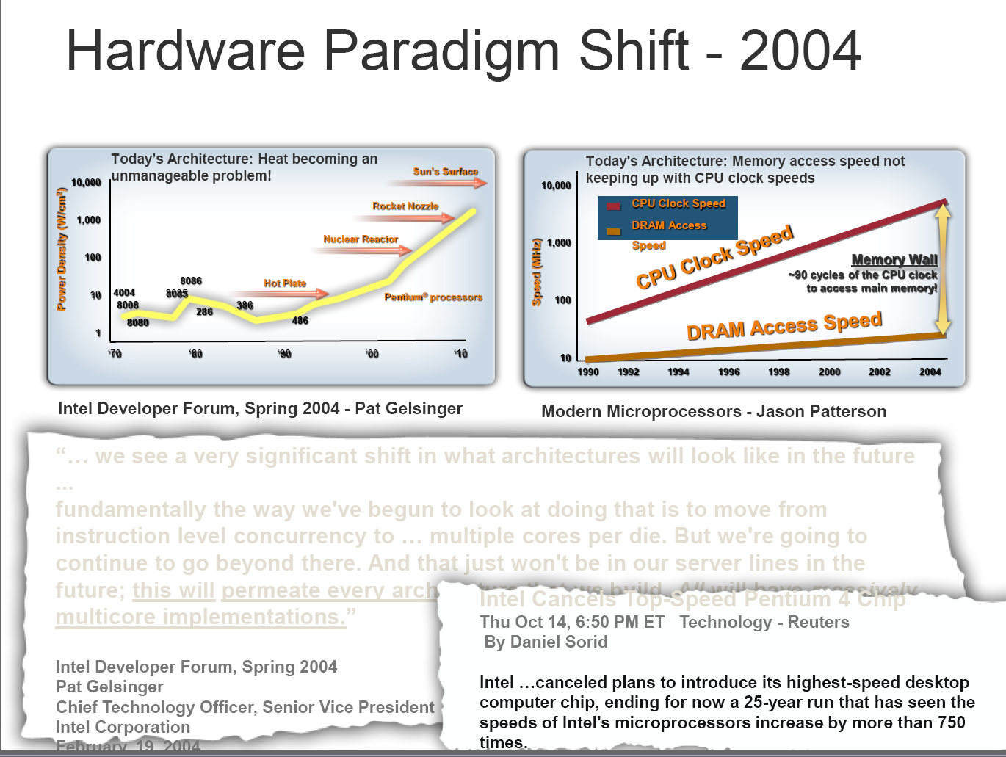
John Manferdelli (Microsoft)

Slide 23
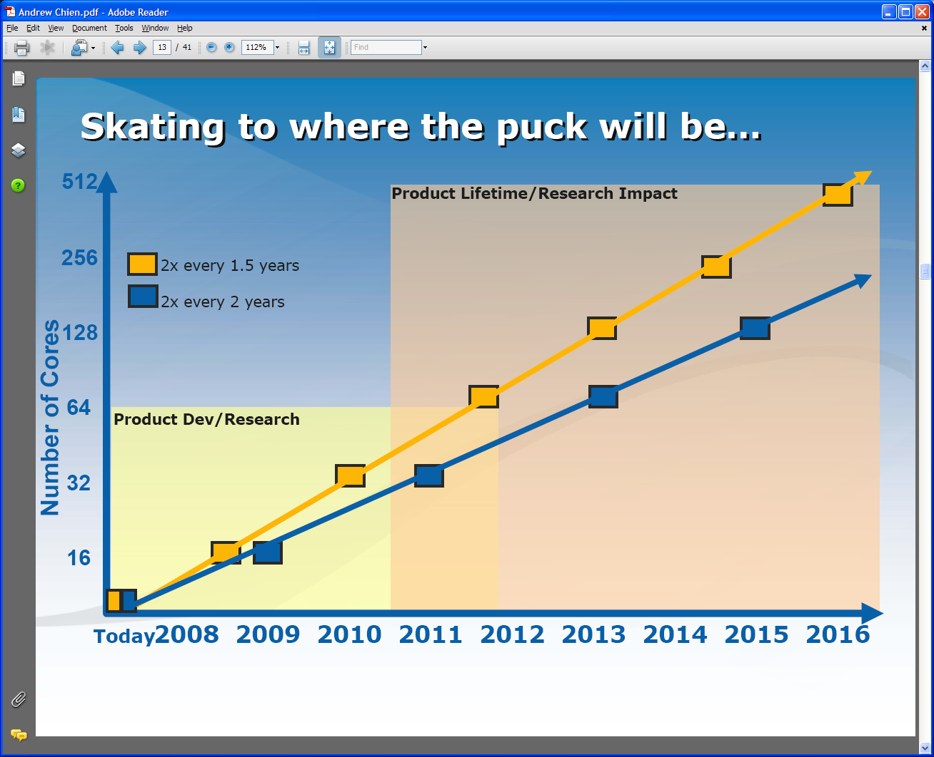
Intel’s Projection
Technology might support:
2010: 16—64 cores 200GF—1 TF
2013: 64—256 cores 500GF– 4 TF
2016: 256--1024 cores 2 TF– 20 TF

Slide 24
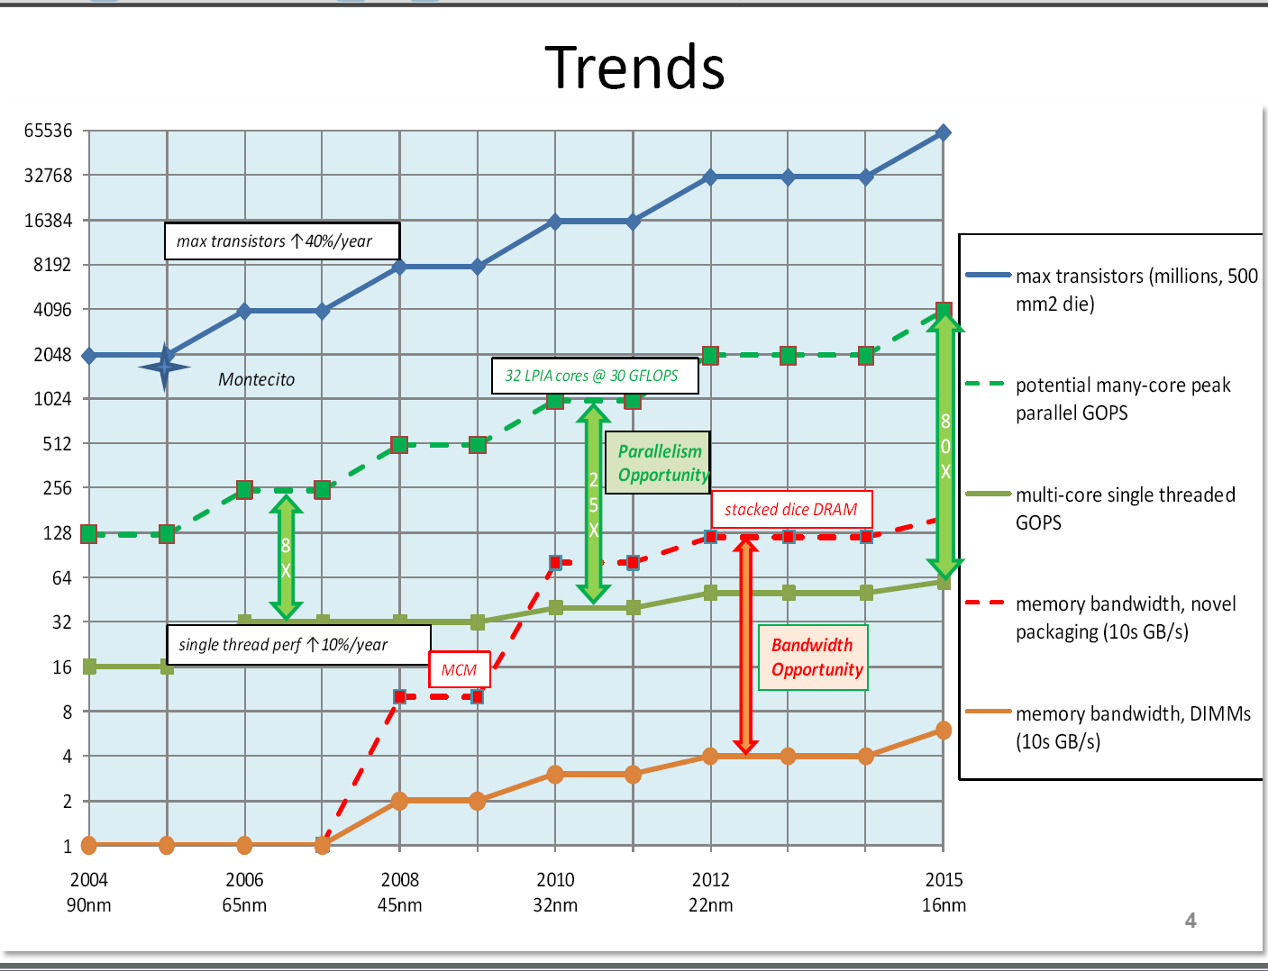
John Manferdelli (Microsoft)

Slide 25
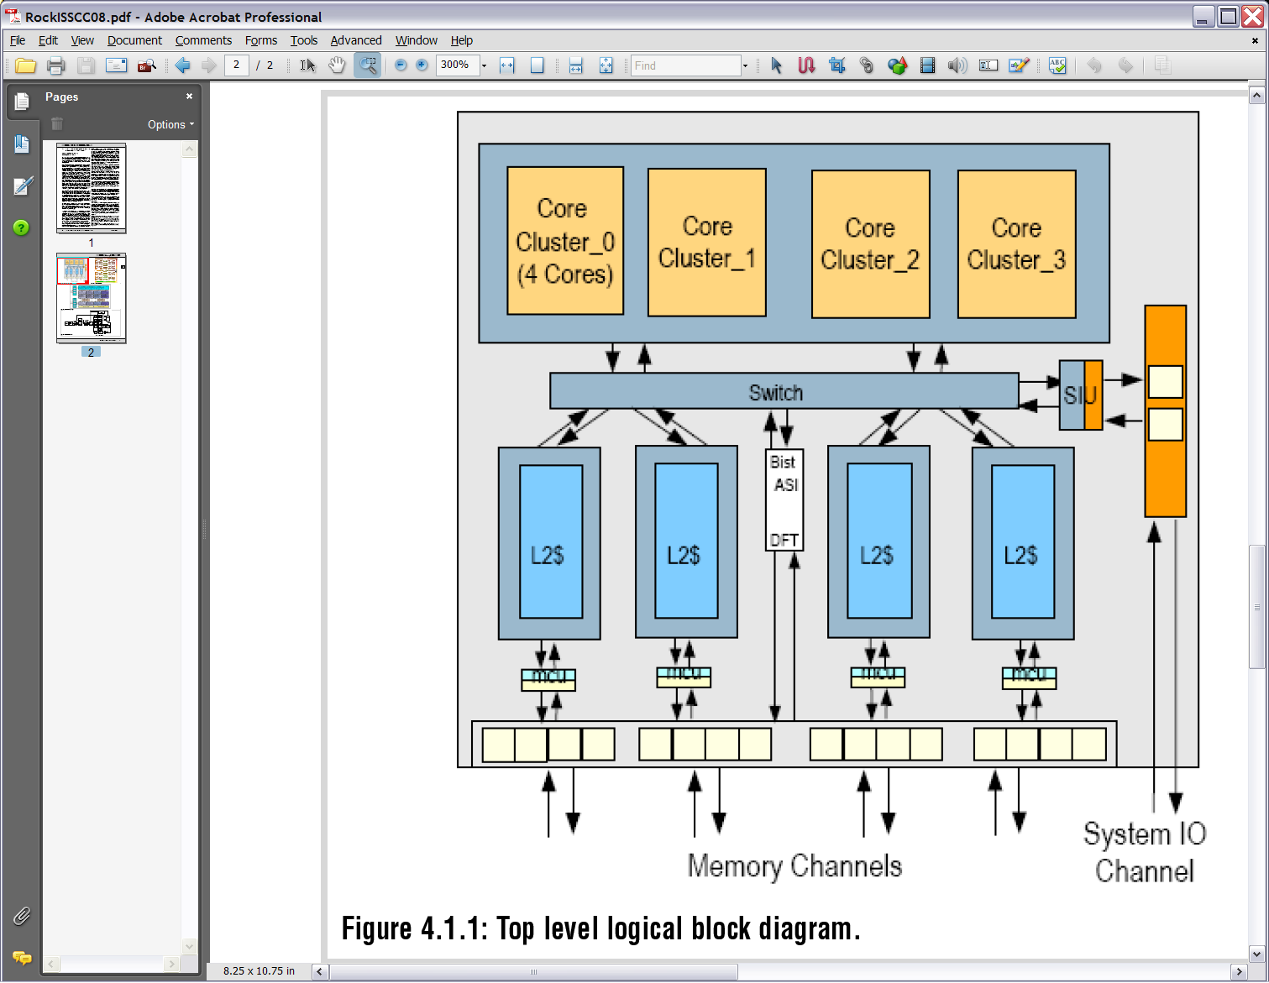
Sun Niagara2
Marc Tremblay, Sun

Slide 26
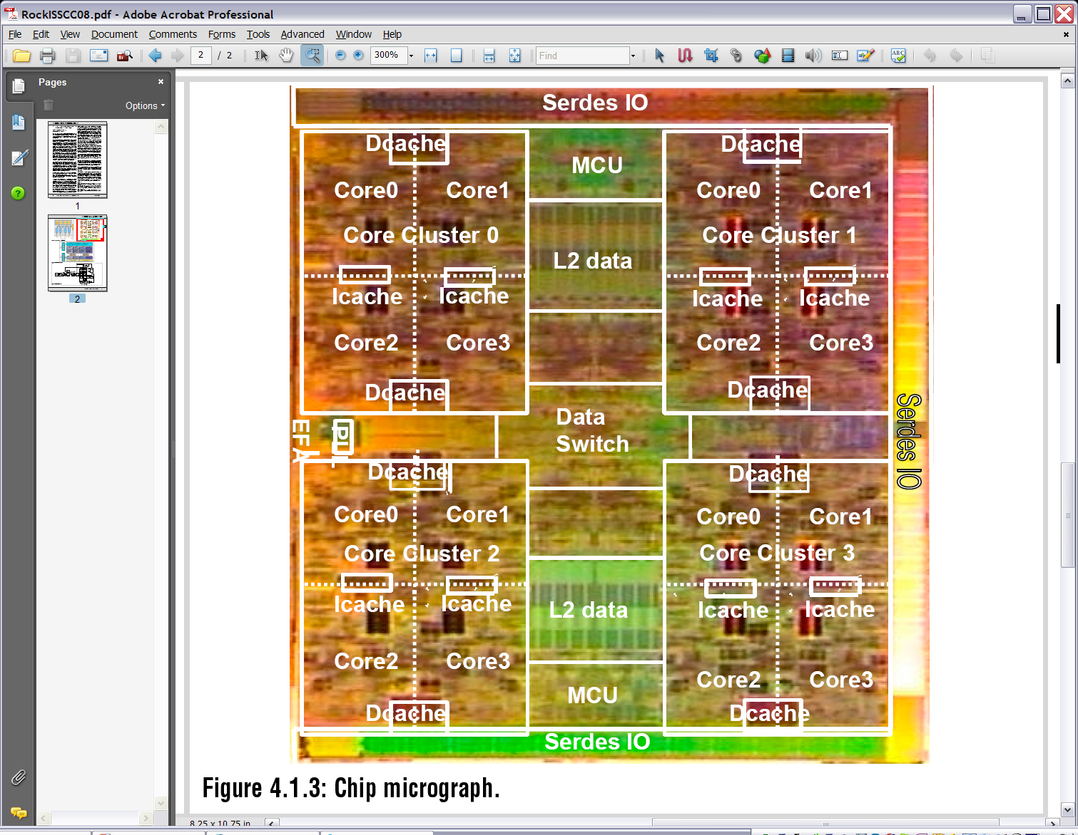
Sun Niagara2
Marc Tremblay, Sun

Slide 27
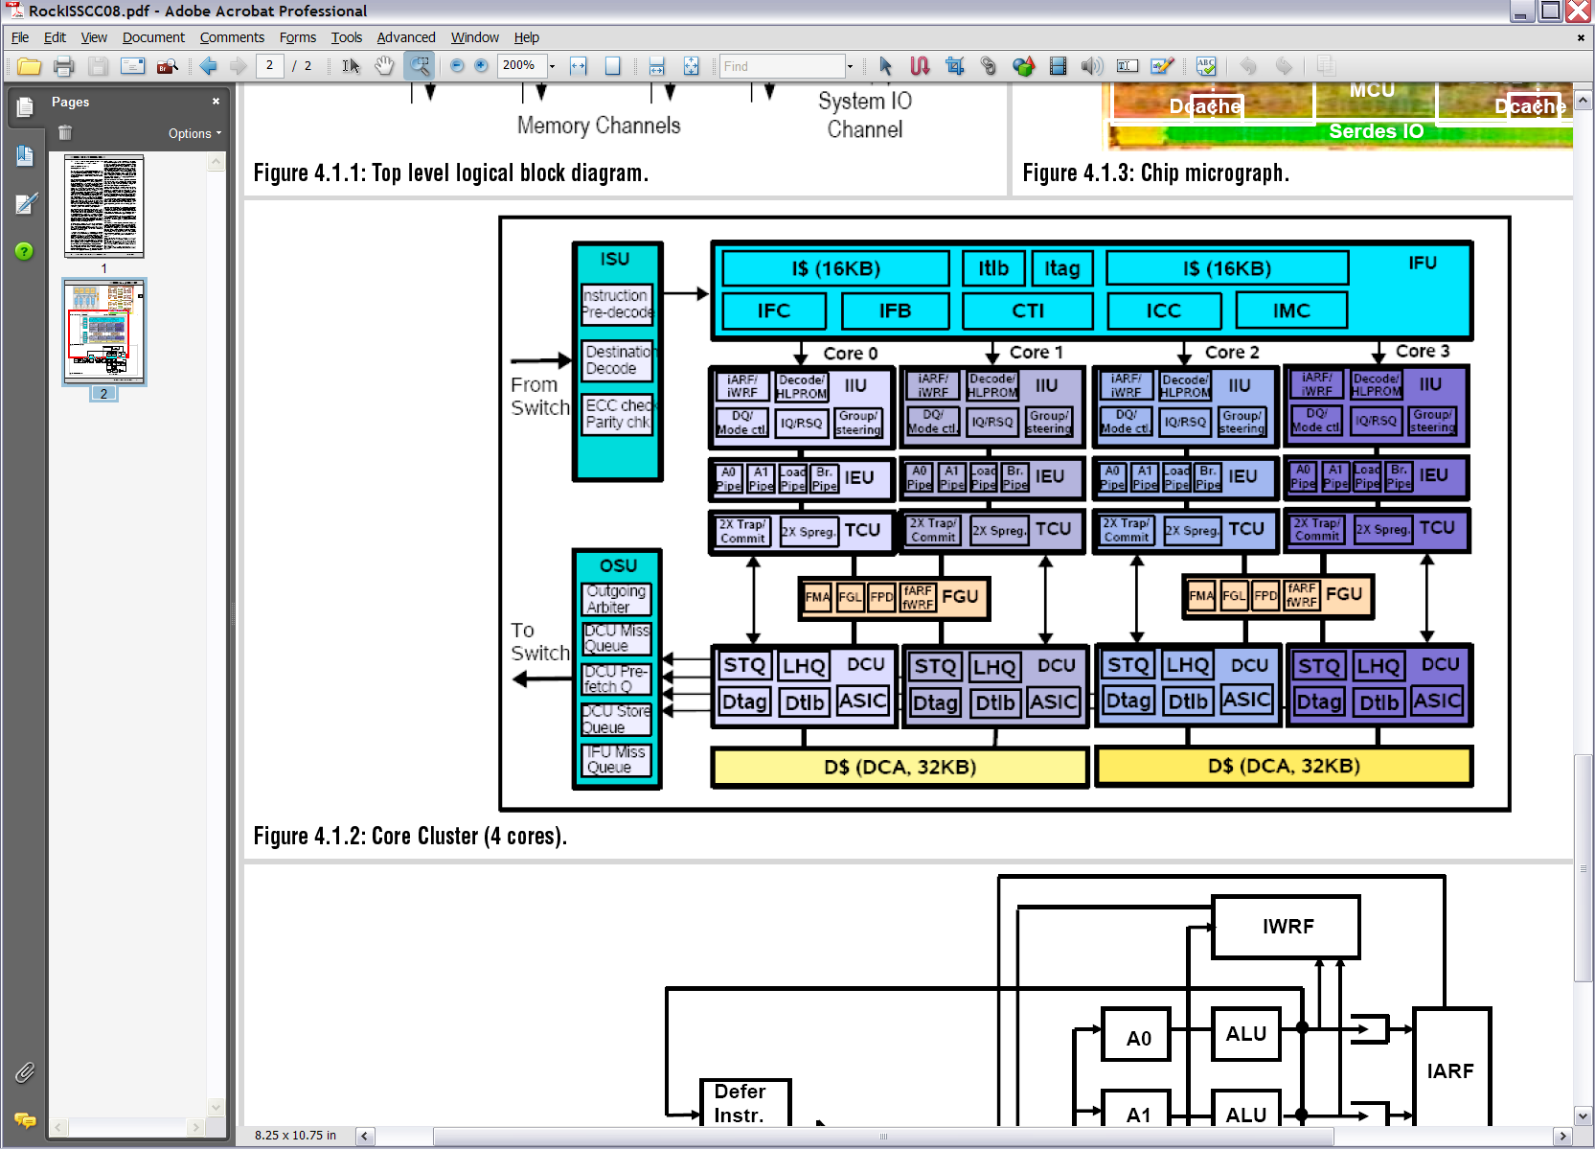
Sun Niagara2
Marc Tremblay, Sun

Slide 28
Vivek Sarkar
312

Slide 29
Vivek Sarkar
312

Slide 30
Vivek Sarkar
312

Slide 31
Multicore
Applications

Slide 32
RMS: Recognition Mining Synthesis
Recognition
Mining
Synthesis
What is …?
Is it …?
What if …?
Model
Find a model
instance
Create a model
instance
Today
Model-less
Real-time streaming and
transactions on
static – structured datasets
Very limited realism
Tomorrow
Model-based
multimodal
recognition
Real-time analytics on
dynamic, unstructured,
multimodal datasets
Photo-realism and
physics-based
animation

Slide 33


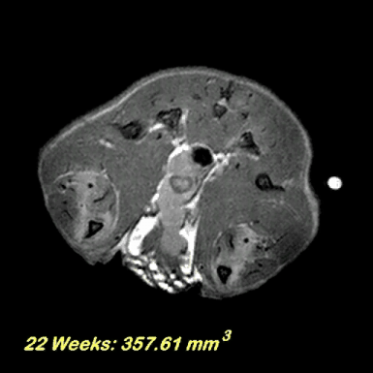

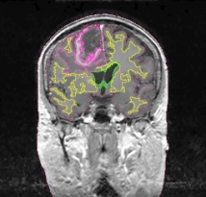

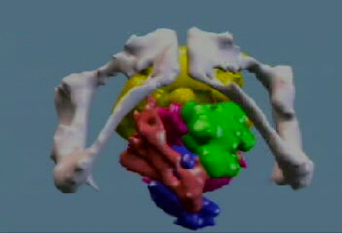
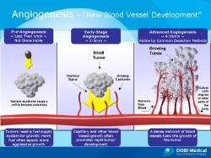
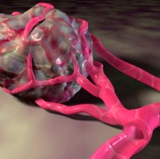

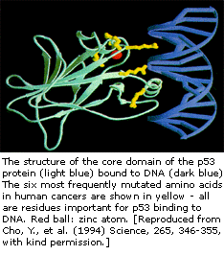
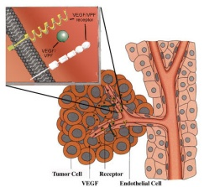
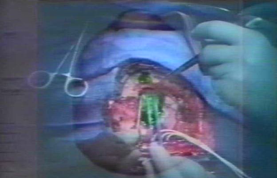
Recognition
Mining
Synthesis
What is a tumor?
Is there a tumor here?
What if the tumor progresses?
It is all about dealing efficiently with complex multimodal datasets
Images courtesy: http://splweb.bwh.harvard.edu:8000/pages/images_movies.html

Slide 34
Intel’s Application Stack

Slide 35
Steve Pawlowski. Intel

Slide 36
Steve Pawlowski. Intel

Slide 37
Steve Pawlowski. Intel

Slide 38
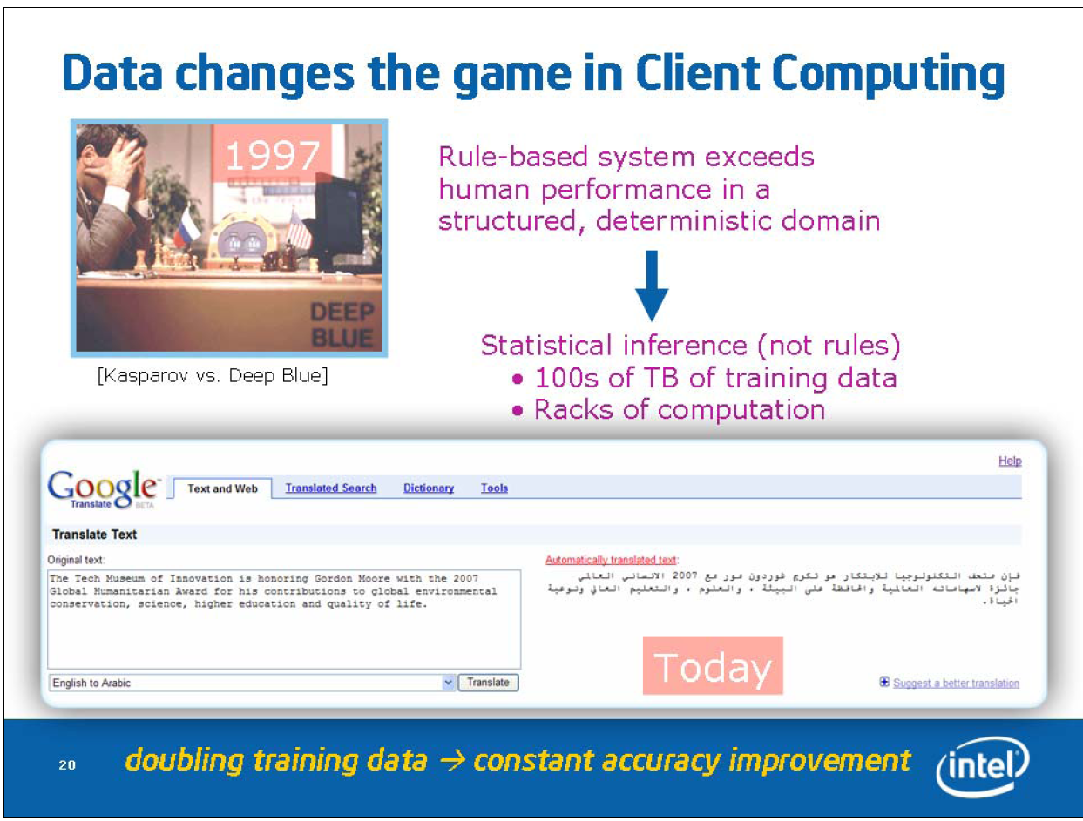
Steve Pawlowski. Intel

Slide 39
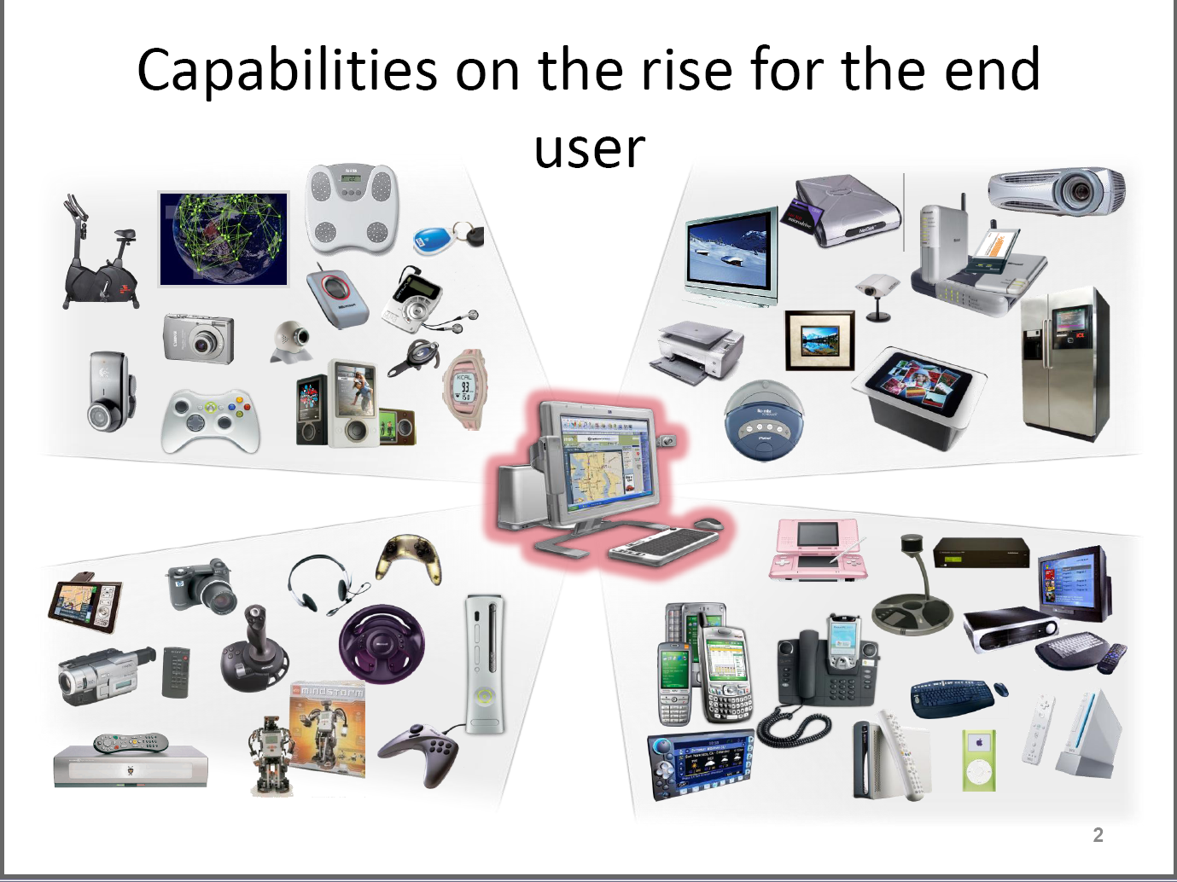
John Manferdelli (Microsoft)

Slide 40
Overall Software and Programming Models

Slide 41
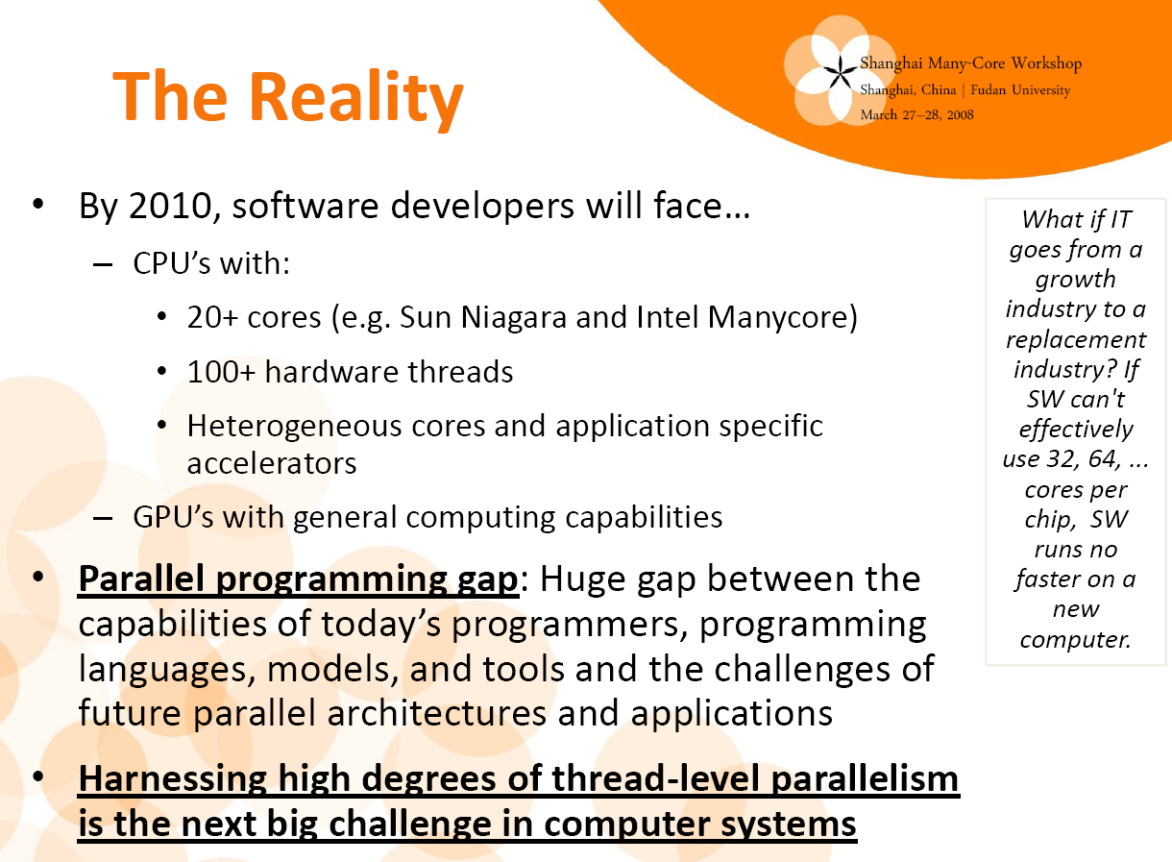
Mark K. Smith, Gelato

Slide 42
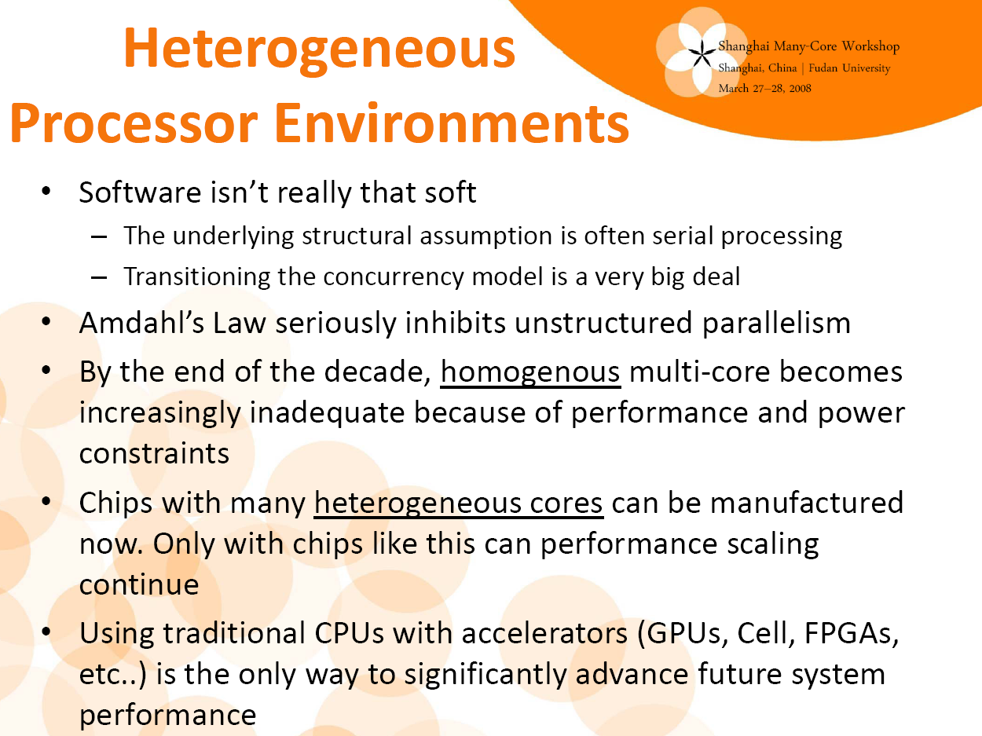
Mark K. Smith, Gelato
I don’t believe much of this

Slide 43
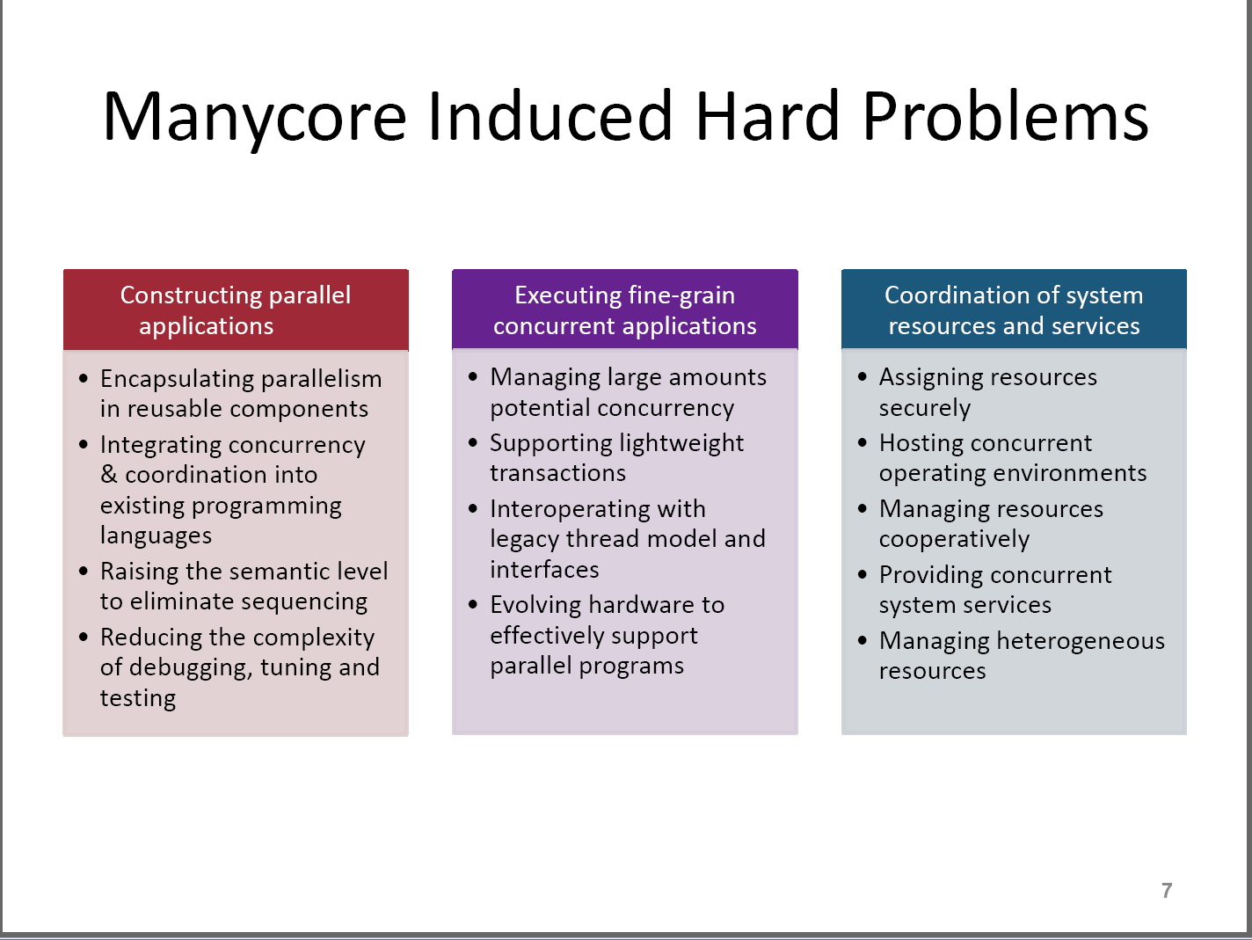
John Manferdelli (Microsoft)

Slide 44
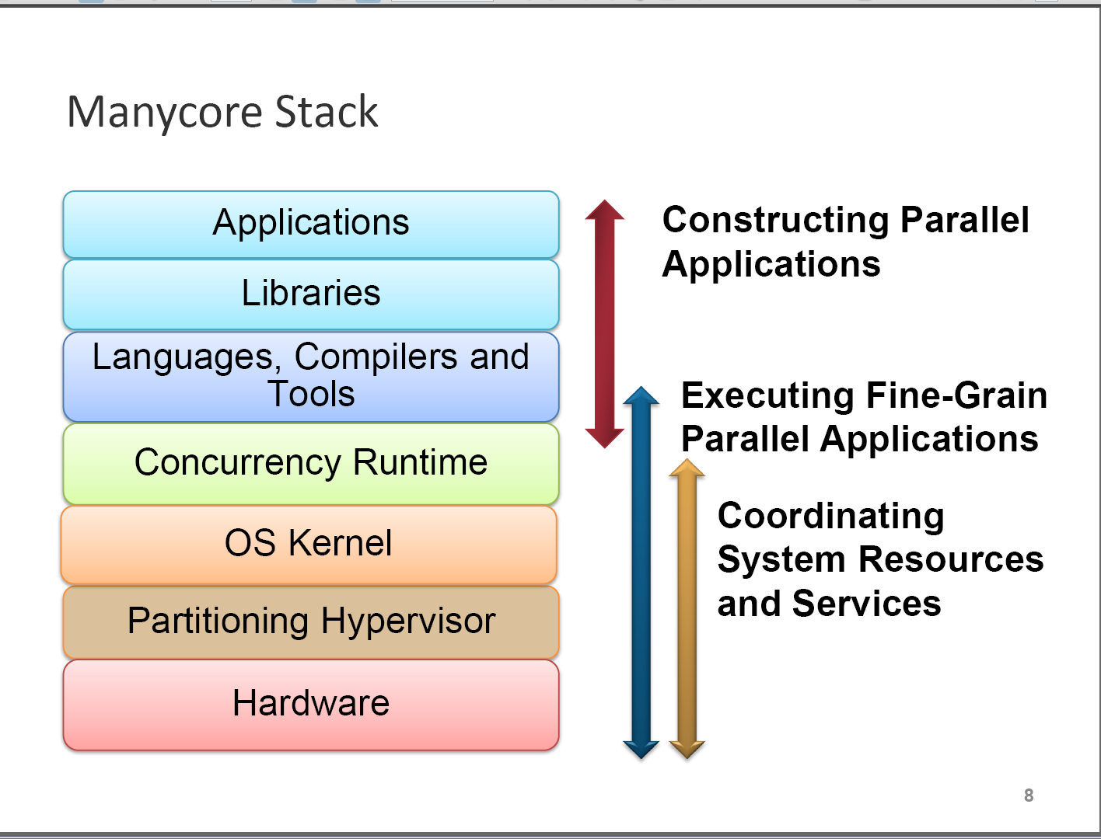
John Manferdelli (Microsoft)

Slide 45
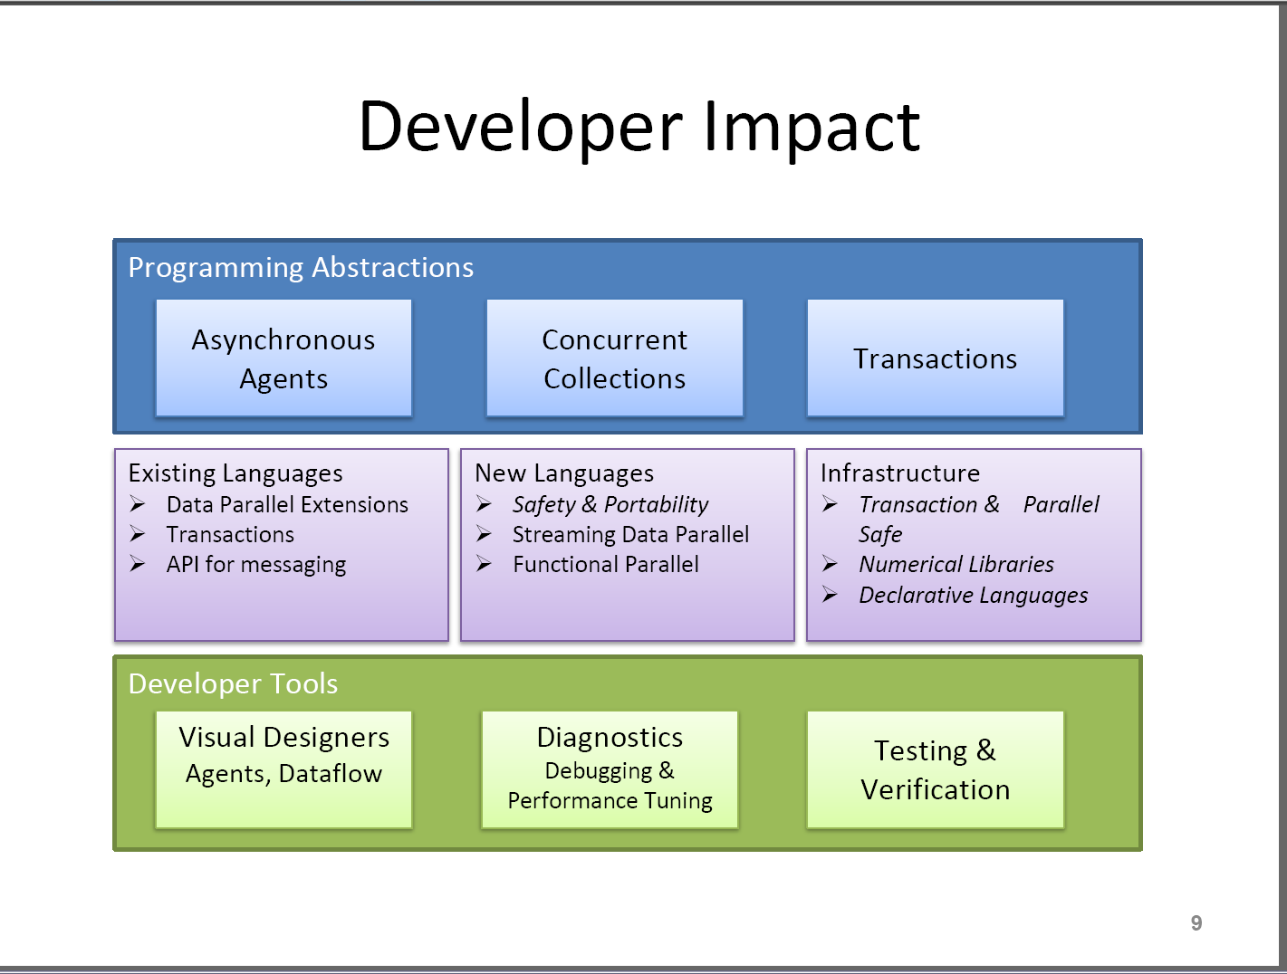
John Manferdelli (Microsoft)

Slide 46
Parallel
Algorithms

Slide 47
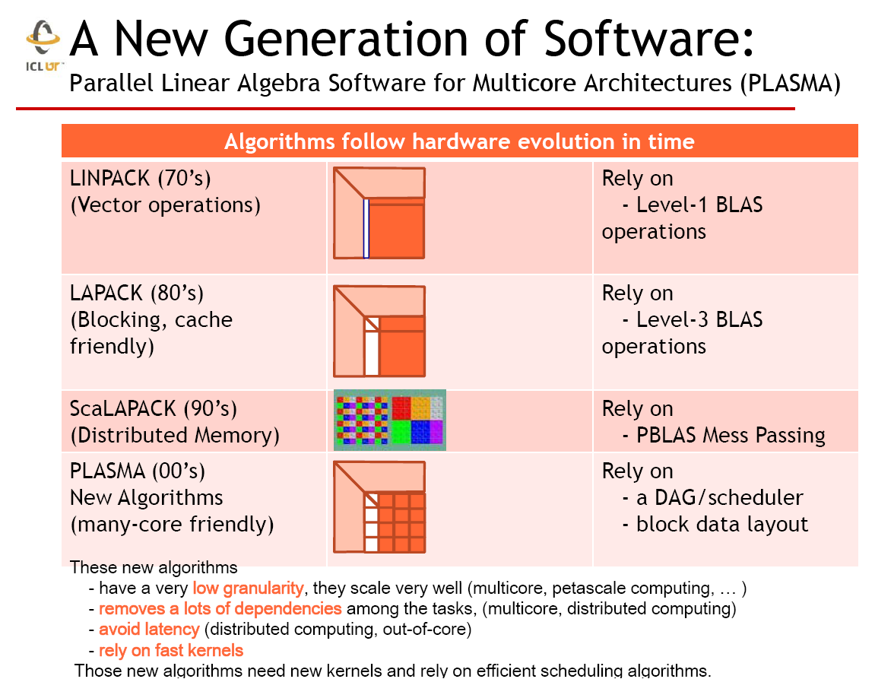
Jack Dongarra

Slide 48
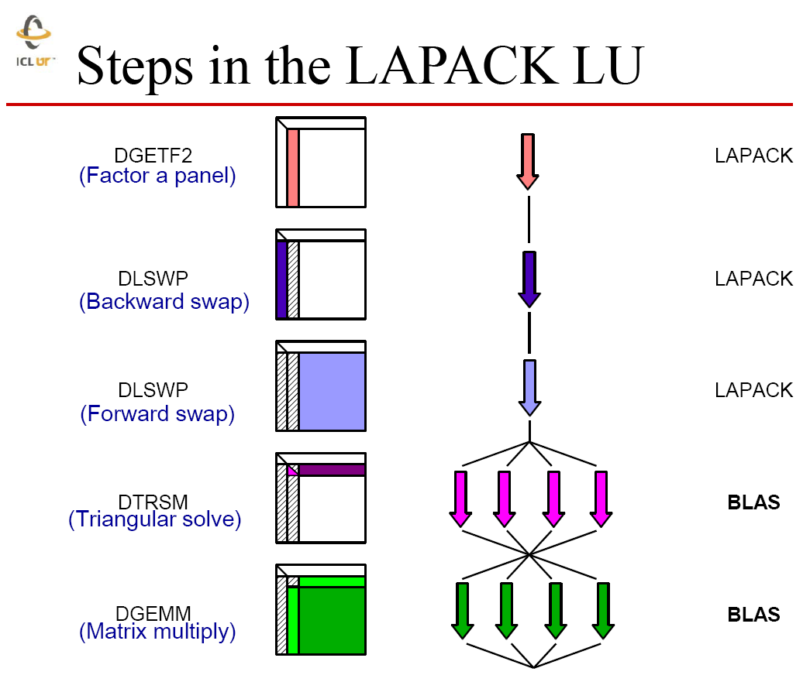
Jack Dongarra

Slide 49
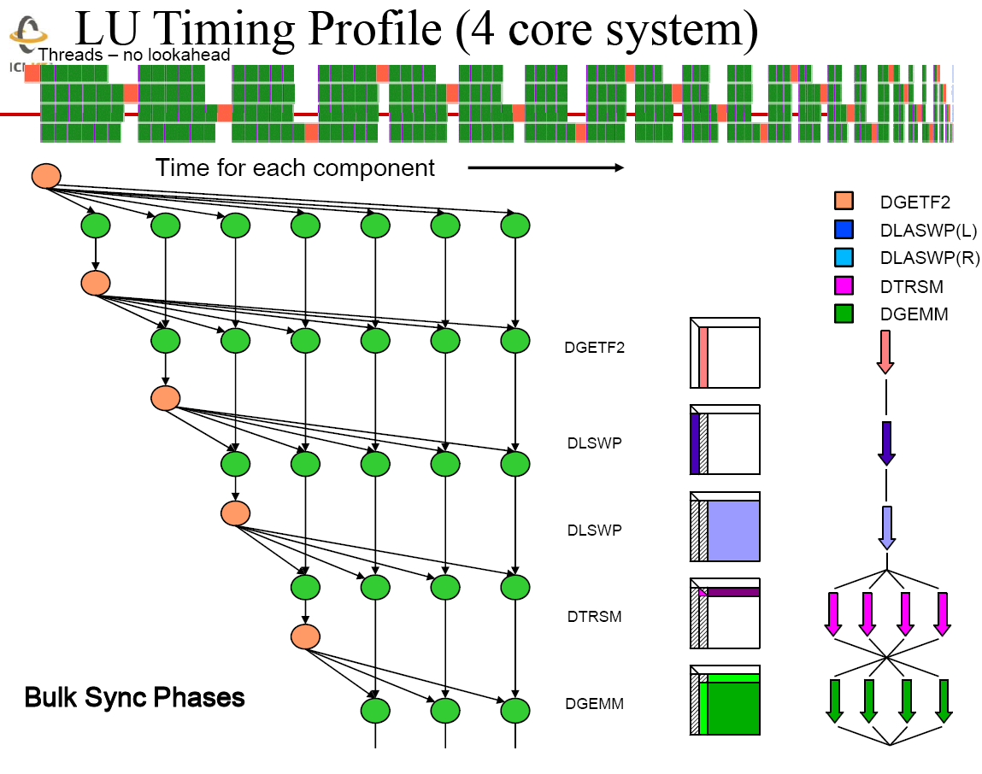
Jack Dongarra

Slide 50
Jack Dongarra

Slide 51
Jack Dongarra
312

Slide 52
Overall Summary

Slide 53
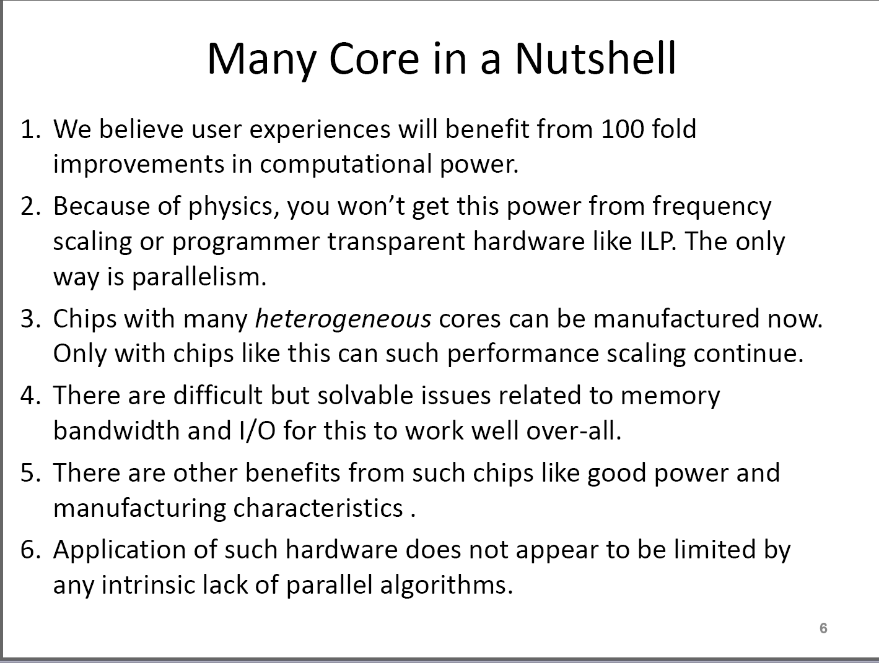
John Manferdelli (Microsoft)

Slide 54
What is Special about Multicore I?
It is (coarse grain) parallel rather than typical sequential chips
It is a shared memory system (SMP)
  All cores access the same memory
  Whereas most parallel computing is done on distributed memory systems (DMP: each processor has its own memory)
However it is not very parallel now and there have been larger SMP’s and much larger DMP’s
Note DMP’s used (upto now) rather than SMP’s as they have proven more successful in marketplace – they “work” and are more cost effective

Slide 55
What is Special about Multicore II?
SMP’s offer lowish latency access to all data (on node) whereas DMP’s require network communication
This allows richer set of programming models and potentially higher performance on some application classes that can benefit from lower latency
  Parallel Compilation with or without user annotation
  “multi-threaded” (as in Java C# )
Multicore can also use classic DMP message-based parallelism (MPI)
Current DMP’s are used either for databases or numerical (scientific) computation
Multicore will be used in a broader class e.g. ALL applications

Slide 56
What is Special about Multicore III?
Most analysis suggests that multicore applications will either be highly parallel
  Embarrassingly parallel as multi-user servers (Classic Grid application) or
  Numerical or Data(base) oriented as in potential client applications (Classic DMP)
And modestly parallel multi threaded classic applications (Word, Windows)
So application class isn’t changed so much
The developers of parallel systems will be quite different and will tend to come from “multi threaded classic applications” area

Slide 57
Software Approaches to Multicore
All traditional methods from HPC Community
  MPI (only broadly successful scheme)
  PGAS
  OpenMP/Automatic Parallelism
HPCS Languages; HPF done correctly?
Graphics Chips (cell, NVIDIA) ad-hoc models similar to previous HPC approaches – largely regular data parallel
Software Transactional Memory; new but only promising in some applications
Many pattern based approaches from commodity software community
  Don’t seem to be generally valid
Some important variants of HPC models (MPI, OpenMP)
Outside HPC, unclear what application requirements are

Slide 58
Why is Speed up not = # cores/threads?
Synchronization Overhead
Load imbalance
  Or there is no good parallel algorithm
Cache impacted by multiple threads
Memory bandwidth needs increase proportionally to number of threads
Scheduling and Interference with O/S threads
  Including MPI/CCR processing threads
  Note current MPI’s not well designed for multi-threaded problems

Slide 59
Synchronization Overhead
Note message passing provides distributed efficient synchronization by act of sending and receiving messages
Otherwise use barriers and locks
Message passing will copy data but note that overhead is typically small for large problem
  Communication ∝ (data size)^{0.67}
Note depending on methodology, without data transfer synchronization is O(1, P or logP) with P number of cores
This compares to work done often ∝ (data size)

Slide 60
Memory to CPU Information Flow
Information is passed by dataflow from main memory (or cache ) to CPU
  i.e. all needed bits must be passed
Information can be passed at essentially no cost by reference between different CPU’s (threads) of a shared memory machine
One usually uses an owner computes rule in distributed memory machines so that one considers data “fixed” in each distributed node
One passes only change events or “edge” data between nodes of a distributed memory machine
  Typically orders of magnitude less
  bandwidth required than for full dataflow
  Transported elements are red
  and edge/full grain size → 0
  as grain size increases

Slide 61
Processes v Threads
Current DMP programs are gotten by dividing problem into N parts and executing as N processes
If N nodes each with C cores, simplest approach is to divide problem into NC parts and execute as NC processes
In future could expect to divide problem into NC parts and execute as N processes, each using T threads where threads run in MPI message parallel style
  Requires changes to MPI implementation
Hybrid programming models divide problem into N parts and execute as N processes, each using T threads where threads use a DIFFERENT parallel computing model such as openMP

Slide 62
Messaging versus Shared Memory?
Note traditional multi-threaded applications choose “natural components” for each thread
In traditional parallel scientific applications one must breakup a single problem
In both cases messaging has huge advantage of safety; one can guarantee there is no problem from multiple threads accessing same memory location in wrong order
Multicore will reduce messaging latency and so help areas like discrete event simulation.

Slide 63
My Current Analysis
Dominant problem with multicore today is dealing with cache and suffering memory bandwidth
Only message passing models appear general and safe
MPI too complicated to be broadly implemented
Current MPI implementations are not optimized for multicore and (negative multicore performance) results should not be taken too seriously
Most applications – even for future commodity systems are either
  Data parallel as in classic HPC
  Use workflow as in current Grids
  Are embarrassingly parallel as in classic multi-user server
  They are not like Windows or Microsoft word

Slide 64
Analysis of Parallel (Scientific)
Applications

Slide 65
Job Mixes (on a Chip)
A1
A2
A3
A4
B
C
D1
D2
E
F
Any computer (chip) will certainly run several different “processes” at the same time
These processes may be totally independent, loosely coupled or strongly coupled
Above we have jobs A B C D E and F with A consisting of 4 tightly coupled threads and D two
  A could be Photoshop with 4 way strongly coupled parallel image processing threads
  B Word,
  C Outlook,
  D Browser with separate loosely coupled layout and media decoding
  E Disk access and
  F desktop search monitoring files
We are aiming at 32-1024 useful threads using significant fraction of CPU capability without saturating memory I/O etc. and without waiting “too much” on other threads

Slide 66
Three styles of “Jobs”
A1
A2
A3
A4
B
C
D1
D2
E
F
Totally independent or nearly so (B C E F) – This used to be called embarrassingly parallel and is now pleasingly so
  This is preserve of job scheduling community and one gets efficiency by statistical mechanisms with (fair) assignment of jobs to cores
  “Parameter Searches” generate this class but these are often not optimal way to search for “best parameters”
  “Multiple users” of a server is an important class of this type
  No significant synchronization and/or communication latency constraints
Loosely coupled (D) is “Metaproblem” with several components orchestrated with pipeline, dataflow or not very tight constraints
  This is preserve of Grid workflow or mashups
  Synchronization and/or communication latencies in millisecond to second or more range
Tightly coupled (A) is classic parallel computing program with components synchronizing often and with tight timing constraints
  Synchronization and/or communication latencies around a microsecond

Slide 67
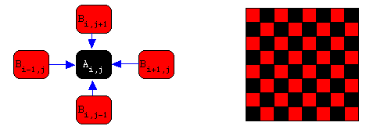
Data Parallelism in Algorithms
Data-parallel algorithms exploit the parallelism inherent in many large data structures.
  A problem is an (identical) update algorithm applied to multiple points in data “array”
  Usually iterate over such “updates”
Features of Data Parallelism
  Scalable parallelism -- can often get million or more way parallelism
  Hard to express when “geometry” irregular or dynamic
Note data-parallel algorithms can be expressed by ALL parallel programming models (Message Passing, HPF like, OpenMP like)

Slide 68
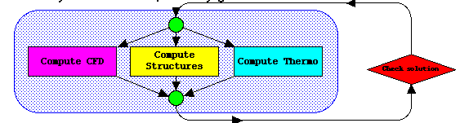
Functional Parallelism in Algorithms
Coarse Grain Functional parallelism exploits the parallelism between the parts of many systems.
  Many pieces to work on ⇔ many independent operations
  Example: Coarse grain Aeroelasticity (aircraft design)
    CFD(fluids) and CSM(structures) and others (acoustics, electromagnetics etc.) can be evaluated in parallel
Analysis:
  Parallelism limited in size -- tens not millions
  Synchronization probably good as parallelism and decomposition natural from problem and usual way of writing software
  Workflow exploits functional parallelism NOT data parallelism

Slide 69
Structure(Architecture) of Applications
Applications are metaproblems with a mix of components (aka coarse grain functional) and data parallelism
Modules are decomposed into parts (data parallelism) and composed hierarchically into full applications.They can be the
  “10,000” separate programs (e.g. structures,CFD ..) used in design of aircraft
  the various filters used in Adobe Photoshop or Matlab image processing system
  the ocean-atmosphere components in integrated climate simulation
  The data-base or file system access of a data-intensive application
  the objects in a distributed Forces Modeling Event Driven Simulation

Slide 70
Motivating Task
Identify the mix of applications on future clients and servers and produce the programming environment and runtime to support effective (aka scalable) use of 32-1024 cores
If applications were pleasingly parallel or loosely coupled, then this is non trivial but straightforward
It appears likely that closely coupled applications will be needed and here we have to have efficient parallel algorithms, express them in some fashion and support with low overhead runtime
  Of course one could gain by switching algorithms e.g. from a tricky to parallelize brand and bound to a loosely coupled genetic optimization algorithm
These lectures are designed to capture current knowledge from parallel computing relevant to producing 32-1024 core scalable applications and associated software

Slide 71
Why Parallel Computing is Hard
Essentially all large applications can be parallelized but unfortunately
The architecture of parallel computers bears modest resemblance to the architecture of applications
  Applications don’t tend to have hierarchical or shared memories and really don’t usually have memories in sense computers have (they have local state?)
Essentially all significant conventionally coded software packages cannot be parallelized
Note parallel computing can be thought of as a map from an application through a model to a computer
Parallel Computing Works because Mother Nature and Society (which we are simulating) are parallel
Think of applications, software and computers as “complex systems” i.e. as collections of “time” dependent entities with connections
  Each is a Complex System S_{i} where i represents “natural system”, theory, model, numerical formulation, software, runtime or computer
  Architecture corresponds to structure of complex system
  I intuitively prefer message passing as it naturally expresses connectivity

Slide 72
Structure of Modern Java System: GridSphere
Carol Song Purdue http://gridreliability.nist.gov/Workshop2/ReliabilityAssessmentSongPurdue.pdf

Slide 73
Are Applications Parallel?
The general complex system is not parallelizable but in practice, complex systems that we want to represent in software are parallelizable (as nature and (some) systems/algorithms built by people are parallel)
  General graph of connections and dependencies such in GridSphere software typically has no significant parallelism (except inside a graph node)
  However systems to be simulated are built by replicating entities (mesh points, cores) and are naturally parallel
Scalable parallelism requires a lot of “replicated entities” where we will use n (grain size) as number of entities nN_{proc} divided by number of processors N_{proc}
Entities could be threads, particles, observations, mesh points, database records ….
Important lesson from scientific applications: only requirement for efficient parallel computing is that grain size n be large and efficiency of implementation only depends on n plus hardware parameters

Slide 74
Seismic Simulation of Los Angeles Basin
This is a (sophisticated) wave equation and you divide Los Angeles geometrically and assign roughly equal number of grid points to each processor
Divide surface into 4 parts and assign calculation of waves in each part to a separate processor

Slide 75
Parallelizable Software
Traditional software maps (in a simplistic view) everything into time and parallelizing it is hard as we don’t easily know which time (sequence) orderings are required and which are gratuitous
Note parallelization is happy with lots of connections – we can simulate the long range interactions between N particles or the Internet, as these connections are complex but spatial
It surprises me that there is not more interaction between parallel computing and software engineering
  Intuitively there ought to be some common principles as inter alia both are trying to avoid extraneous interconnections
S_{natural application}
S_{computer}
Time
Time
Map
Space
Space

Slide 76
Typical modern application performance

Slide 77
Performance of Typical Science Code I
FLASH Astrophysics code from DoE Center at Chicago
Plotted as time as a function of number of nodes
Scaled Speedup as constant grain size as number of nodes increases

Slide 78
Performance of Typical Science Code II
FLASH Astrophysics code from DoE Center at Chicago on Blue Gene
Note both communication and simulation time are independent of number of processors – again the scaled speedup scenario
Simulation
Communication

Slide 79
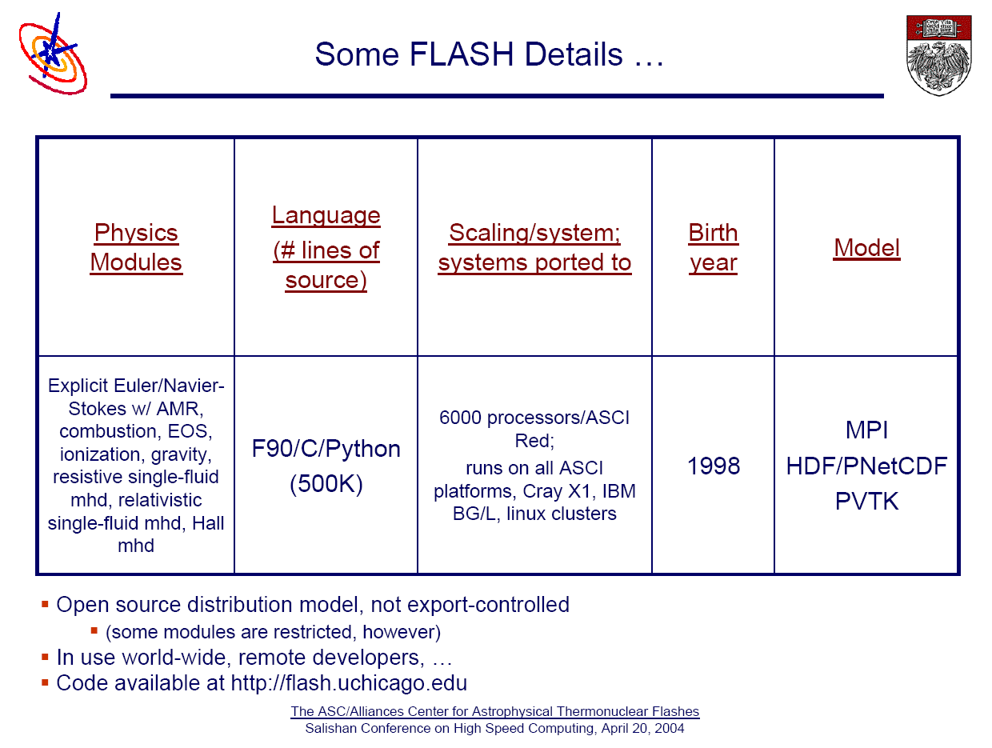
FLASH is a pretty serious code

Slide 80
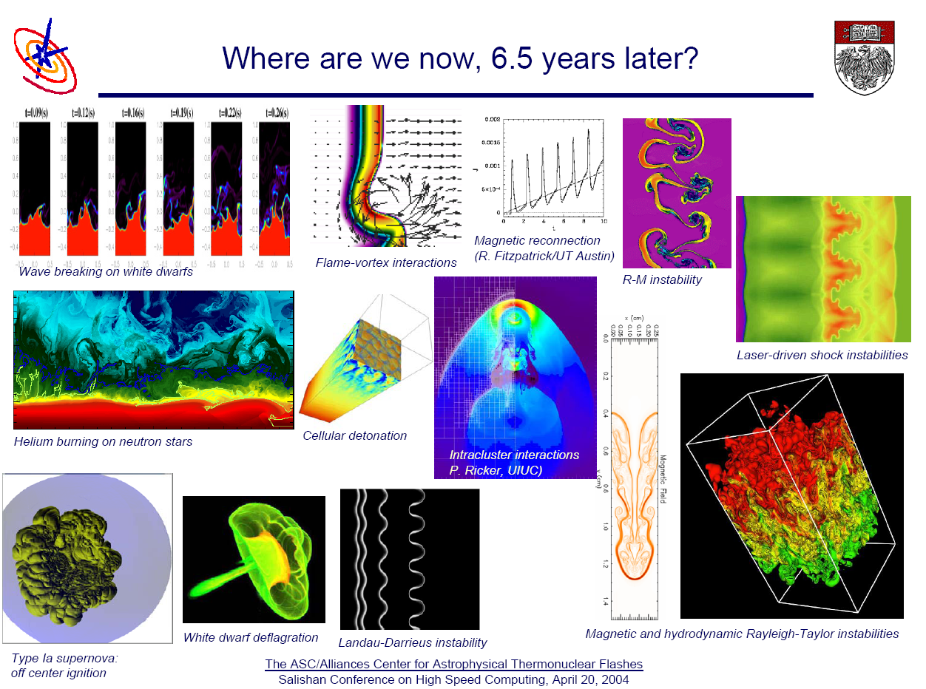
Rich Dynamic Irregular Physics

Slide 81
FLASH Scaling at fixed total problem size
Increasing Problem Size
Rollover occurs at increasing number of processors as problem size increases

Slide 82
Now we discuss classes of application

Slide 83
“Space-Time” Picture
Computer
Time
Data-parallel applications map spatial structure of problem on parallel structure of both CPU’s and memory
However “left over” parallelism has to map into time on computer
Data-parallel languages support this
T₄
T₃
T₂
Application Time
t₄
t₃
T₁
t₂
t₁
t₀
T₀
Application Space
4-way
Parallel
Computer
(CPU’s)
“Internal” (to data chunk) application spatial dependence (n degrees of freedom) maps into time on the computer

Slide 84
Data Parallel Time Dependence
A simple form of data parallel applications are synchronous with all elements of the application space being evolved with essentially the same instructions
Such applications are suitable for SIMD computers and run well on vector supercomputers (and GPUs but these are more general than just synchronous)
However synchronous applications also run fine on MIMD machines
SIMD CM-2 evolved to MIMD CM-5 with same data parallel language CMFortran
The iterative solutions to Laplace’s equation are synchronous as are many full matrix algorithms
Application Time
Synchronous
Synchronization on MIMD machines is accomplished by messaging
It is automatic on SIMD machines!
t₄
t₃
t₂
t₁
t₀
Application Space
Identical evolution algorithms

Slide 85
Local Messaging for Synchronization
MPI_SENDRECV is typical primitive
Processors do a send followed by a receive or a receive followed by a send
In two stages (needed to avoid race conditions), one has a complete left shift
Often follow by equivalent right shift, do get a complete exchange
This logic guarantees correctly updated data is sent to processors that have their data at same simulation time
………
Application and Processor Time
Communication
Phase
Compute
Phase
Communication
Phase
Compute
Phase
Communication
Phase
Compute
Phase
8 Processors
Communication
Phase
Application Space

Slide 86


Loosely Synchronous Applications
This is most common large scale science and engineering and one has the traditional data parallelism but now each data point has in general a different update
  Comes from heterogeneity in problems that would be synchronous if homogeneous
Time steps typically uniform but sometimes need to support variable time steps across application space – however ensure small time steps are δt = (t₁-t₀)/Integer so subspaces with finer time steps do synchronize with full domain
The time synchronization via messaging is still valid
However one no longer load balances (ensure each processor does equal work in each time step) by putting equal number of points in each processor
Load balancing although NP complete is in practice surprisingly easy
Application Time
t₄
t₃
t₂
t₁
t₀
Application Space
Distinct evolution algorithms for each data point in each processor

Slide 87
Irregular 2D Simulation -- Flow over an Airfoil
The Laplace grid points become finite element mesh nodal points arranged as triangles filling space
All the action (triangles) is near near wing boundary
Use domain decomposition but no longer equal area as equal triangle count

Slide 88

Heterogeneous Problems
Simulation of cosmological cluster (say 10 million stars )
Lots of work per star as very close together
( may need smaller time step)
Little work per star as force changes slowly and can be well approximated by low order multipole expansion

Slide 89
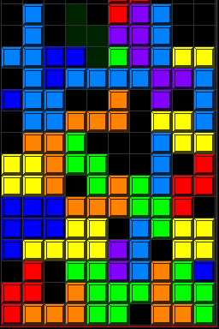
Asynchronous Applications
Here there is no natural universal ‘time’ as there is in science algorithms where an iteration number or Mother Nature’s time gives global synchronization
Here there is no natural universal ‘time’ as there is in science algorithms where an iteration number or Mother Nature’s time gives global synchronization
Loose (zero) coupling or special features of application needed for successful parallelization
In computer chess, the minimax scores at parent nodes provide multiple dynamic synchronization points
Loose (zero) coupling or special features of application needed for successful parallelization
In computer chess, the minimax scores at parent nodes provide multiple dynamic synchronization points
Application Time
Application Time
Application Space
Application Space

Slide 90
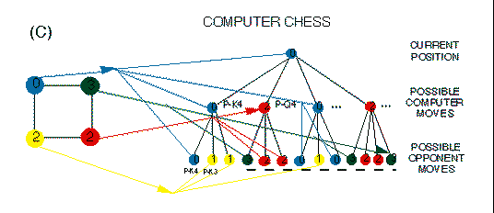
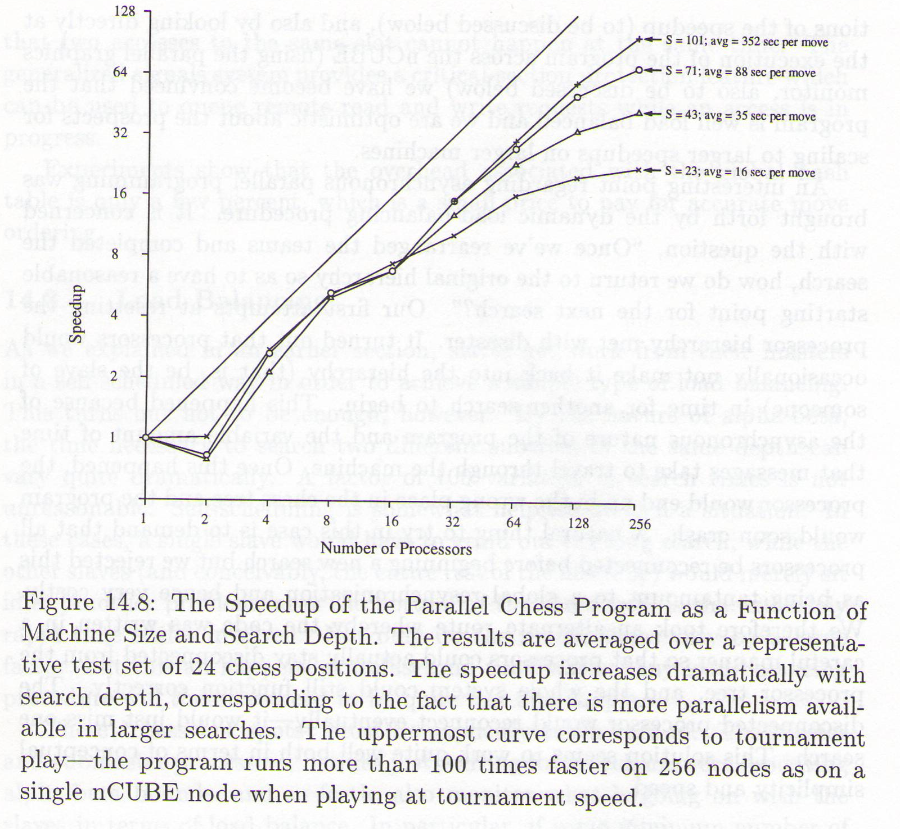
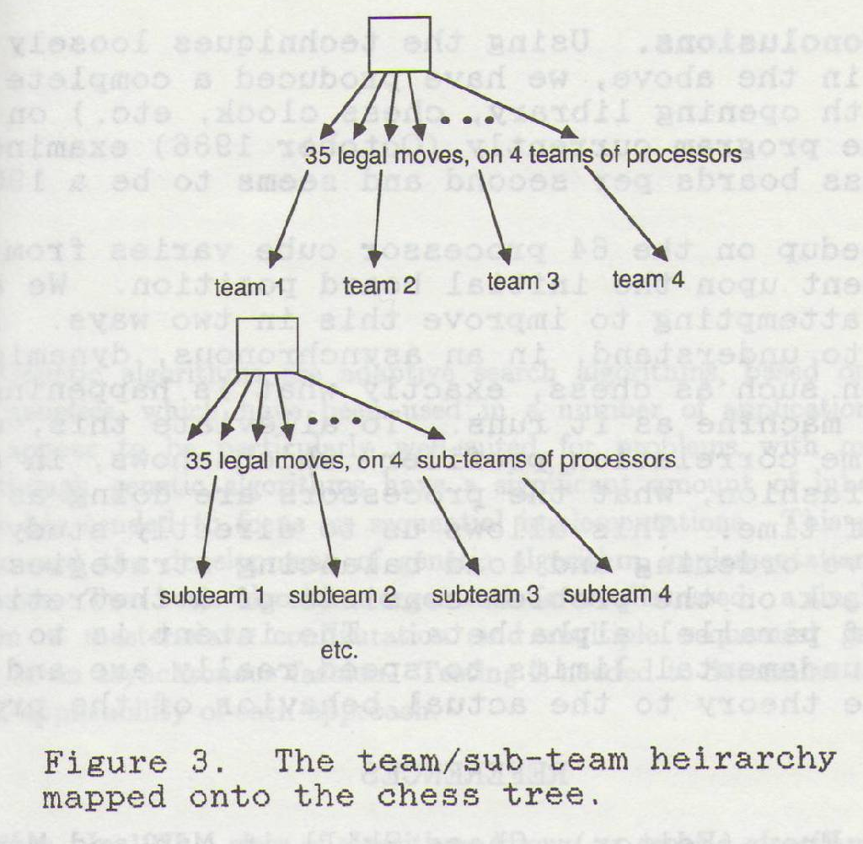
Computer Chess
Thread level parallelism unlike position evaluation parallelism used in other systems
Competed with poor reliability and results in 1987 and 1988 ACM Computer Chess Championships
Increasing search depth

Slide 91
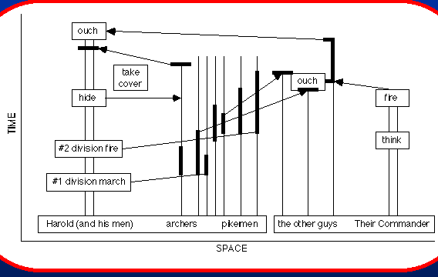
Discrete Event Simulations
These are familiar in military and circuit (system) simulations when one uses macroscopic approximations
  Also probably paradigm of most multiplayer Internet games/worlds
Note Nature is perhaps synchronous when viewed quantum mechanically in terms of uniform fundamental elements (quarks and gluons etc.)
It is loosely synchronous when considered in terms of particles and mesh points
It is asynchronous
when viewed in
terms of tanks,
people, arrows etc.
Battle of Hastings

Slide 92
Dataflow
This includes many data analysis and Image processing engines like AVS and Microsoft Robotics Studio
Multidisciplinary science linkage as in
  Ocean Land and Atmospheric
  Structural, Acoustic, Aerodynamics, Engines, Control, Radar Signature, Optimization
Either transmit all data (successive image processing), interface data (as in air flow – wing boundary) or trigger events (as in discrete event simulation)
Use Web Service or Grid workflow in many eScience projects
Often called functional parallelism with each linked function data parallel and typically these are large grain size and correspondingly low communication/calculation ratio and efficient distributed execution
Fine grain dataflow has significant communication requirements
Large Applications
Optimization
Communication Bus
Wing
Airflow
Engine Airflow
Radar Signature
Noise
Structural Analysis

Slide 93
Work/Dataflow and Parallel Computing I
Decomposition is fundamental (and most difficult) issue in (generalized) data parallelism (including computer chess for example)
One breaks a single application into multiple parts and carefully synchronize them so they reproduce original application
Number and nature of parts typically reflects hardware on which application will run
As parts are in some sense “artificial”, role of concepts like objects and services not so clear and also suggests different software models
  Reflecting microsecond (parallel computing) versus millisecond (distributed computing) latency difference

Slide 94
Work/Dataflow and Parallel Computing II
Composition is one fundamental issue expressed as coarse grain dataflow or functional parallelism and addressed by workflow and mashups
Now the parts are natural from the application and are often naturally distributed
Task is to integrate existing parts into a new application
Encapsulation, interoperability and other features of object and service oriented architectures are clearly important
Presumably software environments tradeoff performance versus usability, functionality etc. and software with highest performance (lowest latency) will be hardest to use and maintain – correct?
So one should match software environment used to integration performance requirements
  e.g. use services and workflow not language integration for loosely coupled applications

Slide 95
Other Application Classes
Pipelining is a particular Dataflow topology
Pleasingly parallel applications such as analyze the several billion independent events per year from the Large Hadron Collider LHC at CERN are staple Grid/workflow applications as is the associated master-worker or farming processing paradigm
High latency unimportant as hidden by event processing time while as in all observational science the data is naturally distributed away from users and computing
  Note full data needs to be flowed between event filters
Independent job scheduling is a Tetris style packing problem and can be handled by workflow technology

Slide 96
Amdahl’s Law

Slide 97
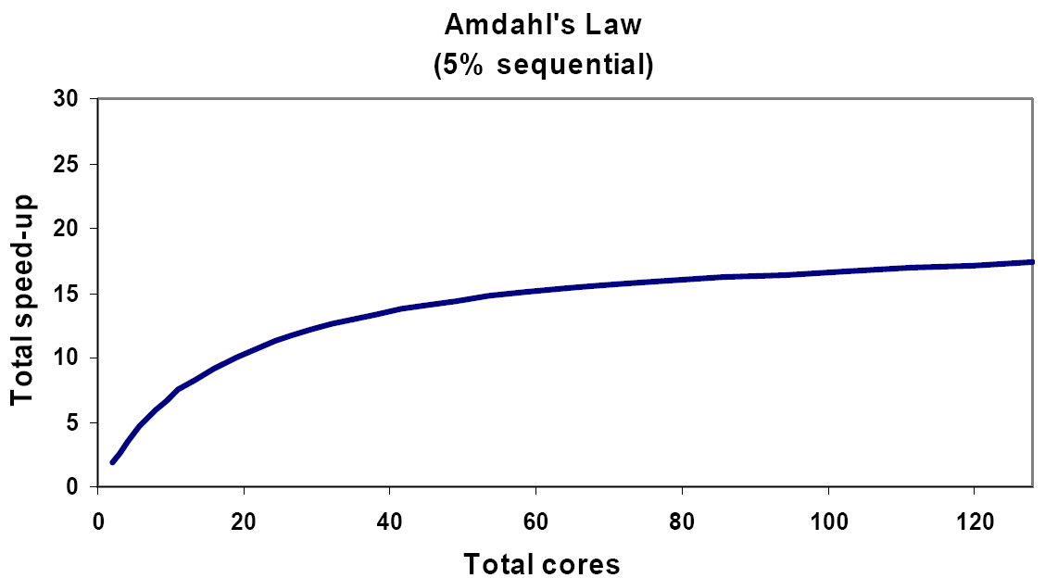
Amdahl’s misleading law I
Amdahl’s law notes that if the sequential portion of a program is x%, then the maximum achievable speedup is 100/x, however many parallel CPU’s one uses.
This is realistic as many software implementations have fixed sequential parts; however large (science and engineering) problems do not have large sequential components and so Amdahl’s law really says “Proper Parallel Programming is too hard”

Slide 98
Amdahl’s misleading law II
Let N = nN_{proc} be number of points in some problem
Consider trivial exemplar code
  X= 0; Sequential
  for( i= 0 to N) { X= X+A(i) } Parallel
Where parallel sum distributes n of the A(i) on each processor and takes time O(n) without overhead to find partial sums
Sums would be combined at end taking a time O(logN_{proc})
So we find “sequential” O(1) + O(logN_{proc})
While parallel component is O(n)
So as problem size increases (n increases) the sequential component does not keep a fixed percentage but declines
Almost by definition intrinsic sequential component cannot depend on problem size
So Amdahl’s law is in principle unimportant

Slide 99
Hierarchical Algorithms meet Amdahl
Consider a typical multigrid algorithm where one successively halves the resolution at each step
Assume there are n mesh points per process at finest resolution and problem two dimensional so communication time complexity is c √n
At finest mesh fractional communication overhead α c /√n
Total parallel complexity is n (1 + 1/2 + 1/4 ….) .. +1 = 2n and total serial complexity is 2nN_{proc}
The total communication time is c√ n (1+1/√2 + 1/2 +
1/2√ 2 + ..) = 3.4 c√ n
So the communication overhead is increased by 70% but in scalable fashion as it still only depends on grain size and tends to zero at large grain size
Level 4 Mesh
Level 3 Mesh
Level 2 Mesh
Level 1 Mesh
Level 0 Mesh
0 1 2 3
Processors

Slide 100
A Discussion of Software Models

Slide 101
Programming Paradigms
At a very high level, there are three broad classes of parallelism
Coarse grain functional parallelism typified by workflow and often used to build composite “metaproblems” whose parts are also parallel
  This area has several good solutions getting better
Large Scale loosely synchronous data parallelism where dynamic irregular work has clear synchronization points
Fine grain functional parallelism as used in search algorithms which are often data parallel (over choices) but don’t have universal synchronization points
Pleasingly parallel applications can be considered special cases of functional parallelism
I strongly recommend “unbundling” support of these models!
  Each is complicated enough on its own

Slide 102
Parallel Software Paradigms I: Workflow
Workflow supports the integration (orchestration) of existing separate services (programs) with a runtime supporting inter-service messaging, fault handling etc.
  Subtleties such as distributed messaging and control needed for performance
In general, a given paradigm can be realized with several different ways of expressing it and supported by different runtimes
  One needs to discuss in general Expression, Application structure and Runtime
Grid or Web Service workflow can be expressed as:
  Graphical User Interface allowing user to choose from a library of services, specify properties and service linkage
  XML specification as in BPEL
  Python (Grid), PHP (Mashup) or JavaScript scripting

Slide 103
The Marine Corps Lack of Programming Paradigm Library Model
One could assume that parallel computing is “just too hard for real people” and assume that we use a Marine Corps of programmers to build as libraries excellent parallel implementations of “all” core capabilities
  e.g. the primitives identified in the Intel application analysis
  e.g. the primitives supported in Google MapReduce, HPF, PeakStream, Microsoft Data Parallel .NET etc.
These primitives are orchestrated (linked together) by overall frameworks such as workflow or mashups
The Marine Corps probably is content with efficient rather than easy to use programming models

Slide 104
Parallel Software Paradigms II: Component Parallel and Program Parallel
We generalize workflow model to the component parallel paradigm where one explicitly programs the different parts of a parallel application with the linkage either specified externally as in workflow or in components themselves as in most other component parallel approaches
  In the two-level Grid/Web Service programming model, one programs each individual service and then separately programs their interaction; this is an example of a component parallel paradigm
In the program parallel paradigm, one writes a single program to describe the whole application and some combination of compiler and runtime breaks up the program into the multiple parts that execute in parallel

Slide 105
Parallel Software Paradigms III: Component Parallel and Program Parallel continued
In a single virtual machine as in single shared memory machine with possible multi-core chips, standard languages are both program parallel and component parallel as a single multi-threaded program explicitly defines the code and synchronization for parallel threads
  We will consider programming of threads as component parallel
Note that a program parallel approach will often call a built in runtime library written in component parallel fashion
  A parallelizing compiler could call an MPI library routine
Could perhaps better call “Program Parallel” as “Implicitly Parallel” and “Component Parallel” as “Explicitly Parallel”

Slide 106
Parallel Software Paradigms IV: Component Parallel and Program Parallel continued
Program Parallel approaches include
  Data structure parallel as in Google MapReduce, HPF (High Performance Fortran), HPCS (High-Productivity Computing Systems) or “SIMD” co-processor languages
  Parallelizing compilers including OpenMP annotation
Component Parallel approaches include
  MPI (and related systems like PVM) parallel message passing
  PGAS (Partitioned Global Address Space)
  C++ futures and active objects
  Microsoft CCR and DSS
  Workflow and Mashups (already discussed)
  Discrete Event Simulation

Slide 107
Data Structure Parallel I
Reserving data parallel to describe the application property that parallelism achieved from simultaneous evolution of different degrees of freedom in Application Space
Data Structure Parallelism is a Program Parallel paradigm that expresses operations on data structures and provides libraries implementing basic parallel operations such as those needed in linear algebra and traditional language intrinsics
Typical High Performance Fortran built on array expression in Foretran90 and supports full array statements such as
  B = A1 + A2
  B = EOSHIFT(A,-1)
  C = MATMUL(A,X)
HPF also allows parallel forall loops
Such support is also seen in co-processor support of GPU (PeakStream), ClearSpeed and Microsoft Data Parallel .NET support

Slide 108
Data Structure Parallel II
HPF had several problems including mediocre early implementations (My group at Syracuse produced the first!) but on a longer term, they exhibited
  Unpredictable performance
  Inability to express complicated parallel algorithms in a natural way
  Greatest success was on Earth Simulator as Japanese produced an excellent compiler while IBM had cancelled theirs years before
Note we understood limited application scope but negative reception of early compilers prevented issues being addressed; probably we raised expectations too much!
HPF now being replaced by HPCS Languages X10, Chapel and Fortress but these are still under development

Slide 109
Data Structure Parallel III
HPCS Languages Fortress (Sun), X10 (IBM) and Chapel (Cray) are designed to address HPF problems but they are a long way from being proven in practice in either design or implementation
  Will HPCS languages extend outside scientific applications
  Will people adopt a totally new language as opposed to an extension of an existing language
  Will HPF difficulties remain to any extent?
  How hard will compilers be to write?
HPCS Languages include a wealth of capabilities including parallel arrays, multi-threading and workflow.
  They have support for 3 key paradigms identified earlier and so should address broad problem class
HPCS approach seems ambitious to me and more conservative would be to focus on unique language-level data structure parallel support and build on existing language(s)
  There are less “disruptive” ways to support coarse and fine grain functional parallelism

Slide 110
Parallelizing Compilers I
The simplest Program parallel approach is a parallelizing compiler
In syntax like
  for( i=1; i<n; i++) {
    k=something;
    A(i)= function(A(i+k)); }
It is not clear what parallelism is possible
  k =1 all if careful; k= -1 none
On a distributed memory machine, it is often unclear what instructions involve remote memory access and expensive communication
In general parallelization information (such as value of k above) is “lost” when one codes a parallel algorithm in a sequential language
Whole program compiler analysis more likely to be able to find needed information and so identify parallelism.

Slide 111
Parallelizing Compilers II
Data Parallelism corresponds to multiple for loops over the degrees of freedom
  for( iouter1=1; i<n; i++) {
    for( iouter2=1; i<n; i++) { ………………….
      for( iinner2=1; i<n; i++) {
        for( iinner1=1; i<n; i++) { ….. }}…}}
The outer loops tend to be the scalable (large) “global” data parallelism and the inner loops “local” loops over for example degrees of freedom at a mesh point (5 for CFD Navier Stokes) or over multiple (x,y,z) properties of a particle
Inner loops are most attractive for parallelizing compilers as minimizes number of undecipherable data dependencies
Overlaps with very successful loop reorganization, vectorization and instruction level parallelization
Parallelizing Compilers are likely to be very useful for small number of cores but of decreasing success as core count increases

Slide 112
OpenMP and Parallelizing Compilers
Compiler parallelization success can clearly be optimized by careful writing of sequential code to allow data dependencies to be removed or at least amenable to analysis.
Further OpenMP (Open Specifications for Multi Processing) is a sophisticated set of annotations for traditional C C++ or Fortran codes to aid compilers producing parallel codes
It provides parallel loops and collective operations such as summation over loop indices
Parallel Sections provide traditional multi-threaded capability

Slide 113
OpenMP Parallel Constructs
SECTIONS
DO/for loop
SINGLE
Master Thread
Master Thread
Master Thread
Fork
Fork
Fork
Heterogeneous Team
Homogeneous Team
Join
Join
Join
Master Thread again with an implicit barrier synchronization
In distributed memory MPI style programs, the “master thread” is typically replicated and global operations like sums deliver results to all components

Slide 114
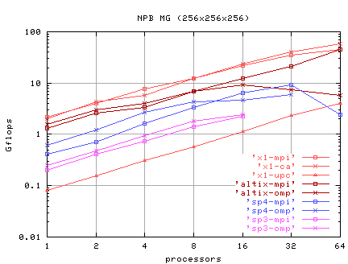
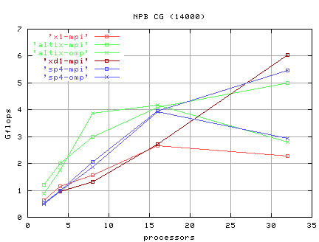
Performance of OpenMP, MPI, CAF, UPC
Multigrid
Conjugate Gradient
NAS Benchmarks
Oak Ridge SGI Altix and other machines
http://www.csm.ornl.gov/~dunigan/sgi/
CAF
MPI
MPI
MPI
MPI
OpenMP
OpenMP
MPI
OpenMP
MPI
MPI
UPC
OpenMP
OpenMP
MPI

Slide 115
Component Parallel I: MPI
Always the final parallel execution will involve multiple threads and/or processes
In Program parallel model, a high level description as a single program is broken up into components by the compiler.
In Component parallel programming, the user explicitly specifies the code for each component
This is certainly hard work but has advantage that always works and has a clearer performance model
MPI is the dominant scalable parallel computing paradigm and uses a component parallel model
  There are a fixed number of processes that are long running
  They have explicit message send and receive using a rendezvous model

Slide 116
MPI Execution Model
Rendezvous for set of “local” communications but as in this case with a global “structure”
Gives a global synchronization with local communication
SPMD (Single Program Multiple Data) with each thread identical code including “computing”
and explicit MPI sends and receives
8 fixed executing threads (processes)

Slide 117
MPI Features I
MPI aimed at high performance communication and original 1995 version had 128 functions but 6 are key:
  MPI_INIT Initialize
  MPI_Comm_rank Find Thread number in pool allowing one to work out what part of data you are responsible for
  MPI_Comm_Size Find total number of threads
  MPI_Send Send data to processor
  MPI_Recv Receive data from processor
  MPI_Finalize Clean up – get rid of threads etc.
Key concepts include
  Ability to define data structures for messages (relevant for C, Fortran)
  Ability to address general sets of processes (multicast with reduction)
  Ability to label messages using common tags allowing different message sets to coexist and not intefere

Slide 118
MPI Features II
Both simple MPI_SEND and MPI_RECV and a slew of collective communications
  Barrier, Broadcast, Gather, Scatter, All-to-all, Exchange
  General reduction operation (sum, minimum, scan)
  e.g. All threads send out a vector and at end of operation, all have the vector that sums over those sent by each thread
  Need different implementations on each interconnect
Blocking, non-blocking, buffered, synchronous, asynchronous messaging
Topologies to decompose set of threads onto a mesh
I/O in MPI-2 that doubles number of functions!
MPICH most famous implementation and OpenMPI is a fresh rewrite including fault-tolerance

Slide 119
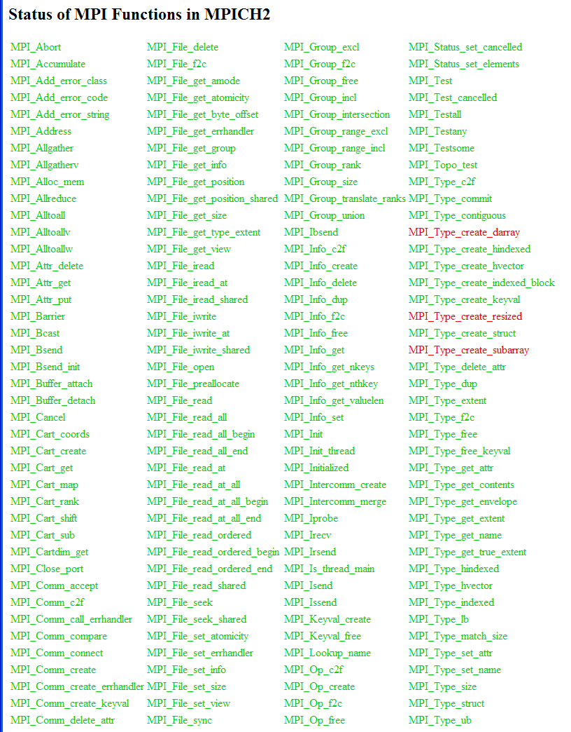
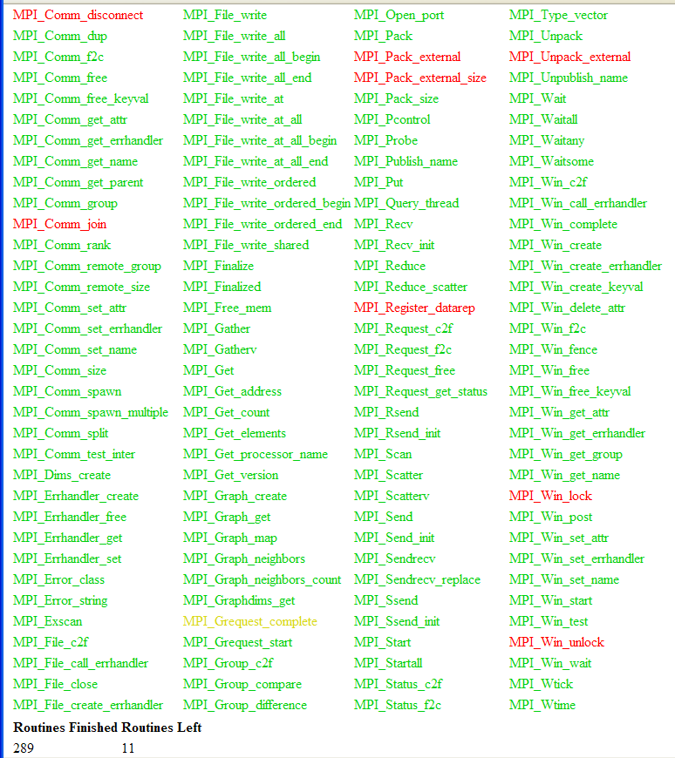
300 MPI2 routines from
Argonne
MPICH2

Slide 120
MPICH2 Performance

Slide 121
Multicore MPI Performance

Slide 122
Why people like MPI!
Jason J Beech-Brandt, and Andrew A. Johnson, at AHPCRC Minneapolis
BenchC is unstructured finite element CFD Solver
Looked at
OpenMP on
shared memory
Altix with some
effort to
optimize
Optimized UPC
on several
machines
After Optimization of UPC
cluster
cluster

Slide 123
Component Parallel: PGAS Languages I
PGAS (Partitioned Global Address Space) Languages have been explored for 30 years (perhaps more) but have never been very popular
  Probably because it was difficult to write efficient compilers for the complicated problems for which the had most possible advantage
  However there is a growing interest confined to small communities probably spurred by better implementations
  HPCS Languages offer PGAS capabilities
In MPI, one writes program for each thread addressing its local variables with local indices. There are clever tricks like ghost points to make the code cleaner and more similar to sequential version
  One uses MPI_Comm_rank or equivalent to find out which part of Application you are addressing
  There is still quite a bit of bookkeeping to get MPI calls correct and transfer data to and from correct locations

Slide 124
Ghost Cells
Suppose you are writing code to solve Laplace’s equation for 8 by 8 set of Green mesh points
One would communicate values on neighboring red mesh points and be able to update
Easiest code corresponds to dimensioning array to 10 by 10 and preloading effective boundary values in red cells
This is termed use of Halo or Ghost points

Slide 125
PGAS Languages II
In the PGAS approach, one still writes the code for the component but use some form of global index
  In contrast with MPI and other “pure” messaging systems one uses “local” indices with the “global” value implicit from the particular processors that messages were gotten from and user is responsible for calculating global implications of local indices
Global references in component code (external to component) are translated into appropriate MPI (on distributed memory) calls to transfer information using the usual “owner computes” rule i.e. component where variable stored updates it
  Non trivial performance issue for compiler to generate suitable large messages to avois too much overhead from message latency
Co-array Fortran CAF extensions will be adopted by Fortran standards committee (X3J3)
UPC is a C-based PGAS language developed at NSA
Titanium from Berkeley and the obscure HPJava (Indiana University) are extensions of Java

Slide 126
Other Component Parallel Models
Shared memory (as in multicore) allows more choices as one no longer needs to send messages
  One may choose to use messages as less likelihood of race conditions
However even MPI on a shared memory need not actually transfer data as one can simply transfer a reference to information
However loosely synchronous problems have a clear efficient synchronization mechanism whereas other applications may not
Appropriate Mechanisms depends on application structure
Is structure?
or

Slide 127
Component Synchronization Patterns
There are (at least) 3 important “synchronization patterns” which must get implemented by messaging on distributed
Reductions (such as global sums over subsets of threads) are present in all applications; this a well known hot spot example
  Here one can use libraries which is default in MPI/PGAS as the structure is quite simple and easy to optimize for each architecture
Structured Synchronization is characteristic of loosely synchronous problems and is application specific but can be arranged to happen at natural barriers; note all threads are communicating and synchronizing together and often involve multicast
  Explicit messaging seems attractive as hard otherwise to avoid race conditions as need data values to be well defined and not updated on the fly
Erratic Synchronization as in updating shared databases as in Computer Chess hash table; here often particular synchronization points are not likely to have interference between multiple threads and so one can use locks or similar approaches that are not good for more intense but structured synchronization
  Locks or queues of updates seem to fit this

Slide 128
Vivek Sarkar
312

Slide 129
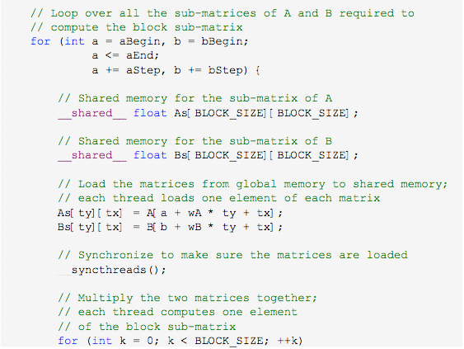
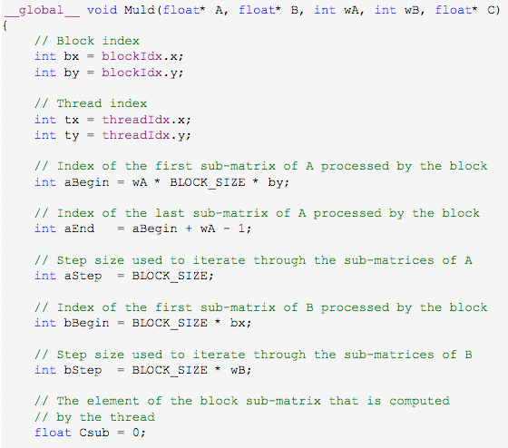
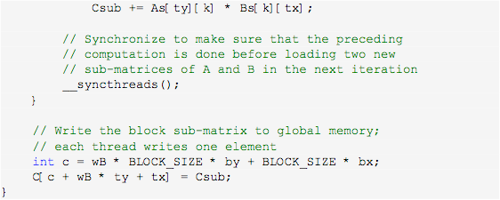
Vivek Sarkar
Matrix Multiply Example in CUDA (device)
312

Slide 130
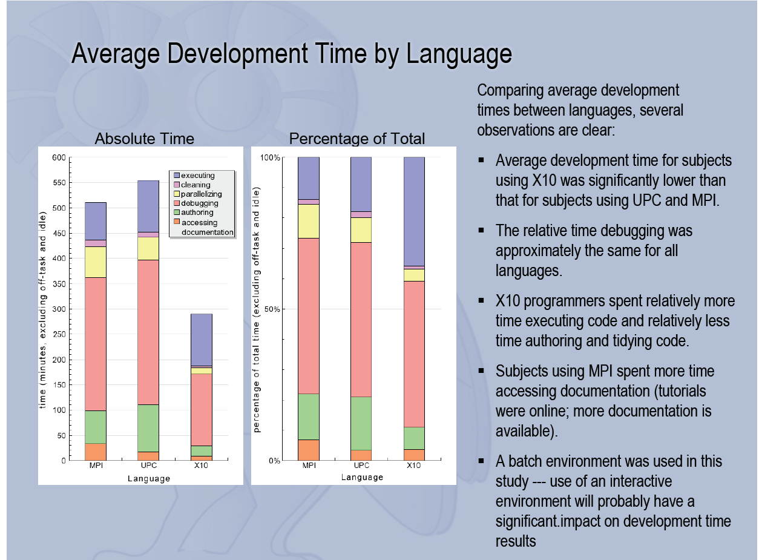
Vivek Sarkar
312

Slide 131
Summary So Far
Michael Heroux on use of SMP v DMP
SMP alone is insufficient for scalable parallelism.
DMP alone is certainly sufficient, but can we improve by selective use of SMP within DMP?
Analysis of key preconditioned Krylov kernels gives insight into possibilities of using SMP with DMP, and results can be extended to other algorithms.
Most of the straight-forward techniques for introducing SMP into DMP will not work.
Level scheduled ILU is one possible example of effectively using SMP within DMP (not always satisfactory).
Most fruitful use of SMP within DMP seems to have a common theme of allowing multiple processes to have dynamic asynchronous access to large (read-only) data sets.

Slide 132
Implications for Multicore Chips
Michael Heroux on use of SMP v DMP
MPI-only use of multicore is a respectable option.
  May be the ultimate right answer for scalability and ease of programming.
  Assumption: MPI is multicore-aware. Not completely true right now.
  Helpful: High task affinity. Single program image per chip.
Flexible, robust multicore kernels will be complicated.
  Task parallelism is preferred if available (Media Player/Outlook).
  Similar issues as Cray SMP programming:
    How many cores can (available) or should (problem size) be used?
    Illustrates difference between hetero/homo-geneous multicore.
Data placement issues similar to Origin (if # CMP>1).
  Task affinity important.
  Mitigating factor:
    On-chip data movement is at processor speeds.
    Shared cache should help?

Slide 133
About MPI
Michael Heroux on use of SMP v DMP
Uncomfortable defending MPI: But…
Can Parallel Programming be Easy?
  Memory management is key.
  Is it bad that parallel programming hard? Isn’t programming hard?
La-Z-Boy principle* impacts MPI adoption also.
MPI is not that hard, does not impact majority of code.
Real problem: Serial to MPI transition is not gradual.
Can the mass market produce new parallel language quickly? Not convinced.
Can develop MPI-based code that is portable, today!
Still hope for better.
* Don’t need to write parallel code because uni-processors are getting
faster (No longer applies to next-gen processors).

Slide 134
Colt Gan, Intel

Slide 135
Horror of Hybrid Computing
Many parallel systems have distributed shared memory nodes and indeed all multicore clusters are of this type
This could be supported by say OpenMP on the shared memory nodes and MPI between the distributed nodes.
Such hybrid computing models are common but it is not clear if they are better than “pure MPI” on both distributed and shared memory
MPI is typically more efficient than OpenMP and many applications have enough data (outer loop) parallelism (i.e. they are large enough) that it can be used for both shared and distributed parallelism
If one uses OpenMP, natural to exploit inner loop not the outer loop data parallelism
  Funny to use two software models for the same parallelism

Slide 136
Parallel Runtime
Locks and Barriers
Software Transactional Memory
MPI
RTI (Run Time Infrastructure) which is runtime for DoD HLA (High Level Architecture) Discrete Event Simulation
CCR multi-input multi-output messaging
There is also Message oriented Middleware and that used to support Web Services and Peer to peer networks

