Slide 1
Science Gateway Advanced Support Activities in PTI
Marlon Pierce
Indiana University

Slide 2
Staff Member | Primary Projects | Funding
Marlon Pierce | All | Multiple sources
Suresh Marru | ODI, GridChem, LEAD, UltraScan | TeraGrid GIG
Yu Ma | iCenter, QuakeSim | IU Base Funding
Joshua Rosen | BioDrugScreen, AVATS | NSF OGCE
Sidd Maini | FutureGrid, AVATS | PTI Core Funding (Lilly)
Raminder Singh | GridChem, UltraScan | TeraGrid GIG
Archit Kulshrestha | EST Pipeline, BioDrugScreen, FutureGrid | TeraGrid RP
Zhenhua Guo (student) | MyOSG | NASA
Xiaoming Gao (student) | QuakeSim | NASA
Jun Wang (pending) | PolarGrid, QuakeSim | NASA, NSF
Sangmi Pallickara (Alum) | EST Pipeline, BioDrugScreen | TeraGrid RP

Slide 3
OGCE Gateway Tool Adaption & Reuse
LEAD
LEAD
Experiment Builder, XRegistry Interface
GFac, XBaya, XRegistry, FTR
Eventing System
GridChem
XBaya
GridChem
Ultrascan
OGCE
Re-engineer, Generalize, Build, Test and Release
Resource Discovery Service
GFac, Eventing System
OVP/
RST/
MIG
BioVLab
TeraGrid
User Portal
XBaya, GFac
GPIR, File Browser
ODI
Workflow Suite, Gadget Container
OGCE Team
Bio Drug Screen
Gadget Container, GTLab, Javascript Cog, XRegistry Interface, Experiment Builder, Axis2 Gfac, Axis2 Eventing System, Resource Prediction Service, Swarm
Swarm->GFac
EST Pipeline
Swarm->GFac
Future Grid
GFac, Xbaya, …
3
3
Notes:
3
3

Slide 4
Gateway Hosting Service
Allocatable TeraGrid Resource providing Virtual Machine hosting of Science Gateways.
This has been a valuable resource for our group.
We should look for ways to expand its usage, such as supporting data collections
Courtesy: Mike Lowe, Dave Hancock.

Slide 5
BioDrugScreen Portal
Support: Josh Rosen and Archit Kulshrestha
Collaboration: Samy Meroueh, IUPUI

Slide 6
BioDrugScreen
A computational drug discovery resource
Contains millions of pre-docked and pre-scored complexes between thousands of targets from the human proteome and thousands of drug-like small molecules
Allows drug researchers to develop their own scoring functions of calculating how well a drug will interact with a protein.

Slide 7
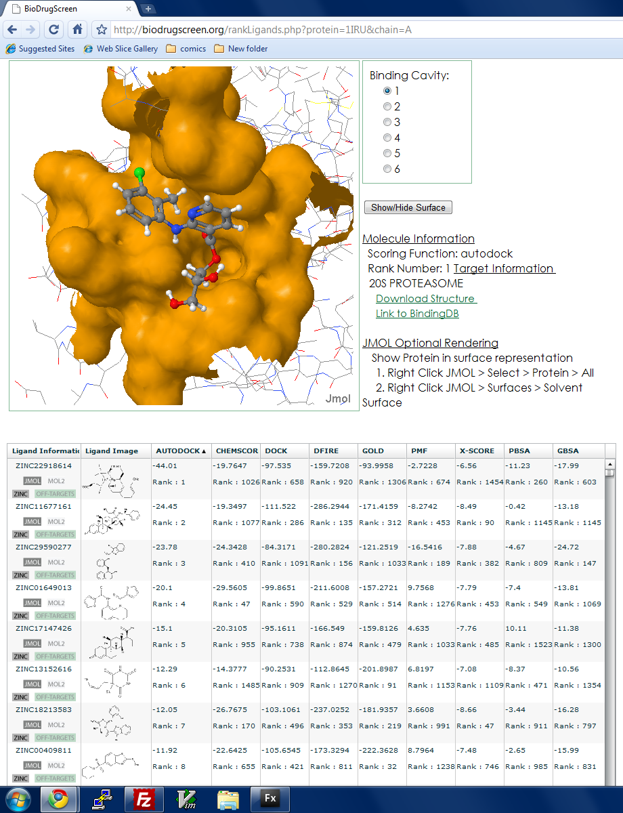
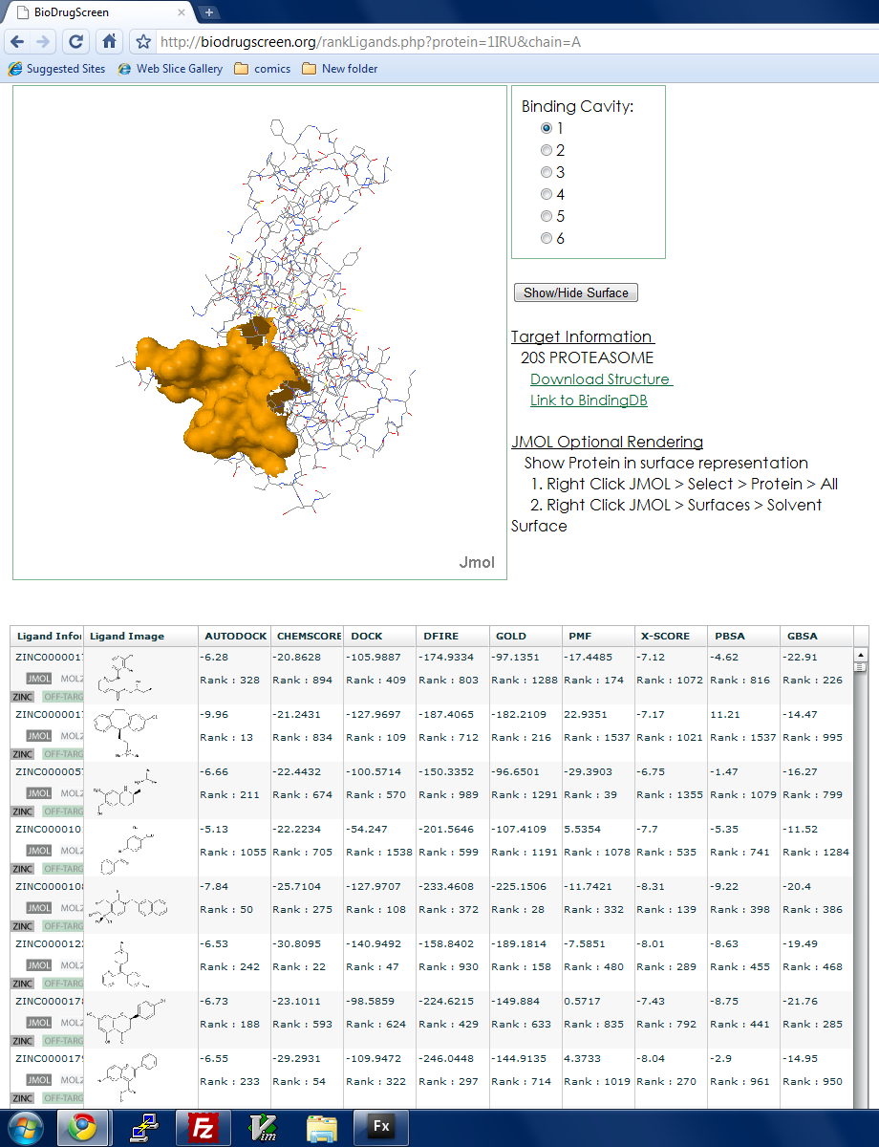
Small drug-like molecules from NCI diversity set are docked into 205 proteasome protein target. Orange area is an identified target area of the protein. Visualization uses JMol. Docking done with Amber on the TeraGrid. Proteins are obtained from the PDB. Samy maintains his own database of protein structures and small molecules.

Slide 8
Support Provided
Proteins that have not had their docking and scores calculated need to have these run on the Teragrid.
An Web interface needed to be created so users can submit their own jobs.
We developed the interface between the site’s submissions and the Teragrid using the Swarm Service.
Also prototyping GFac support
Using Flash and javascript, we developed an improved data presentation for the ranking page

Slide 9
UltraScan Gateway
Staff: Raminder Singh
Collaborators: Borries Demeler and Emre Brookes, UTHSCSA

Slide 10
UltraScan Science Gateway
A biophysics gateway for investigating properties and structure-function relationships of biological macromolecules, nanoparticles, polymers and colloids that are implicated in many diseases, including cancer.
High-resolution analysis and modeling of hydrodynamic data from an analytical ultracentrifuge.
TeraGrid as a backup spill over resources but still is one of the heaviest user consuming 1.75 million SU’s in 6 months.

Slide 11
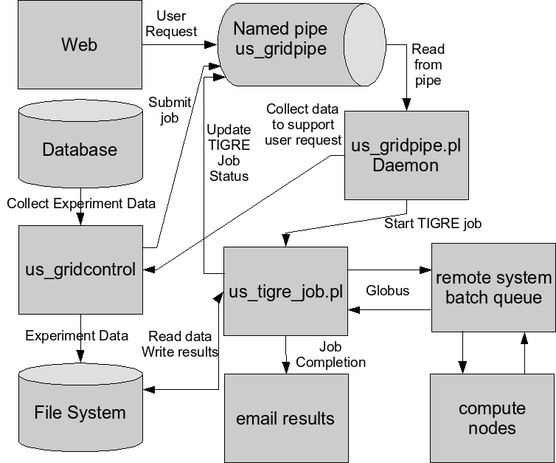
UltraScan Advanced Support
Porting to new architectures and parallel performance enhancements.
New workflow implementations, new grid computing and grid middleware support:
Reliability problems with WSGram
Missing job status
Only supports Gram4, needs porting to other middleware
Issues with data movement.
Need Fault tolerance at all levels.
Users decide resources manually, need automated scheduling.
Current Architecture

Slide 12
UltraScan OGCE Integration
Enhance the perl job submission daemon and monitoring with OGCE GFac service.
Implement and iteratively enhance fault tolerance.
Port to community account usage with Gridshib auditing support.
Support UNICORE to run jobs on other European and Australian resources.

Slide 13
GridChem
Support: Suresh Marru, Raminder Singh
Collaborators: Sudhakar Pamidighantam, NCSA

Slide 14
GridChem Science Gateway
A chemistry/material Science Gateway for running computational chemistry codes, workflows, and parameter sweeps.
Integrates molecular science applications and tools for community use.
400+ users heavily using TeraGrid. One of the consistent Top 5 TeraGrid Gateway users.
Supports all popular Chemistry applications including Gaussian, GAMESS, NWChem, QMCPack, Amber and MolPro, CHARMM

Slide 15
GridChem Advanced Support
GridChem supports single application executions
Advanced support request for supporting workflows
Improved Fault Tolerance

Slide 16
GridChem OGCE Integration
OGCE workflow tools wrapped Gaussian & CHARMM chemistry applications
Coupled Butane workflow using Gaussian & CHARMM Integration
100 member Gaussian parametric sweeps
Integration with Pegasus workflow tools
Ye Fan, Master’s student

Slide 17
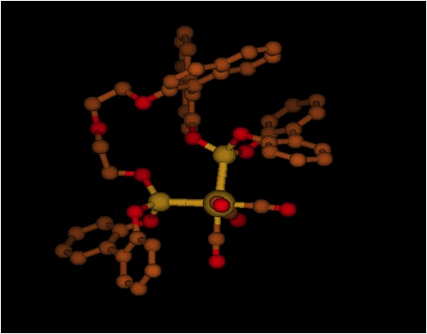
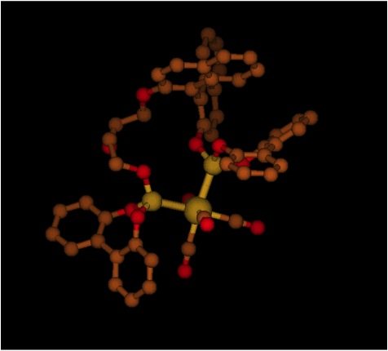
GridChem Using OGCE Tools
Initial Structure
Optimized Structure
GridChem using OGCE Workflow Tools to construct and execute CHARMM and Gaussian Molecular chemistry Models

Slide 18
Future Grid User Portal
Support: Sidd Maini, Archit Kulshrestha

Slide 19
Future Grid User Portal
Our strategy is to build all components as Google Gadgets that interact with REST Services
Can live in iGoogle as well as containers like Drupal.
Take advantage of OpenID and OAuth
Initial target gadgets: Knowledge Base, Amazon EC2 Clients, Inca Clients
Future Work: services, gadgets, and workflows for managing machine images with Xcat.

Slide 20
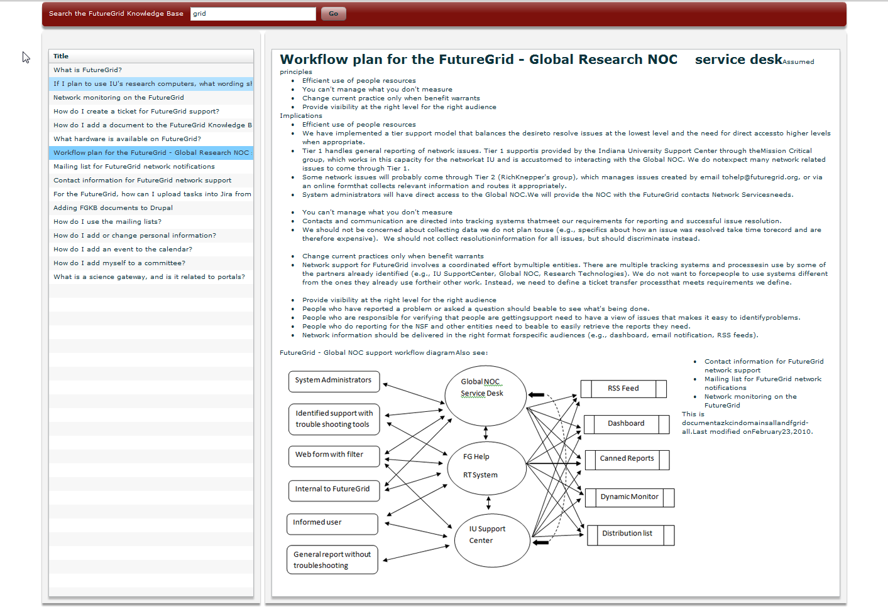
Future Grid KnowledgeBase (FGKB)
Task:
Develop FGKB Web App
Search KB Documents
Technology used: Adobe Flex / PHP / KB REST API

Slide 21
Current Status: Basic Search and Retrieval
Live URL: http://tinyurl.com/ykaa9gr

Slide 22
EC2 Client User Interface
Link: http://tinyurl.com/ylkohj7
See list of images available
Launch them
Terminate them
Next Step: Add more EC2 features, integrate with FutureGrid user database

Slide 23
Portal Embedded Gadgets

Slide 24
FutureGrid Machine Image Services
FutureGrid will use Xcat to dynamically create and manage clusters from preconfigured images
On both real hardware and Virtual machines.
We are working to capture common XCat tasks as scripts
These scripts can be wrapped as secure services using OGCE’s GFac.
Several tasks can be linked together as workflows visually composed with OGCE’s XBaya.
You can still use Pegasus/Condor as the workflow engine

Slide 25
OGCE Software for Science Gateways
Software and Architectural Approach

Slide 26
Science Gateways Layer Cake
User Interfaces
Web/Gadget Container
Web/Gadget Interfaces
Web Enabled Desktop Applications
Gateway Abstraction Interfaces
Application Abstractions
Fault Tolerance
Application
Monitoring
User Management
Information Services
Gateway Services
Workflow System
Auditing & Reporting
Registry
Security
Provenance & Metadata Management
Resource Middleware
Cloud Interfaces
Grid Middleware
SSH & Resource Managers
Compute Resources
Computational Clouds
Computational Grids
Local Resources
Color Coding
OGCE Gateway Components
Complimentary Gateway Components
Dependent resource provider components

Slide 27
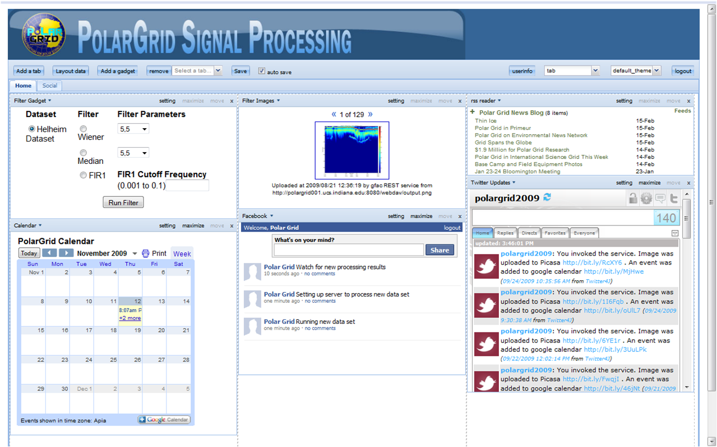
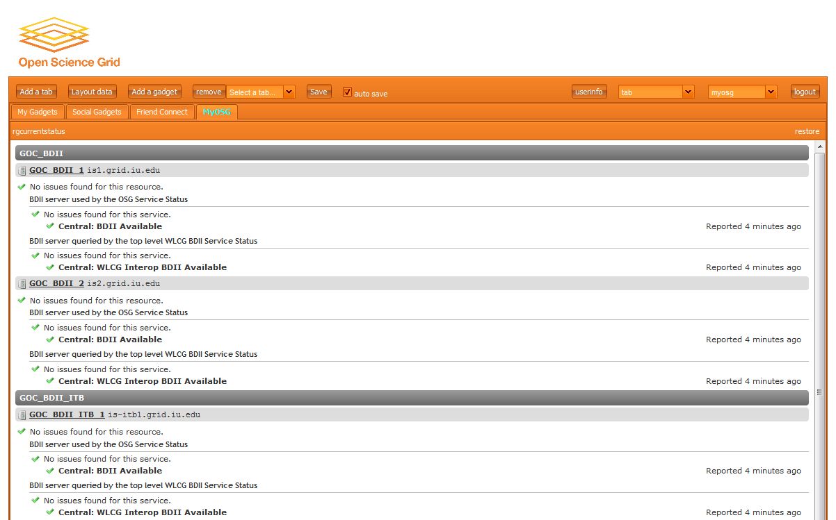
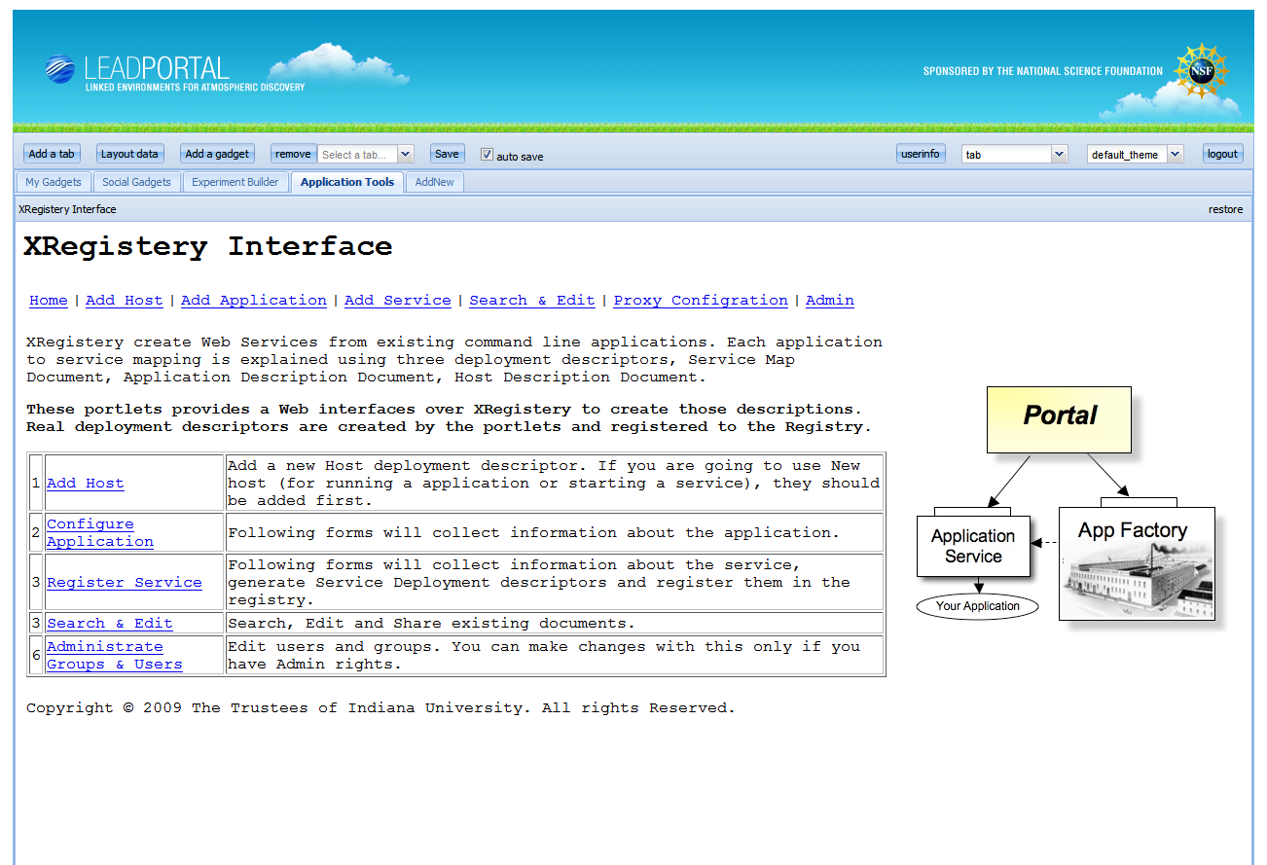
Google Gadget-Based Science Gateways
PolarGrid
MyOSG
LEAD

Slide 28
GFac Current & Future Features
Apache Axis2
Globus
Input Handlers
Registry Interface
Scheduling Interface
Monitoring Interface
Campus Resources
Output Handlers
Fault Tolerance
Data Management Abstraction
Amazon Eucalyptus
Auditing
Checkpoint Support
Job Management
Abstraction
Unicore
Condor
Color Coding
Existing Features
Planned/Requested Features

Slide 29
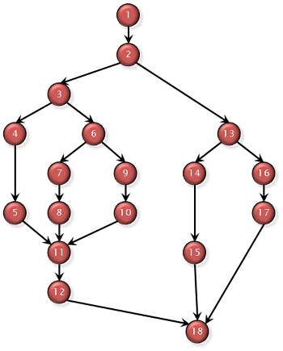
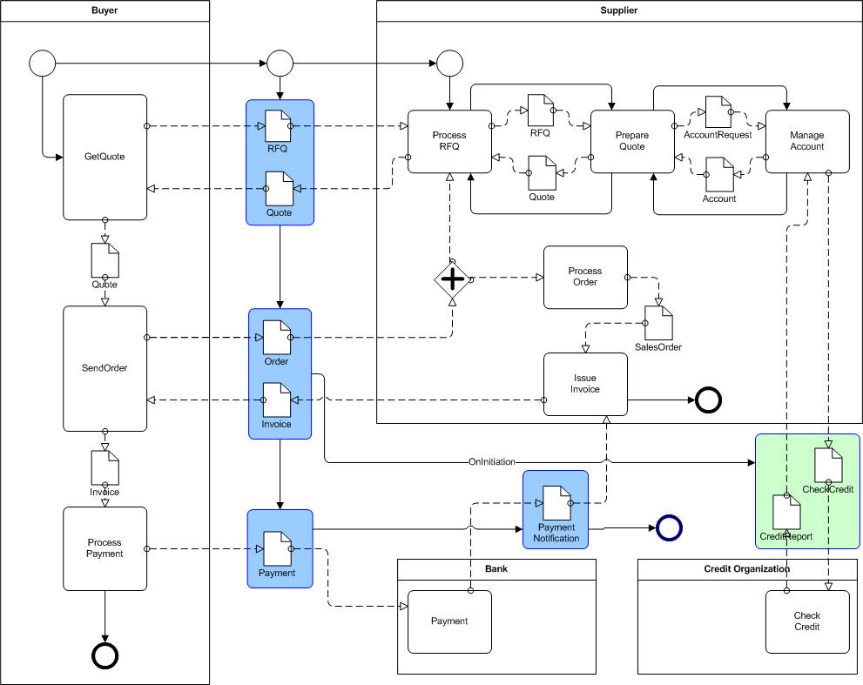
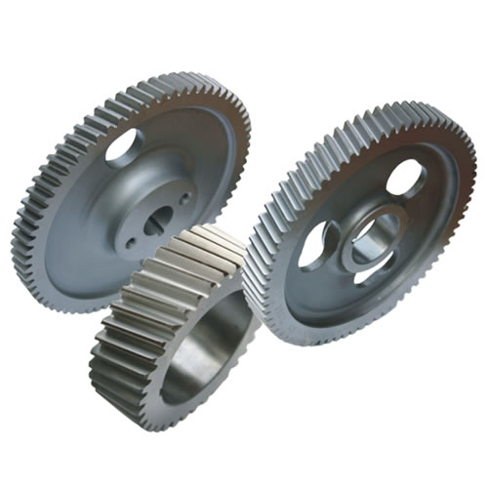
OGCE Layered Workflow Architecture: Derived from LEAD Workflow System
Workflow Interfaces (Design & Definition)
XBaya GUI (Composition, Deploying, Steering & Monitoring)
Flex/Web Composition
Gadget Interface for Input Binding
Workflow Specification
BPEL 2.0
Python
Scufl
BPEL 1.0
Java Code
Pegasus DAG
Workflow Execution & Control Engines
Apache ODE
Dynamic Enactor
Condor DAGMan
GBPEL
Jython Interpreter
Taverna

Slide 30
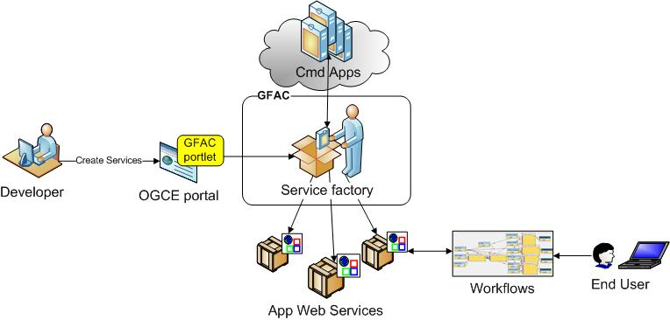
Putting It All Together

Slide 31
Software Strategy
Focus on gadget container and tools for running science applications on grids and clouds.
Provide a tool set that can be used in whole or in part.
If you just want GFac, then you can use it without buying an entire framework.
Outsource security, information services, data and metadata, advanced job handling, etc to other providers.
MyProxy, TG IIS, Globus, Condor, XMC Cat, iRods, etc.

Slide 32
Packaging, Building, and Testing
All builds are designed to be self contained
Use Apache Maven 2.x
Download includes everything you need.
Portal, Axis Services, and Xregistry all build nightly on the NMI Build and Test facility at UW.
Several Linux platforms, Mac PPC, and Mac X86
Java 1.5
Apache JMeter test suite for the portal.
Run against your installation
Automated tests nightly

Slide 33
Next Steps
Apache Incubator Project for XBaya, GFac and supporting workflow tools
WIYN ODI instrument pipeline and gateway
Robert Henschel and Scott Michael are leading overall effort.
Suresh and Raminder are working 50% time through early April on technical evaluation of integrating NHPPS software with OGCE
New Collaboration: Craig Mattocks, UNC will build a storm surge forecasting gateway
Broadly similar to LEAD and SCOOP
Archit will be the point of contact
Local gateway tutorial in early April
Sun Kim’s group, UNC Group, CGB
Others welcome
Gadget Container additional applications
OGCE grid gadgets packaged release, SimpleGrid

Slide 34
More Information, Acknowledgements
Website: www.collab-ogce.org
Blog/RSS Feed: collab-ogce.blogspot.com
Email: mpierce@cs.indiana.edu, smarru@cs.indiana.edu
Geoffrey Fox, Craig Stewart, and Dennis Gannon have spent years laying the foundation for this work

Slide 35
Backup Slides

Slide 36
EST Assembly Pipeline
Support: Archit Kulshrestha, Chin Hua Kong
Collaborator: Qunfeng Dong, UNT

Slide 37
Our goal is to provide a Web service-based science portal that can handle the largest mRNA clustering problems.
Computation is outsourced to Grids (TeraGrid) and Clouds (Amazon)
Not provided by in-house clusters.
This is an open service, open architecture approach.
These codes have very different scheduling requirements
http://swarm.cgb.indiana.edu

Slide 38
EST Assembly Pipeline
OGCE SWARM is used to intelligently submit thousands of jobs to compute resources of various sizes such as workstations and Grid enabled supercomputers.
TeraGrid’s BigRed, Ranger, and Cobalt: PACE, RepeatMasker
Local clusters: CAP3
Support for Job submission to the Cloud is being developed and will address the need for resources larger (in terms of available memory) than clusters currently available.

Slide 39
UltraScan Gateway
Staff: Raminder Singh
Collaborators: Borries Demeler and Emre Brookes, UTHSCSA

Slide 40
UltraScan Science Gateway
A biophysics gateway for investigating properties and structure-function relationships of biological macromolecules, nanoparticles, polymers and colloids that are implicated in many diseases, including cancer.
High-resolution analysis and modeling of hydrodynamic data from an analytical ultracentrifuge.
TeraGrid as a backup spill over resources but still is one of the heaviest user consuming 1.75 million SU’s in 6 months.

Slide 41
UltraScan Advanced Support
Porting to new architectures and parallel performance enhancements.
New workflow implementations, new grid computing and grid middleware support:
Reliability problems with WSGram
Missing job status
Only supports Gram4, needs porting to other middleware
Issues with data movement.
Need Fault tolerance at all levels.
Users decide resources manually, need automated scheduling.
Current Architecture

Slide 42
UltraScan OGCE Integration
Enhance the perl job submission daemon with OGCE Gfac service.
Enhance socket and email based job monitoring with OGCE Eventing System
Implement and iteratively enhance fault tolerance.
Port to Community account usage with gridshib auditing support.
Support Unicore to run jobs on other European and Australian resources.

Slide 43
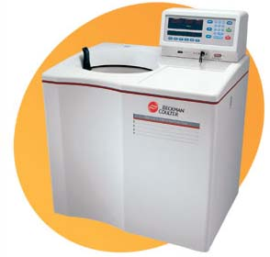
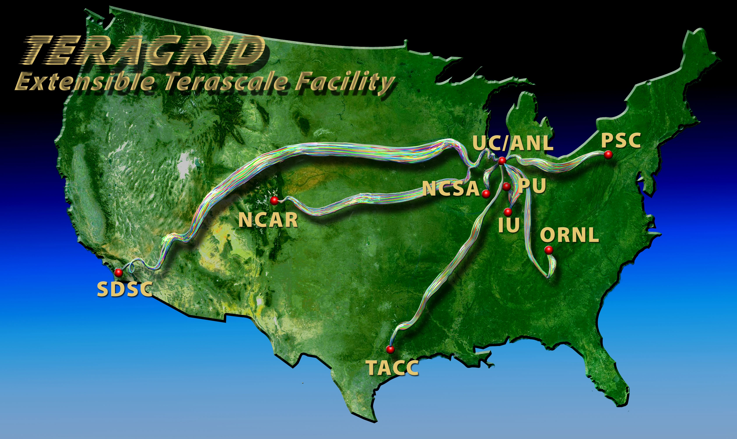
OGCE based UltraScan development Architecture
Manual Process
Quarry Gateway Hosting Machine
UltraScan Middleware
GFac, Eventing System, Fault Tolerance
Europe & Australian Grids

Slide 44
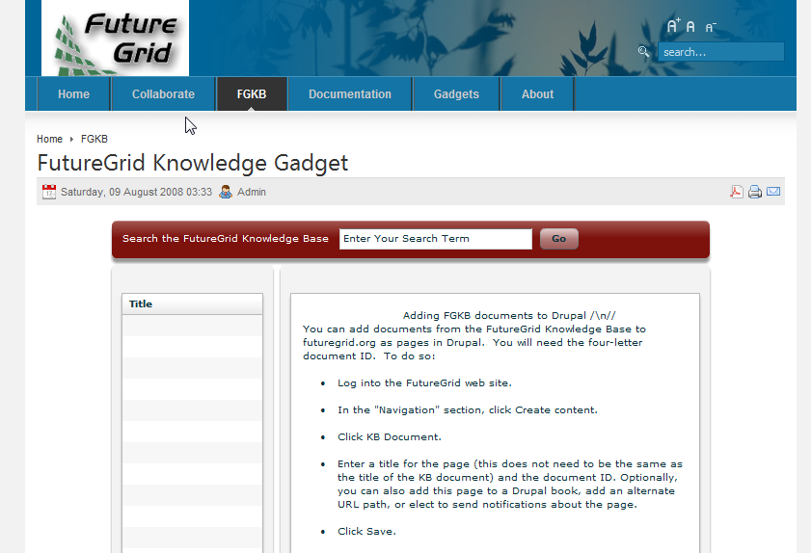
Future Grid KB
Image Manager
Experiment Browser
INCA Monitor
Downloadable Gadgets

Slide 45
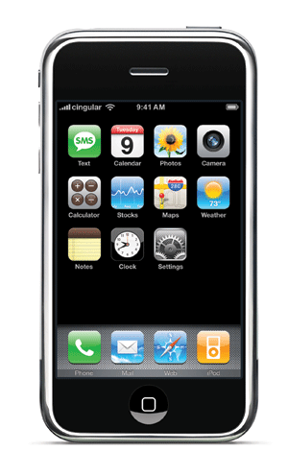
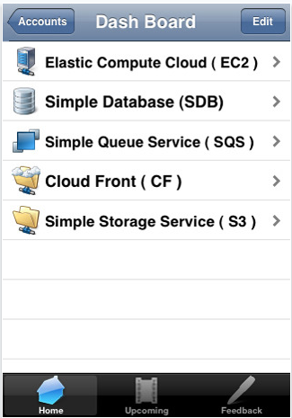
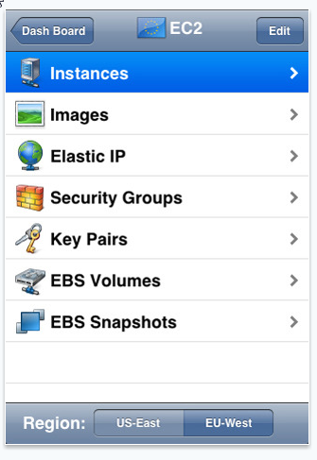
Deployment (in future)
Image Management
FG INCA MONITOR
Experiment Management
iGoogle Gadgets
iPhone Application

Slide 46
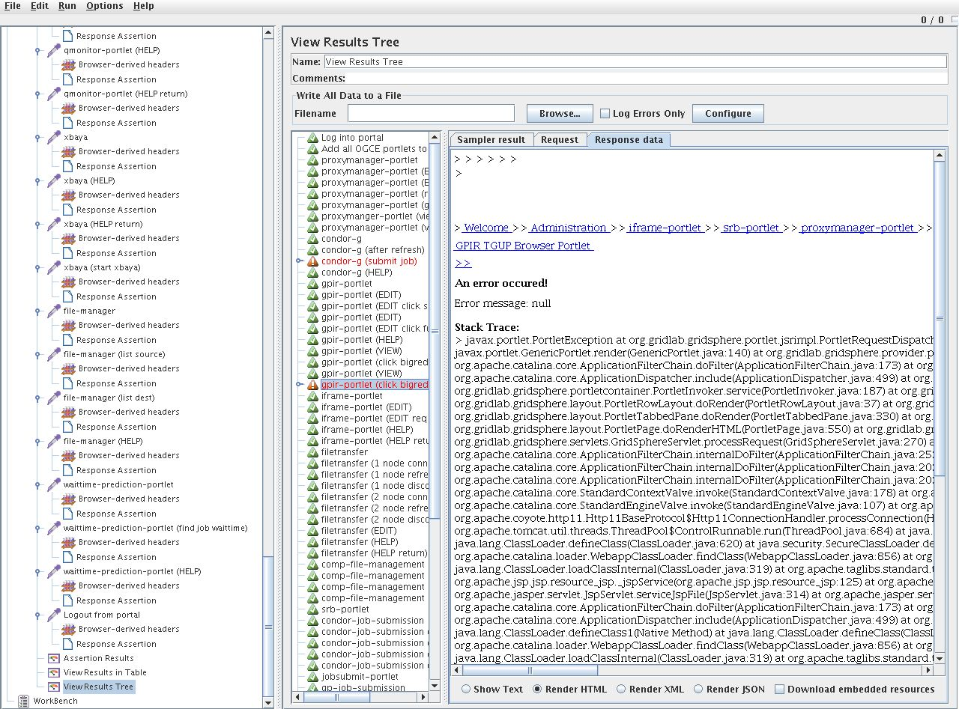
JMeter test suite

Slide 47
Why Gadgets?
We have redesigned many OGCE components to work as gadgets.
Fugang Wang’s Cyberaide JavaScript gives us an API
Framework and language independent
Client-side HTML, CSS, and JavaScript, not server-side Java
Integration and content under user’s control, not portal administrator’s
Can be integrated into iGoogle and similar containers.
140,000 published gadgets
Joomla, Drupal, Liferay, etc
We can potentially provide HUBzero gadgets

Slide 48
OGCE based UltraScan development Architecture
Manual Process
Quarry Gateway Hosting Machine
UltraScan Middleware
GFac and supporting services
Europe & Australian Grids

Slide 49
BioDrugScreen Next Steps
We want to expand the user generated function process, including the ability for a user to save a function and have multiple functions
Interaction between users will be enhanced, allowing them to share their functions and findings.

