Slide 1


parallel data mining on
multicore and clusters Systems
7th International Conference on Grid and Cooperative Computing October 24-26 2008 Shenzhen, China
Judy Qiu
xqiu@indiana.edu, http://www.infomall.org/salsa
Research Computing UITS, Indiana University Bloomington IN
Geoffrey Fox, Huapeng Yuan, Seung-Hee Bae
Community Grids Laboratory, Indiana University Bloomington IN
George Chrysanthakopoulos, Henrik Frystyk Nielsen
Microsoft Research, Redmond WA

Slide 2
Why Data-mining?
What applications can use the 128 cores expected in 2013?
Over same time period real-time and archival data will increase as fast as or faster than computing
  Internet data fetched to local PC or stored in “cloud”
  Surveillance
  Environmental monitors, Instruments such as LHC at CERN, High throughput screening in bio- and chemo-informatics
  Results of Simulations
Intel RMS analysis suggests Gaming and Generalized decision support (data mining) are ways of using these Cycles
The Landscape of parallel computing research: A view from Berckely
  Composition of an application: seven dwarfs

Slide 3
Intel’s Application Stack

Slide 4
Multicore SALSA Project
Service Aggregated Linked Sequential Activities
We generalize the well known CSP (Communicating Sequential Processes) of Hoare to describe the low level approaches to fine grain parallelism as “Linked Sequential Activities” in SALSA.
We use term “activities” in SALSA to allow one to build services from either threads, processes (usual MPI choice) or even just other services.
We choose term “linkage” in SALSA to denote the different ways of synchronizing the parallel activities that may involve shared memory rather than some form of messaging or communication.
There are several engineering and research issues for SALSA
  There is the critical communication optimization problem area for communication inside chips, clusters and Grids.
  We need to discuss what we mean by services
  The requirements of multi-language support
Further it seems useful to re-examine MPI and define a simpler model that naturally supports threads or processes and the full set of communication patterns needed in SALSA (including dynamic threads).

Slide 5
Status of SALSA Project
Status: is developing a suite of parallel data-mining capabilities: currently
  Clustering with deterministic annealing (DA) – vector-based and Pairwise
  Mixture Models (Expectation Maximization) with DA
  Metric Space Mapping for visualization and analysis (MDS)
  Matrix algebra as needed
Results: currently
  On a multicore machine (mainly thread-level parallelism)
    Microsoft CCR supports “MPI-style “ dynamic threading and via .Net provides a DSS a service model of computing;
    Detailed performance measurements with Speedups of 7.5 or above on 8-core systems for “large problems” using deterministic annealed (avoid local minima) algorithms for clustering, Gaussian Mixtures, GTM (dimensional reduction) etc.
  Extension to multicore clusters (process-level parallelism)
    MPI.Net provides C# interface to MS-MPI on windows cluster
    Initial performance results show linear speedup on up to 8 nodes dual core clusters
  Collaboration:
Application Collaboration
Cheminformatics
Rajarshi Guha
David Wild
Bioinformatics
Haiku Tang
Demographics (GIS)
Neil Devadasan
IU Bloomington and IUPUI
SALSA Team
Geoffrey Fox
Xiaohong Qiu
Seung-Hee Bae
Huapeng Yuan
Indiana University
Technology Collaboration
George Chrysanthakopoulos
Henrik Frystyk Nielsen
Microsoft

Slide 6
Services vs. Micro-parallelism
Micro-parallelism uses low latency CCR threads or MPI processes
Services can be used where loose coupling natural
  Input data
  Algorithms
    PCA
    DAC GTM GM DAGM DAGTM – both for complete algorithm and for each iteration
    Pairwise
    Linear Algebra used inside or outside above
    Metric embedding MDS, Bourgain, Quadratic Programming ….
    HMM, SVM ….
  User interface: GIS (Web map Service) or equivalent

Slide 7
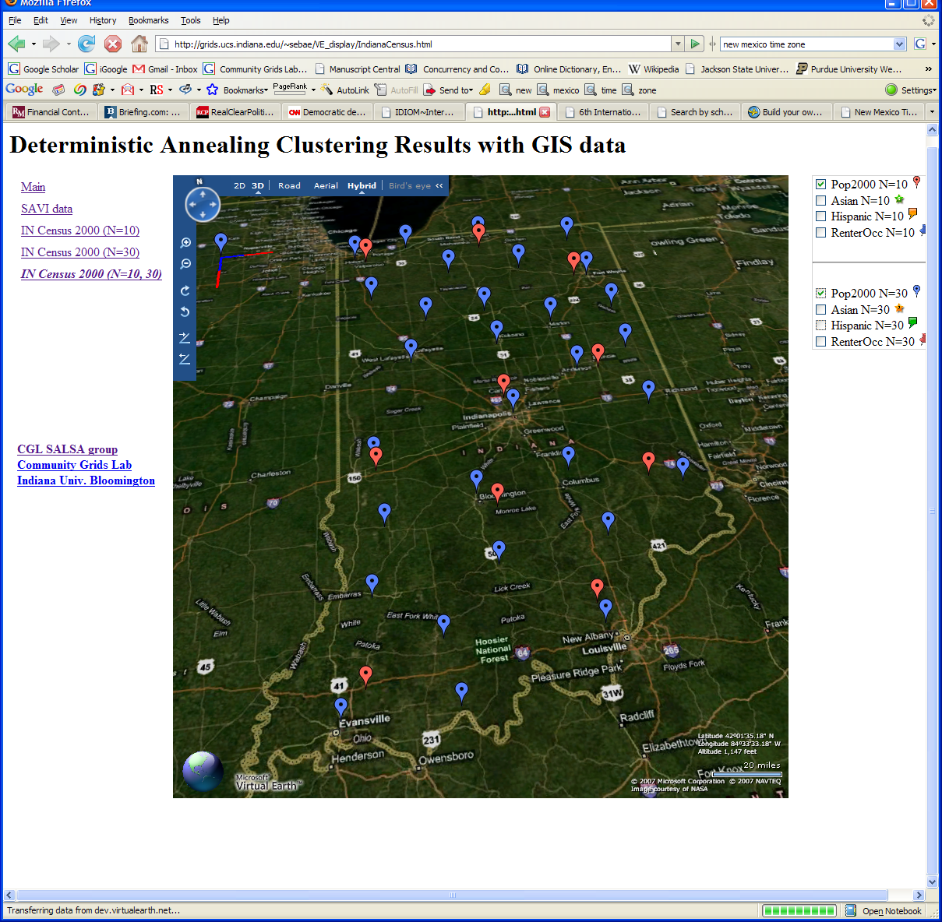
Deterministic Annealing Clustering of Indiana Census Data
Decrease temperature (distance scale) to discover more clusters

Slide 8
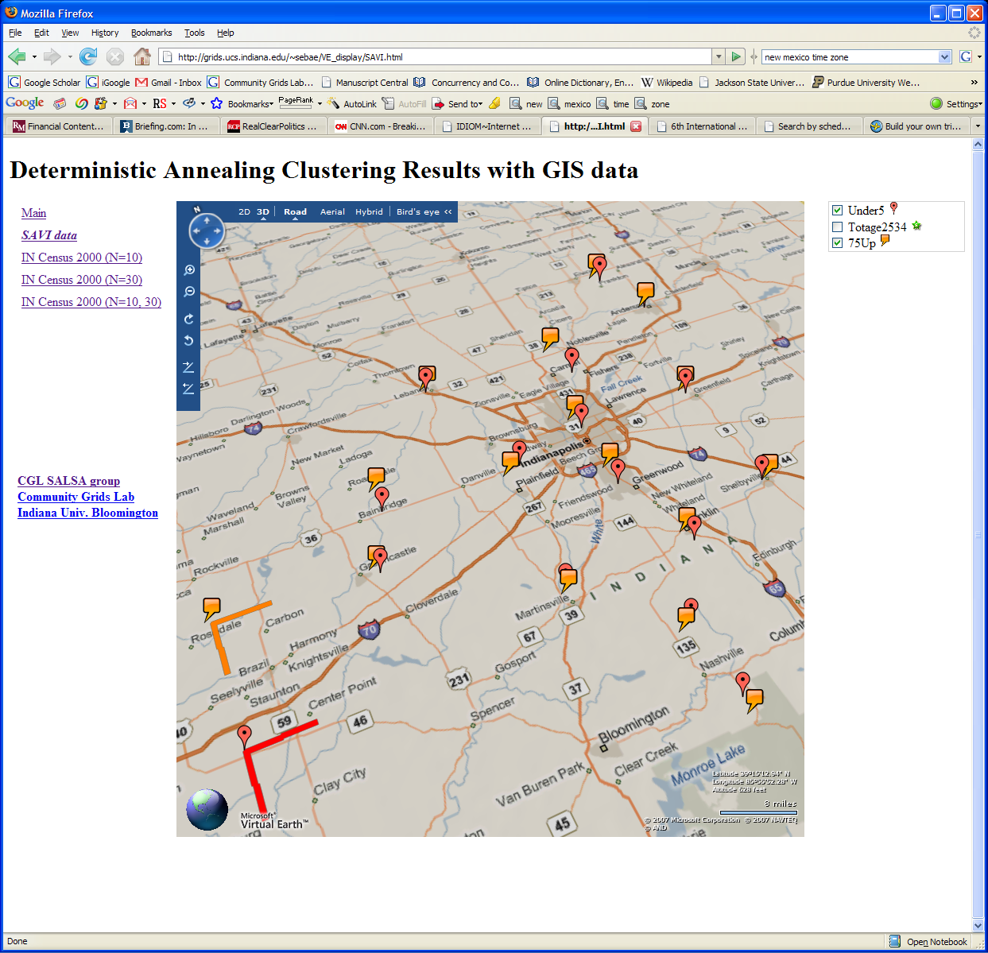

Notes:
This shows on Microsoft virtual Earth how one could use clustering to find locations of different population types. This corresponds to more extensive data than in census available for Indianapolis and the county (Brown) south of it
Here we compare under 5 population (red) with age bracket 25-34 (green). Note they are very similarly located as you might expect. The distance scales are shown on bottom left
In next animation we compare same under 5 population (red) with age bracket 75 and over (orange). Now we see more differences. The distance scales are shown on bottom left

Slide 9
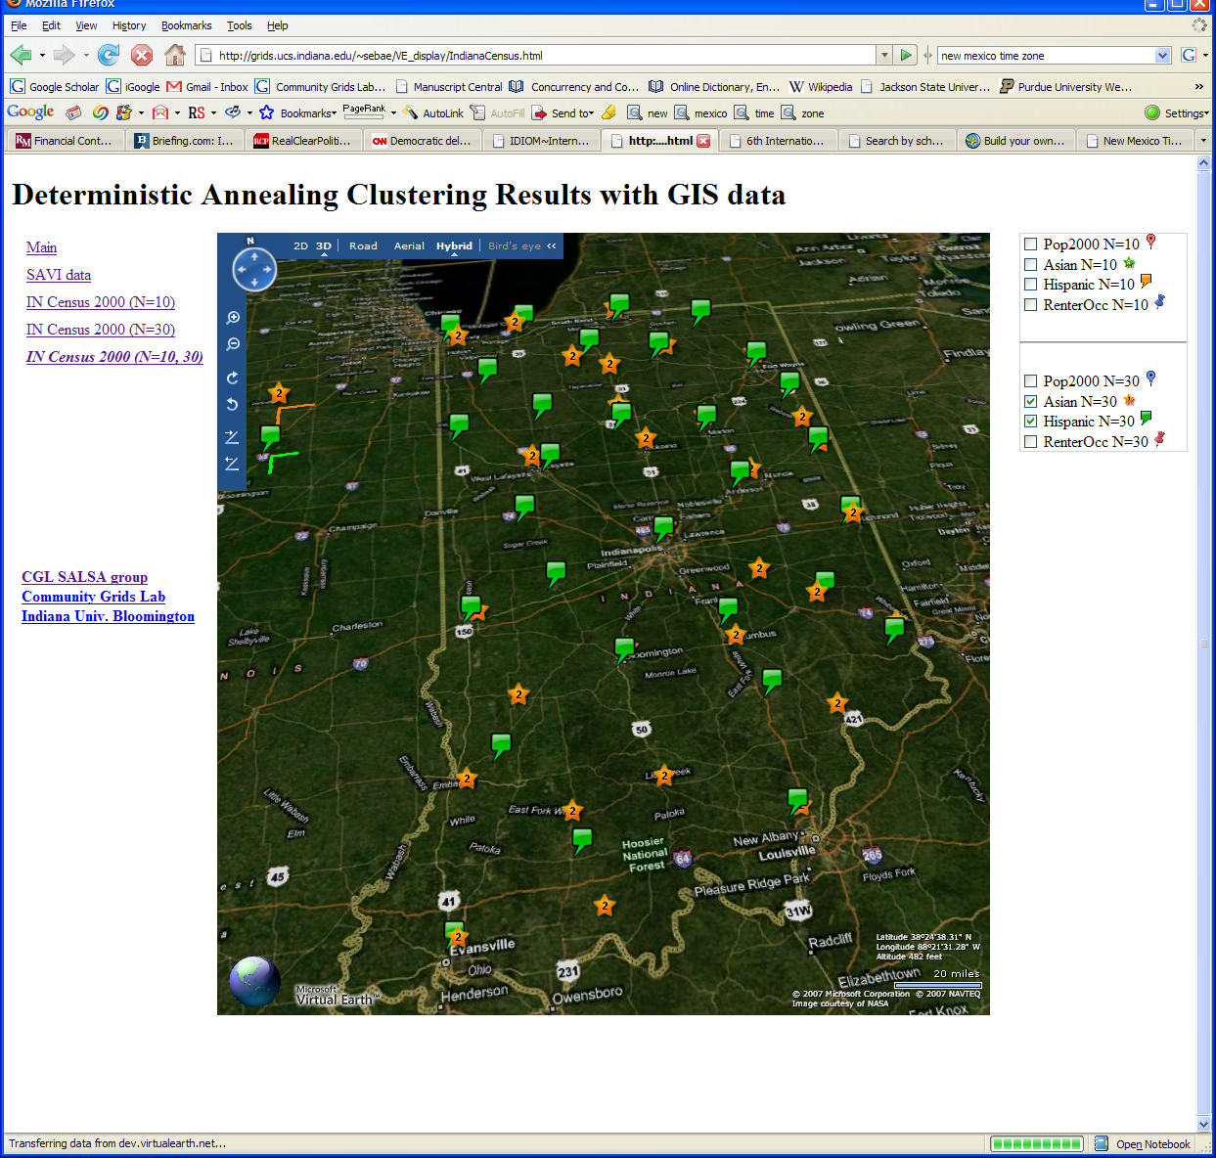

Slide 10
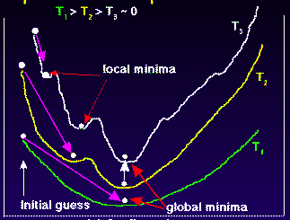
Deterministic
Annealing
F({Y}, T)
Solve Linear Equations for each temperature
Nonlinearity removed by approximating with solution at previous higher temperature
Configuration {Y}
Minimum evolving as temperature decreases
Movement at fixed temperature going to local minima if not initialized “correctly”

Slide 11

N data points E(x) in D dim. space and Minimize F by EM
  Deterministic Annealing Clustering (DAC)
  Generative Topographic Mapping (GTM)
  Deterministic Annealing Gaussian
  Mixture models (DAGM)
  Traditional Gaussian
  mixture models GM
a(x) = 1/N or generally p(x) with Σ p(x) =1
g(k)=1 and s(k)=0.5
T is annealing temperature varied down from ∞ with final value of 1
Vary cluster center Y(k) but can calculate weight P_{k} and correlation matrix s(k) = σ(k)² (even for matrix σ(k)²) using IDENTICAL formulae for Gaussian mixtures
K starts at 1 and is incremented by algorithm
a(x) = 1 and g(k) = (1/K)(β/2π)^{D/2}
s(k) = 1/ β and T = 1
Y(k) = Σ_{m=1}^{M} W_{m}φ_{m}(X(k))
Choose fixed φ_{m}(X) = exp( - 0.5 (X-μ_{m})²/σ² )
Vary W_{m} and β but fix values of M and K a priori
Y(k) E(x) W_{m} are vectors in original high D dimension space
X(k) and μ_{m} are vectors in 2 dimensional mapped space
As DAGM but set T=1 and fix K
a(x) = 1
g(k)={P_{k}/(2πσ(k)²)^{D/2}}^{1/T}
s(k)= σ(k)² (taking case of spherical Gaussian)
T is annealing temperature varied down from ∞ with final value of 1
Vary Y(k) P_{k} and σ(k)
K starts at 1 and is incremented by algorithm
  DAGTM: Deterministic Annealed
  Generative Topographic Mapping
GTM has several natural annealing versions based on either DAC or DAGM: under investigation
SALSA
Notes:
11

Slide 12
MPI Exchange Latency in µs (20-30 µs computation between messaging)
Machine | OS | Runtime | Grains | Parallelism | MPI Latency
Intel8c:gf12 (8 core 2.33 Ghz) (in 2 chips) | Redhat | MPJE(Java) | Process | 8 | 181
 |  | MPICH2 (C) | Process | 8 | 40.0
 |  | MPICH2:Fast | Process | 8 | 39.3
 |  | Nemesis | Process | 8 | 4.21
Intel8c:gf20 (8 core 2.33 Ghz) | Fedora | MPJE | Process | 8 | 157
 |  | mpiJava | Process | 8 | 111
 |  | MPICH2 | Process | 8 | 64.2
Intel8b (8 core 2.66 Ghz) | Vista | MPJE | Process | 8 | 170
 | Fedora | MPJE | Process | 8 | 142
 | Fedora | mpiJava | Process | 8 | 100
 | Vista | CCR (C#) | Thread | 8 | 20.2
AMD4 (4 core 2.19 Ghz) | XP | MPJE | Process | 4 | 185
 | Redhat | MPJE | Process | 4 | 152
 |  | mpiJava | Process | 4 | 99.4
 |  | MPICH2 | Process | 4 | 39.3
 | XP | CCR | Thread | 4 | 16.3
Intel(4 core) | XP | CCR | Thread | 4 | 25.8
Messaging CCR versus MPI C# v. C v. Java
SALSA
Notes:
12

Slide 13
Parallel Multicore
Deterministic Annealing Clustering
Parallel Overhead
on 8 Threads Intel 8b
Speedup = 8/(1+Overhead)
10 Clusters
Overhead = Constant1 + Constant2/n
Constant1 = 0.05 to 0.1 (Client Windows) due to
thread runtime fluctuations
20 Clusters
10000/(Grain Size n = points per core)

Slide 14
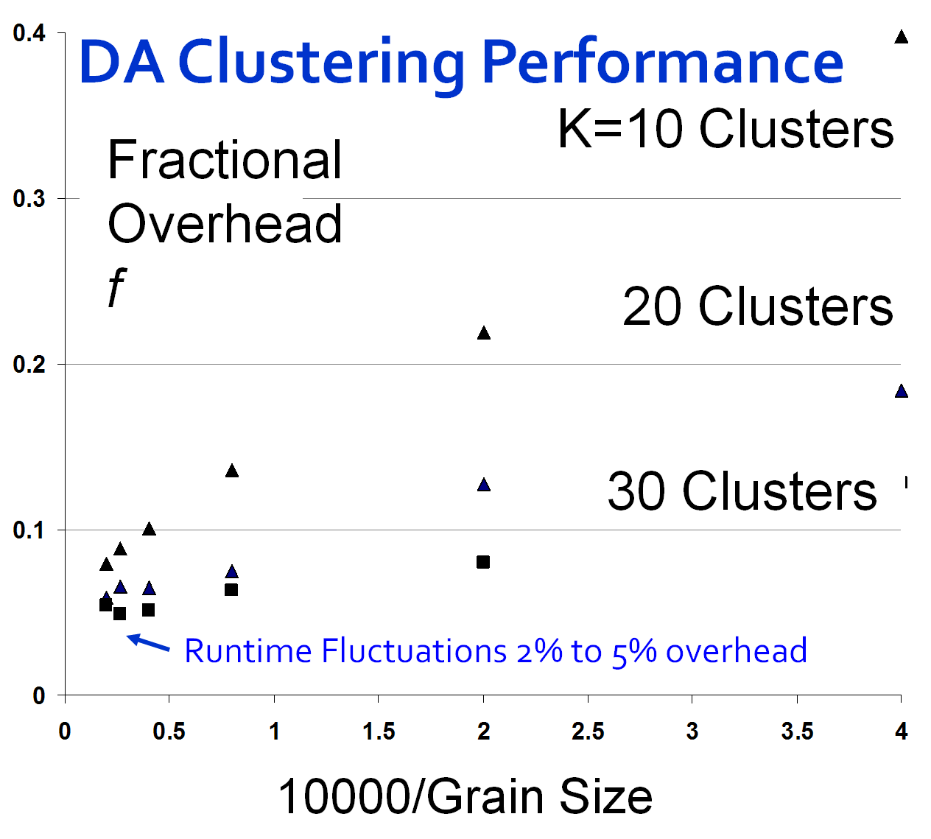
Speedup = Number of cores/(1+f)
f = (Sum of Overheads)/(Computation per core)
Computation ∝ Grain Size n . # Clusters K
Overheads are
Synchronization: small with CCR
Load Balance: good
Memory Bandwidth Limit: → 0 as K → ∞
Cache Use/Interference: Important
Runtime Fluctuations: Dominant large n, K
All our “real” problems have f ≤ 0.05 and
speedups on 8 core systems greater than 7.6
Notes:
14

Slide 15
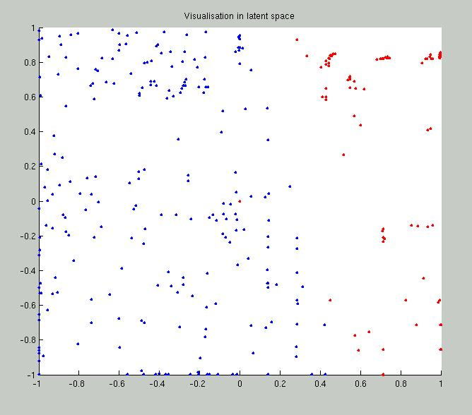
2 Clusters of Chemical Compounds in 155 Dimensions Projected into 2D
Deterministic Annealing for Clustering of 335 compounds
Method works on much larger sets but choose this as answer known
GTM (Generative Topographic Mapping) used for mapping 155D to 2D latent space
Much better than PCA (Principal Component Analysis) or SOM (Self Organizing Maps)

Slide 16
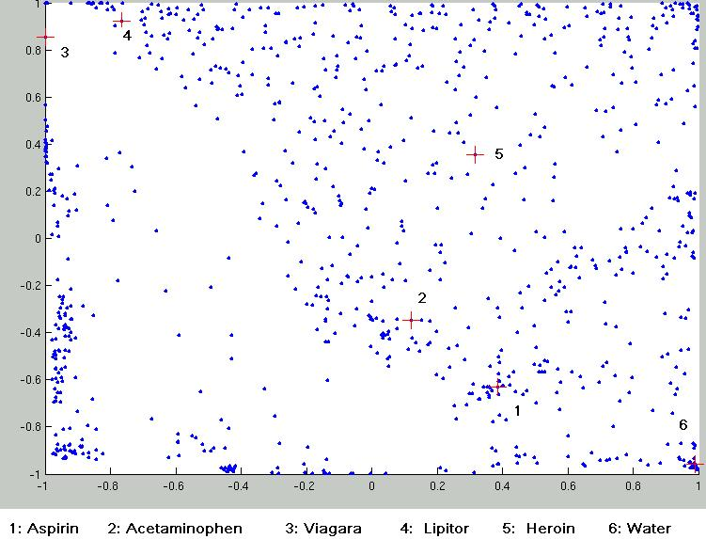
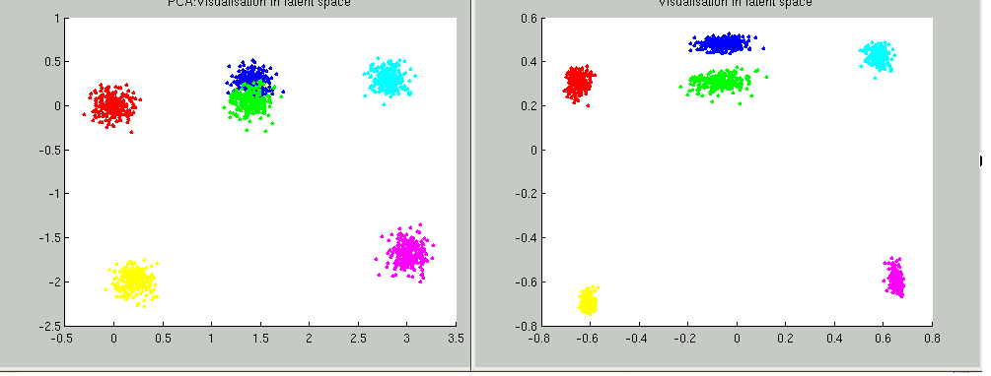
Parallel Generative Topographic Mapping GTM
Reduce dimensionality preserving topology and perhaps distances
Here project to 2D
GTM Projection of PubChem: 10,926,94 0compounds in 166 dimension binary property space takes 4 days on 8 cores. 64X64 mesh of GTM clusters interpolates PubChem. Could usefully use 1024 cores! David Wild will use for GIS style 2D browsing interface to chemistry
PCA
GTM
Linear PCA v. nonlinear GTM on 6 Gaussians in 3D
PCA is Principal Component Analysis
GTM Projection of 2 clusters
of 335 compounds in 155
dimensions
SALSA

Slide 17
MPI-CCR model
Distributed memory systems have shared memory nodes
(today multicore) linked by a messaging network
CCR
CCR
CCR
CCR
Core
Core
Core
Core
Core
Core
Core
Core
Cache
Cache
Cache
Cache
L2 Cache
Dataflow
L2 Cache
L2 Cache
L2 Cache
L3 Cache
L3 Cache
L3 Cache
L3 Cache
Main
Memory
Main
Memory
Main
Memory
Main
Memory
Cluster 1
MPI
Cluster 2
MPI
Cluster 3
Cluster 4
Interconnection Network
“Dataflow” or Events
DSS/Mash up/Workflow

Slide 18
8 Node 2-core Windows Cluster: CCR & MPI.NET
Execution Time ms
Label | ||ism | MPI | CCR | Nodes
1 | 16 | 8 | 2 | 8
2 | 8 | 4 | 2 | 4
3 | 4 | 2 | 2 | 2
4 | 2 | 1 | 2 | 1
5 | 8 | 8 | 1 | 8
6 | 4 | 4 | 1 | 4
7 | 2 | 2 | 1 | 2
8 | 1 | 1 | 1 | 1
9 | 16 | 16 | 1 | 8
10 | 8 | 8 | 1 | 4
11 | 4 | 4 | 1 | 2
12 | 2 | 2 | 1 | 1
Run label
Parallel Overhead f
Scaled Speed up: Constant data points per parallel unit (1.6 million points)
Speed-up = ||ism P/(1+f)
f = PT(P)/T(1) - 1
≈ 1- efficiency
Cluster of Intel Xeon CPU (2 cores) 3050@2.13GHz 2.00 GB of RAM
Run label
Notes:
Each run is about 1000 MPI synchronization points per run
Many MPI calls at each synchronization point
See earlier for runtime fluctuations
Negative overhead just says fluctuation in T(1)
Windows runtime fluctuations serious on many nodes as synchronization makes fluctuations on one node affect all nodes
Note execution time multiplied by P in overhead so small fluctuations in runtime magnified in f

Slide 19
1 Node 4-core Windows Opteron: CCR & MPI.NET
Label | ||ism | MPI | CCR | Nodes
1 | 4 | 1 | 4 | 1
2 | 2 | 1 | 2 | 1
3 | 1 | 1 | 1 | 1
4 | 4 | 2 | 2 | 1
5 | 2 | 2 | 1 | 1
6 | 4 | 4 | 1 | 1
Execution Time ms
Run label
Scaled Speed up: Constant data points per parallel unit (0.4 million points)
Speed-up = ||ism P/(1+f)
f = PT(P)/T(1) - 1
≈ 1- efficiency
MPI uses REDUCE, ALLREDUCE (most used) and BROADCAST
AMD Opteron (4 cores) Processor 275 @ 2.19GHz 4 .00 GB of RAM
Parallel Overhead f
Run label

Slide 20
Overhead versus Grain Size
Speed-up = (||ism P)/(1+f) Parallelism P = 16 on experiments here
f = PT(P)/T(1) - 1 ≈ 1- efficiency
Fluctuations serious on Windows
We have not investigated fluctuations directly on clusters where synchronization between nodes will make more serious
MPI somewhat better performance than CCR; probably because multi threaded implementation has more fluctuations
Need to improve initial results with averaging over more runs
8 MPI Processes
2 CCR threads per process
Parallel Overhead f
16 MPI Processes
100000/Grain Size(data points per parallel unit)

Slide 21
Parallel Deterministic Annealing Clustering
Scaled Speedup Tests on four 8-core Systems
(10 Clusters; 160,000 points per cluster per thread)
Parallel Overhead
32-way
16-way
8-way
4-way
2-way
1, 2, 4, 8, 16, 32-way parallelism
(1,1,1)
(2,1,1)
(1,2,1)
(1,1,2)
(4,1,1)
(2,2,1)
(1,4,1)
(2,1,2)
(1,2,2)
(1,1,4)
(4,2,1)
(2,4,1)
(1,8,1)
(4,1,2)
(2,2,2)
(1,4,2)
(2,1,4)
(1,2,4)
(1,1,8)
(4,4,1)
(2,8,1)
(4,2,2)
(2,4,2)
(4,1,4)
(2,2,4)
(2,1,8)
(4,8,1)
(4,4,2)
(4,2,4)
(4,1,8)
(node,
MPI process,
CCR thread)
Parallel Patterns

Slide 22
Parallel Deterministic Annealing Clustering
Scaled Speedup Tests on two 16-core Systems
(10 Clusters; 160,000 points per cluster per thread)
Parallel Overhead
32-way
16-way
2-way
8-way
4-way
1, 2, 4, 8, 16, 32-way parallelism
(1,1,1)
(2,1,1)
(1,2,1)
(1,1,2)
(2,2,1)
(2,1,2)
(node,
MPI process,
CCR thread)
(1,4,1)
(1,2,2)
(1,1,4)
(2,4,1)
(2,2,2)
(1,4,2)
(2,1,4)
(1,2,4)
(1,1,8)
(2,4,2)
(2,2,4)
(1,4,4)
(2,1,8)
(1,2,8)
(1,1,16)
(2,4,4)
(2,2,8)
(2,1,16)
Parallel Patterns

Slide 23
Issues and Futures
The MPI-CCR model is an important extension that take s CCR in multicore node to cluster
  brings computing power to a new level (nodes * cores)
  bridges the gap between commodity and high performance computing systems
This class of data mining does/will parallelize well on current/future multicore nodes
Several engineering issues for use in large applications
  Need access to a 32~ 128 node Windows cluster
  MPI or cross-cluster CCR?
  Service model to integrate modules
  Need high performance linear algebra for C#
    Access linear algebra services in a different language?
  Need equivalent of Intel C Math Libraries for C# (vector arithmetic – level 1 BLAS)
  Future work is more applications; refine current algorithms
    DAGTM
    Clustering with pairwise distances but no vector spaces
    MDS Dimensional Scaling with EM-like SMACOF and deterministic annealing
New parallel algorithms
  Bourgain Random Projection for metric embedding
  Support use of Newton’s Method (Marquardt’s method) as EM alternative
  Later HMM and SVM

Slide 24
www.infomall.org/SALSA

