Slide 1


Performance of Windows Multicore Systems on Threading and MPI
May 17, 2010 Melbourne, Australia
Judy Qiu
xqiu@indiana.edu, http://salsahpc.indiana.edu
Assistant Director, Pervasive Technology Institute
Indiana University Bloomington

Slide 2
Why Data-mining?
What applications can use the 128 cores expected in 2013?
Over same time period real-time and archival data will increase as fast as or faster than computing
  Internet data fetched to local PC or stored in “cloud”
  Surveillance
  Environmental monitors, Instruments such as LHC at CERN, High throughput screening in bio- , chemo-, medical informatics
  Results of Simulations
Intel RMS analysis suggests Gaming and Generalized decision support (data mining) are ways of using these cycles
SALSA is developing a suite of parallel data-mining capabilities: currently
  Clustering with deterministic annealing (DA)
  Mixture Models (Expectation Maximization) with DA
  Metric Space Mapping for visualization and analysis
  Matrix algebra as needed

Slide 3
Intel’s Application Stack

Slide 4
Status of SALSA Project
Technology Collaboration
George Chrysanthakopoulos
Henrik Frystyk Nielsen
Microsoft Research
SALSA Team
Judy Qiu
Adam Hughes
Seung-Hee Bae
Hong Youl Choi
Jaliya Ekanayake
Thilina Gunarathne
Yang Ruan
Hui Li
Bingjing Zhang
Saliya Ekanayake
Stephen Wu
Indiana University
Application Collaboration
Cheminformatics
Rajarshi Guha, David Wild
Bioinformatics
Haiku Tang, Mina Rho
IU Medical School
Gilbert Liu, Shawn Hoch
Demographics (GIS)
Neil Devadasan

Slide 5
Multicore SALSA Project
Service Aggregated Linked Sequential Activities
We generalize the well known CSP (Communicating Sequential Processes) of Hoare to describe the low level approaches to fine grain parallelism as “Linked Sequential Activities” in SALSA.
We use term “activities” in SALSA to allow one to build services from either threads, processes (usual MPI choice) or even just other services.
We choose term “linkage” in SALSA to denote the different ways of synchronizing the parallel activities that may involve shared memory rather than some form of messaging or communication.
There are several engineering and research issues for SALSA
  There is the critical communication optimization problem area for communication inside chips, clusters and Grids.
  We need to discuss what we mean by services
  The requirements of multi-language support
Further it seems useful to re-examine MPI and define a simpler model that naturally supports threads or processes and the full set of communication patterns needed in SALSA (including dynamic threads).

Slide 6
Status of SALSA Project
Status: is developing a suite of parallel data-mining capabilities: currently
  Clustering with deterministic annealing (DA)
  Mixture Models (Expectation Maximization) with DA
  Metric Space Mapping for visualization and analysis
  Matrix algebra as needed
Results: currently
  On a multicore machine (mainly thread-level parallelism)
    Microsoft CCR supports “MPI-style “ dynamic threading and via .Net provides a DSS a service model of computing;
    Detailed performance measurements with Speedups of 7.5 or above on 8-core systems for “large problems” using deterministic annealed (avoid local minima) algorithms for clustering, Gaussian Mixtures, GTM (dimensional reduction) etc.
  Extension to multicore clusters (process-level parallelism)
    MPI.Net provides C# interface to MS-MPI on windows cluster
    Initial performance results show linear speedup on up to 8 nodes dual core clusters

Slide 7
Considering a Collection of computers
We can have various hardware
  Multicore – Shared memory, low latency
  High quality Cluster – Distributed Memory, Low latency
  Standard distributed system – Distributed Memory, High latency
We can program the coordination of these units by
  Threads on cores
  MPI on cores and/or between nodes
  MapReduce/Hadoop/Dryad../AVS for dataflow
  Workflow linking services
  These can all be considered as some sort of execution unit exchanging messages with some other unit
And there are higher level programming models such as OpenMP, PGAS, HPCS Languages

Slide 8
Runtime System Used
micro-parallelism
  Microsoft CCR (Concurrency and Coordination Runtime)
    supports both MPI rendezvous and dynamic (spawned) threading style of parallelism
    has fewer primitives than MPI but can implement MPI collectives with low latency threads
    http://msdn.microsoft.com/robotics/
  Microsoft TPL (Task Parallel Library)
    TPL supports a loop parallelism model familiar from OpenMP.
    a component of the Parallel FX library, the next generation of concurrency
    contains sophisticated algorithms for dynamic work distribution and automatically adapts to the workload
macro-paralelism (inter-service communication)
  Microsoft DSS (Decentralized System Services) built in terms of CCR for service model
  Mash up
  Workflow (Grid)
  MPI.Net
    a C# wrapper around MS-MPI implementation (msmpi.dll)
    supports MPI processes
    parallel C# programs can run on windows clusters
    http://www.osl.iu.edu/research/mpi.net/

Slide 9
Data Parallel Run Time Architectures
CCR Ports
Trackers
CCR Ports
Pipes
MPI
Disk HTTP
CCR Ports
Trackers
CCR Ports
Pipes
MPI
Disk HTTP
CCR Ports
Trackers
CCR Ports
Pipes
MPI
Disk HTTP
CCR Ports
Trackers
CCR Ports
Pipes
MPI
Disk HTTP
CGL MapReduce is long running processing with asynchronous distributed
Rendezvous
synchronization
CCR (Multi Threading) uses short or long
running threads communicating via shared memory and
Ports (messages)
Microsoft DRYAD
uses short running processes communicating via pipes, disk or shared memory between cores
MPI is long running processes with Rendezvous for message exchange/
synchronization
CCR (Multi Threading) uses short or long
running threads communicating via shared memory and
Ports (messages)
Yahoo Hadoop uses short running processes communicating via disk and tracking processes

Slide 10
MPI-CCR model
Distributed memory systems have shared memory nodes
(today multicore) linked by a messaging network
CCR
CCR
CCR
CCR
Core
Core
Core
Core
Core
Core
Core
Core
Cache
Cache
Cache
Cache
L2 Cache
Dataflow
L2 Cache
L2 Cache
L2 Cache
L3 Cache
L3 Cache
L3 Cache
L3 Cache
Main
Memory
Main
Memory
Main
Memory
Main
Memory
Cluster 1
MPI
Cluster 2
MPI
Cluster 3
Cluster 4
Interconnection Network
“Dataflow” or Events
DSS/Mash up/Workflow

Slide 11
Services vs. Micro-parallelism
Micro-parallelism uses low latency CCR threads or MPI processes
Services can be used where loose coupling natural
  Input data
  Algorithms
    PCA
    DAC GTM GM DAGM DAGTM – both for complete algorithm and for each iteration
    Linear Algebra used inside or outside above
    Metric embedding MDS, Bourgain, Quadratic Programming ….
    HMM, SVM ….
  User interface: GIS (Web map Service) or equivalent

Slide 12
Parallel Programming Strategy
“Main Thread” and Memory M
MPI/CCR/DSS
From other nodes
MPI/CCR/DSS
From other nodes
0
m₀
1
m₁
2
m₂
3
m₃
4
m₄
5
m₅
6
m₆
7
m₇
Subsidiary threads t with memory m_{t}
Use Data Decomposition as in classic distributed memory but use shared memory for read variables. Each thread uses a “local” array for written variables to get good cache performance
Multicore and Cluster use same parallel algorithms but different runtime implementations; algorithms are
        Accumulate matrix and vector elements in each process/thread
        At iteration barrier, combine contributions (MPI_Reduce)
        Linear Algebra (multiplication, equation solving, SVD)

Slide 13
General Formula DAC GM GTM DAGTM DAGM
N data points E(x) in D dimensions space and minimize F by EM
  Deterministic Annealing Clustering (DAC)
F is Free Energy
EM is well known expectation maximization method
p(x) with Σ p(x) =1
T is annealing temperature varied down from ∞ with final value of 1
Determine cluster center Y(k) by EM method
K (number of clusters) starts at 1 and is incremented by algorithm

Slide 14
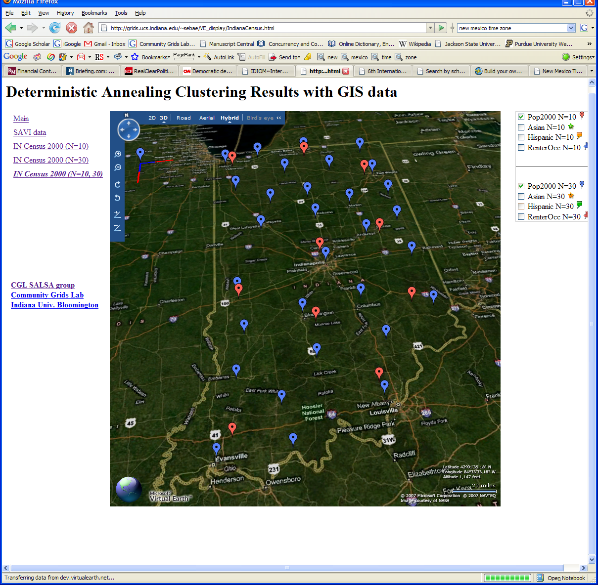
Deterministic Annealing Clustering of Indiana Census Data
Decrease temperature (distance scale) to discover more clusters

Slide 15
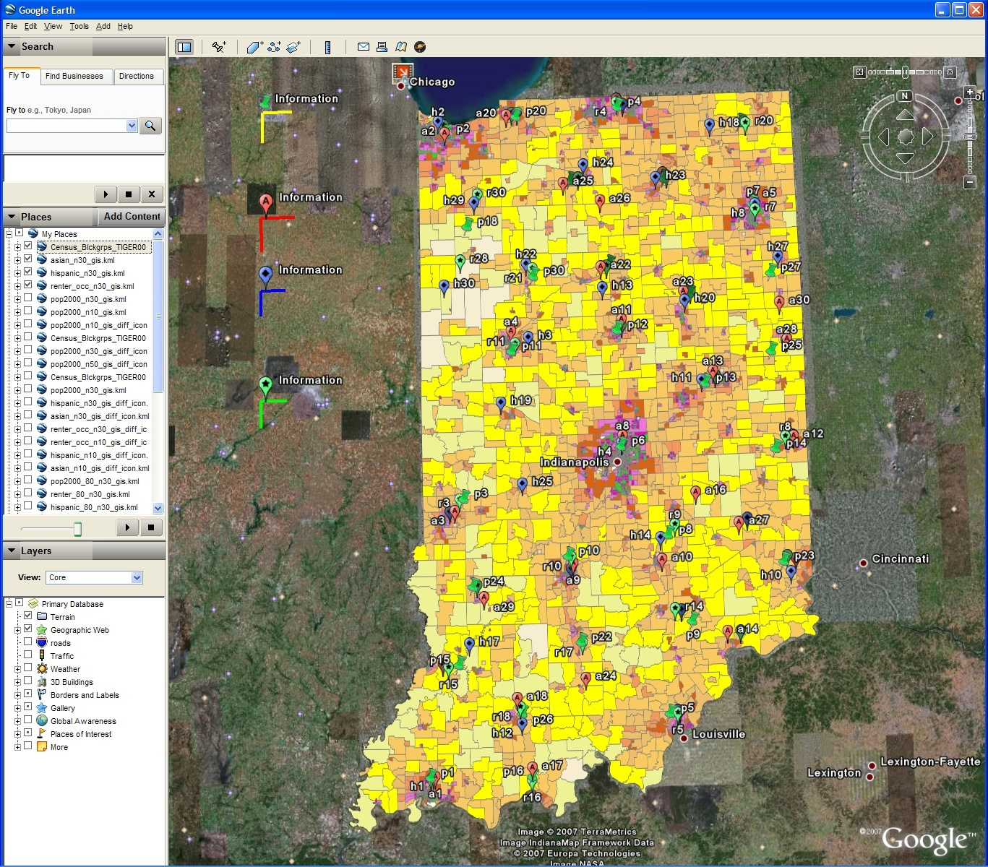
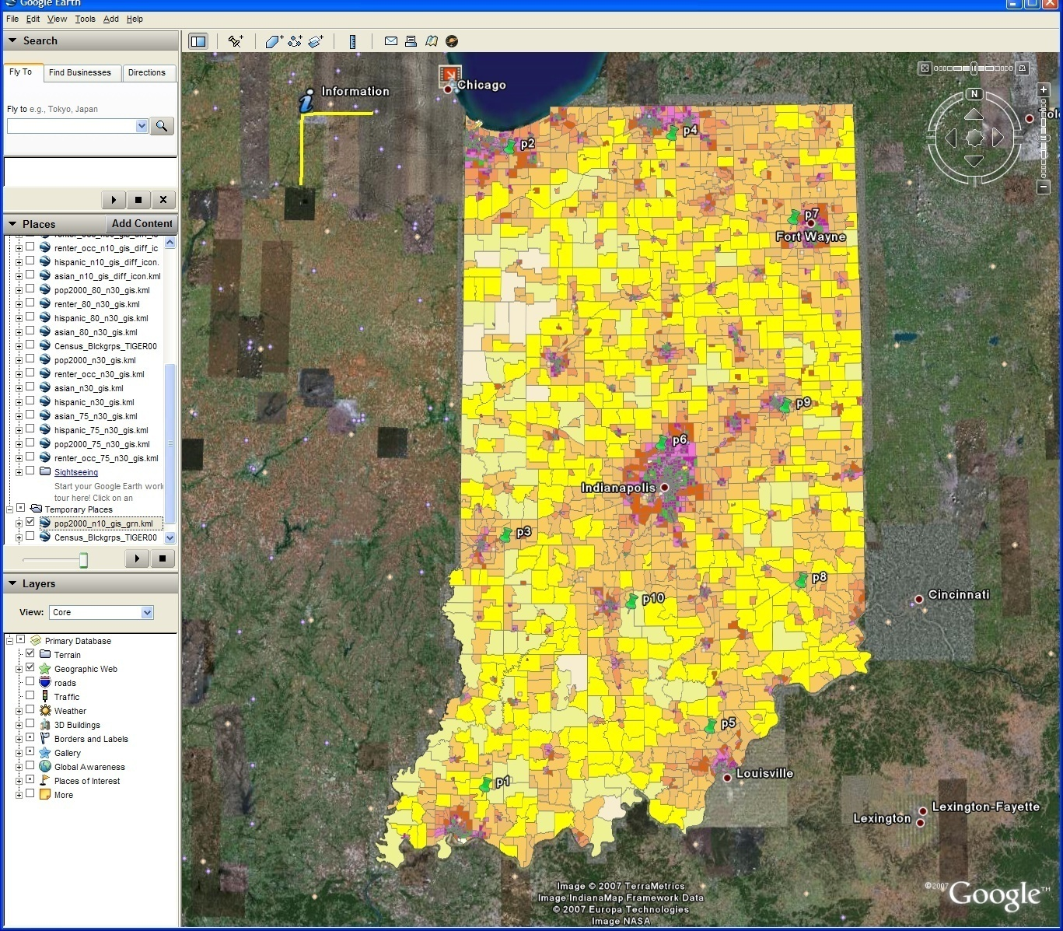
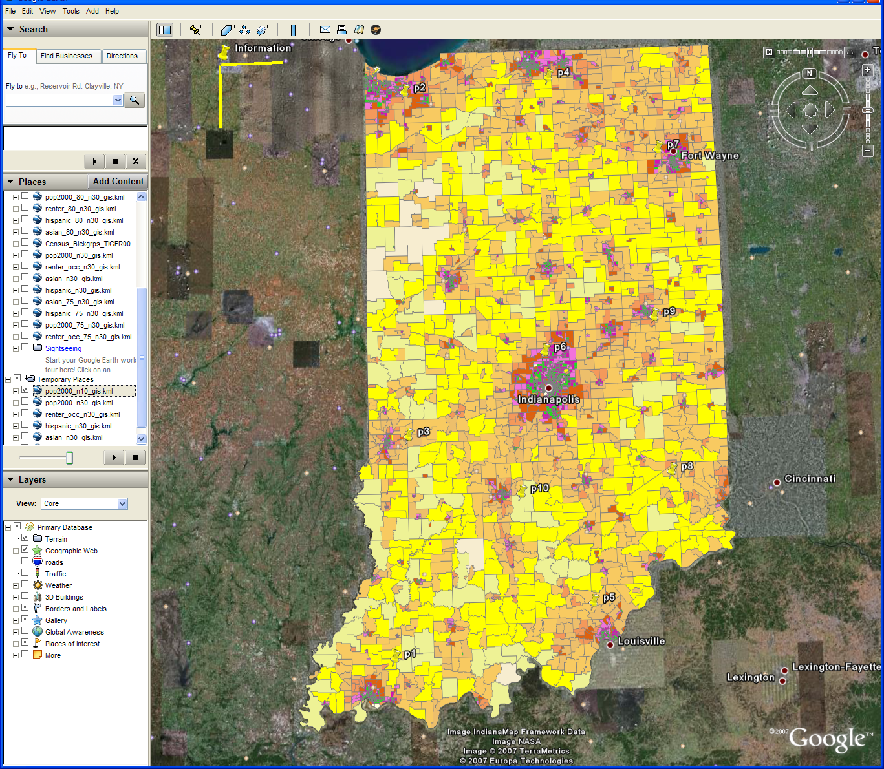
Changing resolution of GIS Clutering
Total
Asian
Hispanic
Renters
GIS Clustering
30 Clusters
30 Clusters
10 Clusters

Slide 16
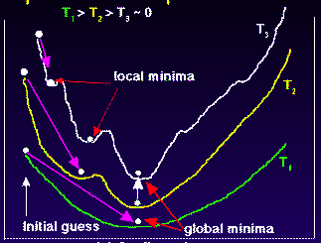
Deterministic
Annealing
F({Y}, T)
Solve Linear Equations for each temperature
Nonlinearity removed by approximating with solution at previous higher temperature
Configuration {Y}
Minimum evolving as temperature decreases
Movement at fixed temperature going to local minima if not initialized “correctly”

Slide 17

N data points E(x) in D dim. space and Minimize F by EM
  Deterministic Annealing Clustering (DAC)
  Generative Topographic Mapping (GTM)
  Deterministic Annealing Gaussian
  Mixture models (DAGM)
  Traditional Gaussian
  mixture models GM
a(x) = 1/N or generally p(x) with Σ p(x) =1
g(k)=1 and s(k)=0.5
T is annealing temperature varied down from ∞ with final value of 1
Vary cluster center Y(k) but can calculate weight P_{k} and correlation matrix s(k) = σ(k)² (even for matrix σ(k)²) using IDENTICAL formulae for Gaussian mixtures
K starts at 1 and is incremented by algorithm
a(x) = 1 and g(k) = (1/K)(β/2π)^{D/2}
s(k) = 1/ β and T = 1
Y(k) = Σ_{m=1}^{M} W_{m}φ_{m}(X(k))
Choose fixed φ_{m}(X) = exp( - 0.5 (X-μ_{m})²/σ² )
Vary W_{m} and β but fix values of M and K a priori
Y(k) E(x) W_{m} are vectors in original high D dimension space
X(k) and μ_{m} are vectors in 2 dimensional mapped space
As DAGM but set T=1 and fix K
a(x) = 1
g(k)={P_{k}/(2πσ(k)²)^{D/2}}^{1/T}
s(k)= σ(k)² (taking case of spherical Gaussian)
T is annealing temperature varied down from ∞ with final value of 1
Vary Y(k) P_{k} and σ(k)
K starts at 1 and is incremented by algorithm
  DAGTM: Deterministic Annealed
  Generative Topographic Mapping
GTM has several natural annealing versions based on either DAC or DAGM: under investigation
SALSA
Notes:
17

Slide 18
Parallel Multicore
Deterministic Annealing Clustering
Parallel Overhead
on 8 Threads Intel 8b
Speedup = 8/(1+Overhead)
10 Clusters
Overhead = Constant1 + Constant2/n
Constant1 = 0.05 to 0.1 (Client Windows) due to
thread runtime fluctuations
20 Clusters
10000/(Grain Size n = points per core)

Slide 19
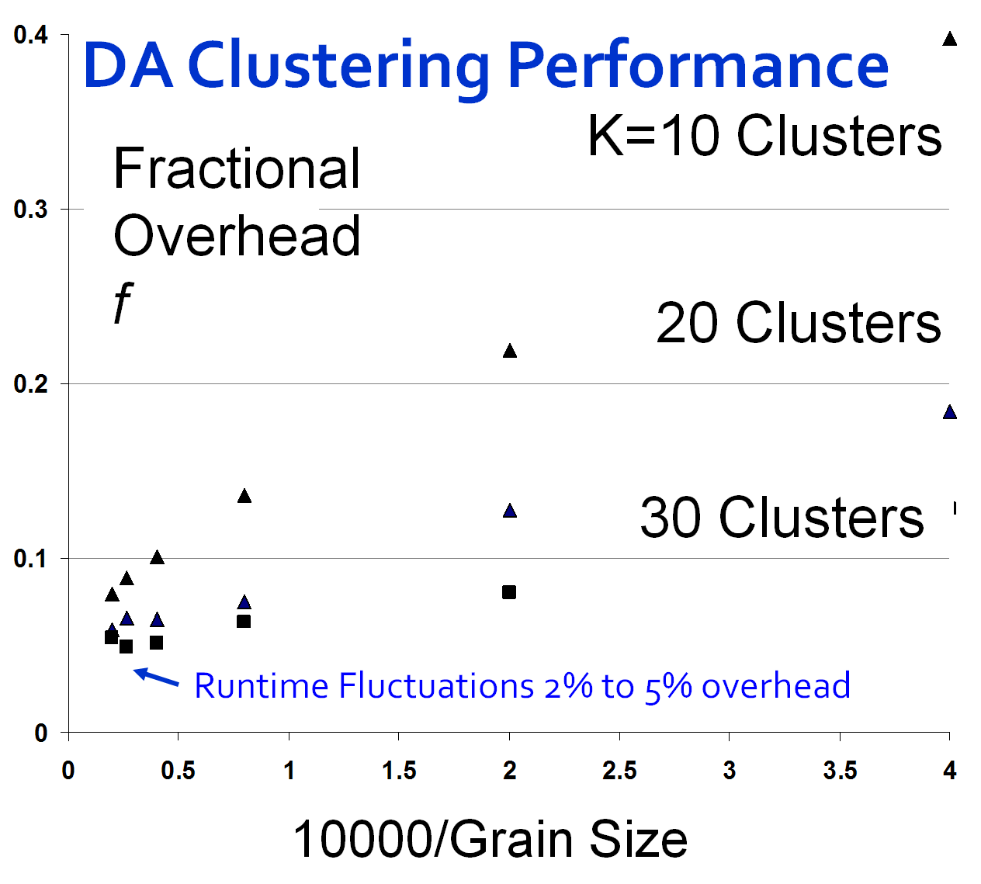
Speedup = Number of cores/(1+f)
f = (Sum of Overheads)/(Computation per core)
Computation ∝ Grain Size n . # Clusters K
Overheads are
Synchronization: small with CCR
Load Balance: good
Memory Bandwidth Limit: → 0 as K → ∞
Cache Use/Interference: Important
Runtime Fluctuations: Dominant large n, K
All our “real” problems have f ≤ 0.05 and
speedups on 8 core systems greater than 7.6
SALSA
Notes:
19

Slide 20
MPI Exchange Latency in μs
(20-30 computation between messaging)
Machine | OS | Runtime | Grains | Parallelism | MPI Exchange Latency (µs)
Intel8c:gf12 (8 core 2.33 Ghz) (in 2 chips) | Redhat | MPJE (Java) | Process | 8 | 181
 |  | MPICH2 (C) | Process | 8 | 40.0
 |  | MPICH2: Fast | Process | 8 | 39.3
 |  | Nemesis | Process | 8 | 4.21
Intel8c:gf20 (8 core 2.33 Ghz) | Fedora | MPJE | Process | 8 | 157
 |  | mpiJava | Process | 8 | 111
 |  | MPICH2 | Process | 8 | 64.2
Intel8b (8 core 2.66 Ghz) | Vista | MPJE | Process | 8 | 170
 | Fedora | MPJE | Process | 8 | 142
 | Fedora | mpiJava | Process | 8 | 100
 | Vista | CCR (C#) | Thread | 8 | 20.2
AMD4 (4 core 2.19 Ghz) | XP | MPJE | Process | 4 | 185
 | Redhat | MPJE | Process | 4 | 152
 |  | mpiJava | Process | 4 | 99.4
 |  | MPICH2 | Process | 4 | 39.3
 | XP | CCR | Thread | 4 | 16.3
Intel4 (4 core 2.8 Ghz) | XP | CCR | Thread | 4 | 25.8

Slide 21
Why is Speed up not = # cores/threads?
Synchronization Overhead
Load imbalance
  Or there is no good parallel algorithm
Cache impacted by multiple threads
Memory bandwidth needs increase proportionally to number of threads
Scheduling and Interference with O/S threads
  Including MPI/CCR processing threads
  Note current MPI’s not well designed for multi-threaded problems

Slide 22
High Performance
Dimension Reduction and Visualization
Need is pervasive
  Large and high dimensional data are everywhere: biology, physics, Internet, …
  Visualization can help data analysis
Visualization of large datasets with high performance
  Map high-dimensional data into low dimensions (2D or 3D).
  Need Parallel programming for processing large data sets
  Developing high performance dimension reduction algorithms:
    MDS(Multi-dimensional Scaling), used earlier in DNA sequencing application
    GTM(Generative Topographic Mapping)
    DA-MDS(Deterministic Annealing MDS)
    DA-GTM(Deterministic Annealing GTM)
  Interactive visualization tool PlotViz
We are supporting drug discovery by browsing 60 million compounds in PubChem database with 166 features each

Slide 23
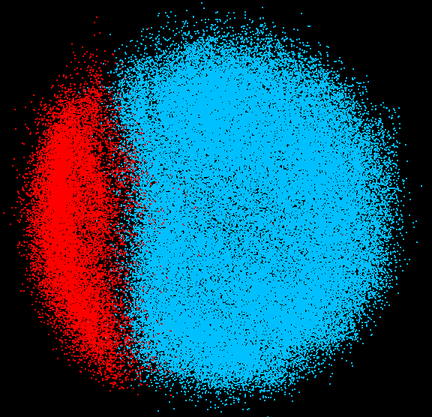
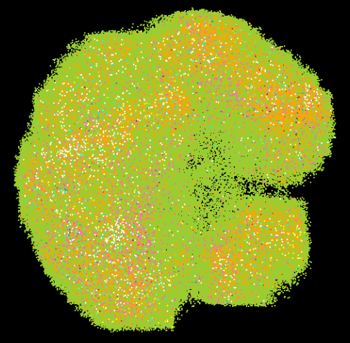
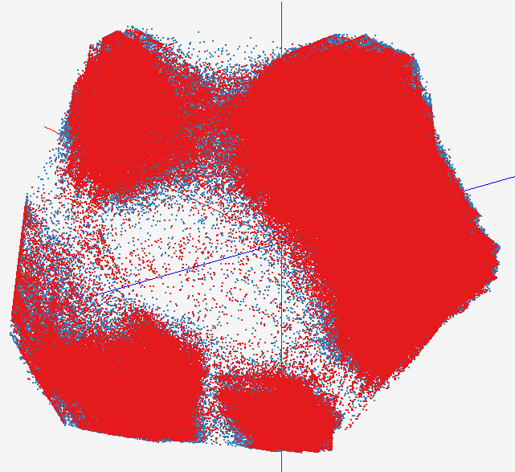
High Performance Data Visualization..
First time using Deterministic Annealing for parallel MDS and GTM algorithms to visualize large and high-dimensional data
Processed 0.1 million PubChem data having 166 dimensions
Parallel interpolation can process 60 million PubChem points
GTM with interpolation for
2M PubChem data
2M PubChem data is plotted in 3D with GTM interpolation approach. Blue points are 100k sampled data and red points are 2M interpolated points.
MDS for 100k PubChem data
100k PubChem data having 166 dimensions are visualized in 3D space. Colors represent 2 clusters separated by their structural proximity.
GTM for 930k genes and diseases
Genes (green color) and diseases (others) are plotted in 3D space, aiming at finding cause-and-effect relationships.
PubChem project, http://pubchem.ncbi.nlm.nih.gov/

Slide 24
Deterministic Annealing for Pairwise Clustering
Clustering is a well known data mining algorithm with K-means best known approach
Two ideas that lead to new supercomputer data mining algorithms
Use deterministic annealing to avoid local minima
Do not use vectors that are often not known – use distances δ(i,j) between points i, j in collection – N=millions of points are available in Biology; algorithms go like N² . Number of clusters
Developed (partially) by Hofmann and Buhmann in 1997 but little or no application
Minimize H_{PC} = 0.5 ∑_{i=1}^{N} ∑_{j=1}^{N} δ(i, j) ∑_{k=1}^{K} M_{i}(k) M_{j}(k) / C(k)
M_{i}(k) is probability that point i belongs to cluster k
C(k) = ∑_{i=1}^{N} M_{i}(k) is number of points in k’th cluster
M_{i}(k) ∝ exp( -ε_{i}(k)/T ) with Hamiltonian ∑_{i=1}^{N} ∑_{k=1}^{K} M_{i}(k) ε_{i}(k)
Reduce T from large to small values to anneal

Slide 25
Alu and Metagenomics Workflow
“All pairs” problem
Data is a collection of N sequences. Need to calcuate N² dissimilarities (distances) between sequnces (all pairs).
  These cannot be thought of as vectors because there are missing characters
  “Multiple Sequence Alignment” (creating vectors of characters) doesn’t seem to work if N larger than O(100), where 100’s of characters long.
Step 1: Can calculate N² dissimilarities (distances) between sequences
Step 2: Find families by clustering (using much better methods than Kmeans). As no vectors, use vector free O(N²) methods
Step 3: Map to 3D for visualization using Multidimensional Scaling (MDS) – also O(N²)
Results:
N = 50,000 runs in 10 hours (the complete pipeline above) on 768 cores

Slide 26


Biology MDS and Clustering Results
Alu Families
This visualizes results of Alu repeats from Chimpanzee and Human Genomes. Young families (green, yellow) are seen as tight clusters. This is projection of MDS dimension reduction to 3D of 35399 repeats – each with about 400 base pairs
Metagenomics
This visualizes results of dimension reduction to 3D of 30000 gene sequences from an environmental sample. The many different genes are classified by clustering algorithm and visualized by MDS dimension reduction

Slide 27
Threading versus MPI on node
Always MPI between nodes
Clustering by Deterministic Annealing
(Parallel Overhead = [PT(P) – T(1)]/T(1), where T time and P number of parallel units)
MPI
MPI
Parallel Overhead
MPI
Thread
Thread
Thread
Thread
Thread
MPI
MPI
MPI
MPI
Thread
Thread
Parallel Patterns (ThreadsxProcessesxNodes)
Note MPI best at low levels of parallelism
Threading best at Highest levels of parallelism (64 way breakeven)
Uses MPI.Net as an interface to MS-MPI

Slide 28
Typical CCR Comparison with TPL
Efficiency = 1 / (1 + Overhead)
Hybrid internal threading/MPI as intra-node model works well on Windows HPC cluster
Within a single node TPL or CCR outperforms MPI for computation intensive applications like clustering of Alu sequences (“all pairs” problem)
TPL outperforms CCR in major applications

Slide 29
Issues and Futures
This class of data mining does/will parallelize well on current/future multicore nodes
The Hybrid MPI-CCR model is an important extension that take s CCR in multicore
node to cluster
  brings computing power to a new level (nodes * cores)
  bridges the gap between commodity and high performance computing systems
Several engineering issues for use in large applications
  Need access to a 128~512 node Windows cluster
  MPI or cross-cluster CCR?
  Service model to integrate modules
  Need high performance linear algebra for C# (PLASMA from UTenn)
    Access linear algebra services in a different language?
  Need equivalent of Intel C Math Libraries for C# (vector arithmetic – level 1 BLAS)
Current work is more applications; refine current algorithms such as DAGTM
  Clustering with pairwise distances but no vector spaces
  MDS Dimensional Scaling with EM-like SMACOF and deterministic annealing
Future work is new parallel algorithms
  Support use of Newton’s Method (Marquardt’s method) as EM alternative
  Later HMM and SVM
  Bourgain Random Projection for metric embedding

Slide 30
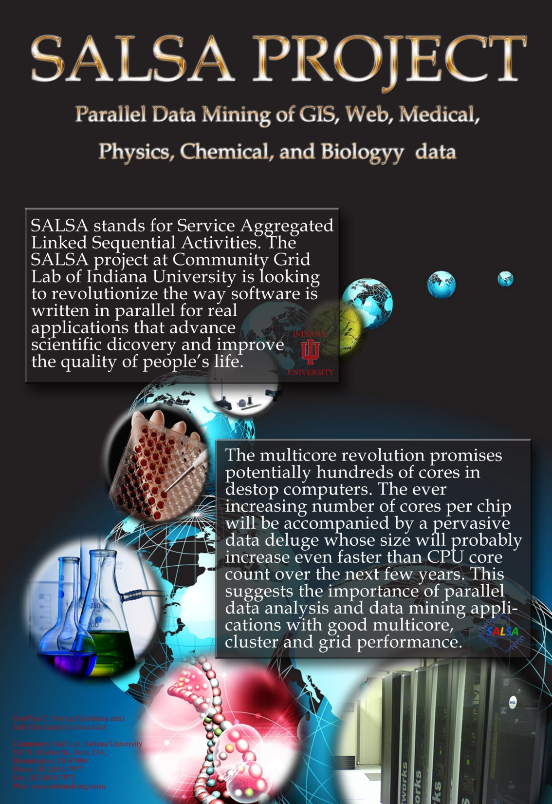
salsahpc.indiana.edu

