Slide 1
QuakeSim Science Gateway: ACES Update
Marlon Pierce, Jun Wang, Yu Ma, Jun Ji, Xiaoming Gao, Geoffrey Fox
Indiana University

Slide 2
QuakeSim Overview
QuakeSim is a science gateway that provides Web user and Web service interfaces to earthquake modeling tools:
Fault deformation analysis: Disloc, Simplex, GeoFEST
GPS time series analysis: RDAHMM
Data sources include
QuakeTables Fault Database: fault models
Scripps GRWS: GPS data products
UNAVCO: GPS data products
All tools are exposed as online services. Inputs and outputs are URLs. We export results as KML for use outside the portal.
All user interface Web components work as both portlets and Google gadgets.

Slide 3
ACESPortal
QuakeSim Portal
ACESCloud Services
GIS, Datamining, Ensemble Simulations
Disloc, Simplex, GeoFEST, RDAHMM
ACESCloud Platform
Core Interfaces
Cloud Resources
Development (FutureGrid) and Production
ACESCloud Data Standard Interfaces
Earthquake Data
GPS signals
Data Sources Simulation/Instruments

Slide 4
Available Gateway Applications
Application | Purpose | Data Source | Compared To
GeoFEST | Finite element deformation model | Faults | GPS and InSAR surface deformation
Disloc | Surface displacements from fault motion | Faults | GPS and InSAR surface deformation
Simplex | Inversion for fault motion from deformation data | InSAR and GPS surface deformation | Fault data constrain model
RIPI (results only) | Seismic pattern analysis | Seismicity | Earthquake faults
RDAHMM | Time series analysis | GPS | Earthquake, aquifer sources

Slide 5
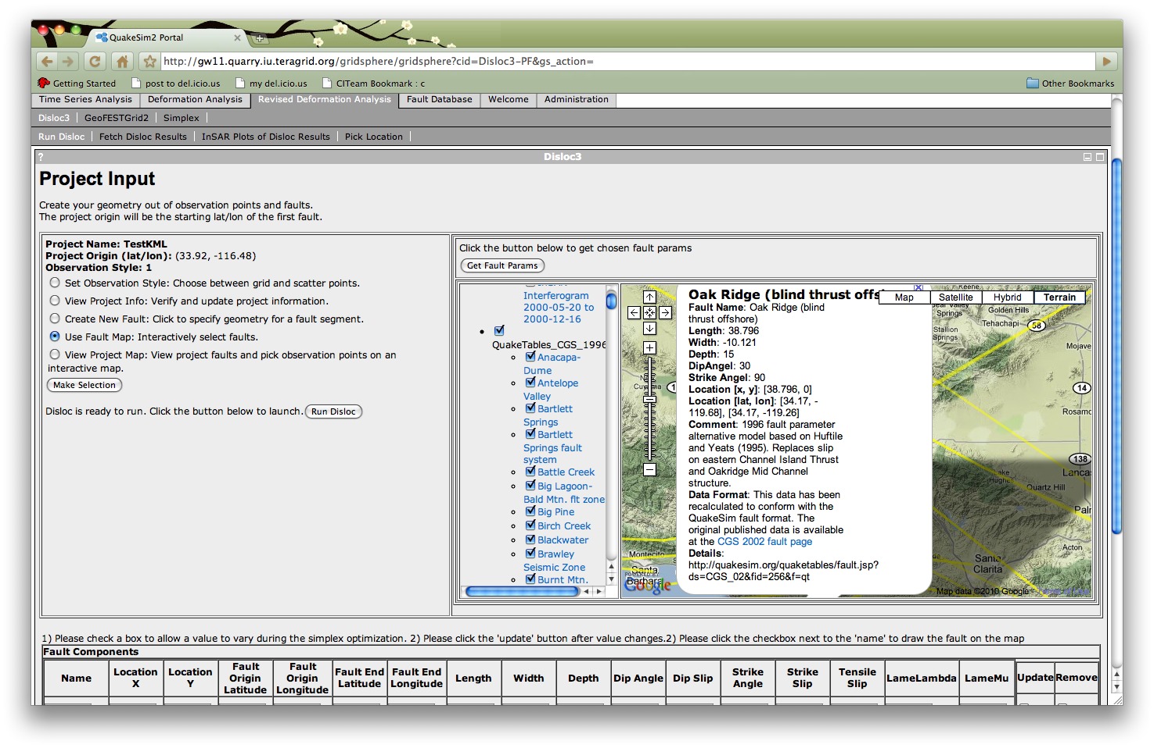
Deformation Tool Enhancements
Deformation tools updated to to interact with the upgraded Fault Database.
Faults now organized into appropriate CGS catalogs and accessible by KML-emitting REST services for each catalog.
Upgraded map interfaces to display the new KML and integrate its data into the Disloc, Simplex, and GeoFEST application submission tools.
Disloc portlet showing upgraded map interface. Faults in the map come from the revised QuakeTables fault database’s KML service. Parameter values for the fault model in the dialog box are extracted and used to set up deformation jobs.

Slide 6
RSS-Driven Disloc and InSAR Plotting Service
We developed a version of the Disloc tool that is driven by the USGS M>5.0 Earthquake RSS feed.
You can view results anonymously.
You also can log in with Google ID and copy results to your personal workspace.
Can edit parameters submission parameters.

Slide 7
Disloc-RSS Service and User Interface
KMLGenerator
3. Generate displacement arrows per earthquake case
AutomatedRssDisloc
Webservice
1. Request
Disloc
RssDisloc3
4. Send
InsarGenerator
3. Read pre-calculated results for the earthquake or run Disloc, InsarGenerator and store the results if the earthquake case isn’t pre-calculated.
2. Update if it has been an hour since the last update
Pre-calculated results
USGS earthquake RSS feed
http://earthquake.usgs.gov/
earthquakes/catalogs/
7day-M5.xml

Slide 8
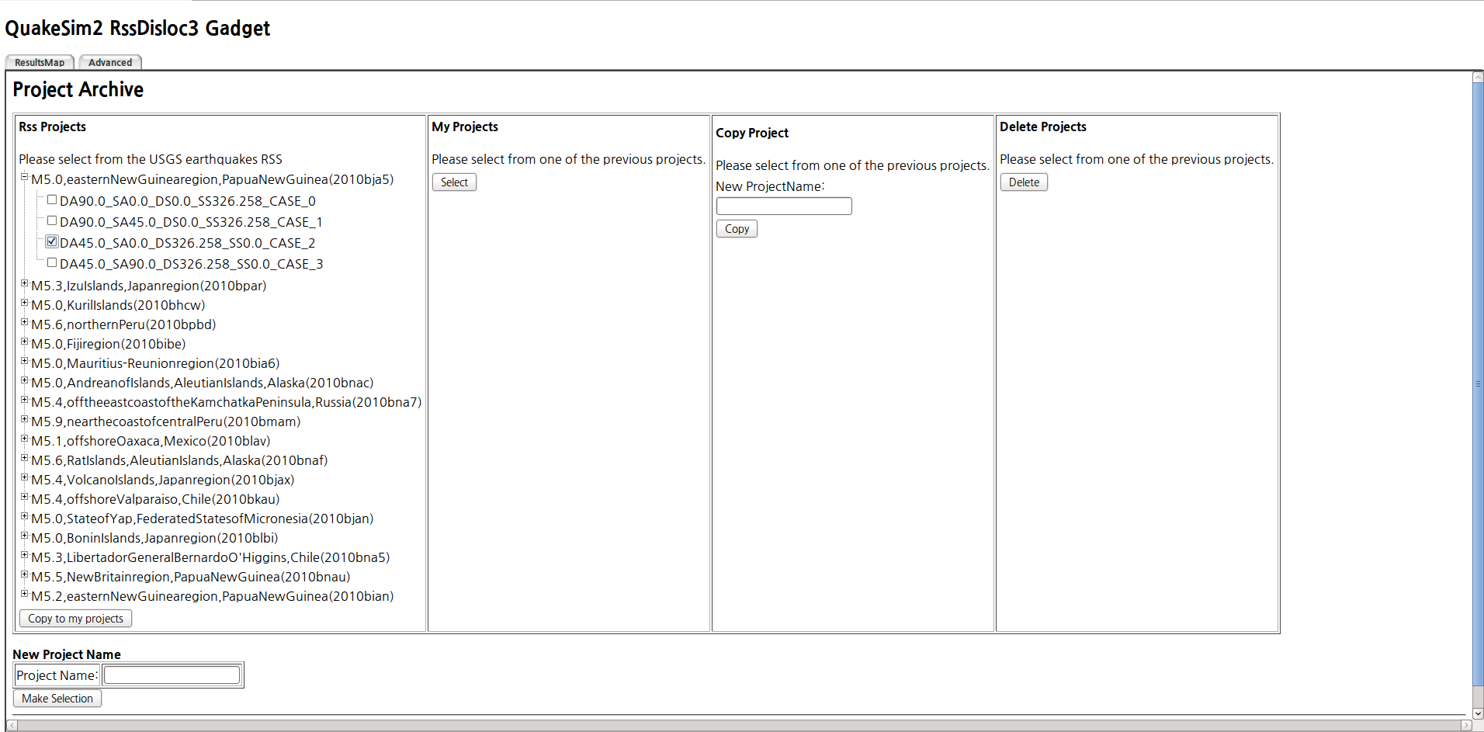
Users can copy the earthquakes into their personal workspace to modify the default Disloc settings.

Slide 9
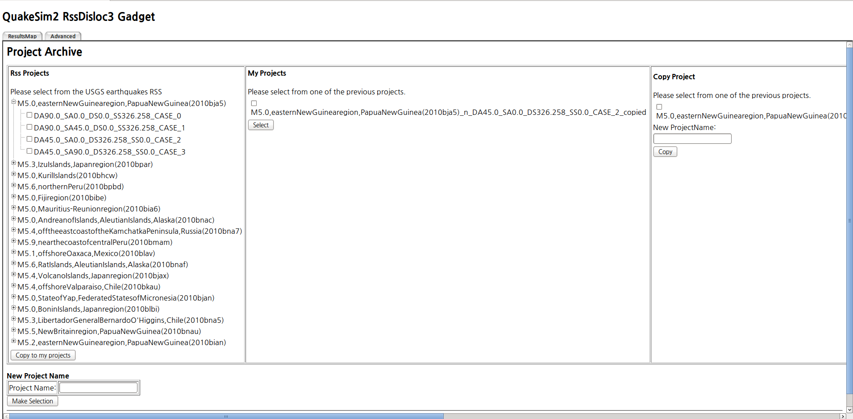
The copied project already has pre-calculated disloc result, displacement arrows kml, insar image kml.

Slide 10
User can see the results at ‘FetchResults’, ‘InSarPlots’.

Slide 11
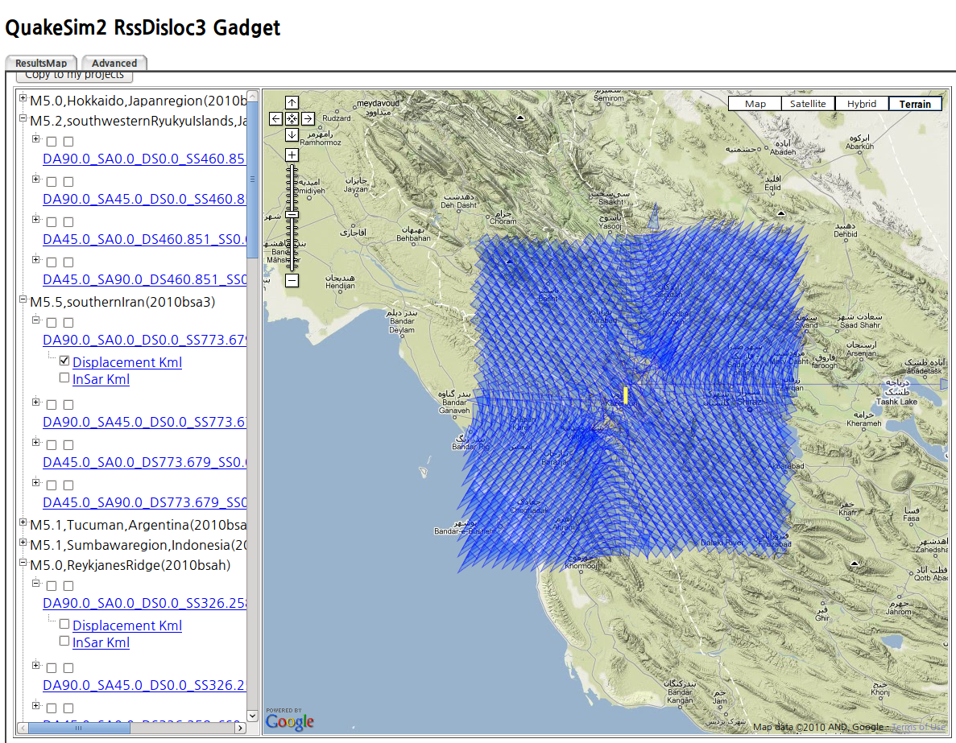
Subscribes to USGS earthquake RSS feed, calculates Disloc deformations and InSAR interferograms for every earthquake in the world with M>5. Uses previously developed Disloc services and since the same case number makes same results, it reuses the pre-calculated data from the second run. Plot is M 5.5 earthquake in southern Iran. Arrows are displacements. Detailed information in clickable popup.

Slide 12
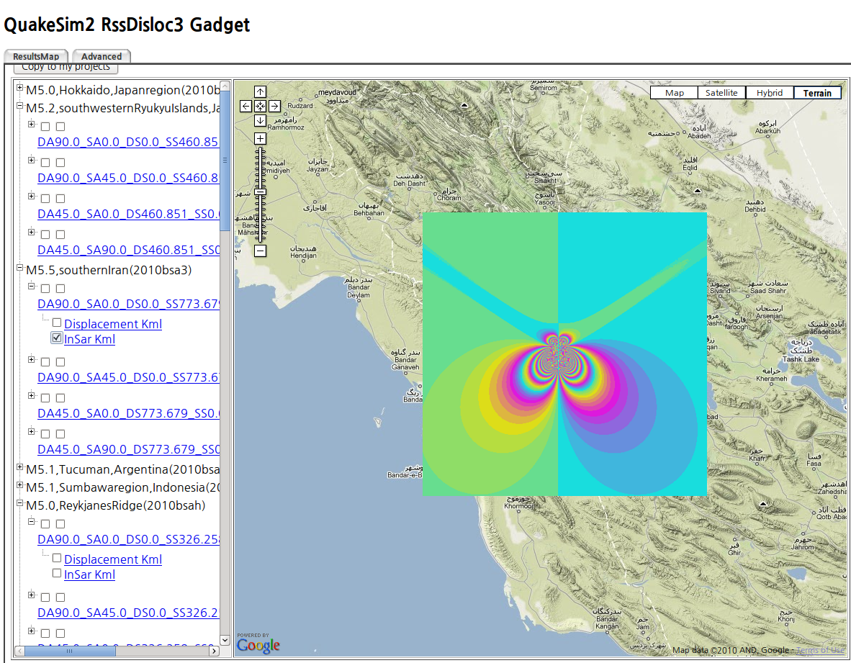
Interferogram plot of the same earthquake in previous slide.

Slide 13
Simplex Updates
Simplex is an inversion code that determines best-fit fault models for a particular set of observed displacements or velocities.
We have added UNAVCO GPS station velocities to Simplex’s user interface.
Using a Web service provided by UNAVCO.
Supplements JPL GIPSY and Scripps GLOBK values from Yehuda Bock’s team’s GRWS service.
This is introduces a problem, since the services give different values.
Need an easy interface for selecting the ones you want.

Slide 14
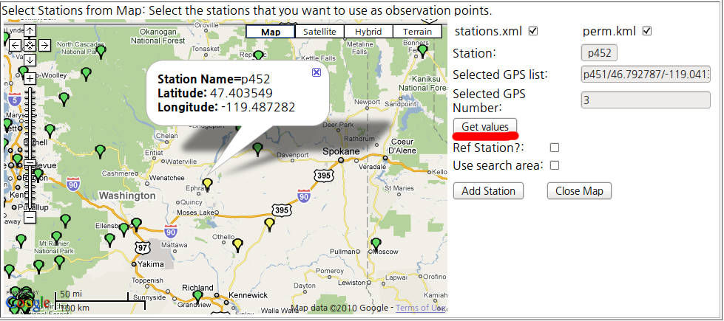
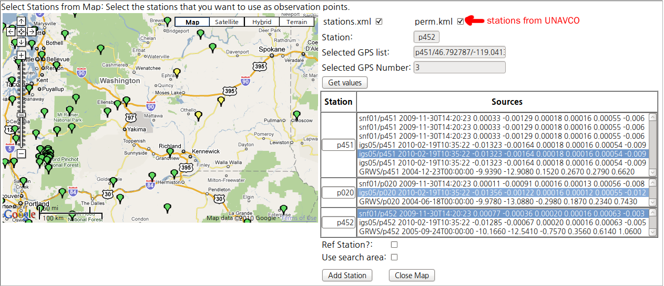
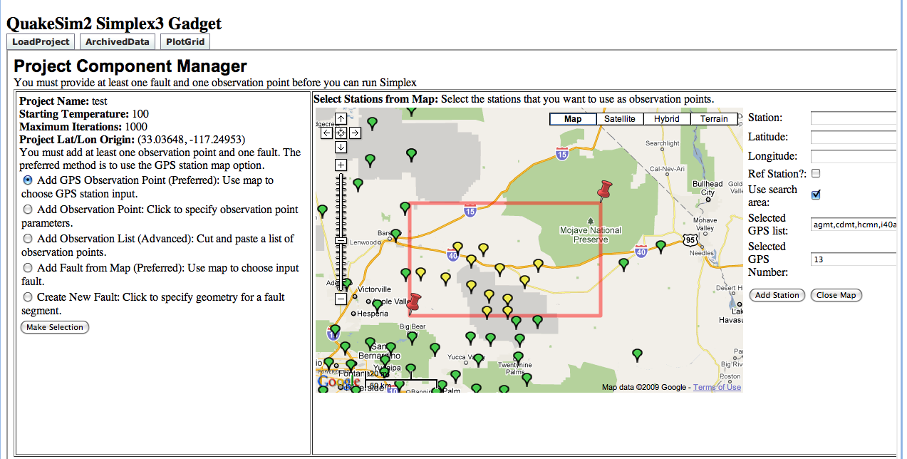
Select GPS stations with map interface. This may have multiple values.
View multiple values, select the data source that you want.
Optionally, select multiple GPS stations with draggable box.

Slide 15
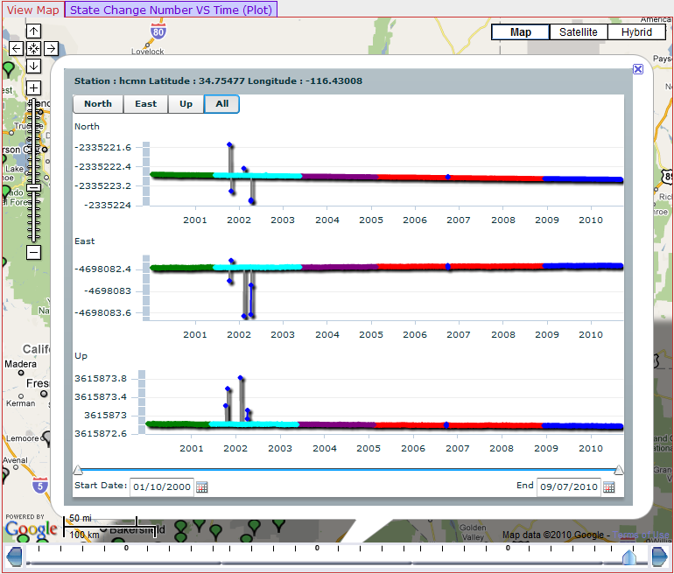
RDAHMM GPS Viewer Updates
RDAHMM and GPS user interfaces are described in more detail in a companion talk by Robert Granat.
We highlight here some improvements to the GPS results viewer.
This is an Adobe Flash application embedded into Google maps in the “Daily RDAHMM” gadget.

Slide 16
New Interactive Plotting Component
- better point and line connections
- zoom-in and zoom-out in time scale
- slide-though along time axis

Slide 17
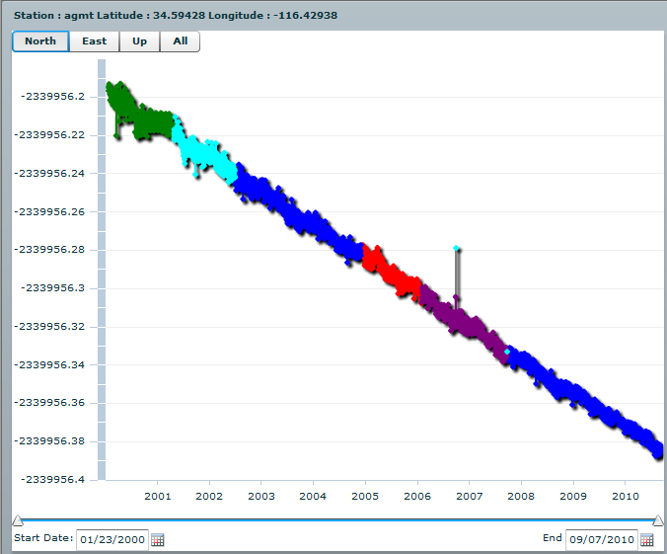
We made several updates to our interactive GPS viewer.

Slide 18
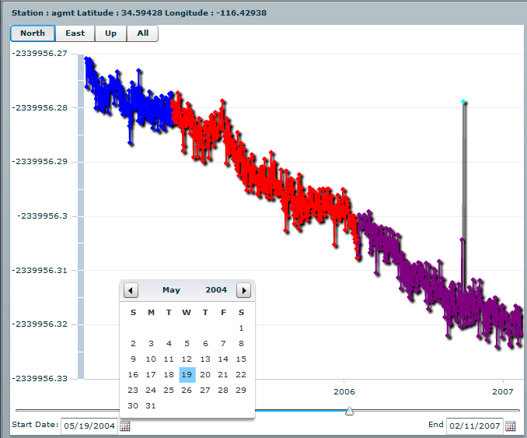
Specific Date Chooser

Slide 19
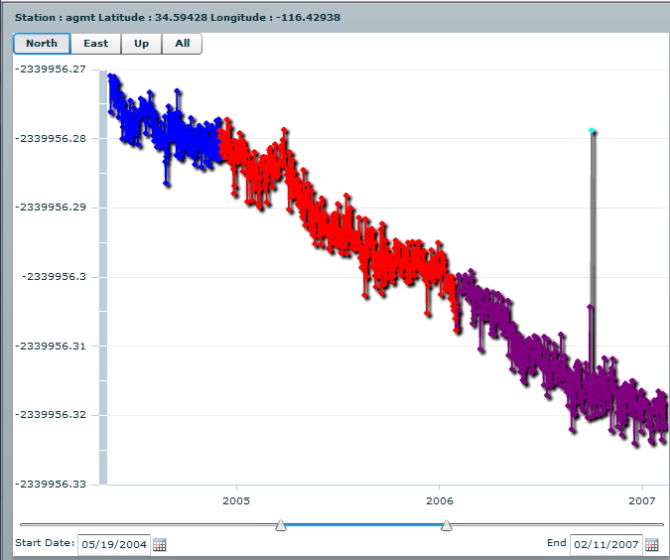
A dual slider allows you to navigate by hand. The slider also moves as a whole to keep the
Interval static.

Slide 20
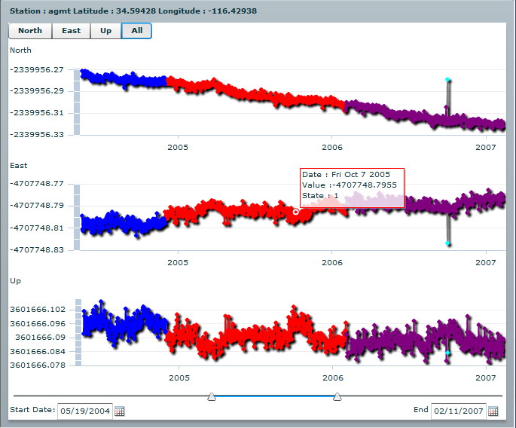
Pop-ups with detailed. point specific data can be found by moving the
mouse over the graphs.

Slide 21
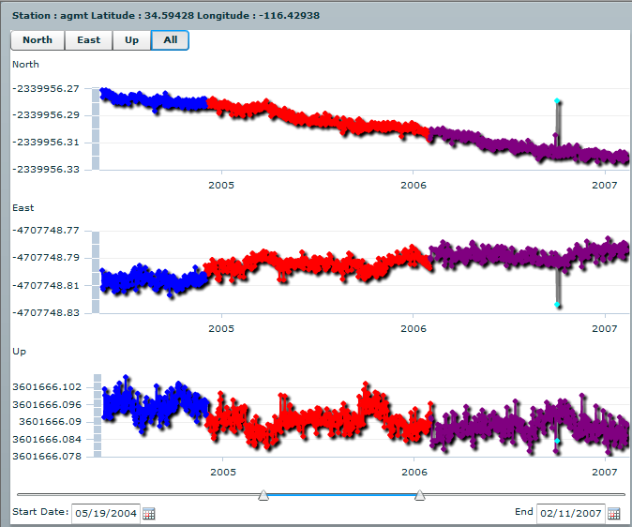
All three axes can be displayed simultaneously to see the whole picture. The
date filtering applies to each graph so the data lines up properly.

Slide 22
Conclusion
QuakeSim portal provides access to deformation and time series analysis tools.
Tools are available as separate Web services and can be used outside the portal
See X. Gao’s (Granat) talk for a demonstration.
We also make service results available as URLs and use KML is a data delivery format across the project.
USC and UC-Davis have complimentary KML services.
You can import everything into Google Earth (for example) if you like this better than the portal interfaces.
Portal interfaces work as both Google gadgets and Java Portlets.
Gadgets support Google’s single sign on.

