Slide 1
Qualifying Exam
Jaliya Ekanayake

Slide 2
Agenda
Research/Projects so far…
Future Direction

Slide 3
NB2MQ – Bridging Two Messaging Frameworks
Naradabrokering and IBM Websphere MQ are two messaging frameworks which support publish/subscribe messaging as well as JMS messaging
However they are not totally compatible
Solution:
A bridge to map the messages between two frameworks
Use only the “free” client libraries of the Websphere MQ V6
Topic
Connections
NBMQ Bridge
Topic
Subscriptions
NB2MQ
NB Broker
Network
MQ
Network
MQ2NB
Topic
Subscriptions
Topic
Connections
NB2MQ
Listener
Queue
Senders
Message Size | NB2MQ |  | MQ2NB
 | In-Order Msgs/Sec | No-Order Msgs/Sec | In-Order Msgs/Sec | No-Order Msgs/Sec
100B | 350 | 530 | 320 | 310
1KB | 330 | 500 | 290 | 290
4KB | 200 | 390 | 220 | 230
Configuration
MQ2NB
Senders
Queue
Listener
Architecture of the Message Bridge

Slide 4
Multi-cores -> Higher Performance?
To verify this, we measured the performance of Apache Axis2 deployed in Tomcat server on different multi-core machines.
Why Axis2 in Tomcat?
A multi-thread application written in Java which is supposed to handle large number of concurrent requests.
Measured the Round Trip Time (RTT) for a web service invocation.
Avoid overloading client machines by placing clients in multiple machines.
Test different multi-core machines.
JDK1.5 vs JRockit from BEA.
Synchronized
Start signal
Client1
Apache
Axis2 on Tomcat 5
Multi-core machine
Client2
Client N
Clients Running on
Multiple Machines
All the clients are started simultaneously by signaling the listener embedded in clients

Slide 5
Multi-cores cont.
Multi Processors vs Multi-cores
Higher number of cores – better performance for multi-threaded applications.
Load distribution
Intel Xeon 2.4 GHz – Two Processors | AMD Dual Core Opteron 280 2.4GHz
1000 Messages per Second 10 milliseconds RTT | 1900 Messages per Second 10 milliseconds RTT
Sun T1000 6 Core | Sun T1000 8 Core
2000 Messages per Second 20 millisecond RTT | 2600 Messages per Second 20 millisecond RTT

Slide 6
A Scalable Approach for the Secure and Authorized Tracking of the Availability of Entities in Distributed Systems
Scheme to track the availability/status of entities in a distributed system
Push/Pull paradigms both have their limitations
Use publish/subscribe messaging
Minimum message exchange
No N*(N-1) tracking
Transport Independent
Only authorized trackers would be allowed to track entities
Using Topic Discovery Mechanism
Supports encrypted message exchange
Physical location of an entity is not exposed
Published in IPDPS 07
E
Entities
E
E
E
B
B
Broker
Network
B
T
T
Trackers

Slide 7
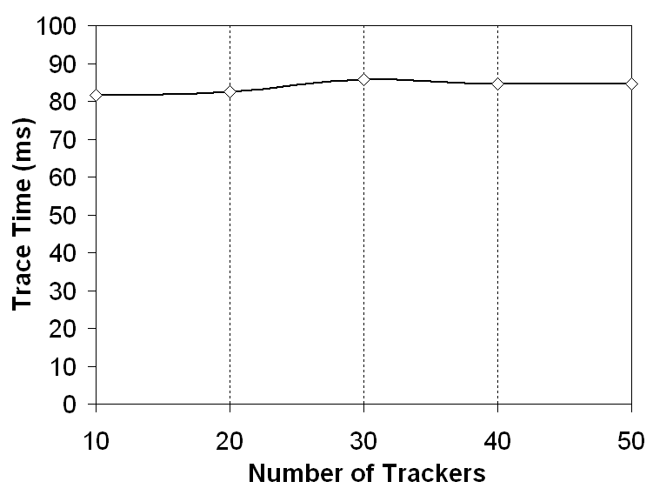
Tracking Entities cont.
E
Traced Entity
Brokers
B
B
B
B
T
T
T
T
Trackers
Test Topology
Trace Routing Overhead vs. Number of Trackers
Traced Entity
E
T
T
Brokers
B
B
B
B
Trackers
T
T

Slide 8
Extending The Naradabrokering for C++ Clients
To extends the publish/subscribe capabilities of Naradabrokering to Python/C++ users.
To support the integration of Clarens project from Caltech with Naradabrokering.
JNI Version
Implemented a bridge using JNI/Java
Provide publish/subscribe capabilities using a simple C++ API
C++ Version
No need of JVM
Same publish/subscribe API as above
Endianness
Different Platforms
C++ Pub/Sub Clients
Naradabrokering
Service Client (C++)
BridgeServiceClient(Java)
JNI
NB C++ Bridge
Architecture of the JNI Bridge
C++ Pub/Sub Clients
Naradabrokering
C++/Java Communication
Architecture of the C++ Bridge

Slide 9
Service Discovery Framework for C++/Python Clients
To support load-balanced access to ROOT applications.
ROOT – C++ Application written mostly by CERN.
Rootlet – Python web service that wraps the ROOT application.
Asynchronous discovery of services based on their load information will help balance the load on ROOT Applications.
Agents keeps track of available services (rootlets)
Applications (ROOTs) keep updating its status to rootlets.
Clients can Discover Agents/Services based on the type, availability, and, load information.
Agent Discovery
Only Authorized entities can discover agents
Service Discovery
Secure /Authorization
C
Clarens Server
Status
Update
ROOT
Rootlet Service
1
2
Pings
Register
A
A
Agents
Gossip
A
Service
Discovery
3
C1
C2
Cn
C++/Python Clients

Slide 10
Systems of Systems
Today’s systems incorporates systems ranging from the bleeding edge technologies like Web2.0, Google gadgets etc… to robust grid services and legacy systems to provide “services” to the user.
Adaptation of different standards and technologies makes the systems incompatible with each other.
Use of SOAP 1.1 and SOAP 1.2
Different data representations (Physics, Chemistry, Bioinformatics Areas)
Requirement for different Quality of Services
E.g. Use of WS-Security, WS- ReliableExchange
Adaptation of different Standard
E.g. WS-Notification vs. WS-Eventing
Optimized messages
MTOM,SWA
Use of different transports
Use of different styles
E.g. REST/SOAP
Integration of such systems requires a capabilities of a Mediator

Slide 11
A Mediator.
Most of the research work in this area focuses on building mediators.
A single mediator will not scale well.
Produces a single point of failure.
A possible Improvement would be to “Distribute the Mediation” logic to multiple entities.
System A
System B
M
Mediator

Slide 12
Distributed Mediation
Multiple mediators with same capabilities can mediate the communication between systems.
Should be transparent to the Systems.
Should maintain contexts.
M
System A
Mediators
System B
M
M
Mediators can be parts of
System A or System B or Some other
Where to Start?
Apache Synapse
Virtual Private Networks
Skype

Slide 13
Thank You!

Slide 14
Multi-core contd..

Slide 15
Axis2 Performance on Tomcat 5 with JDK 1.5 The web service simply build the xml tree and returns it (echo operation). Payload size is 400 Bytes
Machine | Messages per Second | Round Trip Time (milliseconds)
Intel(R) Xeon(TM) CPU 2.40GHz Two Real CPUs with Two cores each | 717 | 5.5
 | 935 | 5.5
 | 1280 | 16
 | 1311 | 25.5
 | 1322 | 45
Sun Fire(TM) T1000 System clock frequency: 200 MHz Memory size: 8184 MB 6 Cores Each with 4 Threads 24 Parallel Threads | 464 | 6.5
 | 795 | 7.5
 | 879 | 11
 | 1716 | 15
 | 2030 | 15
 | 2284 | 23.5
 | 2581 | 22.5
 | 2733 | 59
Sun Fire(TM) T1000 System clock frequency: 200 MHz Memory size: 8184 MB 8 Cores Each with 4 Threads 32 Parallel Threads | 657 | 6.5
 | 993 | 9.5
 | 1164 | 9.5
 | 1632 | 13
 | 2538 | 17
 | 2818 | 20
 | 2976 | 30
Hewlette-Packard HP xw9300 Workstation Dual core AMD Opteron Processor 275 2.19 GHz, 4GB Ram Two Processors each with two cores. | 584 | 6
 | 882 | 7
 | 968 | 7
 | 1421 | 6.5
 | 1862 | 8
 | 2120 | 13.5
 | 3080 | 15.5
 | 3084 | 22.5

