Slide 1
Data Science Curriculum at Indiana University
EDISON Workshop
September 21 2014
RDA4 Amsterdam
Geoffrey Fox
gcf@indiana.edu
Informatics, Computing and Physics
Indiana University Bloomington

Slide 2
School of Informatics and Computing at Indiana University

Slide 3
Background of the School
The School of Informatics was established in 2000 as first of its kind in the United States.
Computer Science was established in 1971 and became part of the school in 2005.
Library and Information Science was established in 1951 and became part of the school in 2013.
Now named the School of Informatics and Computing.

Slide 4
What Is Our School About?
The broad range of computing and information technology: science, a broad range of applications and human and societal implications.
United by a focus on information and technology, our extensive programs include:
Computer Science
Informatics
Information Science
Library Science
Data Science (starting)

Slide 5
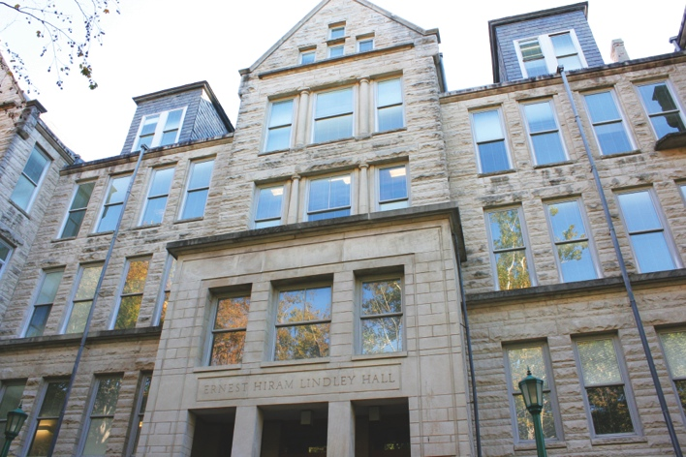
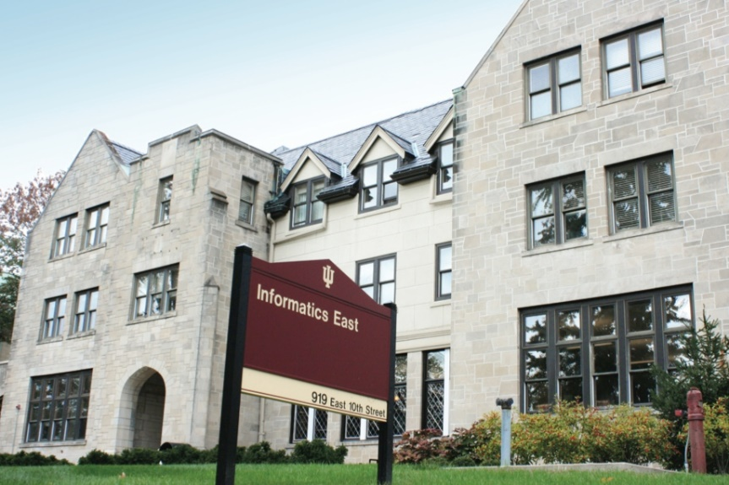
Size of School (2013-2014)
Undergraduates mainly Informatics;
Graduates mainly Computer Science
Faculty 97
(85 tenure track)
Students
Undergraduate 1,191
Master’s 644
Ph.D. 263
Female Undergraduates 21% (⬆68% since 2007)
Female Graduate Students 28% (⬆4% since 2007)

Slide 6
Data Science Cosmically

Slide 7
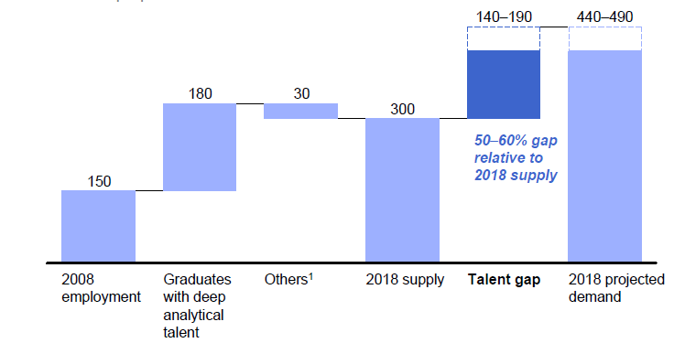
McKinsey Institute on Big Data Jobs
There will be a shortage of talent necessary for organizations to take advantage of big data. By 2018, the United States alone could face a shortage of 140,000 to 190,000 people with deep analytical skills as well as 1.5 million managers and analysts with the know-how to use the analysis of big data to make effective decisions.
Perhaps Informatics/ILS aimed at 1.5 million jobs. Computer Science covers the 140,000 to 190,000
http://www.mckinsey.com/mgi/publications/big_data/index.asp.

Slide 8
Job Trends
Big Data about an order of magnitude larger than data science
21 September 2014
15,639 jobs have “big data” phrase

Slide 9
What is Data Science?
The next slide gives a definition arrived by a NIST study group fall 2013.
The previous slide says there are several jobs but that’s not enough! Is this a field – what is it and what is its core?
The emergence of the 4th or data driven paradigm of science illustrates significance - http://research.microsoft.com/en-us/collaboration/fourthparadigm/
Discovery is guided by data rather than by a model
The End of (traditional) science http://www.wired.com/wired/issue/16-07 is famous here
Another example is recommender systems in Netflix, e-commerce etc.
Here data (user ratings of movies or products) allows an empirical prediction of what users like
Here we define points in spaces (of users or products), cluster them etc. – all conclusions coming from data

Slide 10
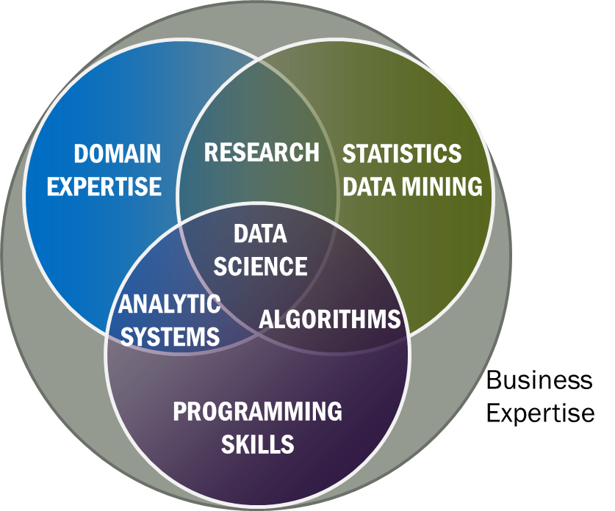
Data Science Definition from NIST Public Working Group
Data Science is the extraction of actionable knowledge directly from data through a process of discovery, hypothesis, and analytical hypothesis analysis.
A Data Scientist is a practitioner who has sufficient knowledge of the overlapping regimes of expertise in business needs, domain knowledge, analytical skills and programming expertise to manage the end-to-end scientific method process through each stage in the big data lifecycle.
See Big Data Definitions in http://bigdatawg.nist.gov/V1_output_docs.php
Notes:
Big Data refers to digital data volume, velocity and/or variety whose management requires scalability across coupled horizontal resources
Data Science is the extraction of actionable knowledge directly from data through a process of discovery, hypothesis, and analytical hypothesis analysis.
A Data Scientist is a practitioner who has sufficient knowledge of the overlapping regimes of expertise in business needs, domain knowledge, analytical skills and programming expertise to manage the end-to-end scientific method process through each stage in the big data lifecycle.

Slide 11
Some Existing Online Data Science Activities
Indiana University is “blended”: online and/or residential; other universities offer residential
We may discount online when total cost ~$11,500 (in state price)
$35,490
30

Slide 12
Data Science Curriculum at Indiana University
Faculty in Data Science is “virtual department”
4 course Certificate: purely online, started January 2014
10 course Masters: online/residential, will start January 2015

Slide 13
Indiana University Data Science Site

Slide 14
Indiana University Data Science Certificate
We currently have 75 students admitted into the Data Science Certificate program (from 81 applications)
36 students admitted in Spring 2014; 14 of these have signed up for fall classes
39 students admitted in Fall 2014; 34 of these have signed up for fall classes and 4 are in process
We expected many more applicants
Two tracks for information only
Decision Maker (little software) ~= McKinsey “managers and analysts”
Technical ~= McKinsey “people with deep analytical skills”
Total tuition costs for the twelve credit hours for this certificate is approximately $4,500. (Factor of three lower than out of state $14,198 and ~ in-state rate $4,603)

Slide 15
IU Data Science Masters Features
Fully approved by University and State October 14 2014
Blended online and residential
Department of Information and Library Science, Division of Informatics and Division of Computer Science in the Department of Informatics and Computer Science, School of Informatics and Computing and the Department of Statistics, College of Arts and Science, IUB
30 credits (10 conventional courses)
Basic (general) Masters degree plus tracks
Currently only track is “Computational and Analytic Data Science ”
Other tracks expected
A purely online 4-course Certificate in Data Science has been running since January 2014 (Technical and Decision Maker paths)
A Ph.D. Minor in Data Science has been proposed.

Slide 16
3 Types of Students
Professionals wanting skills to improve job or “required” by employee to keep up with technology advances
Traditional sources of IT Masters
Students in non IT fields wanting to do “domain specific data science”

Slide 17
What do students want?
Degree with some relevant curriculum
Data Science and Computer Science distinct BUT
Real goal often “Optional Practical Training” OPT allowing graduated students visa to work for US companies
Must have spent at least a year in US in residential program
Residential CS Masters (at IU) 95% foreign students
Online program students quite varied but mostly USA professionals aiming to improve/switch job

Slide 18
IU and Competition
With Computer Science, Informatics, ILS, Statistics, IU has particularly broad unrivalled technology base
Other universities have more domain data science than IU
Existing Masters in US in table. Many more certificates and related degrees (such as business analytics)
School | Program | Campus | Online | Degree
Columbia University | Data Science | Yes | No | MS 30 cr
Illinois Institute of Technology | Data Science | Yes | No | MS 33 cr
New York University | Data Science | Yes | No | MS 36 cr
University of California Berkeley School of Information | Master of Information and Data Science | Yes | Yes | M.I.D.S
University of Southern California | Computer Science with Data Science | Yes | No | MS 27 cr

Slide 19
Basic Masters Course Requirements
One course from two of three technology areas
I. Data analysis and statistics
II. Data lifecycle (includes “handling of research data”)
III. Data management and infrastructure
One course from (big data) application course cluster
Other courses chosen from list maintained by Data Science Program curriculum committee (or outside this with permission of advisor/ Curriculum Committee)
Capstone project optional
All students assigned an advisor who approves course choice.
Due to variation in preparation will label courses
Decision Maker
Technical
Corresponding to two categories in McKinsey report – note Decision Maker had an order of magnitude more job openings expected

Slide 20
Computational and Analytic Data Science track
For this track, data science courses have been reorganized into categories reflecting the topics important for students wanting to prepare for computational and analytic data science careers for which a strong computer science background is necessary. Consequently, students in this track must complete additional requirements,
1) A student has to take at least 3 courses (9 credits) from Category 1 Core Courses. Among them, B503 Analysis of Algorithms is required and the student should take at least 2 courses from the following 3:
B561 Advanced Database Concepts,
[STAT] S520 Introduction to Statistics OR (New Course) Probabilistic Reasoning
B555 Machine Learning OR I590 Applied Machine Learning
2) A student must take at least 2 courses from Category 2 Data Systems, AND, at least 2 courses from Category 3 Data Analysis. Courses taken in Category 1 can be double counted if they are also listed in Category 2 or Category 3.
3) A student must take at least 3 courses from Category 2 Data Systems, OR, at least 3 courses from Category 3 Data Analysis. Again, courses taken in Category 1 can be double counted if they are also listed in Category 2 or Category 3. One of these courses must be an application domain course

Slide 21
Comparing Google Course Builder (GCB) and Microsoft Office Mix

Slide 22
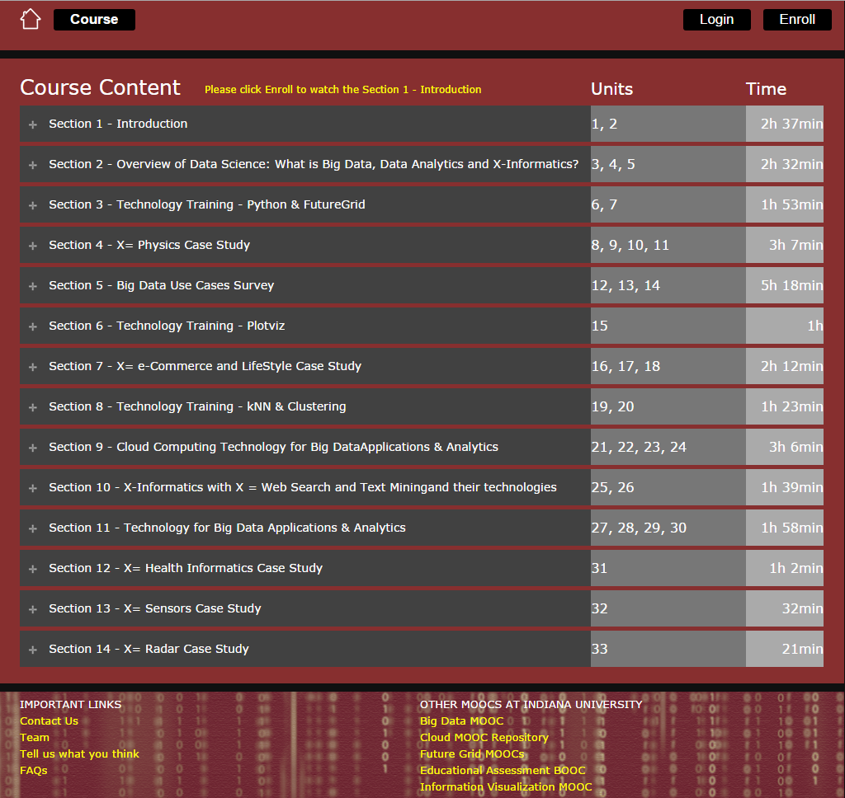
Big Data Applications and Analytics
All Units and Sections

Slide 23
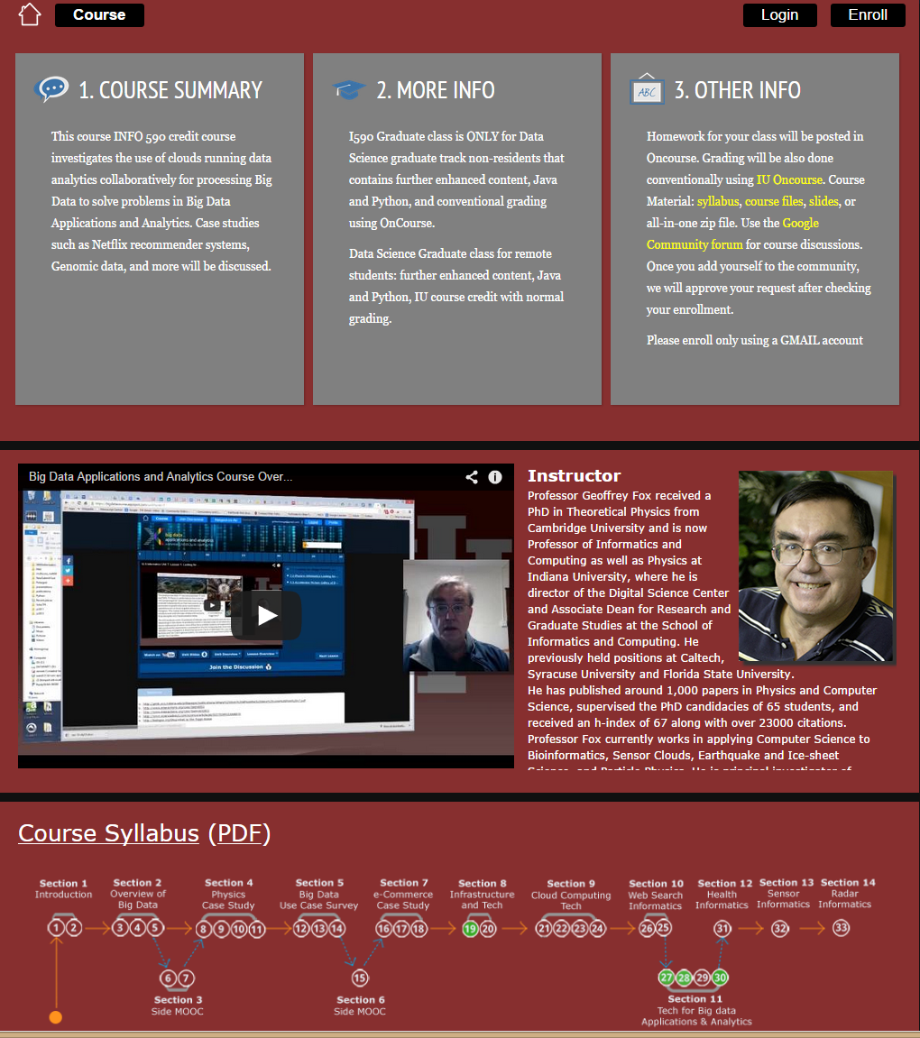
Big Data Applications and Analytics
General Information on Home Page

Slide 24
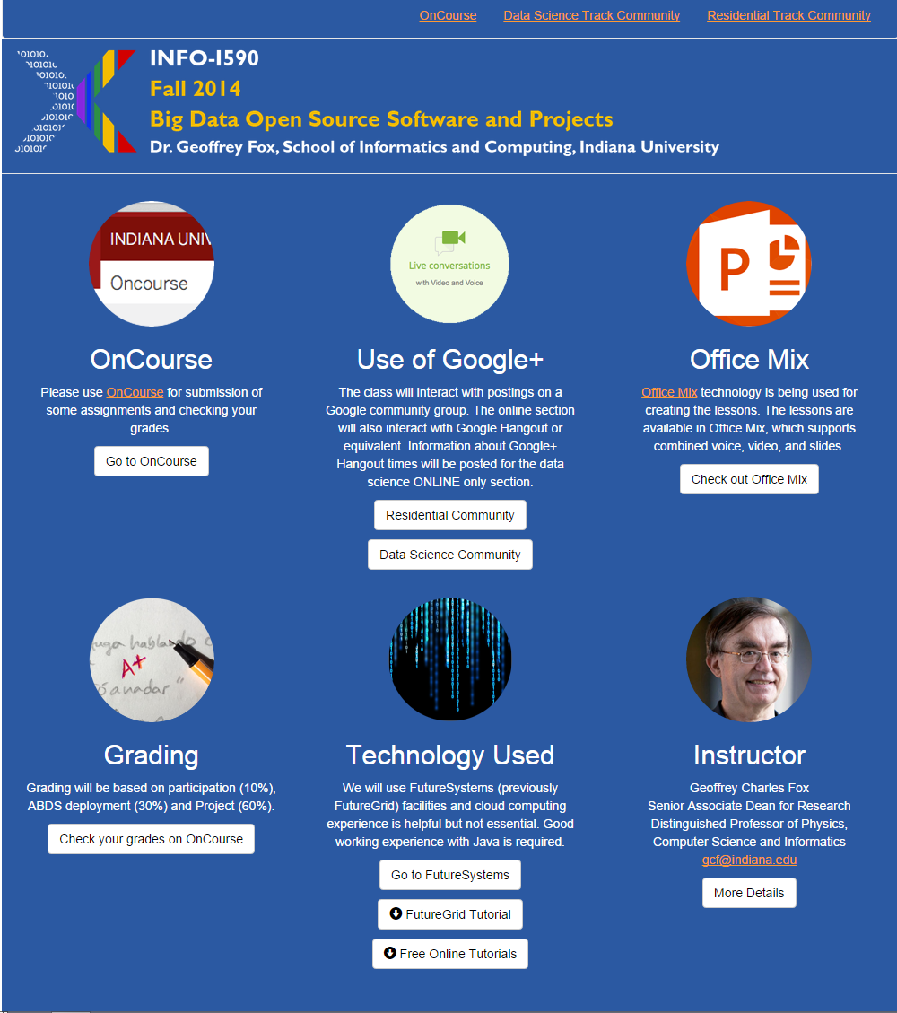
Office Mix Site General Material
Create video in PowerPoint with laptop web cam
Exported to Microsoft Video Streaming Site

Slide 25
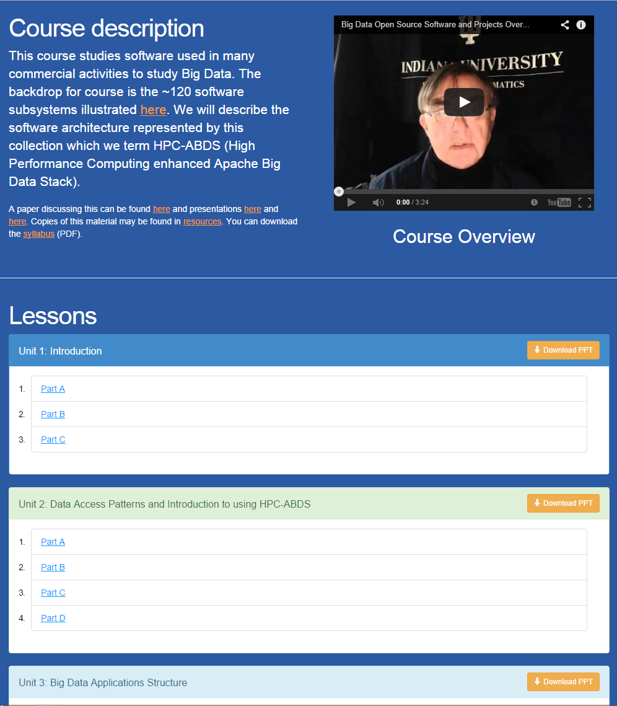
Office Mix Site Lectures
Made as ~15 minute lessons linked here
Metadata on Microsoft Site

Slide 26
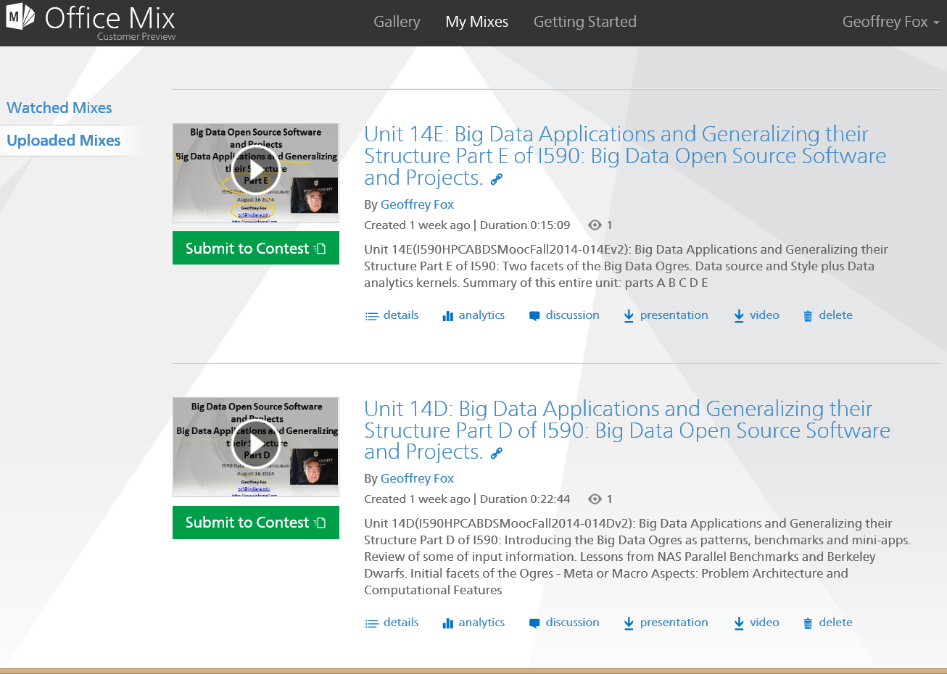
The lessons on my Microsoft Site

Slide 27
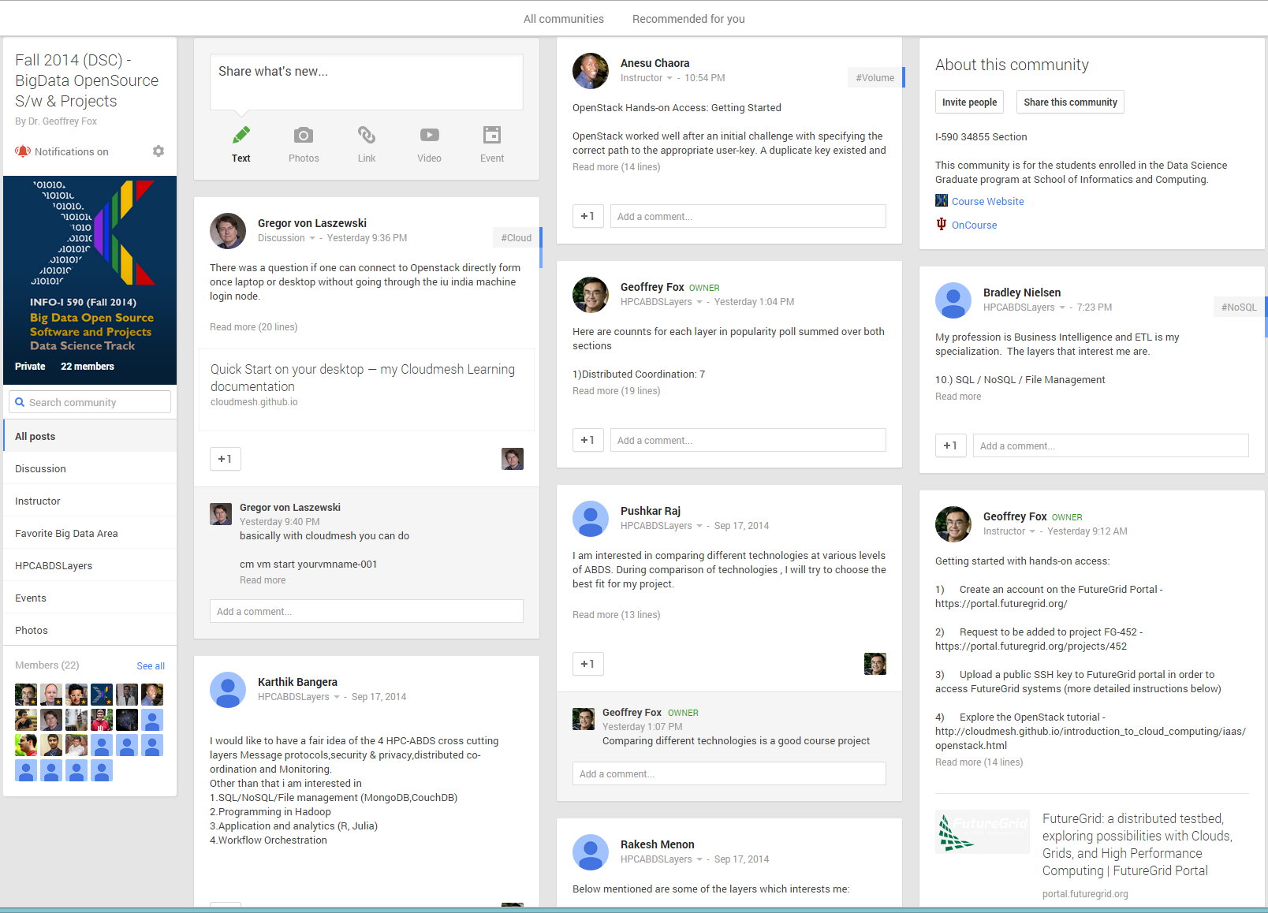
Google Community Group

Slide 28
Potpourri of Online Technologies
Canvas (Indiana University Default): Best for interface with IU grading and records
Google Course Builder: Best for management and integration of components
Ad hoc web pages: alternative easy to build integration
Mix: Best faculty preparation interface
Adobe Presenter/Camtasia: More powerful video preparation that support subtitles but not clearly needed
Google Community: Good social interaction support
YouTube: Best user interface for videos
Hangout: Best for instructor-students online interactions (one instructor to 9 students with live feed). Hangout on air mixes live and streaming (30 second delay from archived YouTube) and more participants

Slide 29
Details of Masters Degree

Slide 30
Computational and Analytic Data Science track
Category 1: Core Courses
CSCI B503 Analysis of Algorithms
CSCI B555 Machine Learning OR INFO I590 Applied Machine Learning
CSCI B561 Advanced Database Concepts
STAT S520 Introduction to Statistics OR (New Course) Probabilistic Reasoning
Category 2: Data Systems
CSCI B534 Distributed Systems CSCI B561 Advanced Database Concepts, CSCI B662 Database Systems & Internal Design
CSCI B649 Cloud Computing CSCI B649 Advanced Topics in Privacy
CSCI P538 Computer Networks
INFO I533 Systems & Protocol Security & Information Assurance
ILS Z534: Information Retrieval: Theory and Practice

Slide 31
Computational and Analytic Data Science track
Category 3: Data Analysis
CSCI B565 Data Mining
CSCI B555 Machine Learning
INFO I590 Applied Machine Learning
INFO I590 Complex Networks and Their Applications
STAT S520 Introduction to Statistics
(New Course) Probabilistic Reasoning
(New Course CSCI) Algorithms for Big Data
Category 4: Elective Courses
CSCI B551 Elements of Artificial Intelligence
CSCI B553 Probabilistic Approaches to Artificial Intelligence
CSCI B659 Information Theory and Inference
CSCI B661 Database Theory and Systems Design
INFO I519 Introduction to Bioinformatics
INFO I520 Security For Networked Systems
INFO I529 Machine Learning in Bioinformatics
INFO I590 Relational Probabilistic Models
ILS Z637 - Information Visualization
Every course in 500/600 SOIC related to data that is not in the list
All courses from STAT that are 600 and above

Slide 32
Admissions
Decided by Data Science Program Curriculum Committee
Need some computer programming experience (either through coursework or experience), and a mathematical background and knowledge of statistics will be useful
Tracks can impose stronger requirements
3.0 Undergraduate GPA
A 500 word personal statement
GRE scores are required for all applicants.
3 letters of recommendation

Slide 33
Four Areas I and II
I. Data analysis and statistics: gives students skills to develop and extend algorithms, statistical approaches, and visualization techniques for their explorations of large scale data. Topics include data mining, information retrieval, statistics, machine learning, and data visualization and will be examined from the perspective of “big data,” using examples from the application focus areas described in Section IV.
II. Data lifecycle: gives students an understanding of the data lifecycle, from digital birth to long-term preservation. Topics include data curation, data stewardship, issues related to retention and reproducibility, the role of the library and data archives in digital data preservation and scholarly communication and publication, and the organizational, policy, and social impacts of big data.

Slide 34
Four Areas III and IV
III. Data management and infrastructure: gives students skills to manage and support big data projects. Data have to be described, discovered, and actionable. In data science, issues of scale come to the fore, raising challenges of storage and large-scale computation. Topics in data management include semantics, metadata, cyberinfrastructure and cloud computing, databases and document stores, and security and privacy and are relevant to both data science and “big data” data science.
IV. Big data application domains: gives students experience with data analysis and decision making and is designed to equip them with the ability to derive insights from vast quantities and varieties of data. The teaching of data science, particularly its analytic aspects, is most effective when an application area is used as a focus of study. The degree will allow students to specialize in one or more application areas which include, but are not limited to Business analytics, Science informatics, Web science, Social data informatics, Health and Biomedical informatics.

Slide 35
I. Data Analysis and Statistics
CSCI B503 Analysis of Algorithms
CSCI B553 Probabilistic Approaches to Artificial Intelligence
CSCI B652: Computer Models of Symbolic Learning
CSCI B659 Information Theory and Inference
CSCI B551: Elements of Artificial Intelligence
CSCI B555: Machine Learning
CSCI B565: Data Mining
INFO I573: Programming for Science Informatics
INFO I590 Visual Analytics
INFO I590 Relational Probabilistic Models
INFO I590 Applied Machine Learning
ILS Z534: Information Retrieval: Theory and Practice
ILS Z604: Topics in Library and Information Science: Big Data Analysis for Web and Text
ILS Z637: Information Visualization
STAT S520 Intro to Statistics
STAT S670: Exploratory Data Analysis
STAT S675: Statistical Learning & High-Dimensional Data Analysis
(New Course CSCI) Algorithms for Big Data
(New Course CSCI) Probabilistic Reasoning
All courses from STAT that are 600 and above

Slide 36
II. Data Lifecycle
INFO I590: Data Provenance
INFO I590 Complex Systems
ILS Z604 Scholarly Communication
ILS Z636: Semantic Web
ILS Z652: Digital Libraries
ILS Z604: Data Curation
(New Course INFO): Social and Organizational Informatics of Big Data
(New Course ILS: Project Management for Data Science
(New Course ILS): Big Data Policy

Slide 37
III. Data Management and Infrastructure
CSCI B534: Distributed Systems
CSCI B552: Knowledge-Based Artificial Intelligence
CSCI B561: Advanced Database Concepts
CSCI B649: Cloud Computing (offered online)
CSCI B649 Advanced Topics in Privacy
CSCI B649: Topics in Systems: Cloud Computing for Data Intensive Sciences
CSCI B661: Database Theory and System Design
CSCI B662 Database Systems & Internal Design
CSCI B669: Scientific Data Management and Preservation
CSCI P536: Operating Systems
CSCI P538 Computer Networks
INFO I520 Security For Networked Systems
INFO I525: Organizational Informatics and Economics of Security
INFO I590 Complex Networks and their Applications
INFO I590: Topics in Informatics: Data Management for Big Data
INFO I590: Topics in Informatics: Big Data Open Source Software and Projects
ILS S511: Database
Every course in 500/600 SOIC related to data that is not in the list

Slide 38
IV. Application areas
CSCI B656: Web mining
CSCI B679: Topics in Scientific Computing: High Performance Computing
INFO I519 Introduction to Bioinformatics
INFO I529 Machine Learning in Bioinformatics
INFO I533 Systems & Protocol Security & Information Assurance
INFO I590: Topics in Informatics: Big Data Applications and Analytics
INFO I590: Topics in Informatics: Big Data in Drug Discovery, Health and Translational Medicine
ILS Z605: Internship in Data Science
Kelley School of Business: business analytics course(s)
Other courses from Indiana University e.g. Physics Data Analysis

Slide 39
Technical Track of General DS Masters
Year 1 Semester 1:
INFO 590: Topics in Informatics: Big Data Applications and Analytics
ILS Z604: Big Data Analytics for Web and Text
STAT S520: Intro to Statistics
Year 1: Semester 2:
CSCI B661: Database Theory and System Design
ILS Z637: Information Visualization
STAT S670: Exploratory Data Analysis
Year 1: Summer:
CSCI B679: Topics in Scientific Computing: High Performance Computing
Year 2: Semester 3:
CSCI B555: Machine Learning
STAT S670: Exploratory Data Analysis
CSCI B649: Cloud Computing

Slide 40
Computational and Analytic Data Science track
Year 1 Semester 1:
B503 Analysis of Algorithms
B561 Advanced Database Concepts
S520 Introduction to Statistics
Year 1: Semester 2:
B649 Cloud Computing
Z534: Information Retrieval: Theory and Practice
B555 Machine Learning
Year 1: Summer:
ILS 605: Internship in Data Science
Year 2: Semester 3:
B565 Data Mining
I520 Security For Networked Systems
Z637 - Information Visualization

Slide 41
An Information-oriented Track
Year 1 Semester 1:
INFO 590: Topics in Informatics: Big Data Applications and Analytics
ILS Z604 Big Data Analytics for Web and Text.
STAT S520 Intro to Statistics
Year 1: Semester 2:
CSCI B661 Database Theory and System Design
ILS Z637: Information Visualization
ILS Z653: Semantic Web
Year 1: Summer:
ILS 605: Internship in Data Science
Year 2: Semester 3:
ILS Z604 Data Curation
ILS Z604 Scholarly Communication
INFO I590: Data Provenance

Slide 42
MOOC’s
The MOOC version of Big Data Applications and Analytics has ~2000 students enrolled.
Coursera Offerings are much larger enrollment

Slide 43
Background
MOOC’s are a “disruptive force” in the educational environment
Coursera, Udacity, Khan Academy and many others
MOOC’s have courses and technologies
Google Course Builder and OpenEdX are open source MOOC technologies
Blackboard and others are learning management systems with (some) MOOC support

Slide 44
MOOC Style Implementations
Courses from commercial sources, universities and partnerships
Courses with 100,000 students (free)
Georgia Tech a leader in rigorous academic curriculum – MOOC style Masters in Computer Science (pay tuition, get regular GT degree)
Indiana University a much more modest Data Science certificate with 4 MOOC courses Spring 2014
Interesting way to package tutorial material for computers and software e.g.
FutureGrid has had 24 EOT projects over last year (semester courses to workshops)
Support by MOOC modules on how to use FutureGrid

Slide 45
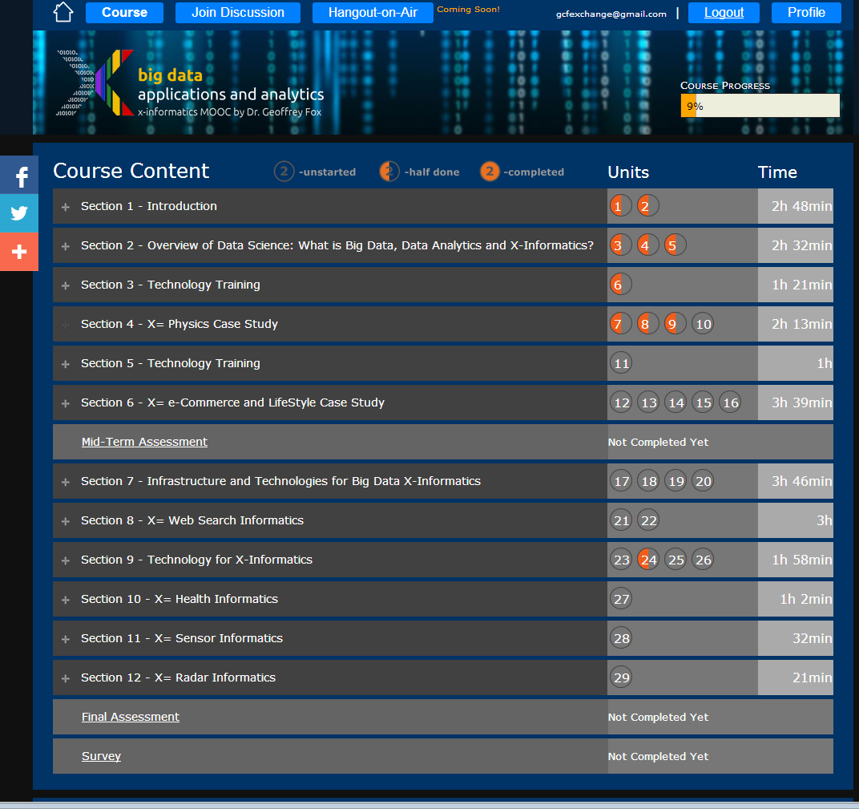
Example Google
Course Builder
MOOC
4 levels
Course
Section (12)
Units(29)
Lessons(~150)
Units are ~ traditional lecture
Lessons are ~10 minute segments
http://x-informatics.appspot.com/course

Slide 46
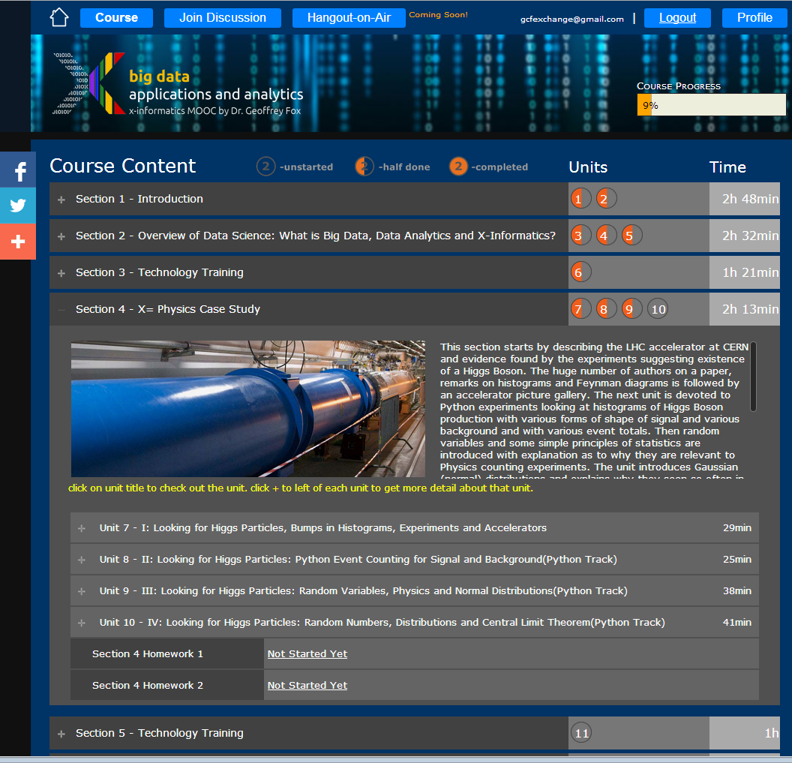
Example Google
Course Builder
MOOC
The Physics Section expands to 4 units and 2 Homeworks
Unit 9 expands to 5 lessons
Lessons played on Youtube
“talking head video + PowerPoint”
http://x-informatics.appspot.com/course

Slide 50
MOOCs in SC community
Activities like CI-Tutor and HPC University are community activities that have collected much re-usable education material
MOOC’s naturally support re-use at lesson or higher level
e.g. include MPI on XSEDE MOOC as part of many parallel programming classes
Need to develop agreed ways to use backend servers (HPC or Cloud) to support MOOC laboratories
Students should be able to take MOOC classes from tablet or phone
Parts of MOOC’s (Units or Sections) can be used as modules to enhance classes in outreach activities

Slide 51
Cloud MOOC Repository
http://iucloudsummerschool.appspot.com/preview

Slide 52
Structure of Google Course Builder (GCB) Course

Slide 53
Structure of GCB Course I
3 for-credit sections: Undergraduate, graduate, Online Data Science Certificate plus an older free MOOC
A online course resource built with Google Course Builder and enhancements CGL Mooc Builder http://moocbuilder.soic.indiana.edu/ built by us and available as open source that allow convenient assembly of the different course components. These components include
5-15 minute video segments called lessons and containing curricula material (instructor desktop often containing PowerPoint slides).
Lessons are assembled into units totaling around 45 minutes – 2 hours and roughly equivalent to a traditional class.
Units linked into sections that together make up a coherent description of a major topic in course; for example “introduction” “Big Data and the Higgs Boson” and “Cloud Technology” are sections in these classes

Slide 54
Structure of GCB Course II
The 3 sections share the same online site with 14 sections; 33 units and 220 lessons totaling 28.7 hours of video. The average lesson length was 7.8 minutes with 52 minute average for units and sections averaging just over 2 hours with a maximum length of 5 hours 18 minutes. Offering 1) was similar but had earlier versions of material.
Each lesson had a video located on YouTube and an abstract (called lesson overview in figure 1 below). This interface show all lessons (13) for this unit and that each unit has its own abstract and slides available. There are also a list of follow-up resources associated with units and illustrated at bottom of figure 1. In the middle of figure 1, one sees the link to YouTube hosting of this lesson and 3 discussion links; one for each offering 2), 3) and4). These are described later.

Slide 55
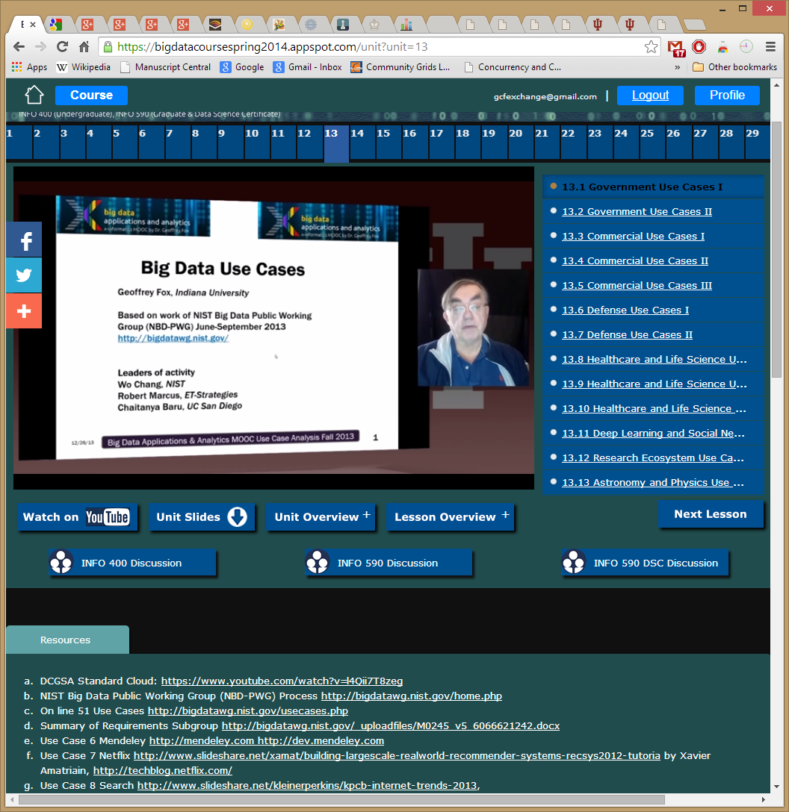
A typical lesson (the first in unit 13) Note links to all units across the top (29 of 33 units) shown)

Slide 56
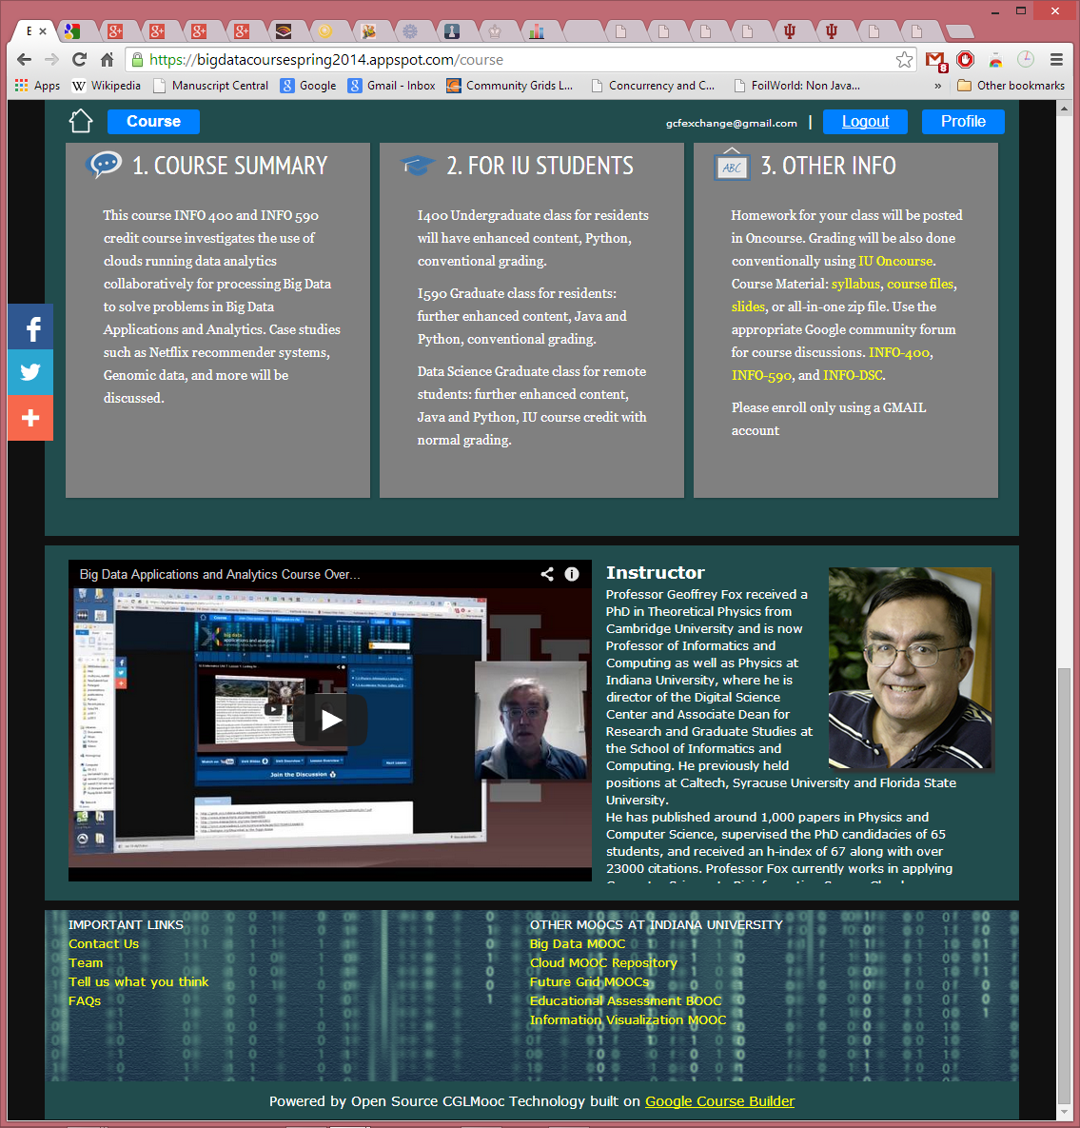
Course Home Page with Overview material

Slide 57
Course Home Page showing Syllabus
Note that we have a course – section – unit – lesson hierarchy (supported by Mooc Builder) with abstracts available at each level of hierarchy. The home page has overview information (shown earlier) plus a list of all sections and a syllabus shown above.

Slide 58
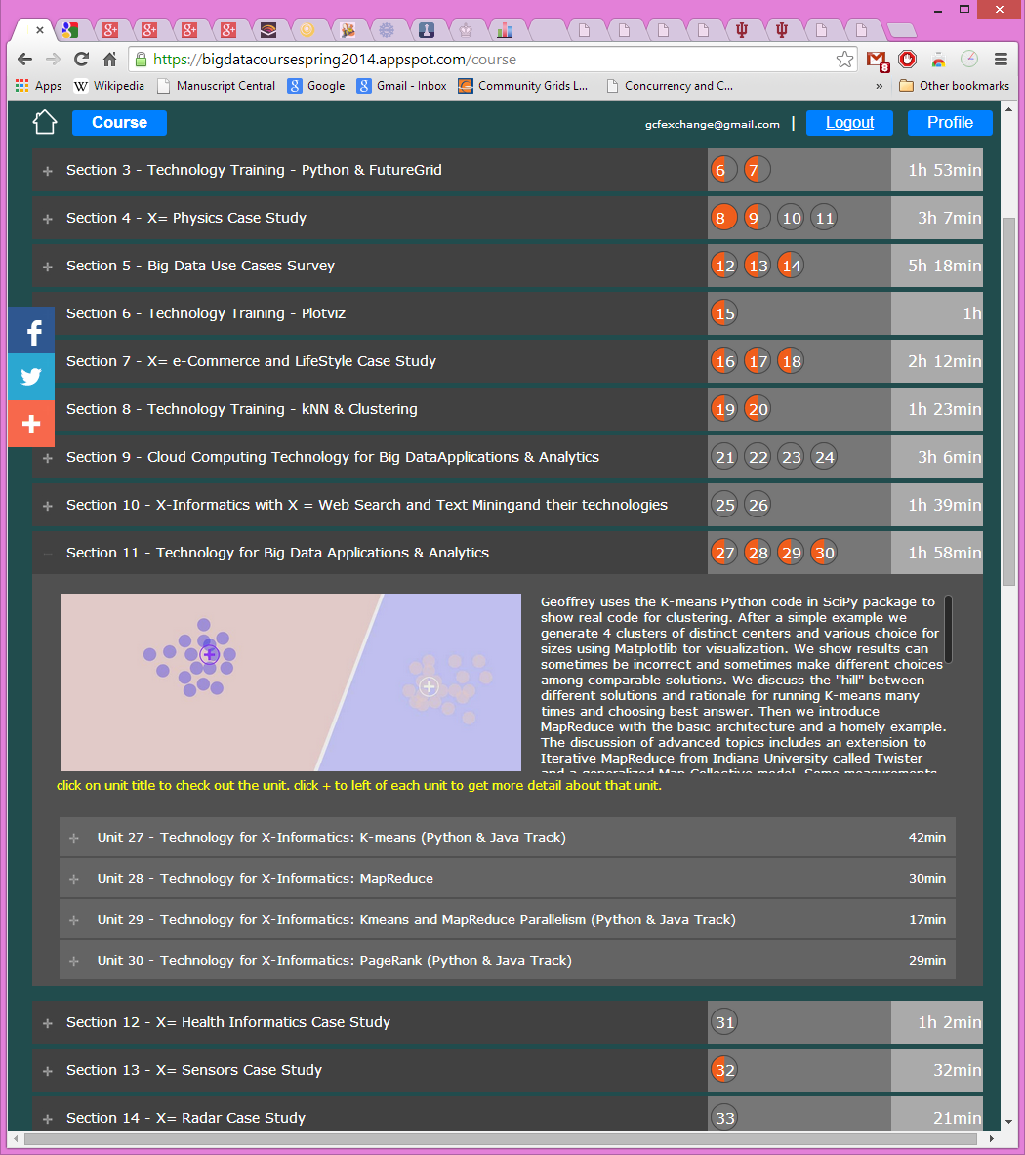
List of Sections with one (Section 11) expanded to show abstract and constituent units.
Figure shows a partial list of sections showing how one can interactively browse the hierarchy. The next level would expose an individual unit.

Slide 59
Homeworks
These are online within Google Course Builder for the MOOC with peer assessment. In the 3 credit offerings, all graded material (homework and projects) is conducted traditionally through Indiana University Oncourse (superceded by Canvas).
Oncourse was additionally used to assign which videos should be watched each week and the discussion forum topics described later (these were just “special homeworks in Oncourse). In the non-residential data science certificate class, the students were on a variable schedule (as typically working full time and many distractions; one for example had faculty position interviews) and considerable latitude was given for video and homework completion dates.

Slide 60
Discussion Forums
Each offering had a separate set of electronic discussion forums which were used for class announcements (replicating Oncourse) and for assigned discussions. Figure 5 illustrates an assigned discussion on the implications of the success of e-commerce for the future of “real malls”. The students were given “participation credit” for posting here and these were very well received. Our next offering will make greater use of these forums. Based on student feedback we will encourage even greater participation through students both posting and commenting. Note I personally do not like specialized (walled garden) forums and the class forums were set up using standard Google Community Groups with a familiar elegant interface. These community groups also link well to Google Hangouts described later.
As well as interesting topics, all class announcements were made in the “Instructor” forum repeating information posted at Oncourse. Of course no sensitive material such as returned homework was posted on this site.

Slide 61
Hangouts
For the purely online offering, we supplemented the asynchronous material described above with real-time interactive Google Hangout video sessions illustrated in figure 6. Given varied time zones and weekday demands on students, these were held at 1pm Eastern on Sundays. Google Hangouts are conveniently scheduled from community page and offer interactive video and chat capabilities that were well received. Other technologies such as Skype are also possible. Hangouts are restricted to 10-15 people which was sufficient for this course. Not all of 12 students attended a given class. The Hangouts focused on general data science issues and the mechanics of the class.

Slide 62
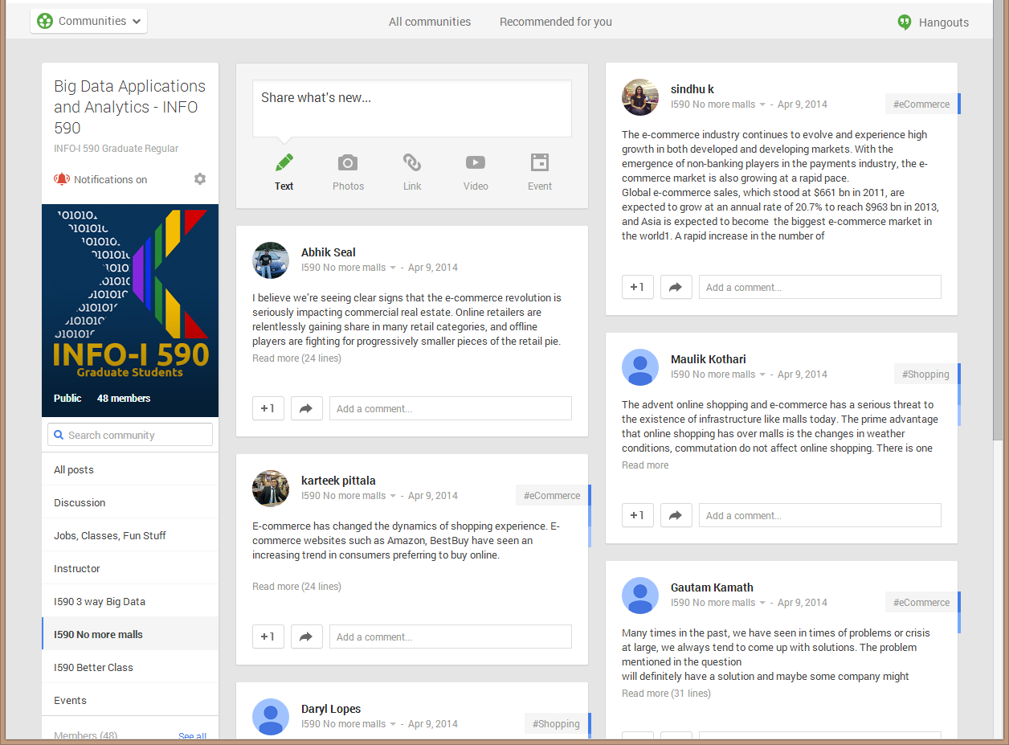
Figure 5: The community group for one of classes and one forum (“No more malls”)

Slide 63
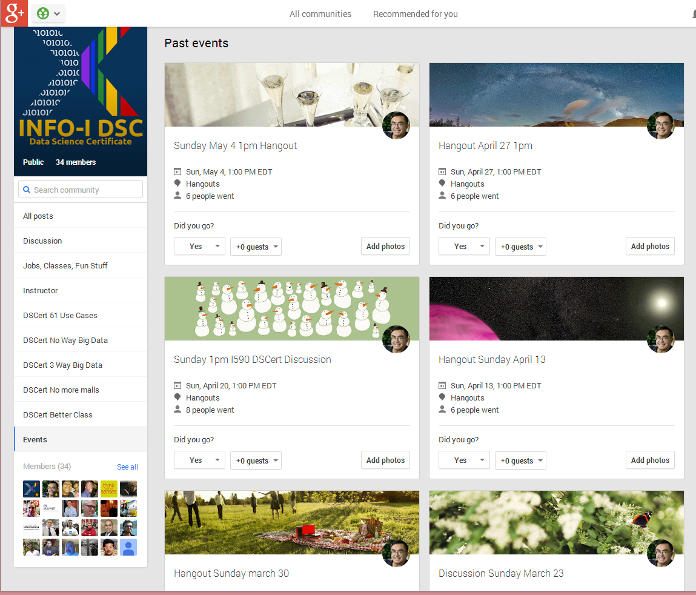
Figure 6: Community Events for Online Data Science Certificate Course

Slide 64
In class Sessions
The residential sections had regular in class sessions; one 90 minute session per class each week. This was originally two sessions but reduced to one partly because online videos turned these into “flipped classes” with less need for in class time and partly to accommodate more students (77 total graduate and undergraduate). These classes were devoted to discussions of course material, homework and largely the discussion forum topics. This part of course was not greatly liked by the students – especially the undergraduate section which voted in favor of a model with only the online components (including the discussion forums which they recommended expanding). In particular the 9.30am start time was viewed as too early and intrinsically unattractive.

