Slide 1
Research and the School of Informatics and Computing
Geoffrey Fox
gcf@indiana.edu
Associate Dean for Research and Graduate Studies, School of Informatics and Computing
Indiana University Bloomington
Director, Digital Science Center, Pervasive Technology Institute

Slide 2
Research
From web dictionaries:
Diligent and systematic inquiry or investigation into a subject in order to discover or revise facts, theories, applications, etc.
Scholarly or scientific investigation or inquiry. See Synonyms at inquiry.
Close, careful study.
Root: 1577, "act of searching closely," from M.Fr. recerche (1539), from O.Fr. recercher "seek out, search closely," from re-, intensive prefix, + cercher "to seek for" (see search). Meaning "scientific inquiry" is first attested 1639. Phrase research and development is recorded from 1923
I will define as “Thoughtful study of well posed interesting/important question taking account of other relevant studies”

Slide 3
Some key aspects of “Research”
Becoming a researcher; Identifying and applying to graduate school; what jobs are there – industry, university, national laboratory
What is and isn’t Research (Research v Development)
Is your research novel?
Identification and elaboration of research topics
Methodologies of (scientific) study
Identification of “state of the art”
Mentoring, (Long term) Collaboration …
Patience and Hard work
Ethics, acknowledgements
(Multimedia) presentation of results from “PowerPoints” to posters/movies and papers

Slide 4
Research in School of Informatics and Computing
http://www.soic.indiana.edu/research/index.shtml
Can divide research into 3 broad areas
  Largely Informatics
  Largely Applied Computer Science
  Traditional Core Computer Science
As in most fields, there are more opportunities and greater growth in areas outside core although latter remains critical

Slide 5
Largely Informatics
Security
Bioinformatics
Cheminformatics
Health Informatics
Music Informatics
Complex Networks and Systems
Social Informatics
Human Computer Interaction Design
These fields are covered in many universities but often not in Computer Science (although much of Security often in CS)

Slide 6
Largely Applied Computer Science
Cyberinfrastructure and High Performance Computing
Data, Databases and Search
Image Processing/ Computer Vision
Ubiquitous Computing
Robotics
Visualization and Computer Graphics
These are fields you will find in many computer science departments but are focused on using computers

Slide 7
Largely Core Computer Science
Computer Architecture
Computer Networking
Programming Languages and Compilers
Artificial Intelligence, Artificial Life and Cognitive Science
Computation Theory and Logic
Quantum Computing
These are traditional important fields of Computer Science providing ideas and tools used in Informatics and Applied Computer Science

Slide 8
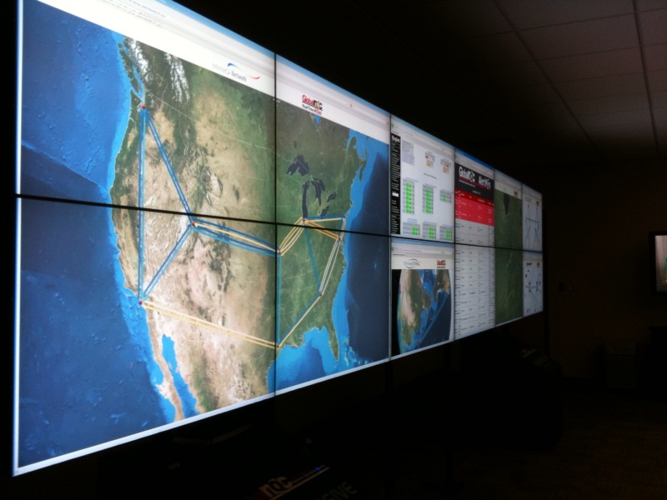
IU Research areas in a nutshell -- Security
Importance of security is obvious from discussion of Internet viruses and need to login to everything
Center CACR headed by Fred Cate of Law School has a policy emphasis
  Airport Security processes
  Implications of Cyber attacks on banks
  Privacy issues for Health records
CSC studies mathematical foundations and implications for networks and computers e.g.
  Viruses on cell phones
  Anonymizing networks
  Use of incidental information (e.g. size of message) to break security

Slide 9

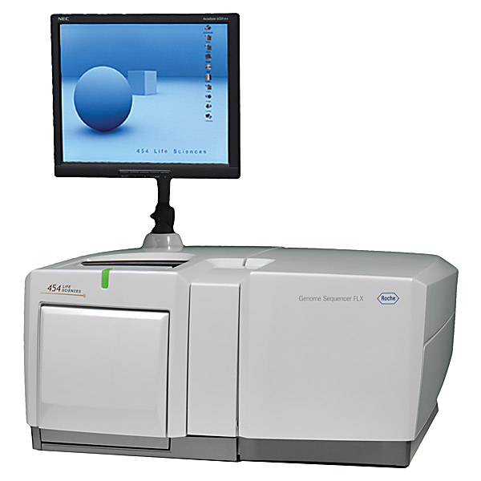
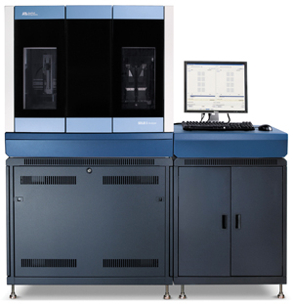

Bioinformatics
This is field that researches algorithms and processes to analyze biology data
Center for Genomics and Bioinformatics is centered in Biology and responsible for several machines that analyze biology data. (new generation of DNA sequencers)
School Bioinformatics faculty collaborate with biology and chemistry helping them draw conclusions from data
  Proteomics studies structure of proteins
  Text mining from Internet reports
  Metagenomics – studies of samples with many different genes present
  Linking genes to disease
  Study of gene sequence structure and methods to assemble fragments (produced by high throughput instruments) into full genes
Note computing applications in other sciences typically performed in discipline (see Cyberinfrastructure and HPC)
Illumina/Solexa Roche/454 Life Sciences Applied Biosystems/SOLiD
Internet
~300 million base pairs per day leading to
~3000 sequences per day per instrument
? 500 instruments at ~0.5M$ each
Read Alignment
Pairwise
clustering
Form block
Pairings
Sequence
alignment
Dissimilarity
Matrix
N(N-1)/2 values
Visualization
Plotviz
FASTA File
N Sequences
Blocking
MPI
MDS
MapReduce

Slide 10
Chemical Informatics
Cheminformatics studies small molecules that are used in areas such as Pharmaceutical Industry (chemical are drugs interacting selecting with biological compounds) or Energy where they are often catalysts
Indiana University studies interface between chemistry and Biology
  Often with Lilly – major state company
Algorithms to help identify chemicals that might be promising drugs (follow up with expensive experiments)
  PubChem has over 60 million compounds

Slide 11
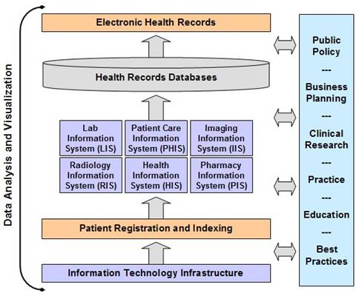
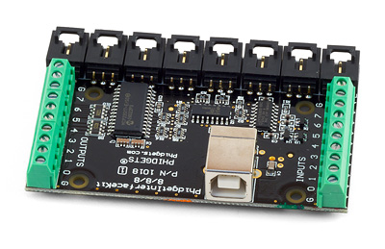
Health Informatics
Bioinformatics studies complex molecules; Cheminformatics studies smaller molecules; Health informatics studies medical information issues at level of people and populations (collections of people)
  All of these (plus study of imaging) can be called Medical Informatics
Ethos project looks at uses of devices to help elders manage their life and retain privacy
Studies of medical records – their management and structure
  Major efforts at IU Medical School Indianapolis
Epidemiology is the study of factors affecting the health and illness of populations

Slide 12
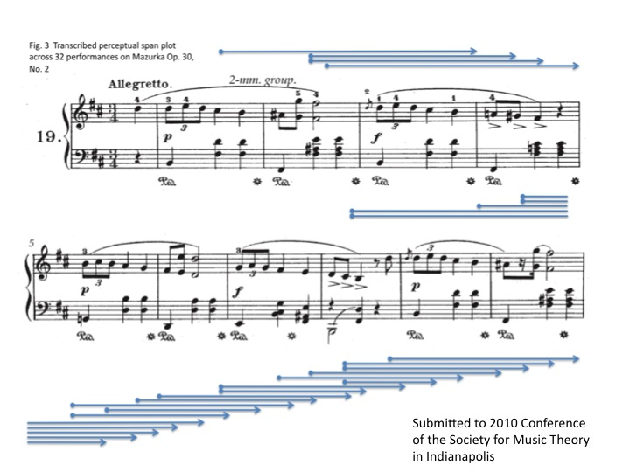
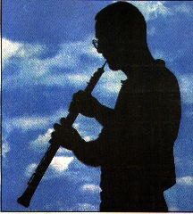
Music Informatics
Studies structure of music
Electronic generation of music
Crosses fields of Computer Science, Statistics, Acoustics, and Electronic Music
Techniques similar to Bioinformatics in that both fields use “data mining” extensively
Notes:
We present a novel method of measuring the perceptual present from performance timing data by reframing the question of the duration of the perceptual present to a related inquiry: at a given location in the piece, how many previous beats are sufficient to predict the duration of the current beat? We address this by building and testing probabilistic graphical models that include different ranges of pervious beats in predicting the current. We compute the likelihood for each model with timing data across all performers and perform statistical tests on each pair of those models to exclude those seem to arise by chance. We choose the model that has uncompromised predicting power but incorporates a smaller range of previous beats. A perceptual span plot across 32 performances on Mazurka Op. 30, No. 2 is shown as an example

Slide 13
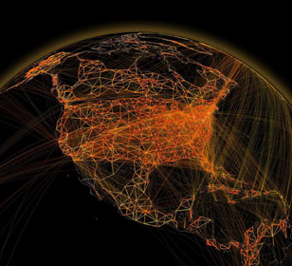
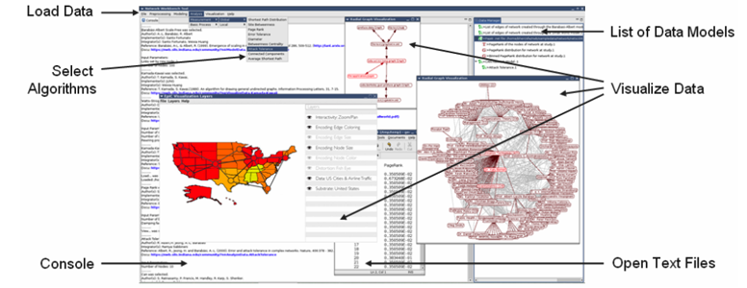
Complex Systems and Networks
Physics and Chemistry studies systems with known equations of motion (those from Newton, Einstein and Dirac)
There is a growing interest in systems that have no obvious equations
  Internet, transportation systems, stock market, biological systems as in collections of cells
And Epidemics such as H1N1 spread via movement of people especially by air (at long distance)
End of cold war was a phase transition in world political system

Slide 14
TeraGrid Web of Science

Slide 15
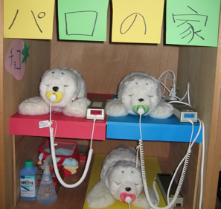
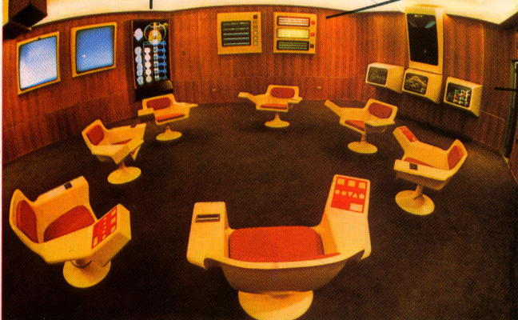
Social Informatics
Applications of Information Technology to Social Science OR application of Social Science to Information Technology
Can use different methodology to other parts of SOIC – gather data from interviewing people rather than machines (as in recording data from colliding particles at CERN accelerator)
Topics include social issues in scientific teams, role of information technology in government and how people interact with robots.
Notes:
Japanese toy robots (Selma)
This photo depicts the Cybersyn Opsroom - the control center envisioned by British cybernetician Stafford Beer and constructed in Santiago between 1971-1973.

Slide 16
Human Computer Interaction Design
Interactions of Information technology with people
Designing usable electronic products that do what you want e.g. control systems to encourage energy conservation
Theory behind virtual reality as in Interaction of people in Second Life and Gaming
Building usable software systems
Organization of Digital artifacts

Slide 17
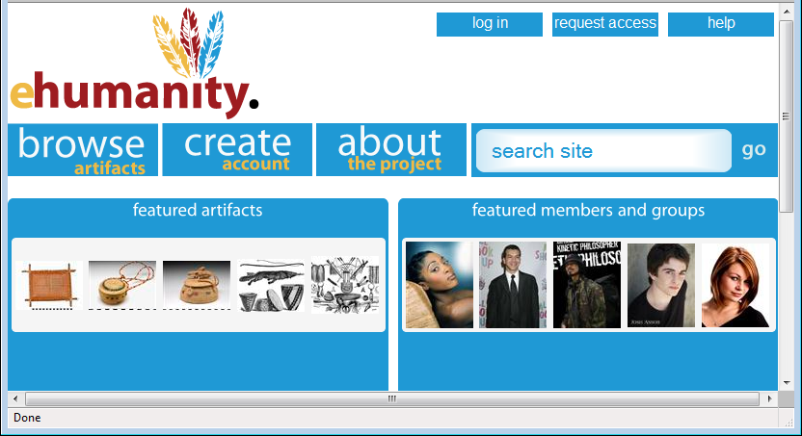
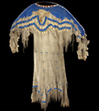
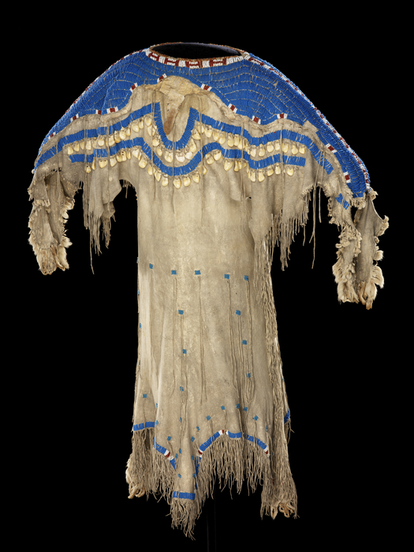














Girl's dress
e-Humanity
Culture/People:
Date Created: | circa 1850
Place: | South Dakota; USA (inferred)
Media/Materials: | Glass pony beads, deerhide/deerskin, elk tooth/teeth, wool cloth, sinew
Techniques: | Sewn, lazy/lane stitch beadwork
Collection History/ Provenance: | Collection history unknown; said to have been collected circa 1850; purchased by MAI in 1916 from an unknown source, possibly with funds donated by Mrs. George (Thea) Heye.
Dimensions: | 112 x 151 cm
Catalog Number: | 5/3776
Source: | National Museum of the American Indian
References: | http://en.wikipedia.org/wiki/Sioux
Return to Home
Sioux
Related Artifacts
Total: 2
Total: 5
beads blue dress
girl's dress long sinew
Sioux South Dakota
tan wool 1800’s
Comments / Ratings: 2
My grandmother has a dress just like this in her attic. 10.19.2009 9:38AM MST
I love this design. Where can I buy one? ☺ 10.18.2009 1:37PM MST
Average Rating:
(4.0/5.0)
Created by K. Wilson
Notes:
Feedback/Suggestions:

Slide 18
Cyberinfrastructure and
High Performance Computing
Generalizes to Computer Systems or Distributed Systems and can include Sensor nets
Cyberinfrastructure is worldwide electronic fabric supporting science research (such as simulate early universe) or development (stewardship of nuclear stockpile in era when testing forbidden – simulate aging of nuclear devices)
High Performance Computing includes algorithms and software for parallel computers where one could use 200,000 cores simultaneously
Collaborate with many application areas such as particle physics, weather and climate, polar science (melting of glaciers), earthquake forecasting as well as all areas of Medical Informatics
Indiana strong in this area with collaboration with UITS – the University Information Technology Support Organization as part of TeraGrid

Slide 19
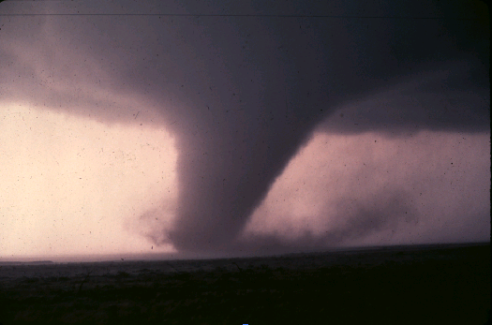
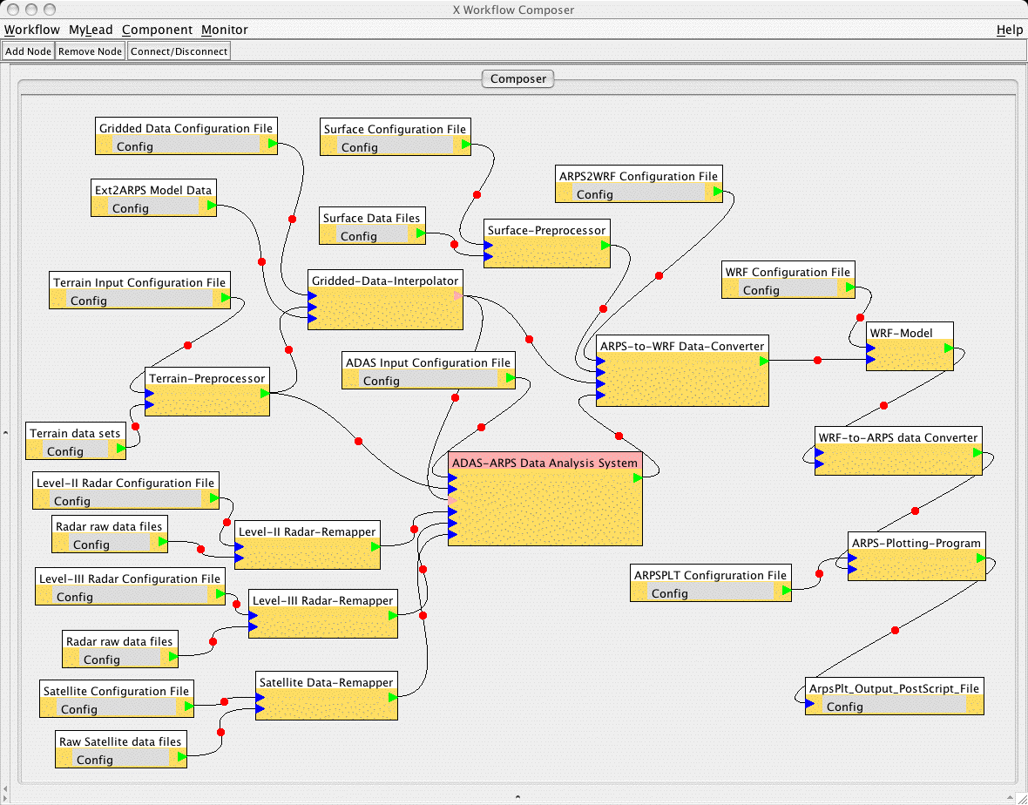
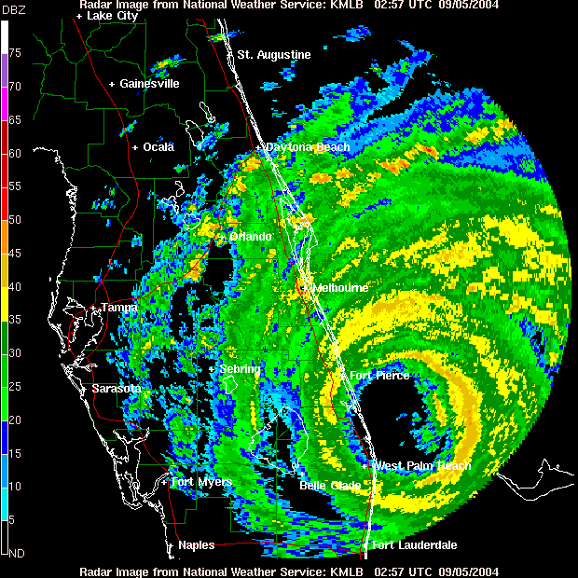
Data, Databases and Search
A striking feature of many areas is the “Data Deluge” where we see the Internet and data from scientific instruments increasing exponentially in size
http://research.microsoft.com/en-us/collaboration/fourthparadigm/
Bioinformatics and Cheminformatics “high throughput” devices illustrate data deluge
One needs to store , access and manage data (databases are large CS area) including adding metadata (data describing data)
One needs to “mine” data (machine learning, data mining ..)
One needs to query data (from indices) or search it in Google style

Slide 20
SS

Slide 21
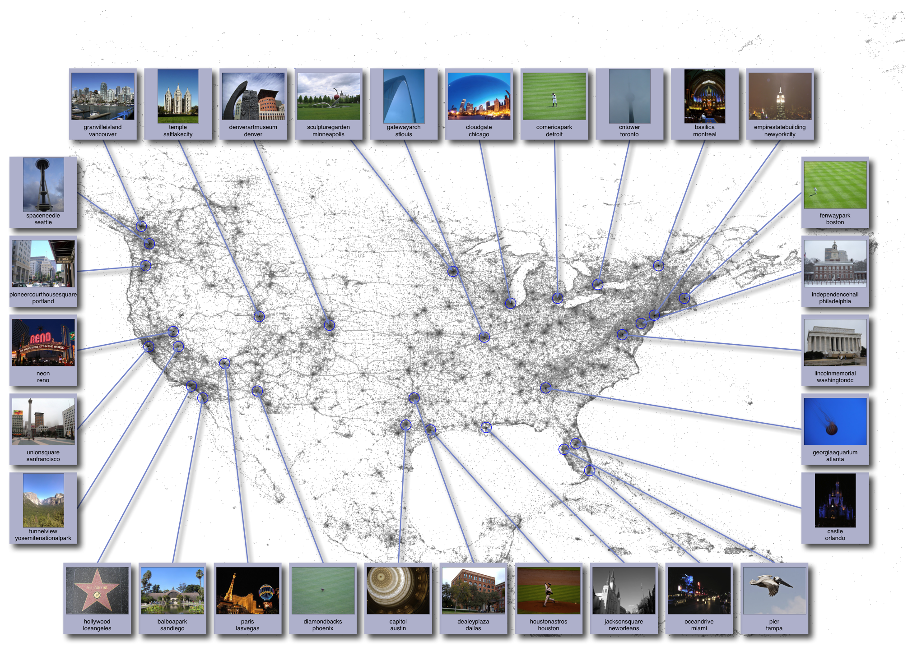
Image Analysis
http://www.cs.cornell.edu/~crandall/photomap/
Image processing has been a well studied area with classic studies from “handwriting recognition” “recognizing targets in military applications” and “robotic’ (interpret images to aid navigation)
The Internet with Flickr and Image search has re-invigorated field
First example from Crandall in SOIC is Organizing geo-tagged images from Flickr
Second example is automating determination of glacier beds

Slide 22
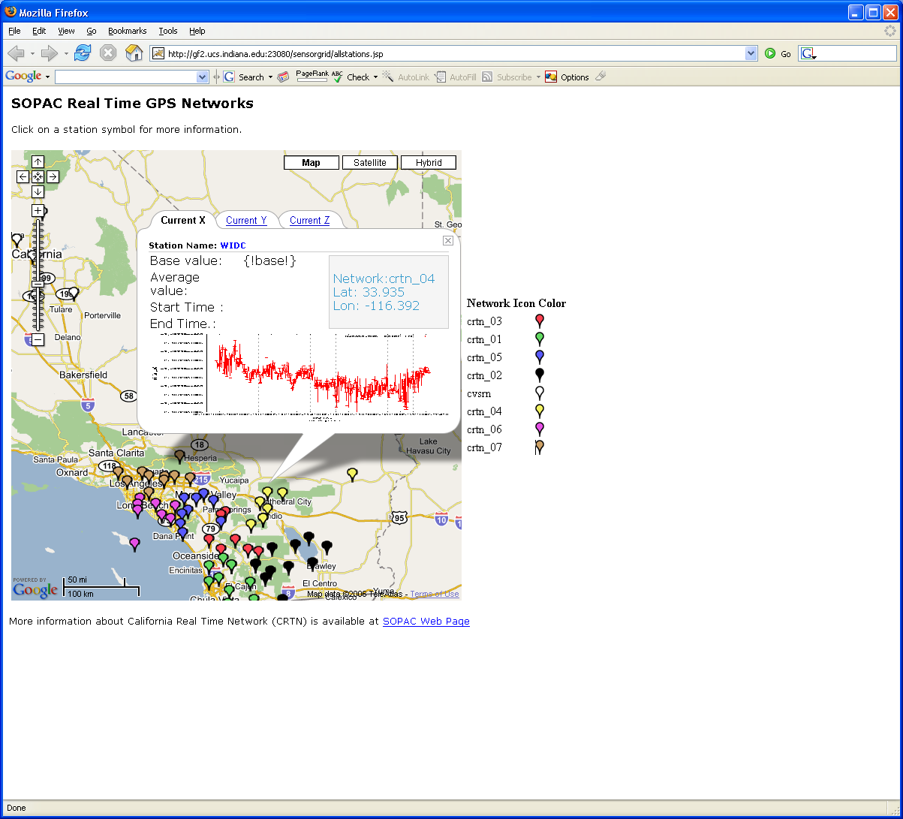
Ubiquitous Computing
As chips get smaller and cheaper, there are more and more entities with computers in them
  4.6 Billion cell phones at end of 2009
You can sprinkle your home and indeed your body with devices
  Ubiquitous City project in Korea studies implications of this trend including needed Cyberinfrastructure
Health Science advances from devices on body
Earthquake forecasting uses network of GPS and Seismic sensors

Slide 23

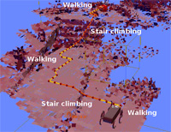
Robotics
This is study of computer controlled “machines” such as
  Vehicles (say on Mars) or human-formed robots
  Surgical instruments
Involves areas such as image processing to disentangle what Robot sees and “artificial intelligence” to make decisions
Interactions between Humans and Robots
  Natural Language understanding
  How do humans react to robots rather than people!

Slide 24

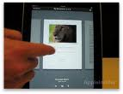
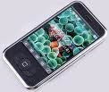








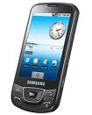










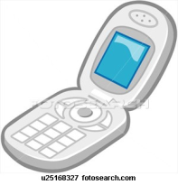
Sensors as a Service
Cell phones are important sensor/Collaborative device
Other Services
Sensors as a Service
Clients
Sensor Processing as a Service (MapReduce)

Slide 25
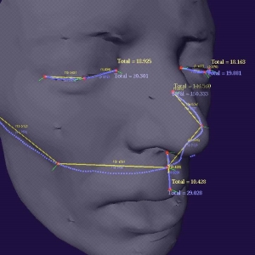

Visualization and Computer Graphics
Computer Graphics underlies gaming and Pixar movies and involves visualizing computer constructed objects/scenes
  Elegant theory of lighting
  This is very compute intensive and uses farms of computers
Visualization more broadly is trying to add power of human eye to increase discovery
  Many challenges when one is looking at something not easily mapped to 2D screen (such as a three dimensional flow of plasma at center of universe)
  Mapping abstract data (“information visualization”) such as genes that are lists of base pairs
  Interesting devices include 3D glasses and sophisticated environments such as caves

Slide 26
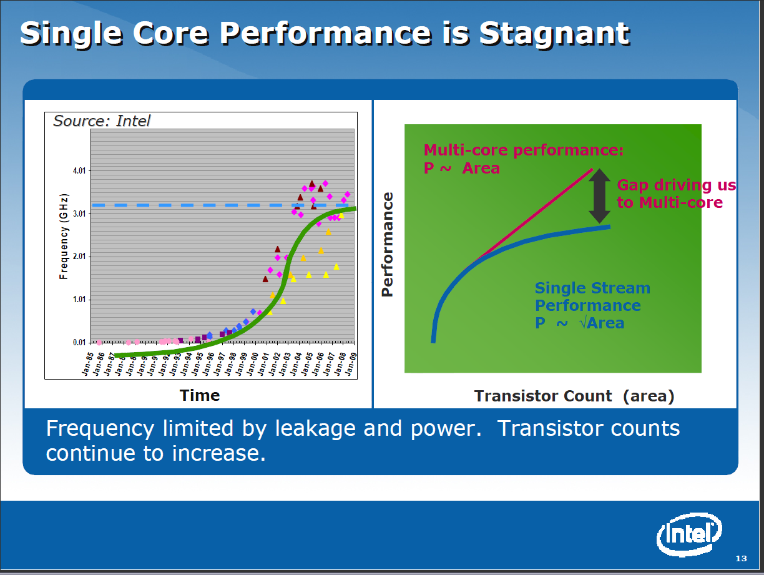
Computer Architecture
This field studies designs of computer and in particular the CPU
This field has tended to move from universities to industry as chips have become complicated and the infrastructure to produce them so expensive.
There is still a lot of innovation with discussion of number of cores in a single chip – this is 4-8 for mainline Intel/AMD chips but GPU’s have an order of magnitude more
Other specializations interesting including those for particular languages such as Scheme

Slide 27

Computer Networking
Computer hardware studies the computers; computer networking their links; Cyberinfrastructure/Computer systems the software on top of computer hardware and networking
New Internet architecture design – the current approach will not have enough addresses as we get flood of small devices connected to internet
Performance analysis of IPSec and optimizations (network message protocol)
Several areas on intersection of networking and secrity
  Distributed reputation systems
  DNS configuration and security
  Malware in peer-to-peer
  applications
  Prevention of IP source address
  forgery (IP Spoofing)
  Routing and trust
  Network security for mobile devices

Slide 28

Programming Languages and Compilers
This studies the expression of a problem to put on a computer (Language) and the conversion of this Language into machine executable form (Compilers)
There are many styles of Languages and different compiler challenges (such as targeting parallel computers)
Some languages address subsets of
problems (The Internet, Physics)
Indiana University pioneers in Scheme
Language and aspects of parallel
computing
  Compilers need “run-time” to support
  code execution (as OpenMPI for parallelism)

Slide 29
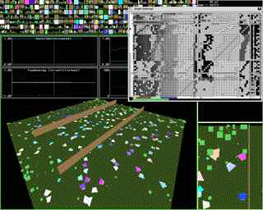
Artificial Intelligence, Artificial Life and Cognitive Science
Here are areas that look at developing computing systems that “think” i.e. make decisions similar to humans
Some model how people work together and others how brains (many neurons) function
Cognitive science is the interdisciplinary study of mind and the nature of intelligence. Centered in College of Arts and Science with strong School of Informatics and Computing collaboration
  error-making, creative translation, scientific discovery, musical composition, the comprehension and invention of jokes, the nature of sexist language and default imagery, philosophy of mind, and foundations of artificial intelligence

Slide 30
Computation Theory and Logic
Quantum Computing
Validation of imperative, declarative, and object-oriented programs
Program feasibility certification
Typing disciplines and monads for functional and object-oriented programs
Automatic support and logical foundations of syntactic theories
Non-classical logics and their computational contents
Models of information and computation
Computational and mathematical foundations of linguistics
New logical paradigms (e.g. visual, parallel, hybrid) that transcend traditional sequential and symbolic formalisms

Slide 31
SOIC Graduate Degrees
PhD in Computer Science
PhD in Informatics (one degree)
  Tracks in Bioinformatics, Cheminformatics, Complex Systems, HCI, Music, Health Informatics, Security, Social Informatics
Masters in Computer Science
Masters Program in Informatics (4 degrees)
  HCI
  Bioinformatics
  Security
  General

Slide 32
Applying to Graduate Program
http://www.soic.indiana.edu/prospective/grad-admit/index.shtml
FALL SEMESTER
  Deadline for Admission and Financial Aid
    International students: December 1
    Domestic students: January 15
  Deadline for Admission without Aid
    International students: March 15
    Domestic students: June 15
SPRING SEMESTER for Master of Science in Computer Science and Master of Science in Security Informatics programs
  Deadline is October 1 for all applicants (international and domestic students).

