Slide 1
SBIR Final Meeting
Collaboration Sensor Grid and Grids of Grids
Information Management
Anabas
July 8, 2008

Slide 2
Introduction I
Grids and Cyberinfrastructure have emerged as key technologies to support distributed activities that span scientific data gathering networks with commercial RFID or (GPS enabled) cell phone nets. This SBIR extends the Grid implementation of SaaS (Software as a Service) to SensaaS (Sensor as a service) with a scalable architecture consistent with commercial protocol standards and capabilities. The prototype demonstration supports layered sensor nets and an Earthquake science GPS analysis system with a Grid of Grids management environment that supports the inevitable system of systems that will be used in DoD’s GiG.

Slide 3
Introduction II
The final delivered software both demonstrates the concept and provides a framework with which to extend both the supported sensors and core technology
The SBIR team was led by Anabas which provided collaboration Grid and the expertise that developed SensaaS. Indiana University provided core technology and the Earthquake science application. Ball Aerospace integrated NetOps into the SensaaS framework and provided DoD relevant sensor application.
Extensions to support the growing sophistication of layered sensor nets and evolving core technologies are proposed

Slide 4
Background (cont’d)
ANABAS
Objectives
Integrate Global Grid Technology with multi-layered sensor technology to provide a Collaboration Sensor Grid for Network-Centric Operations research to examine and derive warfighter requirements on the GIG.
Build Net Centric Core Enterprise Services compatible with GGF/OGF and Industry.
Add key additional services including advance collaboration services and those for sensors and GIS.
Support Systems of Systems by federating Grids of Grids supporting a heterogeneous software production model allowing greater sustainability and choice of vendors.
Build tool to allow easy construction of Grids of Grids.
Demonstrate the capabilities through sensor-centric applications with situational awareness.

Slide 5
Technology Evolution
During course of SBIR, there was substantial technology evolution in especially mainstream commercial Grid applications
These evolved from (Globus) Grids to clouds allowing enterprise data centers of 100x current scale
This would impact Grid components supporting background data processing and simulation as these need not be distributed
However Sensors and their real time interpretation are naturally distributed and need traditional Grid systems
Experience has simplified protocols and deprecated use of some complex Web Service technologies

Slide 6
Background
ANABAS
Commercial Backdrop
XaaS or X as a Service is dominant trend
X = S: Software (applications) as a Service
X = I: Infrastructure (data centers) as a Service
X = P: Platform (distributed O/S) as a Service
Grids are any collection of Services and manage distributed services or distributed collections of Services i.e. Grids to give Grids of Grids
We added
X = C: Collections (Grids) as a Service and
X = Sens: Sensors as a Service

Slide 7
Background (cont’d)
ANABAS
Technologies
Anabas Impromptu Collaboration Framework
Indiana University NaradaBrokering Messaging System
Ball Aerospace & Technology’s NetOps (Network Operations) Situational Awareness technology
Sun Microsystems Java platform
Haskell Programming Language (Ball)
Low cost sensors (e.g. Wii Remote sensor, RFID reader and tags, GPS sensors, accelerometer, gyroscope, compass, ultrasonic, temperature, audio/video recorders, etc.)

Slide 8
ANABAS
Results of the SBIR
Key Software Systems and Modules
Ready For Use
An Enabling and Extensible Collaborative Sensor-Centric Grid Framework that supports UDOP/COP using SensaaS (Sensor as a Service).
An API for third-party legacy or new applications to easily acquire grid situational awareness.
An API for sensor developers to easily integrate sensors with collaboration sensor grid to enhancement situational awareness.
A Grid Builder Management System to build, deployment, management, monitor sensor and general grids.
Examples of integrating filter (compute) and collaboration grids with Sensor Grids in Grid of Grids scenario
A NetOps Situational Awareness Sensor-Grid Demo Client.
An Impromptu Sensor-Grid Demo Client with support for UDOP and Earthquake Science.

Slide 9
Typical Sensor Grid Interface

Slide 10
Component Grids Integrated
ANABAS
Sensor display and control
  A sensor is a time-dependent stream of information with a geo-spatial location.
  A static electronic entity is a broken sensor with a broken GPS! i.e. a sensor architecture applies to everything
Filters for GPS and video analysis (Compute or Simulation Grids)
Earthquake forecasting
Collaboration Services
NetOps Situational Awareness Service

Slide 11
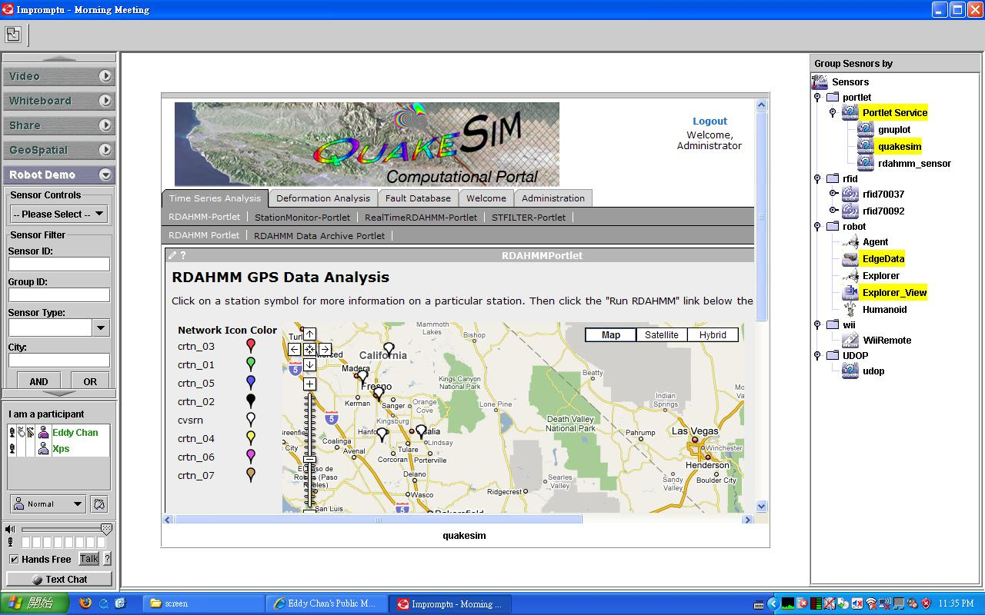
QuakeSim Grid of Grids with RDAHMM Filter (Compute) Grid

Slide 12
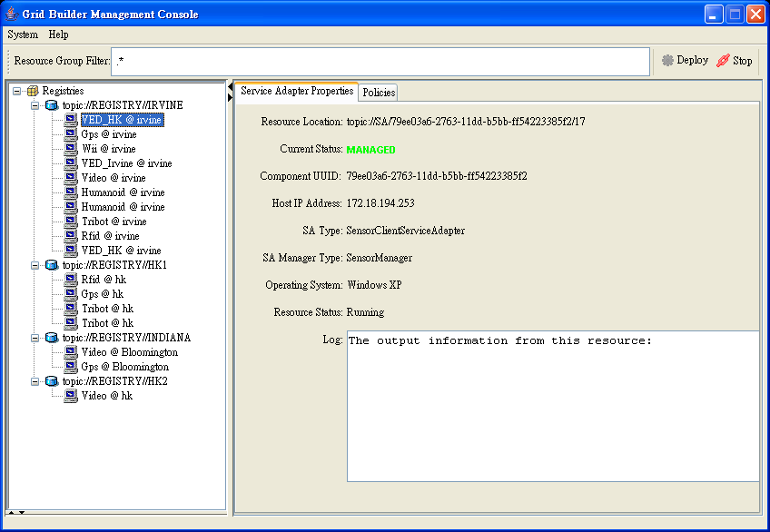
Grid Builder Service Management Interface

Slide 13
Commercialization
ANABAS
Three-prong strategy:
Work with Ball and AFRL to get input for DoD application requirements for an integrable Grid situational awareness product.
Harden SBIR result prototype to seek In-Q-Tel type of funding to commericalize and customize the prototype for Home Land Security applications.
Commercial mobile solution applications for social networks with large number of sensors like the iPhone or Google phone.

Slide 14
Future Research
ANABAS
Trusted Sensing (at level of individual sensors)
Layered Sensor Grid (i.e. collections of sensors)
Grid of Grids

