Slide 1
Parallel Applications And Tools For Cloud Computing Environments
CloudCom 2010
Indianapolis, Indiana, USA
Nov 30 – Dec 3, 2010

Slide 2
Azure MapReduce

Slide 3
AzureMapReduce
A MapRedue runtime for Microsoft Azure using Azure cloud services
Azure Compute
Azure BLOB storage for in/out/intermediate data storage
Azure Queues for task scheduling
Azure Table for management/monitoring data storage
Advantages of the cloud services
Distributed, highly scalable & available
Backed by industrial strength data centers and technologies
Decentralized control
Dynamically scale up/down
No Single Point of Failure

Slide 4
AzureMapReduce Features
Familiar MapReduce programming model
Combiner step
Fault Tolerance
Rerunning of failed and straggling tasks
Web based monitoring console
Easy testing and deployment
Customizable
Custom Input & output formats
Custom Key and value implementations
Load balanced global queue based scheduling

Slide 5
Advantages
Fills the void of parallel programming frameworks on Microsoft Azure
Well known, easy to use programming model
Overcome the possible unreliability's of cloud compute nodes
Designed to co-exist with eventual consistency of cloud services
Allow the user to overcome the large latencies of cloud services by using coarser grained tasks
Minimal management/maintanance overhead

Slide 6
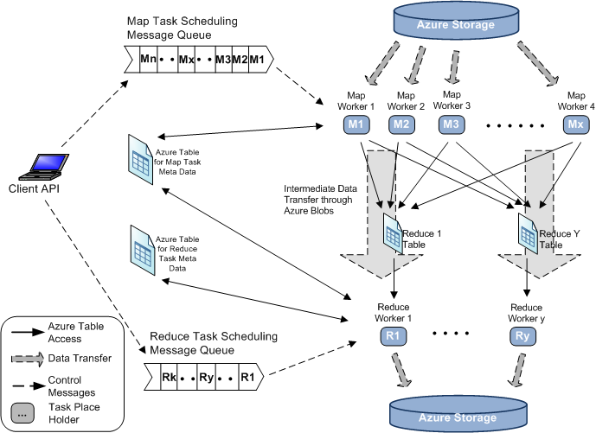
AzureMapReduce Architecture

Slide 7
Performance
Smith Watermann Pairwise Distance All-Pairs Normalized Performance
CAP3 Sequence Assembly Parallel Efficiency

Slide 8
Large-scale PageRank with Twister

Slide 9
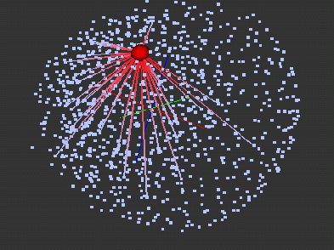
Pagerank with MapReduce
Efficient processing of large scale Pagerank challenges current MapReduce runtimes.
Difficulties: messaging > memory > computation
Implementations: Twister, DryadLINQ, Hadoop, MPI
Optimization strategies
Load static data in memory
Fit partition size to memory
Local merge in Reduce stage
Results Visualization with PlotViz3
1K 3D vertices processed with MDS
Red vertex represent “wikipedia.org”

Slide 10
Pagerank Optimization Strategies
Implement with DryadLINQ with 50 million web pages on a 32 nodes Windows HPC cluster
Split web graph in different granularity coarse granularity: split whole web graph into 1280 files. fine granularity: split whole web graph into 256 files.
Implement with Twister and Hadoop with 50 million web pages.
Twister caches the partitions of web graph in memory during multiple iteration, while Hadoop need reload partition from disk to memory for each iteration.

Slide 11
Pagerank Architecture

Slide 12
Twister BLAST

Slide 13
Twister-BLAST
A simple parallel BLAST application based on Twister MapReduce framework
Runs on a single machine, a cluster, or Amazon EC2 cloud platform
Adaptable to the latest BLAST tool (BLAST+ 2.2.24)

Slide 14
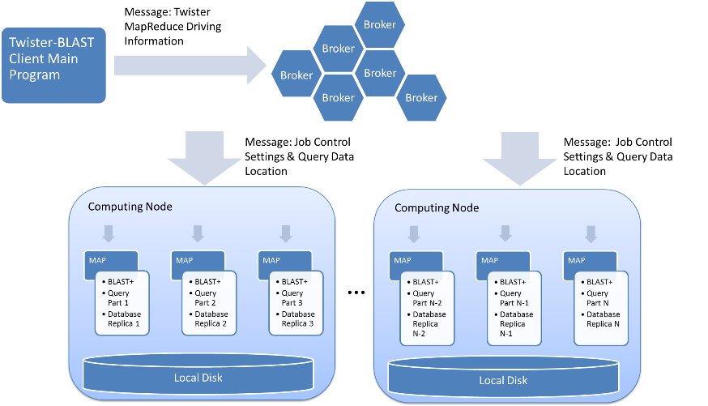
Twister-BLAST Architecture

Slide 15
Database Management
Replicated to all the nodes, in order to support BLAST binary execution
Compression before replication
Transported through file share script tool in Twister

Slide 16
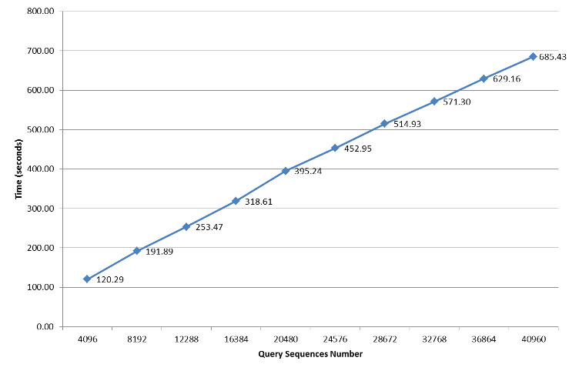
Twister-BLAST Performance

Slide 17
SALSA Portal and Biosequence Analysis Workflow

Slide 18
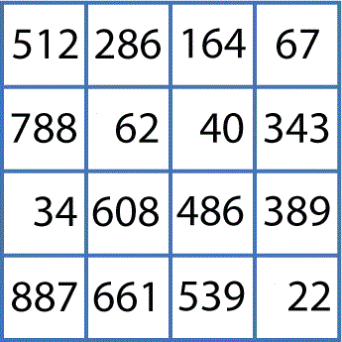
Biosequence Analysis
Conceptual Workflow
Pairwise Clustering
Cluster Indices
Pairwise Alignment & Distance Calculation
Alu Sequences
Visualization
3D Plot
Distance Matrix
Coordinates
Multi-Dimensional Scaling

Slide 19
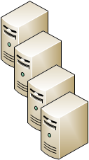
Biosequence Analysis
Workflow Implementation
Job Configuration and Submission Tool
Microsoft HPC Cluster
Submit
Distribute Job
Compute Nodes
Cluster Head-node
Sequence Aligning
Pairwise Clustering
Dimension Scaling
PlotViz - 3D Visualization Tool
Retrieve Results
Write Results

Slide 20
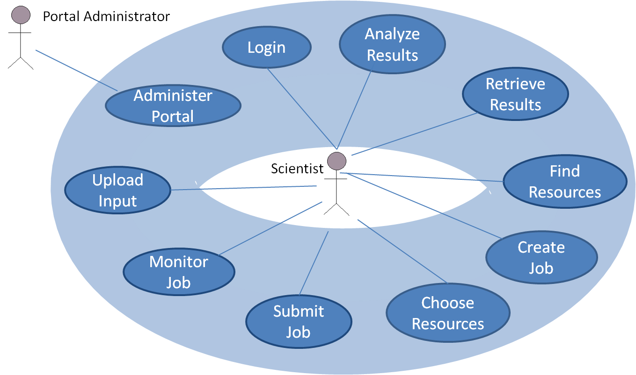
SALSA Portal
Use Cases
<<extend>>
Create Biosequence Analysis Job

Slide 21
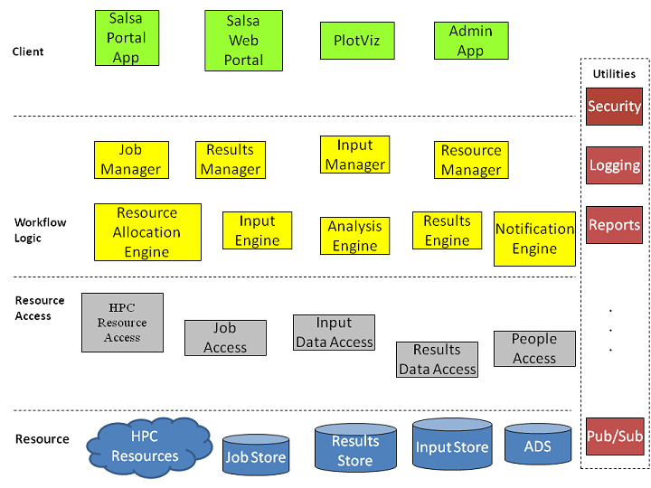
SALSA Portal
Architecture

Slide 22
PlotViz Visualization with parallel MDS/GTM

Slide 23
PlotViz
A tool for visualizing data points
Dimension reduction by GTM and MDS
Browse large and high-dimensional data
Use many open (value-added) data
Parallel Visualization Algorithms
GTM (Generative Topographic Mapping)
MDS (Multi-dimensional Scaling)
Interpolation extensions to GTM and MDS

Slide 24
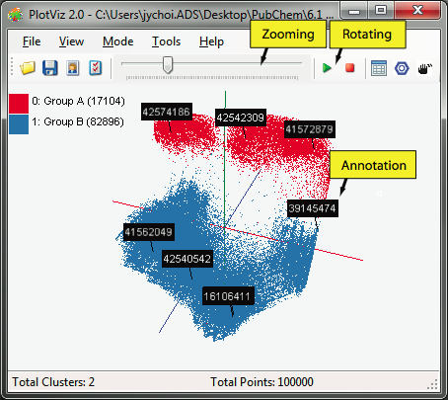
PlotViz System Overview
3-D Map File
SPARQL query
Meta data
PlotViz
Light-weight client
DrugBank
CTD
QSAR
Visualization Algorithms
PubChem
Chem2Bio2RDF
Parallel dimension reduction algorithms
Aggregated public databases

Slide 25
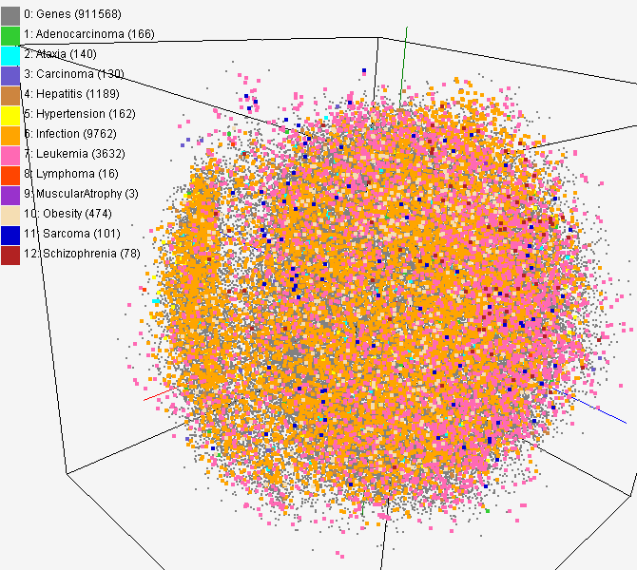
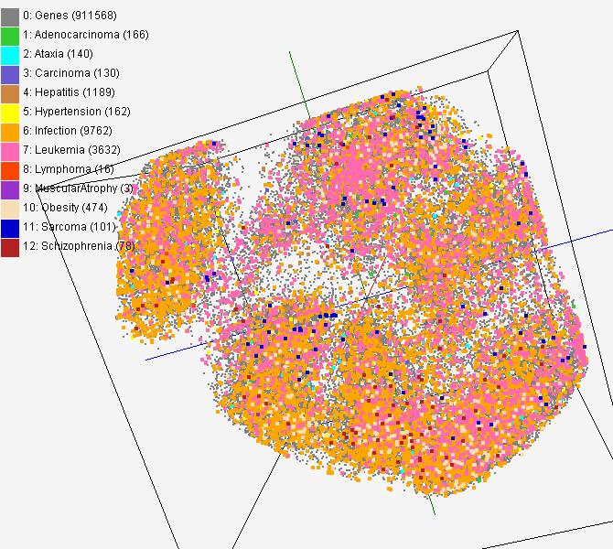
CTD data for gene-disease
PubChem data with CTD visualization by using MDS (left) and GTM (right)
About 930,000 chemical compounds are visualized as a point in 3D space, annotated by the related genes in Comparative Toxicogenomics Database (CTD)

Slide 26
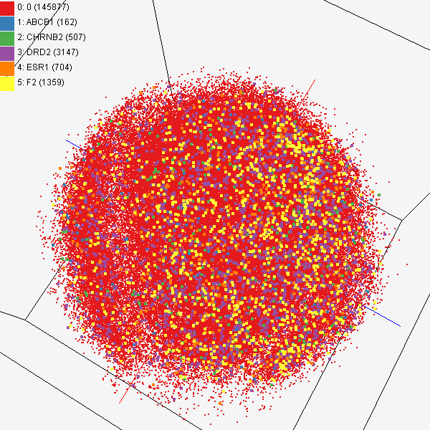
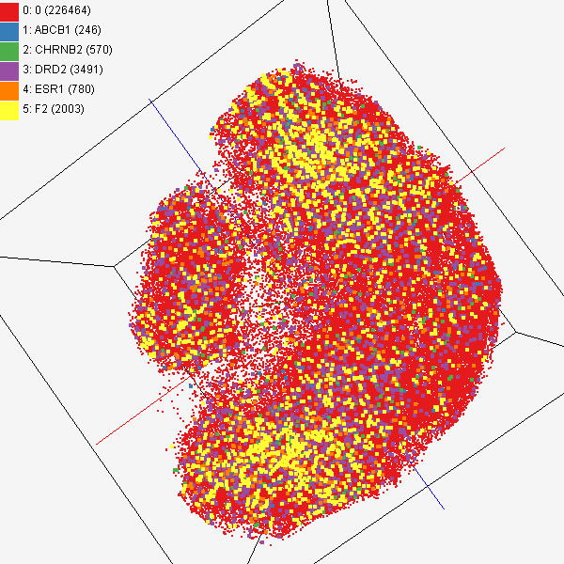
Chem2Bio2RDF
Chemical compounds shown in literatures, visualized by MDS (left) and GTM (right)
Visualized 234,000 chemical compounds which may be related with a set of 5 genes of interest (ABCB1, CHRNB2, DRD2, ESR1, and F2) based on the dataset collected from major journal literatures which is also stored in Chem2Bio2RDF system.

Slide 27
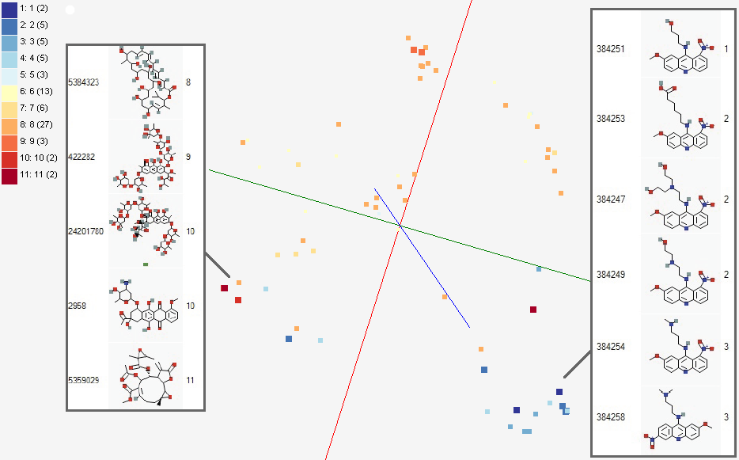
Activity Cliffs
GTM Visualization of bioassay activities

Slide 28
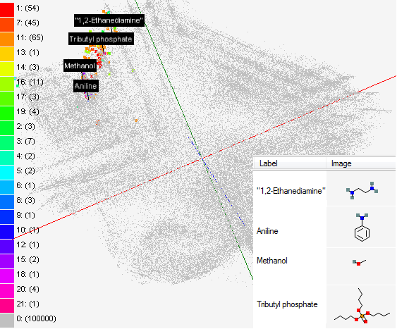
Solvent Screening
Visualizing 215 solvents
215 solvents (colored and labeled) are embedded with 100,000 chemical compounds (colored in grey) in PubChem database

