Slide 1
Science Cloud (Dynamic Virtual Cluster) Architecture
Smith Waterman Dissimilarities, CAP-3 Gene Assembly, PhyloD Using DryadLINQ, High Energy Physics, Clustering, Multidimensional Scaling, Generative Topological Mapping
Applications
Services and Workflow
Runtimes
Apache Hadoop / Twister/ MPI
Microsoft DryadLINQ / Twister / MPI
Linux Bare-system
Linux Virtual Machines
Windows Server 2008 HPC
Bare-system
Windows Server 2008 HPC
Infrastructure software
Xen Virtualization
Virtualization
XCAT Infrastructure
Hardware
iDataplex Bare-metal Nodes
Dynamic Virtual Cluster provisioning via XCAT on iDataPlex
Supports both stateful and stateless OS images

Slide 2
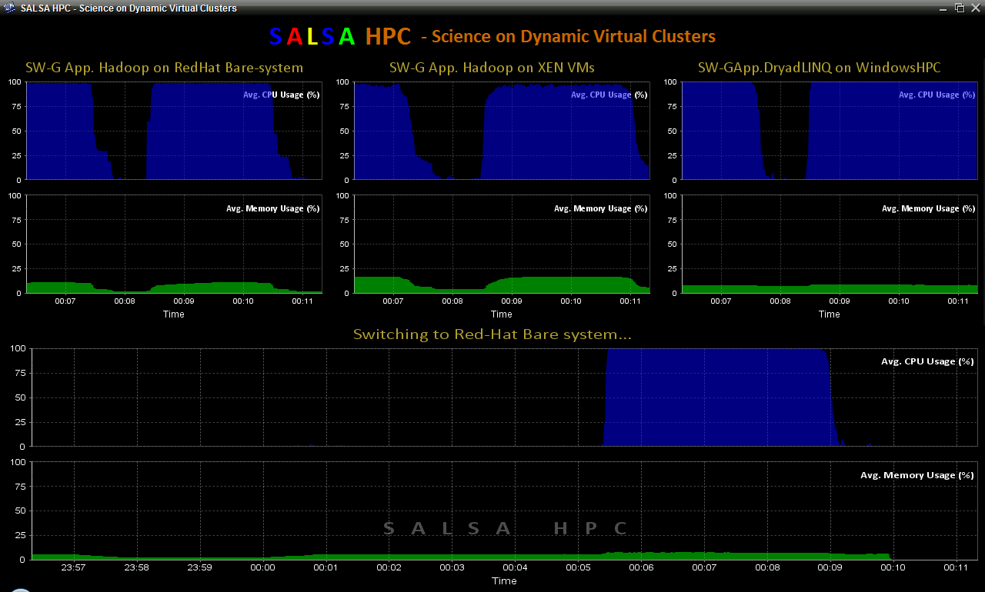
SALSAHPC Dynamic Virtual Cluster on FutureGrid -- Demo at SC09
Demonstrate the concept of Science on Clouds on FutureGrid
Dynamic Cluster Architecture
Monitoring & Control Infrastructure
Monitoring Infrastructure
Monitoring Interface
Pub/Sub Broker Network
SW-G Using Hadoop
SW-G Using Hadoop
SW-G Using DryadLINQ
Linux
Bare-system
Linux on Xen
Windows Server 2008 Bare-system
Virtual/Physical Clusters
Summarizer
XCAT Infrastructure
XCAT Infrastructure
Switcher
iDataplex Bare-metal Nodes
(32 nodes)
iDataplex Bare-metal Nodes
Switchable clusters on the same hardware (~5 minutes between different OS such as Linux+Xen to Windows+HPCS)
Support for virtual clusters
SW-G : Smith Waterman Gotoh Dissimilarity Computation as an pleasingly parallel problem suitable for MapReduce style applications

Slide 3
SALSAHPC Dynamic Virtual Cluster on FutureGrid -- Demo at SC09
Demonstrate the concept of Science on Clouds using a FutureGrid cluster
Top: 3 clusters are switching applications on fixed environment. Takes approximately 30 seconds.
Bottom: Cluster is switching between environments: Linux; Linux +Xen; Windows + HPCS.
Takes approxomately 7 minutes
SALSAHPC Demo at SC09. This demonstrates the concept of Science on Clouds using a FutureGrid iDataPlex.

Slide 4
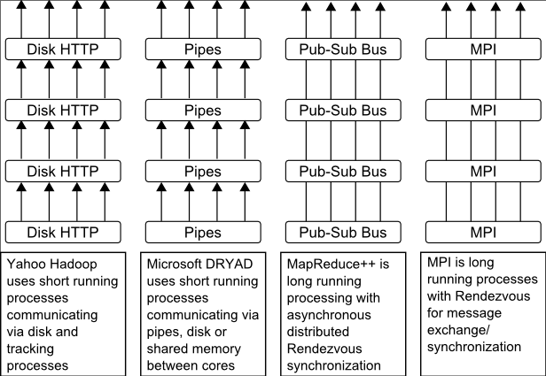
http://www.iterativemapreduce.org/
Pub/Sub Broker Network
Map Worker
M
Streaming based communication
Intermediate results are directly transferred from the map tasks to the reduce tasks – eliminates local files
Cacheable map/reduce tasks
Static data remains in memory
Combine phase to combine reductions
User Program is the composer of MapReduce computations
Extends the MapReduce model to iterative computations
Worker Nodes
R
Reduce Worker
D
D
MR
Driver
User
Program
M
M
M
M
D
MRDeamon
R
R
R
R
Data Read/Write
Communication
Data Split
File System
Iterate
Static
data
Configure()
User Program
Map(Key, Value)
δ flow
Reduce (Key, List<Value>)
Combine (Key, List<Value>)
Different synchronization and intercommunication mechanisms used by the parallel runtimes
Close()

Slide 5
Twister New Release

Slide 6
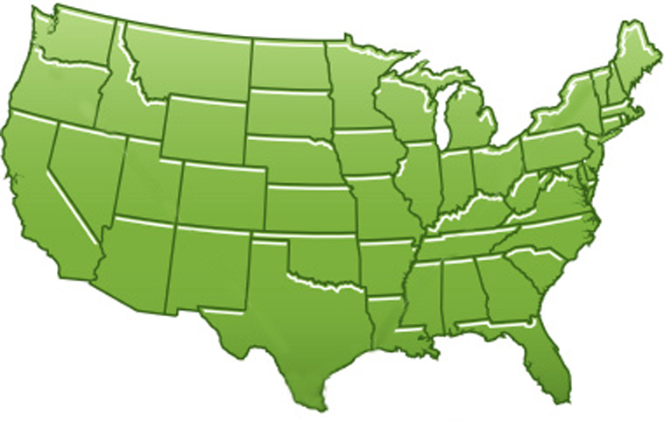
300+ Students learning about Twister & Hadoop
MapReduce technologies, supported by FutureGrid.
July 26-30, 2010 NCSA Summer School Workshop
http://salsahpc.indiana.edu/tutorial
Washington
University
University of
Minnesota
Michigan
State
Johns
Hopkins
Univ.Illinois
at Chicago
Iowa
State
Penn
State
IBM Almaden
Research Center
Notre
Dame
University of
California at
Los Angeles
Indiana
University
San Diego
Supercomputer
Center
University of
Texas at El Paso
University of
Arkansas
University
of Florida

Slide 7
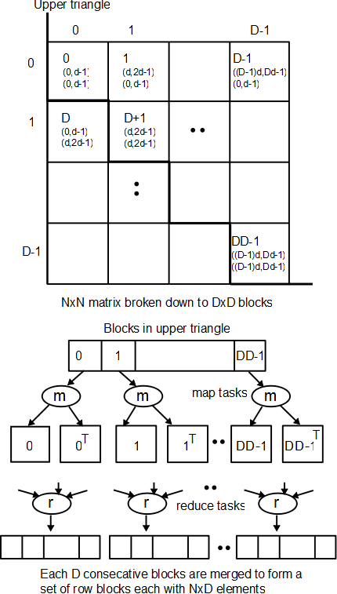
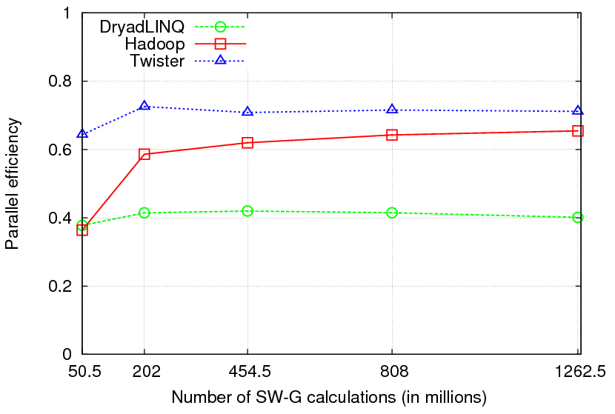
Pair wise Sequence Comparison using Smith Waterman Gotoh
Typical MapReduce computation
Comparable efficiencies
Twister performs the best
Xiaohong Qiu, Jaliya Ekanayake, Scott Beason, Thilina Gunarathne, Geoffrey Fox, Roger Barga, Dennis Gannon “Cloud Technologies for Bioinformatics Applications”, Proceedings of the 2nd ACM Workshop on Many-Task Computing on Grids and Supercomputers (SC09), Portland, Oregon, November 16th, 2009
Jaliya Ekanayake, Thilina Gunarathne, Xiaohong Qiu, “Cloud Technologies for Bioinformatics Applications”, invited paper submitted to the Journal of IEEE Transactions on Parallel and Distributed Systems (under review).

Slide 8
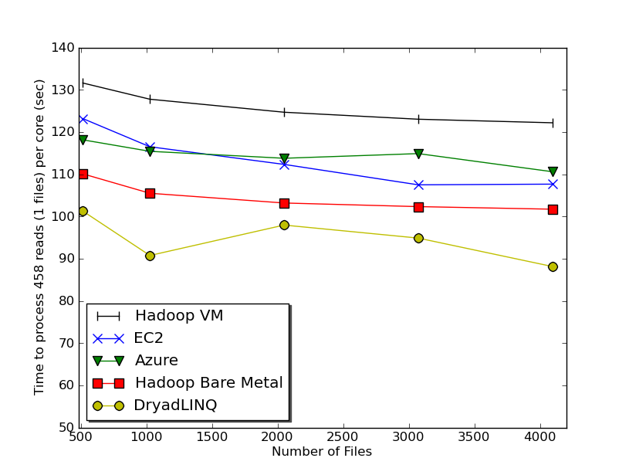
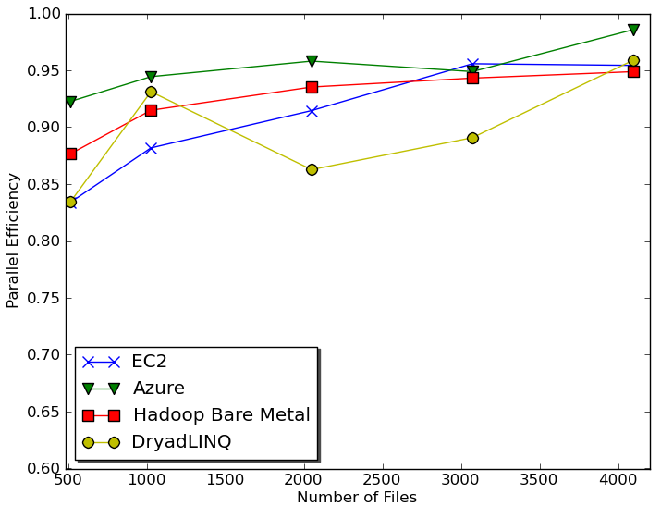
Sequence Assembly in the Clouds
CAP3 - Expressed Sequence Tagging
Input files (FASTA)
CAP3
CAP3
Output files
Cap3 parallel efficiency
Cap3 – Per core per file (458 reads in each file) time to process sequences
Thilina Gunarathne, Tak-Lon Wu, Judy Qiu, and Geoffrey Fox,
“Cloud Computing Paradigms for Pleasingly Parallel Biomedical Applications”, March 21, 2010. Proceedings of Emerging Computational Methods for the Life Sciences Workshop of ACM HPDC 2010 conference, Chicago, Illinois, June 20-25, 2010.

Slide 9
Acknowledgements
SALSA Group
http://salsahpc.indiana.edu
Judy Qiu, Adam Hughes, Ryan Hartman, Geoffrey Fox
Jaliya Ekanayake, Thilina Gunarathne, Jong Youl Choi, Seung-Hee Bae,
Yang Ruan, Hui Li, Bingjing Zhang, Saliya Ekanayake, Stephen Wu
Collaborators
Yves Brun, Peter Cherbas, Dennis Fortenberry, Roger Innes, David Nelson, Homer Twigg,
Craig Stewart, Haixu Tang, Mina Rho, David Wild, Bin Cao, Qian Zhu, Maureen Biggers, Gilbert Liu,
Neil Devadasan
Support by
Research Technologies of UITS and School of Informatics and Computing

