Slide 1

IU Twister Supports Data Intensive
Science Applications
http://salsahpc.indiana.edu
School of Informatics and Computing
Indiana University

Slide 2

Application Classes
Old classification of Parallel software/hardware in terms of
5 (becoming 6) “Application architecture” Structures)
1 | Synchronous | Lockstep Operation as in SIMD architectures | SIMD
2 | Loosely Synchronous | Iterative Compute-Communication stages with independent compute (map) operations for each CPU. Heart of most MPI jobs | MPP
3 | Asynchronous | Computer Chess; Combinatorial Search often supported by dynamic threads | MPP
4 | Pleasingly Parallel | Each component independent – in 1988, Fox estimated at 20% of total number of applications | Grids
5 | Metaproblems | Coarse grain (asynchronous) combinations of classes 1)-4). The preserve of workflow. | Grids
6 | MapReduce++ | It describes file(database) to file(database) operations which has subcategories including. Pleasingly Parallel Map Only Map followed by reductions Iterative “Map followed by reductions” – Extension of Current Technologies that supports much linear algebra and datamining | Clouds Hadoop/ Dryad Twister
Notes:
CGL-MapReduce is an example of MapReduce++ -- supports MapReduce model with iteration (data stays in memory and communication via streams not files)

Slide 3
Applications & Different Interconnection Patterns
Map Only | Classic MapReduce | Ite rative Reductions MapReduce++ | Loosely Synchronous
CAP3 Analysis Document conversion (PDF -> HTML) Brute force searches in cryptography Parametric sweeps | High Energy Physics (HEP) Histograms SWG gene alignment Distributed search Distributed sorting Information retrieval | Expectation maximization algorithms Clustering Linear Algebra | Many MPI scientific applications utilizing wide variety of communication constructs including local interactions
- CAP3 Gene Assembly - PolarGrid Matlab data analysis | - Information Retrieval - HEP Data Analysis - Calculation of Pairwise Distances for ALU Sequences | Kmeans Deterministic Annealing Clustering - Multidimensional Scaling MDS | - Solving Differential Equations and - particle dynamics with short range forces
Input
iterations
Input
Input
map
map
map
Pij
reduce
Output
reduce
Domain of MapReduce and Iterative Extensions
MPI

Slide 4

Motivation
Data Deluge
MapReduce
Classic Parallel Runtimes (MPI)
Data Centered, QoS
Efficient and Proven techniques
Experiencing in many domains
Expand the Applicability of MapReduce to more classes of Applications
Iterative MapReduce
Map-Only
MapReduce
More Extensions
iterations
Input
Input
Input
map
map
map
Pij
reduce
reduce
Output

Slide 5

Twister(MapReduce++)
Pub/Sub Broker Network
Map Worker
M
Streaming based communication
Intermediate results are directly transferred from the map tasks to the reduce tasks – eliminates local files
Cacheable map/reduce tasks
  Static data remains in memory
Combine phase to combine reductions
User Program is the composer of MapReduce computations
Extends the MapReduce model to iterative computations
Worker Nodes
R
Reduce Worker
D
D
MR
Driver
User
Program
M
M
M
M
D
MRDeamon
R
R
R
R
Data Read/Write
Communication
Data Split
File System
Iterate
Static
data
Configure()
User Program
Map(Key, Value)
δ flow
Reduce (Key, List<Value>)
Combine (Key, List<Value>)
Different synchronization and intercommunication mechanisms used by the parallel runtimes
Close()

Slide 6

Twister New Release

Slide 7
TwisterMPIReduce
PairwiseClustering
MPI
Multi Dimensional Scaling MPI
Generative Topographic Mapping MPI
Other …
TwisterMPIReduce
Azure Twister (C# C++)
Java Twister
Microsoft Azure
FutureGrid
Local Cluster
Amazon EC2
Runtime package supporting subset of MPI mapped to Twister
Set-up, Barrier, Broadcast, Reduce

Slide 8


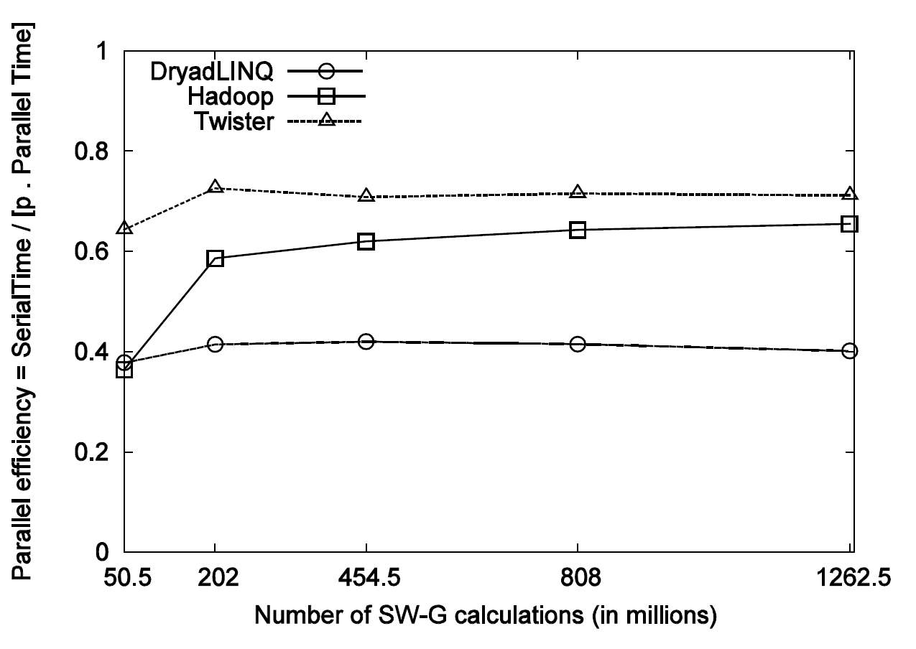
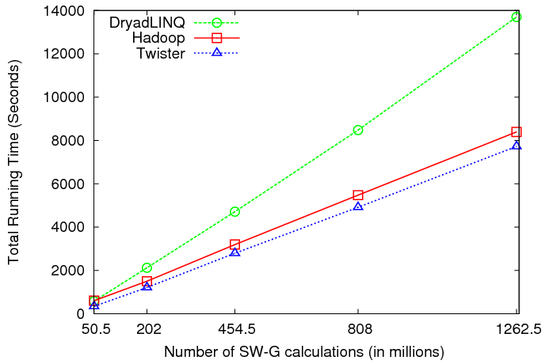
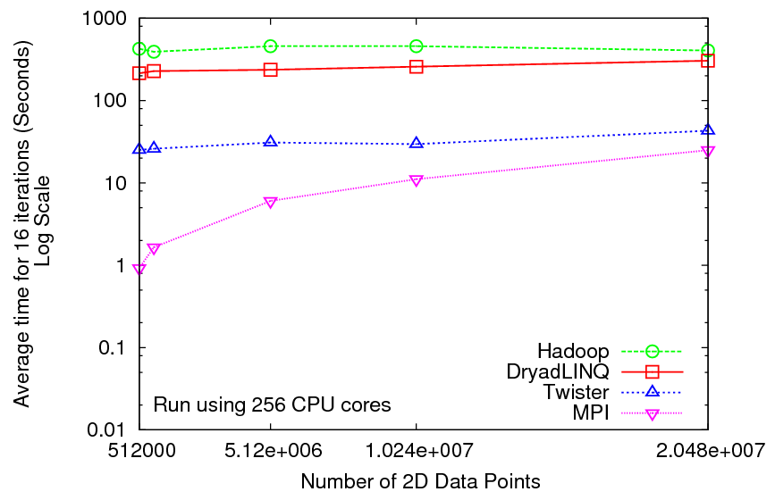
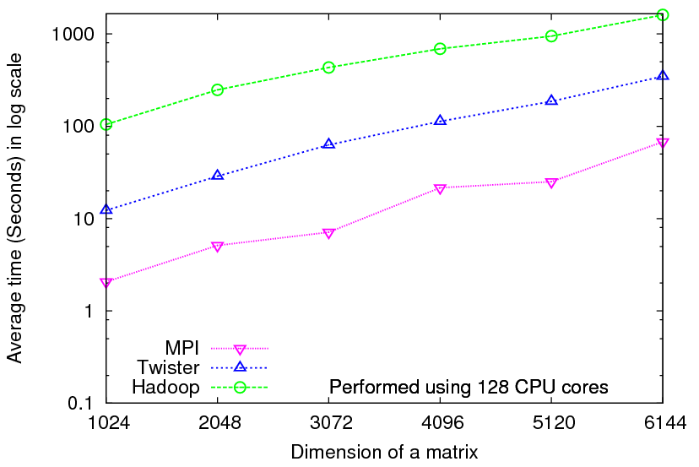
Iterative Computations
K-means
Matrix Multiplication
Smith Waterman
Performance of K-Means
Performance Matrix Multiplication

Slide 9
A Programming Model for Iterative MapReduce
Distributed data access
In-memory MapReduce
Distinction on static data and variable data (data flow vs. δ flow)
Cacheable map/reduce tasks (long running tasks)
Combine operation
Support fast intermediate data transfers
Iterate
Static
data
Configure()
User Program
Map(Key, Value)
δ flow
Reduce (Key, List<Value>)
Combine (Map<Key,Value>)
Close()
Twister Constraints for Side Effect Free map/reduce tasks
Computation Complexity >> Complexity of Size of the Mutant Data (State)

Slide 10

Iterative MapReduce using Existing Runtimes
Variable Data – e.g. Hadoop distributed cache
Static Data
Loaded in Every Iteration
New map/reduce tasks in every iteration
Map(Key, Value)
Iterate
Local disk -> HTTP -> Local disk
Main Program
Reduce (Key, List<Value>)
Reduce outputs are saved into multiple files
Focuses mainly on single step map->reduce computations
Considerable overheads from:
  Reinitializing tasks
  Reloading static data
  Communication & data transfers
Notes:
Cheng Tao et al. Proposed MapReduce for Machine Learning on Multicore

Slide 11
Features of Existing Architectures(1)
  Google, Apache Hadoop, Sector/Sphere,
  Dryad/DryadLINQ (DAG based)
Programming Model
  MapReduce (Optionally “map-only”)
  Focus on Single Step MapReduce computations (DryadLINQ supports more than one stage)
Input and Output Handling
  Distributed data access (HDFS in Hadoop, Sector in Sphere, and shared directories in Dryad)
  Outputs normally goes to the distributed file systems
Intermediate data
  Transferred via file systems (Local disk-> HTTP -> local disk in Hadoop)
  Easy to support fault tolerance
  Considerably high latencies
Notes:
Cascading is there, but that is for multiple MapReduce computations.

Slide 12
Features of Existing Architectures(2)
Scheduling
  A master schedules tasks to slaves depending on the availability
  Dynamic Scheduling in Hadoop, static scheduling in Dryad/DryadLINQ
  Naturally load balancing
Fault Tolerance
  Data flows through disks->channels->disks
  A master keeps track of the data products
  Re-execution of failed or slow tasks
  Overheads are justifiable for large single step MapReduce computations
  Iterative MapReduce

Slide 13
Iterative MapReduce using Twister
Static Data
Loaded only once
Configure()
Iterate
Main Program
Long running map/reduce tasks (cached)
Map(Key, Value)
Direct data transfer via pub/sub
Reduce (Key, List<Value>)
Combiner operation to collect all reduce outputs
Combine (Map<Key,Value>)
Distributed data access
Distinction on static data and variable data (data flow vs. δ flow)
Cacheable map/reduce tasks (long running tasks)
Combine operation
Support fast intermediate data transfers
Notes:
Cheng Tao et al. Proposed MapReduce for Machine Learning on Multicore

Slide 14
Twister Architecture
Master Node
B
Pub/sub
Broker Network
Twister
Driver
B
B
B
Main Program
One broker serves several Twister daemons
Twister Daemon
Twister Daemon
map
reduce
Cacheable tasks
Worker Pool
Worker Pool
Scripts perform:
Data distribution, data collection, and partition file creation
Local Disk
Local Disk
Worker Node
Worker Node

Slide 15
Twister Programming Model
Worker Nodes
configureMaps(..)
Local Disk
configureReduce(..)
Cacheable map/reduce tasks
while(condition){
runMapReduce(..)
May send <Key,Value> pairs directly
Map()
Iterations
Reduce()
Combine() operation
Communications/data transfers via the pub-sub broker network
updateCondition()
Two configuration options :
Using local disks (only for maps)
Using pub-sub bus
} //end while
close()
User program’s process space

Slide 16
Twister API
configureMaps(PartitionFile partitionFile)
configureMaps(Value[] values)
configureReduce(Value[] values)
runMapReduce()
runMapReduce(KeyValue[] keyValues)
runMapReduceBCast(Value value)
map(MapOutputCollector collector, Key key, Value val)
reduce(ReduceOutputCollector collector, Key key,List<Value> values)
combine(Map<Key, Value> keyValues)

Slide 17
Input/Output Handling
Node 0
Node 1
Node n
Data Manipulation Tool
A common directory in local disks of individual nodes
e.g. /tmp/twister_data
Partition File
Data Manipulation Tool:
  Provides basic functionality to manipulate data across the local disks of the compute nodes
  Data partitions are assumed to be files (Contrast to fixed sized blocks in Hadoop)
  Supported commands:
    mkdir, rmdir, put,putall,get,ls,
    Copy resources
    Create Partition File

Slide 18
Partition File
File No | Node IP | Daemon No | File partition path
4 | 156.56.104.96 | 2 | /home/jaliya/data/mds/GD-4D-23.bin
5 | 156.56.104.96 | 2 | /home/jaliya/data/mds/GD-4D-0.bin
6 | 156.56.104.96 | 2 | /home/jaliya/data/mds/GD-4D-27.bin
7 | 156.56.104.96 | 2 | /home/jaliya/data/mds/GD-4D-20.bin
8 | 156.56.104.97 | 4 | /home/jaliya/data/mds/GD-4D-23.bin
9 | 156.56.104.97 | 4 | /home/jaliya/data/mds/GD-4D-25.bin
10 | 156.56.104.97 | 4 | /home/jaliya/data/mds/GD-4D-18.bin
11 | 156.56.104.97 | 4 | /home/jaliya/data/mds/GD-4D-15.bin
Partition file allows duplicates
One data partition may reside in multiple nodes
In an event of failure, the duplicates are used to re-schedule the tasks

Slide 19
The use of pub/sub messaging
Intermediate data transferred via the broker network
Network of brokers used for load balancing
  Different broker topologies
Interspersed computation and data transfer minimizes large message load at the brokers
Currently supports
  NaradaBrokering
  ActiveMQ
map task queues
Map workers
E.g.
100 map tasks, 10 workers in 10 nodes
Broker network
~ 10 tasks are producing outputs at once
Reduce()

Slide 20
Twister Applications
Twister extends the MapReduce to iterative algorithms
Several iterative algorithms we have implemented
  Matrix Multiplication
  K-Means Clustering
  Pagerank
  Breadth First Search
  Multi dimensional scaling (MDS)
Non iterative applications
  HEP Histogram
  Biology All Pairs using Smith Waterman Gotoh algorithm
  Twister Blast

Slide 21

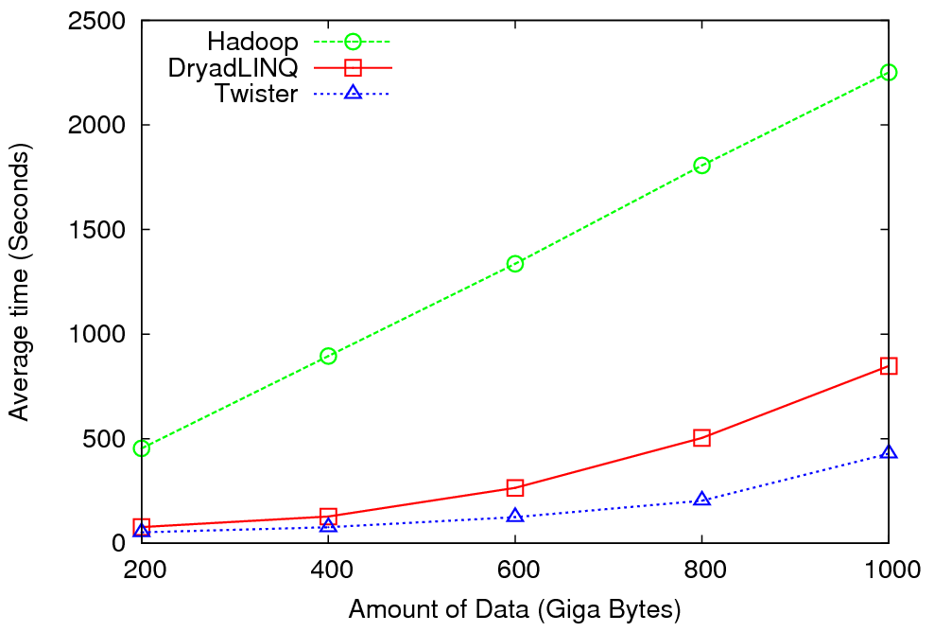
High Energy Physics Data Analysis
An application analyzing data from Large Hadron Collider (1TB but 100 Petabytes eventually)
Input to a map task: <key, value>
key = Some Id value = HEP file Name
Output of a map task: <key, value>
key = random # (0<= num<= max reduce tasks)
value = Histogram as binary data
Input to a reduce task: <key, List<value>>
key = random # (0<= num<= max reduce tasks)
value = List of histogram as binary data
Output from a reduce task: value
value = Histogram file
Combine outputs from reduce tasks to form the final histogram

Slide 22

Reduce Phase of Particle Physics
“Find the Higgs” using Dryad
Higgs in Monte Carlo
Combine Histograms produced by separate Root “Maps” (of event data to partial histograms) into a single Histogram delivered to Client
This is an example using MapReduce to do distributed histogramming.

Slide 23

All-Pairs Using DryadLINQ
125 million distances
4 hours & 46 minutes
Calculate Pairwise Distances (Smith Waterman Gotoh)
Calculate pairwise distances for a collection of genes (used for clustering, MDS)
Fine grained tasks in MPI
Coarse grained tasks in DryadLINQ
Performed on 768 cores (Tempest Cluster)
Moretti, C., Bui, H., Hollingsworth, K., Rich, B., Flynn, P., & Thain, D. (2009). All-Pairs: An Abstraction for Data Intensive Computing on Campus Grids. IEEE Transactions on Parallel and Distributed Systems , 21, 21-36.

Slide 24
Dryad versus MPI for Smith Waterman
Flat is perfect scaling

Slide 25
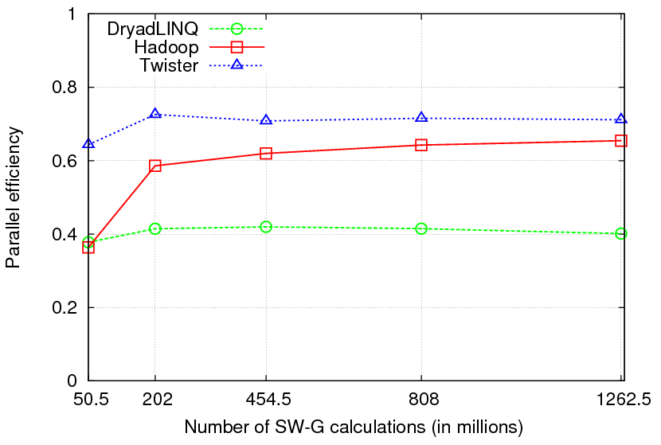

Pairwise Sequence Comparison using Smith Waterman Gotoh
Typical MapReduce computation
Comparable efficiencies
Twister performs the best

Slide 27
K-Means Clustering
N- dimension space
Euclidean
Distance
Points distributions in n dimensional space
Identify a given number of cluster centers
Use Euclidean distance to associate points to cluster centers
Refine the cluster centers iteratively

Slide 28
K-Means Clustering - MapReduce
Each map task processes a data partition
nth cluster centers
map
map
map
map
While(){
}
Main Program
reduce
(n+1) th cluster centers
Map tasks calculates Euclidean distance from each point in its partition to each cluster center
Map tasks assign points to cluster centers and sum the partial cluster center values
Emit cluster center sums + number of points assigned
Reduce task sums all the corresponding partial sums and calculate new cluster centers

Slide 29
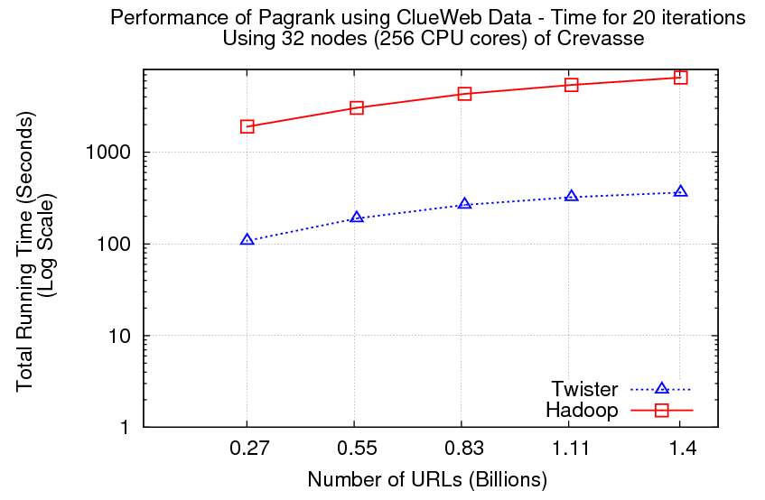
Pagerank – An Iterative MapReduce Algorithm
Partial Adjacency Matrix
Current
Page ranks (Compressed)
M
Partial
Updates
R
C
Partially merged
Updates
Iterations
Well-known pagerank algorithm [1]
Used ClueWeb09 [2] (1TB in size) from CMU
Reuse of map tasks and faster communication pays off
[1] Pagerank Algorithm, http://en.wikipedia.org/wiki/PageRank
[2] ClueWeb09 Data Set, http://boston.lti.cs.cmu.edu/Data/clueweb09/

Slide 30
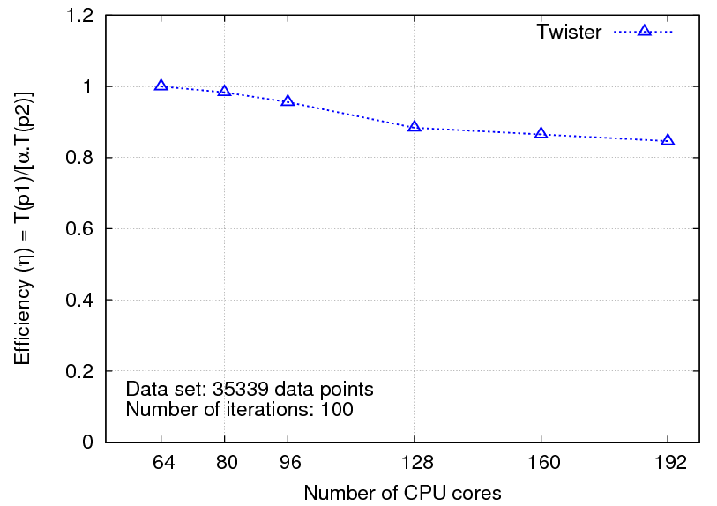
Multi-dimensional Scaling
While(condition)
{
<X> = [A] [B] <C>
C = CalcStress(<X>)
}
While(condition)
{
<T> = MapReduce1([B],<C>)
<X> = MapReduce2([A],<T>)
C = MapReduce3(<X>)
}
Maps high dimensional data to lower dimensions (typically 2D or 3D)
SMACOF (Scaling by Majorizing of COmplicated Function)[1]
[1] J. de Leeuw, "Applications of convex analysis to multidimensional scaling," Recent Developments in Statistics, pp. 133-145, 1977.

Slide 31
2916 iterations
(384 CPUcores)
968 iterations
(384 CPUcores)
343 iterations
(768 CPU cores)

Slide 32
  Future work of Twister
Integrating a distributed file system
Integrating with a high performance messaging system
Programming with side effects yet support fault tolerance

Slide 33

http://salsahpc.indiana.edu/tutorial/index.html

Slide 34


















300+ Students learning about Twister & Hadoop
MapReduce technologies, supported by FutureGrid.
July 26-30, 2010 NCSA Summer School Workshop
http://salsahpc.indiana.edu/tutorial
Washington
University
University of
Minnesota
Michigan
State
Johns
Hopkins
Univ.Illinois
at Chicago
Iowa
State
Penn
State
IBM Almaden
Research Center
Notre
Dame
University of
California at
Los Angeles
Indiana
University
San Diego
Supercomputer
Center
University of
Texas at El Paso
University of
Arkansas
University
of Florida

Slide 35


Slide 36

http://salsahpc.indiana.edu/CloudCom2010

