Slide 1
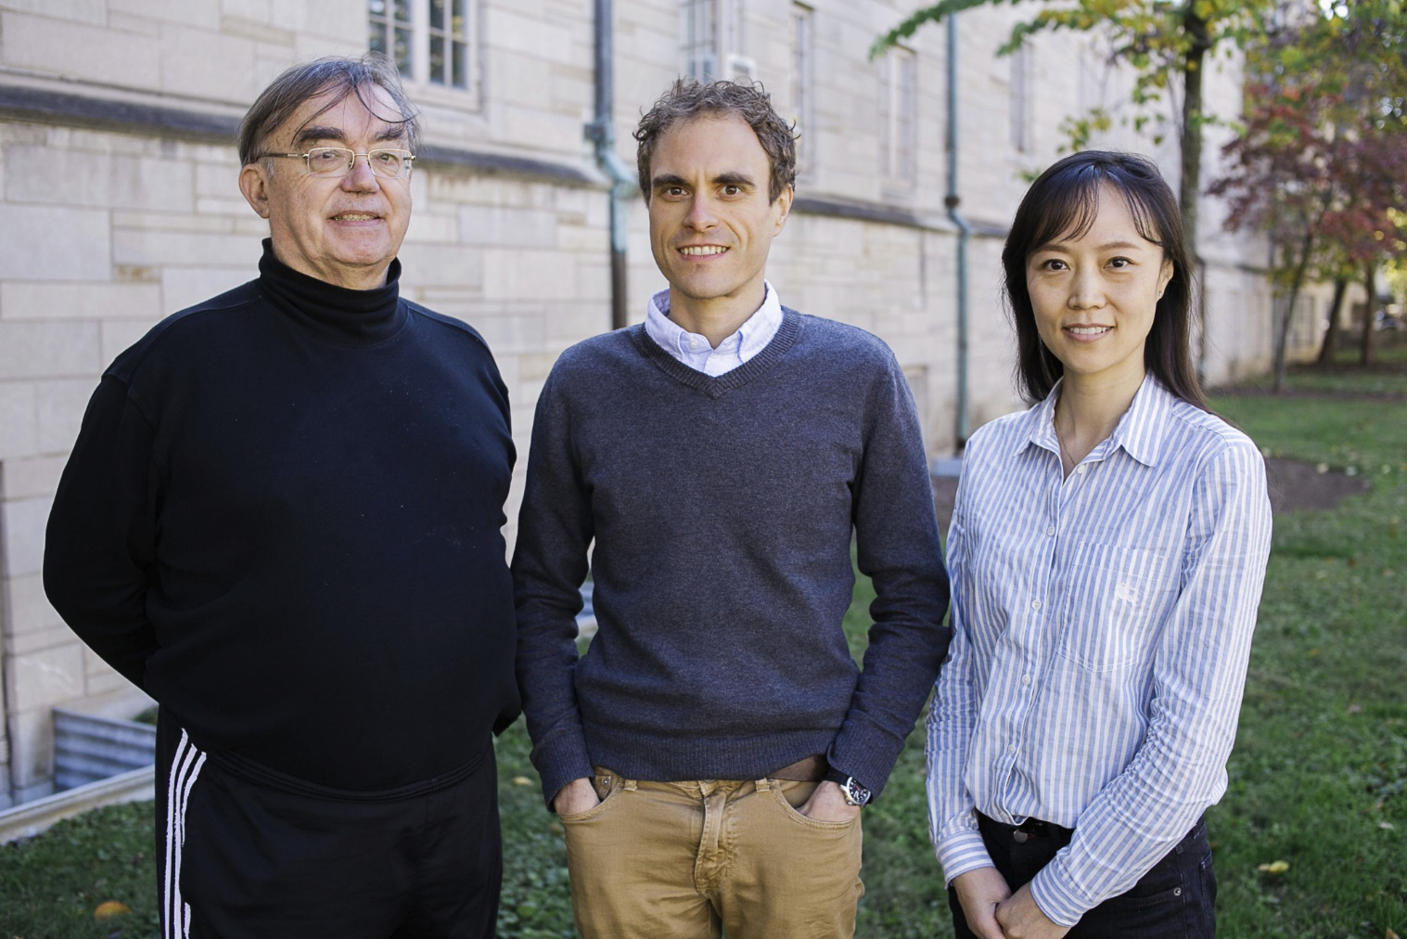
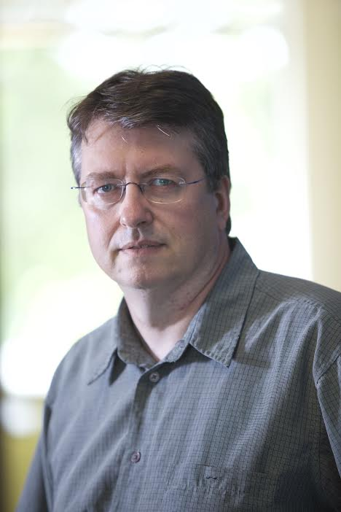
Data Science at
Digital Science Center@SOIC
Indiana University Faculty
Geoffrey Fox, David Crandall, Judy Qiu, Gregor von Laszewski

Slide 2
Digital Science Center Research Areas
Digital Science Center Facilities
RaPyDLI Deep Learning Environment
HPC-ABDS and Cloud DIKW Big Data Environments
Java Grande Runtime
CloudIOT Internet of Things Environment
SPIDAL Scalable Data Analytics Library
Big Data Ogres Classification and Benchmarks
Cloudmesh Cloud and Bare metal Automation
XSEDE TAS Monitoring citations and system metrics
Data Science Education with MOOC’s

Slide 3
DSC Computing Systems
Working with SDSC on NSF XSEDE Comet System (Haswell)
Adding 64-128 node Haswell based system (Juliet)
  128-256 GB memory per node
  Substantial conventional disk per node (8TB) plus PCI based SSD
  Infiniband with SR-IOV
Older machines
  India (128 nodes, 1024 cores), Bravo (16 nodes, 128 cores), Delta(16 nodes, 192 cores), Echo(16 nodes, 192 cores), Tempest (32 nodes, 768 cores) with large memory, large disk and GPU
  Cray XT5m with 672 cores
Optimized for Cloud research and Large scale Data analytics exploring storage models, algorithms
Bare-metal v. Openstack virtual clusters
Extensively used in Education

Slide 4
NSF Data Science Project I
3 yr. XPS: FULL: DSD: Collaborative Research: Rapid Prototyping HPC Environment for Deep Learning IU, Tennessee (Dongarra), Stanford (Ng)
“Rapid Python Deep Learning Infrastructure” (RaPyDLI) Builds optimized Multicore/GPU/Xeon Phi kernels (best exascale dataflow) with Python front end for general deep learning problems with ImageNet exemplar. Leverage Caffe from UCB.
Large neural networks combined with large datasets (typically imagery, video, audio, or text) are increasingly the top performers in benchmark tasks for vision, speech, and Natural Language Processing. Training often requires customization of the neural network architecture, learning criteria, and dataset pre-processing.
Classified OUT
IN

Slide 5
NSF Data Science Project II
5 yr. Datanet: CIF21 DIBBs: Middleware and High Performance Analytics Libraries for Scalable Data Science IU, Rutgers (Jha), Virginia Tech (Marathe), Kansas (Paden), Stony Brook (Wang), Arizona State(Beckstein), Utah(Cheatham)
HPC-ABDS: Cloud-HPC interoperable software performance of HPC (High Performance Computing) and the rich functionality of the commodity Apache Big Data Stack.
SPIDAL (Scalable Parallel Interoperable Data Analytics Library): Scalable Analytics for Biomolecular Simulations, Network and Computational Social Science, Epidemiology, Computer Vision, Spatial Geographical Information Systems, Remote Sensing for Polar Science and Pathology Informatics.

Slide 6
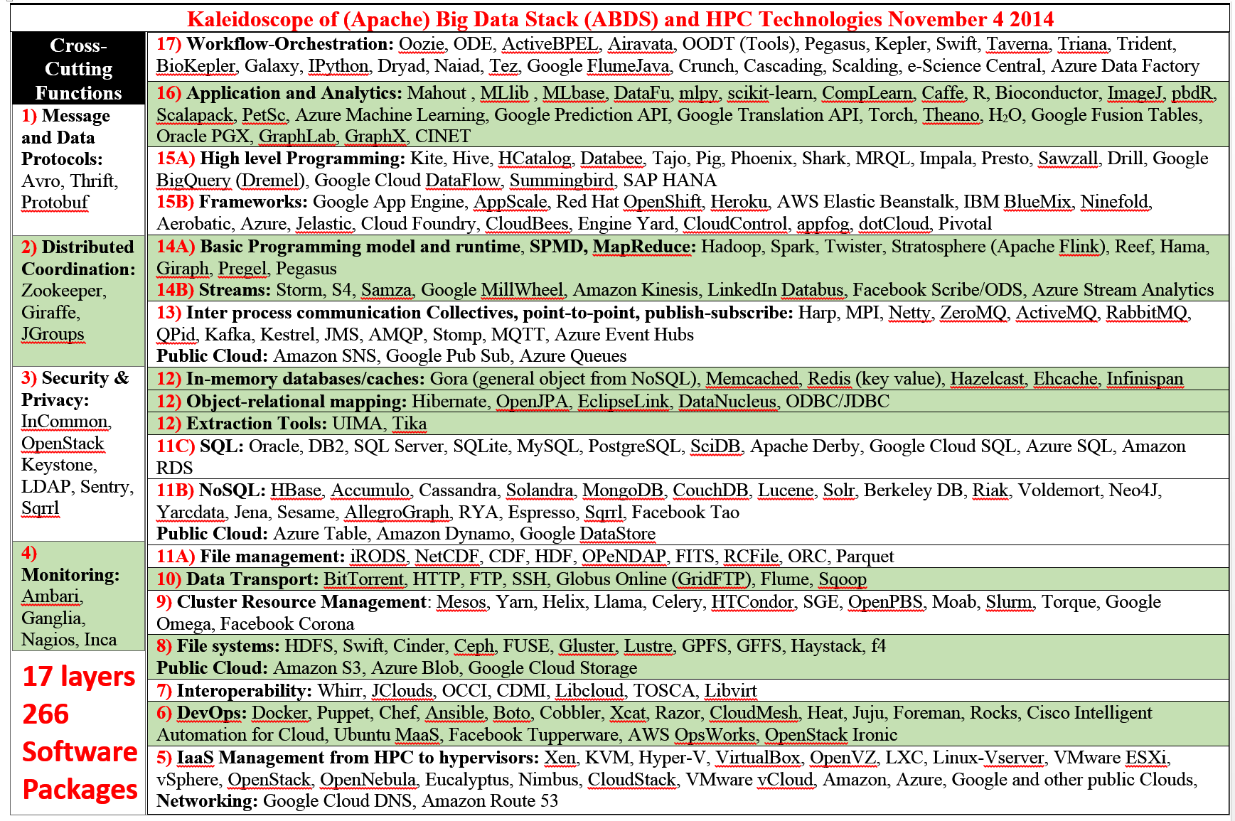
Big Data Software Model

Slide 7
Harp Plug-in to Hadoop
Make ABDS high performance – do not replace it!
Work of Judy Qiu and Bingjing Zhang.
Left diagram shows architecture of Harp Hadoop Plug-in that adds high performance communication, Iteration (caching) and support for rich data abstractions including key-value
Right side shows efficiency for 16 to 128 nodes (each 32 cores) on WDA-SMACOF dimension reduction dominated by conjugate gradient

Slide 8
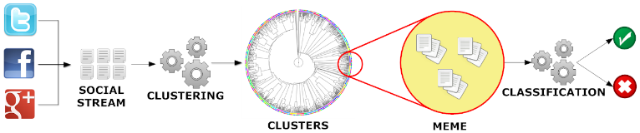
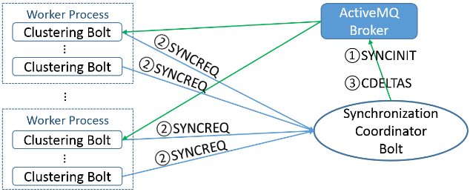
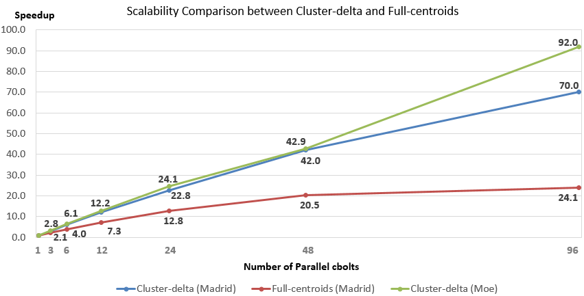
Parallel Tweet Clustering with Storm
Judy Qiu and Xiaoming Gao
Storm Bolts coordinated by ActiveMQ to synchronize parallel cluster center updates
Speedup on up to 96 bolts on two clusters Moe and Madrid
Red curve is old algorithm;
green and blue new algorithm

Slide 9
Java Grande and C# on 40K point DAPWC Clustering
Very sensitive to threads v MPI
C#
Java
C# Hardware 0.7 performance Java Hardware
64 way parallel
128 way parallel
256 way
parallel
T X P
Nodes
Total

Slide 10
Cloud DIKW based on HPC-ABDS to integrate streaming and batch Big Data
System Orchestration / Dataflow / Workflow
Archival Storage – NOSQL like Hbase
Batch Processing (Iterative MapReduce)
Analytics
Raw Data
Data
Information
Knowledge
Wisdom
Decisions
Analytics
Streaming Processing (Iterative MapReduce)
Storm
Storm
Storm
Storm
Storm
Storm
Pub-Sub
Internet of Things (Smart Grid)

Slide 11
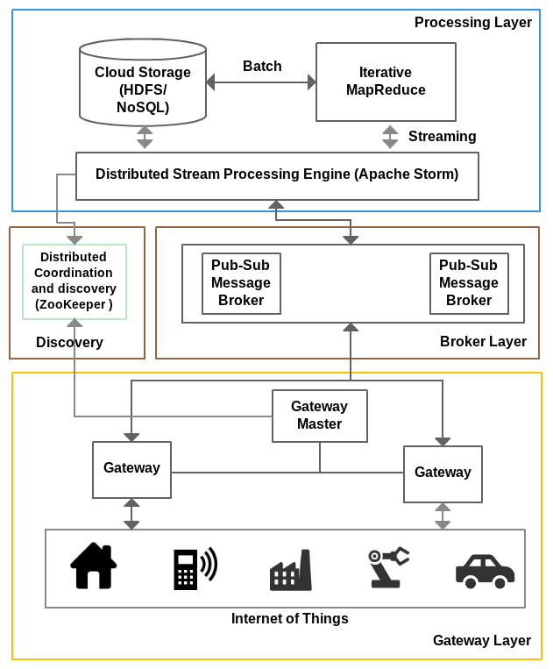
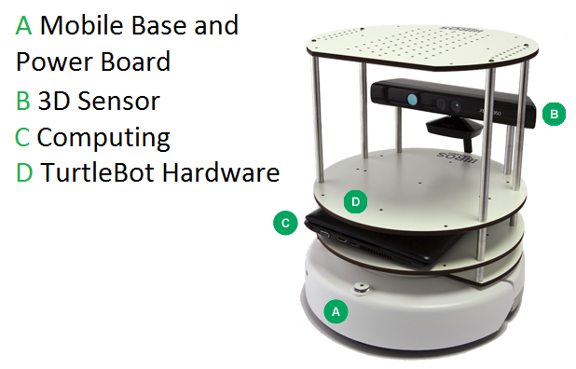
IOTCloud
Device → Pub-Sub→Storm → Datastore → Data Analysis
Apache Storm provides scalable distributed system for processing data streams coming from devices in real time.
For example Storm layer can decide to store the data in cloud storage for further analysis or to send control data back to the devices
Evaluating Pub-Sub Systems ActiveMQ, RabbitMQ, Kafka, Kestrel
Turtlebot and Kinect

Slide 12
RabbitMQ out-performs Kafka with Storm
Kafka Latency
RabbitMQ Latency

Slide 13
Big Data Ogres and their Facets
51 Big Data use cases: http://bigdatawg.nist.gov/usecases.php
Ogres classify Big Data Applications with facets and benchmarks
Facets I: Features identified from 51 use cases: PP(26), MR(18), MR-Statistics(7), MR-Iterative(23), Graph(9), Fusion(11), Streaming/DDDAS(41), Classify(30), Search/Query(12), Collaborative Filtering(4), LML(36), GML(23), Workflow(51), GIS(16), HPC(5), Agents(2)
  MR MapReduce; L/GML Local/Global Machine Learning
Facets II: Some broad features familiar from past like
  BSP (Bulk Synchronous Processing) or not?
  SPMD (Single Program Multiple Data) or not?
  Iterative or not?
  Regular or Irregular?
  Static or dynamic?,
  communication/compute and I-O/compute ratios
  Data abstraction (array, key-value, pixels, graph…)
Facets III: Data Processing Architectures

Slide 14
Benchmark: Core Analytics I
Map-Only
  Pleasingly parallel - Local Machine Learning LML
MapReduce:
  Search/Query/Index
  Summarizing statistics as in LHC Data analysis (histograms) Recommender Systems (Collaborative Filtering)
  Linear Classifiers (Bayes, Random Forests)
Alignment and Streaming Genomic Alignment, Incremental Classifiers
Global Analytics: Nonlinear Solvers (structure depends on objective function)
  Stochastic Gradient Descent SGD and approximations to Newton’s Method
  Levenberg-Marquardt solver

Slide 15
Benchmark: Core Analytics II
Global Analytics: Map-Collective (See Mahout, MLlib)
Often use matrix-matrix,-vector operations, solvers (conjugate gradient)
  Clustering (many methods), Mixture Models, LDA (Latent Dirichlet Allocation), PLSI (Probabilistic Latent Semantic Indexing)
  SVM and Logistic Regression
  Outlier Detection (several approaches)
  PageRank, (find leading eigenvector of sparse matrix)
  SVD (Singular Value Decomposition)
  MDS (Multidimensional Scaling)
  Learning Neural Networks (Deep Learning)
  Hidden Markov Models
Graph Analytics (Global Analytics subset)
Graph Structure and Graph Simulation
Communities, subgraphs/motifs, diameter, maximal cliques, connected components, Betweenness centrality, shortest path
Linear/Quadratic Programming, Combinatorial Optimization, Branch and Bound

Slide 16

Protein Universe Browser for COG Sequences with a few illustrative biologically identified clusters

Slide 17
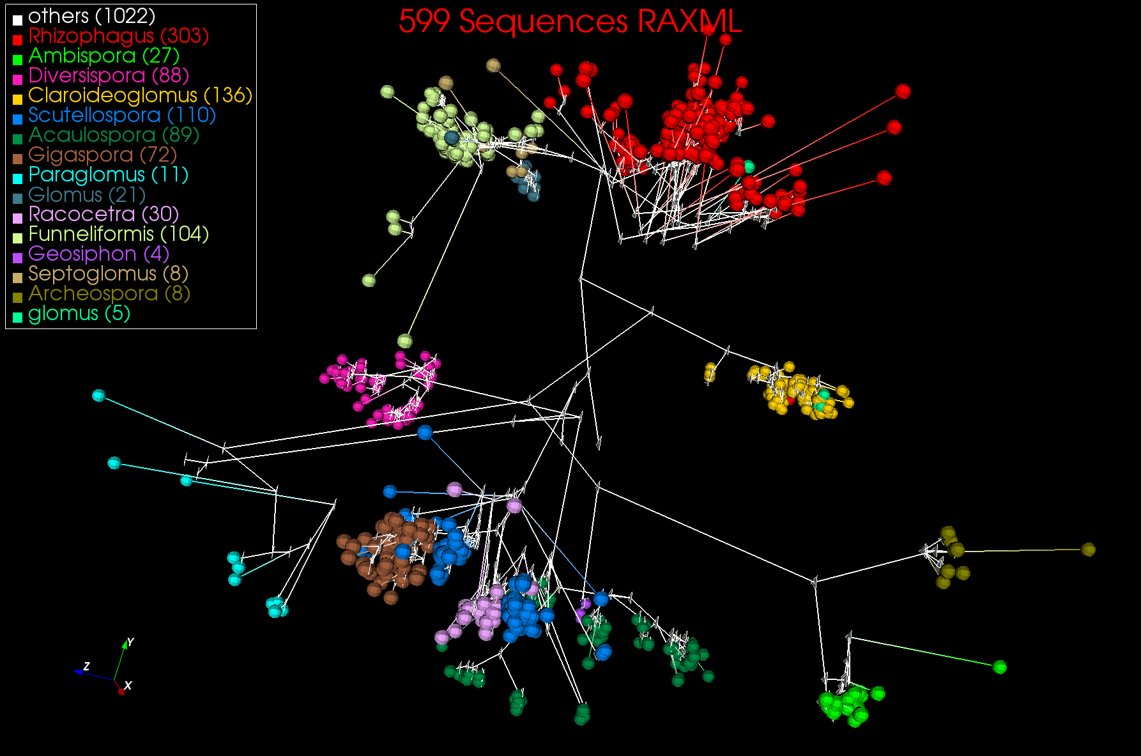
3D Phylogenetic Tree from WDA SMACOF

Slide 18
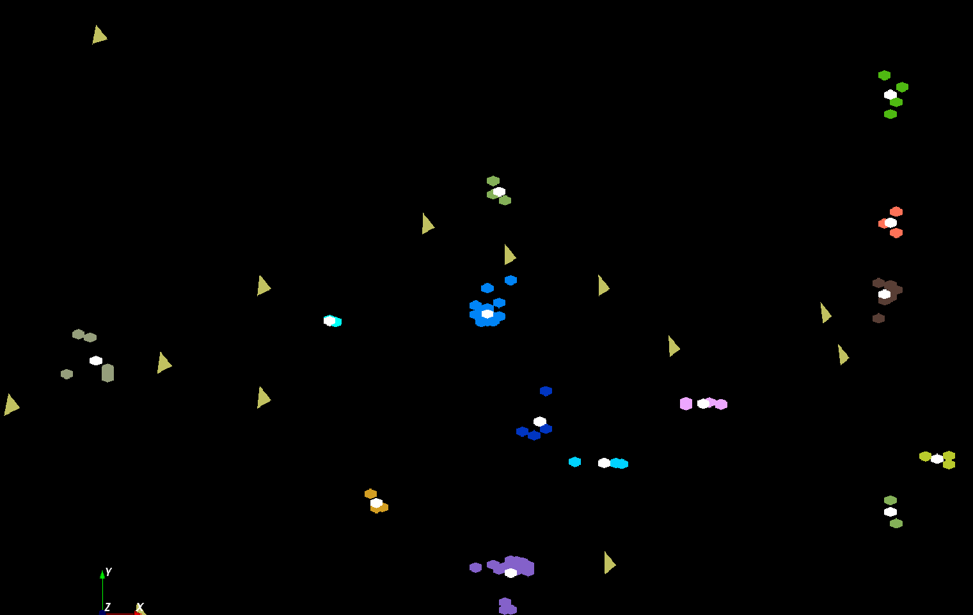
LC-MS Proteomics Mass Spectrometry
The brownish triangles are peaks outside any cluster.
The colored hexagons are peaks inside clusters with the white hexagons being determined cluster center
Fragment of 30,000 Clusters
241605 Points

Slide 19
Cloudmesh Software Defined System Toolkit
Cloudmesh Open source http://cloudmesh.github.io/ supporting
  The ability to federate a number of resources from academia and industry. This includes existing FutureSystems infrastructure, Amazon Web Services, Azure, HP Cloud, Karlsruhe using several IaaS frameworks
  IPython-based workflow as an interoperable onramp
Supports reproducible computing environments
Uses internally Libcloud and Cobbler
Celery Task/Query manager (AMQP - RabbitMQ)
MongoDB
Gregor von Laszewski
Fugang Wang
Notes:
Due to its integrated services Cloudmesh provides the ability to be an onramp for other clouds.
It provides information services to various system level sensors to give access to sensor and utilization data. Internally, it can be used to optimize the system usage.
The provisioning experience from FutureGrid has taught us that we need to provide
the creation of new clouds (rain)
the repartitioning of resources between services (cloud shifting)
and the integration of external cloud resources in case of over provisioning (cloud bursting)
As we deal with many IaaS frameworks, we need an abstraction layer on top of the IaaS framework.
Experiment management is conducted with workflows controlled in shells, Python/iPython, as well as systems such as OpenStack's Heat.
Accounting is supported through additional services such as user management and charge rate management.
Not all features are yet implemented. Figure shows the main functionality that we target at this time to implement.

