Slide 1
HPC in the Cloud – Clearing the Mist or Lost in the Fog
Panel at SC11
Seattle
November 17 2011
Geoffrey Fox
gcf@indiana.edu
http://www.infomall.org http://www.salsahpc.org
Director, Digital Science Center, Pervasive Technology Institute
Associate Dean for Research and Graduate Studies, School of Informatics and Computing
Indiana University Bloomington

Slide 2
Question for the Panel
How does the Cloud fit in the HPC landscape today and what’s its likely role in the future?
More specifically:
  What advantages of HPC in the Cloud have you observed?
  What shortcomings of HPC in the Cloud have you observed and how can they be overcome?
  Given the possible variations in cloud services, implementation and business model what combinations are likely to work best for HPC?

Slide 3
Some Observations
Distinguish HPC machines and HPC problems
Classic HPC machines as MPI engines offer highest possible performance on closely coupled problems
Clouds offer from different points of view
  On-demand service (elastic)
  Economies of scale from sharing
  Powerful new software models such as MapReduce, which have advantages over classic HPC environments
  Plenty of jobs making it attractive for students & curricula
  Security challenges
HPC problems running well on clouds have above advantages
  Tempered by free access to some classic HPC systems

Slide 4
What Applications work in Clouds
Pleasingly parallel applications of all sorts analyzing roughly independent data or spawning independent simulations
  Long tail of science
  Integration of distributed sensors (Internet of Things)
Science Gateways and portals
Workflow federating clouds and classic HPC
Commercial and Science Data analytics that can use MapReduce (some of such apps) or its iterative variants (most analytic apps)

Slide 5
Clouds and Grids/HPC
Synchronization/communication Performance
Grids > Clouds > Classic HPC Systems
Clouds appear to execute effectively Grid workloads but are not easily used for closely coupled HPC applications
Service Oriented Architectures and workflow appear to work similarly in both grids and clouds
Assume for immediate future, science supported by a mixture of
  Clouds – see application discussion
  Grids/High Throughput Systems (moving to clouds as convenient)
  Supercomputers (“MPI Engines”) going to exascale

Slide 6
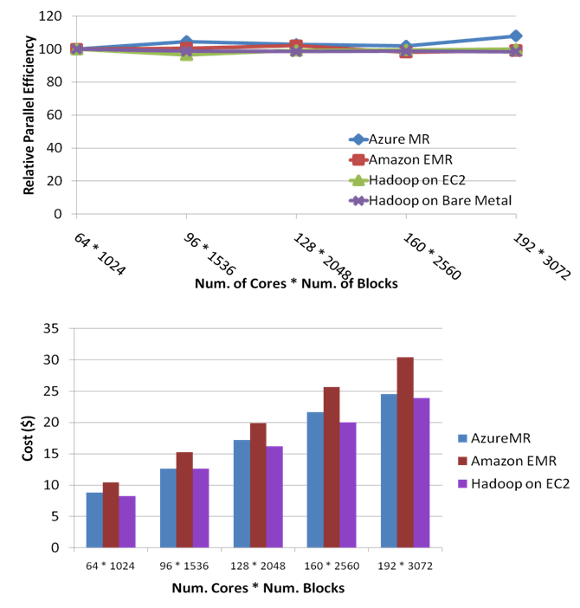
Smith-Waterman-Gotoh All Pairs Sequence Alignment Performance
Pleasingly Parallel
Azure
Amazon (2 ways)
HPC MapReduce
Notes:
~123 million sequence alignments, for under 30$ with zero up front hardware cost,

Slide 7
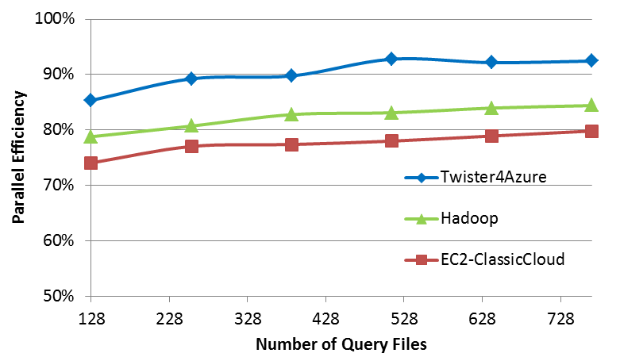
Performance for Blast Sequence Search
Azure, HPC, Amazon

Slide 8

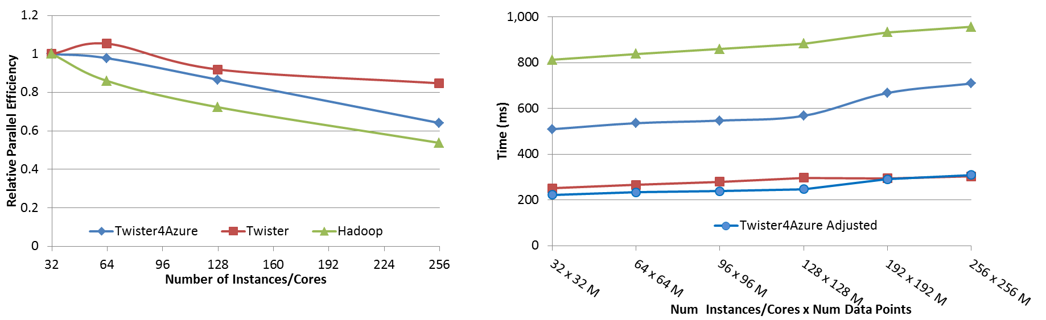




Performance – Azure Kmeans Clustering
Task Execution Time Histogram
Number of Executing Map Task Histogram
Strong Scaling with 128M Data Points
Weak Scaling
Performance with/without
data caching
Speedup gained using data cache
Scaling speedup
Increasing number of iterations
Notes:
Right(c): Twister4Azure executing Map Task histogram for 128 million data points in 128 Azure small instances
Figure 5. KMeansClustering Scalability. Left(a): Relative parallel efficiency of strong scaling using 128 million data points.
Center(b): Weak scaling. Workload per core is kept constant (ideal is a straight horizontal line).

Slide 9
Kmeans Speedup normalized to
32 at 32 cores
HPC
Cloud
HPC

Slide 10
Application Classification
(a) Map Only
(b) Classic MapReduce
(c) Iterative MapReduce
(d) Loosely or Bulk Synchronous
Input
Iterations
Input
Input
map
map
map
P_{ij}
reduce
reduce
Output
BLAST Analysis
Smith-Waterman Distances
Parametric sweeps
PolarGrid data anal
High Energy Physics Histograms
Distributed search
Distributed sorting
Information retrieval
Expectation maximization Clustering e.g. Kmeans
Linear Algebra
Multidimensional Scaling
Page Rank
Many MPI scientific applications such as solving differential equations and particle dynamics
Domain of MapReduce and Iterative Extensions
MPI

Slide 11
What can we learn?
There are many pleasingly parallel simulations and data analysis algorithms which are super for clouds
There are interesting data mining algorithms needing iterative parallel run times
There are linear algebra algorithms with dodgy compute/communication ratios but can be done with reduction collectives not lots of MPI-SEND/RECV
Expectation Maximization good for Iterative MapReduce

Slide 12
Architecture of Data Repositories?
Traditionally governments set up repositories for data associated with particular missions
  For example EOSDIS (Earth Observation), GenBank (Genomics), NSIDC (Polar science), IPAC (Infrared astronomy)
  LHC/OSG computing grids for particle physics
This is complicated by volume of data deluge, distributed instruments as in gene sequencers (maybe centralize?) and need for intense computing like Blast
  i.e. repositories need HPC?

Slide 13
Clouds as Support for Data Repositories?
The data deluge needs cost effective computing
  Clouds are by definition cheapest
  Need data and computing co-located
Shared resources essential (to be cost effective and large)
  Can’t have every scientists downloading petabytes to personal cluster
Need to reconcile distributed (initial source of ) data with shared computing
  Can move data to (disciple specific) clouds
  How do you deal with multi-disciplinary studies
Data repositories of future will have cheap data and elastic cloud analysis support?

