Slide 1
Cloud Services for Big Data Analytics
June 27 2014
Second International Workshop on Service and Cloud Based Data Integration (SCDI 2014)
Anchorage AK
Geoffrey Fox
gcf@indiana.edu
http://www.infomall.org
School of Informatics and Computing
Digital Science Center
Indiana University Bloomington

Slide 2
Abstract
We present a software model built on the Apache software stack (ABDS) that is well used in modern cloud computing, which we enhance with HPC concepts to derive HPC-ABDS.
  We discuss layers in this stack
We discuss how to implement this in a world of multiple infrastructures and evolving software environments for users, developers and administrators
We present Cloudmesh as supporting Software-Defined Distributed System as a Service or SDDSaaS with multiple services on multiple clouds/HPC systems.
We use a sample of over 50 big data applications to identify characteristics of data intensive applications and propose a big data version of the famous Berkeley dwarfs and NAS parallel benchmarks.
  We consider hardware from clouds to HPC.
  We illustrate issues with examples with image data
  This tells you needed services

Slide 3
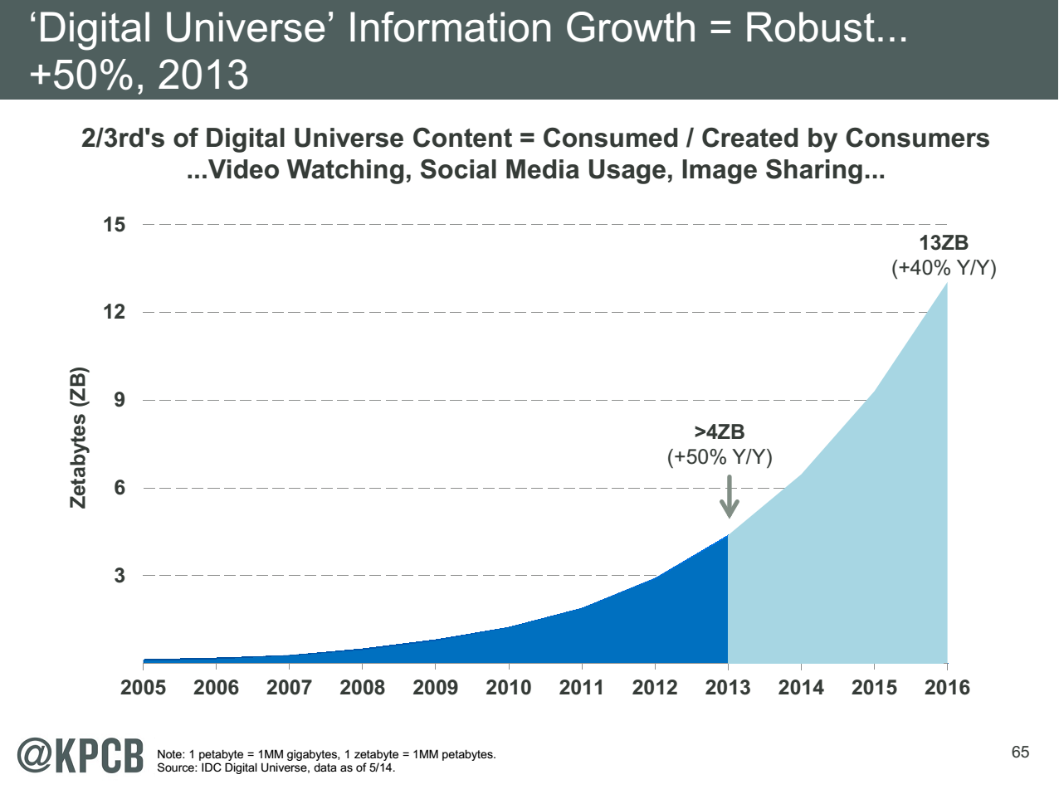
Note largest science ~100 petabytes = 0.000025 total
http://www.kpcb.com/internet-trends

Slide 4
HPC-ABDS
Integrating High Performance Computing with Apache Big Data Stack
Shantenu Jha, Judy Qiu, Andre Luckow

Slide 5
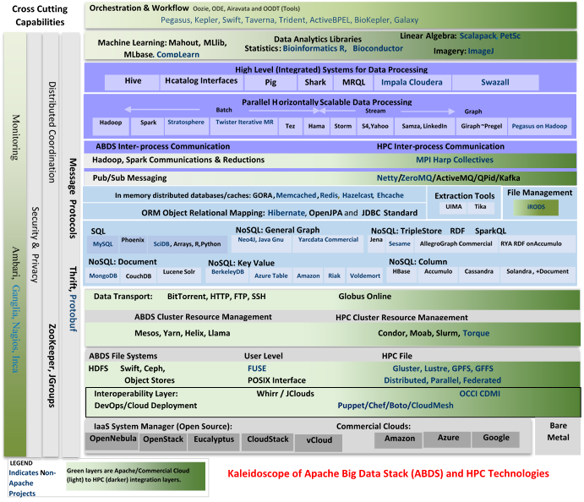

Slide 6
HPC-ABDS
~120 Capabilities
>40 Apache
Green layers have strong HPC Integration opportunities
Goal
Functionality of ABDS
Performance of HPC

Slide 7
Broad Layers in HPC-ABDS
Workflow-Orchestration
Application and Analytics: Mahout, MLlib, R…
High level Programming
Basic Programming model and runtime
  SPMD, Streaming, MapReduce, MPI
Inter process communication
  Collectives, point-to-point, publish-subscribe
In-memory databases/caches
Object-relational mapping
SQL and NoSQL, File management
Data Transport
Cluster Resource Management (Yarn, Slurm, SGE)
File systems(HDFS, Lustre …)
DevOps (Puppet, Chef …)
IaaS Management from HPC to hypervisors (OpenStack)
Cross Cutting
  Message Protocols
  Distributed Coordination
  Security & Privacy
  Monitoring

Slide 8
Useful Set of Analytics Architectures
Pleasingly Parallel: including local machine learning as in parallel over images and apply image processing to each image
- Hadoop could be used but many other HTC, Many task tools
Search: including collaborative filtering and motif finding implemented using classic MapReduce (Hadoop)
Map-Collective or Iterative MapReduce using Collective Communication (clustering) – Hadoop with Harp, Spark …..
Map-Communication or Iterative Giraph: (MapReduce) with point-to-point communication (most graph algorithms such as maximum clique, connected component, finding diameter, community detection)
  Vary in difficulty of finding partitioning (classic parallel load balancing)
Shared memory: thread-based (event driven) graph algorithms (shortest path, Betweenness centrality)
Ideas like workflow are “orthogonal” to this

Slide 9
Getting High Performance on Data Analytics (e.g. Mahout, R…)
On the systems side, we have two principles:
  The Apache Big Data Stack with ~120 projects has important broad functionality with a vital large support organization
  HPC including MPI has striking success in delivering high performance,
  however with a fragile sustainability model
There are key systems abstractions which are levels in HPC-ABDS software stack where Apache approach needs careful integration with HPC
  Resource management
  Storage
  Programming model -- horizontal scaling parallelism
  Collective and Point-to-Point communication
  Support of iteration
  Data interface (not just key-value)
In application areas, we define application abstractions to support:
  Graphs/network
  Geospatial
  Genes
  Images, etc.

Slide 10

HPC-ABDS Hourglass
HPC ABDS
System (Middleware)
120 Software Projects
System Abstractions/standards
Data format
Storage
HPC Yarn for Resource management
Horizontally scalable parallel programming model
Collective and Point-to-Point communication
Support of iteration (in memory databases)
Application Abstractions/standards
Graphs, Networks, Images, Geospatial ….
SPIDAL (Scalable Parallel Interoperable Data Analytics Library) or High performance Mahout, R, Matlab…
High performance
Applications

Slide 11
Parallel Global Machine Learning Examples

Slide 12
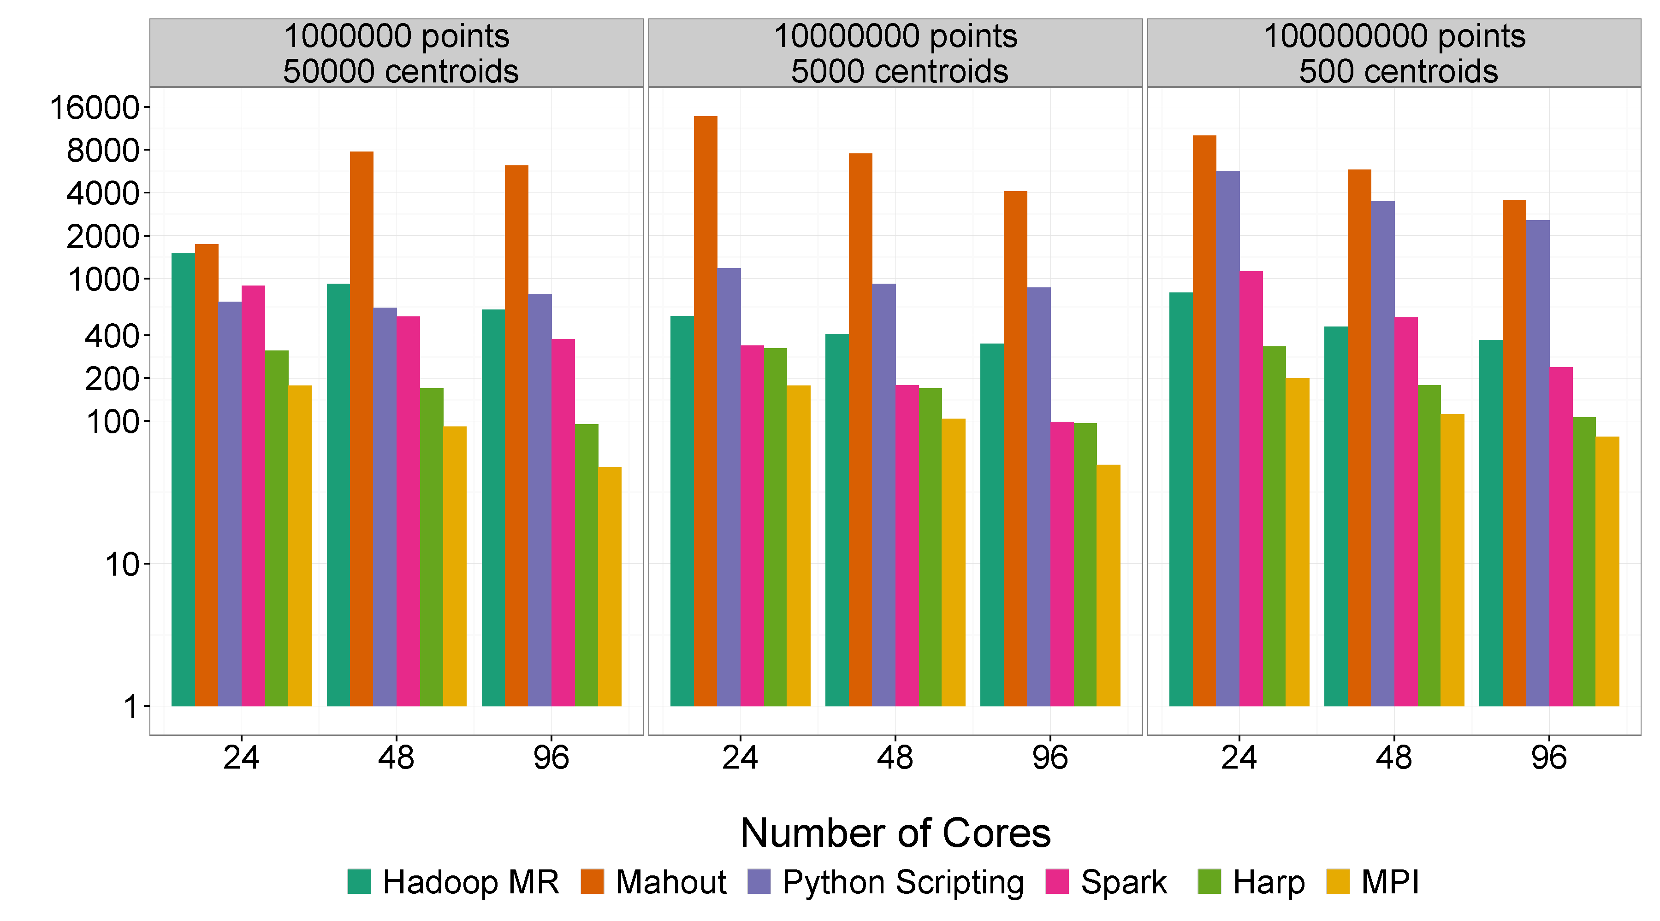
Mahout and Hadoop MR – Slow due to MapReduce
Python slow as Scripting
Spark Iterative MapReduce, non optimal communication
Harp Hadoop plug in with ~MPI collectives
MPI fastest as C not Java
Increasing Communication
Identical Computation

Slide 13
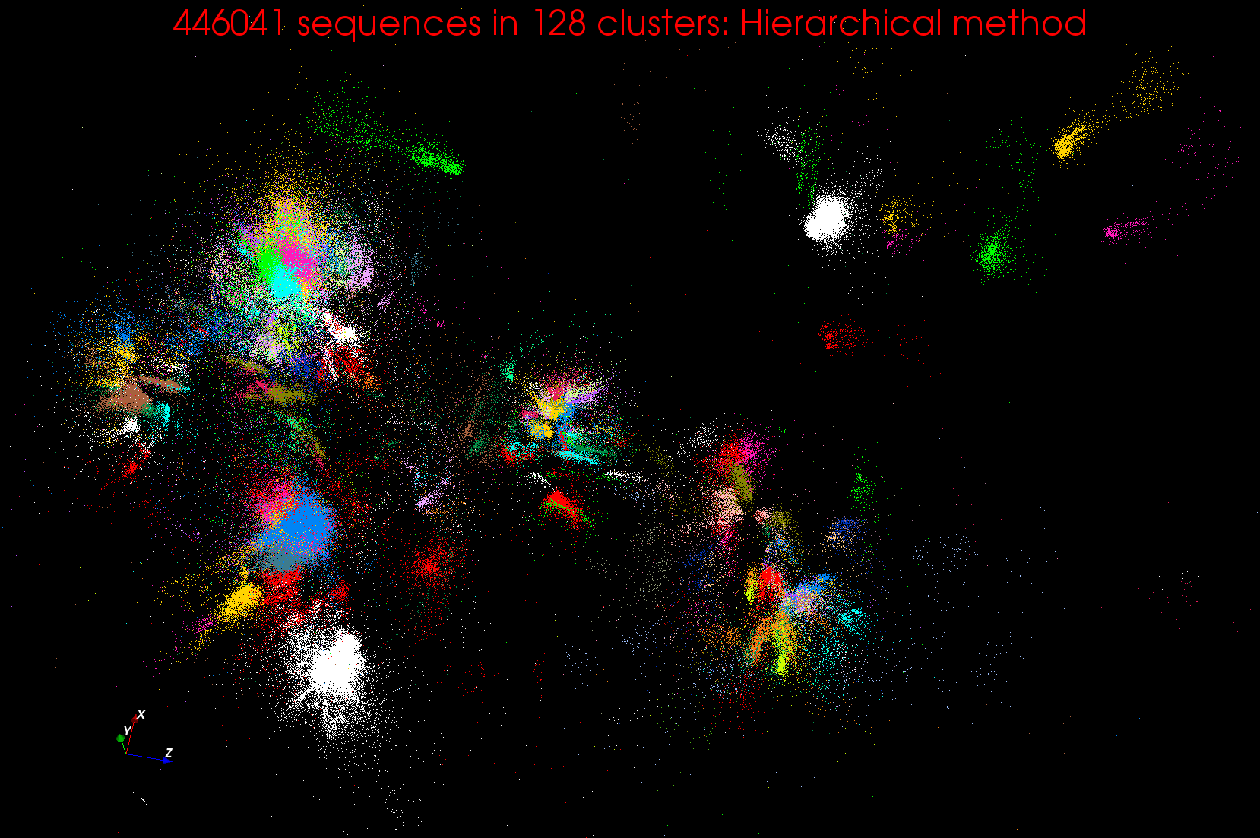
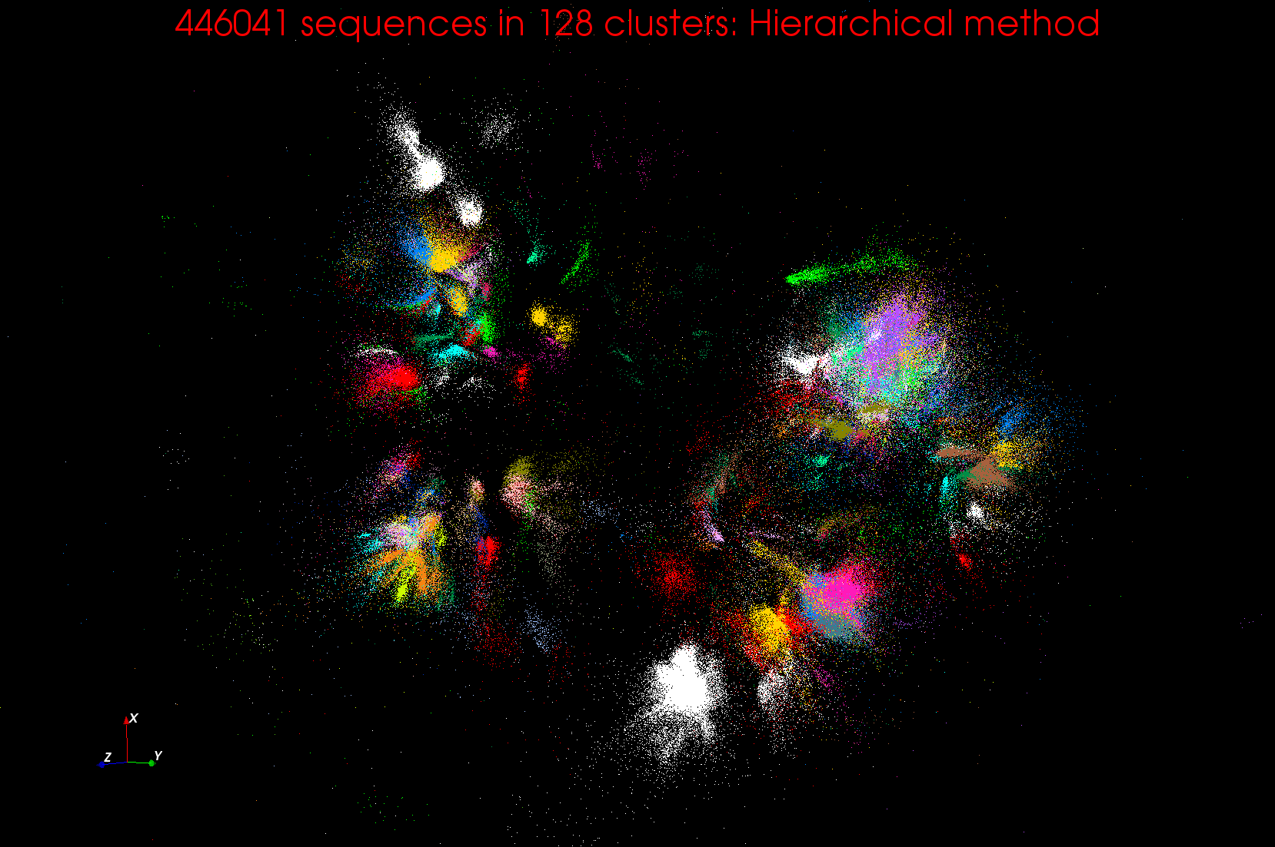
Clustering and MDS Large Scale O(N²) GML

Slide 14
WDA SMACOF MDS (Multidimensional Scaling) using Harp on Big Red 2
Parallel Efficiency: on 100-300K sequences
Conjugate Gradient (dominant time) and Matrix Multiplication

Slide 15
Features of Harp Hadoop Plugin
Hadoop Plugin (on Hadoop 1.2.1 and Hadoop 2.2.0)
Hierarchical data abstraction on arrays, key-values and graphs for easy programming expressiveness.
Collective communication model to support various communication operations on the data abstractions
Caching with buffer management for memory allocation required from computation and communication
BSP style parallelism
Fault tolerance with checkpointing

Slide 16
Building a Big Data Ecosystem that is broadly deployable

Slide 17
Using Lots of Services
To enable Big data processing, we need to support those processing data, those developing new tools and those managing big data infrastructure
Need Software, CPU’s, Storage, Networks delivered as Software-Defined Distributed System as a Service or SDDSaaS
  SDDSaaS integrates component services from lower levels of Kaleidoscope up to different Mahout or R components and the workflow services that integrate them
Given richness and rapid evolution of field, we need to enable easy use of the Kaleidoscope (and other) software.
Make a list of basic software services needed
Then define them as Puppet/Chef Puppies/recipes
Compose them with SDDSL Language (later)
Specify infrastructures
Administrators, developers run Cloudmesh to deploy on demand
Application users directly access Data Analytics as Software as a Service created by Cloudmesh

Slide 18
Software-Defined Distributed
System (SDDS) as a Service
FutureGrid uses
SDDS-aaS Tools
Provisioning
Image Management
IaaS Interoperability
NaaS, IaaS tools
Expt management
Dynamic IaaS NaaS
DevOps
CS Research Use e.g. test new compiler or storage model
Class Usages e.g. run GPU & multicore
Applications
Software
(Application
Or Usage) SaaS
CloudMesh is a SDDSaaS tool that uses Dynamic Provisioning and Image Management to provide custom environments for general target systems
Involves (1) creating,
(2) deploying, and
(3) provisioning
of one or more images in a set of machines on demand http://cloudmesh.futuregrid.org/
Cloud e.g. MapReduce
HPC e.g. PETSc, SAGA
Computer Science e.g. Compiler tools, Sensor nets, Monitors
Platform
PaaS
Infra
structure
IaaS
Software Defined Computing (virtual Clusters)
Hypervisor, Bare Metal
Operating System
Network
NaaS
Software Defined Networks
OpenFlow GENI

Slide 19
Maybe a Big Data Initiative would include
OpenStack
Slurm
Yarn
Hbase
MySQL
iRods
Memcached
Kafka
Harp
Hadoop, Giraph, Spark
Storm
Hive
Pig
Mahout – lots of different analytics
R -– lots of different analytics
Kepler, Pegasus, Airavata
Zookeeper
Ganglia, Nagios, Inca

Slide 20
CloudMesh Architecture
Cloudmesh is a SDDSaaS toolkit to support
  A software-defined distributed system encompassing virtualized and bare-metal infrastructure, networks, application, systems and platform software with a unifying goal of providing Computing as a Service.
  The creation of a tightly integrated mesh of services targeting multiple IaaS frameworks
  The ability to federate a number of resources from academia and industry. This includes existing FutureGrid infrastructure, Amazon Web Services, Azure, HP Cloud, Karlsruhe using several IaaS frameworks
  The creation of an environment in which it becomes easier to experiment with platforms and software services while assisting with their deployment.
  The exposure of information to guide the efficient utilization of resources. (Monitoring)
  Support reproducible computing environments
  IPython-based workflow as an interoperable onramp
Cloudmesh exposes both hypervisor-based and bare-metal provisioning to users and administrators
Access through command line, API, and Web interfaces.

Slide 21
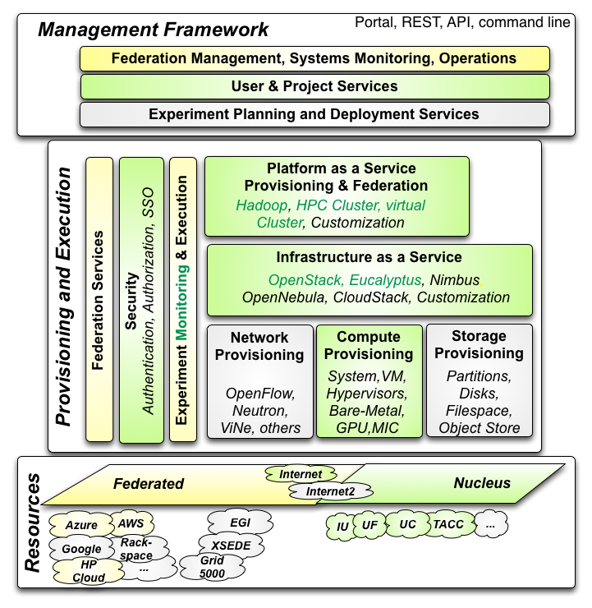

Cloudmesh Architecture
Cloudmesh Management Framework for monitoring and operations, user and project management, experiment planning and deployment of services needed by an experiment
Provisioning and execution environments to be deployed on resources to (or interfaced with) enable experiment management.
Resources.
FutureGrid, SDSC Comet, IU Juliet

Slide 22
Cloudmesh Functionality
Notes:
Due to its integrated services Cloudmesh provides the ability to be an onramp for other clouds.
It provides information services to various system level sensors to give access to sensor and utilization data. Internally, it can be used to optimize the system usage.
The provisioning experience from FutureGrid has taught us that we need to provide
the creation of new clouds (rain)
the repartitioning of resources between services (cloud shifting)
and the integration of external cloud resources in case of over provisioning (cloud bursting)
As we deal with many IaaS frameworks, we need an abstraction layer on top of the IaaS framework.
Experiment management is conducted with workflows controlled in shells, Python/iPython, as well as systems such as OpenStack's Heat.
Accounting is supported through additional services such as user management and charge rate management.
Not all features are yet implemented. Figure shows the main functionality that we target at this time to implement.

Slide 23
Building Blocks of Cloudmesh
Uses internally Libcloud and Cobbler
Celery Task/Query manager (AMQP - RabbitMQ)
MongoDB
Accesses via abstractions external systems/standards
OpenPBS, Chef
Openstack (including tools like Heat), AWS EC2, Eucalyptus, Azure
Xsede user management (Amie) via Futuregrid
Implementing Slurm, OCCI, Ansible, Puppet
Evaluating Razor, Juju, Xcat (Original Rain used this), Foreman

Slide 24
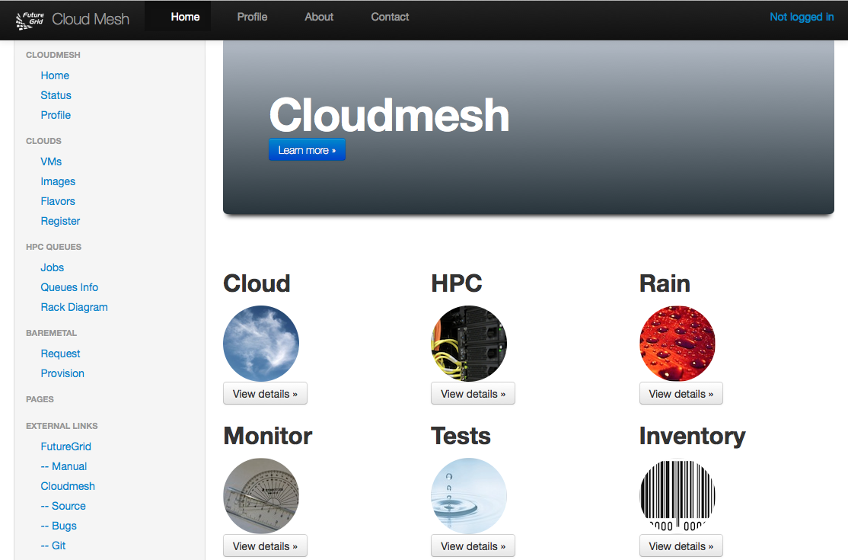
Cloudmesh User Interface
Notes:
A starting window allows to chose from the different functionality

Slide 25
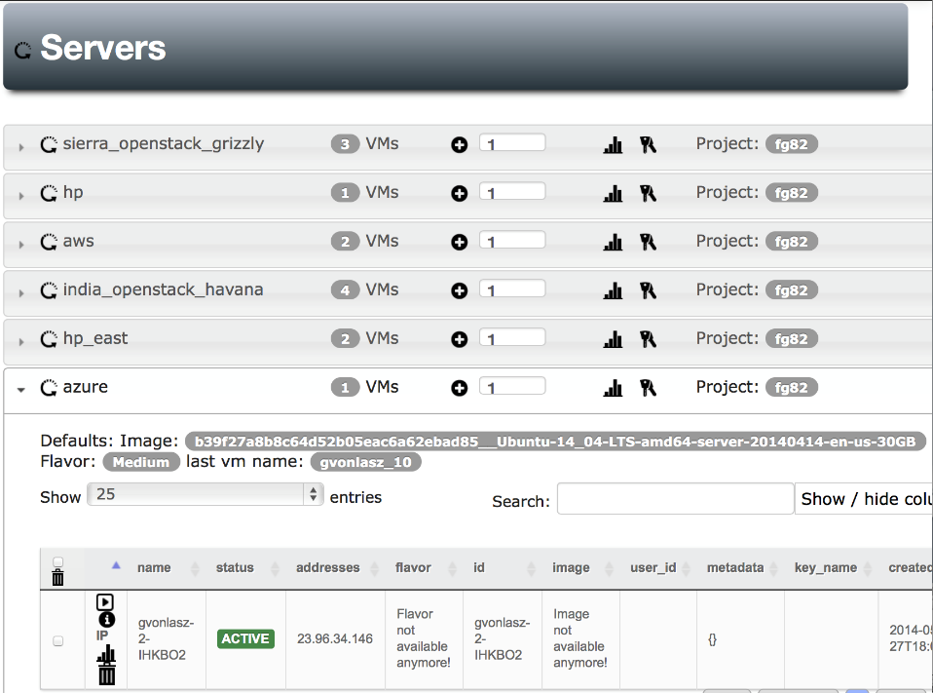
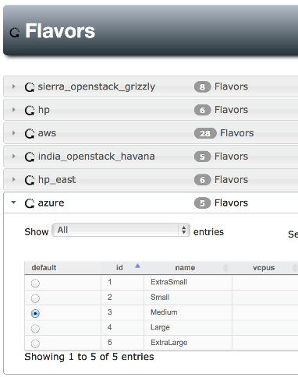
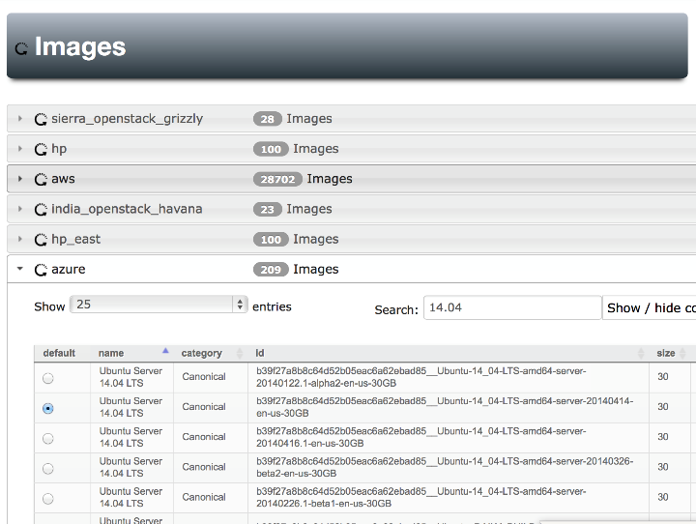
Notes:
Yes Azure is also there, Our gui can easily handle searching for images , we can set defaults for each cloud (images & flavors), pressing the + button will give us a new server with the specified defaults

Slide 26
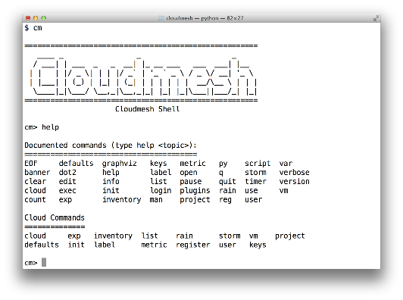
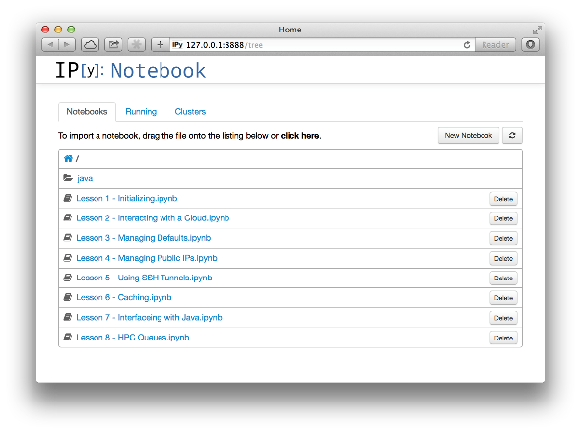
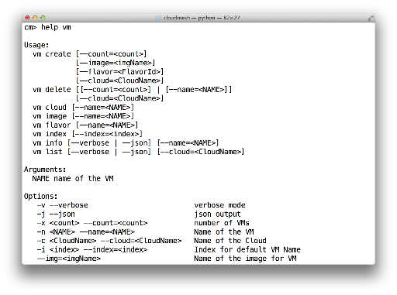
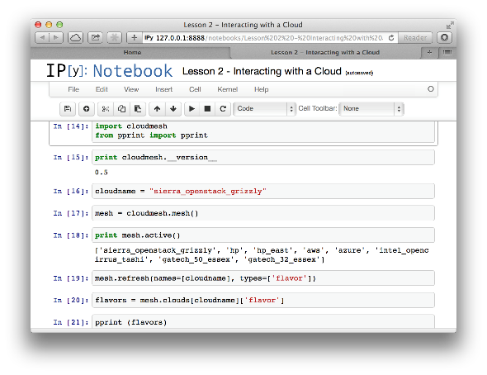
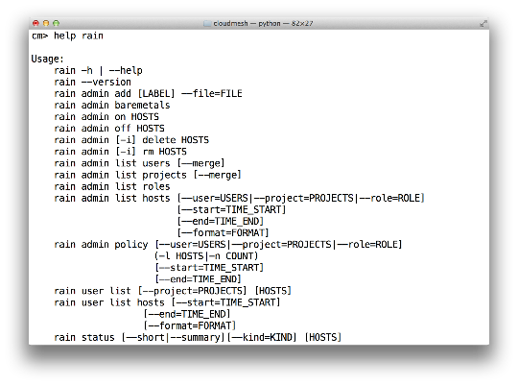
Cloudmesh Shell & bash & IPython
Notes:
Cloudmesh provides more than shell commands it has an integrated shell

Slide 27
SDDS Software Defined Distributed Systems
Cloudmesh builds infrastructure as SDDS consisting of one or more virtual clusters or slices with extensive built-in monitoring
These slices are instantiated on infrastructures with various owners
Controlled by roles/rules of Project, User, infrastructure
One needs general hypervisor and bare-metal slices to support FG research
The experiment management system is intended to integrates ISI Precip, FG Cloudmesh and tools latter invokes
Enables reproducibility in experiments.
User in Project
Request
Execution in Project
Python or REST API
Repository
SDDSL
Results
Request
SDDS
CMMon
CMPlan
User Roles
CMExec
Infrastructure (Cluster, Storage, Network, CPS)
Select
Plan
Requested SDDS as federated Virtual Infrastructures
CMProv
#1Virtual infra.
Instance Type
Current State
Management Structure
Provisioning Rules
Usage Rules (depends on user roles)
Linux
Image and Template Library
#2 Virtual infra.
#3Virtual infra.
Windows
Linux
#4 Virtual infra.
User role and infrastructure rule dependent security checks
Mac OS X

Slide 28
What is SDDSL?
There is an OASIS standard activity TOSCA (Topology and Orchestration Specification for Cloud Applications)
But this is similar to mash-ups or workflow (Taverna, Kepler, Pegasus, Swift ..) and we know that workflow itself is very successful but workflow standards are not
  OASIS WS-BPEL (Business Process Execution Language) didn’t catch on
As basic tools (Cloudmesh) use Python and Python is a popular scripting language for workflow, we suggest that Python is SDDSL
  IPython Notebooks are natural log of execution provenance

Slide 29
Cloudmesh as an On-Ramp
As an On-Ramp, CloudMesh deploys recipes on multiple platforms so you can test in one place and do production on others
Its multi-host support implies it is effective at distributed systems
It will support traditional workflow functions such as
  Specification of an execution dataflow
  Customization of Recipe
  Specification of program parameters
Workflow quite well explored in Python https://wiki.openstack.org/wiki/NovaOrchestration/WorkflowEngines
IPython notebook preserves provenance of activity

Slide 30
CloudMesh Administrative View of SDDS aaS
CM-BMPaaS (Bare Metal Provisioning aaS) is a systems view and allows Cloudmesh to dynamically generate anything and assign it as permitted by user role and resource policy
  FutureGrid machines India, Bravo, Delta, Sierra, Foxtrot are like this
  Note this only implies user level bare metal access if given user is authorized and this is done on a per machine basis
  It does imply dynamic retargeting of nodes to typically safe modes of operation (approved machine images) such as switching back and forth between OpenStack, OpenNebula, HPC on Bare metal, Hadoop etc.
CM-HPaaS (Hypervisor based Provisioning aaS) allows Cloudmesh to generate "anything" on the hypervisor allowed for a particular user
  Platform determined by images available to user
  Amazon, Azure, HPCloud, Google Compute Engine
CM-PaaS (Platform as a Service) makes available an essentially fixed Platform with configuration differences
  XSEDE with MPI HPC nodes could be like this as is Google App Engine and Amazon HPC Cluster. Echo at IU (ScaleMP) is like this
  In such a case a system administrator can statically change base system but the dynamic provisioner cannot

Slide 31
CloudMesh User View of SDDS aaS
Note we always consider virtual clusters or slices with nodes that may or may not have hypervisors
BM-IaaS: Bare Metal (root access) Infrastructure as a service with variants e.g. can change firmware or not
H-IaaS: Hypervisor based Infrastructure (Machine) as a Service. User provided a collection of hypervisors to build system on.
  Classic Commercial cloud view
PSaaS Physical or Platformed System as a Service where user provided a configured image on either Bare Metal or a Hypervisor
  User could request a deployment of Apache Storm and Kafka to control a set of devices (e.g. smartphones)

Slide 32
Cloudmesh Infrastructure Types
Nucleus Infrastructure:
  Persistent Cloudmesh Infrastructure with defined provisioning rules and characteristics and managed by CloudMesh
Federated Infrastructure:
  Outside infrastructure that can be used by special arrangement such as commercial clouds or XSEDE
  Typically persistent and often batch scheduled
  CloudMesh can use within prescribed provisioning rules and users restricted to those with permitted access; interoperable templates allow common images to nucleus
Contributed Infrastructure
  Outside contributions to a particular Cloudmesh project managed by Cloudmesh in this project
  Typically strong user role restrictions – users must belong to a particular project
  Can implement a Planetlab like environment by contributing hardware that can be generally used with bare-metal provisioning

Slide 33
NIST Big Data Use Cases
Chaitin Baru, Bob Marcus, Wo Chang co-leaders

Slide 34

Use Case Template
26 fields completed for 51 areas
Government Operation: 4
Commercial: 8
Defense: 3
Healthcare and Life Sciences: 10
Deep Learning and Social Media: 6
The Ecosystem for Research: 4
Astronomy and Physics: 5
Earth, Environmental and Polar Science: 10
Energy: 1

Slide 35
51 Detailed Use Cases: Contributed July-September 2013
Covers goals, data features such as 3 V’s, software, hardware
26 Features for each use case
Biased to science
http://bigdatawg.nist.gov/usecases.php
https://bigdatacoursespring2014.appspot.com/course (Section 5)
Government Operation(4): National Archives and Records Administration, Census Bureau
Commercial(8): Finance in Cloud, Cloud Backup, Mendeley (Citations), Netflix, Web Search, Digital Materials, Cargo shipping (as in UPS)
Defense(3): Sensors, Image surveillance, Situation Assessment
Healthcare and Life Sciences(10): Medical records, Graph and Probabilistic analysis, Pathology, Bioimaging, Genomics, Epidemiology, People Activity models, Biodiversity
Deep Learning and Social Media(6): Driving Car, Geolocate images/cameras, Twitter, Crowd Sourcing, Network Science, NIST benchmark datasets
The Ecosystem for Research(4): Metadata, Collaboration, Language Translation, Light source experiments
Astronomy and Physics(5): Sky Surveys including comparison to simulation, Large Hadron Collider at CERN, Belle Accelerator II in Japan
Earth, Environmental and Polar Science(10): Radar Scattering in Atmosphere, Earthquake, Ocean, Earth Observation, Ice sheet Radar scattering, Earth radar mapping, Climate simulation datasets, Atmospheric turbulence identification, Subsurface Biogeochemistry (microbes to watersheds), AmeriFlux and FLUXNET gas sensors
Energy(1): Smart grid

Slide 36
Big Data Patterns – the Ogres
What services are needed?

Slide 37
Would like to capture “essence of these use cases”
“small” kernels, mini-apps
Or Classify applications into patterns
Do it from HPC background not database viewpoint
e.g. focus on cases with detailed analytics
Section 5 of my class https://bigdatacoursespring2014.appspot.com/preview classifies 51 use cases with ogre facets

Slide 38
What are “mini-Applications”
Use for benchmarks of computers and software (is my parallel compiler any good?)
In parallel computing, this is well established
  Linpack for measuring performance to rank machines in Top500 (changing?)
  NAS Parallel Benchmarks (originally a pencil and paper specification to allow optimal implementations; then MPI library)
  Other specialized Benchmark sets keep changing and used to guide procurements
    Last 2 NSF hardware solicitations had NO preset benchmarks – perhaps as no agreement on key applications for clouds and data intensive applications
  Berkeley dwarfs capture different structures that any approach to parallel computing must address
  Templates used to capture parallel computing patterns
Also database benchmarks like TPC

Slide 39
HPC Benchmark Classics
Linpack or HPL: Parallel LU factorization for solution of linear equations
NPB version 1: Mainly classic HPC solver kernels
  MG: Multigrid
  CG: Conjugate Gradient
  FT: Fast Fourier Transform
  IS: Integer sort
  EP: Embarrassingly Parallel
  BT: Block Tridiagonal
  SP: Scalar Pentadiagonal
  LU: Lower-Upper symmetric Gauss Seidel

Slide 40
13 Berkeley Dwarfs
Dense Linear Algebra
Sparse Linear Algebra
Spectral Methods
N-Body Methods
Structured Grids
Unstructured Grids
MapReduce
Combinational Logic
Graph Traversal
Dynamic Programming
Backtrack and Branch-and-Bound
Graphical Models
Finite State Machines
First 6 of these correspond to Colella’s original.
Monte Carlo dropped.
N-body methods are a subset of Particle in Colella.
Note a little inconsistent in that MapReduce is a programming model and spectral method is a numerical method.
Need multiple facets!

Slide 41
51 Use Cases: What is Parallelism Over?
People: either the users (but see below) or subjects of application and often both
Decision makers like researchers or doctors (users of application)
Items such as Images, EMR, Sequences below; observations or contents of online store
  Images or “Electronic Information nuggets”
  EMR: Electronic Medical Records (often similar to people parallelism)
  Protein or Gene Sequences;
  Material properties, Manufactured Object specifications, etc., in custom dataset
  Modelled entities like vehicles and people
Sensors – Internet of Things
Events such as detected anomalies in telescope or credit card data or atmosphere
(Complex) Nodes in RDF Graph
Simple nodes as in a learning network
Tweets, Blogs, Documents, Web Pages, etc.
  And characters/words in them
Files or data to be backed up, moved or assigned metadata
Particles/cells/mesh points as in parallel simulations

Slide 42
51 Use Cases: Low-Level (Run-time) Computational Types
PP(26): Pleasingly Parallel or Map Only
MR(18 +7 MRStat): Classic MapReduce
MRStat(7): Simple version of MR where key computations are simple reduction as coming in statistical averages
MRIter(23): Iterative MapReduce
Graph(9): complex graph data structure needed in analysis
Fusion(11): Integrate diverse data to aid discovery/decision making; could involve sophisticated algorithms or could just be a portal
Streaming(41): some data comes in incrementally and is processed this way
(Count) out of 51

Slide 43
51 Use Cases: Higher-Level Computational Types or Features
Classification(30): divide data into categories
S/Q/Index(12): Search and Query
CF(4): Collaborative Filtering
Local ML(36): Local Machine Learning
Global ML(23): Deep Learning, Clustering, LDA, PLSI, MDS, Large Scale Optimizations as in Variational Bayes, Lifted Belief Propagation, Stochastic Gradient Descent, L-BFGS, Levenberg-Marquardt (Sometimes call EGO or Exascale Global Optimization)
Workflow: (Left out of analysis but very common)
GIS(16): Geotagged data and often displayed in ESRI, Microsoft Virtual Earth, Google Earth, GeoServer etc.
HPC(5): Classic large-scale simulation of cosmos, materials, etc. generates big data
Agent(2): Simulations of models of data-defined macroscopic entities represented as agents
Not Independent

Slide 44
Global Machine Learning aka EGO – Exascale Global Optimization
Typically maximum likelihood or χ² with a sum over the N data items – documents, sequences, items to be sold, images etc. and often links (point-pairs). Usually it’s a sum of positive number as in least squares
Covering clustering/community detection, mixture models, topic determination, Multidimensional scaling, (Deep) Learning Networks
PageRank is “just” parallel linear algebra
Note many Mahout algorithms are sequential – partly as MapReduce limited; partly because parallelism unclear
  MLLib (Spark based) better
SVM and Hidden Markov Models do not use large scale parallelization in practice?
Detailed papers on particular parallel graph algorithms

Slide 45
One example:
Image based Applications

Slide 46
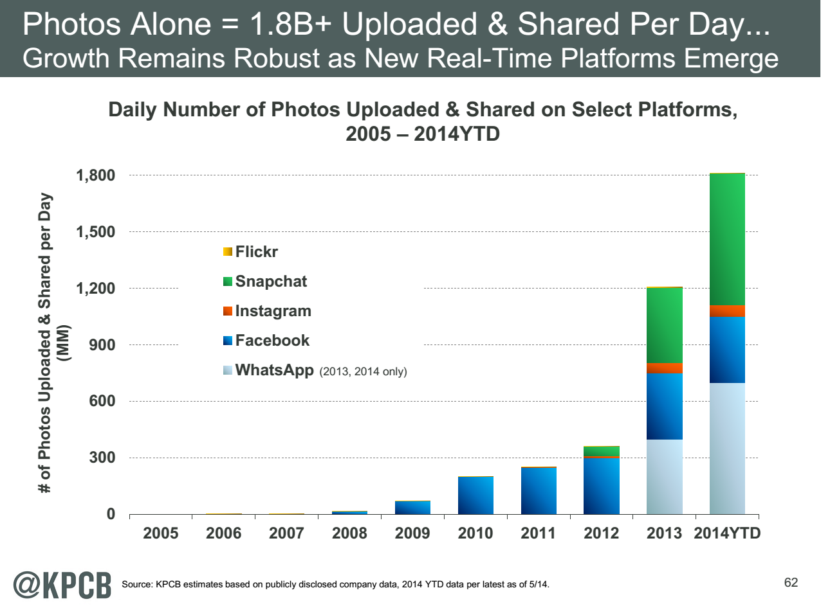
http://www.kpcb.com/internet-trends

Slide 47
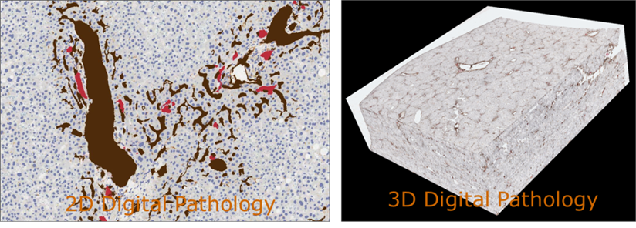
17:Pathology Imaging/ Digital Pathology I
Healthcare
Life Sciences
Application: Digital pathology imaging is an emerging field where examination of high resolution images of tissue specimens enables novel and more effective ways for disease diagnosis. Pathology image analysis segments massive (millions per image) spatial objects such as nuclei and blood vessels, represented with their boundaries, along with many extracted image features from these objects. The derived information is used for many complex queries and analytics to support biomedical research and clinical diagnosis.
MR, MRIter, PP, Classification
Streaming
Parallelism over Images

Slide 48
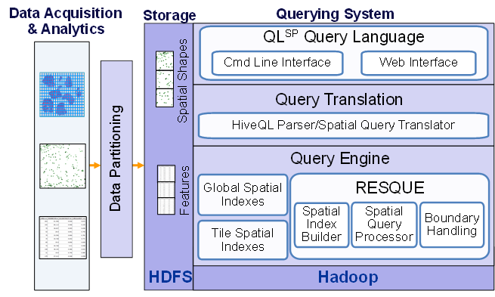
17:Pathology Imaging/ Digital Pathology II
Healthcare
Life Sciences
Current Approach: 1GB raw image data + 1.5GB analytical results per 2D image. MPI for image analysis; MapReduce + Hive with spatial extension on supercomputers and clouds. GPU’s used effectively. Figure below shows the architecture of Hadoop-GIS, a spatial data warehousing system over MapReduce to support spatial analytics for analytical pathology imaging.
Futures: Recently, 3D pathology imaging is made possible through 3D laser technologies or serially sectioning hundreds of tissue sections onto slides and scanning them into digital images. Segmenting 3D microanatomic objects from registered serial images could produce tens of millions of 3D objects from a single image. This provides a deep “map” of human tissues for next generation diagnosis. 1TB raw image data + 1TB analytical results per 3D image and 1PB data per moderated hospital per year.
Architecture of Hadoop-GIS, a spatial data warehousing system over MapReduce to support spatial analytics for analytical pathology imaging
Parallelism over images or over pixels within image (especially for GPU)

Slide 49
18: Computational Bioimaging
Healthcare
Life Sciences
Application: Data delivered from bioimaging is increasingly automated, higher resolution, and multi-modal. This has created a data analysis bottleneck that, if resolved, can advance the biosciences discovery through Big Data techniques.
Current Approach: The current piecemeal analysis approach does not scale to situation where a single scan on emerging machines is 32 TB and medical diagnostic imaging is annually around 70 PB even excluding cardiology. One needs a web-based one-stop-shop for high performance, high throughput image processing for producers and consumers of models built on bio-imaging data.
Futures: Goal is to solve that bottleneck with extreme scale computing with community-focused science gateways to support the application of massive data analysis toward massive imaging data sets. Workflow components include data acquisition, storage, enhancement, minimizing noise, segmentation of regions of interest, crowd-based selection and extraction of features, and object classification, organization, and search. Use ImageJ, OMERO, VolRover, advanced segmentation and feature detection software.
Largely Local Machine Learning and Pleasingly Parallel

Slide 50
26: Large-scale Deep Learning
Deep Learning
Social Networking
Application: Large models (e.g., neural networks with more neurons and connections) combined with large datasets are increasingly the top performers in benchmark tasks for vision, speech, and Natural Language Processing. One needs to train a deep neural network from a large (>>1TB) corpus of data (typically imagery, video, audio, or text). Such training procedures often require customization of the neural network architecture, learning criteria, and dataset pre-processing. In addition to the computational expense demanded by the learning algorithms, the need for rapid prototyping and ease of development is extremely high.
Current Approach: The largest applications so far are to image recognition and scientific studies of unsupervised learning with 10 million images and up to 11 billion parameters on a 64 GPU HPC Infiniband cluster. Both supervised (using existing classified images) and unsupervised applications
Futures: Large datasets of 100TB or more may be necessary in order to exploit the representational power of the larger models. Training a self-driving car could take 100 million images at megapixel resolution. Deep Learning shares many characteristics with the broader field of machine learning. The paramount requirements are high computational throughput for mostly dense linear algebra operations, and extremely high productivity for researcher exploration. One needs integration of high performance libraries with high level (python) prototyping environments
Classified OUT
IN
MRIter,EGO Classification
Parallelism over Nodes in NN, Data being classified
Global Machine Learning but Stochastic Gradient Descent only use small fraction of total images (100’s) at each iteration so parallelism over images not clearly useful

Slide 51
27: Organizing large-scale, unstructured collections of consumer photos I
Application: Produce 3D reconstructions of scenes using collections of millions to billions of consumer images, where neither the scene structure nor the camera positions are known a priori. Use resulting 3D models to allow efficient browsing of large-scale photo collections by geographic position. Geolocate new images by matching to 3D models. Perform object recognition on each image. 3D reconstruction posed as a robust non-linear least squares optimization problem where observed relations between images are constraints and unknowns are 6-D camera pose of each image and 3D position of each point in the scene.
Current Approach: Hadoop cluster with 480 cores processing data of initial applications. Note over 500 billion images (too small) on Facebook and over 5 billion on Flickr with over 1800 (was 500 a year ago) million images added to social media sites each day.
Deep Learning
Social Networking
Global Machine Learning after Initial Local steps

Slide 52
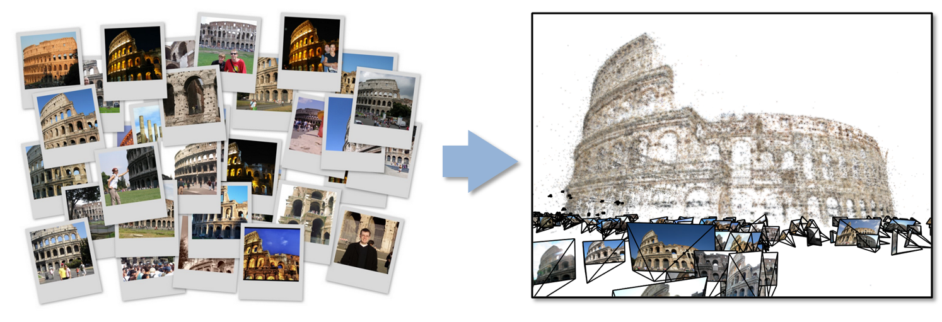
27: Organizing large-scale, unstructured collections of consumer photos II
Futures: Need many analytics, including feature extraction, feature matching, and large-scale probabilistic inference, which appear in many or most computer vision and image processing problems, including recognition, stereo resolution, and image denoising. Need to visualize large-scale 3D reconstructions, and navigate large-scale collections of images that have been aligned to maps.
Deep Learning
Social Networking
Global Machine Learning after Initial Local ML pleasingly parallel steps

Slide 53
36: Catalina Real-Time Transient Survey (CRTS): a digital, panoramic, synoptic sky survey I
Astronomy & Physics
Application: The survey explores the variable universe in the visible light regime, on time scales ranging from minutes to years, by searching for variable and transient sources. It discovers a broad variety of astrophysical objects and phenomena, including various types of cosmic explosions (e.g., Supernovae), variable stars, phenomena associated with accretion to massive black holes (active galactic nuclei) and their relativistic jets, high proper motion stars, etc. The data are collected from 3 telescopes (2 in Arizona and 1 in Australia), with additional ones expected in the near future (in Chile).
Current Approach: The survey generates up to ~ 0.1 TB on a clear night with a total of ~100 TB in current data holdings. The data are preprocessed at the telescope, and transferred to Univ. of Arizona and Caltech, for further analysis, distribution, and archiving. The data are processed in real time, and detected transient events are published electronically through a variety of dissemination mechanisms, with no proprietary withholding period (CRTS has a completely open data policy). Further data analysis includes classification of the detected transient events, additional observations using other telescopes, scientific interpretation, and publishing. In this process, it makes a heavy use of the archival data (several PB’s) from a wide variety of geographically distributed resources connected through the Virtual Observatory (VO) framework.
PP, ML, Classification
Streaming, workflow
Parallelism over Images and Events: Celestial events identified in Telescope Images

Slide 54
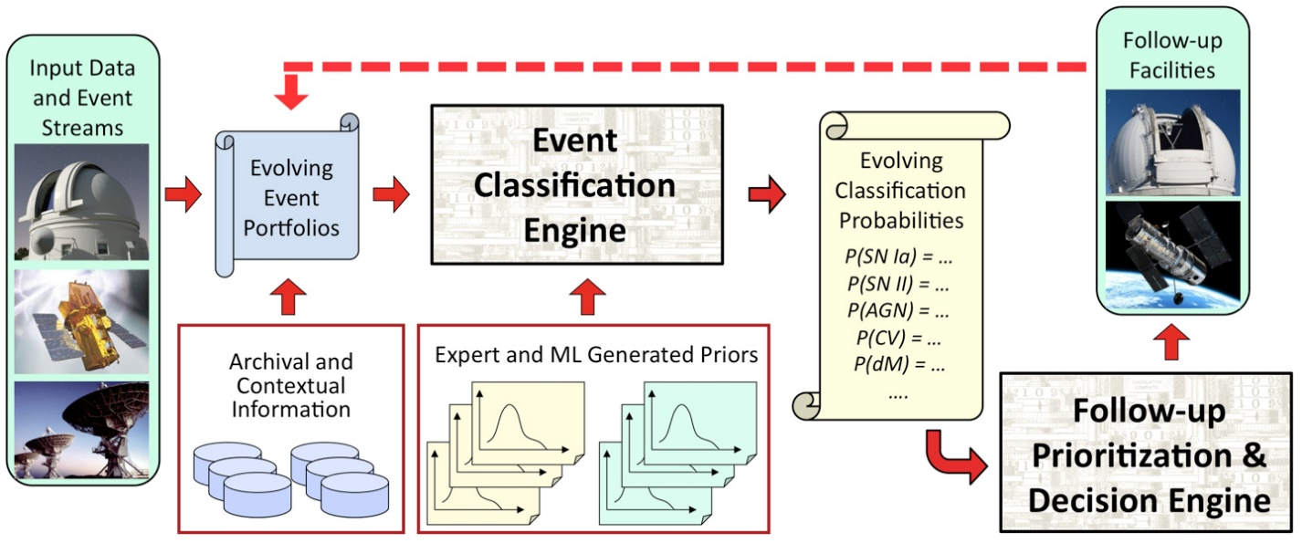
36: Catalina Real-Time Transient Survey (CRTS): a digital, panoramic, synoptic sky survey II
Astronomy & Physics
Futures: CRTS is a scientific and methodological testbed and precursor of larger surveys to come, notably the Large Synoptic Survey Telescope (LSST), expected to operate in 2020’s and selected as the highest-priority ground-based instrument in the 2010 Astronomy and Astrophysics Decadal Survey. LSST will gather about 30 TB per night.

Slide 55
43: Radar Data Analysis for CReSIS Remote Sensing of Ice Sheets IV
Earth, Environmental and Polar Science
Typical CReSIS echogram with Detected Boundaries. The upper (green) boundary is between air and ice layer while the lower (red) boundary is between ice and terrain
PP, GIS
Streaming
Parallelism over Radar Images

Slide 56
44: UAVSAR Data Processing, Data Product Delivery, and Data Services II
Earth, Environmental and Polar Science
Combined unwrapped coseismic interferograms for flight lines 26501, 26505, and 08508 for the October 2009 – April 2010 time period. End points where slip can be seen on the Imperial, Superstition Hills, and Elmore Ranch faults are noted. GPS stations are marked by dots and are labeled.
PP, GIS
Streaming
Parallelism over Radar Images

Slide 57
Other Facets of the Ogres

Slide 58
Application Class Facet of Ogres
Classification (30) divide data into categories
Search Index and query (12)
Maximum Likelihood or χ² minimizations
Expectation Maximization (often Steepest descent)
Local (pleasingly parallel) Machine Learning (36) contrasted to
(Exascale) Global Optimization (23) (such as Learning Networks, Variational Bayes and Gibbs Sampling)
Do they Use Agents (2) as in epidemiology (swarm approaches)?
Higher-Level Computational Types or Features in earlier slide also has
CF(4): Collaborative Filtering in Core Analytics Facet
and two categories in data source and style
GIS(16): Geotagged data and often displayed in ESRI, Microsoft Virtual Earth, Google Earth, GeoServer etc.
HPC(5): Classic large-scale simulation of cosmos, materials, etc. generates big data

Slide 59
Problem Architecture Facet of Ogres (Meta or MacroPattern)
Pleasingly Parallel – as in BLAST, Protein docking, some (bio-)imagery including Local Analytics or Machine Learning – ML or filtering pleasingly parallel, as in bio-imagery, radar images (pleasingly parallel but sophisticated local analytics)
Classic MapReduce for Search and Query
Global Analytics or Machine Learning requiring iterative programming models
Problem set up as a graph as opposed to vector, grid
SPMD (Single Program Multiple Data)
Bulk Synchronous Processing: well-defined compute-communication phases
Fusion: Knowledge discovery often involves fusion of multiple methods.
Workflow (often used in fusion)
Note problem and machine architectures are related
Slight expansion of an earlier slides on:
Major Analytics Architectures in Use Cases
Pleasingly parallel (Map-Only)
Search (MapReduce)
Map-Collective
Map-Communication as in MPI
Shared Memory
Low-Level (Run-time) Computational Types used to label 51 use cases
PP(26): Pleasingly Parallel
MR(18 +7 MRStat): Classic MapReduce
MRStat(7)
MRIter(23)
Graph(9)
Fusion(11)
Streaming(41) In data source
Notes:
Big dwarfs are Ogres
Implement Ogres in ABDS+

Slide 60
4 Forms of MapReduce
(a) Map Only
(b) Classic MapReduce
(c) Iterative Map Reduce or Map-Collective
(d) Point to Point
Input
Input
Iterations
Input
map
map
map
P_{ij}
reduce
reduce
Output
BLAST Analysis
Local Machine Learning
Pleasingly Parallel
High Energy Physics (HEP) Histograms
Distributed search
Expectation maximization Clustering e.g. K-means
Linear Algebra, PageRank
Classic MPI
PDE Solvers and particle dynamics
Domain of MapReduce and Iterative Extensions
MPI
Giraph
All of them are Map-Communication?

Slide 61
One Facet of Ogres has Computational Features
Flops per byte;
Communication Interconnect requirements;
Is application (graph) constant or dynamic?
Most applications consist of a set of interconnected entities; is this regular as a set of pixels or is it a complicated irregular graph?
Is communication BSP or Asynchronous? In latter case shared memory may be attractive;
Are algorithms Iterative or not?
Data Abstraction: key-value, pixel, graph, vector
  Are data points in metric or non-metric spaces?
Core libraries needed: matrix-matrix/vector algebra, conjugate gradient, reduction, broadcast

Slide 62
Data Source and Style Facet of Ogres
(i) SQL
(ii) NOSQL based
(iii) Other Enterprise data systems (10 examples from Bob Marcus)
(iv) Set of Files (as managed in iRODS)
(v) Internet of Things
(vi) Streaming and
(vii) HPC simulations
(viii) Involve GIS (Geographical Information Systems)
Before data gets to compute system, there is often an initial data gathering phase which is characterized by a block size and timing. Block size varies from month (Remote Sensing, Seismic) to day (genomic) to seconds or lower (Real time control, streaming)
There are storage/compute system styles: Shared, Dedicated, Permanent, Transient
Other characteristics are needed for permanent auxiliary/comparison datasets and these could be interdisciplinary, implying nontrivial data movement/replication
Notes:
Big dwarfs are Ogres
Implement Ogres in ABDS+

Slide 63
Analytics Facet (kernels) of the Ogres

Slide 64
Core Analytics Facet of Ogres (microPattern) I
Map-Only
Pleasingly parallel - Local Machine Learning
MapReduce: Search/Query
Summarizing statistics as in LHC Data analysis (histograms)
Recommender Systems (Collaborative Filtering)
Linear Classifiers (Bayes, Random Forests)
Global Analytics
Nonlinear Solvers (structure depends on objective function)
  Stochastic Gradient Descent SGD
  (L-)BFGS approximation to Newton’s Method
  Levenberg-Marquardt solver
Map-Collective I (need to improve/extend Mahout, MLlib)
Outlier Detection, Clustering (many methods),
Mixture Models, LDA (Latent Dirichlet Allocation), PLSI (Probabilistic Latent Semantic Indexing)

Slide 65
Core Analytics Facet of Ogres (microPattern) II
Map-Collective II
Use matrix-matrix,-vector operations, solvers (conjugate gradient)
SVM and Logistic Regression
PageRank, (find leading eigenvector of sparse matrix)
SVD (Singular Value Decomposition)
MDS (Multidimensional Scaling)
Learning Neural Networks (Deep Learning)
Hidden Markov Models
Map-Communication
Graph Structure (Communities, subgraphs/motifs, diameter, maximal cliques, connected components)
Network Dynamics - Graph simulation Algorithms (epidemiology)
Asynchronous Shared Memory
Graph Structure (Betweenness centrality, shortest path)

Slide 66
Lessons / Insights
Integrate (don’t compete) HPC with “Commodity Big data” (Google to Amazon to Enterprise Data Analytics)
  i.e. improve Mahout; don’t compete with it
  Use Hadoop plug-ins rather than replacing Hadoop
Enhanced Apache Big Data Stack HPC-ABDS has ~120 members
Opportunities at Resource management, Data/File, Streaming, Programming, monitoring, workflow layers for HPC and ABDS integration
Need to capture as services – developing a HPC-Cloud interoperability environment
Data intensive algorithms do not have the well developed high performance libraries familiar from HPC
  Need to develop needed services at all levels of stack from users of Mahout to those developing better run time and programming environments

