Slide 1
Cloud Services for Big Data Analytics
June 27 2014
Second International Workshop on Service and Cloud Based Data Integration (SCDI 2014)
Anchorage AK
Geoffrey Fox
gcf@indiana.edu
http://www.infomall.org
School of Informatics and Computing
Digital Science Center
Indiana University Bloomington

Slide 2
Abstract
We present a software model built on the Apache software stack (ABDS) that is well used in modern cloud computing, which we enhance with HPC concepts to derive HPC-ABDS.
  We discuss layers in this stack
  We give examples of integrating ABDS with HPC
We discuss how to implement this in a world of multiple infrastructures and evolving software environments for users, developers and administrators
We present Cloudmesh as supporting Software-Defined Distributed System as a Service or SDDSaaS with multiple services on multiple clouds/HPC systems.
  We explain the functionality of Cloudmesh as well as the 3 administrator and 3 user modes supported

Slide 3
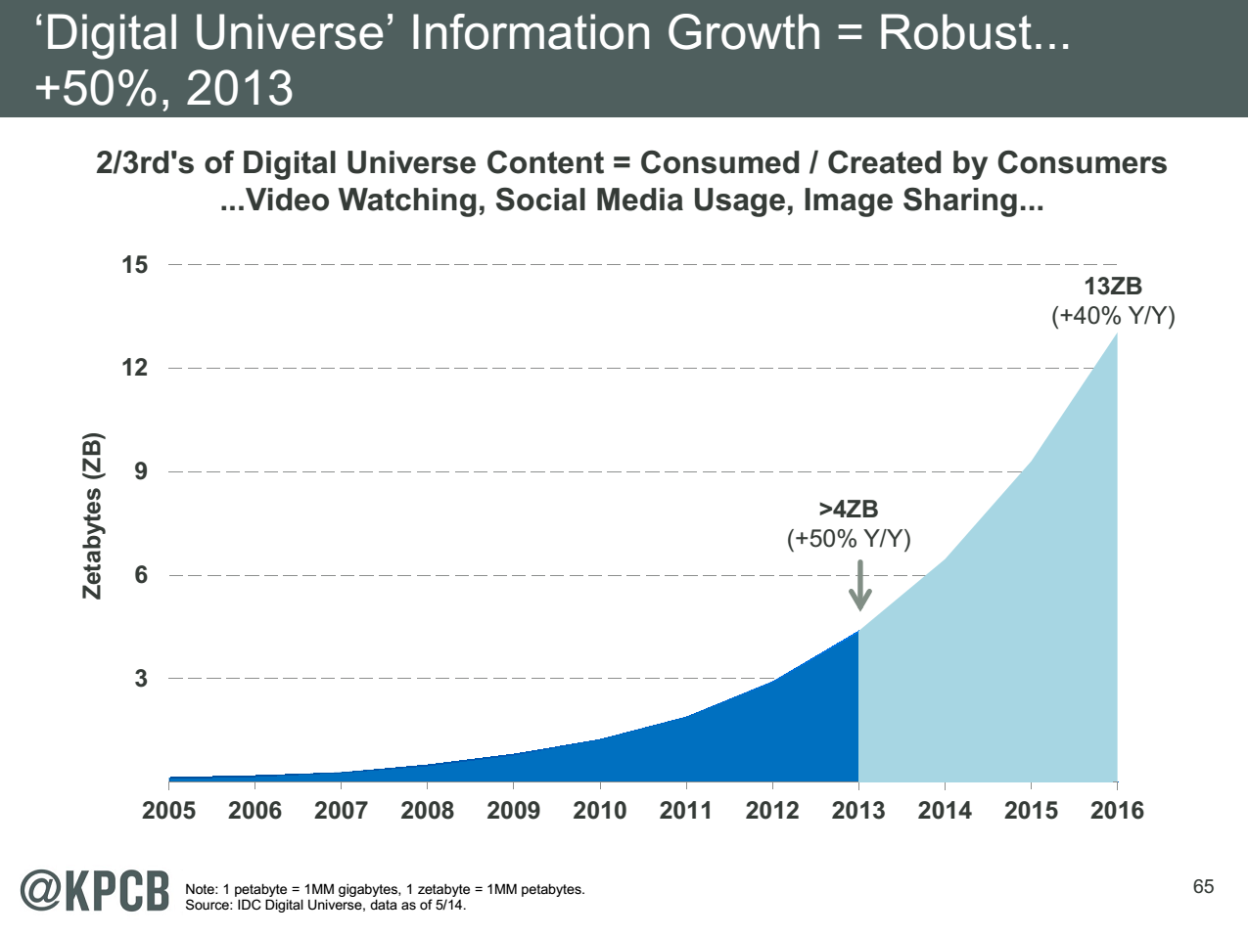
Note largest science ~100 petabytes = 0.000025 total
http://www.kpcb.com/internet-trends

Slide 4
HPC-ABDS
Integrating High Performance Computing with Apache Big Data Stack
Shantenu Jha, Judy Qiu, Andre Luckow

Slide 5
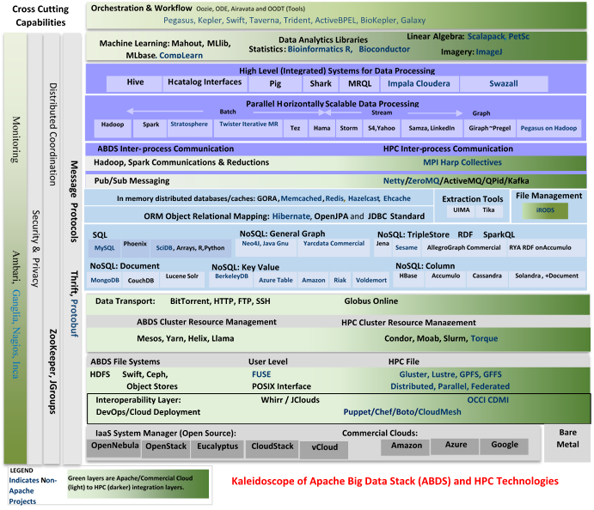

Slide 6
HPC-ABDS
~120 Capabilities
>40 Apache
Green layers have strong HPC Integration opportunities
Goal
Functionality of ABDS
Performance of HPC

Slide 7
Broad Layers in HPC-ABDS
Workflow-Orchestration
Application and Analytics: Mahout, MLlib, R…
High level Programming
Basic Programming model and runtime
  SPMD, Streaming, MapReduce, MPI
Inter process communication
  Collectives, point-to-point, publish-subscribe
In-memory databases/caches
Object-relational mapping
SQL and NoSQL, File management
Data Transport
Cluster Resource Management (Yarn, Slurm, SGE)
File systems(HDFS, Lustre …)
DevOps (Puppet, Chef …)
IaaS Management from HPC to hypervisors (OpenStack)
Cross Cutting
  Message Protocols
  Distributed Coordination
  Security & Privacy
  Monitoring

Slide 8
Useful Set of Analytics Architectures
Pleasingly Parallel: including local machine learning as in parallel over images and apply image processing to each image
- Hadoop could be used but many other HTC, Many task tools
Search: including collaborative filtering and motif finding implemented using classic MapReduce (Hadoop)
Map-Collective or Iterative MapReduce using Collective Communication (clustering) – Hadoop with Harp, Spark …..
Map-Communication or Iterative Giraph: (MapReduce) with point-to-point communication (most graph algorithms such as maximum clique, connected component, finding diameter, community detection)
  Vary in difficulty of finding partitioning (classic parallel load balancing)
Shared memory: thread-based (event driven) graph algorithms (shortest path, Betweenness centrality)
Ideas like workflow are “orthogonal” to this

Slide 9
Getting High Performance on Data Analytics (e.g. Mahout, R…)
On the systems side, we have two principles:
  The Apache Big Data Stack with ~120 projects has important broad functionality with a vital large support organization
  HPC including MPI has striking success in delivering high performance,
  however with a fragile sustainability model
There are key systems abstractions which are levels in HPC-ABDS software stack where Apache approach needs careful integration with HPC
  Resource management
  Storage
  Programming model -- horizontal scaling parallelism
  Collective and Point-to-Point communication
  Support of iteration
  Data interface (not just key-value)
In application areas, we define application abstractions to support:
  Graphs/network
  Geospatial
  Genes
  Images, etc.

Slide 10

HPC-ABDS Hourglass
HPC ABDS
System (Middleware)
120 Software Projects
System Abstractions/standards
Data format
Storage
HPC Yarn for Resource management
Horizontally scalable parallel programming model
Collective and Point-to-Point communication
Support of iteration (in memory databases)
Application Abstractions/standards
Graphs, Networks, Images, Geospatial ….
SPIDAL (Scalable Parallel Interoperable Data Analytics Library) or High performance Mahout, R, Matlab…
High performance
Applications

Slide 11
Parallel Global Machine Learning Examples

Slide 12
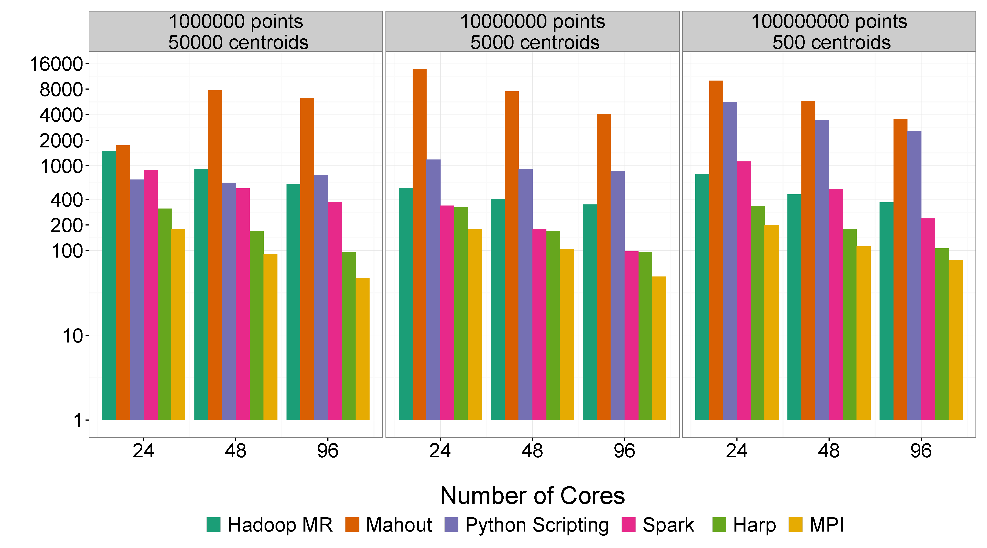
Mahout and Hadoop MR – Slow due to MapReduce
Python slow as Scripting
Spark Iterative MapReduce, non optimal communication
Harp Hadoop plug in with ~MPI collectives
MPI fastest as C not Java
Increasing Communication
Identical Computation

Slide 13
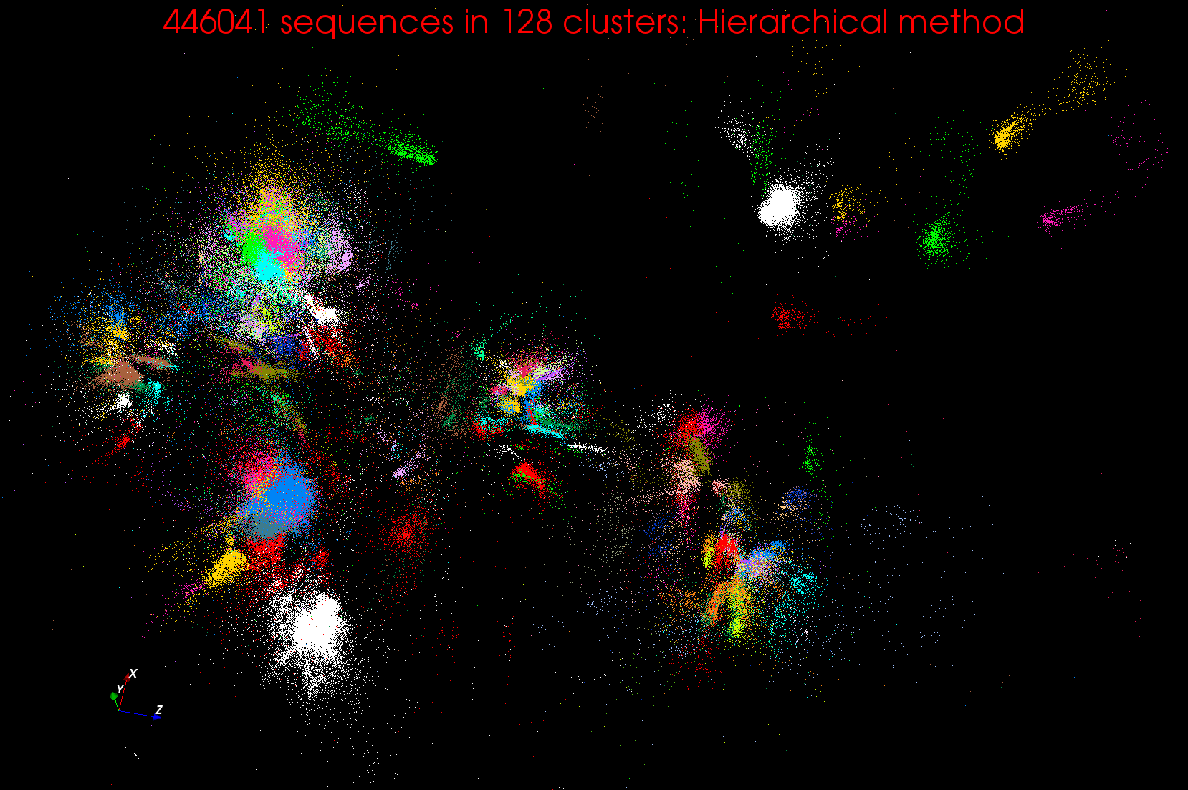
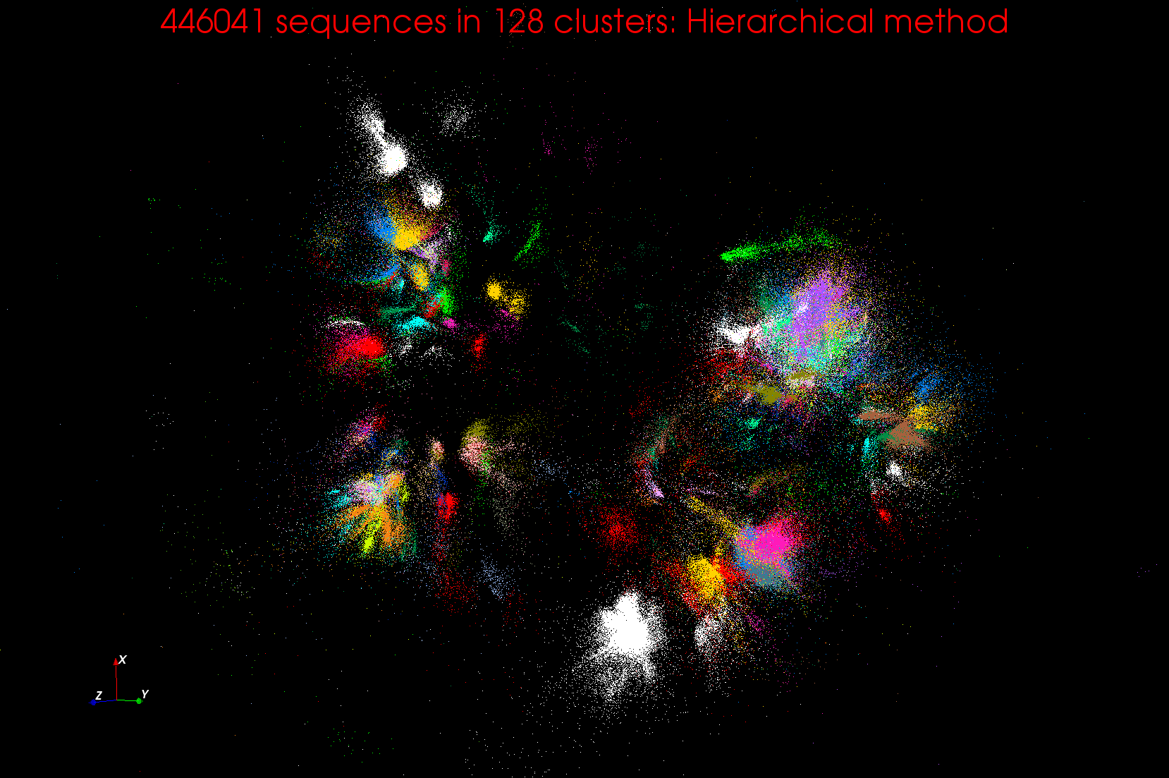
Clustering and MDS Large Scale O(N²) GML

Slide 14
WDA SMACOF MDS (Multidimensional Scaling) using Harp on Big Red 2
Parallel Efficiency: on 100-300K sequences
Conjugate Gradient (dominant time) and Matrix Multiplication

Slide 15
Features of Harp Hadoop Plugin
Hadoop Plugin (on Hadoop 1.2.1 and Hadoop 2.2.0)
Hierarchical data abstraction on arrays, key-values and graphs for easy programming expressiveness.
Collective communication model to support various communication operations on the data abstractions
Caching with buffer management for memory allocation required from computation and communication
BSP style parallelism
Fault tolerance with checkpointing

Slide 16
Building a Big Data Ecosystem that is broadly deployable

Slide 17
Using Lots of Services
To enable Big data processing, we need to support those processing data, those developing new tools and those managing big data infrastructure
Need Software, CPU’s, Storage, Networks delivered as Software-Defined Distributed System as a Service or SDDSaaS
  SDDSaaS integrates component services from lower levels of Kaleidoscope up to different Mahout or R components and the workflow services that integrate them
Given richness and rapid evolution of field, we need to enable easy use of the Kaleidoscope (and other) software.
Make a list of basic software services needed
Then define them as Puppet/Chef Puppies/recipes
Compose them with SDDSL Language (later)
Specify infrastructures
Administrators, developers run Cloudmesh to deploy on demand
Application users directly access Data Analytics as Software as a Service created by Cloudmesh

Slide 18
Software-Defined Distributed
System (SDDS) as a Service
FutureGrid uses
SDDS-aaS Tools
Provisioning
Image Management
IaaS Interoperability
NaaS, IaaS tools
Expt management
Dynamic IaaS NaaS
DevOps
CS Research Use e.g. test new compiler or storage model
Class Usages e.g. run GPU & multicore
Applications
Software
(Application
Or Usage) SaaS
CloudMesh is a SDDSaaS tool that uses Dynamic Provisioning and Image Management to provide custom environments for general target systems
Involves (1) creating,
(2) deploying, and
(3) provisioning
of one or more images in a set of machines on demand http://cloudmesh.futuregrid.org/
Cloud e.g. MapReduce
HPC e.g. PETSc, SAGA
Computer Science e.g. Compiler tools, Sensor nets, Monitors
Platform
PaaS
Infra
structure
IaaS
Software Defined Computing (virtual Clusters)
Hypervisor, Bare Metal
Operating System
Network
NaaS
Software Defined Networks
OpenFlow GENI

Slide 19
Maybe a Big Data Initiative would include
OpenStack
Slurm
Yarn
Hbase
MySQL
iRods
Memcached
Kafka
Harp
Hadoop, Giraph, Spark
Storm
Hive
Pig
Mahout – lots of different analytics
R -– lots of different analytics
Kepler, Pegasus, Airavata
Zookeeper
Ganglia, Nagios, Inca

Slide 20
CloudMesh Architecture
Cloudmesh is a SDDSaaS toolkit to support
  A software-defined distributed system encompassing virtualized and bare-metal infrastructure, networks, application, systems and platform software with a unifying goal of providing Computing as a Service.
  The creation of a tightly integrated mesh of services targeting multiple IaaS frameworks
  The ability to federate a number of resources from academia and industry. This includes existing FutureGrid infrastructure, Amazon Web Services, Azure, HP Cloud, Karlsruhe using several IaaS frameworks
  The creation of an environment in which it becomes easier to experiment with platforms and software services while assisting with their deployment.
  The exposure of information to guide the efficient utilization of resources. (Monitoring)
  Support reproducible computing environments
  IPython-based workflow as an interoperable onramp
Cloudmesh exposes both hypervisor-based and bare-metal provisioning to users and administrators
Access through command line, API, and Web interfaces.

Slide 21
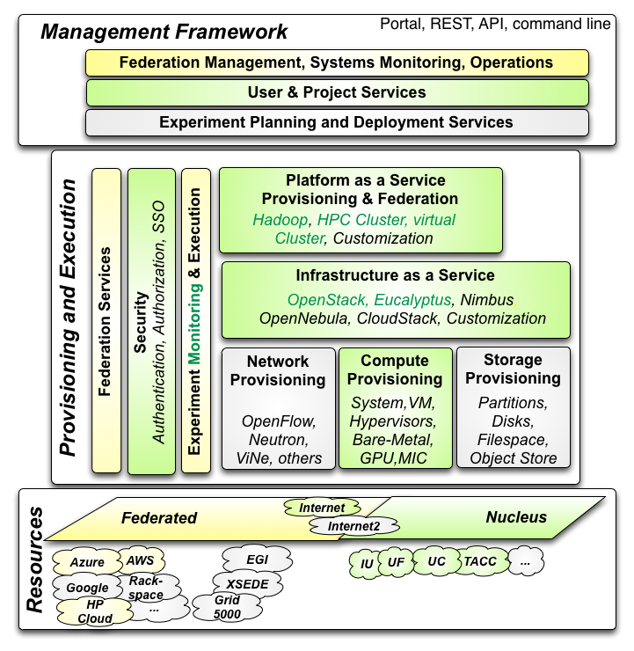

Cloudmesh Architecture
Cloudmesh Management Framework for monitoring and operations, user and project management, experiment planning and deployment of services needed by an experiment
Provisioning and execution environments to be deployed on resources to (or interfaced with) enable experiment management.
Resources.
FutureGrid, SDSC Comet, IU Juliet

Slide 22
Cloudmesh Functionality
Notes:
Due to its integrated services Cloudmesh provides the ability to be an onramp for other clouds.
It provides information services to various system level sensors to give access to sensor and utilization data. Internally, it can be used to optimize the system usage.
The provisioning experience from FutureGrid has taught us that we need to provide
the creation of new clouds (rain)
the repartitioning of resources between services (cloud shifting)
and the integration of external cloud resources in case of over provisioning (cloud bursting)
As we deal with many IaaS frameworks, we need an abstraction layer on top of the IaaS framework.
Experiment management is conducted with workflows controlled in shells, Python/iPython, as well as systems such as OpenStack's Heat.
Accounting is supported through additional services such as user management and charge rate management.
Not all features are yet implemented. Figure shows the main functionality that we target at this time to implement.

Slide 23
Building Blocks of Cloudmesh
Uses internally Libcloud and Cobbler
Celery Task/Query manager (AMQP - RabbitMQ)
MongoDB
Accesses via abstractions external systems/standards
OpenPBS, Chef
OpenStack (including tools like Heat), AWS EC2, Eucalyptus, Azure
Xsede user management (Amie) via Futuregrid
Implementing Docker, Slurm, OCCI, Ansible, Puppet
Evaluating Razor, Juju, Xcat (Original Rain used this), Foreman

Slide 24
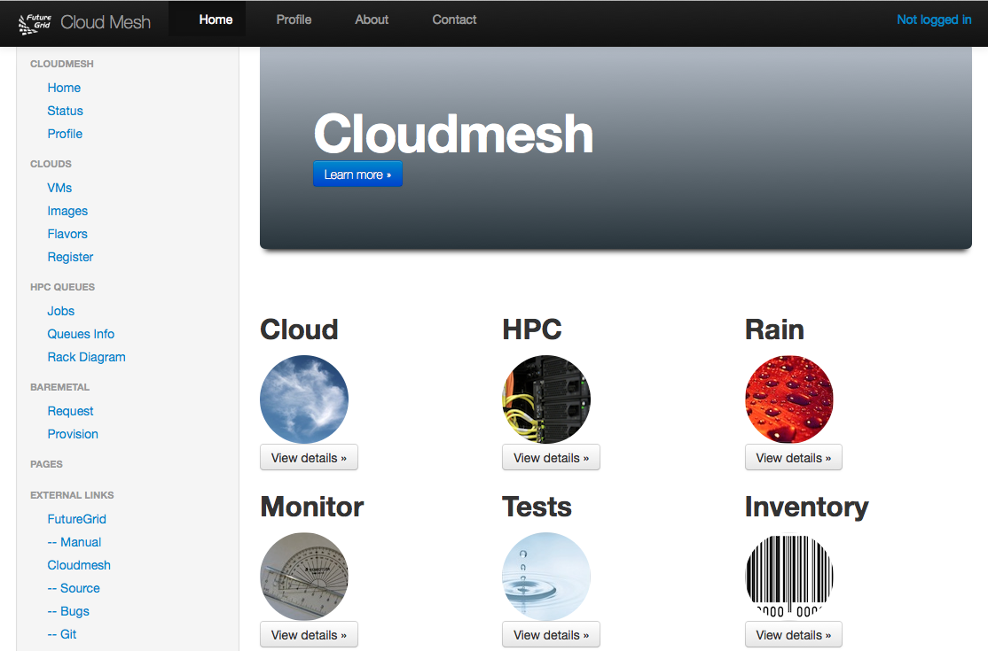
Cloudmesh User Interface
Notes:
A starting window allows to chose from the different functionality

Slide 25
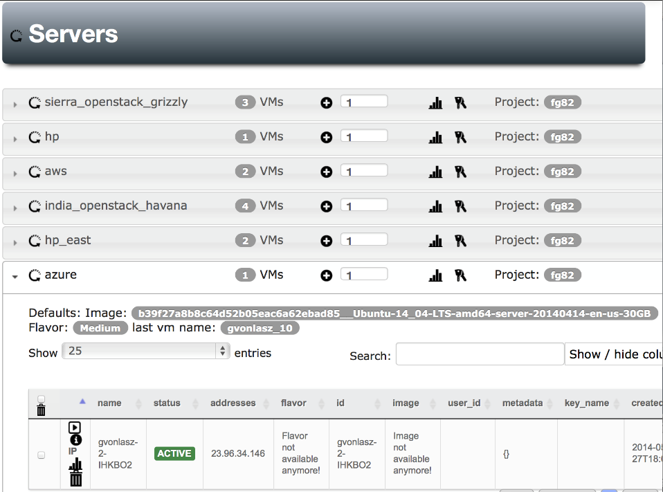
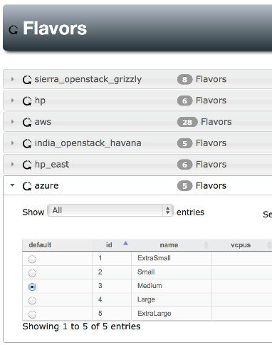
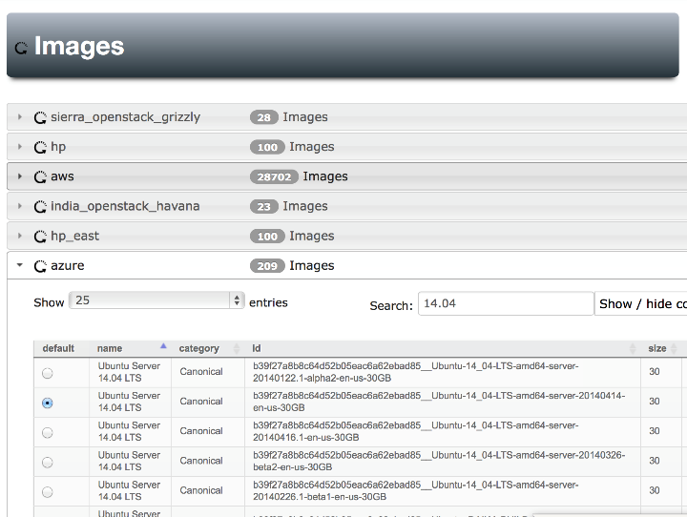
Notes:
Yes Azure is also there, Our gui can easily handle searching for images , we can set defaults for each cloud (images & flavors), pressing the + button will give us a new server with the specified defaults

Slide 26
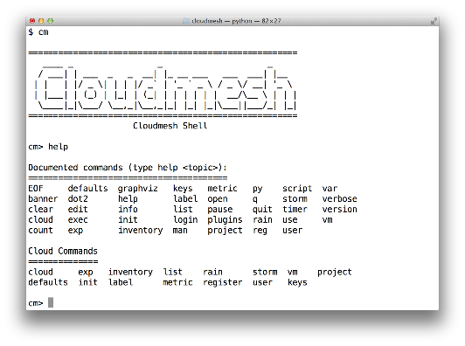
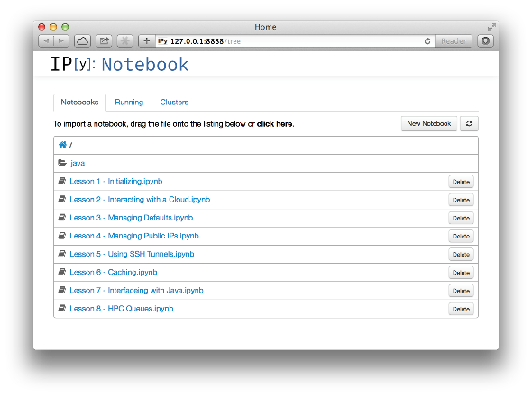
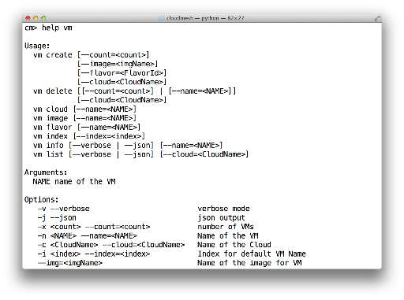
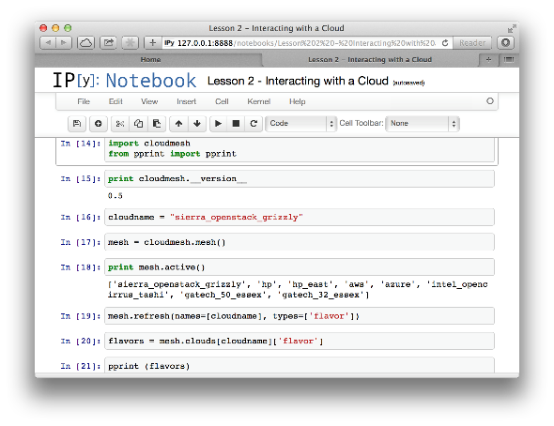
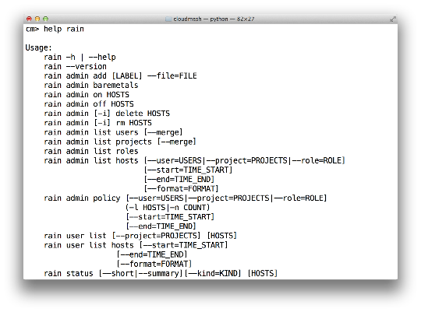
Cloudmesh Shell & bash & IPython
Notes:
Cloudmesh provides more than shell commands it has an integrated shell

Slide 27
SDDS Software Defined Distributed Systems
Cloudmesh builds infrastructure as SDDS consisting of one or more virtual clusters or slices with extensive built-in monitoring
These slices are instantiated on infrastructures with various owners
Controlled by roles/rules of Project, User, infrastructure
One needs general hypervisor and bare-metal slices to support FG research
The experiment management system is intended to integrates ISI Precip, FG Cloudmesh and tools latter invokes
Enables reproducibility in experiments.
User in Project
Request
Execution in Project
Python or REST API
Repository
SDDSL
Results
Request
SDDS
CMMon
CMPlan
User Roles
CMExec
Infrastructure (Cluster, Storage, Network, CPS)
Select
Plan
Requested SDDS as federated Virtual Infrastructures
CMProv
#1Virtual infra.
Instance Type
Current State
Management Structure
Provisioning Rules
Usage Rules (depends on user roles)
Linux
Image and Template Library
#2 Virtual infra.
#3Virtual infra.
Windows
Linux
#4 Virtual infra.
User role and infrastructure rule dependent security checks
Mac OS X

Slide 28
What is SDDSL?
There is an OASIS standard activity TOSCA (Topology and Orchestration Specification for Cloud Applications)
But this is similar to mash-ups or workflow (Taverna, Kepler, Pegasus, Swift ..) and we know that workflow itself is very successful but workflow standards are not
  OASIS WS-BPEL (Business Process Execution Language) didn’t catch on
As basic tools (Cloudmesh) use Python and Python is a popular scripting language for workflow, we suggest that Python is SDDSL
  IPython Notebooks are natural log of execution provenance

Slide 29
Cloudmesh as an On-Ramp
As an On-Ramp, CloudMesh deploys recipes on multiple platforms so you can test in one place and do production on others
Its multi-host support implies it is effective at distributed systems
It will support traditional workflow functions such as
  Specification of an execution dataflow
  Customization of Recipe
  Specification of program parameters
Workflow quite well explored in Python https://wiki.openstack.org/wiki/NovaOrchestration/WorkflowEngines
IPython notebook preserves provenance of activity

Slide 30
CloudMesh Administrative View of SDDS aaS
CM-BMPaaS (Bare Metal Provisioning aaS) is a systems view and allows Cloudmesh to dynamically generate anything and assign it as permitted by user role and resource policy
  FutureGrid machines India, Bravo, Delta, Sierra, Foxtrot are like this
  Note this only implies user level bare metal access if given user is authorized and this is done on a per machine basis
  It does imply dynamic retargeting of nodes to typically safe modes of operation (approved machine images) such as switching back and forth between OpenStack, OpenNebula, HPC on Bare metal, Hadoop etc.
CM-HPaaS (Hypervisor based Provisioning aaS) allows Cloudmesh to generate "anything" on the hypervisor allowed for a particular user
  Platform determined by images available to user
  Amazon, Azure, HPCloud, Google Compute Engine
CM-PaaS (Platform as a Service) makes available an essentially fixed Platform with configuration differences
  XSEDE with MPI HPC nodes could be like this as is Google App Engine and Amazon HPC Cluster. Echo at IU (ScaleMP) is like this
  In such a case a system administrator can statically change base system but the dynamic provisioner cannot

Slide 31
CloudMesh User View of SDDS aaS
Note we always consider virtual clusters or slices with nodes that may or may not have hypervisors
BM-IaaS: Bare Metal (root access) Infrastructure as a service with variants e.g. can change firmware or not
H-IaaS: Hypervisor based Infrastructure (Machine) as a Service. User provided a collection of hypervisors to build system on.
  Classic Commercial cloud view
PSaaS Physical or Platformed System as a Service where user provided a configured image on either Bare Metal or a Hypervisor
  User could request a deployment of Apache Storm and Kafka to control a set of devices (e.g. smartphones)

Slide 32
Cloudmesh Infrastructure Types
Nucleus Infrastructure:
  Persistent Cloudmesh Infrastructure with defined provisioning rules and characteristics and managed by CloudMesh
Federated Infrastructure:
  Outside infrastructure that can be used by special arrangement such as commercial clouds or XSEDE
  Typically persistent and often batch scheduled
  CloudMesh can use within prescribed provisioning rules and users restricted to those with permitted access; interoperable templates allow common images to nucleus
Contributed Infrastructure
  Outside contributions to a particular Cloudmesh project managed by Cloudmesh in this project
  Typically strong user role restrictions – users must belong to a particular project
  Can implement a Planetlab like environment by contributing hardware that can be generally used with bare-metal provisioning

Slide 33
Lessons / Insights
Integrate (don’t compete) HPC with “Commodity Big data” (Google to Amazon to Enterprise Data Analytics)
  i.e. improve Mahout; don’t compete with it
  Use Hadoop plug-ins rather than replacing Hadoop
Enhanced Apache Big Data Stack HPC-ABDS has ~120 members
Opportunities at Resource management, Data/File, Streaming, Programming, monitoring, workflow layers for HPC and ABDS integration
Need to capture as services – developing a HPC-Cloud interoperability environment
Data intensive algorithms do not have the well developed high performance libraries familiar from HPC
  Need to develop needed services at all levels of stack from users of Mahout to those developing better run time and programming environments

