Slide 1
Cyberinfrastructure and Its Application
Cyberinfrastructure Day
Salish Kootenai College, Pablo MT
August 2 2011
Geoffrey Fox
gcf@indiana.edu
http://www.infomall.org http://www.futuregrid.org
Director, Digital Science Center, Pervasive Technology Institute
Associate Dean for Research and Graduate Studies, School of Informatics and Computing
Indiana University Bloomington
Notes:
SALSA is
Service Aggregated Linked Sequential Activities

Slide 2
Important Trends
Data Deluge in all fields of science
Multicore implies parallel computing important again
Performance from extra cores – not extra clock speed
GPU enhanced systems can give big power boost
Clouds – new commercially supported data center model replacing compute grids (and your general purpose computer center)
Light weight clients: Sensors, Smartphones and tablets accessing and supported by backend services in cloud
Commercial efforts moving much faster than academia in both innovation and deployment

Slide 3
Big Data in Many Domains
According to one estimate, we created 150 exabytes (billion gigabytes) of data in 2005. In 2010, we created 1,200 exabytes
Enterprise Storage sold in 2010 was 15 Exabytes; BUT total storage sold (including flash memory etc.) was 1500 Exabytes
Size of the web ~ 3 billion web pages: MapReduce at Google was on average processing 20PB per day in January 2008
During 2009, American drone aircraft flying over Iraq and Afghanistan sent back around 24 years’ worth of video footage
http://www.economist.com/node/15579717
New models being deployed this year will produce ten times as many data streams as their predecessors, and those in 2011 will produce 30 times as many
~108 million sequence records in GenBank in 2009, doubling in every 18 months
~20 million purchases at Wal-Mart a day
90 million Tweets a day
Astronomy, Particle Physics, Medical Records …
Most scientific task shows CPU:IO ratio of 10000:1 – Dr. Jim Gray
The Fourth Paradigm: Data-Intensive Scientific Discovery
Large Hadron Collider at CERN; 100 Petabytes to find Higgs Boson
Notes:
For each category, give examples, e.g. Astronomy solon 20 TB night,
http://www.datacenterknowledge.com/archives/2009/12/22/the-data-crunching-powerhouse-behind-avatar/

Slide 6
What is Cyberinfrastructure
Cyberinfrastructure is (from NSF) infrastructure that supports distributed research and learning (e-Science, e-Research, e-Education)
Links data, people, computers
Exploits Internet technology (Web2.0 and Clouds) adding (via Grid technology) management, security, supercomputers etc.
It has two aspects: parallel – low latency (microseconds) between nodes and distributed – highish latency (milliseconds) between nodes
Parallel needed to get high performance on individual large simulations, data analysis etc.; must decompose problem
Distributed aspect integrates already distinct components – especially natural for data (as in biology databases etc.)
6
Notes:
6

Slide 7
e-moreorlessanything
‘e-Science is about global collaboration in key areas of science, and the next generation of infrastructure that will enable it.’ from inventor of term John Taylor Director General of Research Councils UK, Office of Science and Technology
e-Science is about developing tools and technologies that allow scientists to do ‘faster, better or different’ research
Similarly e-Business captures the emerging view of corporations as dynamic virtual organizations linking employees, customers and stakeholders across the world.
This generalizes to e-moreorlessanything including e-DigitalLibrary, e-FineArts, e-HavingFun and e-Education
A deluge of data of unprecedented and inevitable size must be managed and understood.
People (virtual organizations), computers, data (including sensors and instruments) must be linked via hardware and software networks
7
Notes:
7

Slide 8
The Span of Cyberinfrastructure
High definition videoconferencing linking people across the globe
Digital Library of music, curriculum, scientific papers
Flickr, Youtube, Amazon ….
Simulating a new battery design (exascale problem)
Sharing data from world’s telescopes
Using cloud to analyze your personal genome
Enabling all to be equal partners in creating knowledge and converting it to wisdom
Analyzing Tweets…documents to discover which stocks will crash; how disease is spreading; linguistic inference; ranking of institutions

Slide 9
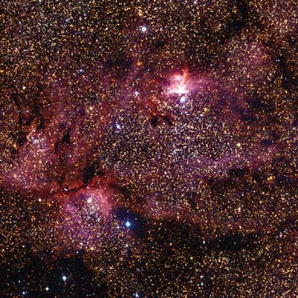
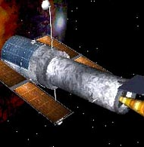
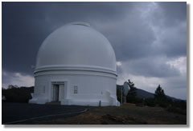
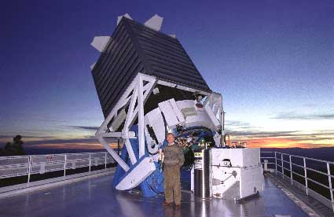
Tracking the Heavens
“The Universe is now being explored systematically, in a panchromatic way, over a range of spatial and temporal scales that lead to a more complete, and less biased understanding of its constituents, their evolution, their origins, and the physical processes governing them.”
Towards a National Virtual Observatory
Hubble Telescope
Palomar Telescope
Sloan Telescope

Slide 10
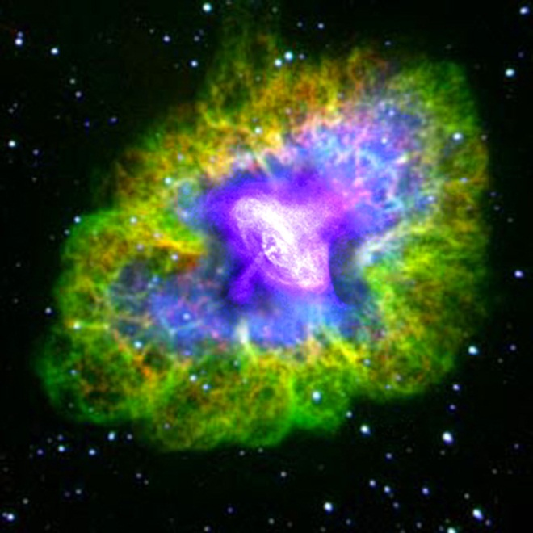
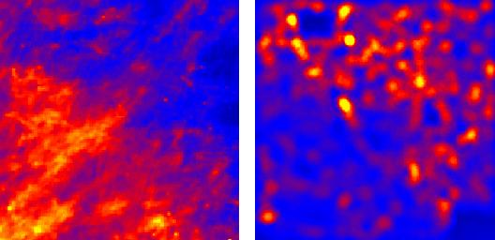
Virtual Observatory Astronomy Grid Integrate Experiments
Radio
Far-Infrared
Visible
Dust Map
Visible + X-ray
Galaxy Density Map

Slide 11
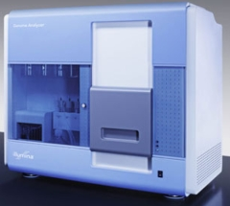
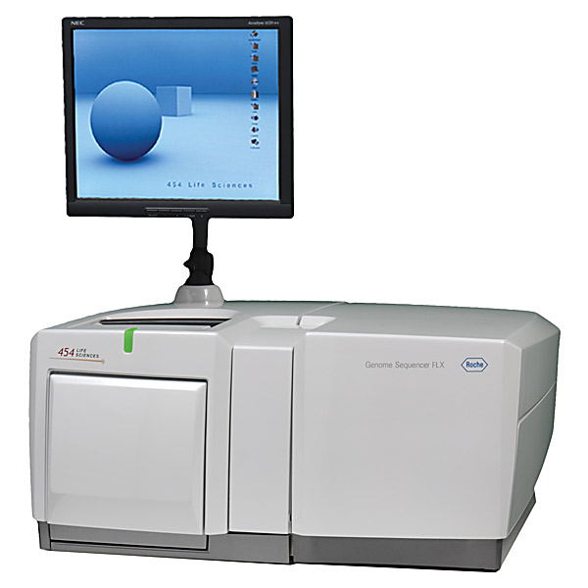
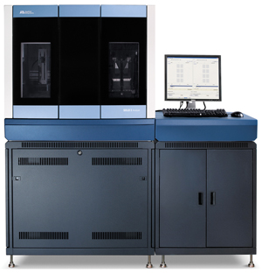
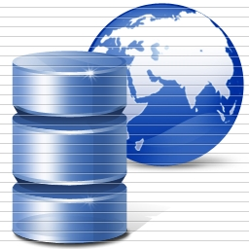
DNA Sequencing Pipeline
Illumina/Solexa Roche/454 Life Sciences Applied Biosystems/SOLiD
Internet
~300 million base pairs per day leading to
~3000 sequences per day per instrument
? 500 instruments at ~0.5M$ each
Read Alignment
Pairwise
clustering
Form block
Pairings
Sequence
alignment
Dissimilarity
Matrix
N(N-1)/2 values
Visualization
Plotviz
FASTA File N Sequences
Blocking
MPI
MDS
MapReduce

Slide 12
100,043 Metagenomics Sequences

Slide 13
Lightweight Cyberinfrastructure to support mobile Data gathering expeditions plus classic central resources (as a cloud)

Slide 14
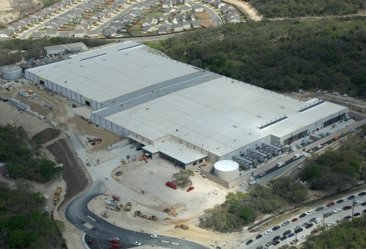
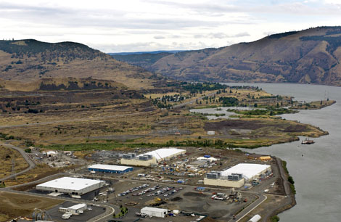
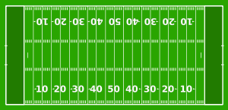
Data Centers Clouds & Economies of Scale I
Range in size from “edge” facilities to megascale.
Economies of scale
Approximate costs for a small size center (1K servers) and a larger, 50K server center.
2 Google warehouses of computers on the banks of the Columbia River, in The Dalles, Oregon
Such centers use 20MW-200MW
(Future) each with 150 watts per CPU
Save money from large size, positioning with cheap power and access with Internet
Technology | Cost in small-sized Data Center | Cost in Large Data Center | Ratio
Network | $95 per Mbps/ month | $13 per Mbps/ month | 7.1
Storage | $2.20 per GB/ month | $0.40 per GB/ month | 5.7
Administration | ~140 servers/ Administrator | >1000 Servers/ Administrator | 7.1
Each data center is
11.5 times
the size of a football field

Slide 15
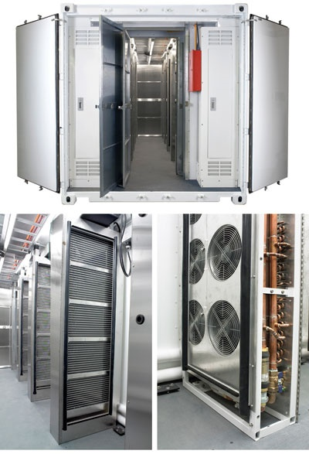
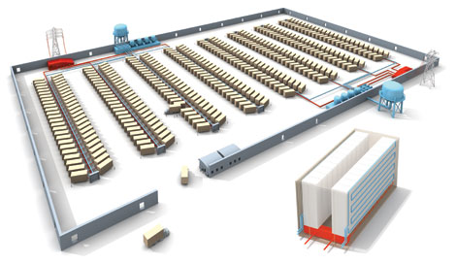
Data Centers, Clouds & Economies of Scale II
Builds giant data centers with 100,000’s of computers; ~ 200-1000 to a shipping container with Internet access
“Microsoft will cram between 150 and 220 shipping containers filled with data center gear into a new 500,000 square foot Chicago facility. This move marks the most significant, public use of the shipping container systems popularized by the likes of Sun Microsystems and Rackable Systems to date.”

Slide 16
Grids MPI and Clouds
Grids are useful for managing distributed systems
Pioneered service model for Science
Developed importance of Workflow
Performance issues – communication latency – intrinsic to distributed systems
Can never run large differential equation based simulations or datamining
Clouds can execute any job class that was good for Grids plus
More attractive due to platform plus elastic on-demand model
MapReduce easier to use than MPI for appropriate parallel jobs
Currently have performance limitations due to poor affinity (locality) for compute-compute (MPI) and Compute-data
These limitations are not “inevitable” and should gradually improve as in July 13 2010 Amazon Cluster announcement
Will probably never be best for most sophisticated parallel differential equation based simulations
Classic Supercomputers (MPI Engines) run communication demanding differential equation based simulations
MapReduce and Clouds replaces MPI for other problems
Much more data processed today by MapReduce than MPI (Industry Informational Retrieval ~50 Petabytes per day)

Slide 17
Clouds and Jobs
Clouds are a major industry thrust with a growing fraction of IT expenditure that IDC estimates will grow to $44.2 billion direct investment in 2013 while 15% of IT investment in 2011 will be related to cloud systems with a 30% growth in public sector.
Gartner also rates cloud computing high on list of critical emerging technologies with for example “Cloud Computing” and “Cloud Web Platforms” rated as transformational (their highest rating for impact) in the next 2-5 years.
Correspondingly there is and will continue to be major opportunities for new jobs in cloud computing with a recent European study estimating there will be 2.4 million new cloud computing jobs in Europe alone by 2015.
Cloud computing is an attractive for projects focusing on workforce development. Note that the recently signed “America Competes Act” calls out the importance of economic development in broader impact of NSF projects

Slide 18
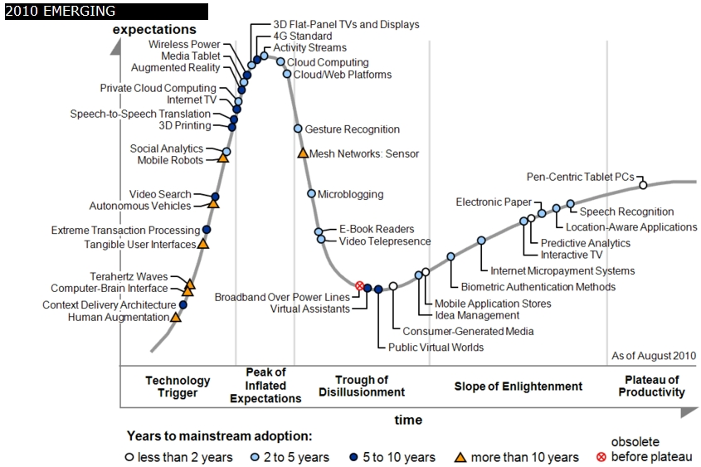
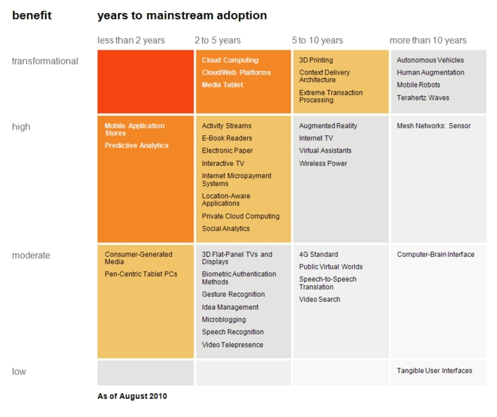
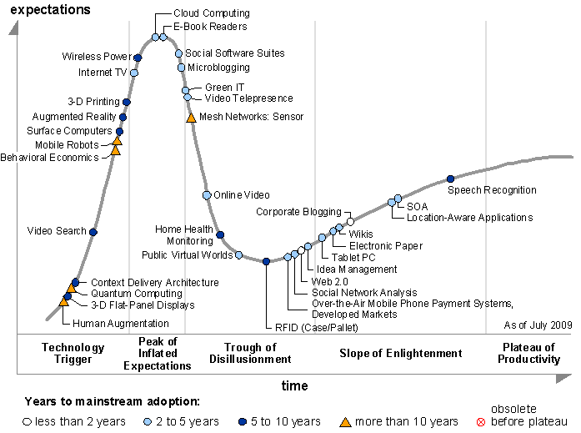
Transformational
High
Moderate
Low
Gartner 2009 Hype Curve
Clouds, Web2.0
Service Oriented Architectures
Cloud Computing
Cloud Web Platforms
Media Tablet

Slide 19
3-way Clouds and/or Cyberinfrastructure
Use it in faculty, graduate student and undergraduate research
~10 students each summer at IU from ADMI
Teach it as it involves areas of Information Technology with lots of job opportunities
Use it to support distributed learning environment
A cloud backend for course materials and collaboration
Green computing infrastructure

Slide 20
C4 = Continuous Collaborative Computational Cloud
C4 EMERGING VISION
While the internet has changed the way we communicate and get entertainment, we need to empower the next generation of engineers and scientists with technology that enables interdisciplinary collaboration for lifelong learning.
Today, the cloud is a set of services that people explicitly have to access (from laptops, desktops, etc.). In 2020 the C4 will be part of our lives, as a larger, pervasive, continuous experience. The measure of success will be how “invisible” it becomes.
C4 Society Vision
We are no prophets and can’t anticipate what exactly will work, but we expect to have high bandwidth and ubiquitous connectivity for everyone everywhere, even in rural areas (using power-efficient micro data centers the size of shoe boxes). Here the cloud will enable business, fun, destruction and creation of regimes (societies)
Wandering through life with a tablet/smartphone hooked to cloud
Education should embrace C4 just as students do
Notes:
C4 Continuous Collaborative Computational Cloud

Slide 21
Higher Education 2020
Computational Thinking
Modeling
& Simulation
C⁴
Continuous
Collaborative
Computational
Cloud
C⁴
I
C⁴ Intelligent Society
N
T
E
C⁴ Intelligent Economy
C(DE)SE
L
L
C⁴ Intelligent People
Internet &
Cyberinfrastructure
I
G
E
Motivating Issues job / education mismatch
Higher Ed rigidity
Interdisciplinary work
Engineering v Science, Little v. Big science
N
C
E
NSF
Educate “Net Generation”
Re-educate pre “Net Generation”
in Science and Engineering
Exploiting and developing C⁴
C⁴ Curricula, programs
C⁴ Experiences (delivery mechanism)
C⁴ REUs, Internships, Fellowships
CDESE is Computational and Data-enabled Science and Engineering

Slide 22
Implementing C4 in a Cloud Computing Curriculum
Generate curricula that will allow students to enter cloud computing workforce
Teach workshops explaining cloud computing to MSI faculty
Write a basic textbook
Design courses at Indiana University
Design modules and modifications suitable to be taught at MSI’s
Help teach initial MSI courses

Slide 23
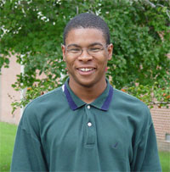
ADMI Cloudy View on Computing Workshop June 2011
Concept and Delivery by Jerome Mitchell:
Undergraduate ECSU,
Masters Kansas, PhD Indiana
Jerome took two courses from IU in this area Fall 2010 and Spring 2011
ADMI: Association of Computer and Information Science/Engineering Departments at Minority Institutions
Offered on FutureGrid (see later)
10 Faculty and Graduate Students from ADMI Universities
The workshop provided information from cloud programming models to case studies of scientific applications on FutureGrid.
At the conclusion of the workshop, the participants indicated that they would incorporate cloud computing into their courses and/or research.

Slide 24
ADMI Cloudy View on Computing Workshop Participants

Slide 25
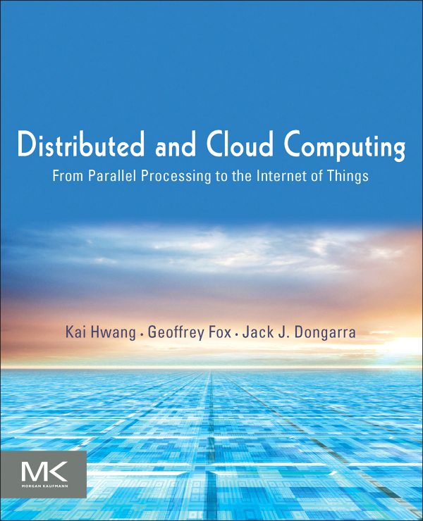
Published October 2011
Morgan Kaufmann

Slide 26
DDCPPIT Contents
Part 1: Systems Modeling, Clustering and Virtualization
Distributed System Models and Enabling Technologies
Computer Clusters for Scalable Computing
Virtual Machines and Virtualization of Clusters and Datacenters
Part 2: Computing Clouds, Service-Oriented Architecture and Programming
Cloud Platform Architecture over Virtualized Datacenters
Service-Oriented Architectures
Cloud Programming and Software Environments
Part 3: Grids, P2P and The Future Internet
Grid Computing and Resource Management
Peer-to-Peer Computing with Overlay Networks
Ubiquitous Clouds and The Internet of Things

Slide 27
Qiu: CSCI-B649 Fall 2010 Topics Class: Cloud Computing for Data Intensive Sciences http://salsahpc.indiana.edu/b649/
This course offers to graduate students cloud computing programming models and tools to support data-intensive science applications.
These include virtual machine-based utility computing environments such as Amazon AWS and Microsoft Azure.
The class covers MapReduce for information retrieval, and scientific data analysis.
Students have the opportunity to understand some commercial cloud systems through projects using FutureGrid resources
Project topics were Matrix Multiplication with DryadLINQ; Implementing PhyloD application with DryadLINQ; Parallelism for Latent Dirichlet allocation (LDA); Memcached Integration with Twister; Improving Twister Messaging System Using Apache Avro; Large Scale PageRank with DryadLINQ; A Survey of Open-Source Cloud Infrastructure; A Survey on Cloud Storage Systems; Performance Analysis of HPC Virtualization Technologies.
The projects were performed on FutureGrid and carefully chosen to include different aspects of the cloud architecture stack from top-level biology and large-scale graphics applications, optimization of MapReduce runtimes, Cloud storage, to low-level virtualization technologies.

Slide 28
Qiu: CSCI-B534 Spring 2011 Class: Distributed Systems http://salsahpc.indiana.edu/b534/
This is motivated by the Internet and the data deluge for science with the emergence of data-oriented analysis as a fourth paradigm of scientific methodology.
The content of B534 covers the design principles, systems architecture, and innovative applications of parallel, distributed, and cloud computing systems.
These include supercomputing clusters, service-orient architecture (SOA), computational grids, P2P (peer-to-peer) networks, virtualized datacenters, and cloud platforms.
The programming project for B534 class is a "platform" building bottom up, giving a stack with virtualization and dynamic provisioning capabilities to support the OS and science applications.
This is a prototype of commercial cloud systems.
Additional class topics included Authentication and Authorization Workflow; Data Transport Image Library; Generalize Azure Blob or Amazon S3; Data-Parallel File System; Queues: Publish Subscribe based queuing system.
Later topics will be added to cover the complete "OS of OSs at Internet scale".

Slide 29
Some Next Steps
Develop Appliances (Virtual machine based preconfigured computer systems) to support programming laboratories
Offer Cloud Computing course with
Web portal support
FutureGrid or Appliances locally
Distance delivery
Deliver first to ECSU, then other MSI’s
Write proposals with Linda Hayden at ECSU and/or Montana and/or AIHEC
Develop Cloud Computing Certificates and other degree offerings
Masters, Undergraduate, Continuing education …..

Slide 30
RS502 ECSU Proposed Class in Cloud Computing and Remote Sensing
RS 502 will be the starting point for introduction of cloud computing methods and will be offered during the spring semester.
RS 502 currently covers Mapping Concepts, Data Structures, Data Management Techniques, Data Acquisition, Global positioning system interface, and data manipulation and analysis.
RS 502 has been taught in the past as a project based course using available data sets and on site visualization packages including ENVI.
The new implementation of RS 502 will be teaching and using cloud computing techniques with CReSIS polar data sets.
We expect about half the course to be the responsibility of Indiana University (Qiu) and the other half ECSU.
The ECSU instructor of record (Dr. LeCompte) will work collaboratively with the IU co-instructor for RS 501 and RS 502.
In addition CReSIS personnel will consult to identify the polar data sets for use in the course

Slide 31
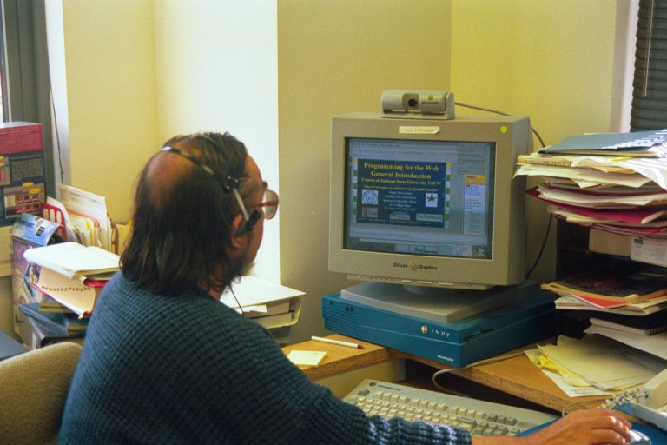
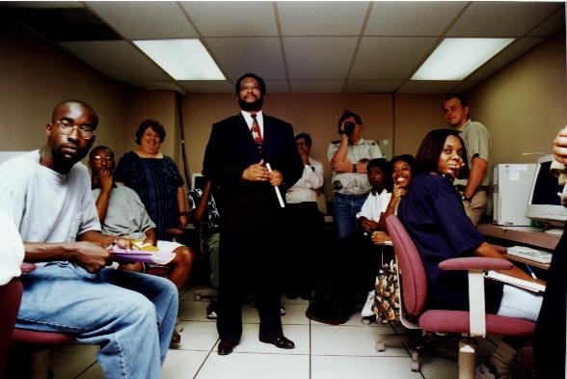
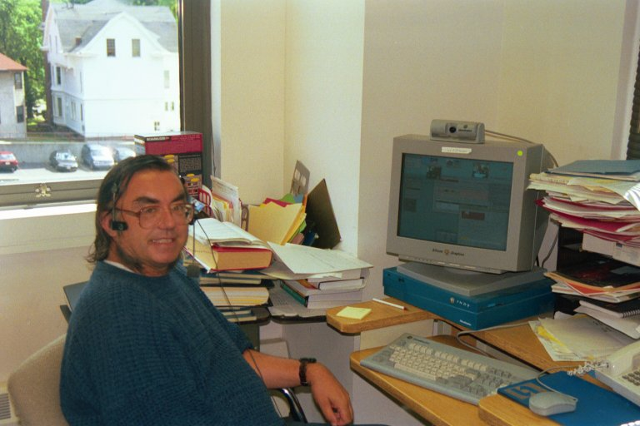
Teaching Jackson State Fall 97 to Fall 2001
JSU
Syracuse

