Slide 1
Master of Arts in Data Science
Geoffrey Fox for Data Science Program
March 23 2014

Slide 2
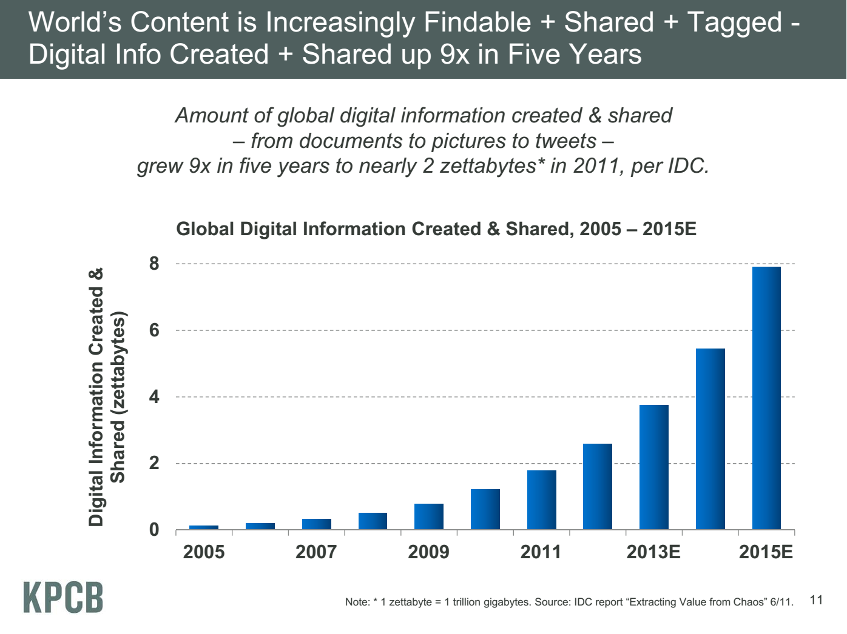
Zettabyte ~10¹⁰ Typical Local Storage (100 Gigabytes)
Zettabyte = 1000 Exabytes
Exabyte = 1000 Petabytes
Petabyte = 1000 Terabyte
Terabyte = 1000 Gigabytes
Gigabyte = 1000 Megabytes
Meeker/Wu May 29 2013 Internet Trends D11 Conference

Slide 3
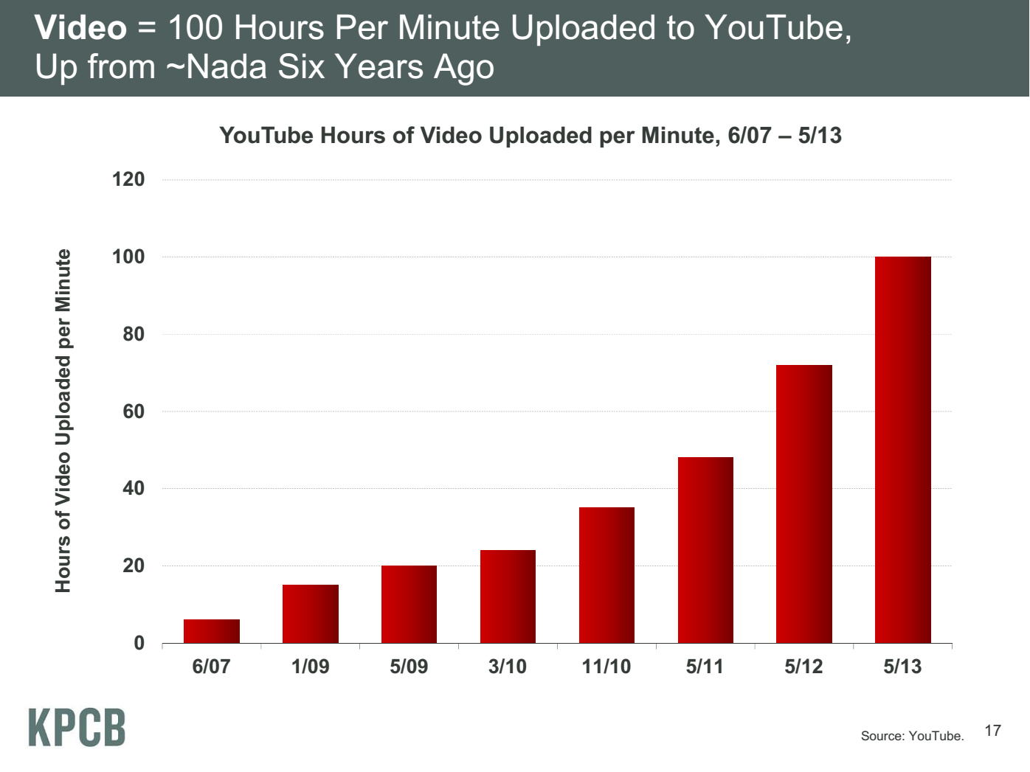
20 hours
Meeker/Wu May 29 2013 Internet Trends D11 Conference

Slide 4
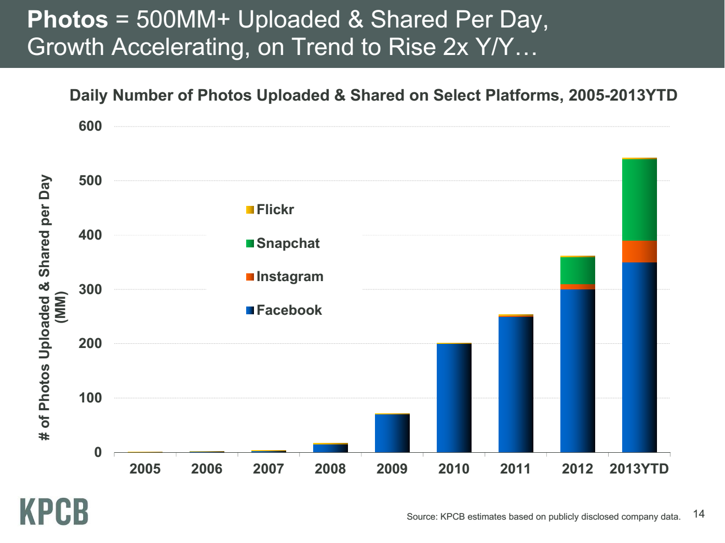
Meeker/Wu May 29 2013 Internet Trends D11 Conference

Slide 5
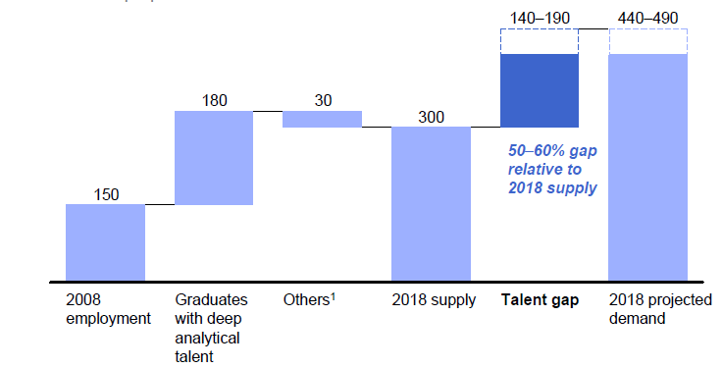
McKinsey Institute on Big Data Jobs
There will be a shortage of talent necessary for organizations to take advantage of big data. By 2018, the United States alone could face a shortage of 140,000 to 190,000 people with deep analytical skills as well as 1.5 million managers and analysts with the know-how to use the analysis of big data to make effective decisions.
Perhaps Informatics/ILS aimed at 1.5 million jobs. Computer Science covers the 140,000 to 190,000
http://www.mckinsey.com/mgi/publications/big_data/index.asp.

Slide 6
Features
Blended online and residential
Department of Information and Library Science, Division of Informatics and Division of Computer Science in the Department of Informatics and Computer Science, School of Informatics and Computing and the Department of Statistics, College of Arts and Science, IUB
30 credits
A Certificate in Data Science in nearing the end of the approval process, and a Ph.D. Minor in Data Science will be proposed.
Basic (general) Masters degree plus tracks
Currently only track is “Computational and Analytic Data Science ”

Slide 7
Clientele
Professionals wanting skills to improve job or “required” by employee to keep up with technology advances
Traditional source of IT Masters
Students in non IT fields wanting to “domain specific data science”

Slide 8
IU and Competition
With Computer Science, Informatics, ILS, Statistics IU has particularly broad technology base
Probably behind others in domain data science
Existing Masters in US in table. Many more certificates and related degrees (business analytics)
School | Program | Campus | Online | Degree
Columbia University | Data Science | Yes | No | MS 30 cr
Illinois Institute of Technology | Data Science | Yes | No | MS 33 cr
New York University | Data Science | Yes | No | MS 36 cr
University of California Berkeley School of Information | Master of Information and Data Science | Yes | Yes | M.I.D.S
University of Southern California | Computer Science with Data Science | Yes | No | MS 27 cr

Slide 9
Admissions
Decided by Data Science Program Curriculum Committee
Need some computer programming experience (either through coursework or experience), and a mathematical background and knowledge of statistics will be useful
Tracks can have stronger requirements
3.0 Undergraduate GPA
A 500 word personal statement
GRE scores are required for all applicants.
3 letters of recommendation

Slide 10
Basic Masters Course Requirements
One course from two of three technology areas
I. Data analysis and statistics
II. Data lifecycle
III. Data management and infrastructure
One course from (big data) application course cluster
Complete capstone project

Slide 11
Computational and Analytic Data Science track
For this track, data science courses have been reorganized into categories reflecting the topics important for students wanting to prepare for computational and analytic data science careers for which a strong computer science background is necessary. Consequently, students in this track must complete additional requirements,
1) A student has to take at least 3 courses (9 credits) from Category 1 Core Courses. Among them, B503 Analysis of Algorithms is required and the student should take at least 2 courses from the following 3:
B561 Advanced Database Concepts,
[STAT] S520 Introduction to Statistics OR (New Course) Probabilistic Reasoning
B555 Machine Learning OR I590 Applied Machine Learning
2) A student must take at least 2 courses from Category 2 Data Systems, AND, at least 2 courses from Category 3 Data Analysis. Courses taken in Category 1 can be double counted if they are also listed in Category 2 or Category 3.
3) A student must take at least 3 courses from Category 2 Data Systems, OR, at least 3 courses from Category 3 Data Analysis. Again, courses taken in Category 1 can be double counted if they are also listed in Category 2 or Category 3. One of these courses must be an application domain course

