Slide 1
The Indiana University School of Informatics
Bobby Schnabel: Dean, Indiana University School of Informatics
Presented by Geoffrey Fox: Associate Dean for Research and Graduate Studies
Bloomington School of Informatics and Computing

Slide 2
What is Informatics and Computing?
Computer Science, In Europe
Cybernetics
Science of Information
Analysis and Application of Data
Applied Computing/Computer Science
In Bloomington School of Informatics and Computing we cover all these themes

Slide 3
Background & Structure of the School
Established in 2000 as first of its kind in the United States
Includes Informatics and Computer Science in Bloomington. (Computer Science was established In 1971 and became part of SoI in 2005)
Bloomington School renamed Informatics and Computing July 1 2009
Includes Informatics at Indiana
University-Purdue University at Indianapolis ( IUPUI )
Not like most i-Schools

Slide 4
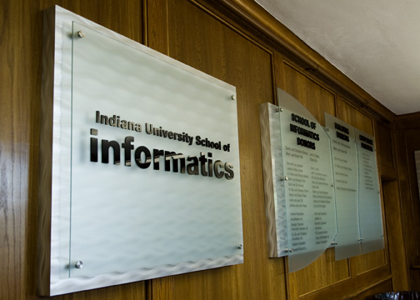
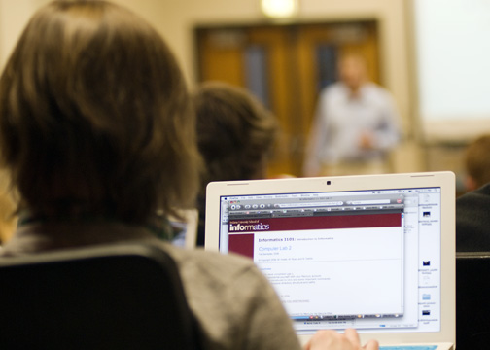
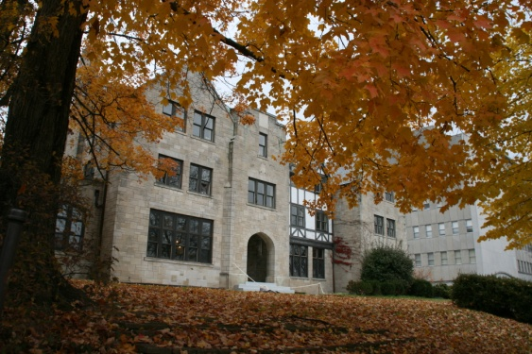
Mission of the School
Excellence in education and research
Partnership for economic development and entrepreneurship
Commitment to diversity-participation of women and underrepresented minorities

Slide 5
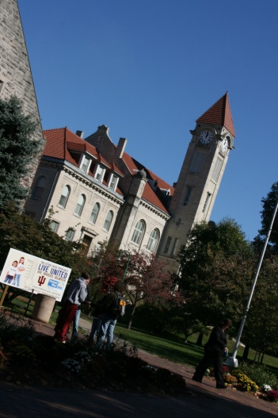
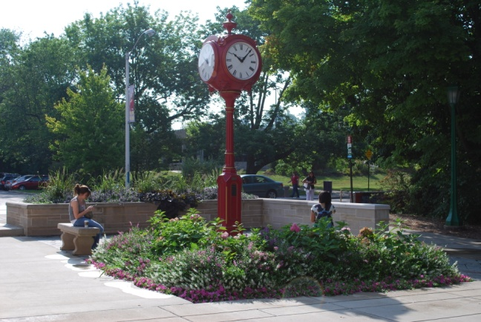
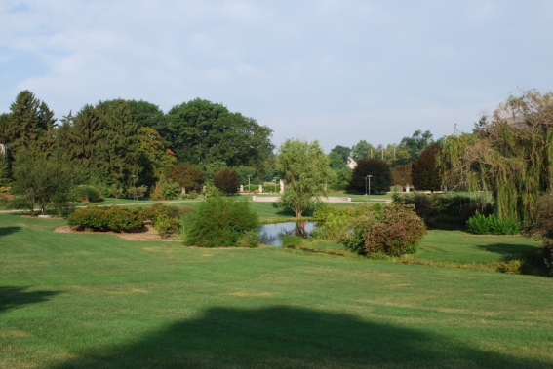
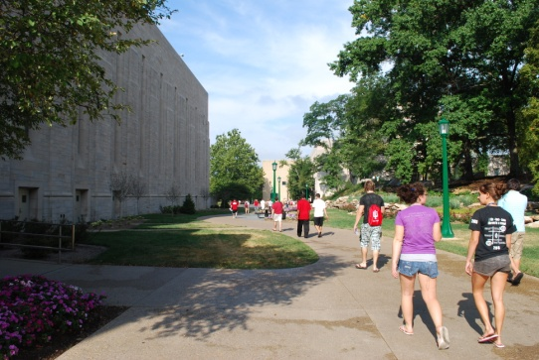
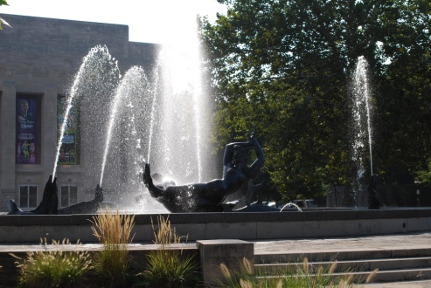
Size of School 2010-2011
Bloomington
Indianapolis
Faculty 74 43
Undergraduate majors 610 542
Graduate Majors 527 158
Degrees Granted 182 146

Slide 6
Explosive growth at IU SOIC Bloomington in past 3 years
Undergraduate majors: 58%
New Undergraduate majors:94%
Masters Enrollments: 121%
PhD Enrollments: 41%
Research awards: 100%

Slide 7
Growth Demands Space
10,000 sq ft Extension joins new two buildings together

Slide 8
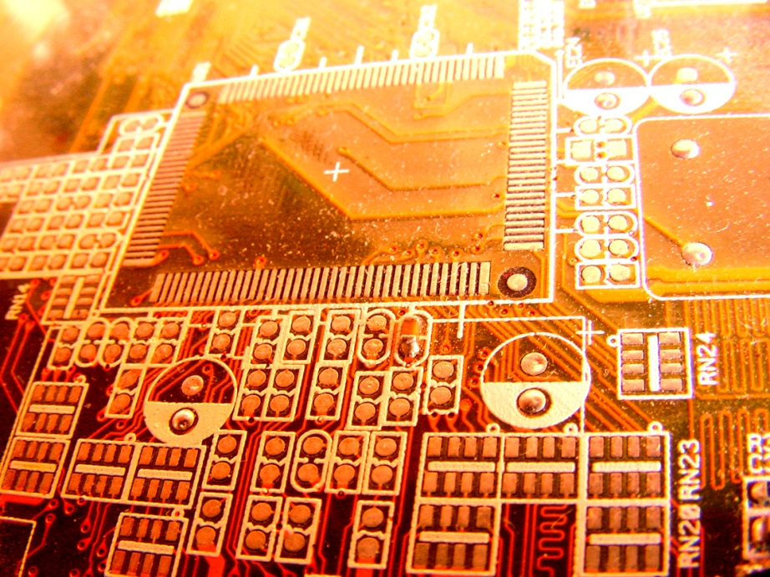
Undergraduate Degree Programs
B.S. degrees in:
Informatics
Computer Science
Health Information Administration
(Indianapolis),
Media Arts and Science
(Indianapolis)
B.A. degree in Computer Science
(Bloomington)

Slide 9
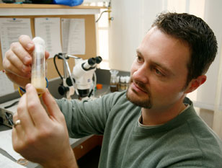
Graduate Degree Programs
PhD
Informatics
Computer Science
Masters (MS)
Bioinformatics
Chemical Informatics
Computer Science
Human Computer Interaction/Design
Security Informatics

Slide 10
Research in Bloomington School of Informatics and Computing
http://www.infomall.org/I399/Materials/I399A.pptx
http://www.soic.indiana.edu/research/index.shtml
http://www.infomall.org/I399/SOICResearch.html
Following is a Summary divided into 3 broad areas
Largely Informatics
Largely Applied Computer Science
Traditional core Computer Science

Slide 11
Largely Informatics
Security
Bioinformatics
Cheminformatics
Health Informatics
Music Informatics
Complex Networks and Systems
Social Informatics
Human Computer Interaction Design (not covered in meetings but identified earlier as possibly interesting to Crane)
These fields are covered in many universities but sometimes not in Computer Science (although Security often in CS)

Slide 12
Largely Applied Computer Science
Distributed systems, Data Fusion, Cyberinfrastructure and High Performance Computing, Parallel Computing, Multicore
Data, Databases, Datamining, Digital Preservation
Text and Image Search
Ubiquitous Computing
Robotics
Visualization and Computer Graphics
These are fields you will find in many computer science departments but are focused on using computers

Slide 13
Largely Core Computer Science
Computer Architecture
Computer Networking
Programming Languages and Compilers
Artificial Intelligence, Artificial Life and Cognitive Science
Computation Theory and Logic
Quantum Computing
These are traditional important fields of Computer Science providing ideas and tools used in Informatics and Applied Computer Science

