Slide 1
Cloud Technologies and
Their Applications
March 26, 2010 Indiana University Bloomington
Judy Qiu
xqiu@indiana.edu
http://salsahpc.indiana.edu
Pervasive Technology Institute
Indiana University
Notes:
SALSA is
Service Aggregated Linked Sequential Activities

Slide 2
Important Trends
  In all fields of science and throughout life (e.g. web!)
  Impacts preservation, access/use, programming model
  Implies parallel computing important again
    Performance from extra cores – not extra clock speed
Data Deluge
Multicore
eSciences
Cloud Technologies
  A spectrum of eScience applications (biology, chemistry, physics …)
  Data Analysis
  Machine learning
  new commercially supported data center model replacing compute grids
Notes:
Within past 5 year, Data -> Hardware -> Software -> Application
Data coming from everywhere 24/7.
Science faces a data deluge.
How to manage and analyze information?
Data are too large to fit into memory and take impractical time to run and get results
e.g. 50K all pairs SWG (O(N2)) takes ~5 hours on 768 cores. A sequential run takes 160 days.
MPI OpenMP RPC RMI

Slide 3
Challenges for CS Research
Science faces a data deluge. How to manage and analyze information?
Recommend CSTB foster tools for data capture, data curation, data analysis
―Jim Gray’s
Talk to Computer Science and Telecommunication Board (CSTB), Jan 11, 2007
There’re several challenges to realizing the vision on data intensive systems and building generic tools (Workflow, Databases, Algorithms, Visualization ).
Cluster-management software
Distributed-execution engine
Language constructs
Parallel compilers
Program Development tools
. . .
Notes:
Jim Gray’s talk to the Computer Science and Telecommunications Board in 2007
His vision of the fourth paradigm of scientific research. Focus on Data-intensive Systems and Scientific communications
New scientific research is highlighted by “data science”

Slide 4
Important Trends
Data Deluge
Multicore
Big Data Sciences
Cloud Technologies
Notes:
Within past 5 year
Data -> Hardware -> Software -> Application
Data coming from everywhere 24/7.
Data are too large to fit into memory and take impractical time to run and get results
e.g. 50K all pairs SWG (O(N2)) takes ~5 hours on 768 cores. A sequential run takes 160 days.
MPI OpenMP RPC RMI

Slide 5
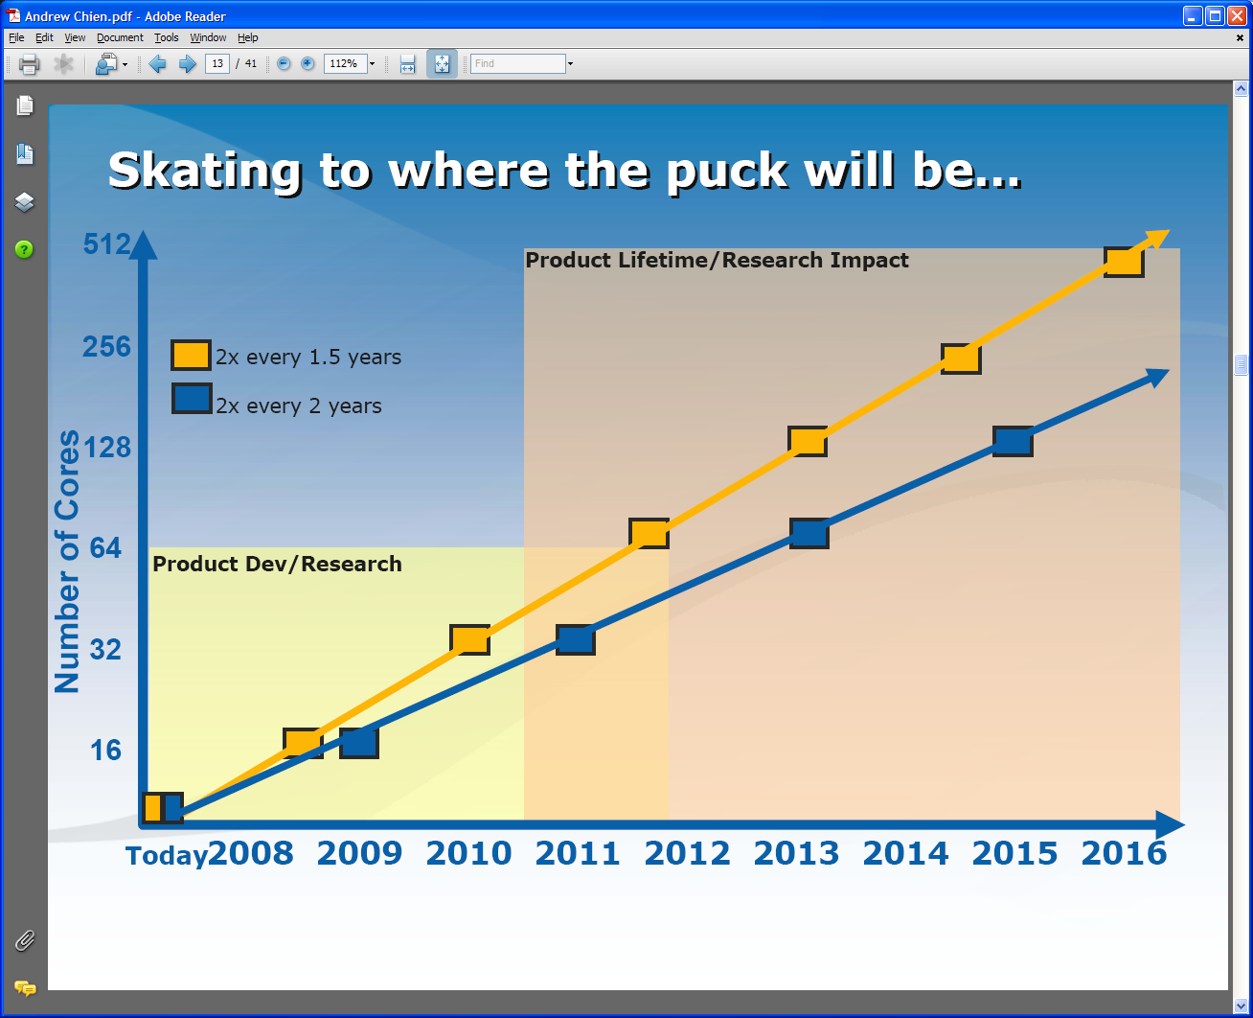
Intel’s Projection

Slide 6
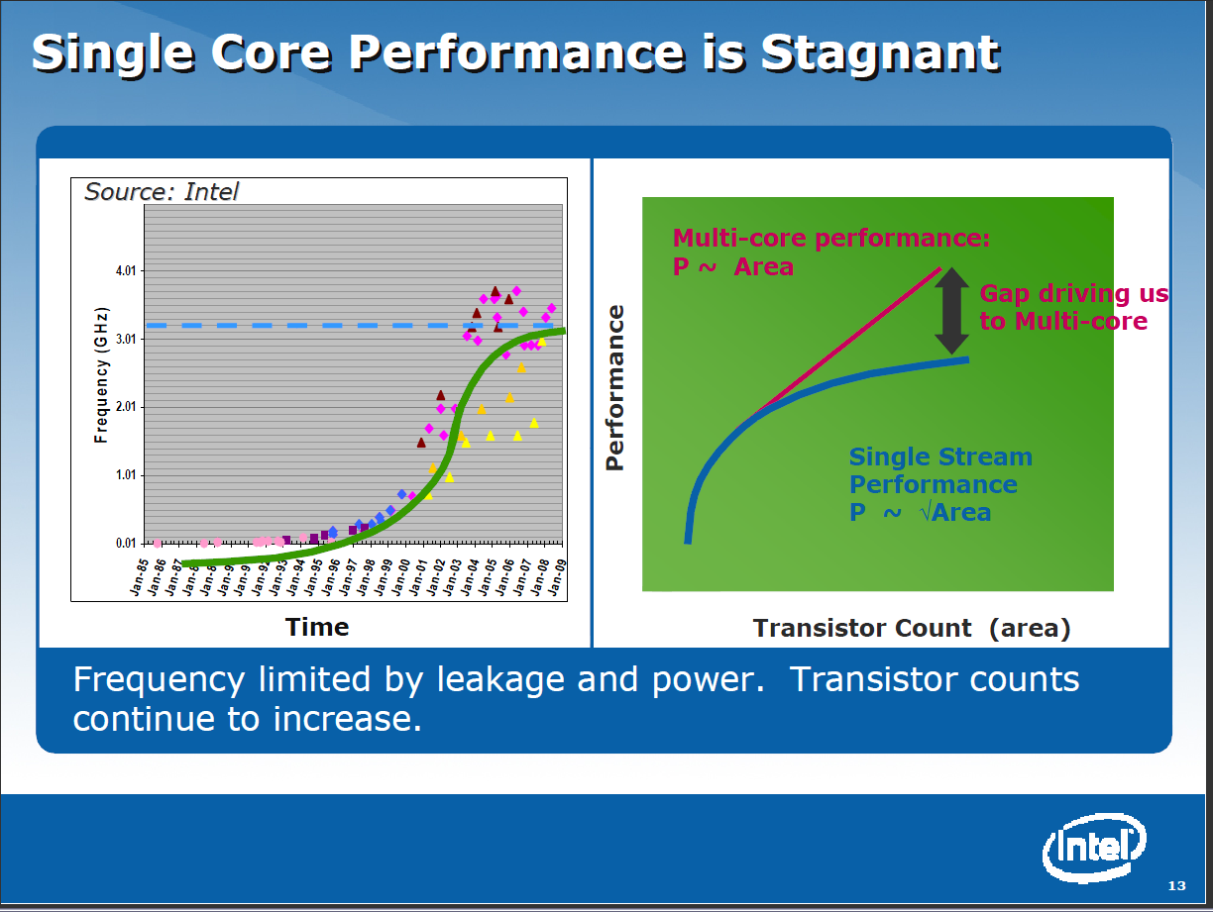

Slide 7
Intel’s Application Stack

Slide 8
Runtime System Used
We implement micro-parallelism using Microsoft CCR
(Concurrency and Coordination Runtime) as it supports both MPI rendezvous and dynamic (spawned) threading style of parallelism http://msdn.microsoft.com/robotics/
CCR Supports exchange of messages between threads using named ports and has primitives like:
  FromHandler: Spawn threads without reading ports
  Receive: Each handler reads one item from a single port
  MultipleItemReceive: Each handler reads a prescribed number of items of a given type from a given port. Note items in a port can be general structures but all must have same type.
  MultiplePortReceive: Each handler reads a one item of a given type from multiple ports.
CCR has fewer primitives than MPI but can implement MPI collectives efficiently
Use DSS (Decentralized System Services) built in terms of CCR for service model
DSS has ~35 µs and CCR a few µs overhead (latency, details later)

Slide 9
Typical CCR Performance Measurement
Performance of CCR vs MPI for MPI Exchange Communication
Machine | OS | Runtime | Grains | Parallelism | MPI Latency
Intel8 (8 core, Intel Xeon CPU, E5345, 2.33 Ghz, 8MB cache, 8GB memory) (in 2 chips) | Redhat | MPJE(Java) | Process | 8 | 181
 |  | MPICH2 (C) | Process | 8 | 40.0
 |  | MPICH2:Fast | Process | 8 | 39.3
 |  | Nemesis | Process | 8 | 4.21
Intel8 (8 core, Intel Xeon CPU, E5345, 2.33 Ghz, 8MB cache, 8GB memory) | Fedora | MPJE | Process | 8 | 157
 |  | mpiJava | Process | 8 | 111
 |  | MPICH2 | Process | 8 | 64.2
Intel8 (8 core, Intel Xeon CPU, x5355, 2.66 Ghz, 8 MB cache, 4GB memory) | Vista | MPJE | Process | 8 | 170
 | Fedora | MPJE | Process | 8 | 142
 | Fedora | mpiJava | Process | 8 | 100
 | Vista | CCR (C#) | Thread | 8 | 20.2
AMD4 (4 core, AMD Opteron CPU, 2.19 Ghz, processor 275, 4MB cache, 4GB memory) | XP | MPJE | Process | 4 | 185
 | Redhat | MPJE | Process | 4 | 152
 |  | mpiJava | Process | 4 | 99.4
 |  | MPICH2 | Process | 4 | 39.3
 | XP | CCR | Thread | 4 | 16.3
Intel4 (4 core, Intel Xeon CPU, 2.80GHz, 4MB cache, 4GB memory) | XP | CCR | Thread | 4 | 25.8
MPI Exchange Latency in µs (20-30 µs computation between messaging)
CCR outperforms Java always and even standard C except for optimized Nemesis

Slide 10
Notes on Performance
Speed up = T(1)/T(P) = ε (efficiency ) P
  with P processors
Overhead f = (PT(P)/T(1)-1) = (1/ε -1)
is linear in overheads and usually best way to record results if overhead small
For communication f ∝ ratio of data communicated to calculation complexity = n^{-0.5} for matrix multiplication where n (grain size) matrix elements per node
Overheads decrease in size as problem sizes n increase (edge over area rule)
Scaled Speed up: keep grain size n fixed as P increases
Conventional Speed up: keep Problem size fixed n ∝ 1/P

Slide 11
Threading versus MPI on node
Always MPI between nodes
Clustering by Deterministic Annealing
(Parallel Overhead = [PT(P) – T(1)]/T(1), where T time and P number of parallel units)
MPI
MPI
Parallel Overhead
MPI
Thread
Thread
Thread
Thread
Thread
MPI
MPI
MPI
MPI
Thread
Thread
Parallel Patterns (ThreadsxProcessesxNodes)
Note MPI best at low levels of parallelism
Threading best at Highest levels of parallelism (64 way breakeven)
Uses MPI.Net as an interface to MS-MPI

Slide 12
Typical CCR Comparison with TPL
Efficiency = 1 / (1 + Overhead)
Hybrid internal threading/MPI as intra-node model works well on Windows HPC cluster
Within a single node TPL or CCR outperforms MPI for computation intensive applications like clustering of Alu sequences (“all pairs” problem)
TPL outperforms CCR in major applications

Slide 13
CCR Overhead for a computation of 23.76 µs between messaging
Intel8b: 8 Core |  | Number of Parallel Computations
(μs) |  | 1 | 2 | 3 | 4 | 7 | 8
Spawned | Pipeline | 1.58 | 2.44 | 3 | 2.94 | 4.5 | 5.06
 | Shift |  | 2.42 | 3.2 | 3.38 | 5.26 | 5.14
 | Two Shifts |  | 4.94 | 5.9 | 6.84 | 14.32 | 19.44
 | Pipeline | 2.48 | 3.96 | 4.52 | 5.78 | 6.82 | 7.18
 | Shift |  | 4.46 | 6.42 | 5.86 | 10.86 | 11.74
 | Exchange As Two Shifts |  | 7.4 | 11.64 | 14.16 | 31.86 | 35.62
 | Exchange |  | 6.94 | 11.22 | 13.3 | 18.78 | 20.16
Rendezvous
MPI

Slide 14
Time Microseconds
Stages (millions)
Overhead (latency) of AMD4 PC with 4 execution threads on MPI style Rendezvous Messaging for Shift and Exchange implemented either as two shifts or as custom CCR pattern

Slide 15
Time Microseconds
Stages (millions)
Overhead (latency) of Intel8b PC with 8 execution threads on MPI style Rendezvous Messaging for Shift and Exchange implemented either as two shifts or as custom CCR pattern

Slide 16
Parallel Pairwise Clustering PWDA
Speedup Tests on eight 16-core Systems (6 Clusters, 10,000 records)
Threading with Short Lived CCR Threads
Parallel Overhead
128-way
64-way
48-way
16-way
32-way
4-way
8-way
2-way
8x1x1
2x8x3
4x4x3
8x1x8
2x8x8
4x2x6
1x2x1
1x8x8
1x1x2
2x1x1
1x2x2
1x4x1
2x1x2
2x2x1
4x1x1
1x4x2
1x8x1
2x2x2
2x4x1
4x1x2
4x2x1
1x8x2
2x4x2
2x8x1
4x2x2
4x4x1
8x1x2
8x2x1
2x8x2
4x4x2
8x2x2
1x8x6
2x4x6
2x4x8
4x2x8
1x16x1
1x16x4
2x8x4
8x2x4
4x4x8
16x1x1
1x16x8
8x2x8
1x16x2
16x1x2
1x16x3
16x1x4
16x1x8
Parallel Patterns (# Thread /process) x (# MPI process /node) x (# node)
June 3 2009

Slide 17
June 11 2009
Parallel Pairwise Clustering PWDA
Speedup Tests on eight 16-core Systems (6 Clusters, 10,000 records)
Threading with Short Lived CCR Threads
Parallel Overhead
Parallel Patterns (# Thread /process) x (# MPI process /node) x (# node)

Slide 18
PWDA Parallel Pairwise data clustering
by Deterministic Annealing run on 24 core computer
Parallel
Overhead
Intra-node
MPI
Inter-node
MPI
Threading
Parallel Pattern (Thread X Process X Node)
June 11 2009

Slide 19
Important Trends
Data Deluge
Multicore
Big Data Sciences
Cloud Technologies
Notes:
Within past 5 year
Data -> Hardware -> Software -> Application
Data coming from everywhere 24/7.
Data are too large to fit into memory and take impractical time to run and get results
e.g. 50K all pairs SWG (O(N2)) takes ~5 hours on 768 cores. A sequential run takes 160 days.
MPI OpenMP RPC RMI

Slide 20


Clouds as Cost Effective Data Centers
Builds giant data centers with 100,000’s of computers; ~ 200
-1000 to a shipping container with Internet access
“Microsoft will cram between 150 and 220 shipping containers filled with data center gear into a new 500,000 square foot Chicago facility. This move marks the most significant, public use of the shipping container systems popularized by the likes of Sun Microsystems and Rackable Systems to date.”

Slide 21

Clouds hide Complexity
SaaS: Software as a Service
IaaS: Infrastructure as a Service or HaaS: Hardware as a Service – get your computer time with a credit card and with a Web interaface
PaaS: Platform as a Service is IaaS plus core software capabilities on which you build SaaS
Cyberinfrastructure is “Research as a Service”
SensaaS is Sensors as a Service
2 Google warehouses of computers on the banks of the Columbia River, in The Dalles, Oregon
Such centers use 20MW-200MW
(Future) each
150 watts per core
Save money from large size, positioning with cheap power and access with Internet

Slide 22
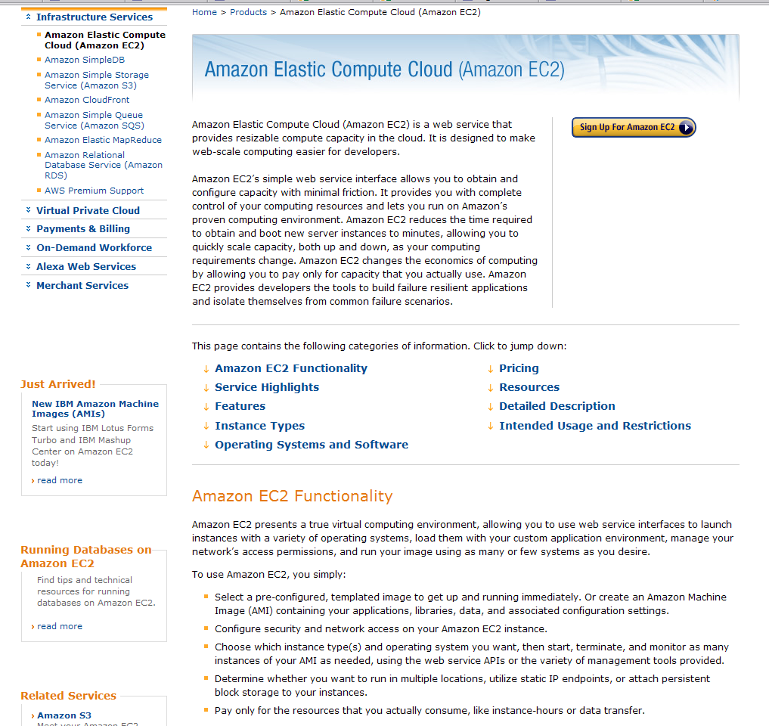

Slide 23
Philosophy of Clouds and Grids
Clouds are (by definition) commercially supported approach to large scale computing
  So we should expect Clouds to replace Compute Grids
  Current Grid technology involves “non-commercial” software solutions which are hard to evolve/sustain
  Maybe Clouds ~4% IT expenditure 2008 growing to 14% in 2012 (IDC Estimate)
Public Clouds are broadly accessible resources like Amazon and Microsoft Azure – powerful but not easy to optimize and perhaps data trust/privacy issues
Private Clouds run similar software and mechanisms but on “your own computers”
Services still are correct architecture with either REST (Web 2.0) or Web Services

Slide 24
Cloud Computing: Infrastructure and Runtimes
Cloud infrastructure: outsourcing of servers, computing, data, file space, utility computing, etc.
  Handled through Web services that control virtual machine lifecycles.
Cloud runtimes: tools (for using clouds) to do data-parallel computations.
  Apache Hadoop (PigLatin, SCOPE), Google MapReduce, Microsoft Dryad, and others
  Designed for information retrieval but are excellent for a wide range of science data analysis applications
  Can also do much traditional parallel computing for data-mining if extended to support iterative operations
  Not usually on Virtual Machines

Slide 25
Map Reduce
The Story of Sam …

Slide 26


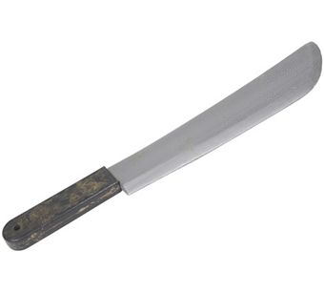
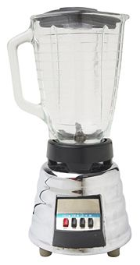

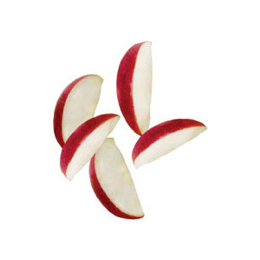
Introduction to MapReduce
One day
Sam thought of “drinking” the apple
He used a to cut the and a and a to make juice.

Slide 27
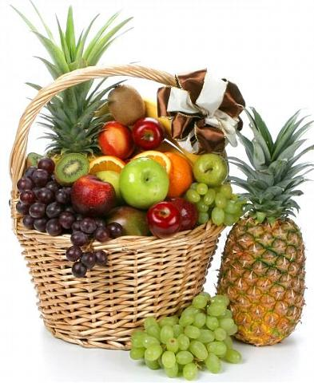

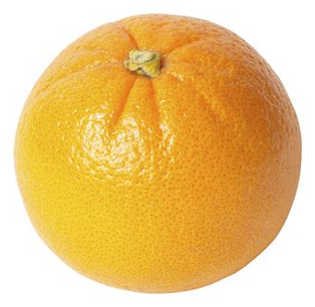

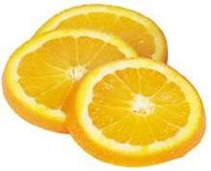
Next Day
Sam applied his invention to all the fruits he could find in the fruit basket
(map ‘( ))
A list of values mapped into another list of values, which gets reduced into a single value
( )
(reduce ‘( ))
Classical Notion of Map Reduce in Functional Programming

Slide 28

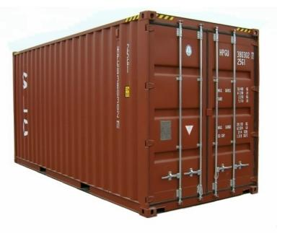
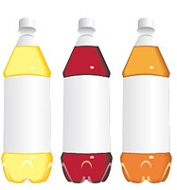
18 Years Later
Sam got his first job in JuiceRUs for his talent in making juice
Wait!
Now, it’s not just one basket but a whole container of fruits
Fruits
Large data and list of values for output
Also, they produce a list of juice types separately
But, Sam had just ONE and ONE
NOT ENOUGH !!

Slide 29



Brave Sam
Implemented a parallel version of his innovation
Fruits
Each input to a map is a list of <key, value> pairs
(<a, > , <o, > , <p, > , …)
Each output of a map is a list of <key, value> pairs
A list of <key, value> pairs mapped into another list of <key, value> pairs which gets grouped by the key and reduced into a list of values
(<a’, > , <o’, > , <p’, > , …)
Grouped by key
Each input to a reduce is a <key, value-list> (possibly a list of these, depending on the grouping/hashing mechanism)
e.g. <a’, ( …)>
Reduced into a list of values
The idea of Map Reduce in Data Intensive Computing

Slide 30
Afterwards
Sam realized,
  To create his favorite mix fruit juice he can use a combiner after the reducers
  If several <key, value-list> fall into the same group (based on the grouping/hashing algorithm) then use the blender (reducer) separately on each of them
  The knife (mapper) and blender (reducer) should not contain residue after use – Side Effect Free
  In general reducer should be associative and commutative
That’s All ─ We think verybody can be Sam ☺

Slide 31
Important Trends
Data Deluge
Multicore
Big Data Sciences
Cloud Technologies
Notes:
Within past 5 year
Data -> Hardware -> Software -> Application
Data coming from everywhere 24/7.
Data are too large to fit into memory and take impractical time to run and get results
e.g. 50K all pairs SWG (O(N2)) takes ~5 hours on 768 cores. A sequential run takes 160 days.
MPI OpenMP RPC RMI

Slide 32
Parallel Data Analysis Algorithms on Multicore
Developing a suite of parallel data-analysis capabilities
  Clustering with deterministic annealing (DA)
  Dimension Reduction for visualization and analysis
  Matrix algebra as needed
    Matrix Multiplication
    Equation Solving
    Eigenvector/value Calculation
Notes:
Results
Microsoft CCR supports MPI, dynamic threading
Detailed performance measurements with Speedups of 7.5 or above on 8-core systems for “large problems” using deterministic annealed (avoid local minima) algorithms for clustering, Gaussian Mixtures, GTM (dimensional reduction) etc.

Slide 33
General Formula DAC GM GTM DAGTM DAGM
N data points E(x) in D dimensions space and minimize F by EM
  Deterministic Annealing Clustering (DAC)
F is Free Energy
EM is well known expectation maximization method
p(x) with Σ p(x) =1
T is annealing temperature (distance resolution) varied down from ∞ with final value of 1
Determine cluster center Y(k) by EM method
K (number of clusters) starts at 1 and is incremented by algorithm
Vector and Pairwise distance versions of DAC
DA also applied to dimension reduce (MDS and GTM)

Slide 34
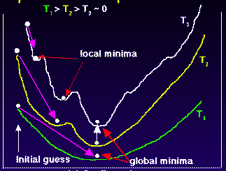
Deterministic
Annealing
F({Y}, T)
Solve Linear Equations for each temperature
Nonlinearity removed by approximating with solution at previous higher temperature
Configuration {Y}
Minimum evolving as temperature decreases
Movement at fixed temperature going to local minima if not initialized “correctly”

Slide 35
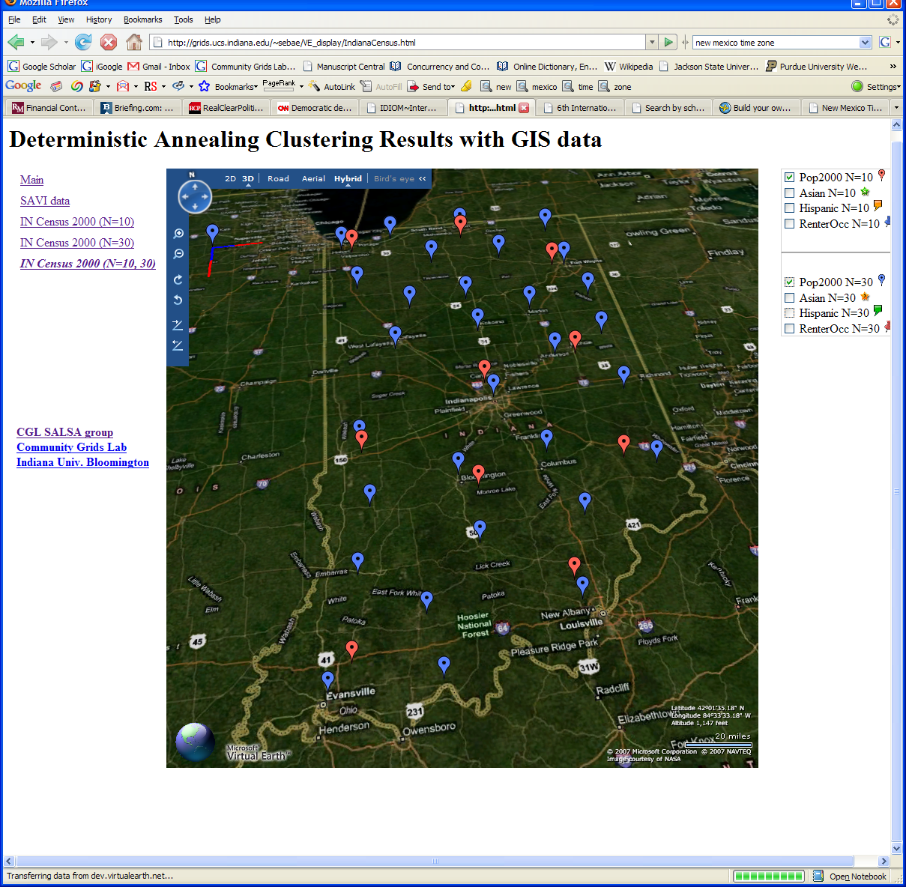
Deterministic Annealing Clustering of Indiana Census Data
Decrease temperature (distance scale) to discover more clusters
Notes:
Blue and Red baloon shows different resolutions.
Notice that the Coarse resolution (in red) doesn’t show Purdue.

Slide 36
Data Intensive Architecture
Instruments
User Data
Files
Files
Files
Visualization
User Portal
Knowledge
Discovery
Users
Files
Files
Files
Initial
Processing
Higher Level
Processing
Such as R
PCA, Clustering
Correlations …
Maybe MPI
Prepare for
Viz
MDS
Notes:
From 1980-2000?, we largely looked at HPC for simulation; now we have data deluge
1) Data starts on some disk/sensor/instrument
It needs to be decomposed/partitioned; often partitioning natural from source of data
2) One runs a filter of some sort extracting data of interest and (re)formatting it
Pleasingly parallel with often “millions” of jobs
Communication latencies can be many milliseconds and can involve disks
3) Using same (or map to a new) decomposition, one runs a possibly parallel application that could require iterative steps between communicating processes or could be pleasing parallel
Communication latencies may be at most some microseconds and involves shared memory or high speed networks
Workflow links 1) 2) 3) with multiple instances of 2) 3)
Pipeline or more complex graphs
Filters are “Maps” or “Reductions” in MapReduce language

Slide 37






MapReduce “File/Data Repository” Parallelism
Instruments
Map = (data parallel) computation reading and writing data
Reduce = Collective/Consolidation phase e.g. forming multiple global sums as in histogram
Communication via Messages/Files
Portals
/Users
Disks
Map₁
Map₂
Map₃
Reduce
Computers/Disks

Slide 38

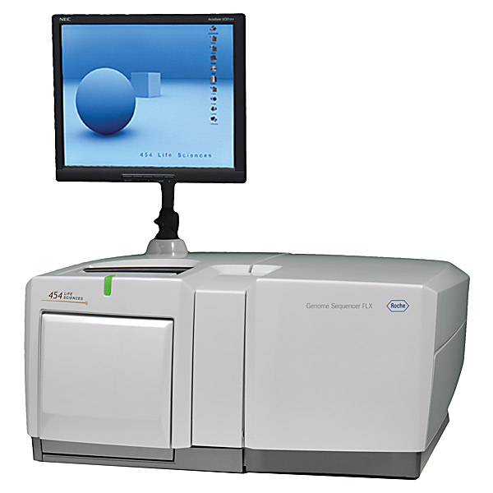
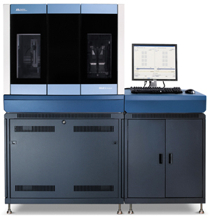
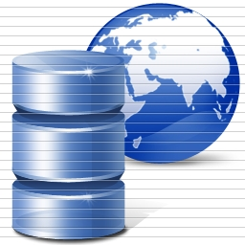
DNA Sequencing Pipeline
Illumina/Solexa Roche/454 Life Sciences Applied Biosystems/SOLiD
Internet
~300 million base pairs per day leading to
~3000 sequences per day per instrument
? 500 instruments at ~0.5M$ each
Read Alignment
Pairwise
clustering
Form block
Pairings
Sequence
alignment
Dissimilarity
Matrix
N(N-1)/2 values
Visualization
Plotviz
FASTA File
N Sequences
Blocking
MPI
MDS
MapReduce

Slide 39
Alu and Sequencing Workflow
Data is a collection of N sequences – 100’s of characters long
  These cannot be thought of as vectors because there are missing characters
  “Multiple Sequence Alignment” (creating vectors of characters) doesn’t seem to work if N larger than O(100)
Can calculate N² dissimilarities (distances) between sequences (all pairs)
Find families by clustering (much better methods than Kmeans). As no vectors, use vector free O(N²) methods
Map to 3D for visualization using Multidimensional Scaling MDS – also O(N²)
N = 50,000 runs in 10 hours (all above) on 768 cores
Our collaborators just gave us 170,000 sequences and want to look at 1.5 million – will develop new algorithms!
MapReduce++ will do all steps as MDS, Clustering just need MPI Broadcast/Reduce

Slide 40
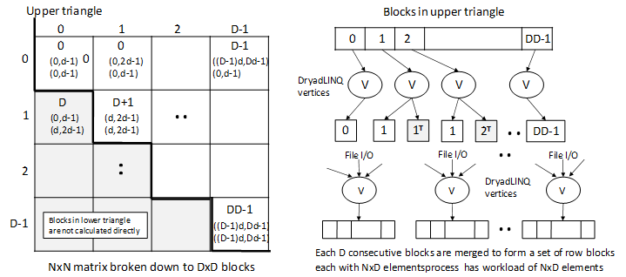
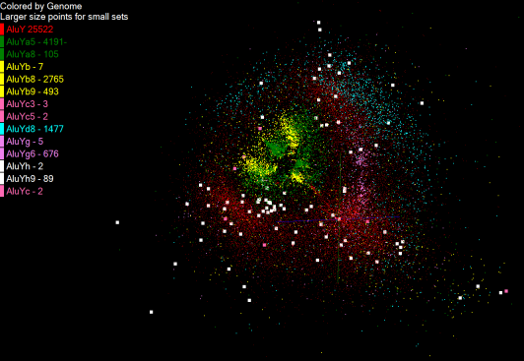
Pairwise Distances – ALU Sequences
125 million distances
4 hours & 46 minutes
Calculate pairwise distances for a collection of genes (used for clustering, MDS)
O(N^2) problem
“Doubly Data Parallel” at Dryad Stage
Performance close to MPI
Performed on 768 cores (Tempest Cluster)
Processes work better than threads when used inside vertices
100% utilization vs. 70%
Notes:
1~180 lines without threading in DryadLINQ, with threading, it is about 400 lines
MPI ~500 lines
The Alu clustering problem [27] is one of the most challenging problems for sequencing clustering because Alus represent the largest repeat families in human genome. There are about 1 million copies of Alu sequences in human genome, in which most insertions can be found in other primates and only a small fraction (~ 7000) are human-specific. This indicates that the classification of Alu repeats can be deduced solely from the 1 million human Alu elements. Notable, Alu clustering can be viewed as a classical case study for the capacity of computational infrastructures because it is not only of great intrinsic biological interests, but also a problem of a scale that will remain as the upper limit of many other clustering problem in bioinformatics for the next few years, e.g. the automated protein family classification for a few millions of proteins predicted from large metagenomics projects. In our work here we examine Alu samples of 35339 and 50,000 sequences.

Slide 41
Hadoop/Dryad Model
Block Arrangement in Dryad
and Hadoop
Execution Model in Dryad
and Hadoop
Need to generate a single file with full NxN distance matrix

Slide 42
class PartialSum
{ public int sum; public int count; };
static double MergeSums(PartialSum[] sums)
{
int totalSum = 0, totalCount = 0;
for (int i = 0; i < sums.Length; ++i)
{
totalSum += sums[i].sum;
totalCount += sums[i].count;
}
return (double)totalSum / (double)totalCount;
}
Using LINQ constructs, this merge method might be re-
placed by the following:
static double MergeSums(PartialSum[] sums)
{
return (double)sums.Select(x => x.sum).Sum() /
(double)sums.Select(x => x.count).Sum();
}
In this fragment, x => x.sum is an example
of a C# lambda expression.

Slide 43
Microsoft Project Objectives
Explore the applicability of Microsoft technologies to real world scientific domains with a focus on data intensive applications
  Expect data deluge will demand multicore enabled data analysis/mining
  Detailed objectives modified based on input from Microsoft such as interest in CCR, Dryad and TPL
Evaluate and apply these technologies in demonstration systems
  Threading: CCR, TPL
  Service model and workflow: DSS and Robotics toolkit
  MapReduce: Dryad/DryadLINQ compared to Hadoop and Azure
  Classical parallelism: Windows HPCS and MPI.NET,
  XNA Graphics based visualization
Work performed using C#
Provide feedback to Microsoft
Broader Impact
  Papers, presentations, tutorials, classes, workshops, and conferences
  Provide our research work as services to collaborators and general science community

Slide 44
Approach
Use interesting applications (working with domain experts) as benchmarks including emerging areas like life sciences and classical applications such as particle physics
  Bioinformatics - Cap3, Alu, Metagenomics, PhyloD
  Cheminformatics - PubChem
  Particle Physics - LHC Monte Carlo
  Data Mining kernels - K-means, Deterministic Annealing Clustering, MDS, GTM, Smith-Waterman Gotoh
Evaluation Criterion for Usability and Developer Productivity
  Initial learning curve
  Effectiveness of continuing development
  Comparison with other technologies
Performance on both single systems and clusters

Slide 45
Overview of Multicore SALSA Project at IU
The term SALSA or Service Aggregated Linked Sequential Activities, describes our approach to multicore computing where we used services as modules to capture key functionalities implemented with multicore threading.
  This will be expanded as a proposed approach to parallel computing where one produces libraries of parallelized components and combines them with a generalized service integration (workflow) model
We have adopted a multi-paradigm runtime (MPR) approach to support key parallel models with focus on MapReduce, MPI collective messaging, asynchronous threading, coarse grain functional parallelism or workflow.
We have developed innovative data mining algorithms emphasizing robustness essential for data intensive applications. Parallel algorithms have been developed for shared memory threading, tightly coupled clusters and distributed environments. These have been demonstrated in kernel and real applications.

Slide 46
Use any Collection of Computers
We can have various hardware
  Multicore – Shared memory, low latency
  High quality Cluster – Distributed Memory, Low latency
  Standard distributed system – Distributed Memory, High latency
We can program the coordination of these units by
  Threads on cores
  MPI on cores and/or between nodes
  MapReduce/Hadoop/Dryad../AVS for dataflow
  Workflow or Mashups linking services
  These can all be considered as some sort of execution unit exchanging information (messages) with some other unit
And there are traditional parallel computing higher level programming models such as OpenMP, PGAS, HPCS Languages not addressed here

Slide 47
Application Classes
(Parallel software/hardware in terms of 5 “Application architecture” Structures)
1 | Synchronous | Lockstep Operation as in SIMD architectures
2 | Loosely Synchronous | Iterative Compute-Communication stages with independent compute (map) operations for each CPU. Heart of most MPI jobs
3 | Asynchronous | Compute Chess; Combinatorial Search often supported by dynamic threads
4 | Pleasingly Parallel | Each component independent – in 1988, Fox estimated at 20% of total number of applications | Grids
5 | Metaproblems | Coarse grain (asynchronous) combinations of classes 1)-4). The preserve of workflow. | Grids
6 | MapReduce++ | It describes file(database) to file(database) operations which has three subcategories. Pleasingly Parallel Map Only Map followed by reductions Iterative “Map followed by reductions” – Extension of Current Technologies that supports much linear algebra and datamining | Clouds
Notes:
CGL-MapReduce is an example of MapReduce++ -- supports MapReduce model with iteration (data stays in memory and communication via streams not files)

Slide 48
Applications & Different Interconnection Patterns
Map Only | Classic MapReduce | Ite rative Reductions MapReduce++ | Loosely Synchronous
CAP3 Analysis Document conversion (PDF -> HTML) Brute force searches in cryptography Parametric sweeps | High Energy Physics (HEP) Histograms SWG gene alignment Distributed search Distributed sorting Information retrieval | Expectation maximization algorithms Clustering Linear Algebra | Many MPI scientific applications utilizing wide variety of communication constructs including local interactions
- CAP3 Gene Assembly - PolarGrid Matlab data analysis | - Information Retrieval - HEP Data Analysis - Calculation of Pairwise Distances for ALU Sequences | Kmeans Deterministic Annealing Clustering - Multidimensional Scaling MDS | - Solving Differential Equations and - particle dynamics with short range forces
Input
iterations
Input
Input
map
map
map
Pij
reduce
Output
reduce
Domain of MapReduce and Iterative Extensions
MPI

Slide 49
Science Cloud (Dynamic Virtual Cluster) Architecture
Smith Waterman Dissimilarities, CAP-3 Gene Assembly, PhyloD Using DryadLINQ, High Energy Physics, Clustering, Multidimensional Scaling, Generative Topological Mapping
Applications
Services
Runtimes
Apache Hadoop / MapReduce++ / MPI
Microsoft DryadLINQ / MPI
Linux Bare-system
Linux Virtual Machines
Windows Server 2008 HPC
Bare-system
Windows Server 2008 HPC
Infrastructure software
Xen Virtualization
Xen Virtualization
XCAT Infrastructure
Hardware
iDataplex Bare-metal Nodes
Dynamic Virtual Cluster provisioning via XCAT
Supports both stateful and stateless OS images

Slide 50
Cloud Related Technology Research
MapReduce
  Hadoop
  Hadoop on Virtual Machines (private cloud)
  Dryad (Microsoft) on Windows HPCS
MapReduce++ generalization to efficiently support iterative “maps” as in clustering, MDS …
Azure Microsoft cloud
FutureGrid dynamic virtual clusters switching between VM, “Baremetal”, Windows/Linux …

Slide 51
Some Life Sciences Applications
EST (Expressed Sequence Tag) sequence assembly program using DNA sequence assembly program software CAP3.
Metagenomics and Alu repetition alignment using Smith Waterman dissimilarity computations followed by MPI applications for Clustering and MDS (Multi Dimensional Scaling) for dimension reduction before visualization
Correlating Childhood obesity with environmental factors by combining medical records with Geographical Information data with over 100 attributes using correlation computation, MDS and genetic algorithms for choosing optimal environmental factors.
Mapping the 26 million entries in PubChem into two or three dimensions to aid selection of related chemicals with convenient Google Earth like Browser. This uses either hierarchical MDS (which cannot be applied directly as O(N²)) or GTM (Generative Topographic Mapping).

Slide 52
MapReduce
3
Data is split into m parts
A hash function maps the results of the map tasks to r reduce tasks
1
D1
map
reduce
O1
5
D2
A combine task may be necessary to combine all the outputs of the reduce functions together
Data
map
reduce
O2
Dm
map
2
data split
map
reduce
map function is performed on each of these data parts concurrently
4
Once all the results for a particular reduce task is available, the framework executes the reduce task
The framework supports:
  Splitting of data
  Passing the output of map functions to reduce functions
  Sorting the inputs to the reduce function based on the intermediate keys
  Quality of services

Slide 53
MapReduce
Data Partitions
Map(Key, Value)
A hash function maps the results of the map tasks to r reduce tasks
Reduce(Key, List<Value>)
Reduce Outputs
Implementations support:
  Splitting of data
  Passing the output of map functions to reduce functions
  Sorting the inputs to the reduce function based on the intermediate keys
  Quality of service

Slide 54
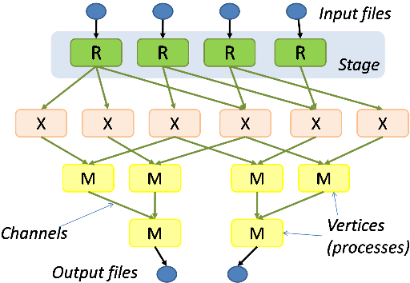
Hadoop & Dryad
Apache Hadoop
Microsoft Dryad
Master Node
Data/Compute Nodes
Job
Tracker
M
M
M
M
R
R
R
R
Name
Node
Data blocks
1
2
2
4
HDFS
3
3
Apache Implementation of Google’s MapReduce
Uses Hadoop Distributed File System (HDFS) manage data
Map/Reduce tasks are scheduled based on data locality in HDFS
Hadoop handles:
  Job Creation
  Resource management
  Fault tolerance & re-execution of failed map/reduce tasks
The computation is structured as a directed acyclic graph (DAG)
  Superset of MapReduce
Vertices – computation tasks
Edges – Communication channels
Dryad process the DAG executing vertices on compute clusters
Dryad handles:
  Job creation, Resource management
  Fault tolerance & re-execution of vertices

Slide 55
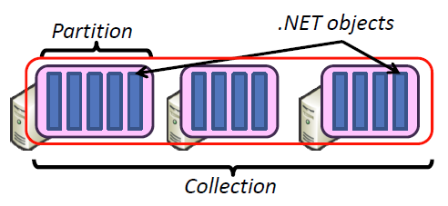
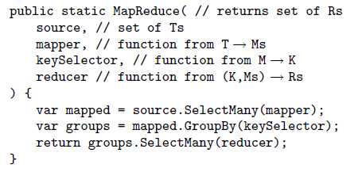
DryadLINQ
Implementation supports:
  Execution of DAG on Dryad
  Managing data across vertices
  Quality of services
Standard LINQ operations
DryadLINQ operations
DryadLINQ Compiler
Vertex :
execution task
Directed Acyclic Graph (DAG) based execution flows
Edge :
communication path
Dryad Execution Engine

Slide 56
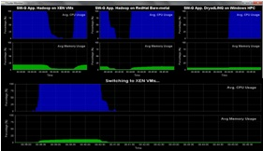
Dynamic Virtual Clusters
Dynamic Cluster Architecture
Monitoring & Control Infrastructure
Monitoring Infrastructure
Monitoring Interface
Pub/Sub Broker Network
SW-G Using Hadoop
SW-G Using Hadoop
SW-G Using DryadLINQ
Linux
Bare-system
Linux on Xen
Windows Server 2008 Bare-system
Virtual/Physical Clusters
Summarizer
XCAT Infrastructure
XCAT Infrastructure
Switcher
iDataplex Bare-metal Nodes
(32 nodes)
iDataplex Bare-metal Nodes
Switchable clusters on the same hardware (~5 minutes between different OS such as Linux+Xen to Windows+HPCS)
Support for virtual clusters
SW-G : Smith Waterman Gotoh Dissimilarity Computation as an pleasingly parallel problem suitable for MapReduce style applications

Slide 57
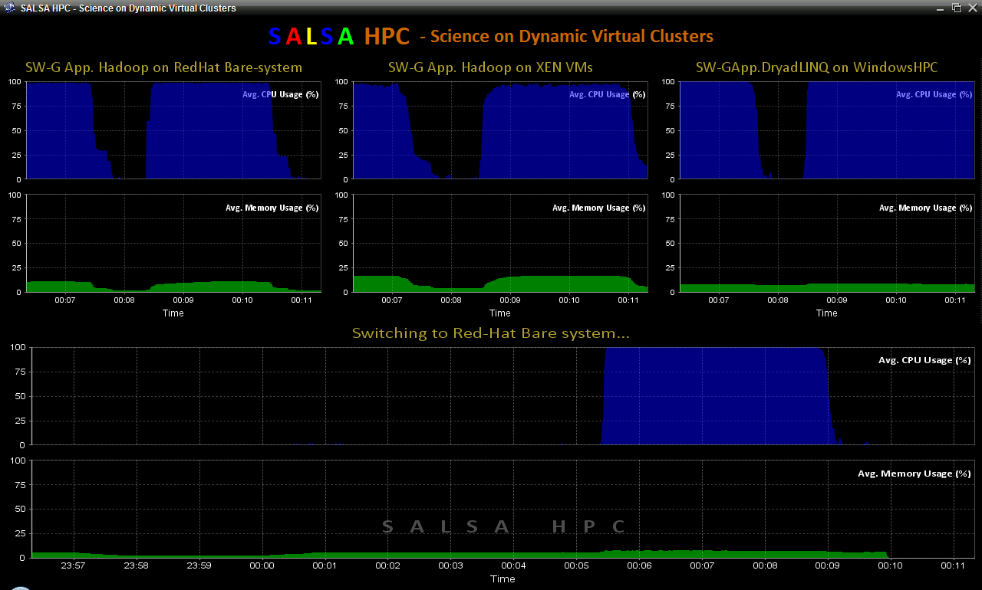
SALSA HPC Dynamic Virtual Clusters Demo
At top, these 3 clusters are switching applications on fixed environment. Takes ~30 Seconds.
At bottom, this cluster is switching between Environments – Linux; Linux +Xen; Windows + HPCS. Takes about ~7 minutes.
It demonstrates the concept of Science on Clouds using a FutureGrid cluster.

Slide 58
8
Client
1, 2, 9, 10
3
4, 6
WS
Daemon
Store
HN
Client submits the job as a zip file to WS
WS returns a GUID for the client
WS hands over the zip and GUID to Daemon
Daemon persists the job in Store with GUID
Daemon invoke HPC Scheduler for the particular job
Daemon poll the HPC Scheduler for the status of stored jobs
HPC Scheduler distributes the job into compute nodes
Daemon notifies client (e.g. mail) when job has completed
Client requests the results from WS using GUID
WS returns the results as a zip file
5, 6
HPC Scheduler
7
CN
CN
CN

Slide 59
Zip Content
  Input Files
    FASTA or Distance file
  Runtime Configuration
    XML to configure MPI versions of SWG, MDS, PWC.
  Output Files
    Empty in the case of request
    Timings, summary, and appropriate output file
  Job Description
    XML file containing info on job (e.g. applications to run, parallelism, total cores, etc.)
Daemon
  File Staging
    Adds a file staging task to the job, but does not record it in job XML.
  Zip/Unzip
    Handles zip/unzip of jobs
  Notification
    Notifies clients (e.g. email) for their completed jobs based on GUID

Slide 60
High Performance
Dimension Reduction and Visualization
Need is pervasive
  Large and high dimensional data are everywhere: biology, physics, Internet, …
  Visualization can help data analysis
Visualization with high performance
  Map high-dimensional data into low dimensions.
  Need high performance for processing large data
  Developing high performance visualization algorithms: MDS(Multi-dimensional Scaling), GTM(Generative Topographic Mapping), DA-MDS(Deterministic Annealing MDS), DA-GTM(Deterministic Annealing GTM), …
Notes:
MDS (Multi-dimensional Scaling)
GTM (Generative Topographic Mapping)
DA-MDS(Deterministic Annealing MDS)
DA-GTM(Deterministic Annealing GTM)

Slide 61
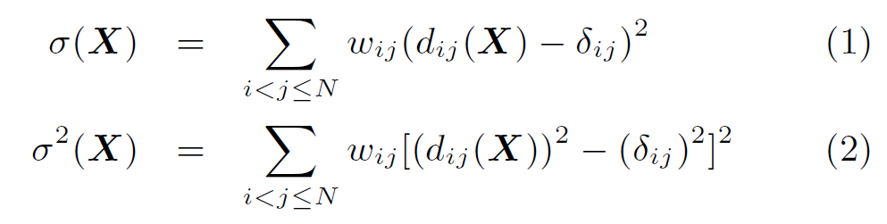

Dimension Reduction Algorithms
Multidimensional Scaling (MDS) [1]
  Given the proximity information among points.
  Optimization problem to find mapping in target dimension of the given data based on pairwise proximity information while minimize the objective function.
  Objective functions: STRESS (1) or SSTRESS (2)
  Only needs pairwise distances δ_{ij} between original points (typically not Euclidean)
  d_{ij}(X) is Euclidean distance between mapped (3D) points
Generative Topographic Mapping
(GTM) [2]
  Find optimal K-representations for the given data (in 3D), known as
  K-cluster problem (NP-hard)
  Original algorithm use EM method for optimization
  Deterministic Annealing algorithm can be used for finding a global solution
  Objective functions is to maximize log-likelihood:
[1] I. Borg and P. J. Groenen. Modern Multidimensional Scaling: Theory and Applications. Springer, New York, NY, U.S.A., 2005.
[2] C. Bishop, M. Svens´en, and C. Williams. GTM: The generative topographic mapping. Neural computation, 10(1):215–234, 1998.

Slide 62
Analysis of 60 Million PubChem Entries
With David Wild
60 million PubChem compounds with 166 features
  Drug discovery
  Bioassay
3D visualization for data exploration/mining
  Mapping by MDS(Multi-dimensional Scaling) and
  GTM(Generative Topographic Mapping)
  Interactive visualization tool PlotViz
  Discover hidden structures

Slide 63
Disease-Gene Data Analysis
Workflow
Disease
-. 34K total
-. 32K unique CIDs
Union
PubChem
MDS/GTM
3D Map
With
Labels
Gene
-. 77K unique CIDs
-. 930K disease and gene data
-. 2M total
-. 147K unique CIDs
(Num of data)

Slide 64
MDS/GTM with PubChem
Project data in the lower-dimensional space by reducing the original dimension
Preserve similarity in the original space as much as possible
GTM needs only vector-based data
MDS can process more general form of input (pairwise similarity matrix)
We have used only 166-bit fingerprints so far for measuring similarity (Euclidean distance)

Slide 65
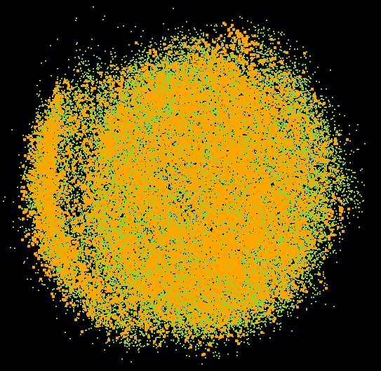
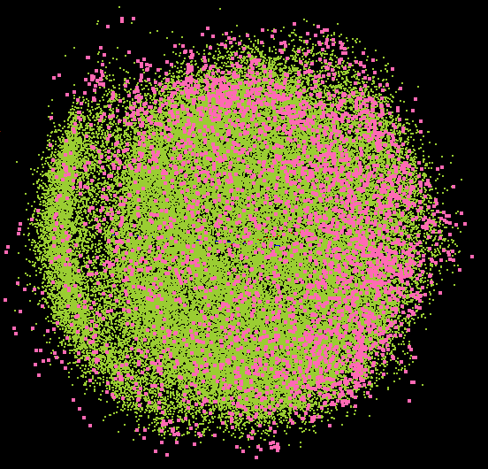
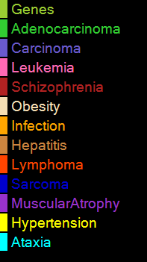
PlotViz Screenshot (I) - MDS

Slide 66
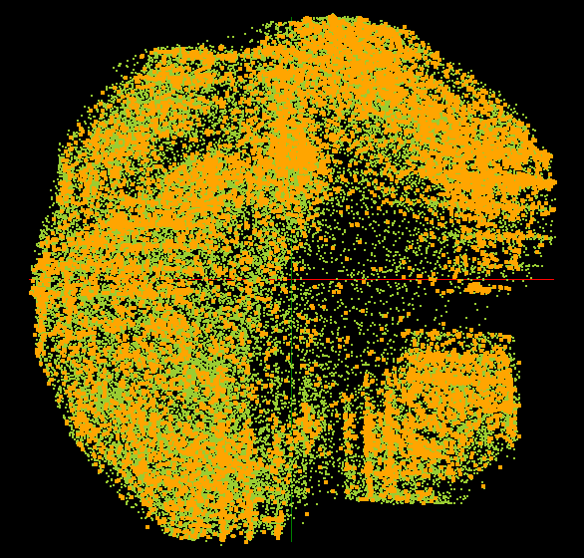
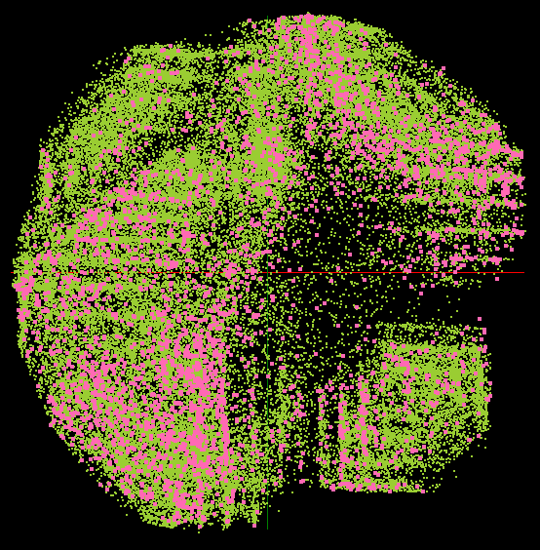
PlotViz Screenshot (II) - GTM

Slide 67
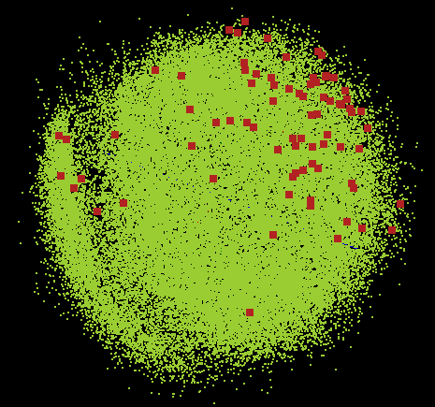
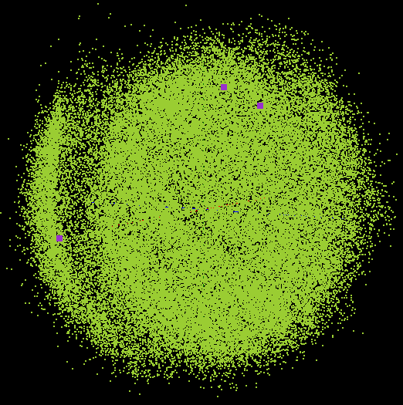
PlotViz Screenshot (III) - MDS

Slide 68
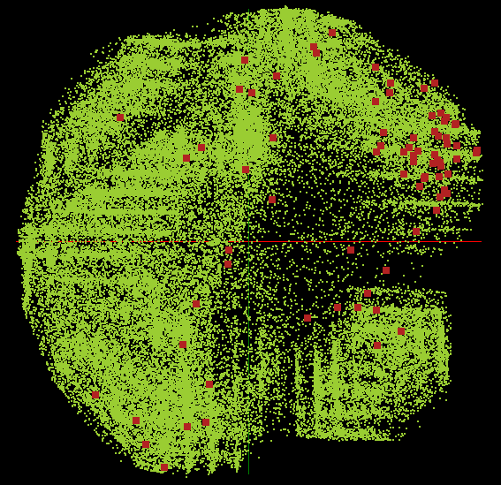
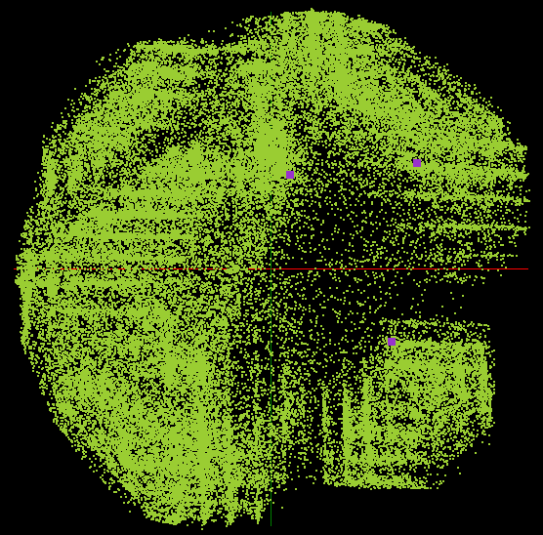
PlotViz Screenshot (IV) - GTM

Slide 69
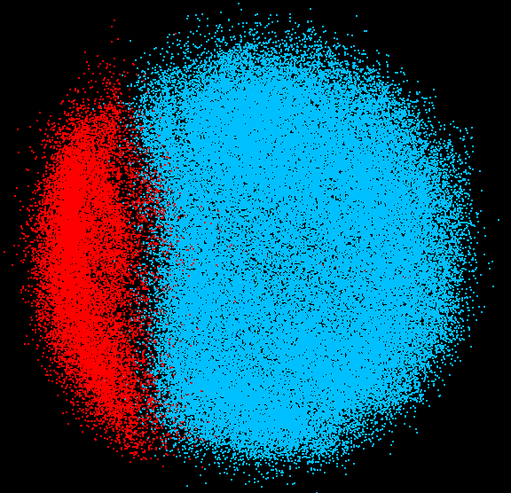
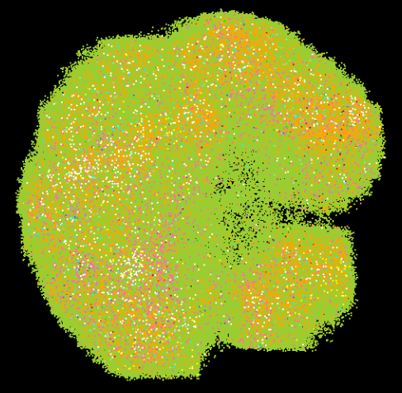
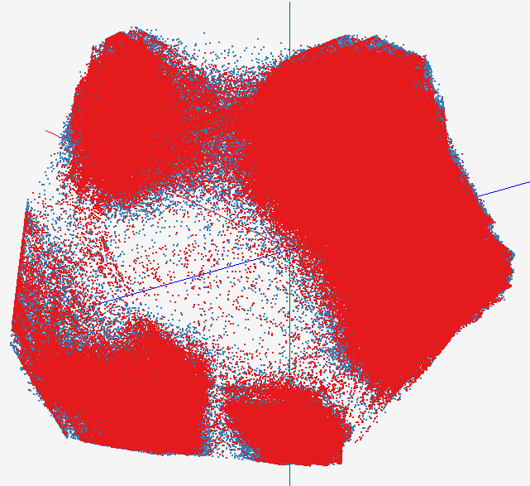
High Performance Data Visualization..
Developed parallel MDS and GTM algorithm to visualize large and high-dimensional data
Processed 0.1 million PubChem data having 166 dimensions
Parallel interpolation can process up to 2M PubChem points
GTM with interpolation for
2M PubChem data
2M PubChem data is plotted in 3D with GTM interpolation approach. Red points are 100k sampled data and blue points are 4M interpolated points.
MDS for 100k PubChem data
100k PubChem data having 166 dimensions are visualized in 3D space. Colors represent 2 clusters separated by their structural proximity.
GTM for 930k genes and diseases
Genes (green color) and diseases (others) are plotted in 3D space, aiming at finding cause-and-effect relationships.
[3] PubChem project, http://pubchem.ncbi.nlm.nih.gov/

Slide 70
Dimension Reduction Algorithms
Multidimensional Scaling (MDS) [1]
  Given the proximity information among points.
  Optimization problem to find mapping in target dimension of the given data based on pairwise proximity information while minimize the objective function.
  Objective functions: STRESS (1) or SSTRESS (2)
  Only needs pairwise distances δ_{ij} between original points (typically not Euclidean)
  d_{ij}(X) is Euclidean distance between mapped (3D) points
Generative Topographic Mapping
(GTM) [2]
  Find optimal K-representations for the given data (in 3D), known as
  K-cluster problem (NP-hard)
  Original algorithm use EM method for optimization
  Deterministic Annealing algorithm can be used for finding a global solution
  Objective functions is to maximize log-likelihood:
[1] I. Borg and P. J. Groenen. Modern Multidimensional Scaling: Theory and Applications. Springer, New York, NY, U.S.A., 2005.
[2] C. Bishop, M. Svens´en, and C. Williams. GTM: The generative topographic mapping. Neural computation, 10(1):215–234, 1998.

Slide 71
Interpolation Method
MDS and GTM are highly memory and time consuming process for large dataset such as millions of data points
MDS requires O(N²) and GTM does O(KN) (N is the number of data points and K is the number of latent variables)
Training only for sampled data and interpolating for out-of-sample set can improve performance
Interpolation is a pleasingly parallel application
n
in-sample
Training
Trained data
N-n
out-of-sample
Interpolated
MDS/GTM map
Interpolation
Total N data

Slide 72
Interpolation Method
Multidimensional Scaling (MDS)
Generative Topographic Mapping (GTM)
Find mapping for a new point based on the pre-mapping result of the sample data (n samples).
For the new input data, find k-NN among those sample data.
Based on the mappings of the k-NN, interpolate the new point.
O(n(N-n)) memory required.
O(n(N-n)) computations
For n samples (n<N), GTM training requires O(Kn)
Training computes the optimal position for K latent variables for n data point
Out-of-sample data (N-n points) is mapped based on the trained result (No training process required)
Interpolation only require O(N-n) memory and time

Slide 73
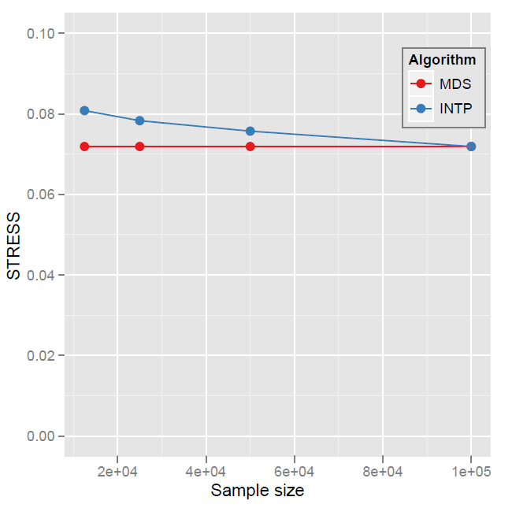
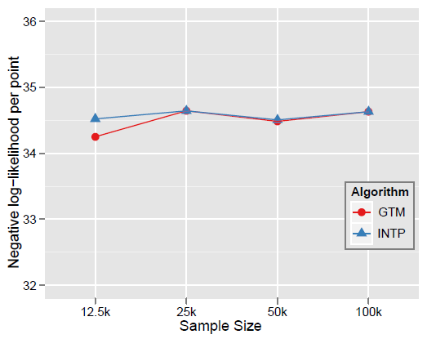

Quality Comparison
(Original vs. Interpolation)
MDS
GTM
Quality comparison between Interpolated result upto 100k based on the sample data (12.5k, 25k, and 50k) and original MDS result w/ 100k.
STRESS:
w_{ij} = 1 / ∑δ_{ij}²
Interpolation result (blue) is getting close to the original (read) result as sample size is increasing.

Slide 74
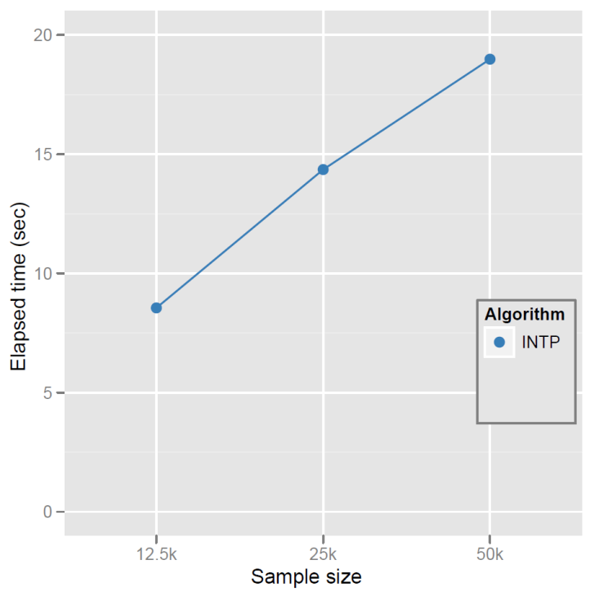
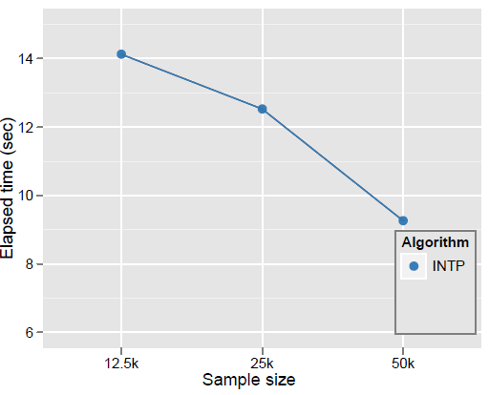
Elapsed Time of Interpolation
MDS
GTM
Elapsed time of parallel MI-MDS running time upto 100k data with respect to the sample size using 16 nodes of the Tempest. Note that the computational time complexity of MI-MDS is O(Mn) where n is the sample size and M = N − n.
Note that original MDS for only 25k data takes 2881.5852 (sec)
Elapsed time for GTM interpolation is O(M) where M=N-n (n is the samples size), which is decreasing as the sample size increased

Slide 75
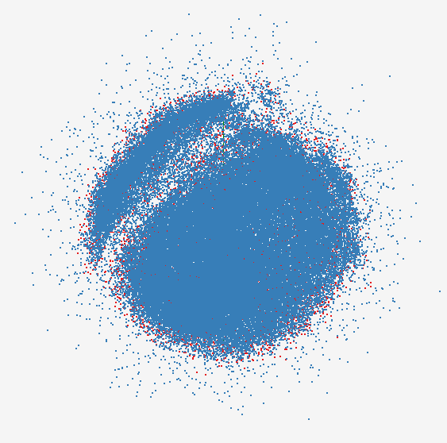
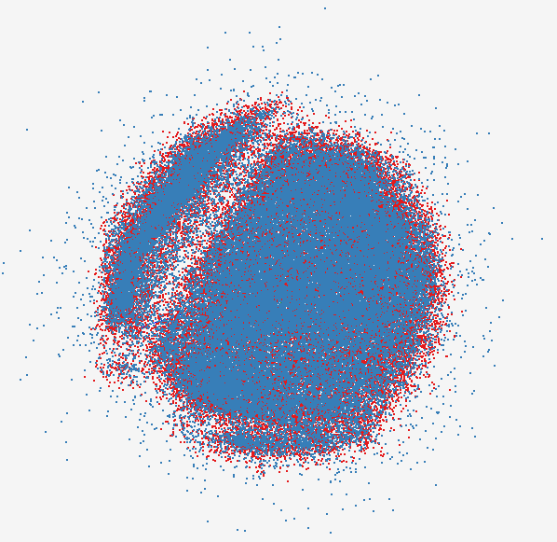
MDS Interpolation
MDS interpolation results for the 112.5k PubChem data with 100k in-sample (blue) and 12.5k out-of-sample (red)
MDS interpolation results for the 150k PubChem data with 100k in-sample (blue) and 50k out-of-sample (red)

Slide 76
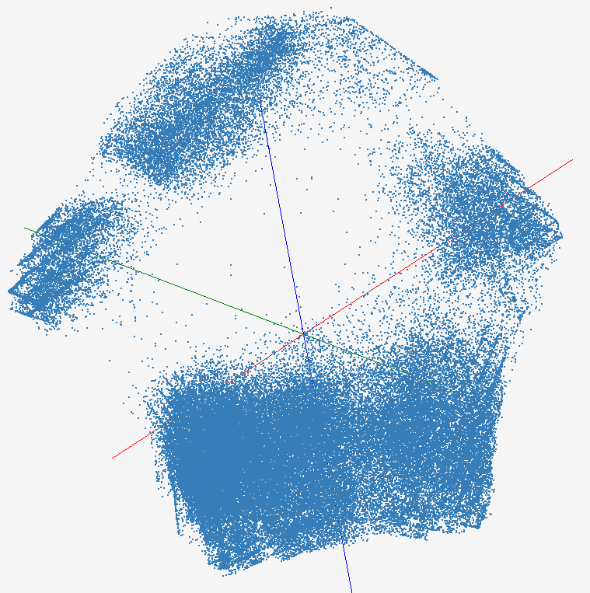
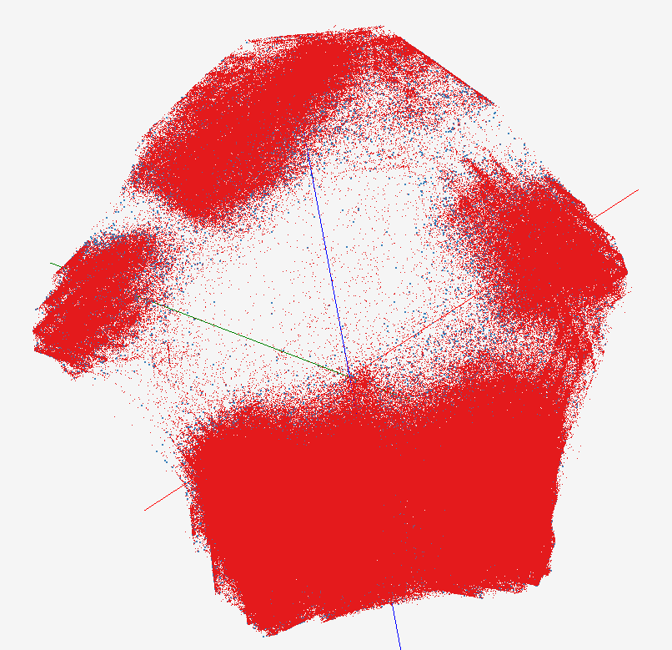
GTM Interpolation
The original GTM result for 100k PubChem dataset
GTM interpolation results for the 2M PubChem data (red points) based on 100k in-sample (blue)

Slide 77
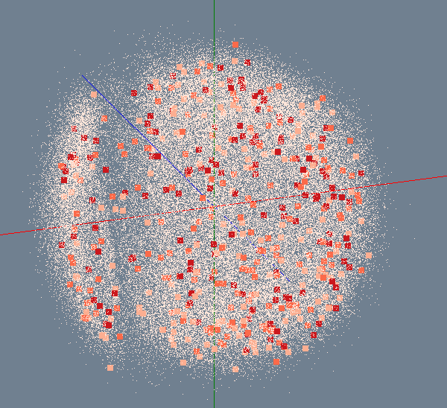
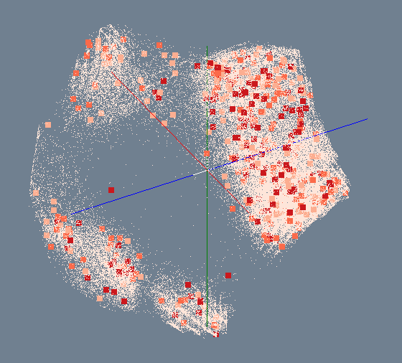
MDS/GTM for 100K PubChem
Number of Activity Results
> 300
200 ~ 300
100 ~ 200
< 100
MDS
GTM

Slide 78
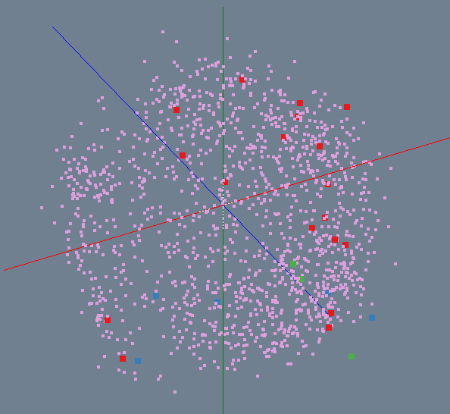
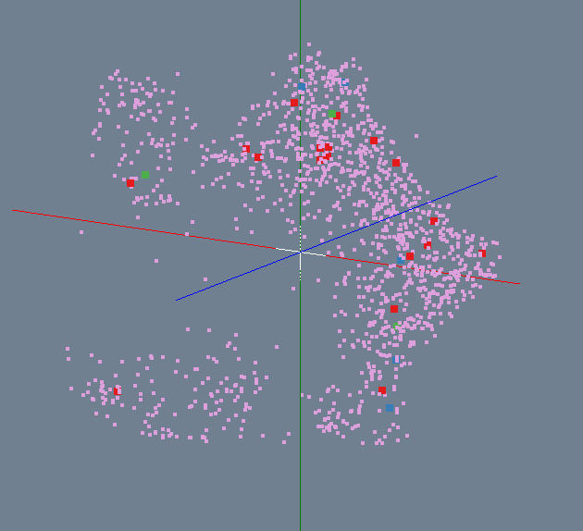
Bioassay activity in PubChem
Highly Active
Active
Inactive
Highly Inactive
MDS
GTM

Slide 79
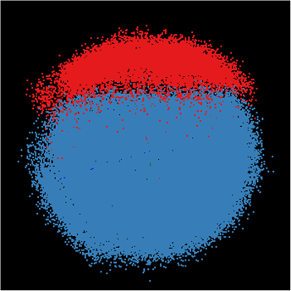
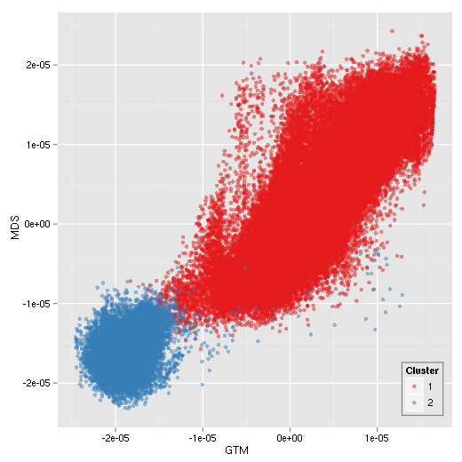

Correlation between MDS/GTM
MDS
GTM
Canonical Correlation between MDS & GTM
Notes:
Colors represent k-mean (k=2) results. Correlation is measured between MDS and GTM by using Canonical Correlation Analysis (CCA) and it shows high-correlation between them.

Slide 80


Biology MDS and Clustering Results
Alu Families
This visualizes results of Alu repeats from Chimpanzee and Human Genomes. Young families (green, yellow) are seen as tight clusters. This is projection of MDS dimension reduction to 3D of 35399 repeats – each with about 400 base pairs
Metagenomics
This visualizes results of dimension reduction to 3D of 30000 gene sequences from an environmental sample. The many different genes are classified by clustering algorithm and visualized by MDS dimension reduction

Slide 81

Hierarchical Subclustering

Slide 82


Applications using Dryad & DryadLINQ (1)
CAP3 [1] - Expressed Sequence Tag assembly to re-construct full-length mRNA
Input files (FASTA)
DryadLINQ
CAP3
CAP3
CAP3
Output files
Perform using DryadLINQ and Apache Hadoop implementations
Single “Select” operation in DryadLINQ
“Map only” operation in Hadoop
[4] X. Huang, A. Madan, “CAP3: A DNA Sequence Assembly Program,” Genome Research, vol. 9, no. 9, pp. 868-877, 1999.

Slide 83


Applications using Dryad & DryadLINQ (2)
PhyloD [2] project from Microsoft Research
Output of PhyloD shows the associations
Derive associations between HLA alleles and HIV codons and between codons themselves
Scalability of DryadLINQ PhyloD Application
[5] Microsoft Computational Biology Web Tools, http://research.microsoft.com/en-us/um/redmond/projects/MSCompBio/

Slide 84

All-Pairs[3] Using DryadLINQ
125 million distances
4 hours & 46 minutes
Calculate Pairwise Distances (Smith Waterman Gotoh)
Calculate pairwise distances for a collection of genes (used for clustering, MDS)
Fine grained tasks in MPI
Coarse grained tasks in DryadLINQ
Performed on 768 cores (Tempest Cluster)
[5] Moretti, C., Bui, H., Hollingsworth, K., Rich, B., Flynn, P., & Thain, D. (2009). All-Pairs: An Abstraction for Data Intensive Computing on Campus Grids. IEEE Transactions on Parallel and Distributed Systems , 21, 21-36.

Slide 85
Dryad versus MPI for Smith Waterman
Flat is perfect scaling

Slide 86
Dryad Scaling on Smith Waterman
Flat is perfect scaling

Slide 87
Dryad for Inhomogeneous Data
Calculation Time per Pair [A,B] α Length A * Length B
Total
Mean Length 400
Computation
Time (ms)
Sequence Length Standard Deviation
Flat is perfect scaling – measured on Tempest
Notes:
Sensitive to small data set; load balance; 10k data size; ??? Labels computation, total

Slide 88
Hadoop/Dryad Comparison
“Homogeneous” Data
Dryad
Hadoop
Time per Alignment (ms)
Dryad with Windows HPCS compared to Hadoop with Linux RHEL on Idataplex
Using real data with standard deviation/length = 0.1
Notes:
Real data; mean length of sequence is 300.

Slide 89
Hadoop/Dryad Comparison
Inhomogeneous Data I
Inhomogeneity of data does not have a significant effect when the sequence lengths are randomly distributed
Dryad with Windows HPCS compared to Hadoop with Linux RHEL on Idataplex (32 nodes)
Notes:
10k data size

Slide 90
Hadoop/Dryad Comparison
Inhomogeneous Data II
This shows the natural load balancing of Hadoop MR dynamic task assignment using a global pipe line in contrast to the DryadLinq static assignment
Dryad with Windows HPCS compared to Hadoop with Linux RHEL on Idataplex (32 nodes)
Notes:
10k data size

Slide 91
Hadoop VM Performance Degradation
Perf. Degradation = (T_{vm} – T_{baremetal})/T_{baremetal}
15.3% Degradation at largest data set size

Slide 92
Block Dependence of Dryad SW-G
Processing on 32 node IDataplex
Dryad Block Size D | 128x128 | 64x64 | 32x32
Time to partition data | 1.839 | 2.224 | 2.224
Time to process data | 30820.0 | 32035.0 | 39458.0
Time to merge files | 60.0 | 60.0 | 60.0
Total Time | 30882.0 | 32097.0 | 39520.0
Smaller number of blocks D increases data size per block and makes cache use less efficient
Other plots have 64 by 64 blocking

Slide 93
Dryad & DryadLINQ Evaluation
Higher Jumpstart cost
  User needs to be familiar with LINQ constructs
Higher continuing development efficiency
  Minimal parallel thinking
  Easy querying on structured data (e.g. Select, Join etc..)
Many scientific applications using DryadLINQ including a High Energy Physics data analysis
Comparable performance with Apache Hadoop
  Smith Waterman Gotoh 250 million sequence alignments, performed comparatively or better than Hadoop & MPI
Applications with complex communication topologies are harder to implement

Slide 94

PhyloD using Azure and DryadLINQ
Derive associations between HLA alleles and HIV codons and between codons themselves

Slide 95
Mapping of PhyloD to Azure

Slide 96
PhyloD Azure Performance
Number of active Azure workers during a run of PhyloD application
Efficiency vs. number of worker roles in PhyloD prototype run on Azure March CTP

Slide 97
CAP3 - DNA Sequence Assembly Program
EST (Expressed Sequence Tag) corresponds to messenger RNAs (mRNAs) transcribed from the genes residing on chromosomes. Each individual EST sequence represents a fragment of mRNA, and the EST assembly aims to re-construct full-length mRNA sequences for each expressed gene.
Input files (FASTA)
GCB-K18-N01
\DryadData\cap3\cap3data
10
0,344,CGB-K18-N01
1,344,CGB-K18-N01
…
9,344,CGB-K18-N01
Cap3data.pf
V
V
Cap3data.00000000
\\GCB-K18-N01\DryadData\cap3\cluster34442.fsa
\\GCB-K18-N01\DryadData\cap3\cluster34443.fsa
...
\\GCB-K18-N01\DryadData\cap3\cluster34467.fsa
Output files
Input files
(FASTA)
IQueryable<LineRecord> inputFiles=PartitionedTable.Get <LineRecord>(uri);
IQueryable<OutputInfo> = inputFiles.Select(x=>ExecuteCAP3(x.line));
[1] X. Huang, A. Madan, “CAP3: A DNA Sequence Assembly Program,” Genome Research, vol. 9, no. 9, pp. 868-877, 1999.

Slide 98

CAP3 - Performance

Slide 99

Application Classes
Old classification of Parallel software/hardware
in terms of 5 (becoming 6) “Application architecture” Structures)
1 | Synchronous | Lockstep Operation as in SIMD architectures
2 | Loosely Synchronous | Iterative Compute-Communication stages with independent compute (map) operations for each CPU. Heart of most MPI jobs | MPP
3 | Asynchronous | Compute Chess; Combinatorial Search often supported by dynamic threads | MPP
4 | Pleasingly Parallel | Each component independent – in 1988, Fox estimated at 20% of total number of applications | Grids
5 | Metaproblems | Coarse grain (asynchronous) combinations of classes 1)-4). The preserve of workflow. | Grids
6 | MapReduce++ | It describes file(database) to file(database) operations which has subcategories including. Pleasingly Parallel Map Only Map followed by reductions Iterative “Map followed by reductions” – Extension of Current Technologies that supports much linear algebra and datamining | Clouds Hadoop/ Dryad Twister
Notes:
CGL-MapReduce is an example of MapReduce++ -- supports MapReduce model with iteration (data stays in memory and communication via streams not files)

Slide 100
Applications & Different Interconnection Patterns
Map Only | Classic MapReduce | Ite rative Reductions MapReduce++ | Loosely Synchronous
CAP3 Analysis Document conversion (PDF -> HTML) Brute force searches in cryptography Parametric sweeps | High Energy Physics (HEP) Histograms SWG gene alignment Distributed search Distributed sorting Information retrieval | Expectation maximization algorithms Clustering Linear Algebra | Many MPI scientific applications utilizing wide variety of communication constructs including local interactions
- CAP3 Gene Assembly - PolarGrid Matlab data analysis | - Information Retrieval - HEP Data Analysis - Calculation of Pairwise Distances for ALU Sequences | Kmeans Deterministic Annealing Clustering - Multidimensional Scaling MDS | - Solving Differential Equations and - particle dynamics with short range forces
Input
iterations
Input
Input
map
map
map
Pij
reduce
Output
reduce
Domain of MapReduce and Iterative Extensions
MPI

Slide 101

Twister(MapReduce++)
Pub/Sub Broker Network
Map Worker
M
Streaming based communication
Intermediate results are directly transferred from the map tasks to the reduce tasks – eliminates local files
Cacheable map/reduce tasks
  Static data remains in memory
Combine phase to combine reductions
User Program is the composer of MapReduce computations
Extends the MapReduce model to iterative computations
Worker Nodes
R
Reduce Worker
D
D
MR
Driver
User
Program
M
M
M
M
D
MRDeamon
R
R
R
R
Data Read/Write
Communication
Data Split
File System
Iterate
Static
data
Configure()
User Program
Map(Key, Value)
δ flow
Reduce (Key, List<Value>)
Combine (Key, List<Value>)
Different synchronization and intercommunication mechanisms used by the parallel runtimes
Close()

Slide 102




Iterative Computations
K-means
Matrix Multiplication
Performance of K-Means
Parallel Overhead Matrix Multiplication

Slide 103


High Energy Physics Data Analysis
Histogramming of events from a large (up to 1TB) data set
Data analysis requires ROOT framework (ROOT Interpreted Scripts)
Performance depends on disk access speeds
Hadoop implementation uses a shared parallel file system (Lustre)
  ROOT scripts cannot access data from HDFS
  On demand data movement has significant overhead
Dryad stores data in local disks
  Better performance

Slide 104

Reduce Phase of Particle Physics
“Find the Higgs” using Dryad
Higgs in Monte Carlo
Combine Histograms produced by separate Root “Maps” (of event data to partial histograms) into a single Histogram delivered to Client

Slide 105
Kmeans Clustering
Time for 20 iterations
Iteratively refining operation
New maps/reducers/vertices in every iteration
File system based communication
Loop unrolling in DryadLINQ provide better performance
The overheads are extremely large compared to MPI
CGL-MapReduce is an example of MapReduce++ -- supports MapReduce model with iteration (data stays in memory and communication via streams not files)
Large
Overheads

Slide 106



Matrix Multiplication & K-Means Clustering
Using Cloud Technologies
Matrix Multiplication
K-Means clustering on 2D vector data
Matrix multiplication in MapReduce model
DryadLINQ and Hadoop, show higher overheads
Twister (MapReduce++) implementation performs closely with MPI
Parallel Overhead
Matrix Multiplication
K-Means Clustering
Average Time
K-means Clustering

Slide 107
Different Hardware/VM configurations
Ref | Description | Number of CPU cores per virtual or bare-metal node | Amount of memory (GB) per virtual or bare-metal node | Number of virtual or bare-metal nodes
BM | Bare-metal node | 8 | 32 | 16
1-VM-8-core (High-CPU Extra Large Instance) | 1 VM instance per bare-metal node | 8 | 30 (2GB is reserved for Dom0) | 16
2-VM-4- core | 2 VM instances per bare-metal node | 4 | 15 | 32
4-VM-2-core | 4 VM instances per bare-metal node | 2 | 7.5 | 64
8-VM-1-core | 8 VM instances per bare-metal node | 1 | 3.75 | 128
Invariant used in selecting the number of MPI processes
Number of MPI processes = Number of CPU cores used

Slide 108

MPI Applications
Feature | Matrix multiplication | K-means clustering | Concurrent Wave Equation
Description | Cannon’s Algorithm square process grid | K-means Clustering Fixed number of iterations | A vibrating string is (split) into points Each MPI process updates the amplitude over time
Grain Size
Computation Complexity | O (n^3) | O(n) | O(n)
Message Size
Communication Complexity | O(n^2) | O(1) | O(1)
Communication/Computation
n
n
1
n
n
d
n
C
1
d
1
n

Slide 109



MPI on Clouds: Matrix Multiplication
Performance - 64 CPU cores
Speedup – Fixed matrix size (5184x5184)
Implements Cannon’s Algorithm
Exchange large messages
More susceptible to bandwidth than latency
At 81 MPI processes, 14% reduction in speedup is seen for 1 VM per node

Slide 110



MPI on Clouds Kmeans Clustering
Performance – 128 CPU cores
Overhead
Perform Kmeans clustering for up to 40 million 3D data points
Amount of communication depends only on the number of cluster centers
Amount of communication << Computation and the amount of data processed
At the highest granularity VMs show at least 33% overhead compared to bare-metal
Extremely large overheads for smaller grain sizes
Overhead = (P * T(P) –T(1))/T(1)

Slide 111



MPI on Clouds
Parallel Wave Equation Solver
Performance - 64 CPU cores
Total Speedup – 30720 data points
Clear difference in performance and speedups between VMs and bare-metal
Very small messages (the message size in each MPI_Sendrecv() call is only 8 bytes)
More susceptible to latency
At 51200 data points, at least 40% decrease in performance is observed in VMs

Slide 112
Child Obesity Study
Discover environmental factors related with child obesity
About 137,000 Patient records with 8 health-related and 97 environmental factors has been analyzed
Health data
Environment data
Genetic Algorithm
BMI
Blood Pressure
Weight
Height
…
Greenness
Neighborhood
Population
Income
…
Canonical Correlation Analysis
Visualization

Slide 113

Apply MDS to Patient Record Data
and correlation to GIS properties
MDS and Primary PCA Vector
MDS of 635 Census Blocks with 97 Environmental Properties
Shows expected Correlation with Principal Component – color varies from greenish to reddish as projection of leading eigenvector changes value
Ten color bins used

Slide 114

Canonical Correlation Analysis
and Multidimensional Scaling
The plot of the first pair of canonical variables for 635 Census Blocks compared to patient records

Slide 115
Summary: Key Features of our Approach I
Intend to implement range of biology applications with Dryad/Hadoop
FutureGrid allows easy Windows v Linux with and without VM comparison
Initially we will make key capabilities available as services that we eventually implement on virtual clusters (clouds) to address very large problems
  Basic Pairwise dissimilarity calculations
  R (done already by us and others)
  MDS in various forms
  Vector and Pairwise Deterministic annealing clustering
Point viewer (Plotviz) either as download (to Windows!) or as a Web service
Note much of our code written in C# (high performance managed code) and runs on Microsoft HPCS 2008 (with Dryad extensions)
  Hadoop code written in Java

Slide 116
Summary: Key Features of our Approach II
Dryad/Hadoop/Azure promising for Biology computations
Dynamic Virtual Clusters allow one to switch between different modes
Overhead of VM’s on Hadoop (15%) acceptable
Inhomogeneous problems currently favors Hadoop over Dryad
MapReduce++ allows iterative problems (classic linear algebra/datamining) to use MapReduce model efficiently
  Prototype Twister released

Slide 117
Convergence is Happening
Multicore
Clouds
Data intensive application (three basic activities):
capture, curation, and analysis (visualization)
Data Intensive
Paradigms
Cloud infrastructure and runtime
Parallel threading and processes
Notes:
Jim Gray’s talk to the Computer Science and Telecommunications Board in 2007
His vision of the fourth paradigm of scientific research. Focus on Data-intensive Systems and Scientific communications
New scientific research is highlighted by “data science”

Slide 118
DNA Sequencing Pipeline
Illumina/Solexa Roche/454 Life Sciences Applied Biosystems/SOLiD
Internet
~300 million base pairs per day leading to
~3000 sequences per day per instrument
? 500 instruments at ~0.5M$ each
Read Alignment
Pairwise
clustering
Form block
Pairings
Sequence
alignment
Dissimilarity
Matrix
N(N-1)/2 values
Visualization
Plotviz
FASTA File
N Sequences
Blocking
MPI
MDS
MapReduce

Slide 119
Future Work
The support for handling large data sets, the concept of moving computation to data, and the better quality of services provided by cloud technologies, make data analysis feasible on an unprecedented scale for assisting new scientific discovery. To facilitate the sharing of the latest research on novel "computational thinking",
Notes:
A glimpse of the future

