Slide 1
Using MapReduce Technologies in Bioinformatics and Medical Informatics
Computing for Systems and Computational Biology Workshop SC09
Portland Oregon November 16 2009
Judy Qiu
xqiu@indiana.edu www.infomall.org/salsa
Community Grids Laboratory
Pervasive Technology Institute
Indiana University
Notes:
SALSA is
Service Aggregated Linked Sequential Activities

Slide 2
Collaborators in SALSA Project
Microsoft Research
Technology Collaboration
Azure (Clouds)
Dennis Gannon
Roger Barga
Dryad (Parallel Runtime)
Christophe Poulain
CCR (Threading)
George Chrysanthakopoulos
DSS (Services)
Henrik Frystyk Nielsen
Indiana University
SALSA Technology Team
Geoffrey Fox
Judy Qiu
Scott Beason
Jaliya Ekanayake
Thilina Gunarathne
Thilina Gunarathne
Jong Youl Choi
Yang Ruan
Seung-Hee Bae
Hui Li
Saliya Ekanayake
Applications
Bioinformatics, CGB
Haixu Tang, Mina Rho,
Peter Cherbas, Qunfeng Dong
IU Medical School
Gilbert Liu
Demographics (Polis Center)
Neil Devadasan
Cheminformatics
David Wild, Qian Zhu
Physics
CMS group at Caltech (Julian Bunn)
Community Grids Lab
and UITS RT – PTI

Slide 3
Dynamic Virtual Cluster Architecture
Smith Waterman Dissimilarities, CAP-3 Gene Assembly, PhyloD Using DryadLINQ, High Energy Physics, Clustering, Multidimensional Scaling, Generative Topological Mapping
Applications
Runtimes
Apache Hadoop / MapReduce++ / MPI
Microsoft DryadLINQ / MPI
Linux Bare-system
Linux Virtual Machines
Windows Server 2008 HPC
Bare-system
Windows Server 2008 HPC
Infrastructure software
Xen Virtualization
Xen Virtualization
XCAT Infrastructure
Hardware
iDataplex Bare-metal Nodes
Dynamic Virtual Cluster provisioning via XCAT
Supports both stateful and stateless OS images

Slide 4
Cluster Configurations
Feature | GCB-K18 @ MSR | iDataplex @ IU | Tempest @ IU
CPU | Intel Xeon CPU L5420 2.50GHz | Intel Xeon CPU L5420 2.50GHz | Intel Xeon CPU E7450 2.40GHz
# CPU /# Cores per node | 2 / 8 | 2 / 8 | 4 / 24
Memory | 16 GB | 32GB | 48GB
# Disks | 2 | 1 | 2
Network | Giga bit Ethernet | Giga bit Ethernet | Giga bit Ethernet / 20 Gbps Infiniband
Operating System | Windows Server Enterprise - 64 bit | Red Hat Enterprise Linux Server -64 bit | Windows Server Enterprise - 64 bit
# Nodes Used | 32 | 32 | 32
Total CPU Cores Used | 256 | 256 | 768
DryadLINQ
Hadoop/ Dryad / MPI
DryadLINQ / MPI

Slide 5






MapReduce “File/Data Repository” Parallelism
Instruments
Map = (data parallel) computation reading and writing data
Reduce = Collective/Consolidation phase e.g. forming multiple global sums as in histogram
Communication via Messages/Files
Portals
/Users
Disks
Map₁
Map₂
Map₃
Reduce
Computers/Disks

Slide 6
Cloud Computing: Infrastructure and Runtimes
Cloud infrastructure: outsourcing of servers, computing, data, file space, etc.
  Handled through Web services that control virtual machine lifecycles.
Cloud runtimes: tools (for using clouds) to do data-parallel computations.
  Apache Hadoop, Google MapReduce, Microsoft Dryad, and others
  Designed for information retrieval but are excellent for a wide range of science data analysis applications
  Can also do much traditional parallel computing for data-mining if extended to support iterative operations
  Not usually on Virtual Machines

Slide 7
Some Life Sciences Applications
EST (Expressed Sequence Tag) sequence assembly program using DNA sequence assembly program software CAP3.
Metagenomics and Alu repetition alignment using Smith Waterman dissimilarity computations followed by MPI applications for Clustering and MDS (Multi Dimensional Scaling) for dimension reduction before visualization
Correlating Childhood obesity with environmental factors by combining medical records with Geographical Information data with over 100 attributes using correlation computation, MDS and genetic algorithms for choosing optimal environmental factors.
Mapping the 26 million entries in PubChem into two or three dimensions to aid selection of related chemicals with convenient Google Earth like Browser. This uses either hierarchical MDS (which cannot be applied directly as O(N²)) or GTM (Generative Topographic Mapping).

Slide 8
Cloud Related Technology Research
MapReduce
  Hadoop
  Hadoop on Virtual Machines (private cloud)
  Dryad (Microsoft) on Windows HPCS
MapReduce++ generalization to efficiently support iterative “maps” as in clustering, MDS …
Azure Microsoft cloud
FutureGrid dynamic virtual clusters switching between VM, “Baremetal”, Windows/Linux …

Slide 9
Alu and Sequencing Workflow
Data is a collection of N sequences – 100’s of characters long
  These cannot be thought of as vectors because there are missing characters
  “Multiple Sequence Alignment” (creating vectors of characters) doesn’t seem to work if N larger than O(100)
Can calculate N² dissimilarities (distances) between sequences (all pairs)
Find families by clustering (much better methods than Kmeans). As no vectors, use vector free O(N²) methods
Map to 3D for visualization using Multidimensional Scaling MDS – also O(N²)
N = 50,000 runs in 10 hours (all above) on 768 cores
Our collaborators just gave us 170,000 sequences and want to look at 1.5 million – will develop new algorithms!
MapReduce++ will do all steps as MDS, Clustering just need MPI Broadcast/Reduce

Slide 10
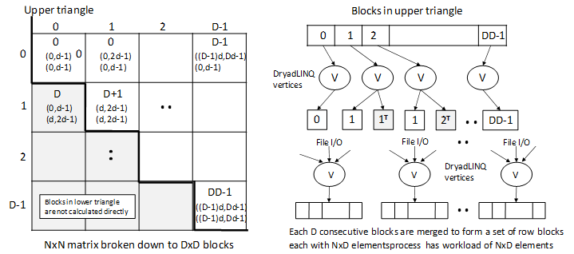
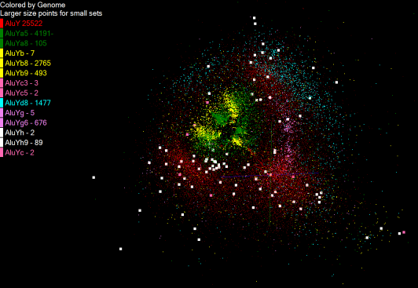
Pairwise Distances – ALU Sequences
125 million distances
4 hours & 46 minutes
Calculate pairwise distances for a collection of genes (used for clustering, MDS)
O(N^2) problem
“Doubly Data Parallel” at Dryad Stage
Performance close to MPI
Performed on 768 cores (Tempest Cluster)
Processes work better than threads when used inside vertices
100% utilization vs. 70%
Notes:
1~180 lines without threading in DryadLINQ, with threading, it is about 400 lines
MPI ~500 lines
The Alu clustering problem [27] is one of the most challenging problems for sequencing clustering because Alus represent the largest repeat families in human genome. There are about 1 million copies of Alu sequences in human genome, in which most insertions can be found in other primates and only a small fraction (~ 7000) are human-specific. This indicates that the classification of Alu repeats can be deduced solely from the 1 million human Alu elements. Notable, Alu clustering can be viewed as a classical case study for the capacity of computational infrastructures because it is not only of great intrinsic biological interests, but also a problem of a scale that will remain as the upper limit of many other clustering problem in bioinformatics for the next few years, e.g. the automated protein family classification for a few millions of proteins predicted from large metagenomics projects. In our work here we examine Alu samples of 35339 and 50,000 sequences.

Slide 11


Slide 12


Slide 13
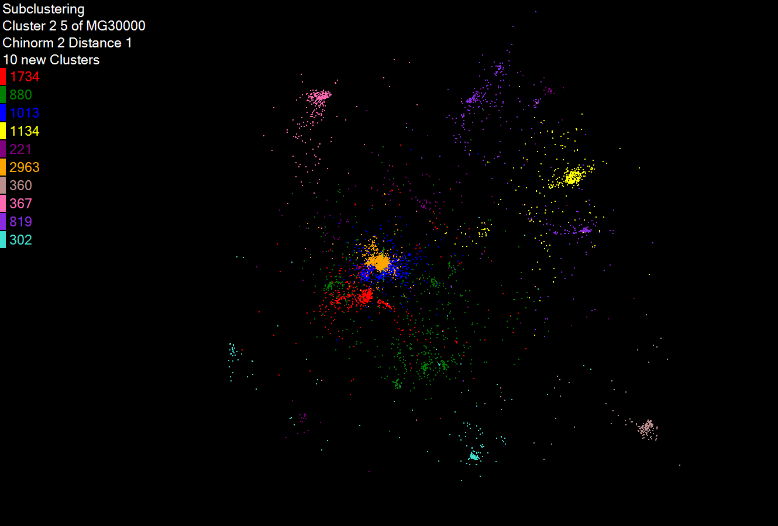
Hierarchical Subclustering

Slide 14
Dryad versus MPI for Smith Waterman
Flat is perfect scaling

Slide 15
Hadoop/Dryad Comparison Inhomogeneous Data I
Inhomogeneity of data does not have a significant effect when the sequence lengths are randomly distributed
Dryad with Windows HPCS compared to Hadoop with Linux RHEL on Idataplex (32 nodes)
Notes:
10k data size

Slide 16
Hadoop/Dryad Comparison Inhomogeneous Data II
This shows the natural load balancing of Hadoop MR dynamic task assignment using a global pipeline in contrast to the DryadLinq static assignment
Dryad with Windows HPCS compared to Hadoop with Linux RHEL on Idataplex (32 nodes)
Notes:
10k data size

Slide 17
Hadoop VM Performance Degradation
Performance Degradation = (T_{vm} – T_{baremetal})/T_{baremetal}
15.3% Degradation at largest data set size

Slide 18
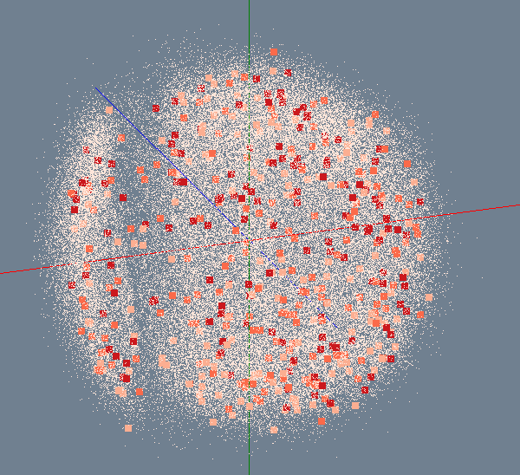
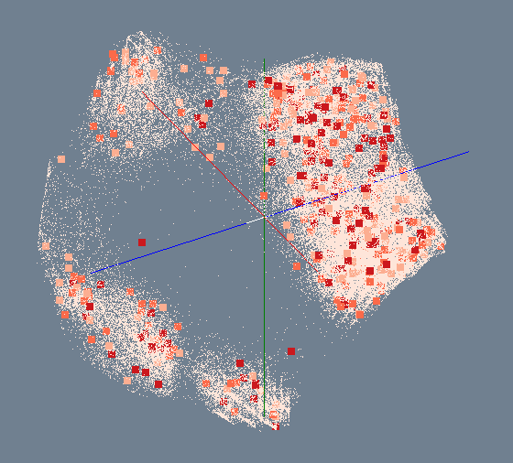
MDS/GTM for 100K (out of 26 million) PubChem entries
Distances in 2D/3D match distances from database properties
Number of Activity Results
> 300
200 ~ 300
100 ~ 200
< 100
MDS
GTM
Developing hierarchical methods to extend to full 26M dataset

Slide 19
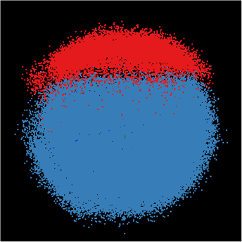
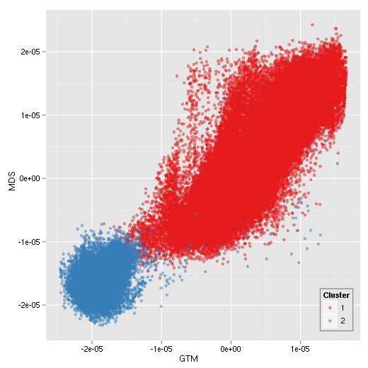
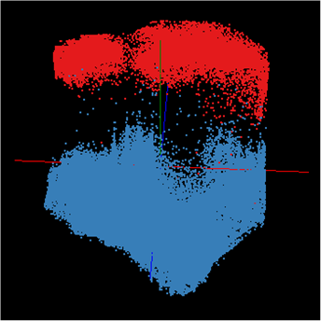
Correlation between MDS/GTM
MDS
GTM
Canonical Correlation between MDS & GTM
Notes:
Colors represent k-mean (k=2) results. Correlation is measured between MDS and GTM by using Canonical Correlation Analysis (CCA) and it shows high-correlation between them.

Slide 20
SALSA HPC
Dynamic Virtual Cluster Hosting
Monitoring Infrastructure
SW-G Using Hadoop
SW-G Using Hadoop
SW-G Using DryadLINQ
SW-G Using Hadoop
SW-G Using Hadoop
SW-G Using DryadLINQ
Linux
Bare-system
Linux on Xen
Windows Server 2008 Bare-system
Cluster Switching from Linux Bare-system to Xen VMs to Windows 2008 HPC
XCAT Infrastructure
iDataplex Bare-metal Nodes (32 nodes)
SW-G : Smith Waterman Gotoh Dissimilarity Computation
– A typical MapReduce style application

Slide 21
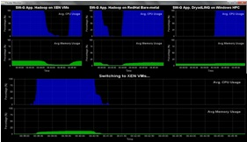
Monitoring Infrastructure
Monitoring Interface
Pub/Sub Broker Network
Virtual/Physical Clusters
Summarizer
XCAT Infrastructure
Switcher
iDataplex Bare-metal Nodes
(32 nodes)

Slide 22
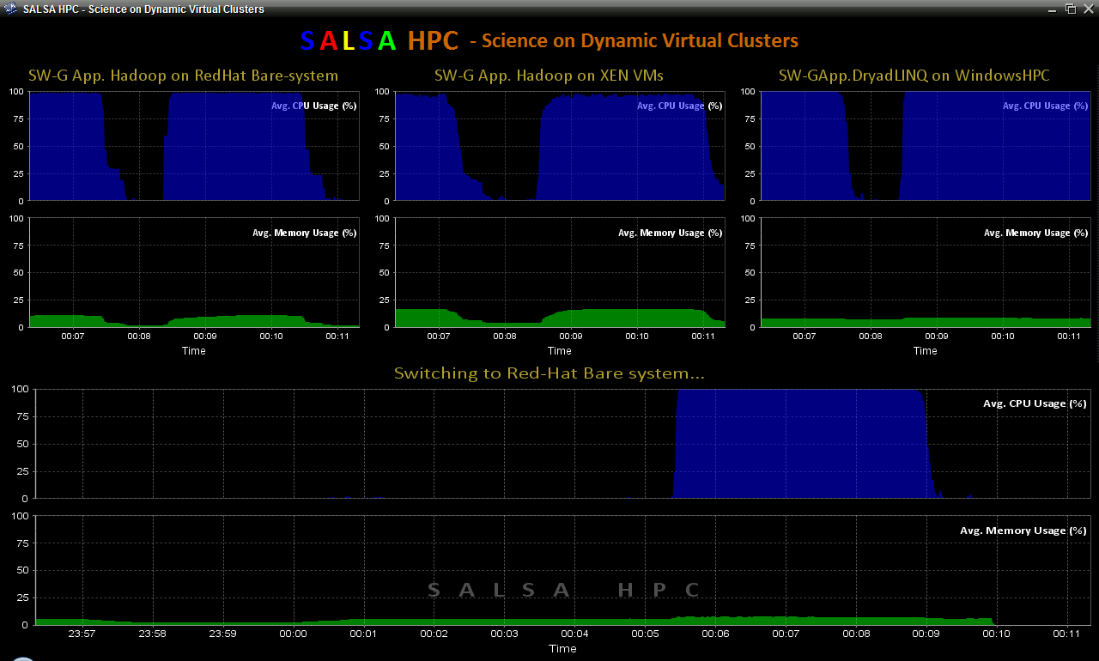
SALSA HPC Dynamic Virtual Clusters
Notes:
Linux –Bare-system -> XEN takes about 7 minutes. XEN -> Windows takes about 5 minutes.
Linux/Hadoop takes about 5 minutes to run and then start back again. Form this 5 minutes about 3-4 minutes is the for the computation.

Slide 23
Summary: Key Features of our Approach
Dryad/Hadoop/Azure promising for Biology computations
Dynamic Virtual Clusters allow one to switch between different modes
Overhead of VM’s on Hadoop (15%) acceptable
Inhomogeneous problems currently favors Hadoop over Dryad
MapReduce++ allows iterative problems (classic linear algebra/datamining) to use MapReduce model efficiently

