Slide 1
Programming Models for Technical Computing on Clouds and Supercomputers (aka HPC)
May 7 2012
Cloud Futures 2012
May 7–8, 2012 , Berkeley, California, United States
Geoffrey Fox
gcf@indiana.edu
Indiana University Bloomington
Dennis Gannon
Microsoft

Slide 2
Science Computing Environments
Large Scale Supercomputers – Multicore nodes linked by high performance low latency network
  Increasingly with GPU enhancement
  Suitable for highly parallel simulations
High Throughput Systems such as European Grid Initiative EGI or Open Science Grid OSG typically aimed at pleasingly parallel jobs
  Can use “cycle stealing”
  Classic example is LHC data analysis
Grids federate resources as in EGI/OSG or enable convenient access to multiple backend systems including supercomputers
  Portals make access convenient and
  Workflow integrates multiple processes into a single job
Specialized visualization, shared memory parallelization etc. machines

Slide 3
Some Observations
Distinguish HPC (Supercomputer) machines and HPC problems
Classic HPC machines as MPI engines offer highest possible performance on closely coupled problems
Clouds offer from different points of view
    On-demand service (elastic)
    Economies of scale from sharing
    Powerful new software models such as MapReduce, which have advantages over classic HPC environments
    Plenty of jobs making it attractive for students & curricula
    Security challenges
HPC problems running well on clouds have above advantages
Note 100% utilization of Supercomputers makes elasticity moot for capability (very large) jobs and makes capacity (many modest) use not be on-demand
Need Cloud-HPC Interoperability

Slide 4
Clouds and Grids/HPC
Synchronization/communication Performance
Grids > Clouds > Classic HPC Systems
Clouds naturally execute effectively Grid workloads but are less clear for closely coupled HPC applications
Service Oriented Architectures and workflow appear to work similarly in both grids and clouds
May be for immediate future, science supported by a mixture of
  Clouds – some practical differences between private and public clouds – size and software
  High Throughput Systems (moving to clouds as convenient)
  Grids for distributed data and access
  Supercomputers (“MPI Engines”) going to exascale

Slide 5
What Applications work in Clouds
Pleasingly parallel applications of all sorts analyzing roughly independent data or spawning independent simulations
  Long tail of science
  Integration of distributed sensors (Internet of Things)
Science Gateways and portals
Workflow federating clouds and classic HPC
Commercial and Science Data analytics that can use MapReduce (some of such apps) or its iterative variants (most other data analytics apps)
Which applications are using clouds?
  Many demonstrations – see today, Venus-C, OOI, HEP ….
  50% of applications on FutureGrid are from Life Science but
  There is more computer science than total applications on FutureGrid
  Locally Lilly corporation is major commercial cloud user (for drug discovery) but Biology department is not

Slide 6
What is FutureGrid?
The FutureGrid project mission is to enable experimental work that advances:
  Innovation and scientific understanding of distributed computing and parallel computing paradigms,
  The engineering science of middleware that enables these paradigms,
  The use and drivers of these paradigms by important applications, and,
  The education of a new generation of students and workforce on the use of these paradigms and their applications.
The implementation of mission includes
  Distributed flexible hardware with supported use
  Identified IaaS and PaaS “core” software with supported use
  Outreach
~4500 cores in 5 major sites

Slide 7
Distribution of FutureGrid Technologies and Areas
200 Projects

Slide 8
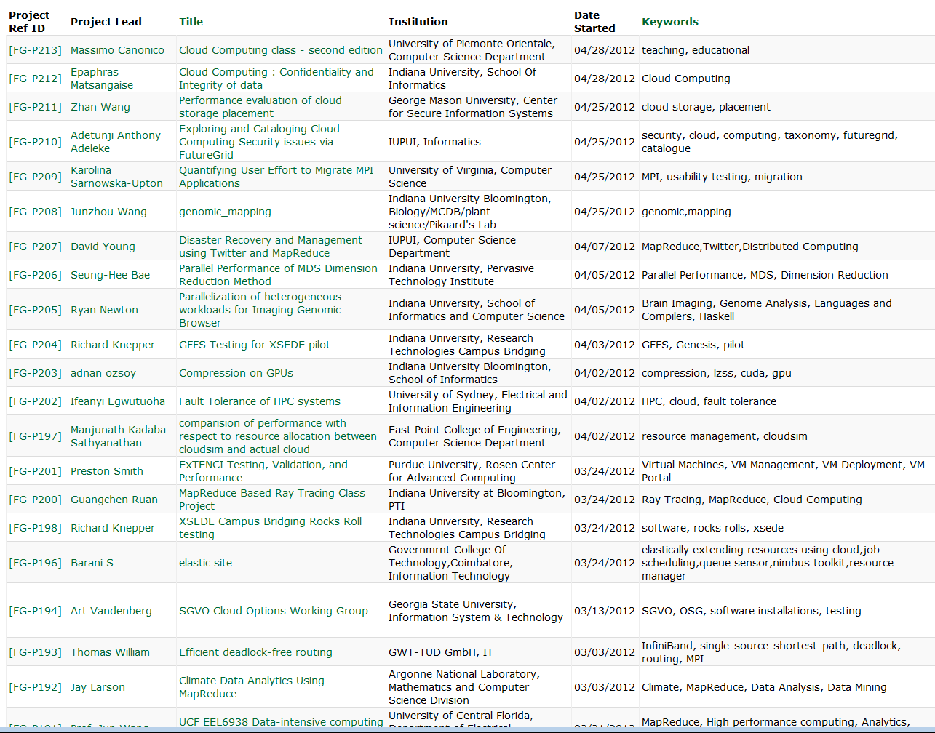
Recent FutureGrid Projects

Slide 9
Parallelism over Users and Usages
“Long tail of science” can be an important usage mode of clouds.
In some areas like particle physics and astronomy, i.e. “big science”, there are just a few major instruments generating now petascale data driving discovery in a coordinated fashion.
In other areas such as genomics and environmental science, there are many “individual” researchers with distributed collection and analysis of data whose total data and processing needs can match the size of big science.
Clouds can provide scaling convenient resources for this important aspect of science.
Can be map only use of MapReduce if different usages naturally linked e.g. exploring docking of multiple chemicals or alignment of multiple DNA sequences
  Collecting together or summarizing multiple “maps” is a simple Reduction

Slide 10
Internet of Things and the Cloud
It is projected that there will be 24 billion devices on the Internet by 2020. Most will be small sensors that send streams of information into the cloud where it will be processed and integrated with other streams and turned into knowledge that will help our lives in a multitude of small and big ways.
It is not unreasonable for us to believe that we will each have our own cloud-based personal agent that monitors all of the data about our life and anticipates our needs 24x7.
The cloud will become increasing important as a controller of and resource provider for the Internet of Things.
As well as today’s use for smart phone and gaming console support, “smart homes” and “ubiquitous cities” build on this vision and we could expect a growth in cloud supported/controlled robotics.
Natural parallelism over “things”

Slide 11
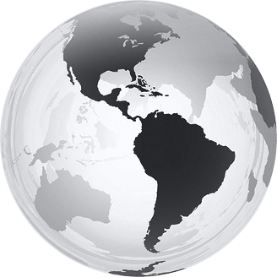
  Internet of Things: Sensor Grids
  A pleasingly parallel example on Clouds
  A sensor (“Thing”) is any source or sink of time series
    In the thin client era, smart phones, Kindles, tablets, Kinects, web-cams are sensors
    Robots, distributed instruments such as environmental measures are sensors
    Web pages, Googledocs, Office 365, WebEx are sensors
    Ubiquitous Cities/Homes are full of sensors
    They have IP address on Internet
  Sensors – being intrinsically distributed are Grids
  However natural implementation uses clouds to consolidate and control and collaborate with sensors
  Sensors are typically “small” and have pleasingly parallel cloud implementations

Slide 12








Sensors as a Service
Output Sensor
Sensors as a Service
Sensor Processing as a Service (could use
MapReduce)
A larger sensor ………

Slide 13
Portal/Gateway
“Just a web role” supporting back end services
Often used to support multiple users accessing a relatively modest size computation
So cloud suitable implementation
Workflow
Loosely coupled orchestrated links of services
Works well on Grids and Clouds as coarse grain (a few large messages between largish tasks) and no tight synchronization

Slide 14
Classic Parallel Computing
HPC: Typically SPMD (Single Program Multiple Data) “maps” typically processing particles or mesh points interspersed with multitude of low latency messages supported by specialized networks such as Infiniband
  Often run large capability jobs with 100K cores on same job
  National DoE/NSF/NASA facilities run 100% utilization
  Fault fragile and cannot tolerate “outlier maps” taking longer than others
Clouds: MapReduce has asynchronous maps typically processing data points with results saved to disk. Final reduce phase integrates results from different maps
  Fault tolerant and does not require map synchronization
  Map only useful special case
HPC+Clouds: Iterative MapReduce caches results between “MapReduce” steps and supports SPMD parallel computing with large messages as seen in parallel linear algebra need in clustering and other data mining

Slide 15
Commercial “Web 2.0” Cloud Applications
Internet search, Social networking, e-commerce, cloud storage
These are larger systems than used in HPC with huge levels of parallelism coming from
  Processing of lots of users or
  An intrinsically parallel Tweet or Web search
MapReduce is suitable (although Page Rank component of search is parallel linear algebra)
Data Intensive
Do not need microsecond messaging latency

Slide 16
4 Forms of MapReduce
(a) Map Only
(b) Classic MapReduce
(c) Iterative MapReduce
(d) Loosely Synchronous
Input
Input
Iterations
Input
map
map
map
P_{ij}
reduce
reduce
Output
BLAST Analysis
Parametric sweep
Pleasingly Parallel
High Energy Physics (HEP) Histograms
Distributed search
Expectation maximization Clustering e.g. Kmeans
Linear Algebra, Page Rank
Classic MPI
PDE Solvers and particle dynamics
Domain of MapReduce and Iterative Extensions
MPI

Slide 17
Data Intensive Iterative Applications I
Important class of (Data analytics) applications
  Data mining, machine learning – often with linear algebra at core
  Expectation maximization
  Driven by data deluge & emerging fields
k ← 0;
MAX ← maximum iterations
δ^{[0]} ← initial delta value
while ( k< MAX_ITER || f(δ^{[k]}, δ^{[k-1]}) )
foreach datum in data
β[datum] ← process (datum, δ^{[k]})
end foreach
δ^{[k+1]} ← combine(β[])
k ← k+1
end while
Notes:
Iterative computations are at the core of the vast majority of data intensive scientific computations.
need to process massive amounts of data and the emergence of data intensive computational fields, such as bioinformatics, chemical informatics and web mining.

Slide 18
Data Intensive Iterative Applications II
Compute
Communication
Reduce/ barrier
Smaller Loop-Variant Data
Broadcast
New Iteration
Larger Loop-Invariant Data
Structure from (Iterative) MapReduce point of view
Notes:
Most of these applications consists of iterative computation and communication steps where single iterations can easily be specified as MapReduce computations.
Large input data sizes which are loop-invariant and can be reused across iterations.
Loop-variant results.. Orders of magnitude smaller…
While these can be performed using traditional MapReduce frameworks, Traditional is not efficient for these types of computations. MR leaves lot of room for improvements in terms of iterative applications.

Slide 19

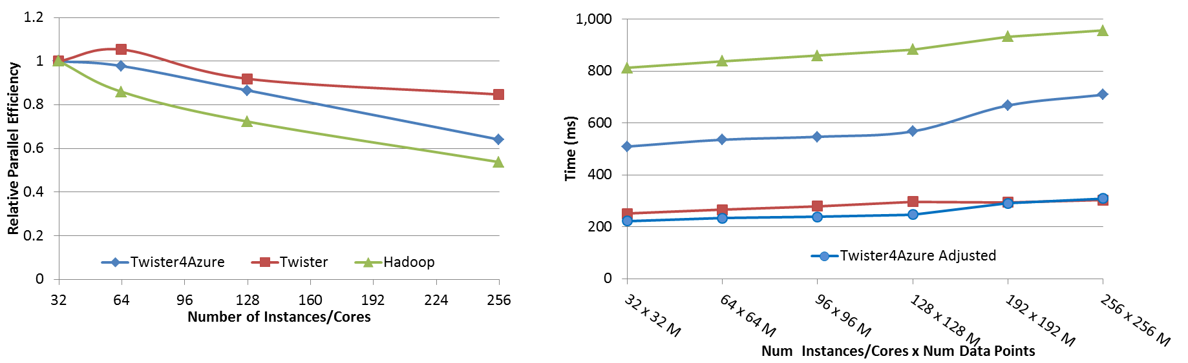




Performance – Kmeans Clustering
Overhead between iterations
First iteration performs the initial data fetch
Task Execution Time Histogram
Number of Executing Map Task Histogram
Scales better than Hadoop on bare metal
Strong Scaling with 128M Data Points
Weak Scaling
Performance with/without
data caching
Speedup gained using data cache
Scaling speedup
Increasing number of iterations
Notes:
Right(c): Twister4Azure executing Map Task histogram for 128 million data points in 128 Azure small instances
Figure 5. KMeansClustering Scalability. Left(a): Relative parallel efficiency of strong scaling using 128 million data points.
Center(b): Weak scaling. Workload per core is kept constant (ideal is a straight horizontal line).

Slide 20
Summary: Usage modes of Clouds
Large Scale internally parallel
  Internet Search or large BLAST problem
Pleasingly parallel over users
  E-commerce or Long Tail of Science
Pleasing parallel over usages (perhaps for same user)
  Internet of Things or parameter searches
Iterative parallel algorithms with large messages
  Data mining
Workflow
  Orchestrate multiple services
Portals
  Web interface to the above modes

Slide 21
What to use in Clouds
HDFS style file system to collocate data and computing
Queues to manage multiple tasks
Tables to track job information
MapReduce and Iterative MapReduce to support parallelism
Services for everything
Portals as User Interface
Appliances and Roles as customized images
Software environments/tools like Google App Engine, memcached
Workflow to link multiple services (functions)

Slide 22
What to use in Grids and Supercomputers?
Portals and Workflow as in clouds
MPI and GPU/multicore threaded parallelism
Services in Grids
Wonderful libraries supporting parallel linear algebra, particle evolution, partial differential equation solution
Parallel I/O for high performance in an application
Wide area File System (e.g. Lustre) supporting file sharing
This is a rather different style of PaaS from clouds –
should we unify?

Slide 23
Is PaaS a good idea?
If you have existing code, PaaS may not be very relevant immediately
  Just need IaaS to put code on clouds
But surely it must be good to offer high level tools?
For example, Twister4Azure (see tomorrow’s talk) built on top of Azure tables, queues, storage
Historically HPCC 1990-2000 built MPI, libraries, (parallel) compilers ..
Grids 2000-2010 built federation, scheduling, portals and workflow
Clouds 2010-…. have an exciting interest in powerful programming models

Slide 24
How to use Clouds I
Build the application as a service. Because you are deploying one or more full virtual machines and because clouds are designed to host web services, you want your application to support multiple users or, at least, a sequence of multiple executions.
  If you are not using the application, scale down the number of servers and scale up with demand.
  Attempting to deploy 100 VMs to run a program that executes for 10 minutes is a waste of resources because the deployment may take more than 10 minutes.
  To minimize start up time one needs to have services running continuously ready to process the incoming demand.
Build on existing cloud deployments. For example use an existing MapReduce deployment such as Hadoop or existing Roles and Appliances (Images)

Slide 25
How to use Clouds II
Use PaaS if possible. For platform-as-a-service clouds like Azure use the tools that are provided such as queues, web and worker roles and blob, table and SQL storage.
  Note HPC systems don’t offer much in PaaS area
Design for failure. Applications that are services that run forever will experience failures. The cloud has mechanisms that automatically recover lost resources, but the application needs to be designed to be fault tolerant.
  In particular, environments like MapReduce (Hadoop, Daytona, Twister4Azure) will automatically recover many explicit failures and adopt scheduling strategies that recover performance "failures" from for example delayed tasks.
  One expects an increasing number of such Platform features to be offered by clouds and users will still need to program in a fashion that allows task failures but be rewarded by environments that transparently cope with these failures. (Need to build more such robust environments)

Slide 26
How to use Clouds III
Use as a Service where possible. Capabilities such as SQLaaS (database as a service or a database appliance) provide a friendlier approach than the traditional non-cloud approach exemplified by installing MySQL on the local disk.
  Suggest that many prepackaged aaS capabilities such as Workflow as a Service for eScience will be developed and simplify the development of sophisticated applications.
Moving Data is a challenge. The general rule is that one should move computation to the data, but if the only computational resource available is a the cloud, you are stuck if the data is not also there.
  Persuade Cloud Vendor to host your data free in cloud
  Persuade Internet2 to provide good link to Cloud
  Decide on Object Store v. HDFS style (or v. Lustre WAFS on HPC)

Slide 27
Private Clouds
Define as non commercial cloud used to support science
What does it take to make private cloud platforms competitive with commercial systems?
Plenty of work at VM management level with Eucalyptus, Nimbus, OpenNebula, OpenStack
  Only now maturing
  Nimbus and OpenNebula pretty solid but not widely adopted in USA
  OpenStack and Eucalyptus recent major improvements
Open source PaaS tools like Hadoop, Hbase, Cassandra, Zookeeper but not integrated into platform
Need dynamic resource management in a “not really elastic” environment as limited size
Federation of distributed components (as in grids) to make a decent size system

Slide 28
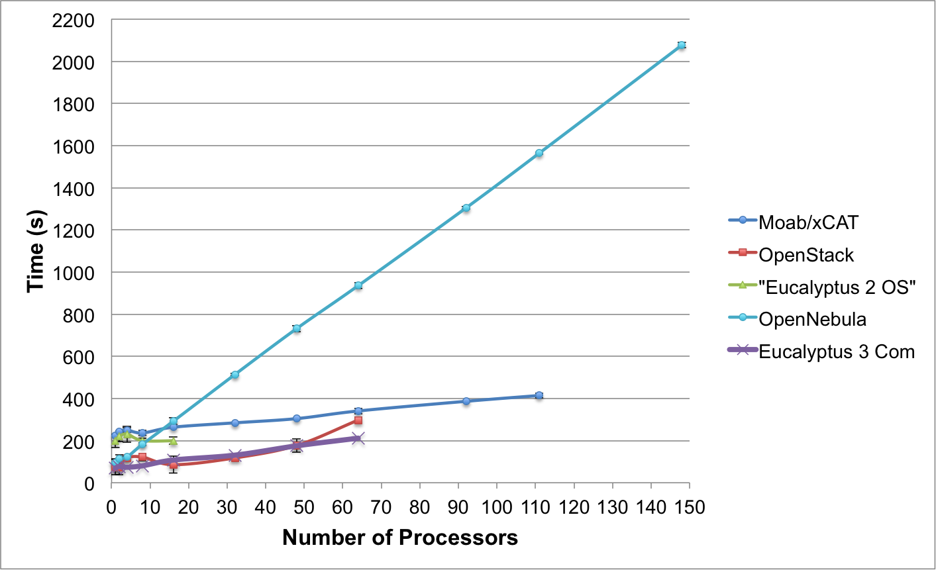
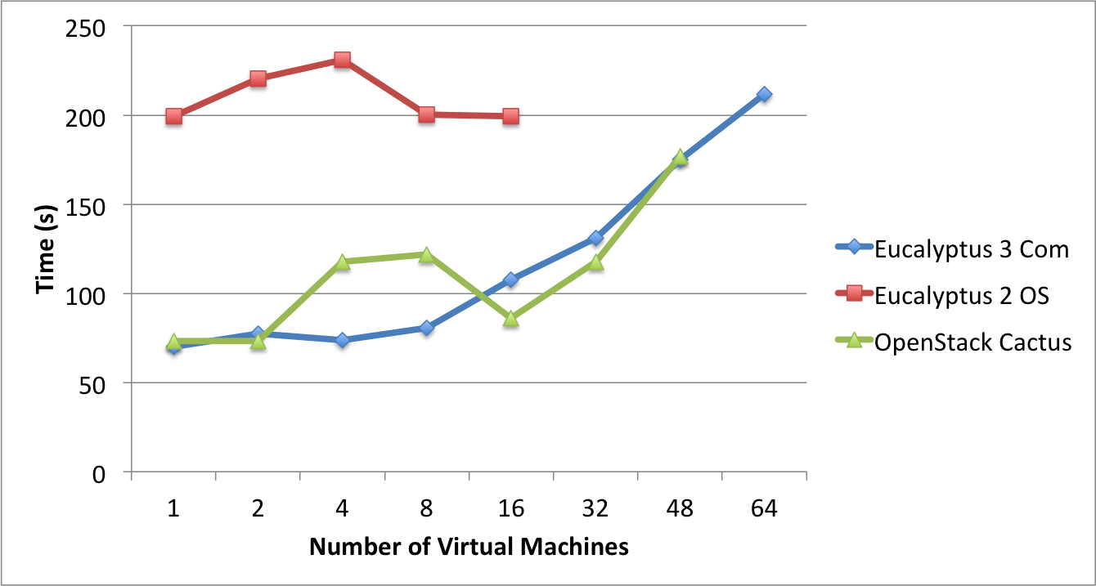
Templated Dynamic Provisioning
Abstract Specification of image mapped to various HPC and Cloud environments
OpenNebula
Parallel provisioning now supported
Moab/xCAT HPC – high as need reboot before use
Essex replaces Cactus
Current Eucalyptus 3 commercial while version 2 Open Source

Slide 29
Some Research Challenges – I
Design algorithms that can exploit/tolerate cloud features
  Elastic access to resources
  Use few large messages – not lots of small ones
  Fault tolerant
  Use library of roles and appliances
  Exploit platforms (queues, tables) and XaaS
Classify and measure performance of these algorithms/applications
Improve performance of clouds
Many security issues
Understand needed standards
Helped by Manish Parashar

Slide 30
Some Research(&D) Challenges – II
Improve MapReduce so it
  Offers HPC Cloud interoperability
  Polymorphic reductions (collectives) exploiting all types of networks
  Supports scientific data and algorithms
Develop storage model to support cloud computing enhanced data repositories
Understand federation of multiple clouds and support of hybrid algorithms split across clouds (e.g. for security or geographical reason)
  Private clouds are not likely to be on huge scale of public clouds
  Cloud bursting important federated system (private + public)
Bring commercial cloud PaaS to HPC and academic clouds
Fault tolerance, high availability, energy efficiency (green clouds)
Train people for the 14 million cloud jobs expected by 2015
Helped by Manish Parashar

Slide 31
Architecture of Data Repositories?
Traditionally governments set up repositories for data associated with particular missions
  For example EOSDIS (Earth Observation), GenBank (Genomics), NSIDC (Polar science), IPAC (Infrared astronomy)
  LHC/OSG computing grids for particle physics
This is complicated by volume of data deluge, distributed instruments as in gene sequencers (maybe centralize?) and need for intense computing like Blast
  i.e. repositories need lots of computing?

Slide 32
Clouds as Support for Data Repositories?
The data deluge needs cost effective computing
  Clouds are by definition cheapest
  Need data and computing co-located
Shared resources essential (to be cost effective and large)
  Can’t have every scientists downloading petabytes to personal cluster
Need to reconcile distributed (initial source of ) data with shared analysis
  Can move data to (discipline specific) clouds
  How do you deal with multi-disciplinary studies
Data repositories of future will have cheap data and elastic cloud analysis support?
  Hosted free if data can be used commercially?

Slide 33
Outreach
Papers are Programming Paradigms for Technical Computing on Clouds and Supercomputers (Fox and Gannon) http://grids.ucs.indiana.edu/ptliupages/publications/Cloud%20Programming%20Paradigms_for__Futures.pdf
http://grids.ucs.indiana.edu/ptliupages/publications/Cloud%20Programming%20Paradigms.pdf
Science Cloud Summer School July 30-August 3 offered virtually
  Aiming at computer science and application students
  Lab sessions on commercial clouds or FutureGrid
Would like volunteers interested in talking or attending!

Slide 34
Using Clouds in a Nutshell
High Throughput Computing; pleasingly parallel; grid applications
Multiple users (long tail of science) and usages (parameter searches)
Internet of Things (Sensor nets) as in cloud support of smart phones
(Iterative) MapReduce including “most” data analysis
Exploiting elasticity and platforms (HDFS, Queues ..)
Use services, portals (gateways) and workflow
Good Strategies:
  Build the application as a service;
  Build on existing cloud deployments such as Hadoop;
  Use PaaS if possible;
  Design for failure;
  Use as a Service (e.g. SQLaaS) where possible;
  Address Challenge of Moving Data

