Slide 1
Clouds from FutureGrid’s Perspective
April 4 2012
Geoffrey Fox
gcf@indiana.edu
Director, Digital Science Center, Pervasive Technology Institute
Associate Dean for Research and Graduate Studies, School of Informatics and Computing
Indiana University Bloomington

Slide 2
What is FutureGrid?
The FutureGrid project mission is to enable experimental work that advances:
Innovation and scientific understanding of distributed computing and parallel computing paradigms,
The engineering science of middleware that enables these paradigms,
The use and drivers of these paradigms by important applications, and,
The education of a new generation of students and workforce on the use of these paradigms and their applications.
The implementation of mission includes
Distributed flexible hardware with supported use
Identified IaaS and PaaS “core” software with supported use
Outreach
~4500 cores in 5 major sites

Slide 3
Distribution of FutureGrid Technologies and Areas
190 Projects

Slide 4
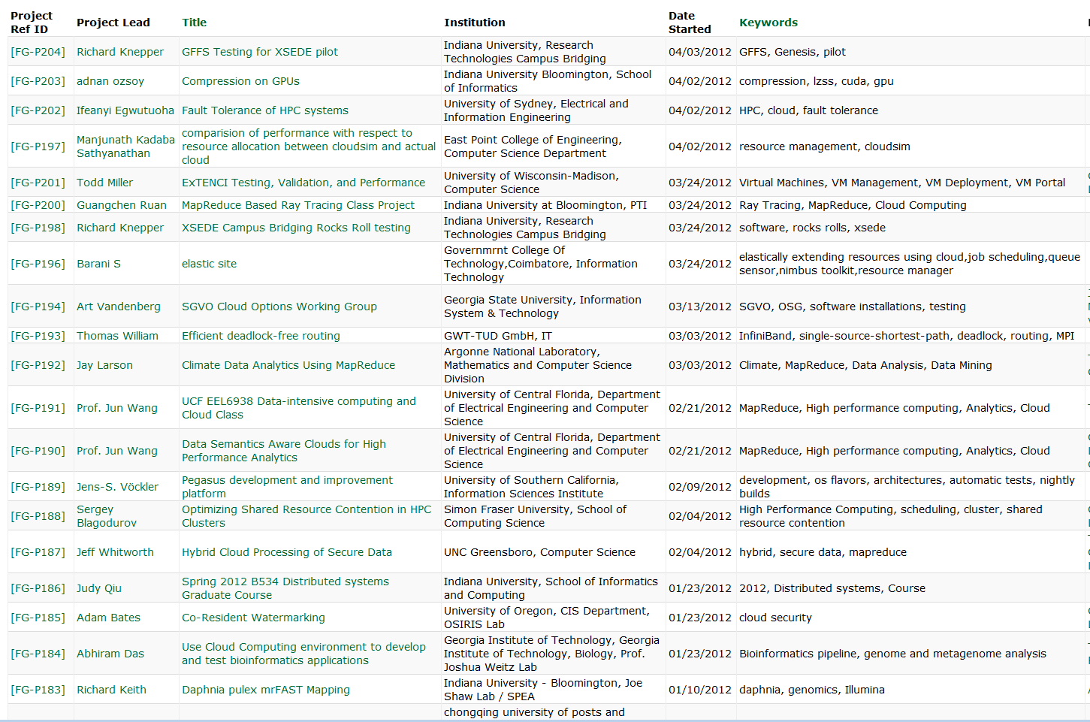
Recent FutureGrid Projects

Slide 5
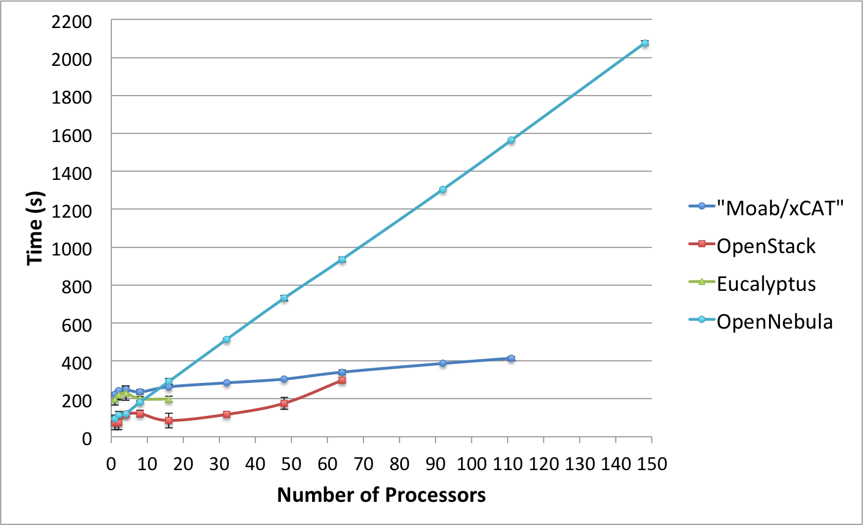
Templated Dynamic Provisioning
Abstract Specification of image mapped to various HPC and Cloud environments

Slide 6
Using Clouds in a Nutshell
High Throughput Computing; pleasingly parallel; grid applications
Multiple users (long tail of science) and usages (parameter searches)
Internet of Things (Sensor nets) as in cloud support of smart phones
(Iterative) MapReduce including “most” data analysis
Exploiting elasticity and platforms (HDFS, Queues ..)
Use services, portals (gateways) and workflow
Good Strategies:
Build the application as a service;
Build on existing cloud deployments such as Hadoop;
Use PaaS if possible;
Design for failure;
Use as a Service (e.g. SQLaaS) where possible;
Address Challenge of Moving Data

Slide 7
4 Forms of MapReduce
(a) Map Only
(b) Classic MapReduce
(c) Iterative MapReduce
(d) Loosely Synchronous
Input
Input
Iterations
Input
map
map
map
P_{ij}
reduce
reduce
Output
BLAST Analysis
Parametric sweep
Pleasingly Parallel
High Energy Physics (HEP) Histograms
Distributed search
Expectation maximization Clustering e.g. Kmeans
Linear Algebra, Page Rank
Classic MPI
PDE Solvers and particle dynamics
Domain of MapReduce and Iterative Extensions
MPI

Slide 8
Performance – Kmeans Clustering
Task Execution Time Histogram
Number of Executing Map Task Histogram
Strong Scaling with 128M Data Points
Weak Scaling
Notes:
Right(c): Twister4Azure executing Map Task histogram for 128 million data points in 128 Azure small instances
Figure 5. KMeansClustering Scalability. Left(a): Relative parallel efficiency of strong scaling using 128 million data points. Center(b): Weak scaling. Workload per core is kept constant (ideal is a straight horizontal line).

Slide 9
Outreach etc.
Programming Paradigms for Technical Computing on Clouds and Supercomputers (Fox and Gannon) http://grids.ucs.indiana.edu/ptliupages/publications/Cloud%20Programming%20Paradigms_for__Futures.pdf
Science Cloud Summer School July 30-August 3
~10 Faculty and Students from MSI’s (sent by ADMI)
Part of virtual summer school in computational science and engineering and expect over 200 participants spread over 10 sites
Science Cloud and MapReduce XSEDE Community groups

