Slide 1
Clouds for Sensors and Data Intensive Applications
May 13 2012
1st International Workshop on Data-intensive Process Management in Large-Scale Sensor Systems (DPMSS 2012): From Sensor Networks to Sensor Clouds
At CCGrid 2012: The 12th IEEE/ACM International Symposium on Cluster, Cloud and Grid Computing
May 13-16, 2012, Ottawa, Canada
Geoffrey Fox
gcf@indiana.edu
Indiana University Bloomington

Slide 2
Science Computing Environments
Large Scale Supercomputers – Multicore nodes linked by high performance low latency network
  Increasingly with GPU enhancement
  Suitable for highly parallel simulations
High Throughput Systems such as European Grid Initiative EGI or Open Science Grid OSG typically aimed at pleasingly parallel jobs
  Can use “cycle stealing”
  Classic example is LHC data analysis
Grids federate compute resources as in EGI/OSG; enable convenient access to multiple backend systems including supercomputers; describe distributed data as in Sensor nets/webs/grids
  Portals make access convenient and
  Workflow integrates multiple processes into a single job
Specialized visualization, shared memory parallelization etc. machines

Slide 3
Some Observations
Classic HPC machines as MPI engines offer highest possible performance on closely coupled problems
Clouds offer from different points of view
    On-demand service (elastic and real-time NOT batch)
    Economies of scale from sharing
    Powerful new software models such as MapReduce, which have advantages over classic HPC environments
    Plenty of jobs making it attractive for students & curricula
    Security challenges
    Lower communication performance
HPC problems running well on clouds have above advantages
  Note 100% utilization of Supercomputers and high throughput systems makes elasticity moot for capability (very large) jobs and makes capacity (many modest) use not be on-demand
Sensors need real-time support and do not need microsecond latency

Slide 4
Clouds and Grids/HPC
Synchronization/communication Performance
Grids > Clouds > Classic HPC Systems
Clouds naturally execute effectively Grid workloads but are less clear for closely coupled HPC applications
Service Oriented Architectures and workflow appear to work similarly in both grids and clouds
May be for immediate future, science supported by a mixture of
  Clouds – some practical differences between private and public clouds – size and software
  High Throughput Systems (moving to clouds as convenient)
  Grids for distributed data (including sensors) and access
  Supercomputers (“MPI Engines”) going to exascale

Slide 5
What Applications work in Clouds
Pleasingly parallel applications of all sorts analyzing roughly independent data or spawning independent simulations
  Long tail of science
  Integration of distributed sensors (Internet of Things)
Science Gateways and portals
Workflow federating clouds and classic HPC
Commercial and Science Data analytics that can use MapReduce (some of such apps) or its iterative variants (most other data analytics apps)
Which applications are using clouds?
  Many demonstrations – see today, Venus-C, OOI, HEP ….
  50% of applications on FutureGrid are from Life Science but
  There is more computer science than total applications on FutureGrid
  Locally Lilly corporation is major commercial cloud user (for drug discovery) but Biology department is not

Slide 6
Parallelism over Users and Usages
“Long tail of science” can be an important usage mode of clouds.
In some areas like particle physics and astronomy, i.e. “big science”, there are just a few major instruments generating now petascale data driving discovery in a coordinated fashion.
In other areas such as genomics and environmental science, there are many “individual” researchers with distributed collection and analysis of data whose total data and processing needs can match the size of big science.
  A laboratory gene sequence is an important “sensor”
Clouds can provide scaling convenient resources for this important aspect of science.
Can be map only use of MapReduce if different usages naturally linked e.g. exploring docking of multiple chemicals or alignment of multiple DNA sequences or summarizing results of multiple sensors
  Collecting together or summarizing multiple “maps” is a simple Reduction

Slide 7
Internet of Things and the Cloud
It is projected that there will soon be 50 billion devices on the Internet. Most will be small sensors that send streams of information into the cloud where it will be processed and integrated with other streams and turned into knowledge that will help our lives in a million small and big ways.
It is not unreasonable for us to believe that we will each have our own cloud-based personal agent that monitors all of the data about our life and anticipates our needs 24x7.
The cloud will become increasing important as a controller of and resource provider for the Internet of Things.
As well as today’s use for smart phone and gaming console support, “smart homes” and “ubiquitous cities” build on this vision and we could expect a growth in cloud supported/controlled robotics.
Natural parallelism over “things”

Slide 8
  Internet of Things: Sensor Grids
  A pleasingly parallel example on Clouds
A Sensor (“Thing”) is any source or sink of a time series
  In the thin client era, Smart phones, Kindles, Tablets, Kinects, Web-cams are sensors
  Robots, distributed instruments such as environmental measures are sensors
  Web pages, Googledocs, Office 365, WebEx are sensors
  Ubiquitous Cities/Homes are full of sensors
  Observational science growing use of sensors from satellites to “dust”
  Static web page is a broken sensor
  They have IP address on Internet
Sensors – being intrinsically distributed are Grids
However natural implementation uses clouds to consolidate and control and collaborate with sensors
Sensors are typically “small” and have pleasingly parallel cloud implementations

Slide 9
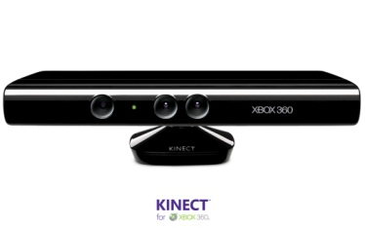
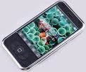







Sensors as a Service
Output Sensor
Sensors as a Service
Sensor Processing as a Service (could use
MapReduce)
A larger sensor ………

Slide 10
Sensor Grid supported by Sensor Cloud
Distributed Access to Sensors
and services driven
by sensor data
Sensor Cloud
Controller and link
to Sensor Services
Sensor Grid
Sensor
Client Application Enterprise App
Notify
Publish
Publish
Sensor Cloud
Control
Subscribe()
Notify()
Unsubscribe()
Sensor
Notify
Client Application Desktop Client
Sensor
Publish
Notify
Client Application Web Client
Pub-Sub Brokers are cloud interface for sensors
Filters subscribe to data from Sensors
Naturally Collaborative
Rebuilding software from scratch as Open Source – collaboration welcome

Slide 11
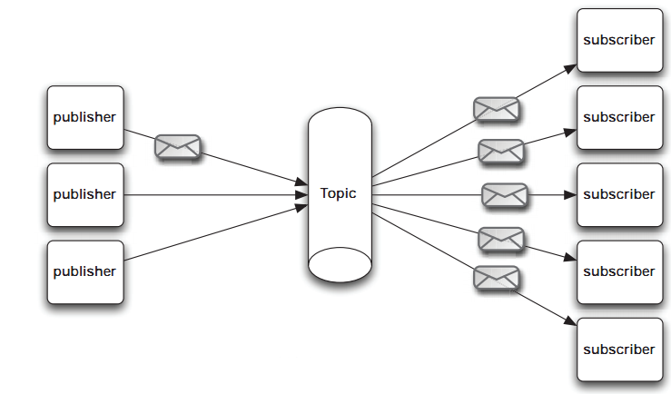
Pub/Sub Messaging
At the core Sensor Cloud is a pub/sub system
Publishers send data to topics with no information about potential subscribers
Subscribers subscribe to topics of interest and similarly have no knowledge of the publishers
URL: https://sites.google.com/site/sensorcloudproject/
Notes:
The publish/subscribe (pub/sub) design pattern [5] describes a loosely-coupled architecture based message-oriented communication between distributed applications. In such an arrangement applications may fire-and-forget messages to a broker that manages the details of message delivery. This is an especially powerful benefit in heterogeneous environments, allowing clients to be written using different languages and even possibly different wire protocols. The pub/sub provider acts as the middle-man, allowing heterogeneous integration and interaction in an asynchronous (non-blocking) manner.
The pub/sub architecture uses destinations known as topics. Publishers address messages to a topic and subscribers register to receive messages from the topic. Publishers and subscribers are generally anonymous and may dynamically publish or subscribe to the content hierarchy. The system takes care of distributing the messages arriving from a topic's multiple publishers to its multiple subscribers. Topics retain messages only as long as it takes to distribute them to current subscribers. Figure 1 illustrates pub/sub messaging.
Message publication is inherently asynchronous in that no fundamental timing dependency exists between the production and the consumption of a message. Messages can be consumed in either of two ways:
Synchronously. A subscriber or a receiver explicitly fetches the message from the destination by calling the receive method. The receive method can block until a message arrives or can time out if a message does not arrive within a specified time limit.
Asynchronously. A client can register a message listener with a consumer. A message listener is similar to an event listener.

Slide 12
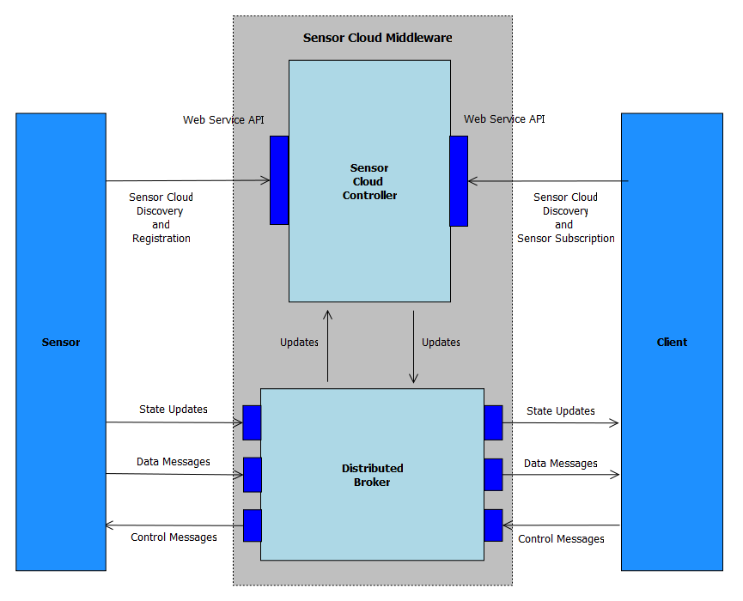
Sensor Cloud Architecture
Originally brokers were from NaradaBrokering
Replacing with ActiveMQ and Netty for streaming

Slide 13
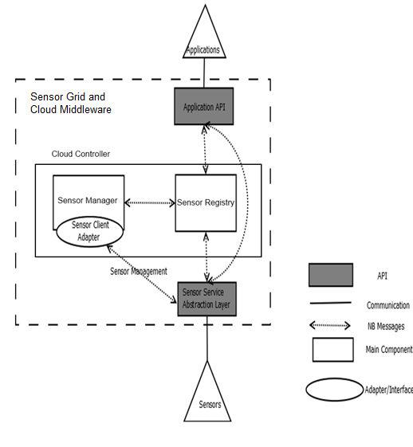
Sensor Cloud Middleware
Sensors are deployed in Grid Builder Domains
Sensors are discovered through the Sensor Cloud
Grid Builder and Sensor Grid are abstractions on top of the underlying Message Broker
Sensors Applications connect via simple Java API
Web interfaces for video (Google WebM), GPS and Twitter sensors

Slide 14
Grid Builder
GB is a sensor management module
1. Define the properties of sensors
2. Deploy sensors according to defined properties
3. Monitor deployment status of sensors
4. Remote Management - Allow management irrespective of the location of the sensors
5. Distributed Management – Allow management irrespective of the location of the manager / user
GB itself posses the following characteristics:
1. Extensible – the use of Service Oriented Architecture (SOA) to provide extensibility and interoperability
2. Scalable - management architecture should be able to scale as number of managed sensors increases
3. Fault tolerant - failure of transports OR management components should not cause management architecture to fail

Slide 15
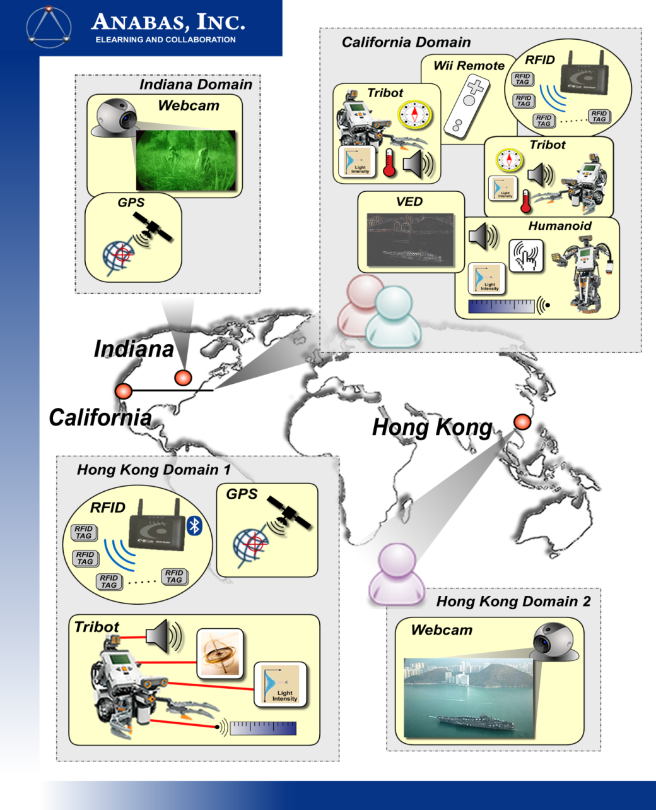
Early Sensor Grid Demonstration

Slide 16
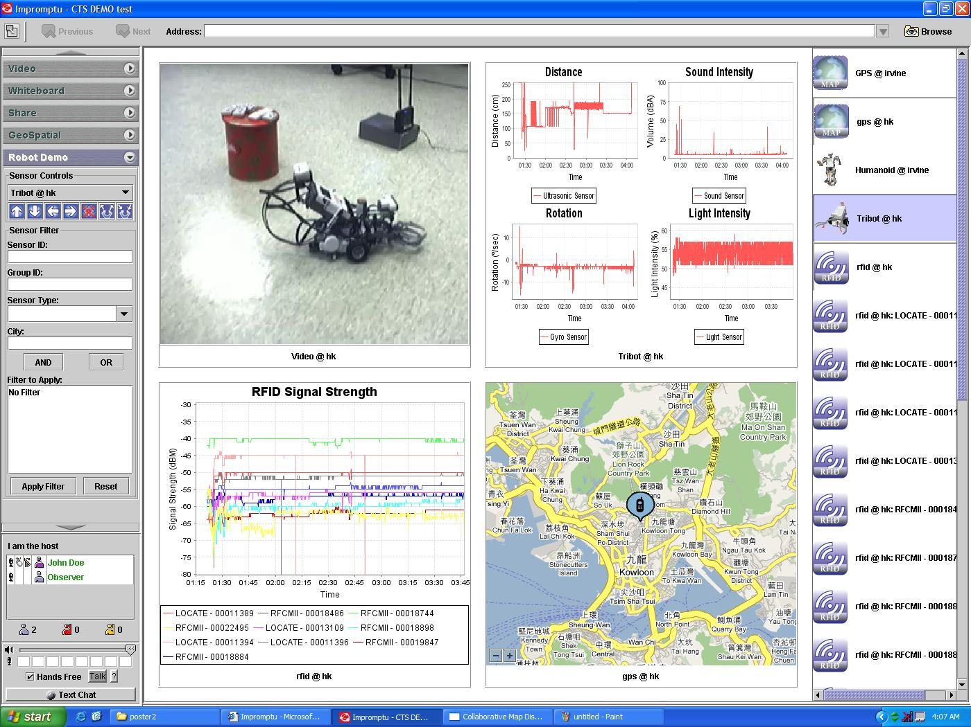

Slide 17
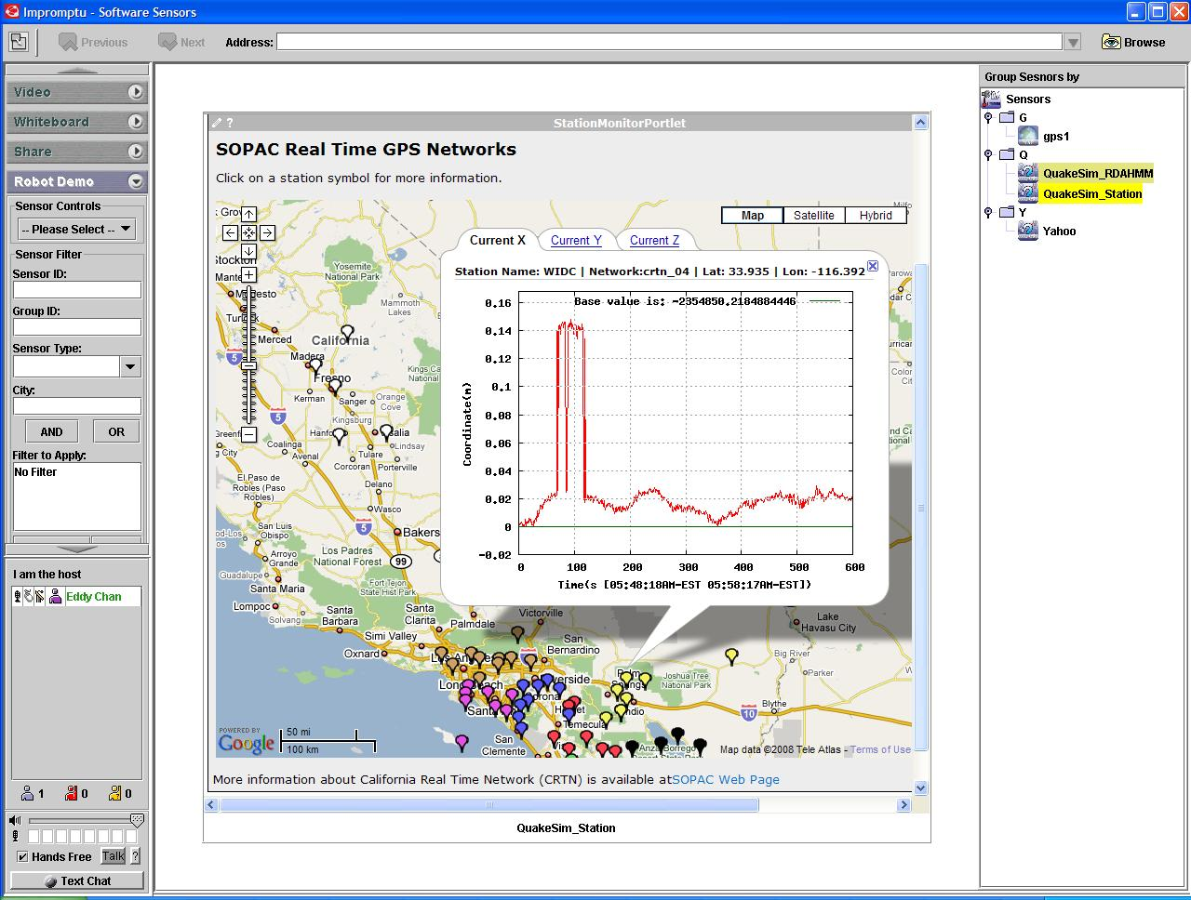

Slide 18
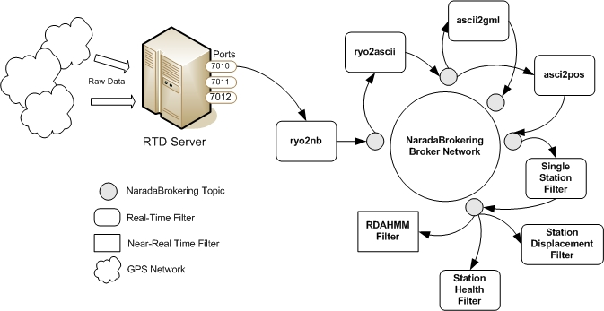
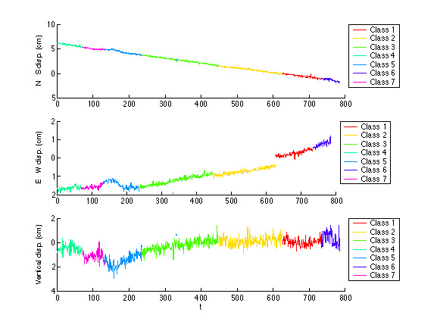
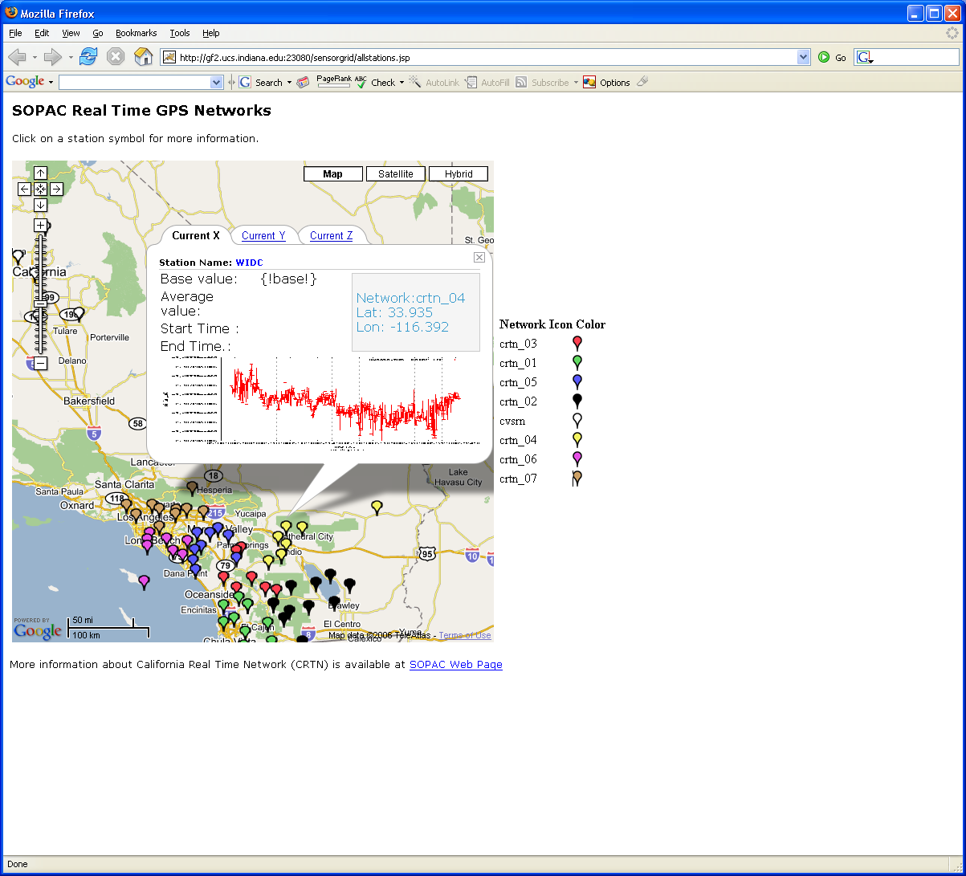
Real-Time GPS Sensor Data-Mining
Services process real time data from ~70 GPS Sensors in Southern California
Brokers and Services on Clouds – no major performance issues
CRTN GPS
Earthquake
Streaming Data
Support
Transformations
Data Checking
Archival
Hidden Markov
Datamining (JPL)
Display (GIS)
Real Time
18
Notes:
18

Slide 19
Lightweight Cyberinfrastructure to support mobile Data gathering expeditions plus classic central resources (as a cloud)
Sensors are airplanes here!

Slide 20
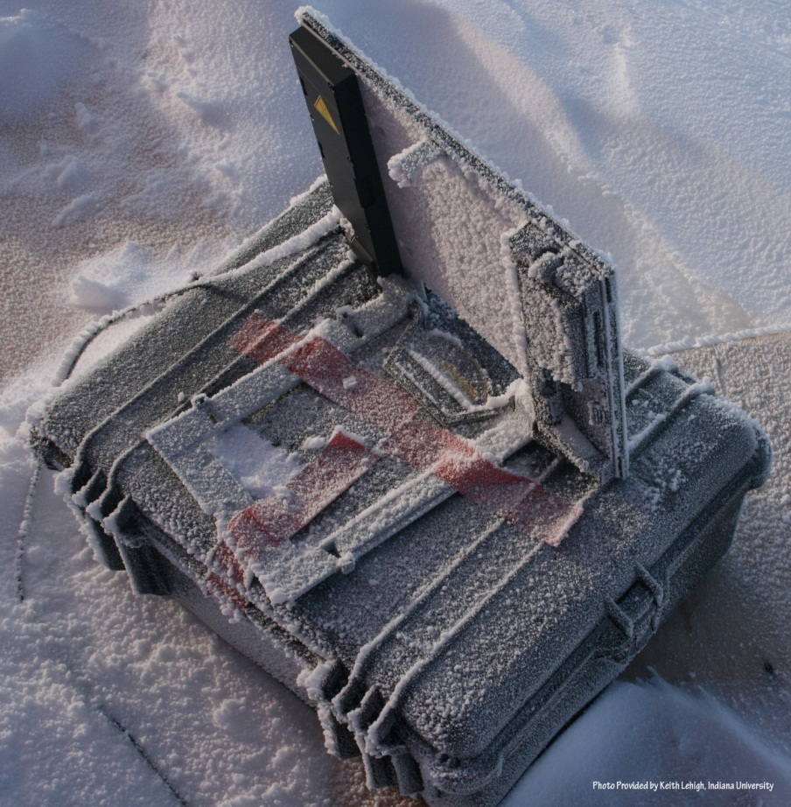
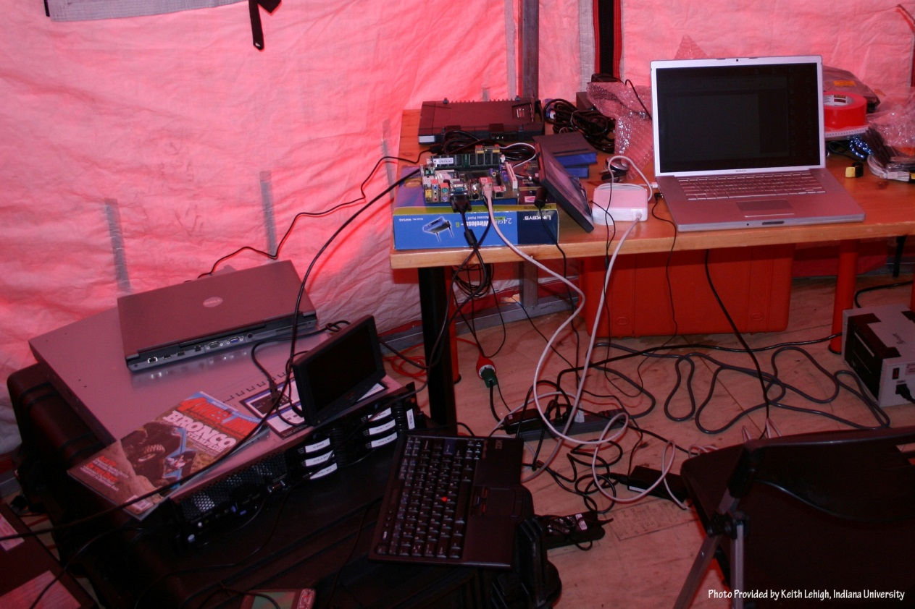
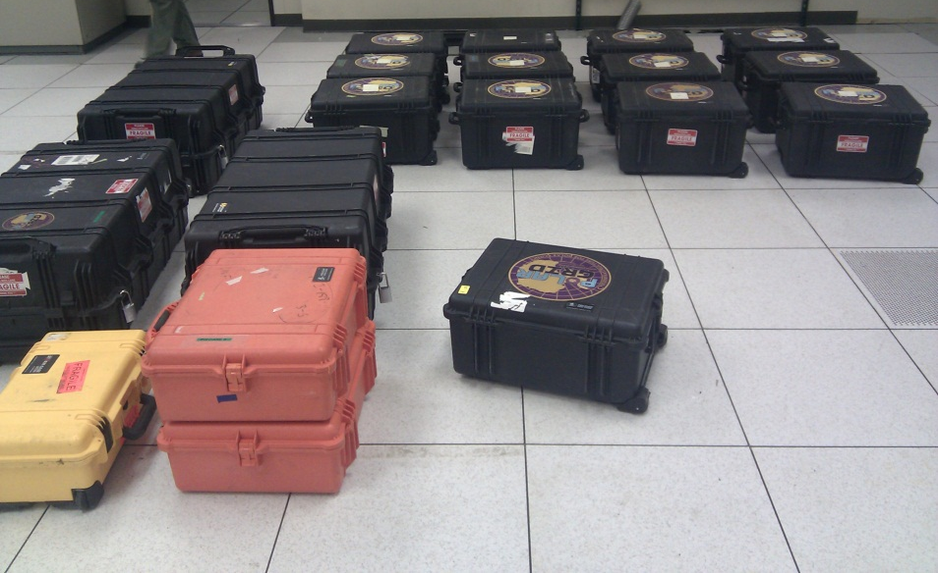
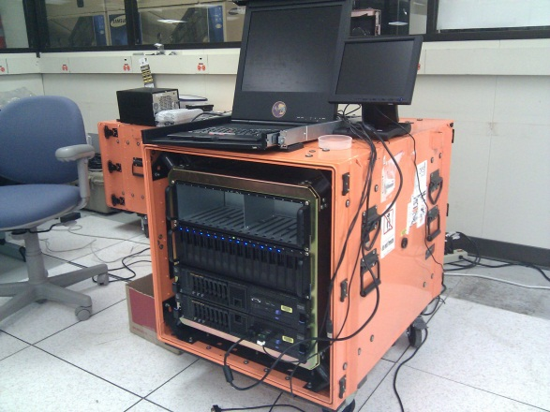

Slide 21
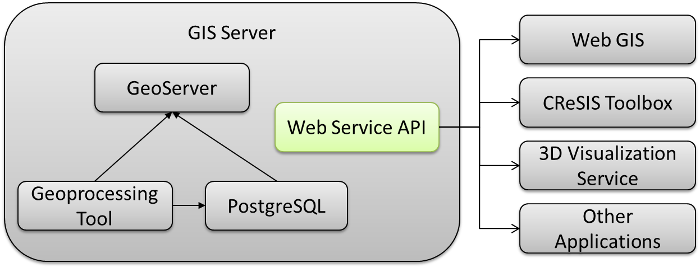
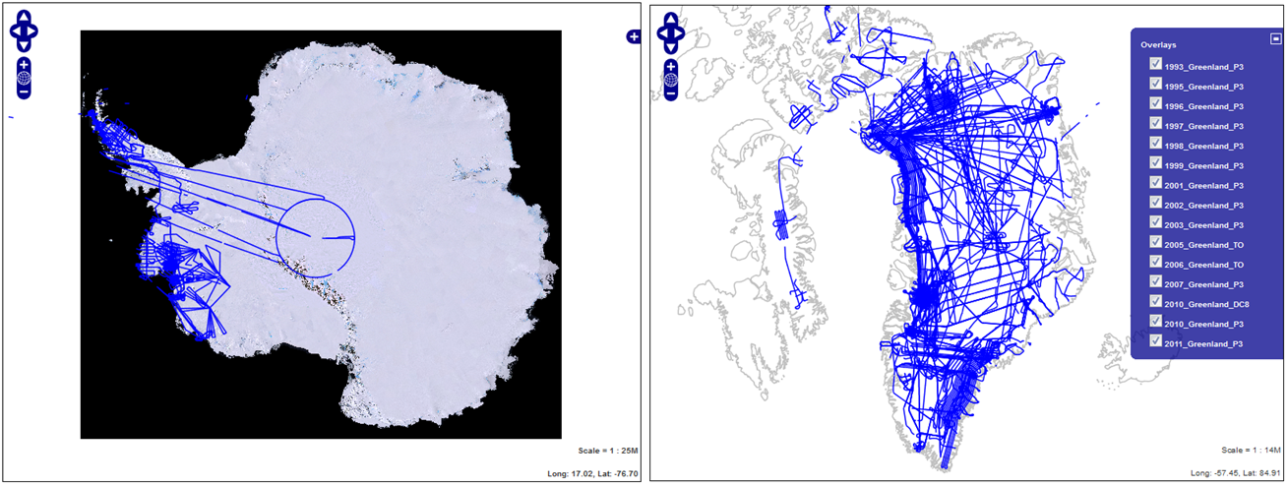
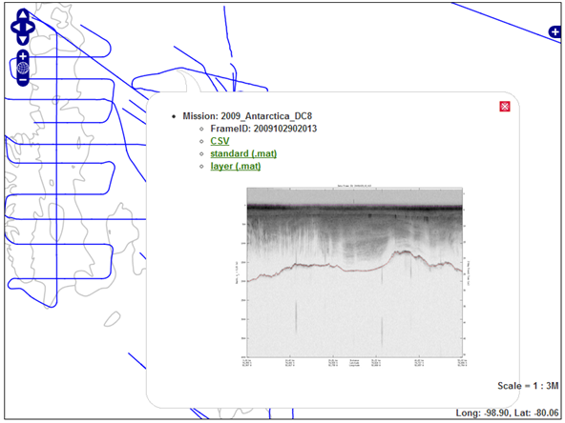
PolarGrid Data Browser

Slide 22
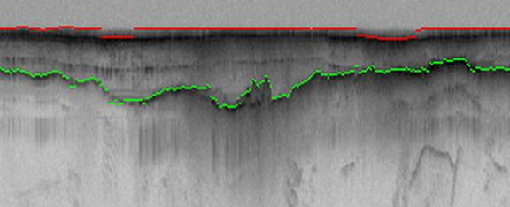
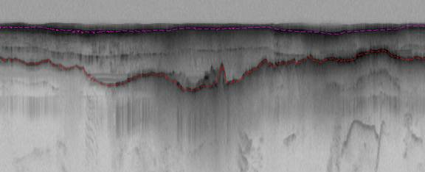
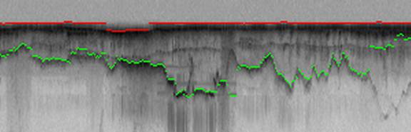
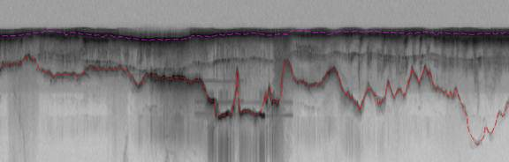
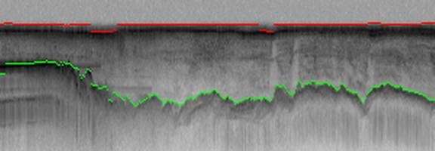
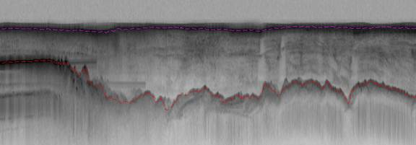
Hidden Markov Method based Layer Finding
P. Felzenszwalb, O. Veksler, Tiered Scene Labeling with Dynamic Programming, IEEE Conference on Computer Vision and Pattern Recognition (CVPR), 2010

Slide 23
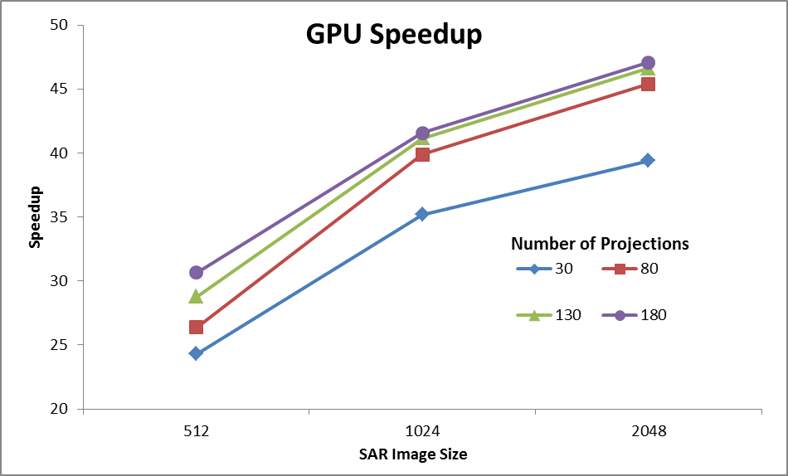
Back Projection
Speedup of GPU wrt Matlab 2 processor Xeon CPU
Wish to replace field hardware by GPU’s to get better power-performance characteristics
Testing environment:
GPU: Geforce GTX 580, 4096 MB, CUDA toolkit 4.0
CPU: 2 Intel Xeon X5492 @ 3.40GHz with 32 GB memory

Slide 24
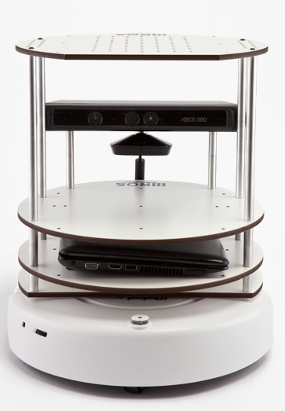
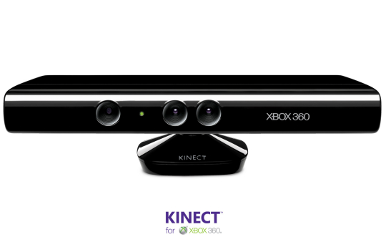
Sensor Grid Performance
Overheads of either pub-sub mechanism or virtualization are <~ one millisecond
Kinect mounted on Turtlebot using pub-sub ROS software gets latency of 70-100 ms and bandwidth of 5 Mbs whether connected to cloud (FutureGrid) or local workstation

Slide 25
What is FutureGrid?
The FutureGrid project mission is to enable experimental work that advances:
  Innovation and scientific understanding of distributed computing and parallel computing paradigms,
  The engineering science of middleware that enables these paradigms,
  The use and drivers of these paradigms by important applications, and,
  The education of a new generation of students and workforce on the use of these paradigms and their applications.
The implementation of mission includes
  Distributed flexible hardware with supported use
  Identified IaaS and PaaS “core” software with supported use
  Outreach
~4500 cores in 5 major sites

Slide 26
Distribution of FutureGrid Technologies and Areas
200 Projects

Slide 27
Some Typical Results
GPS Sensor (1 per second, 1460byte packet)
Low-end Video Sensor (10 per second, 1024byte packet)
High End Video Sensor (30 per second, 7680byte packet)
All with NaradaBrokering pub-sub system – no longer best

Slide 28
GPS Sensor: Multiple Brokers in Cloud

Slide 29
Low-end Video Sensors (surveillance or video conferencing)

Slide 30
High-end Video Sensor

Slide 31
Network Level
Round-trip Latency Due to VM
Round-trip Latency Due to OpenStack VM
Number of iperf connections = 0 Ping RTT = 0.58 ms

Slide 32
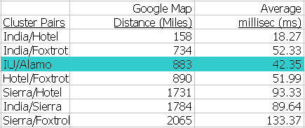
Network Level
– Round-trip Latency Due to Distance

Slide 33
Network Level – Ping RTT with 32 iperf connections
Lowest RTT measured between two FutureGrid clusters.

Slide 34
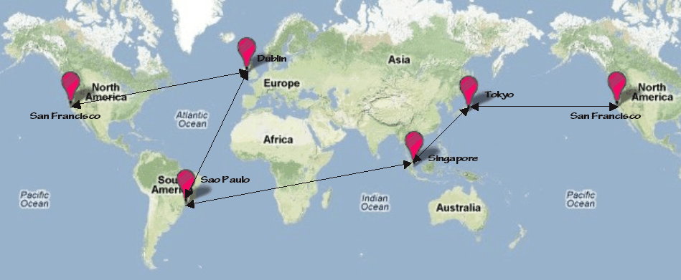
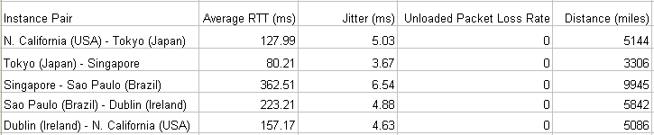
Measurement of Round-trip Latency, Data Loss Rate, Jitter
Five Amazon EC2 clouds selected: California, Tokyo, Singapore, Sao Paulo, Dublin
Web-scale inter-cloud network characteristics

Slide 35
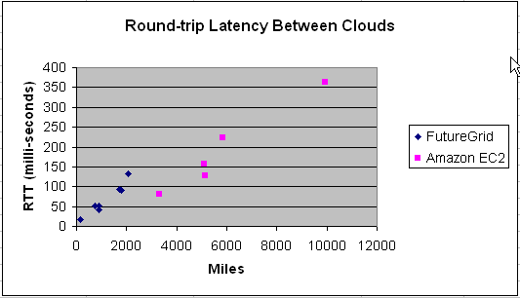
Measured Web-scale and National-scale Inter-Cloud Latency
Inter-cloud latency is proportional to distance between clouds.

Slide 36
Returning to Analysis of Clouds for Research
Portal/Gateway
“Just a web role” supporting back end services
Often used to support multiple users accessing a relatively modest size computation
So cloud suitable implementation
Workflow
Loosely coupled orchestrated links of services
Works well on Grids and Clouds as coarse grain (a few large messages between largish tasks) and no tight synchronization

Slide 37
Classic Parallel Computing
HPC: Typically SPMD (Single Program Multiple Data) “maps” typically processing particles or mesh points interspersed with multitude of low latency messages supported by specialized networks such as Infiniband
  Often run large capability jobs with 100K cores on same job
  National DoE/NSF/NASA facilities run 100% utilization
  Fault fragile and cannot tolerate “outlier maps” taking longer than others
Clouds: MapReduce has asynchronous maps typically processing data points with results saved to disk. Final reduce phase integrates results from different maps
  Fault tolerant and does not require map synchronization
  Map only useful special case
HPC+Clouds: Iterative MapReduce caches results between “MapReduce” steps and supports SPMD parallel computing with large messages as seen in parallel linear algebra need in clustering and other data mining

Slide 38
Commercial “Web 2.0” Cloud Applications
Internet search, Social networking, e-commerce, cloud storage
These are larger systems than used in HPC with huge levels of parallelism coming from
  Processing of lots of users or
  An intrinsically parallel Tweet or Web search
MapReduce is suitable (although Page Rank component of search is parallel linear algebra)
Data Intensive
Do not need microsecond messaging latency

Slide 39
4 Forms of MapReduce
(a) Map Only
(b) Classic MapReduce
(c) Iterative MapReduce
(d) Loosely Synchronous
Input
Input
Iterations
Input
map
map
map
P_{ij}
reduce
reduce
Output
BLAST Analysis
Parametric sweep
Pleasingly Parallel
High Energy Physics (HEP) Histograms
Distributed search
Expectation maximization Clustering e.g. Kmeans
Linear Algebra, Page Rank
Classic MPI
PDE Solvers and particle dynamics
Domain of MapReduce and Iterative Extensions
MPI

Slide 40
What to use in Clouds
HDFS style file system to collocate data and computing
Queues to manage multiple tasks
Tables to track job information
MapReduce and Iterative MapReduce to support parallelism
Services for everything
Portals as User Interface
Appliances and Roles as customized images
Software environments/tools like Google App Engine, memcached
Workflow to link multiple services (functions)

Slide 41
What to use in Grids and Supercomputers?
Portals and Workflow as in clouds
MPI and GPU/multicore threaded parallelism
Services in Grids
Wonderful libraries supporting parallel linear algebra, particle evolution, partial differential equation solution
Parallel I/O for high performance in an application
Wide area File System (e.g. Lustre) supporting file sharing
This is a rather different style of PaaS from clouds –
should we unify?

Slide 42
Using Clouds in a Nutshell
High Throughput Computing; pleasingly parallel; grid applications
Multiple users (long tail of science) and usages (parameter searches)
Internet of Things (Sensor nets) as in cloud support of smart phones
(Iterative) MapReduce including “most” data analysis
Exploiting elasticity and platforms (HDFS, Queues ..)
Use services, portals (gateways) and workflow
Good Strategies:
  Build the application as a service;
  Build on existing cloud deployments such as Hadoop;
  Use PaaS if possible;
  Design for failure;
  Use as a Service (e.g. SQLaaS) where possible;
  Address Challenge of Moving Data

Slide 43
Some Current Activities
Sensor Grid/Cloud https://sites.google.com/site/sensorcloudproject/
Papers are Programming Paradigms for Technical Computing on Clouds and Supercomputers (Fox and Gannon) http://grids.ucs.indiana.edu/ptliupages/publications/Cloud%20Programming%20Paradigms_for__Futures.pdf
http://grids.ucs.indiana.edu/ptliupages/publications/Cloud%20Programming%20Paradigms.pdf
Science Cloud Summer School July 30-August 3 offered virtually
  Aiming at computer science and application students
  Lab sessions on commercial clouds or FutureGrid

