Slide 1
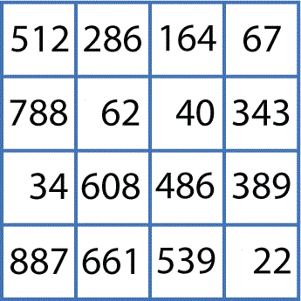
Overview
Objective
Identify similarities present in biological sequences and present them in a comprehensible manner to the biologists
Capturing Similarity
Presenting Similarity
P2 Dimension Reduction
# | X | Y | Z
0 | 0.358 | 0.262 | 0. 295
1 | 0.252 | 0.422 | 0.372
D3
>G0H13NN01D34CL
GTCGTTTAAGCCATTACGTC …
>G0H13NN01DK2OZ
GTCGTTAAGCCATTACGTC …
P1
Distance Calculation
P4 Visualization
D1
D2
D5
P3 Clustering
D4
# | Cluster
0 | 1
1 | 3
Processes:
P1 – Pairwise distance calculation
P2 – Multi-dimensional scaling
P3 – Pairwise clustering
P4 – Visualization
Data:
D1 – Input sequences
D2 – Distance matrix
D3 – Three dimensional coordinates
D4 – Cluster mapping
D5 – Plot file

Slide 2
Applications
Pairwise Distance Calculation
Given a set of gene sequences performs pairwise alignment and distance computation
Pleasingly parallel SPMD implementation with a combine step at the end
Pairwise Clustering with Deterministic Annealing
Given a $NxN$ distance matrix for $N$ sequences classifies sequences into clusters
Threading is used in fork-join style parallel “for” loops
Multi-dimensional Scaling
Given a $NxN$ distance matrix for $N$ sequences maps sequences into xD (usually x=3) points while preserving pairwise distance
Threading is used in fork-join style parallel “for” loops
Vector Sponge Clustering with Deterministic Annealing
Solves problems where k-Means applicable i.e. points have vectors allowing trimmed clusters of user determined size and a sponge to pick up points not in clusters
Threading is used in fork-join style parallel “for” loops

Slide 3
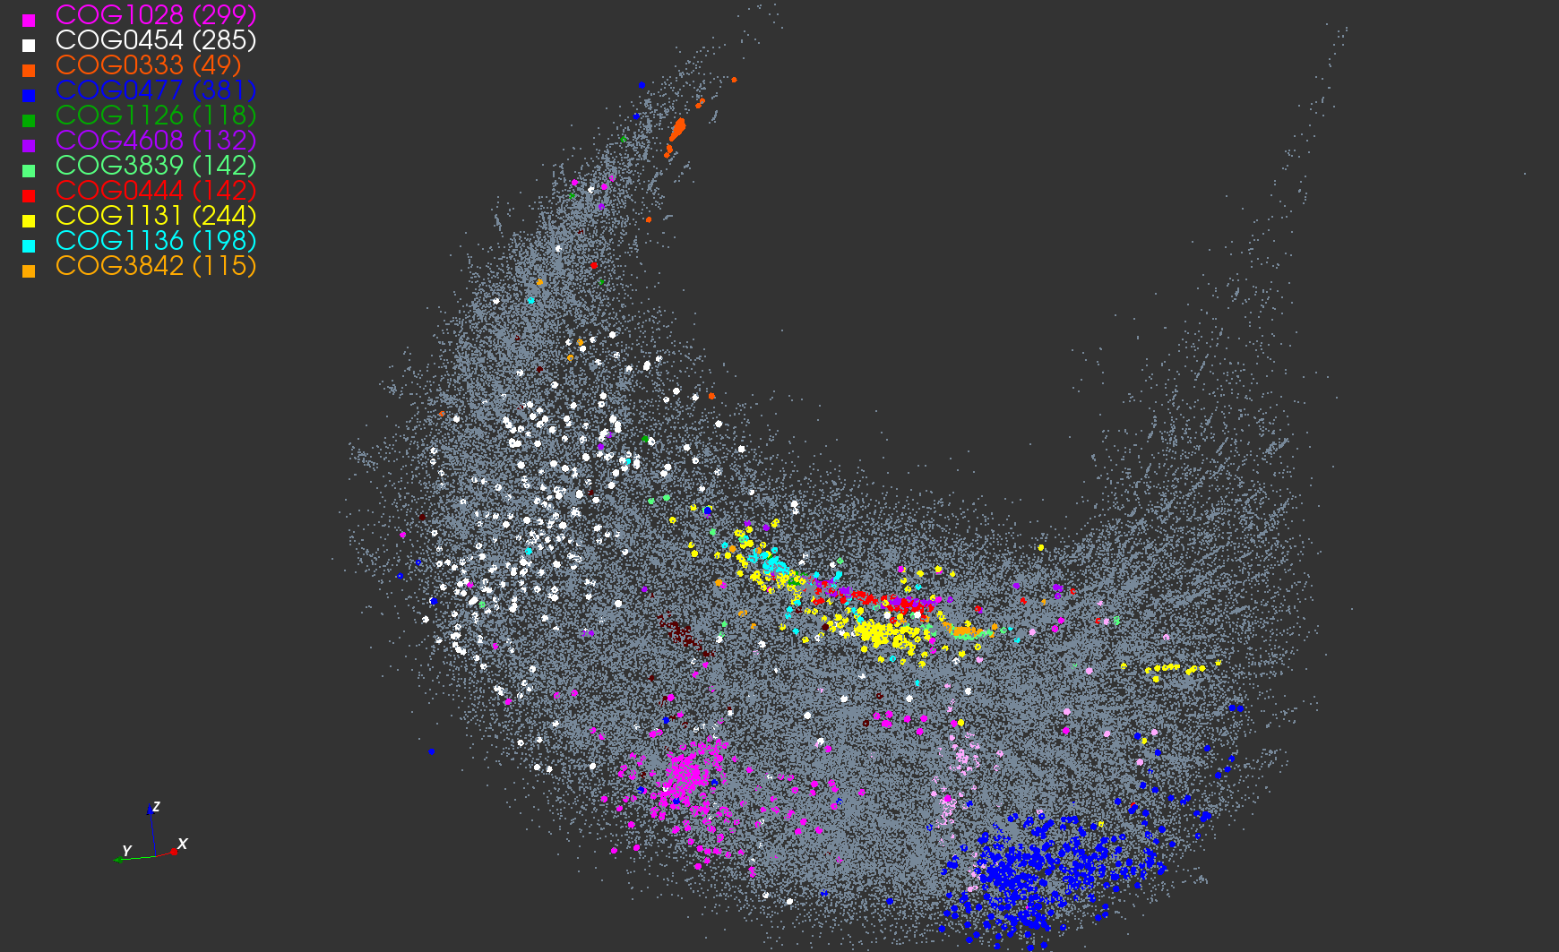
Metagenomics with DA clusters
Pathology 54D
COG Database with a few biology clusters
LC-MS 2D
Lymphocytes 4D

