Slide 1


High Performance Data Mining with Services on Multi-core systems
Shanghai Many-Core Workshop, March 27-28
Judy Qiu
xqiu@indiana.edu, http://www.infomall.org/salsa
Research Computing UITS, Indiana University Bloomington IN
Geoffrey Fox, Huapeng Yuan, Seung-Hee Bae
Community Grids Laboratory, Indiana University Bloomington IN
George Chrysanthakopoulos, Henrik Frystyk Nielsen
Microsoft Research, Redmond WA

Slide 2
Why Data-mining?
What applications can use the 128 cores expected in 2013?
Over same time period real-time and archival data will increase as fast as or faster than computing
  Internet data fetched to local PC or stored in “cloud”
  Surveillance
  Environmental monitors, Instruments such as LHC at CERN, High throughput screening in bio- and chemo-informatics
  Results of Simulations
Intel RMS analysis suggests Gaming and Generalized decision support (data mining) are ways of using these cycles
Notes:
WE want to find “commodity” applications that could use many core systems. Clear that scientific simulations can and will
LHC Large Hadron Collider
RMS Recognition Mining Synthesis
Decision support in government, business, military and even science involves analyzing (mining) many streams of data and presenting it to “decision makers”

Slide 3
Multicore SALSA Project
Service Aggregated Linked Sequential Activities
Link parallel and distributed (Grid) computing by developing parallel modules as services and not as programs or libraries
  e.g. clustering algorithm is a service running on multiple cores
We can divide problem into two parts:
  “Micro-parallelism” : High Performance scalable (in number of cores) parallel kernels or libraries
  “Macro-parallelism” : Composition of kernels into complete applications
Two styles of “micro-parallelism”
  Dynamic search as in scheduling algorithms, Hidden Markov Methods (speech recognition), and computer chess (pruned tree search); irregular synchronization with dynamic threads
  “MPI Style” i.e. several threads running typically in SPMD (Single Program Multiple Data); collective synchronization of all threads together
Most data-mining algorithms (in INTEL RMS) are “MPI Style” and very close to scientific algorithms
Notes:
We assume experts can develop parallel services and general users will compose these and other services (such as Google maps or RSS feeds) into general applications

Slide 4
Status of SALSA Project
Status: is developing a suite of parallel data-mining capabilities: currently
  Clustering with deterministic annealing (DA)
  Mixture Models (Expectation Maximization) with DA
  Metric Space Mapping for visualization and analysis
  Matrix algebra as needed
Results: currently
  Microsoft CCR supports MPI, dynamic threading and via DSS a service model of computing;
  Detailed performance measurements with Speedups of 7.5 or above on 8-core systems for “large problems” using deterministic annealed (avoid local minima) algorithms for clustering, Gaussian Mixtures, GTM (dimensional reduction) etc.
  Collaboration:
SALSA Team
Geoffrey Fox
Xiaohong Qiu
Seung-Hee Bae
Huapeng Yuan
Indiana University
Technology Collaboration
George Chrysanthakopoulos
Henrik Frystyk Nielsen
Microsoft
Application Collaboration
Cheminformatics
Rajarshi Guha
David Wild
Bioinformatics
Haiku Tang
Demographics (GIS)
Neil Devadasan
IU Bloomington and IUPUI
Notes:
Deterministic Annealing for both clustering and Gaussian mixture models reduces chance of getting stuck in a local minima
Metric Space mapping for
Visualizing high dimensional spaces (Cheminformatics over 1000) in 2D (or 3D)
Associating vectors with data (from social science or biology) where one has dissimilarity measures (distances) but not vectors
These vectors help visualization and also allow more powerful datamining

Slide 5
Runtime System Used
We implement micro-parallelism using Microsoft CCR
(Concurrency and Coordination Runtime) as it supports both MPI rendezvous and dynamic (spawned) threading style of parallelism http://msdn.microsoft.com/robotics/
CCR Supports exchange of messages between threads using named ports and has primitives like:
  FromHandler: Spawn threads without reading ports
  Receive: Each handler reads one item from a single port
  MultipleItemReceive: Each handler reads a prescribed number of items of a given type from a given port. Note items in a port can be general structures but all must have same type.
  MultiplePortReceive: Each handler reads a one item of a given type from multiple ports.
CCR has fewer primitives than MPI but can implement MPI collectives efficiently
Use DSS (Decentralized System Services) built in terms of CCR for service model
DSS has ~35 µs and CCR a few µs overhead (latency, details later)
Notes:
CCR has similarities to old OCCAM system used on Transputer
CCR allows custom collectives to be written in C#. We used this for MPI exchange and improved performance by a factor of 2 (in latency) over core CCR primitives
Maybe CCR approach is more realistic than MPI for a broadly adopted standard

Slide 6
General Formula DAC GM GTM DAGTM DAGM
N data points E(x) in D dimensions space and minimize F by EM
  Deterministic Annealing Clustering (DAC)
F is Free Energy
EM is well known expectation maximization method
p(x) with Σ p(x) =1
T is annealing temperature varied down from ∞ with final value of 1
Determine cluster center Y(k) by EM method
K (number of clusters) starts at 1 and is incremented by algorithm
Notes:
We have a set of algorithms with similar formalism. This is just clustering with deterministic annealing, Developed by Fox and his then student Rose 28 years ago. Further developed by several others and has a good reputation. It uses an iterative algorithm like EM but does NOT get stuck in local minima has start with EM at high temperature (where all clusters at centroid of system) and anneal down.
You do not need to specify number of clusters in system. Rather specify final temperature which corresponds to scale of cluster needed

Slide 7
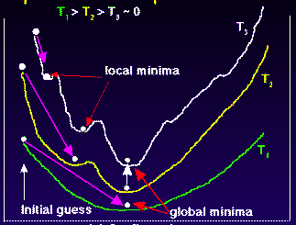
Deterministic
Annealing
F({Y}, T)
Solve Linear Equations for each temperature
Nonlinearity removed by approximating with solution at previous higher temperature
Configuration {Y}
Minimum evolving as temperature decreases
Movement at fixed temperature going to local minima if not initialized “correctly”
Notes:
This illustrates idea behind annealing,
Ordinate (y axis) is objective function F as on slide 6. x axis labels configuration – here set of cluster centers. In annealing one progresses as shown by white lines tracking minima up middle of slide.
Traditional methods as shown by purple line work at high temperature where “energy” function is smooth but not at low temperatures where one gets trapped in local minima

Slide 8
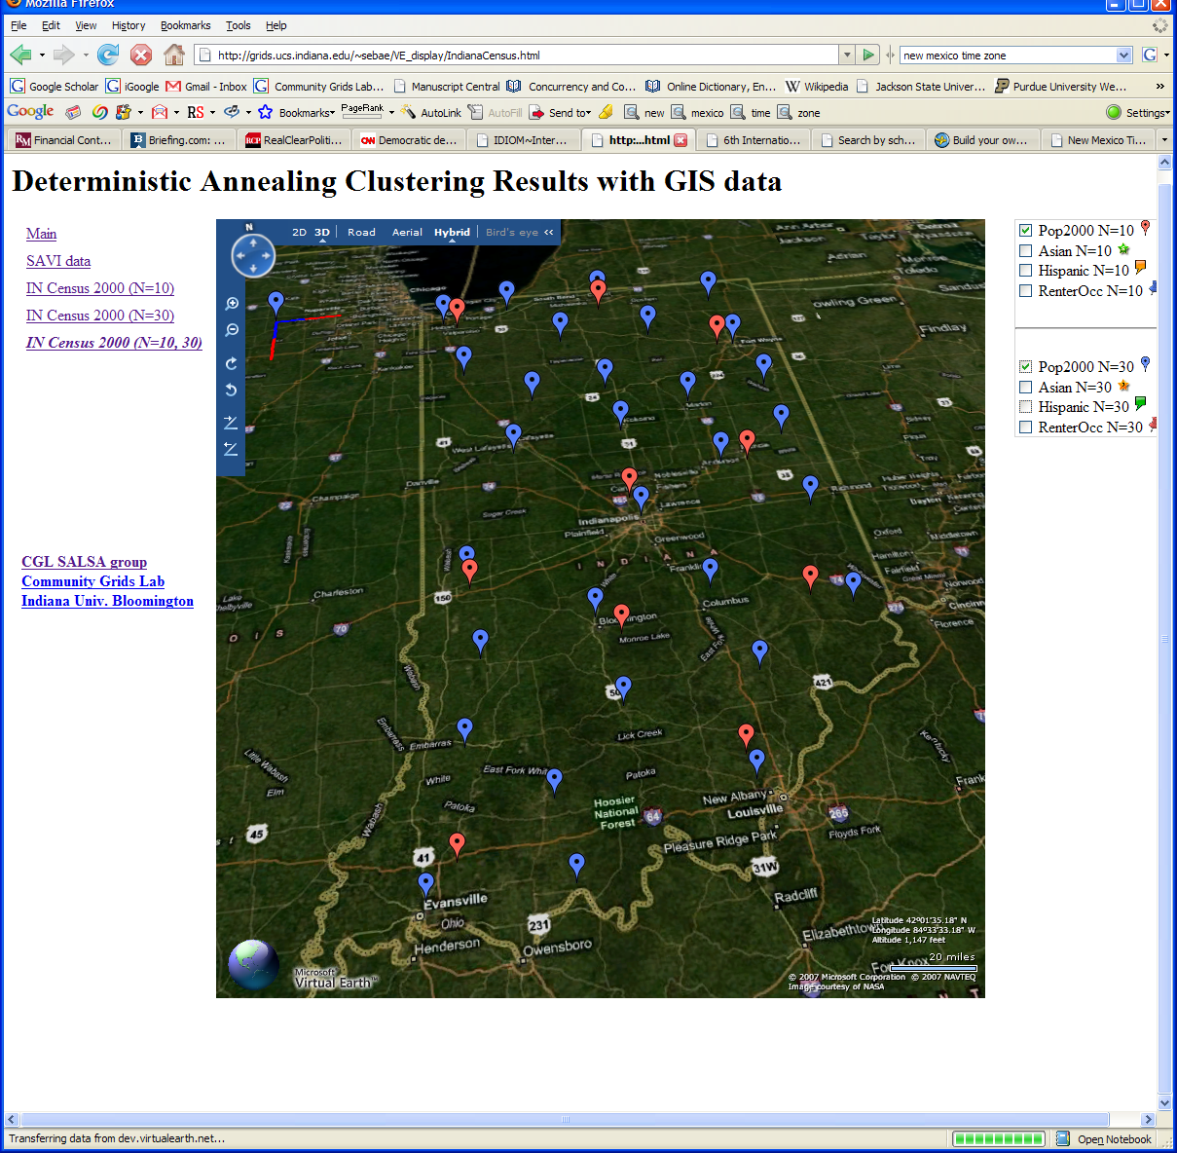
Deterministic Annealing Clustering of Indiana Census Data
Decrease temperature (distance scale) to discover more clusters
Notes:
This illustrates annealing concept
Note Top lefty has scale showing SQRT(T) for Blue (smaller) and Red (larger) points
This shows in Microsoft Virtual Earth the effect of reducing temperature
Higher Temperature (red) has 10 clusters, lower (blue) 30
Note Lafayette (where Purdue is) is not seen at higher temperature

Slide 9
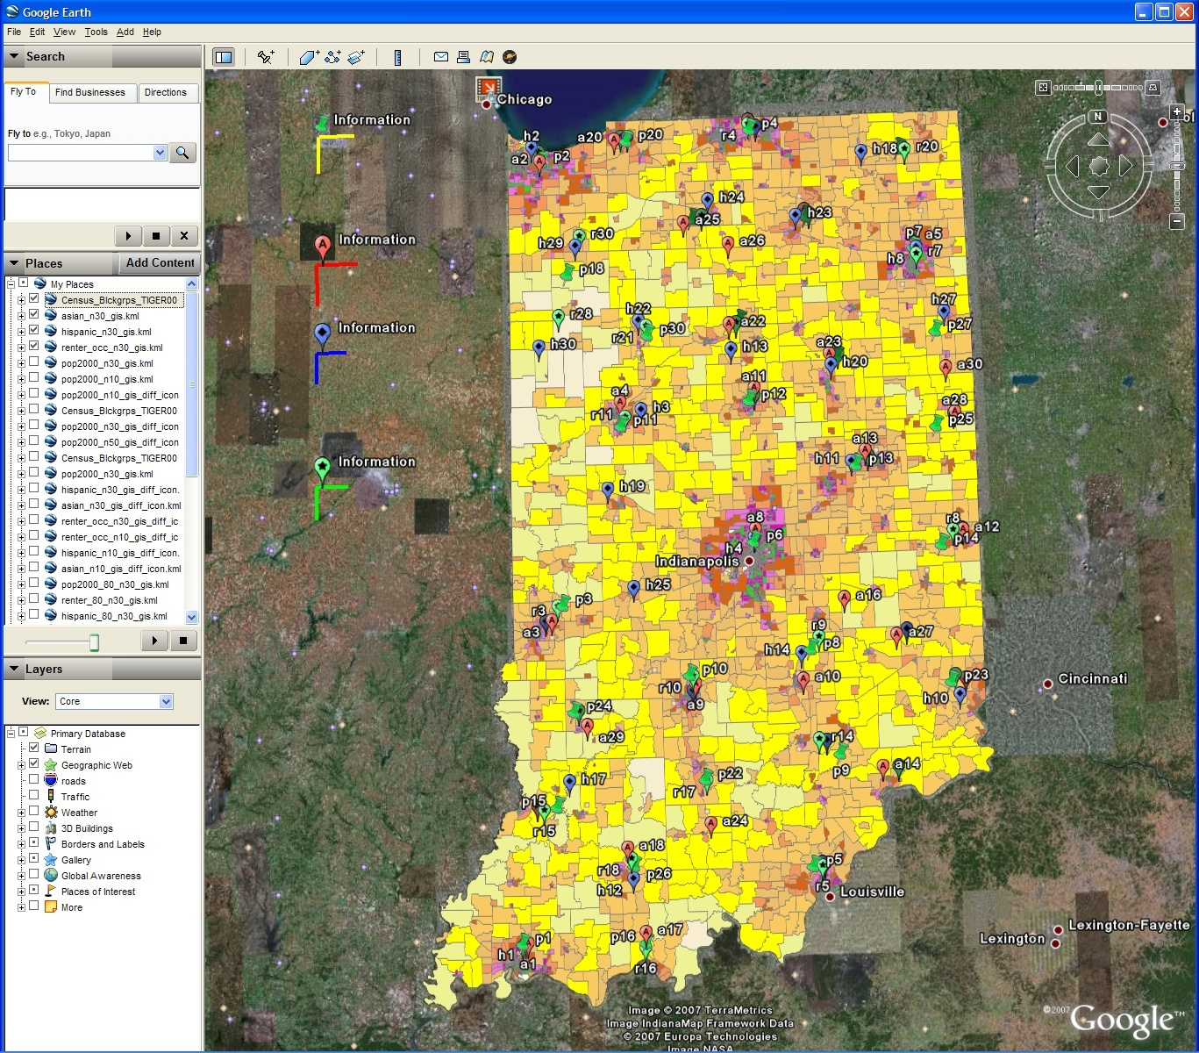
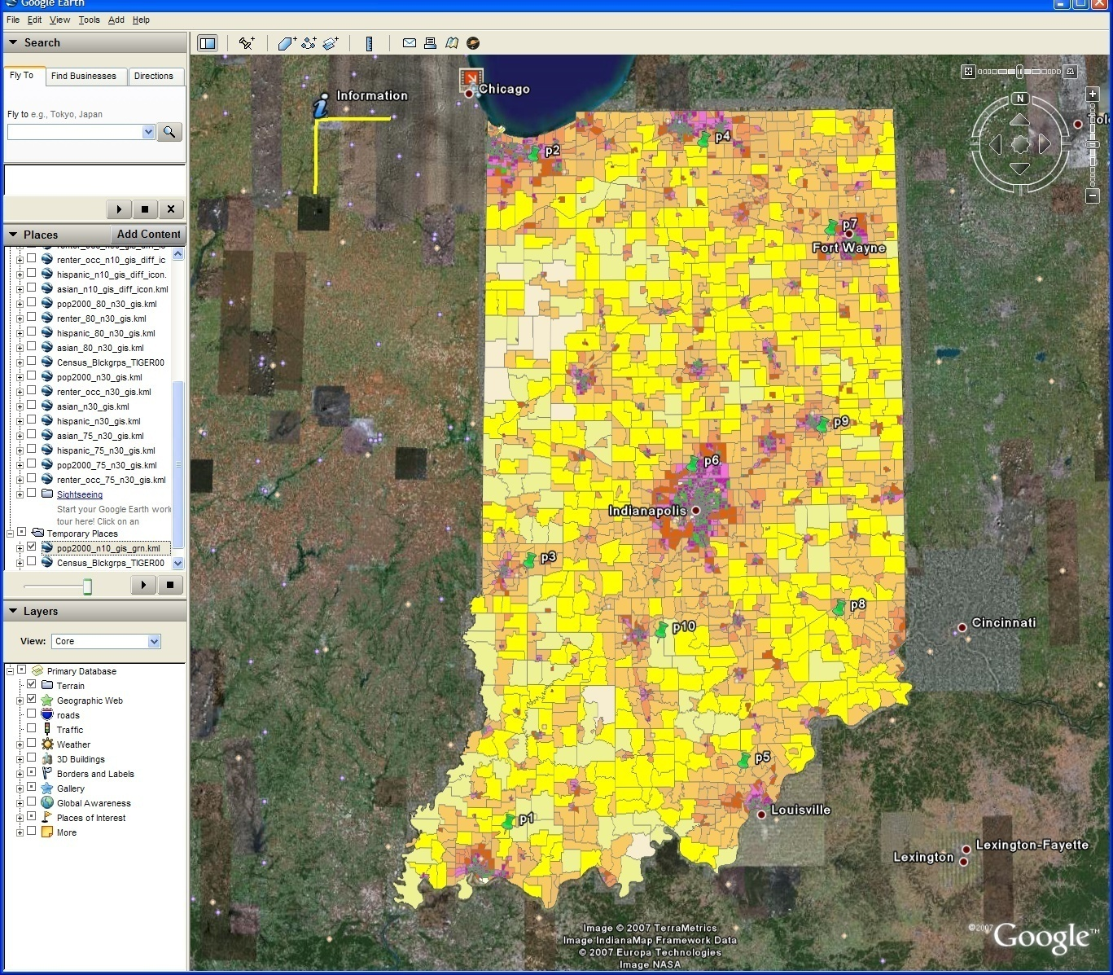
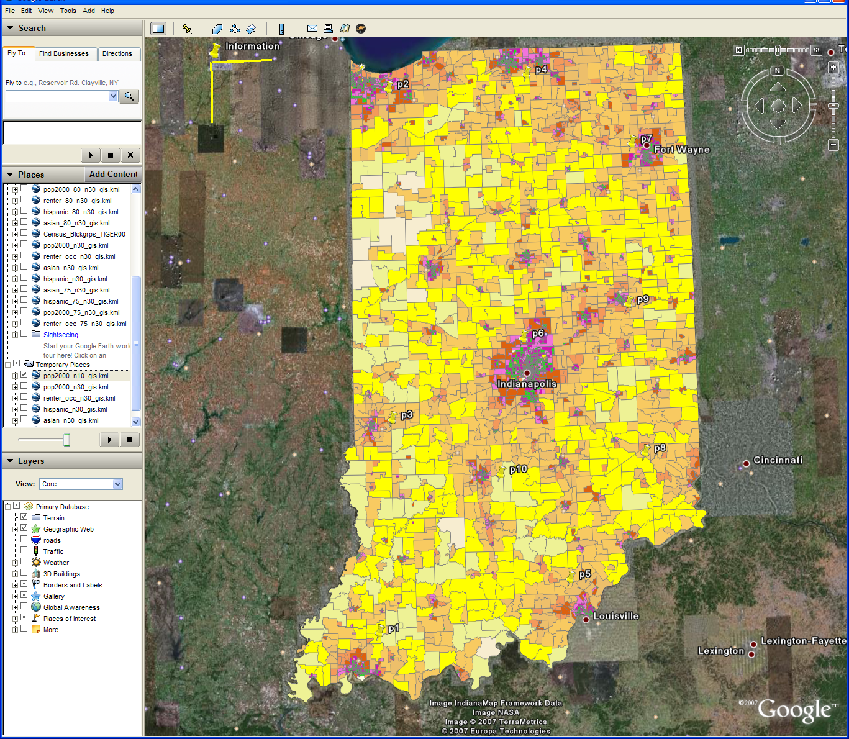
Changing resolution of GIS Clutering
Total
Asian
Hispanic
Renters
30 Clusters
GIS Clustering
30 Clusters
10 Clusters
Notes:
Same display as last slide but using Google Earth
This shows the clusters for 4 population types available in raw census data
Total
Asian
Hispanic
Renters
It has on right 10 clusters shown as black dots for total. Scale is bottom right
Left is 30 clusters with scale on left edge
These maps overlay a density map of census data converting Shape files from US Census to Google KML
This used Shape2Earth program

Slide 10

N data points E(x) in D dim. space and Minimize F by EM
  Deterministic Annealing Clustering (DAC)
  Generative Topographic Mapping (GTM)
  Deterministic Annealing Gaussian
  Mixture models (DAGM)
  Traditional Gaussian
  mixture models GM
a(x) = 1/N or generally p(x) with Σ p(x) =1
g(k)=1 and s(k)=0.5
T is annealing temperature varied down from ∞ with final value of 1
Vary cluster center Y(k) but can calculate weight P_{k} and correlation matrix s(k) = σ(k)² (even for matrix σ(k)²) using IDENTICAL formulae for Gaussian mixtures
K starts at 1 and is incremented by algorithm
a(x) = 1 and g(k) = (1/K)(β/2π)^{D/2}
s(k) = 1/ β and T = 1
Y(k) = Σ_{m=1}^{M} W_{m}φ_{m}(X(k))
Choose fixed φ_{m}(X) = exp( - 0.5 (X-μ_{m})²/σ² )
Vary W_{m} and β but fix values of M and K a priori
Y(k) E(x) W_{m} are vectors in original high D dimension space
X(k) and μ_{m} are vectors in 2 dimensional mapped space
As DAGM but set T=1 and fix K
a(x) = 1
g(k)={P_{k}/(2πσ(k)²)^{D/2}}^{1/T}
s(k)= σ(k)² (taking case of spherical Gaussian)
T is annealing temperature varied down from ∞ with final value of 1
Vary Y(k) P_{k} and σ(k)
K starts at 1 and is incremented by algorithm
  DAGTM: Deterministic Annealed
  Generative Topographic Mapping
GTM has several natural annealing versions based on either DAC or DAGM: under investigation
SALSA
Notes:
This shows all the methods covered by the formula given here. Deterministic clustering is first and with special choices leads to result on slide 6
The next animation show deterministic annealed Gaussian Mixture Models where one allows shape σ and overall probability P as well as center to be determined. This is used in speech recognition and bioinformatics. The annealed version was developed 10 years ago but has little application
The next animation slide shows GTM Generative Topographic Mapping which was developed in Aston University and Microsoft Research. This is used to amp from high to low dimensional space preserving topology (but not detailed distances although nearby points remain nearby). It corresponds to a special form of Gaussian Mixture Model with the cluster centers expressed as a mapping to latent (2D) space
The final animation slide notes
Of course traditional Gaussian mixtures given by this formula – just put T=1 and fix K the number of mixtures
Finally we note we have developed extensions of GTM – given by red formula – with deterministic annealing but we have not applied these yet
10

Slide 11
Parallel Programming Strategy
“Main Thread” and Memory M
MPI/CCR/DSS
From other nodes
MPI/CCR/DSS
From other nodes
0
m₀
1
m₁
2
m₂
3
m₃
4
m₄
5
m₅
6
m₆
7
m₇
Subsidiary threads t with memory m_{t}
Use Data Decomposition as in classic distributed memory but use shared memory for read variables. Each thread uses a “local” array for written variables to get good cache performance
Multicore and Cluster use same parallel algorithms but different runtime implementations; algorithms are
        Accumulate matrix and vector elements in each process/thread
        At iteration barrier, combine contributions (MPI_Reduce)
        Linear Algebra (multiplication, equation solving, SVD)
Notes:
This slides gives the basic programming strategy. The data WRITTEN by a given core is instantiated in the thread memory associated with this core, Data only READ is stored in a shared memory in master thread that spawns the N threads for N cores
Our threads are long running and use rendezvous style synchronization at end of each iterations. We have traditional loosely synchronous style with compute-synchronization phases. Compute phases include calculate matrix elements and vectors, linear algebra with several variations of each in a given algorithm

Slide 12
Parallel Multicore
Deterministic Annealing Clustering
Parallel Overhead
on 8 Threads Intel 8b
Speedup = 8/(1+Overhead)
10 Clusters
Overhead = Constant1 + Constant2/n
Constant1 = 0.05 to 0.1 (Client Windows) due to
thread runtime fluctuations
20 Clusters
10000/(Grain Size n = points per core)
Notes:
This simple graph typifies our results. Note we expect overhead to be proportional to 1/(Number of clusters * Number of Grain Points)
So we plot two cluster numbers. Each shows a straight line versus 10000/grain size
In simple model the lines should go to zero at 10000/grain size = 0 but we don’t see that. We interpret residual overhead at large number of clusters and large grain size as due to “run time fluctuations” (See later)
Note that overhead of 0.05 corresponds to an excellent speed up of 7.6

Slide 13
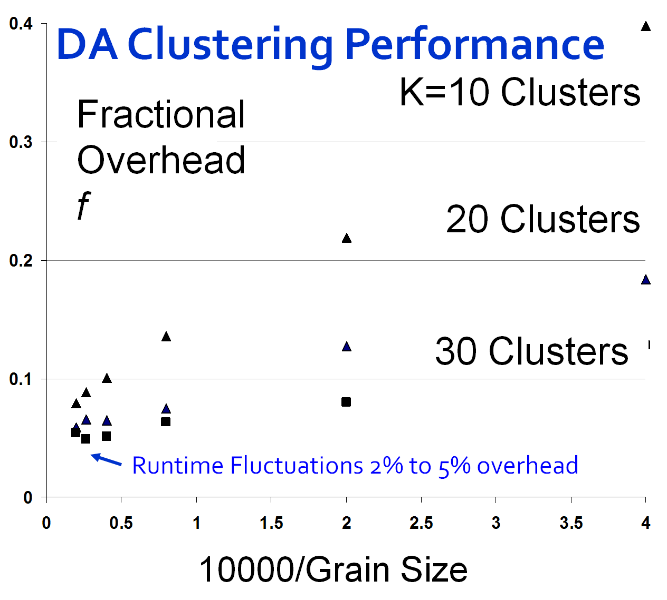
Speedup = Number of cores/(1+f)
f = (Sum of Overheads)/(Computation per core)
Computation ∝ Grain Size n . # Clusters K
Overheads are
Synchronization: small with CCR
Load Balance: good
Memory Bandwidth Limit: → 0 as K → ∞
Cache Use/Interference: Important
Runtime Fluctuations: Dominant large n, K
All our “real” problems have f ≤ 0.05 and
speedups on 8 core systems greater than 7.6
SALSA
Notes:
Here we see more detailed results
GTM shows even lower speed up as it uses a very large (4096) of cluster equivalents
We show a clustering graph (bottom left) similar to previous result but with different number of clusters 10 20 30
In matrix multiplication on top right
For small block size memory bandwidth impacts performance. One does not do enough arithmetic per data fetched from memory
For large block size the performance gets worse as blocks do not fit in cache
One gets good 1 core and 8 core results for block sizes in range 64 to 256 with only a 1% parallel overhead
Note memory bandwidth and cache spilling (out) effects are larger on 8 cores than 1 core. As multiple cores share cache and memory access
13

Slide 14
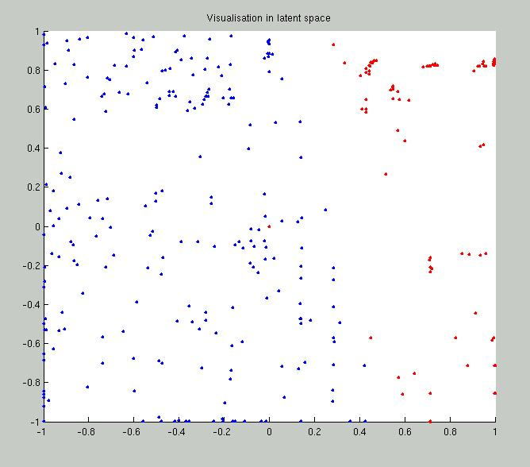
2 Clusters of Chemical Compounds in 155 Dimensions Projected into 2D
Deterministic Annealing for Clustering of 335 compounds
Method works on much larger sets but choose this as answer known
GTM (Generative Topographic Mapping) used for mapping 155D to 2D latent space
Much better than PCA (Principal Component Analysis) or SOM (Self Organizing Maps)
Notes:
Here is a small GTM test program. We use deterministic annealing to find two clusters corresponding to water soluble and water insoluble compounds. There are 155 chemical properties to cluster 335 compounds on.
After clustering we use a separate GTM run to plot the resultant clustering. Without this it is hard to judge clustering. Note the two clusters are shown as red and blue dots in picture

Slide 15
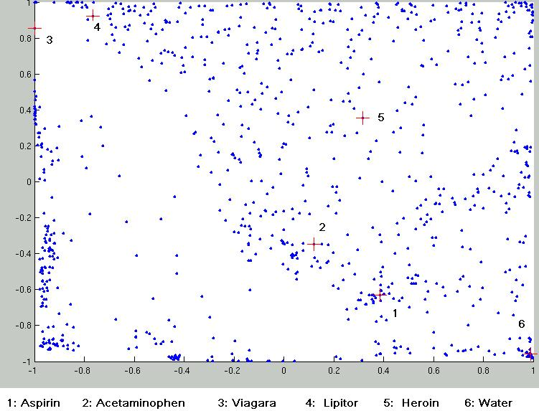
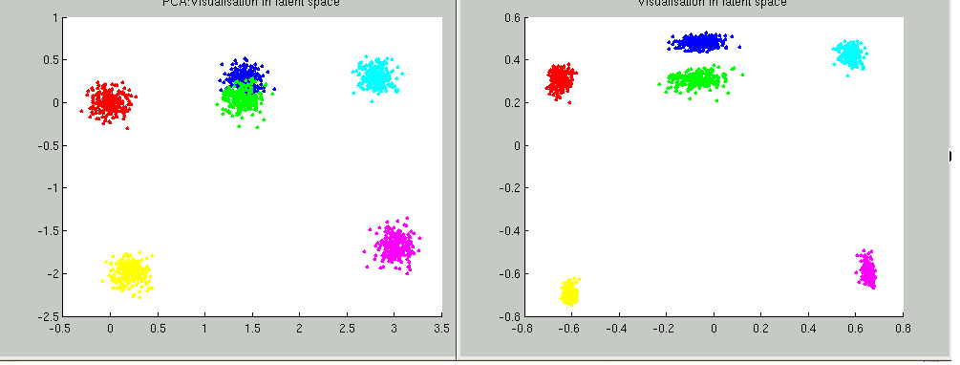
Parallel Generative Topographic Mapping GTM
Reduce dimensionality preserving topology and perhaps distances
Here project to 2D
GTM Projection of PubChem: 10,926,940 compounds in 166 dimension binary property space takes 4 days on 8 cores. 64X64 mesh of GTM clusters interpolates PubChem. Could usefully use 1024 cores! David Wild will use for GIS style 2D browsing interface to chemistry
PCA
GTM
Linear PCA v. nonlinear GTM on 6 Gaussians in 3D
GTM Projection of 2 clusters
of 335 compounds in 155 dimensions
SALSA
Notes:
These are a set of more GTM results repeating one from earlier slide with 335 compounds and two clusters
The bottom left and center results compare GTM with Principal Component analysis for 6 Gaussians in 3D. GTM which is non linear does (a little) better than PCA which is linear. PCA forms covariance matrix and projects onto two leading eigenvectors
The top part of slide shows a 2D mapping of 10.9M compounds in the NIH PubChem. David Wild will use this to develop a browser of this database. The plot shows
First 1000 entries in PubChem plus
B) 6 special compounds including Water Aspirin Heroin Viagara etc.

Slide 16
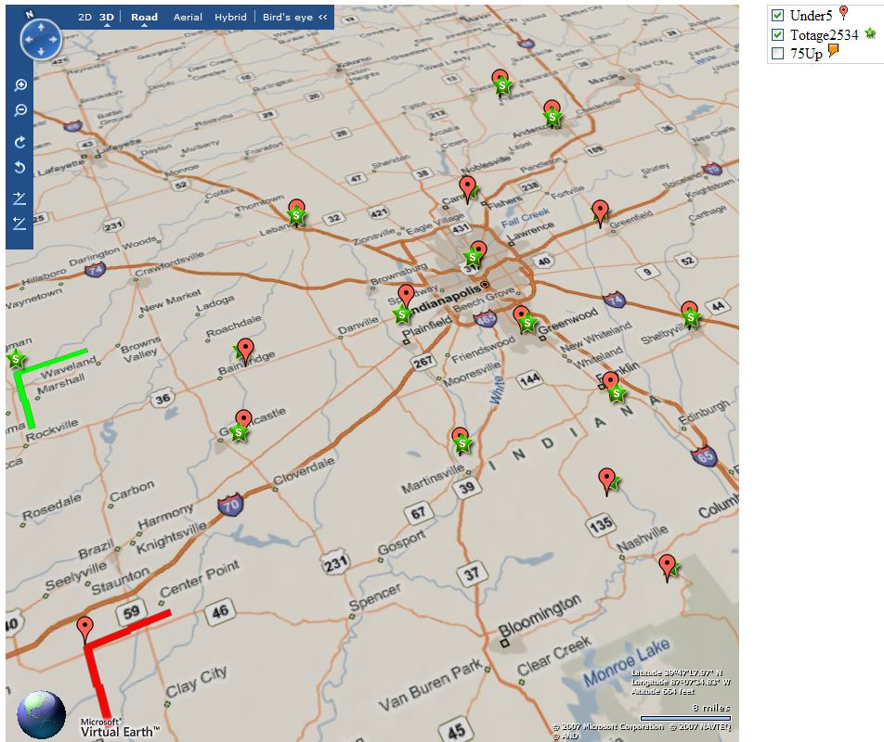

Notes:
This shows on Microsoft virtual Earth how one could use clustering to find locations of different population types. This corresponds to more extensive data than in census available for Indianapolis and the county (Brown) south of it
Here we compare under 5 population (red) with age bracket 25-34 (green). Note they are very similarly located as you might expect. The distance scales are shown on bottom left
In next animation we compare same under 5 population (red) with age bracket 75 and over (orange). Now we see more differences. The distance scales are shown on bottom left

Slide 17
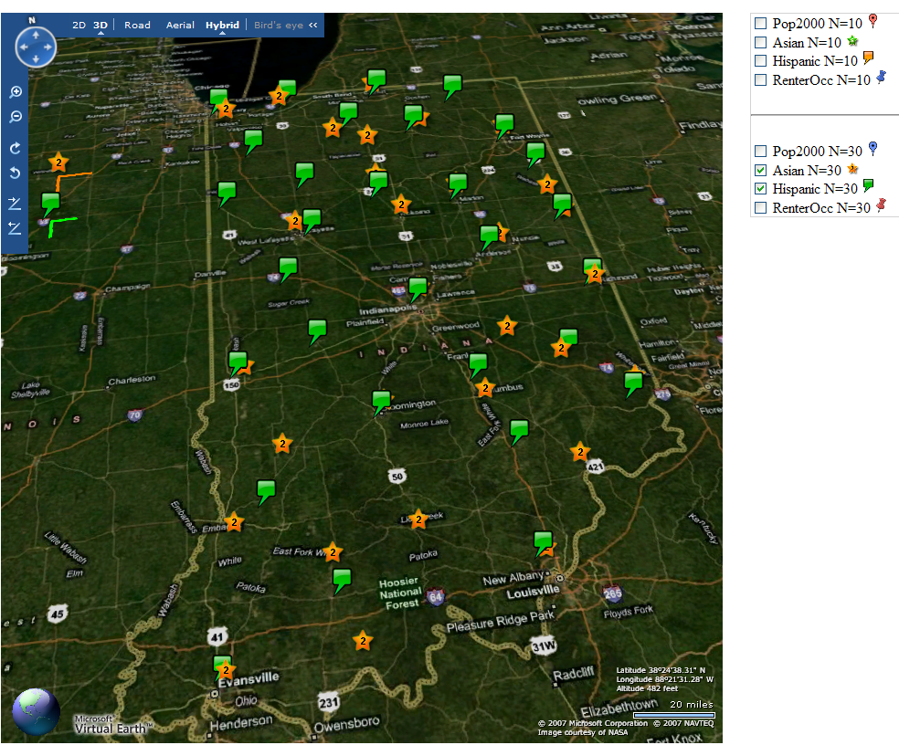
Notes:
This is Microsoft Virtual Earth version of data shown earlier in Google maps. We compare Hispanic and Asian population densities in Indiana (from basic census data). There are significant differences and could help to locate Chinese and Mexican restaurants!

Slide 18
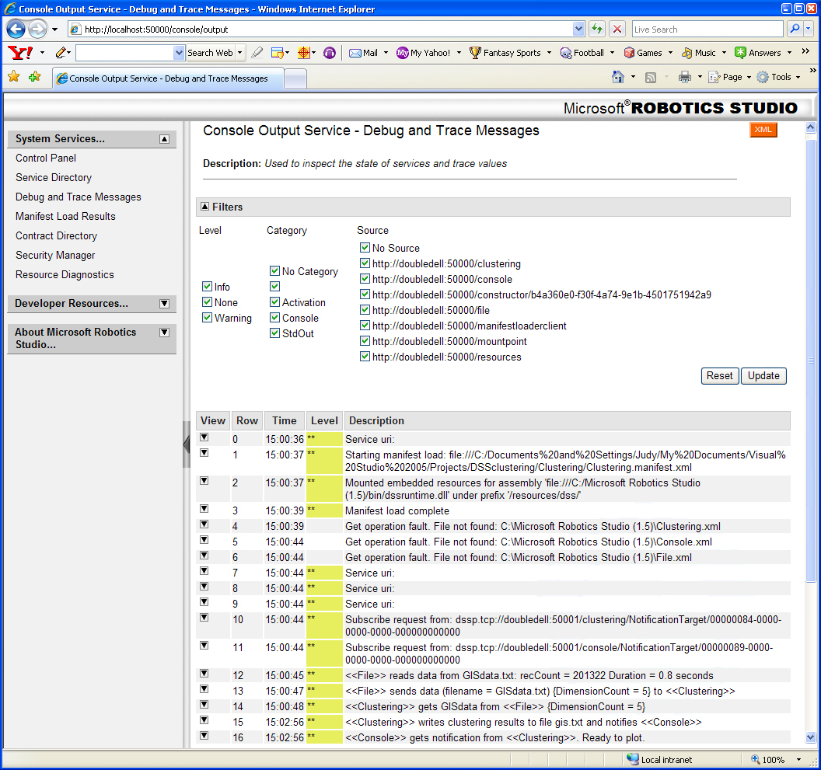
The GIS application using DSS Services
Notes:
Judy Qiu developed this GIS Deterministic Clustering interaction using Microsoft DSS

Slide 19
DSS Service Measurements
Timing of HP Opteron Multicore as a function of number of simultaneous two-way service messages processed (November 2006 DSS Release)
Measurements of Axis 2 shows about 500 microseconds – DSS is 10 times better
Notes:
Latency of messaging in DSS is typically 35 microseconds

Slide 20
MPI Exchange Latency in μs
(20-30 computation between messaging)
Machine | OS | Runtime | Grains | Parallelism | MPI Exchange Latency (µs)
Intel8c:gf12 (8 core 2.33 Ghz) (in 2 chips) | Redhat | MPJE (Java) | Process | 8 | 181
 |  | MPICH2 (C) | Process | 8 | 40.0
 |  | MPICH2: Fast | Process | 8 | 39.3
 |  | Nemesis | Process | 8 | 4.21
Intel8c:gf20 (8 core 2.33 Ghz) | Fedora | MPJE | Process | 8 | 157
 |  | mpiJava | Process | 8 | 111
 |  | MPICH2 | Process | 8 | 64.2
Intel8b (8 core 2.66 Ghz) | Vista | MPJE | Process | 8 | 170
 | Fedora | MPJE | Process | 8 | 142
 | Fedora | mpiJava | Process | 8 | 100
 | Vista | CCR (C#) | Thread | 8 | 20.2
AMD4 (4 core 2.19 Ghz) | XP | MPJE | Process | 4 | 185
 | Redhat | MPJE | Process | 4 | 152
 |  | mpiJava | Process | 4 | 99.4
 |  | MPICH2 | Process | 4 | 39.3
 | XP | CCR | Thread | 4 | 16.3
Intel4 (4 core 2.8 Ghz) | XP | CCR | Thread | 4 | 25.8
Notes:
These results compare MPI exchange latency for various machines and runtimes
In exchange, each core sends and receives two messages at synchronization points.
The best results (4 microseconds) is for MPICH2 optimized for multicore – the Nemesis system
CCR is 20 microseconds on 8 core Intel where vanilla MPICH2 is 40 microseconds with little change if you use “fast” option
Java is always poor both for
mpiJava which uses a Java wrapper of MPICH and
MPJE which is a pure Java implementation of MPI

Slide 21
CCR Overhead for a computation of 23.76 µs between messaging
Intel8b: 8 Core |  | Number of Parallel Computations
(μs) |  | 1 | 2 | 3 | 4 | 7 | 8
Spawned | Pipeline | 1.58 | 2.44 | 3 | 2.94 | 4.5 | 5.06
 | Shift |  | 2.42 | 3.2 | 3.38 | 5.26 | 5.14
 | Two Shifts |  | 4.94 | 5.9 | 6.84 | 14.32 | 19.44
 | Pipeline | 2.48 | 3.96 | 4.52 | 5.78 | 6.82 | 7.18
 | Shift |  | 4.46 | 6.42 | 5.86 | 10.86 | 11.74
 | Exchange As Two Shifts |  | 7.4 | 11.64 | 14.16 | 31.86 | 35.62
 | Exchange |  | 6.94 | 11.22 | 13.3 | 18.78 | 20.16
Rendezvous
MPI
Notes:
Ccr can do dynamic threading sync and MPI-style sync with good latency.
It supports customized collectives (exchange vs. exchange as two shifts) multicore messages like broadcast

Slide 22
Time Microseconds
Stages (millions)
Overhead (latency) of AMD4 PC with 4 execution threads on MPI style Rendezvous Messaging for Shift and Exchange implemented either as two shifts or as custom CCR pattern

Slide 23
Time Microseconds
Stages (millions)
Overhead (latency) of Intel8b PC with 8 execution threads on MPI style Rendezvous Messaging for Shift and Exchange implemented either as two shifts or as custom CCR pattern
Notes:
10 million stages is about 1.5 microseconds computation. It has a dramatic dip and rise. Scheduling depends on the interplay between the hardware and OS. All the threads are sync together is not designed style for windows OS. More work is needed on OS scheduling to get rid of these effect.

Slide 24
Scaled Average Runtime (memory bandwidth and cache effects))
Divide runtime
by
Grain Size n
. # Clusters K
8 cores (threads) and 1 cluster show memory bandwidth effect
80 clusters show cache/memory bandwidth effect
Notes:
This divides all the run times for cluster kernel by Number of Clusters times Grain size. It then divides all by value at grain size 10,000 and 1 core.
This shows effect of memory bandwidth and cache
The largest values are for 8 cores and 1 cluster; the value of 1.5 for 10,000 grain size is much bigger than 1
For 80 clusters, memory bandwidth is less important. You are doing a lot of computing per memory access. There is similarly less difference between 1 core and 8 cores
Note for 80 clusters, scaled runtime is always < 1 showing impact of increased computing per memory access

Slide 25
Run Time Fluctuations for Clustering Kernel
This is average of standard deviation of run time of the 8 threads between messaging synchronization points
Notes:
Top is Windows showing 5% runtime fluctuations
Bottom is Linux (Redhat) showing ten times lower fluctuations.
Here we do lots of identical runs of clustering kernel for 80 clusters on 1 4 or 8 cores
We take this set of run times and find their mean and standard deviation
The standard deviation is larger on 8 than 1 core and much larger for Windows than Linux

Slide 26
Cache Line Interference
Early implementations of our clustering algorithm showed large fluctuations due to the cache line interference effect (false sharing)
We have one thread on each core each calculating a sum of same complexity storing result in a common array A with different cores using different array locations
Thread i stores sum in A(i) is separation 1 – no memory access interference but cache line interference
Thread i stores sum in A(X*i) is separation X
Serious degradation if X < 8 (64 bytes) with Windows
  Note A is a double (8 bytes)
  Less interference effect with Linux – especially Red Hat
Notes:
C# Random Number generator uses an array with a separation of 1 and runs very slowly

Slide 27
Cache Line Interface
Note measurements at a separation X of 8 and X=1024 (and values between 8 and 1024 not shown) are essentially identical
Measurements at 7 (not shown) are higher than that at 8 (except for Red Hat which shows essentially no enhancement at X<8)
As effects due to co-location of thread variables in a 64 byte cache line, align the array with cache boundaries
Notes:
Note Redhat shows almost no dependence on separation
In all cases separation of 8 (cache line size) is similar to 1024 but apart from Redhat the cache line separation of 1 is 5 to 20 slower than cache line separation of 8 or 1024
Locks similar to C#
Different variants of Windows similar
Note C# slower than C on same machine – look at 1024 byte separation values for Intel 8b

Slide 28
Issues and Futures
This class of data mining does/will parallelize well on current/future multicore nodes
Several engineering issues for use in large applications
  How to take CCR in multicore node to cluster (MPI or cross-cluster CCR?)
  Need high performance linear algebra for C# (PLASMA from UTenn)
    Access linear algebra services in a different language?
  Need equivalent of Intel C Math Libraries for C# (vector arithmetic – level 1 BLAS)
  Service model to integrate modules
  Need access to a ~ 128 node Windows cluster
Future work is more applications; refine current algorithms such as DAGTM
New parallel algorithms
  Clustering with pairwise distances but no vector spaces
  Bourgain Random Projection for metric embedding
  MDS Dimensional Scaling with EM-like SMACOF and deterministic annealing
  Support use of Newton’s Method (Marquardt’s method) as EM alternative
  Later HMM and SVM
Notes:
PLASMA is project led by Jack Dongarra to develop a multicore parallel C# Linear Algebra library
Intel C Math library can be used with C# but a bit clumsy
128 node cluster of 8 core systems needed for convenient work on PubChem GTM mapping
Current work on single 8 core PC took a week solid running
DAGTM Deterministic Annealing Generative Topographic Mapping
Bourgain mathematician who developed a method for embedding points with distance d(i,j) defined between them into Euclidean space
HMM Hidden Markov Model
MDS multi dimensional scaling, given a set of points, D(I,j) , if specifies a dimension then it gives vectors of that distance between the vectors are equal to the distance of D(I,j).
SVM Support Vector Machine

Slide 29
http://www.infomall.org/ SALSA
Thank you!

