Slide 1
Scalable Algorithms in the Cloud I
Microsoft Summer School
Doing Research in the Cloud
Moscow State University
August 1 2014
Geoffrey Fox
gcf@indiana.edu
http://www.infomall.org
School of Informatics and Computing
Digital Science Center
Indiana University Bloomington

Slide 2
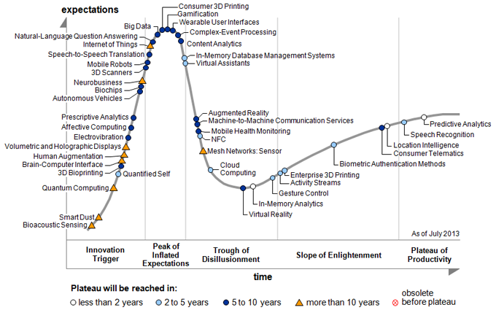
Gartner Emerging Technology Hype Cycle 2013
(2014 version out but costs $2000)

Slide 3
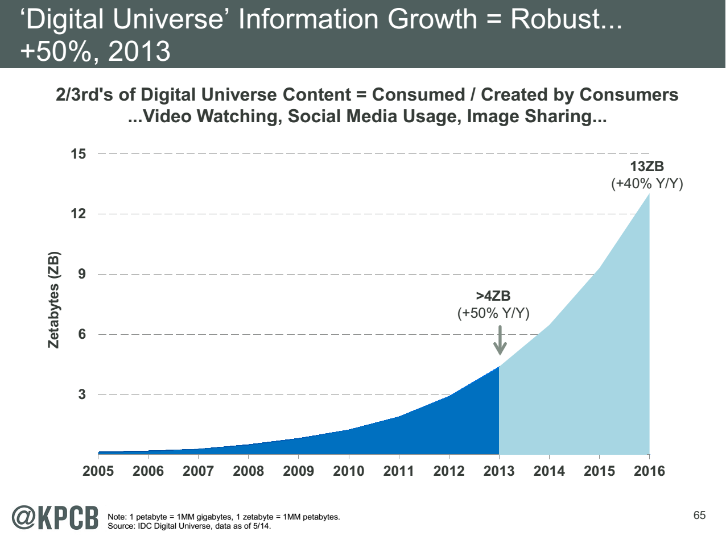
My focus is Science Big Data but note
Note largest science ~100 petabytes = 0.000025 total
Science should take notice of commodity
Converse not clearly true?
http://www.kpcb.com/internet-trends

Slide 4
Jobs

Slide 5

Jobs v. Countries
http://www.microsoft.com/en-us/news/features/2012/mar12/03-05CloudComputingJobs.aspx

Slide 6

McKinsey Institute on Big Data Jobs
There will be a shortage of talent necessary for organizations to take advantage of big data. By 2018, the United States alone could face a shortage of 140,000 to 190,000 people with deep analytical skills as well as 1.5 million managers and analysts with the know-how to use the analysis of big data to make effective decisions.
At IU, Informatics aimed at 1.5 million jobs. Computer Science covers the 140,000 to 190,000
http://www.mckinsey.com/mgi/publications/big_data/index.asp.

Slide 7
NIST Big Data Sub Groups
Led by Chaitin Baru, Bob Marcus, Wo Chang

Slide 8
NBD-PWG (NIST Big Data Public Working Group) Subgroups & Co-Chairs
There were 5 Subgroups
Requirements and Use Cases Sub Group
  Geoffrey Fox, Indiana U.; Joe Paiva, VA; Tsegereda Beyene, Cisco
Definitions and Taxonomies SG
  Nancy Grady, SAIC; Natasha Balac, SDSC; Eugene Luster, R2AD
Reference Architecture Sub Group
  Orit Levin, Microsoft; James Ketner, AT&T; Don Krapohl, Augmented Intelligence
Security and Privacy Sub Group
  Arnab Roy, CSA/Fujitsu Nancy Landreville, U. MD Akhil Manchanda, GE
Technology Roadmap Sub Group
  Carl Buffington, Vistronix; Dan McClary, Oracle; David Boyd, Data Tactics
See http://bigdatawg.nist.gov/usecases.php
And http://bigdatawg.nist.gov/V1_output_docs.php

Slide 9
Big Data Definition
More consensus on Data Science definition than that of Big Data
Big Data refers to digital data volume, velocity and/or variety that:
Enable novel approaches to frontier questions previously inaccessible or impractical using current or conventional methods; and/or
Exceed the storage capacity or analysis capability of current or conventional methods and systems; and
Differentiates by storing and analyzing population data and not sample sizes.
Needs management requiring scalability across coupled horizontal resources
Everybody says their data is big (!) Perhaps how it is used is most important

Slide 10
What is Data Science?
I was impressed by number of NIST working group members who were self declared data scientists
I was also impressed by universal adoption by participants of Apache technologies – see later
McKinsey says there are lots of jobs (1.65M by 2018 in USA) but that’s not enough! Is this a field – what is it and what is its core?
  The emergence of the 4th or data driven paradigm of science illustrates significance - http://research.microsoft.com/en-us/collaboration/fourthparadigm/
  Discovery is guided by data rather than by a model
  The End of (traditional) science http://www.wired.com/wired/issue/16-07 is famous here
Another example is recommender systems in Netflix, e-commerce etc. where pure data (user ratings of movies or products) allows an empirical prediction of what users like

Slide 11
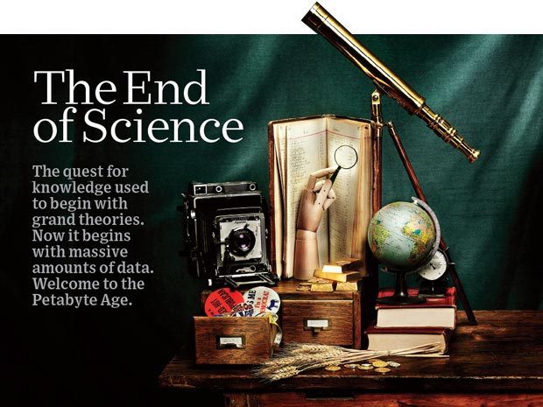
http://www.wired.com/wired/issue/16-07 September 2008

Slide 12
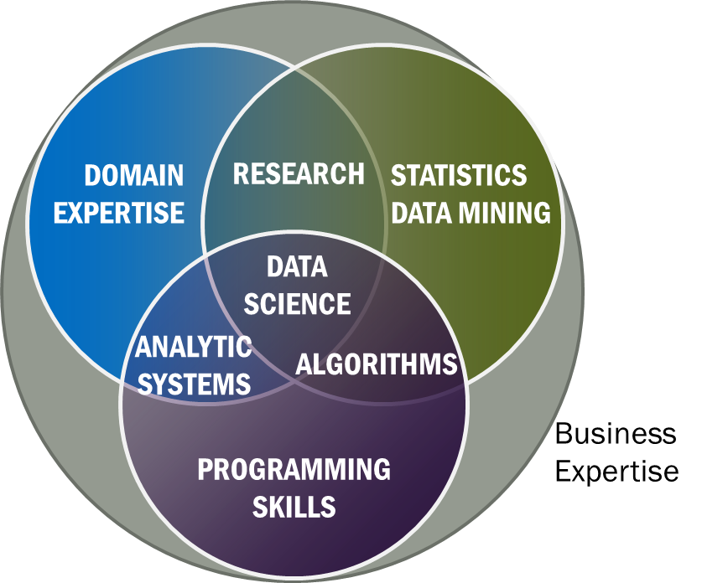
Data Science Definition
Data Science is the extraction of actionable knowledge directly from data through a process of discovery, hypothesis, and analytical hypothesis analysis.
A Data Scientist is a practitioner who has sufficient knowledge of the overlapping regimes of expertise in business needs, domain knowledge, analytical skills and programming expertise to manage the end-to-end scientific method process through each stage in the big data lifecycle.
Notes:
Big Data refers to digital data volume, velocity and/or variety whose management requires scalability across coupled horizontal resources
Data Science is the extraction of actionable knowledge directly from data through a process of discovery, hypothesis, and analytical hypothesis analysis.
A Data Scientist is a practitioner who has sufficient knowledge of the overlapping regimes of expertise in business needs, domain knowledge, analytical skills and programming expertise to manage the end-to-end scientific method process through each stage in the big data lifecycle.

Slide 13
NIST Big Data Reference Architecture
INFORMATION VALUE CHAIN
System Orchestrator
Big Data Application Provider
Analytics
Data Provider
Curation
Visualization
Data Consumer
DATA
DATA
SW
Collection
Access
SW
DATA
SW
K E Y :
Big Data Framework Provider
Processing Frameworks (analytic tools, etc.)
IT VALUE CHAIN
Horizontally Scalable
Service Use
Vertically Scalable
Security & Privacy
DATA
Platforms (databases, etc.)
Management
Horizontally Scalable
Data Flow
Vertically Scalable
Infrastructures
SW
Horizontally Scalable (VM clusters)
Vertically Scalable
Analytics Tools Transfer
Physical and Virtual Resources (networking, computing, etc.)

Slide 14
Top 10 Security & Privacy Challenges: Classification
Infrastructure security
Secure Computations in Distributed Programming Frameworks
Security Best Practices for Non-Relational Data Stores
Data Privacy
Privacy Preserving Data Mining and Analytics
Cryptographically Enforced Data Centric Security
Granular Access Control
Data Management
Secure Data Storage and Transaction Logs
Granular Audits
Data Provenance
Integrity and Reactive Security
End-point validation and filtering
Real time Security Monitoring

Slide 15
NIST Big Data Use Cases

Slide 16

Use Case Template
26 fields completed for 51 areas
Government Operation: 4
Commercial: 8
Defense: 3
Healthcare and Life Sciences: 10
Deep Learning and Social Media: 6
The Ecosystem for Research: 4
Astronomy and Physics: 5
Earth, Environmental and Polar Science: 10
Energy: 1

Slide 17
51 Detailed Use Cases: Contributed July-September 2013
Covers goals, data features such as 3 V’s, software, hardware
26 Features for each use case
Biased to science
http://bigdatawg.nist.gov/usecases.php
https://bigdatacoursespring2014.appspot.com/course (Section 5)
Government Operation(4): National Archives and Records Administration, Census Bureau
Commercial(8): Finance in Cloud, Cloud Backup, Mendeley (Citations), Netflix, Web Search, Digital Materials, Cargo shipping (as in UPS)
Defense(3): Sensors, Image surveillance, Situation Assessment
Healthcare and Life Sciences(10): Medical records, Graph and Probabilistic analysis, Pathology, Bioimaging, Genomics, Epidemiology, People Activity models, Biodiversity
Deep Learning and Social Media(6): Driving Car, Geolocate images/cameras, Twitter, Crowd Sourcing, Network Science, NIST benchmark datasets
The Ecosystem for Research(4): Metadata, Collaboration, Language Translation, Light source experiments
Astronomy and Physics(5): Sky Surveys including comparison to simulation, Large Hadron Collider at CERN, Belle Accelerator II in Japan
Earth, Environmental and Polar Science(10): Radar Scattering in Atmosphere, Earthquake, Ocean, Earth Observation, Ice sheet Radar scattering, Earth radar mapping, Climate simulation datasets, Atmospheric turbulence identification, Subsurface Biogeochemistry (microbes to watersheds), AmeriFlux and FLUXNET gas sensors
Energy(1): Smart grid

Slide 18

Table 4: Characteristics of 6 Distributed Applications
Application Example | Execution Unit | Communication | Coordination | Execution Environment
Montage | Multiple sequential and parallel executable | Files | Dataflow (DAG) | Dynamic process creation, execution
NEKTAR | Multiple concurrent parallel executables | Stream based | Dataflow | Co-scheduling, data streaming, async. I/O
Replica-Exchange | Multiple seq. and parallel executables | Pub/sub | Dataflow and events | Decoupled coordination and messaging
Climate Prediction (generation) | Multiple seq. & parallel executables | Files and messages | Master-Worker, events | @Home (BOINC)
Climate Prediction (analysis) | Multiple seq. & parallel executables | Files and messages | Dataflow | Dynamics process creation, workflow execution
SCOOP | Multiple Executable | Files and messages | Dataflow | Preemptive scheduling, reservations
Coupled Fusion | Multiple executable | Stream-based | Dataflow | Co-scheduling, data streaming, async I/O
Part of Property Summary Table

Slide 19
HPC-ABDS
Integrating High Performance Computing with Apache Big Data Stack
Shantenu Jha, Judy Qiu, Andre Luckow
http://hpc-abds.org/kaleidoscope/

Slide 20
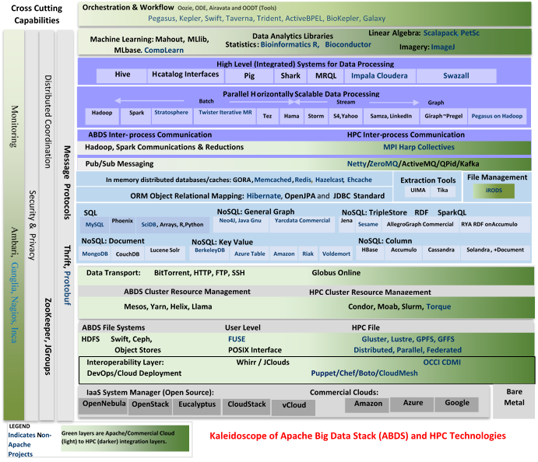

Slide 21
HPC-ABDS
~120 Capabilities
>40 Apache
Green layers have strong HPC Integration opportunities
Goal
Functionality of ABDS
Performance of HPC

Slide 22
Cross-Cutting Functionalities
Message Protocols
Distributed Coordination
Security & Privacy
Monitoring
~120 HPC-ABDS Software capabilities in 17 functionalities
Workflow-Orchestration
Application and Analytics: Mahout, MLlib, R…
High level Programming
Basic Programming model and runtime SPMD, Streaming, MapReduce, MPI
Inter process communication Collectives, point-to-point, publish-subscribe
In-memory databases/caches
Object-relational mapping
SQL and NoSQL, File management
Data Transport
Cluster Resource Management
File systems
DevOps
IaaS Management from HPC to hypervisors
Kaleidoscope of Apache Big Data Stack (ABDS) and HPC Technologies

Slide 23
Some Especially Important or Illustrative HPC-ABDS Software
Workflow: Python or Kepler
Data Analytics: Mahout, R, ImageJ, Scalapack (GML, LML)
High level Programming: Hive, Pig
Parallel Programming model: Hadoop, Spark, Giraph (Twister4Azure, Harp), MPI; Storm, Kapfka (Sensors)
Data Management: Hbase, MongoDB
Distributed Coordination: Zookeeper
Cluster Management: Yarn, Slurm
File Systems: HDFS, Lustre
DevOps: Chef, Puppet, Docker, Cobbler
IaaS: Amazon, Azure, OpenStack, Libcloud
Monitoring: Inca, Ganglia, Nagios

Slide 24
SPIDAL (Scalable Parallel Interoperable Data Analytics Library)
Getting High Performance on Data Analytics
On the systems side, we have two principles:
  The Apache Big Data Stack with ~120 projects has important broad functionality with a vital large support organization
  HPC including MPI has striking success in delivering high performance,
  however with a fragile sustainability model
There are key systems abstractions which are levels in HPC-ABDS software stack where Apache approach needs careful integration with HPC
  Resource management
  Storage
  Programming model -- horizontal scaling parallelism
  Collective and Point-to-Point communication
  Support of iteration
  Data interface (not just key-value)
In application areas, we define application abstractions to support:
  Graphs/network
  Geospatial
  Genes
  Images, etc.

Slide 25
Big Data Patterns

Slide 26
51 Use Cases: What is Parallelism Over?
People: either the users (but see below) or subjects of application and often both
Decision makers like researchers or doctors (users of application)
Items such as Images, EMR, Sequences below; observations or contents of online store
  Images or “Electronic Information nuggets”; pixels within images
  EMR: Electronic Medical Records (often similar to people parallelism)
  Protein or Gene Sequences;
  Material properties, Manufactured Object specifications, etc., in custom dataset
  Modelled entities like vehicles and people
Sensors – Internet of Things
Events such as detected anomalies in telescope or credit card data or atmosphere
(Complex) Nodes in RDF Graph
Simple nodes as in a learning network
Tweets, Blogs, Documents, Web Pages, etc.
  And characters/words in them
Files or data to be backed up, moved or assigned metadata
Particles/cells/mesh points as in parallel simulations

Slide 27
Features of 51 Big Data Use Cases I
PP (26) Pleasingly Parallel or Map Only: bunch of independent tasks
MR (18) Classic MapReduce MR (add MRStat below for full count)
MRStat (7) Simple version of MR where key computations are simple reduction as found in statistical averages such as histograms and averages
MRIter (23) Iterative MapReduce or MPI (Spark, Twister)
Graph (9) Complex graph data structure needed in analysis – Giraph or fourth form of MapReduce (MPI like!)
Fusion (11) Integrate diverse data to aid discovery/decision making; could involve sophisticated algorithms or could just be a portal – loosely coupled dataflow
Streaming (41) Some data comes in incrementally and is processed this way – very important for much commercial web and observational science – data is a time series

Slide 28
Features of 51 Big Data Use Cases II
Classify (30) Classification: divide data into categories (machine learning) with lots of different methods including clustering, SVM, learning networks, Bayesian methods, random Forests
S/Q (12) Index, Search and Query. Key to commercial applications and suitable for MapReduce
CF (4) Collaborative Filtering for recommender engines; another key commercial application running under MapReduce; typical algorithm is k nearest neighbors
LML (36) Local Machine Learning (Independent for each parallel entity). Pleasing parallel running R or Image processing etc. on each item in parallelism.
GML (23) Global Machine Learning: Deep Learning, Clustering, LDA, PLSI, MDS,
  Large Scale Optimizations as in Variational Bayes, MCMC, Lifted Belief Propagation, Stochastic Gradient Descent, L-BFGS, Levenberg-Marquardt . Can call EGO or Exascale Global Optimization with scalable parallel algorithm

Slide 29
Features of 51 Big Data Use Cases III
Workflow (51) Universal “orchestration” or dataflow between different tasks in job
GIS (16) Geographical Information System. Geotagged data and often displayed in ESRI, Microsoft Virtual Earth, Google Earth, GeoServer, ESRI, Minnesota Map Server etc.
HPC (5) Classic large-scale simulation of cosmos, materials, etc. generating (visualization) data to be analyzed for turbulence, particle trajectories etc.
Agent (2) Simulations of models of data-defined macroscopic entities represented as agents. Use in simulations of cities (vehicle flow)or spread of information in complex system.
Note no MPI!

Slide 30
Global Machine Learning aka EGO – Exascale Global Optimization
Typically maximum likelihood or χ² with a sum over the N data items – documents, sequences, items to be sold, images etc. and often links (point-pairs). Usually it’s a sum of positive numbers as in least squares
Covering clustering/community detection, mixture models, topic determination, Multidimensional scaling, (Deep) Learning Networks
PageRank is “just” parallel linear algebra
Note many Mahout algorithms are sequential – partly as MapReduce limited; partly because parallelism unclear
  MLLib (Spark based) better
SVM and Hidden Markov Models do not use large scale parallelization in practice?
Detailed papers on particular parallel graph algorithms
Name invented at Argonne-Chicago workshop

Slide 31
10 Security & Privacy Use Cases
Consumer Digital Media Usage
Nielsen Homescan
Web Traffic Analytics
Health Information Exchange
Personal Genetic Privacy
Pharma Clinic Trial Data Sharing
Cyber-security
Aviation Industry
Military - Unmanned Vehicle sensor data
Education - “Common Core” Student Performance Reporting

Slide 32
7 Computational Giants of
NRC Massive Data Analysis Report
G1: Basic Statistics e.g. MRStat
G2: Generalized N-Body Problems
G3: Graph-Theoretic Computations
G4: Linear Algebraic Computations
G5: Optimizations e.g. Linear Programming
G6: Integration e.g. LDA and other GML
G7: Alignment Problems e.g. BLAST

Slide 33
Implementing Big Data

Slide 34
Useful Set of Analytics Architectures
Pleasingly Parallel: including local machine learning as in parallel over images and apply image processing to each image
- Hadoop could be used but many other HTC, Many task tools
Search: including collaborative filtering and motif finding implemented using classic MapReduce (Hadoop); Alignment
Map-Collective or Iterative MapReduce using Collective Communication (clustering) – Hadoop with Harp, Spark …..
Map-Communication or Iterative Giraph: (MapReduce) with point-to-point communication (most graph algorithms such as maximum clique, connected component, finding diameter, community detection)
  Vary in difficulty of finding partitioning (classic parallel load balancing)
Large and Shared memory: thread-based (event driven) graph algorithms (shortest path, Betweenness centrality) and Large memory applications
Ideas like workflow are “orthogonal” to this

Slide 35
4 Forms of MapReduce
(1) Map Only
(2) Classic MapReduce
(3) Iterative Map Reduce or Map-Collective
(4) Point to Point or Map-Communication
Input
Input
Iterations
Input
map
map
map
Local
reduce
reduce
Output
Graph
BLAST Analysis Local Machine Learning Pleasingly Parallel | High Energy Physics (HEP) Histograms Distributed search Recommender Engines | Expectation maximization Clustering e.g. K-means Linear Algebra, PageRank | Classic MPI PDE Solvers and Particle Dynamics Graph Problems
MapReduce and Iterative Extensions (Spark, Twister) |  |  | MPI, Giraph
Integrated Systems such as Hadoop + Harp with Compute and Communication model separated
Correspond to first 4 of Identified Architectures

Slide 36
Clouds and HPC

Slide 37
2 Aspects of Cloud Computing:
Infrastructure and Runtimes
Cloud infrastructure: outsourcing of servers, computing, data, file space, utility computing, etc..
  Azure exemplifies
Cloud runtimes or Platform: tools to do data-parallel (and other) computations. Valid on Clouds and traditional clusters
  Apache Hadoop, Google MapReduce, Microsoft Dryad, Bigtable, Chubby and others
  MapReduce designed for information retrieval/e-commerce (search, recommender) but is excellent for a wide range of science data analysis applications
  Can also do much traditional parallel computing for data-mining if extended to support iterative operations
  Data Parallel File system as in HDFS and Bigtable
  Will come back to Apache Big Data Stack

Slide 38
Clouds have highlighted SaaS PaaS IaaS
But equally valid for classic clusters
Software
(Application
Or Usage) SaaS
Education
Applications
CS Research Use e.g. test new compiler or storage model
Software Services are building blocks of applications
The middleware or computing environment including HPC, Grids …
Nimbus, Eucalyptus, OpenStack, OpenNebula
CloudStack plus Bare-metal
OpenFlow – likely to grow in importance
Cloud e.g. MapReduce
HPC e.g. PETSc, SAGA
Computer Science e.g. Compiler tools, Sensor nets, Monitors
Platform
PaaS
Infra
structure
IaaS
Software Defined Computing (virtual Clusters)
Hypervisor, Bare Metal
Operating System
Network
NaaS
Software Defined Networks
OpenFlow GENI

Slide 39
(Old) Science Computing Environments
Large Scale Supercomputers – Multicore nodes linked by high performance low latency network
  Increasingly with GPU enhancement
  Suitable for highly parallel simulations
High Throughput Systems such as European Grid Initiative EGI or Open Science Grid OSG typically aimed at pleasingly parallel jobs
  Can use “cycle stealing”
  Classic example is LHC data analysis
Grids federate resources as in EGI/OSG or enable convenient access to multiple backend systems including supercomputers
Use Services (SaaS)
  Portals make access convenient and
  Workflow integrates multiple processes into a single job

Slide 40
Clouds HPC and Grids
Synchronization/communication Performance
Grids > Clouds > Classic HPC Systems
Clouds naturally execute effectively Grid workloads but are less clear for closely coupled HPC applications
Classic HPC machines as MPI engines offer highest possible performance on closely coupled problems
The 4 forms of MapReduce/MPI with increasing synchronization
  Map Only – pleasingly parallel
  Classic MapReduce as in Hadoop; single Map followed by reduction with fault tolerant use of disk
  Iterative MapReduce use for data mining such as Expectation Maximization in clustering etc.; Cache data in memory between iterations and support the large collective communication (Reduce, Scatter, Gather, Multicast) use in data mining
  Classic MPI! Support small point to point messaging efficiently as used in partial differential equation solvers. Also used for Graph algorithms
Use architecture with minimum required synchronization

Slide 41
Increasing Synchronization in Parallel Computing
Grids: least synchronization as distributed
Clouds: MapReduce has asynchronous maps typically processing data points with results saved to disk. Final reduce phase integrates results from different maps
  Fault tolerant and does not require map synchronization
  Dominant need for search and recommender engines
  Map only useful special case
HPC enhanced Clouds: Iterative MapReduce caches results between “MapReduce” steps and supports SPMD parallel computing with large messages as seen in parallel kernels (linear algebra) in clustering and other data mining
HPC: Typically SPMD (Single Program Multiple Data) “maps” typically processing particles or mesh points interspersed with multitude of low latency messages supported by specialized networks such as Infiniband and technologies like MPI
  Often run large capability jobs with 100K (going to 1.5M) cores on same job
  National DoE/NSF/NASA facilities run 100% utilization
  Fault fragile and cannot tolerate “outlier maps” taking longer than others
  Reborn on clouds as Giraph (Pregel) for graph Algorithms
  Often used in HPC unnecessarily when better to use looser synchronization

Slide 42
Parallel Global Machine Learning Examples
Twister4Azure Project

Slide 43
Use of MDS and Clustering
Big Data often involves looking for “structure” in data collections and then classifying points in some fashion.
“Unsupervised” investigation is one approach and here two useful techniques are clustering and MDS (Multi Dimensional Scaling).
Clustering does what name suggests – it finds collections of data that are near each other and associates them as a cluster.
MDS takes data and maps them into Euclidean space. It can be used to reduce dimension -- say to three dimensions so it can be visualized – or to take data that is not in a Euclidean space and map it into one.
Kmeans is a simple famous clustering algorithm that works on points in a Euclidean space. There are also clustering algorithms that work for non-Euclidean spaces and there also fancier clustering algorithms for Euclidean data.
Gene sequences are a good example of data points that are not Euclidean but one can calculate an estimate of distances between them. MDS maps points so distances in mapped Euclidean space are “near” distances in original space whether Euclidean or not.
Twister4Azure implements MDS and Kmeans on Azure

Slide 44
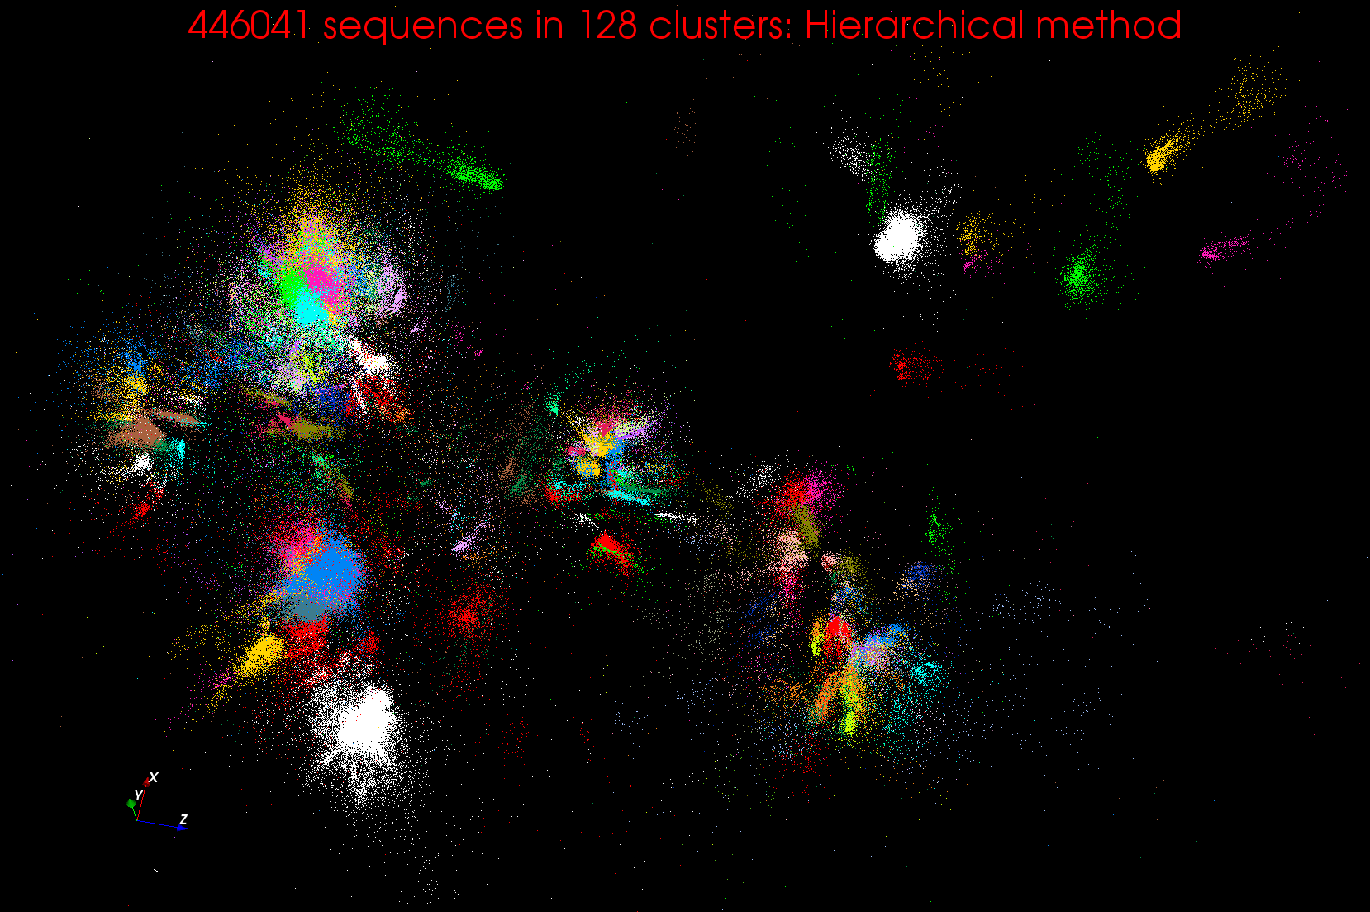
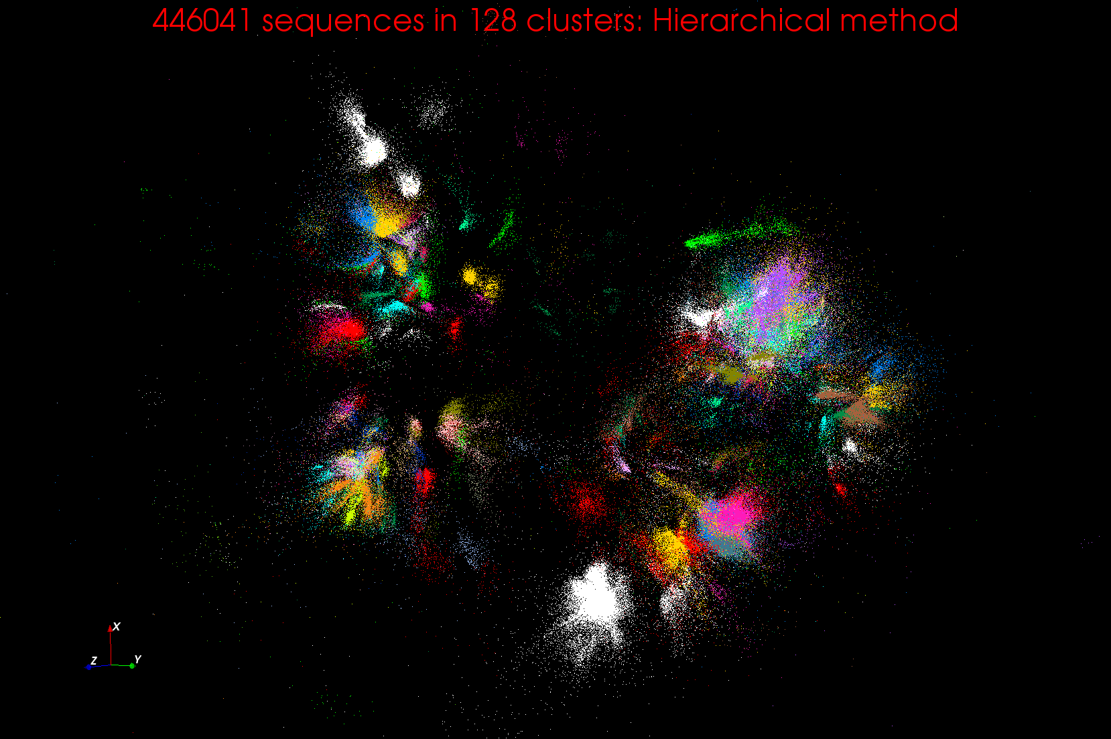
Clustering and MDS Large Scale O(N²) GML

Slide 45
Lessons / Insights
Data Science is interesting
4 important machine and software architectures
Discussed features of Big Data applications
Integrate (don’t compete) HPC with “Commodity Big data” (Google to Amazon to Enterprise Data Analytics)
  i.e. improve Mahout; don’t compete with it
  Use Hadoop plug-ins rather than replacing Hadoop
Enhanced Apache Big Data Stack HPC-ABDS has ~120 members
Opportunities at Resource management, Data/File, Streaming, Programming, monitoring, workflow layers for HPC and ABDS integration
Global Machine Learning or (Exascale Global Optimization) particularly challenging
Discussed Twister4Azure Project

