Slide 1
Big Data Applications and their Software on
Clouds and Supercomputers
Tsinghua University
IV Chair Professor Presentation
August 25 2014
Geoffrey Fox
gcf@indiana.edu
http://www.infomall.org
School of Informatics and Computing
Digital Science Center
Indiana University Bloomington

Slide 2
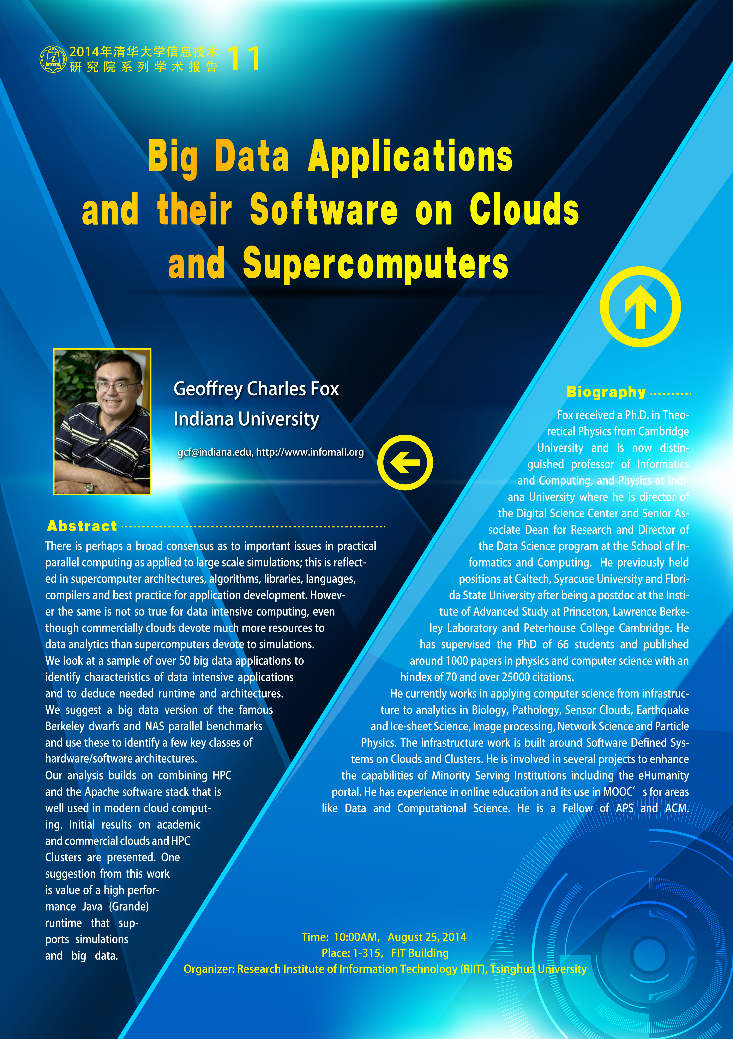

Slide 3
Abstract
There is perhaps a broad consensus as to important issues in practical parallel computing as applied to large scale simulations; this is reflected in supercomputer architectures, algorithms, libraries, languages, compilers and best practice for application development.
  However the same is not so true for data intensive computing, even though commercially clouds devote much more resources to data analytics than supercomputers devote to simulations.
We look at a sample of over 50 big data applications to identify characteristics of data intensive applications and to deduce needed runtime and architectures.
  We suggest a big data version of the famous Berkeley dwarfs and NAS parallel benchmarks and use these to identify a few key classes of hardware/software architectures.
Our analysis builds on combining HPC and the Apache software stack that is well used in modern cloud computing.
  Initial results on academic and commercial clouds and HPC Clusters are presented.
  One suggestion from this work is value of a high performance Java (Grande) runtime that supports simulations and big data

Slide 4
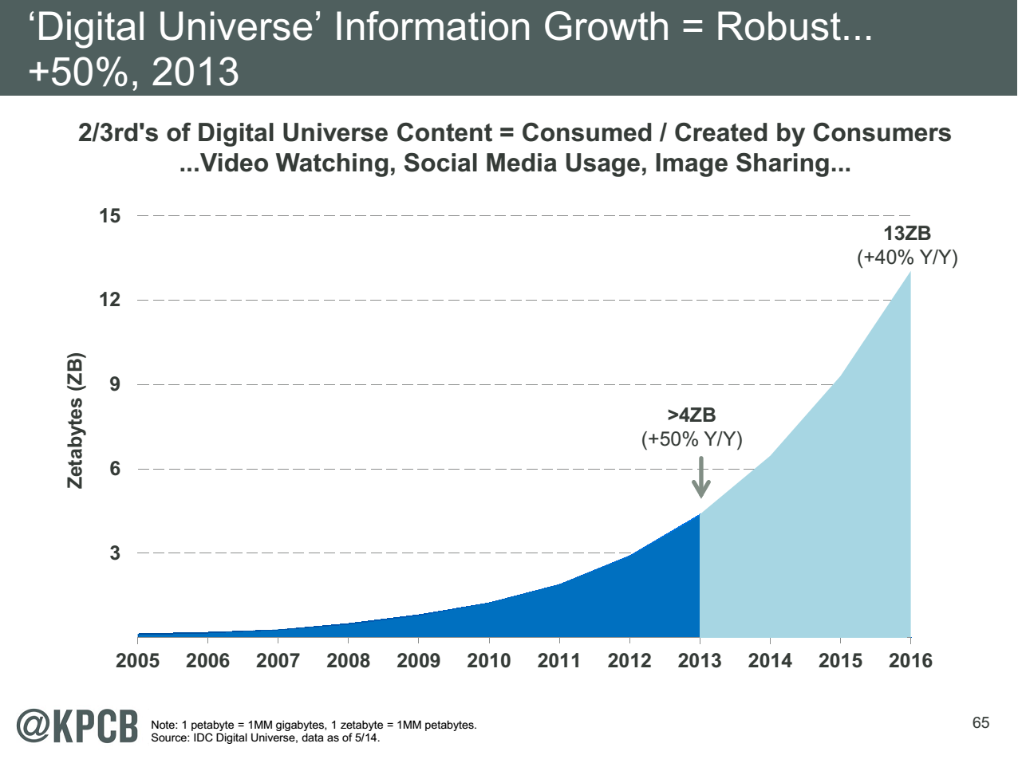
My Research focus is Science Big Data but note
Note largest science ~100 petabytes = 0.000025 total
Science should take notice of commodity
Converse not clearly true?
Note 7 ZB (7. 10²¹) is about a
terabyte (10¹²) for each person in world
http://www.kpcb.com/internet-trends

Slide 5
NIST Big Data Initiative
Led by Chaitin Baru, Bob Marcus, Wo Chang

Slide 6
NBD-PWG (NIST Big Data Public Working Group) Subgroups & Co-Chairs
There were 5 Subgroups
Requirements and Use Cases Sub Group
  Geoffrey Fox, Indiana U.; Joe Paiva, VA; Tsegereda Beyene, Cisco
Definitions and Taxonomies SG
  Nancy Grady, SAIC; Natasha Balac, SDSC; Eugene Luster, R2AD
Reference Architecture Sub Group
  Orit Levin, Microsoft; James Ketner, AT&T; Don Krapohl, Augmented Intelligence
Security and Privacy Sub Group
  Arnab Roy, CSA/Fujitsu Nancy Landreville, U. MD Akhil Manchanda, GE
Technology Roadmap Sub Group
  Carl Buffington, Vistronix; Dan McClary, Oracle; David Boyd, Data Tactics
See http://bigdatawg.nist.gov/usecases.php
And http://bigdatawg.nist.gov/V1_output_docs.php

Slide 7
Big Data Definition
More consensus on Data Science definition than that of Big Data
Big Data refers to digital data volume, velocity and/or variety that:
Enable novel approaches to frontier questions previously inaccessible or impractical using current or conventional methods; and/or
Exceed the storage capacity or analysis capability of current or conventional methods and systems; and
Differentiates by storing and analyzing population data and not sample sizes.
Needs management requiring scalability across coupled horizontal resources
Everybody says their data is big (!) Perhaps how it is used is most important

Slide 8
What is Data Science?
I was impressed by number of NIST working group members who were self declared data scientists
I was also impressed by universal adoption by participants of Apache technologies – see later
McKinsey says there are lots of jobs (1.65M by 2018 in USA) but that’s not enough! Is this a field – what is it and what is its core?
  The emergence of the 4th or data driven paradigm of science illustrates significance - http://research.microsoft.com/en-us/collaboration/fourthparadigm/
  Discovery is guided by data rather than by a model
  The End of (traditional) science http://www.wired.com/wired/issue/16-07 is famous here
Another example is recommender systems in Netflix, e-commerce etc. where pure data (user ratings of movies or products) allows an empirical prediction of what users like

Slide 9
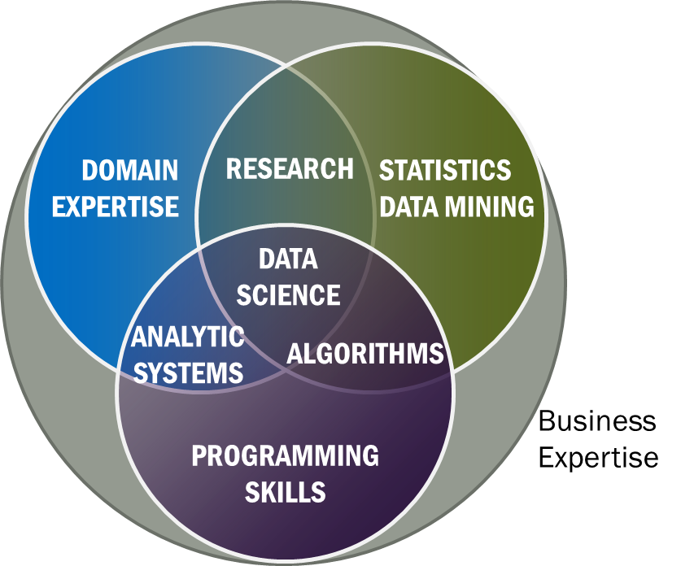
Data Science Definition
Data Science is the extraction of actionable knowledge directly from data through a process of discovery, hypothesis, and analytical hypothesis analysis.
A Data Scientist is a practitioner who has sufficient knowledge of the overlapping regimes of expertise in business needs, domain knowledge, analytical skills and programming expertise to manage the end-to-end scientific method process through each stage in the big data lifecycle.
Notes:
Big Data refers to digital data volume, velocity and/or variety whose management requires scalability across coupled horizontal resources
Data Science is the extraction of actionable knowledge directly from data through a process of discovery, hypothesis, and analytical hypothesis analysis.
A Data Scientist is a practitioner who has sufficient knowledge of the overlapping regimes of expertise in business needs, domain knowledge, analytical skills and programming expertise to manage the end-to-end scientific method process through each stage in the big data lifecycle.

Slide 10
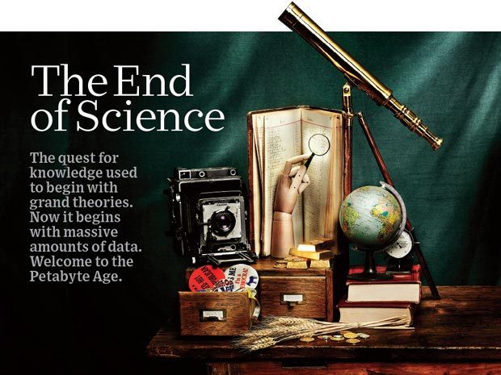
http://www.wired.com/wired/issue/16-07 September 2008

Slide 11
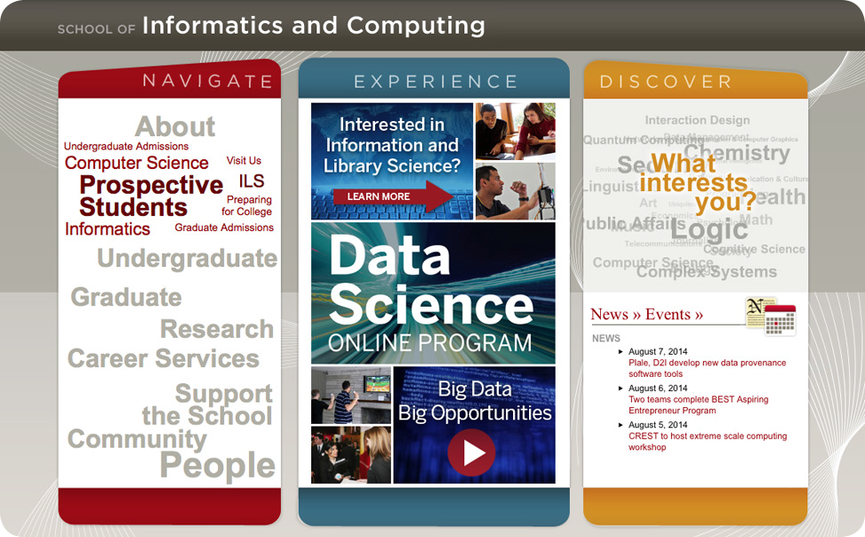
Data Science at Indiana University online certificate and soon a Masters degree

Slide 12

McKinsey Institute on Big Data Jobs
http://www.mckinsey.com/mgi/publications/big_data/index.asp.
There will be a shortage of talent necessary for organizations to take advantage of big data. By 2018, the United States alone could face a shortage of 140,000 to 190,000 people with deep analytical skills as well as 1.5 million managers and analysts with the know-how to use the analysis of big data to make effective decisions.
At IU, Informatics aimed at 1.5 million jobs. Computer Science covers the 140,000 to 190,000

Slide 13
NIST Big Data Reference Architecture
INFORMATION VALUE CHAIN
System Orchestrator
Big Data Application Provider
Analytics
Data Provider
Curation
Visualization
Data Consumer
DATA
DATA
SW
Collection
Access
SW
DATA
SW
K E Y :
Big Data Framework Provider
Processing Frameworks (analytic tools, etc.)
IT VALUE CHAIN
Horizontally Scalable
Service Use
Vertically Scalable
Security & Privacy
DATA
Platforms (databases, etc.)
Management
Horizontally Scalable
Data Flow
Vertically Scalable
Infrastructures
SW
Horizontally Scalable (VM clusters)
Vertically Scalable
Analytics Tools Transfer
Physical and Virtual Resources (networking, computing, etc.)

Slide 14
Top 10 Security & Privacy Challenges: Classification
Infrastructure security
Secure Computations in Distributed Programming Frameworks
Security Best Practices for Non-Relational Data Stores
Data Privacy
Privacy Preserving Data Mining and Analytics
Cryptographically Enforced Data Centric Security
Granular Access Control
Data Management
Secure Data Storage and Transaction Logs
Granular Audits
Data Provenance
Integrity and Reactive Security
End-point validation and filtering
Real time Security Monitoring

Slide 15
NIST Big Data Use Cases

Slide 16

Use Case Template
26 fields completed for 51 areas
Government Operation: 4
Commercial: 8
Defense: 3
Healthcare and Life Sciences: 10
Deep Learning and Social Media: 6
The Ecosystem for Research: 4
Astronomy and Physics: 5
Earth, Environmental and Polar Science: 10
Energy: 1

Slide 17
51 Detailed Use Cases: Contributed July-September 2013
Covers goals, data features such as 3 V’s, software, hardware
26 Features for each use case
Biased to science
http://bigdatawg.nist.gov/usecases.php
https://bigdatacoursespring2014.appspot.com/course (Section 5)
Government Operation(4): National Archives and Records Administration, Census Bureau
Commercial(8): Finance in Cloud, Cloud Backup, Mendeley (Citations), Netflix, Web Search, Digital Materials, Cargo shipping (as in UPS)
Defense(3): Sensors, Image surveillance, Situation Assessment
Healthcare and Life Sciences(10): Medical records, Graph and Probabilistic analysis, Pathology, Bioimaging, Genomics, Epidemiology, People Activity models, Biodiversity
Deep Learning and Social Media(6): Driving Car, Geolocate images/cameras, Twitter, Crowd Sourcing, Network Science, NIST benchmark datasets
The Ecosystem for Research(4): Metadata, Collaboration, Language Translation, Light source experiments
Astronomy and Physics(5): Sky Surveys including comparison to simulation, Large Hadron Collider at CERN, Belle Accelerator II in Japan
Earth, Environmental and Polar Science(10): Radar Scattering in Atmosphere, Earthquake, Ocean, Earth Observation, Ice sheet Radar scattering, Earth radar mapping, Climate simulation datasets, Atmospheric turbulence identification, Subsurface Biogeochemistry (microbes to watersheds), AmeriFlux and FLUXNET gas sensors
Energy(1): Smart grid

Slide 18

Table 4: Characteristics of 6 Distributed Applications
Application Example | Execution Unit | Communication | Coordination | Execution Environment
Montage | Multiple sequential and parallel executable | Files | Dataflow (DAG) | Dynamic process creation, execution
NEKTAR | Multiple concurrent parallel executables | Stream based | Dataflow | Co-scheduling, data streaming, async. I/O
Replica-Exchange | Multiple seq. and parallel executables | Pub/sub | Dataflow and events | Decoupled coordination and messaging
Climate Prediction (generation) | Multiple seq. & parallel executables | Files and messages | Master-Worker, events | @Home (BOINC)
Climate Prediction (analysis) | Multiple seq. & parallel executables | Files and messages | Dataflow | Dynamics process creation, workflow execution
SCOOP | Multiple Executable | Files and messages | Dataflow | Preemptive scheduling, reservations
Coupled Fusion | Multiple executable | Stream-based | Dataflow | Co-scheduling, data streaming, async I/O
Part of Property Summary Table

Slide 19
Distributed Computing Practice for Large-Scale Science & Engineering
S. Jha, M. Cole, D. Katz, O. Rana, M. Parashar, and J. Weissman,
Characteristics of 6 Distributed Applications
Application Example | Execution Unit | Communication | Coordination | Execution Environment
Montage | Multiple sequential and parallel executable | Files | Dataflow (DAG) | Dynamic process creation, execution
NEKTAR | Multiple concurrent parallel executables | Stream based | Dataflow | Co-scheduling, data streaming, async. I/O
Replica-Exchange | Multiple seq. and parallel executables | Pub/sub | Dataflow and events | Decoupled coordination and messaging
Climate Prediction (generation) | Multiple seq. & parallel executables | Files and messages | Master-Worker, events | @Home (BOINC)
Climate Prediction (analysis) | Multiple seq. & parallel executables | Files and messages | Dataflow | Dynamics process creation, workflow execution
SCOOP | Multiple Executable | Files and messages | Dataflow | Preemptive scheduling, reservations
Coupled Fusion | Multiple executable | Stream-based | Dataflow | Co-scheduling, data streaming, async I/O
Note importance of Workflow(dataflow)
Work of

Slide 20
10 Security & Privacy Use Cases
Consumer Digital Media Usage
Nielsen Homescan
Web Traffic Analytics
Health Information Exchange
Personal Genetic Privacy
Pharma Clinic Trial Data Sharing
Cyber-security
Aviation Industry
Military - Unmanned Vehicle sensor data
Education - “Common Core” Student Performance Reporting

Slide 21
Big Data Patterns – the Ogres

Slide 22
Would like to capture “essence of these use cases”
“small” kernels, mini-apps
Or Classify applications into patterns
Do it from HPC background not database viewpoint
e.g. focus on cases with detailed analytics
Section 5 of my class https://bigdatacoursespring2014.appspot.com/preview classifies 51 use cases with ogre facets

Slide 23
HPC Benchmark Classics
Linpack or HPL: Parallel LU factorization for solution of linear equations
NPB version 1: Mainly classic HPC solver kernels
  MG: Multigrid
  CG: Conjugate Gradient
  FT: Fast Fourier Transform
  IS: Integer sort
  EP: Embarrassingly Parallel
  BT: Block Tridiagonal
  SP: Scalar Pentadiagonal
  LU: Lower-Upper symmetric Gauss Seidel

Slide 24
13 Berkeley Dwarfs
Dense Linear Algebra
Sparse Linear Algebra
Spectral Methods
N-Body Methods
Structured Grids
Unstructured Grids
MapReduce
Combinational Logic
Graph Traversal
Dynamic Programming
Backtrack and Branch-and-Bound
Graphical Models
Finite State Machines
First 6 of these correspond to Colella’s original.
Monte Carlo dropped.
N-body methods are a subset of Particle in Colella.
Note a little inconsistent in that MapReduce is a programming model and spectral method is a numerical method.
Need multiple facets!

Slide 25
51 Use Cases: What is Parallelism Over?
People: either the users (but see below) or subjects of application and often both
Decision makers like researchers or doctors (users of application)
Items such as Images, EMR, Sequences below; observations or contents of online store
  Images or “Electronic Information nuggets”
  EMR: Electronic Medical Records (often similar to people parallelism)
  Protein or Gene Sequences;
  Material properties, Manufactured Object specifications, etc., in custom dataset
  Modelled entities like vehicles and people
Sensors – Internet of Things
Events such as detected anomalies in telescope or credit card data or atmosphere
(Complex) Nodes in RDF Graph
Simple nodes as in a learning network
Tweets, Blogs, Documents, Web Pages, etc.
  And characters/words in them
Files or data to be backed up, moved or assigned metadata
Particles/cells/mesh points as in parallel simulations

Slide 26
Features of 51 Use Cases I
PP (26) Pleasingly Parallel or Map Only
MR (18) Classic MapReduce MR (add MRStat below for full count)
MRStat (7) Simple version of MR where key computations are simple reduction as found in statistical averages such as histograms and averages
MRIter (23) Iterative MapReduce or MPI (Spark, Twister)
Graph (9) Complex graph data structure needed in analysis
Fusion (11) Integrate diverse data to aid discovery/decision making; could involve sophisticated algorithms or could just be a portal
Streaming (41) Some data comes in incrementally and is processed this way
Classify (30) Classification: divide data into categories
S/Q (12) Index, Search and Query

Slide 27
Features of 51 Use Cases II
CF (4) Collaborative Filtering for recommender engines
LML (36) Local Machine Learning (Independent for each parallel entity)
GML (23) Global Machine Learning: Deep Learning, Clustering, LDA, PLSI, MDS,
  Large Scale Optimizations as in Variational Bayes, MCMC, Lifted Belief Propagation, Stochastic Gradient Descent, L-BFGS, Levenberg-Marquardt . Can call EGO or Exascale Global Optimization with scalable parallel algorithm
Workflow (51) Universal
GIS (16) Geotagged data and often displayed in ESRI, Microsoft Virtual Earth, Google Earth, GeoServer etc.
HPC (5) Classic large-scale simulation of cosmos, materials, etc. generating (visualization) data
Agent (2) Simulations of models of data-defined macroscopic entities represented as agents

Slide 28
4 Forms of MapReduce
(1) Map Only
(2) Classic MapReduce
(3) Iterative Map Reduce or Map-Collective
(4) Point to Point or Map-Communication
Input
Input
Iterations
Input
map
map
map
Local
reduce
reduce
Output
Graph
PP | MR MRStat | MRIter | Graph, HPC
BLAST Analysis Local Machine Learning Pleasingly Parallel | High Energy Physics (HEP) Histograms Distributed search Recommender Engines | Expectation maximization Clustering e.g. K-means Linear Algebra, PageRank | Classic MPI PDE Solvers and Particle Dynamics Graph Problems
MapReduce and Iterative Extensions (Spark, Twister) |  |  | MPI, Giraph
Integrated Systems such as Hadoop + Harp with Compute and Communication model separated
Correspond to first 4 of Identified Architectures

Slide 29
Useful Set of Analytics Architectures
Pleasingly Parallel: including local machine learning as in parallel over images and apply image processing to each image
- Hadoop could be used but many other HTC, Many task tools
Classic MapReduce including search, collaborative filtering and motif finding implemented using Hadoop etc.
Map-Collective or Iterative MapReduce using Collective Communication (clustering) – Hadoop with Harp, Spark …..
Map-Communication or Iterative Giraph: (MapReduce) with point-to-point communication (most graph algorithms such as maximum clique, connected component, finding diameter, community detection)
  Vary in difficulty of finding partitioning (classic parallel load balancing)
Large and Shared memory: thread-based (event driven) graph algorithms (shortest path, Betweenness centrality) and Large memory applications
Ideas like workflow are “orthogonal” to this

Slide 30
Global Machine Learning aka EGO – Exascale Global Optimization
Typically maximum likelihood or χ² with a sum over the N data items – documents, sequences, items to be sold, images etc. and often links (point-pairs). Usually it’s a sum of positive numbers as in least squares
Covering clustering/community detection, mixture models, topic determination, Multidimensional scaling, (Deep) Learning Networks
PageRank is “just” parallel linear algebra
Note many Mahout algorithms are sequential – partly as MapReduce limited; partly because parallelism unclear
  MLLib (Spark based) better
SVM and Hidden Markov Models do not use large scale parallelization in practice?
Detailed papers on particular parallel graph algorithms
Name invented at Argonne-Chicago workshop

Slide 31
7 Computational Giants of
NRC Massive Data Analysis Report
G1: Basic Statistics e.g. MRStat
G2: Generalized N-Body Problems
G3: Graph-Theoretic Computations
G4: Linear Algebraic Computations
G5: Optimizations e.g. Linear Programming
G6: Integration e.g. LDA and other GML
G7: Alignment Problems e.g. BLAST

Slide 32
Examples: Especially Image and Internet of Things based Applications

Slide 33
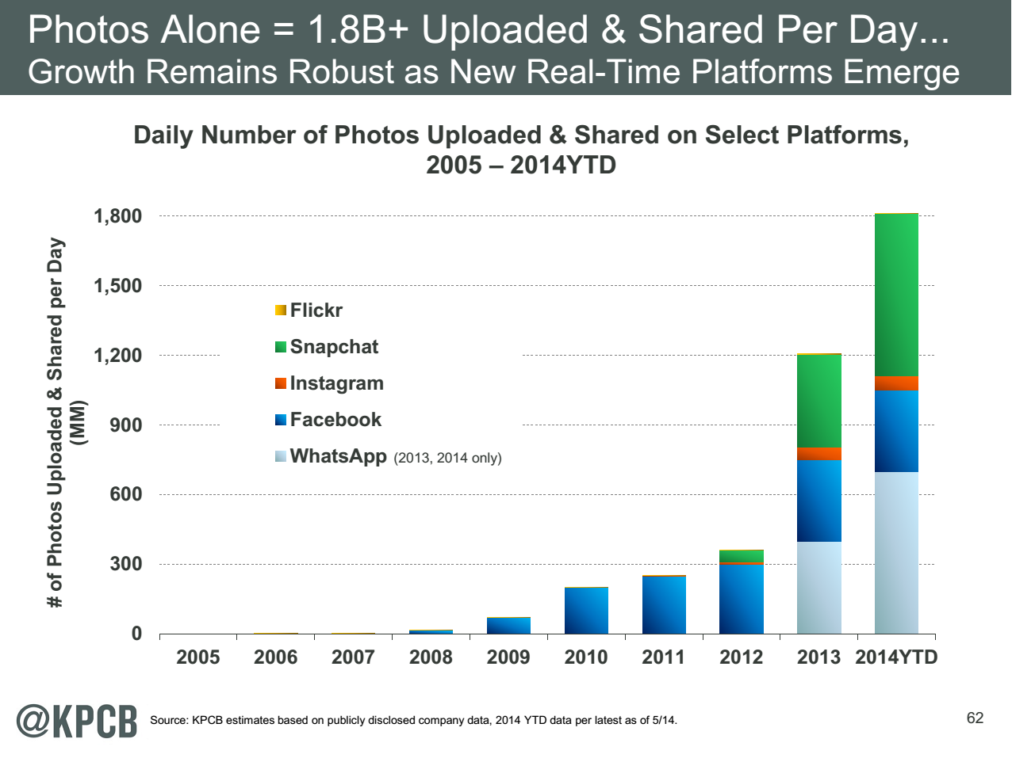
http://www.kpcb.com/internet-trends

Slide 34
13 Image-based Use Cases
13-15 Military Sensor Data Analysis/ Intelligence PP, LML, GIS, MR
7:Pathology Imaging/ Digital Pathology: PP, LML, MR for search becoming terabyte 3D images, Global Classification
18&35: Computational Bioimaging (Light Sources): PP, LML Also materials
26: Large-scale Deep Learning: GML Stanford ran 10 million images and 11 billion parameters on a 64 GPU HPC; vision (drive car), speech, and Natural Language Processing
27: Organizing large-scale, unstructured collections of photos: GML Fit position and camera direction to assemble 3D photo ensemble
36: Catalina Real-Time Transient Synoptic Sky Survey (CRTS): PP, LML followed by classification of events (GML)
43: Radar Data Analysis for CReSIS Remote Sensing of Ice Sheets: PP, LML to identify glacier beds; GML for full ice-sheet
44: UAVSAR Data Processing, Data Product Delivery, and Data Services: PP to find slippage from radar images
45, 46: Analysis of Simulation visualizations: PP LML ?GML find paths, classify orbits, classify patterns that signal earthquakes, instabilities, climate, turbulence

Slide 35
26: Large-scale Deep Learning
Application: Large models (e.g., neural networks with more neurons and connections) combined with large datasets are increasingly the top performers in benchmark tasks for vision, speech, and Natural Language Processing. One needs to train a deep neural network from a large (>>1TB) corpus of data (typically imagery, video, audio, or text). Such training procedures often require customization of the neural network architecture, learning criteria, and dataset pre-processing. In addition to the computational expense demanded by the learning algorithms, the need for rapid prototyping and ease of development is extremely high.
Current Approach: The largest applications so far are to image recognition and scientific studies of unsupervised learning with 10 million images and up to 11 billion parameters on a 64 GPU HPC Infiniband cluster. Both supervised (using existing classified images) and unsupervised applications
Futures: Large datasets of 100TB or more may be necessary in order to exploit the representational power of the larger models. Training a self-driving car could take 100 million images at megapixel resolution. Deep Learning shares many characteristics with the broader field of machine learning. The paramount requirements are high computational throughput for mostly dense linear algebra operations, and extremely high productivity for researcher exploration. One needs integration of high performance libraries with high level (python) prototyping environments
Classified OUT
IN
Deep Learning, Social Networking
GML, EGO, MRIter, Classify

Slide 36
35: Light source beamlines
Application: Samples are exposed to X-rays from light sources in a variety of configurations depending on the experiment. Detectors (essentially high-speed digital cameras) collect the data. The data are then analyzed to reconstruct a view of the sample or process being studied.
Current Approach: A variety of commercial and open source software is used for data analysis – examples including Octopus for Tomographic Reconstruction, Avizo (http://vsg3d.com) and FIJI (a distribution of ImageJ) for Visualization and Analysis. Data transfer is accomplished using physical transport of portable media (severely limits performance) or using high-performance GridFTP, managed by Globus Online or workflow systems such as SPADE.
Futures: Camera resolution is continually increasing. Data transfer to large-scale computing facilities is becoming necessary because of the computational power required to conduct the analysis on time scales useful to the experiment. Large number of beamlines (e.g. 39 at LBNL ALS) means that total data load is likely to increase significantly and require a generalized infrastructure for analyzing gigabytes per second of data from many beamline detectors at multiple facilities.
Research Ecosystem PP, LML, Streaming

Slide 37
Internet of Things and Streaming Apps
It is projected that there will be 24 (Mobile Industry Group) to 50 (Cisco) billion devices on the Internet by 2020.
The cloud natural controller of and resource provider for the Internet of Things.
Smart phones/watches, Wearable devices (Smart People), “Intelligent River” “Smart Homes and Grid” and “Ubiquitous Cities”, Robotics.
Majority of use cases are streaming – experimental science gathers data in a stream – sometimes batched as in a field trip. Below is sample
10: Cargo Shipping Tracking as in UPS, Fedex PP GIS LML
13: Large Scale Geospatial Analysis and Visualization PP GIS LML
28: Truthy: Information diffusion research from Twitter Data PP MR for Search, GML for community determination
39: Particle Physics: Analysis of LHC Large Hadron Collider Data: Discovery of Higgs particle PP Local Processing Global statistics
50: DOE-BER AmeriFlux and FLUXNET Networks PP GIS LML
51: Consumption forecasting in Smart Grids PP GIS LML

Slide 38
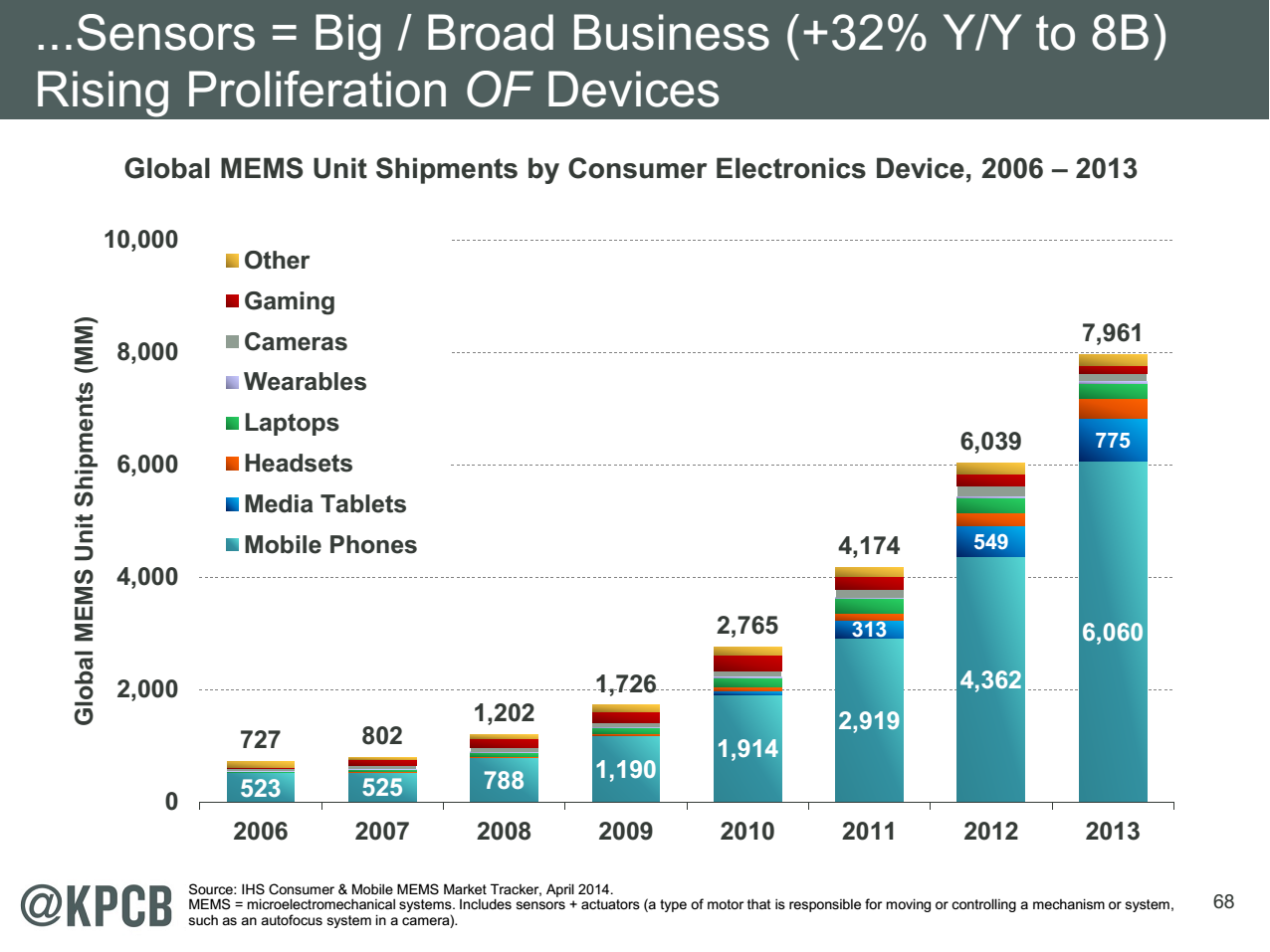
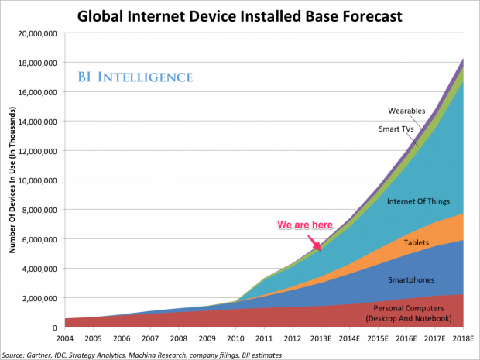
http://www.kpcb.com/internet-trends

Slide 39
http://www.kpcb.com/internet-trends

Slide 40
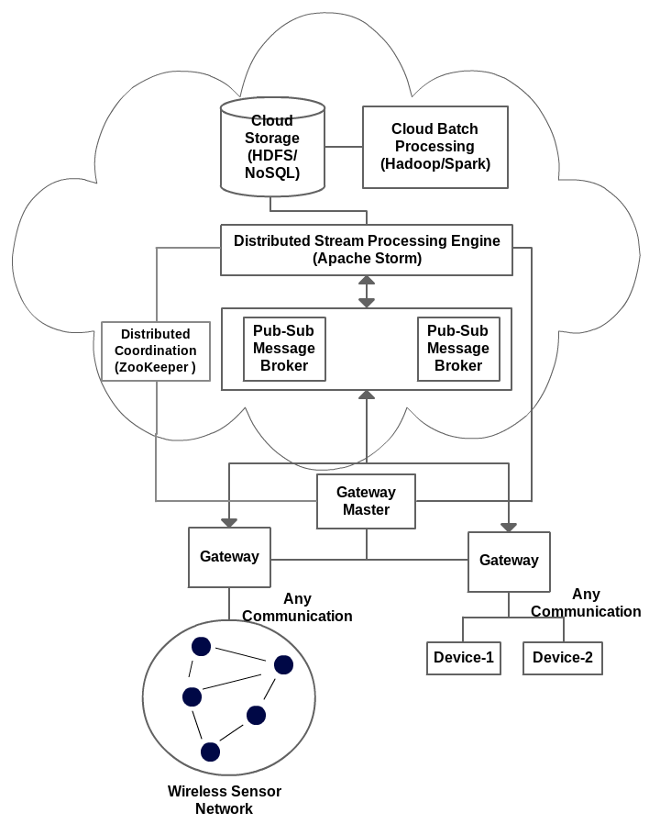
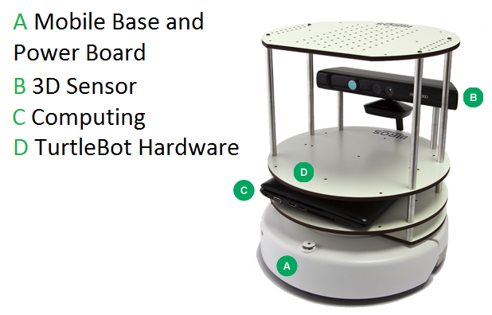
IOTCloud
Device → Pub-Sub→Storm → Datastore → Data Analysis
Apache Storm provides scalable distributed system for processing data streams coming from devices in real time.
For example Storm layer can decide to store the data in cloud storage for further analysis or to send control data back to the devices
Evaluating Pub-Sub Systems ActiveMQ, RabbitMQ, Kafka, Kestrel
Turtlebot and Kinect

Slide 41
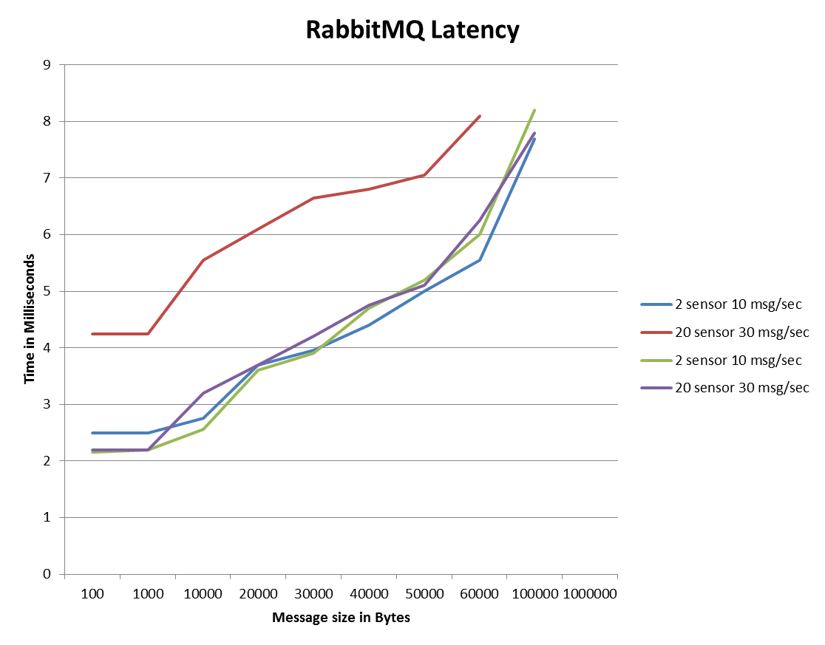
Storm Performance
From Device to Cloud
6 FutureGrid India Medium OpenStack machines
1 Broker machine, RabbitMQ 1 machine hosting ZooKeeper and Storm – Nimbus (Master for Storm)
2 Sensor sites generating data
2 Storm nodes sending back the same data and we measure the unidirectional latency
Using drones and Kinects
System saturates

Slide 42
Facets of the Ogres

Slide 43
Problem Architecture Facet of Ogres (Meta or MacroPattern)
Pleasingly Parallel – as in BLAST, Protein docking, some (bio-)imagery including Local Analytics or Machine Learning – ML or filtering pleasingly parallel, as in bio-imagery, radar images (pleasingly parallel but sophisticated local analytics)
Classic MapReduce: Search, Index and Query and Classification algorithms like collaborative filtering (G1 for MRStat in Table 2, G7)
Global Analytics or Machine Learning requiring iterative programming models (G5,G6). Often from
  Maximum Likelihood or χ² minimizations
  Expectation Maximization (often Steepest descent)
Problem set up as a graph (G3) as opposed to vector, grid
SPMD: Single Program Multiple Data
BSP or Bulk Synchronous Processing: well-defined compute-communication phases
Fusion: Knowledge discovery often involves fusion of multiple methods.
Workflow: All applications often involve orchestration (workflow) of multiple components
Use Agents: as in epidemiology (swarm approaches)
Note problem and machine architectures are related
Notes:
Big dwarfs are Ogres
Implement Ogres in ABDS+

Slide 44
One Facet of Ogres has Computational Features
Flops per byte;
Communication Interconnect requirements;
Is application (graph) constant or dynamic?
Most applications consist of a set of interconnected entities; is this regular as a set of pixels or is it a complicated irregular graph?
Is communication BSP, Asynchronous, Pub-Sub, Collective, Point to Point?
Are algorithms Iterative or not?
Are algorithms governed by dataflow
Data Abstraction: key-value, pixel, graph, vector
  Are data points in metric or non-metric spaces?
  Is algorithm O(N²) or O(N) (up to logs) for N points per iteration (G2)
Core libraries needed: matrix-matrix/vector algebra, conjugate gradient, reduction, broadcast

Slide 45
Data Source and Style Facet of Ogres I
(i) SQL or NoSQL: NoSQL includes Document, Column, Key-value, Graph, Triple store
(ii) Other Enterprise data systems: 10 examples from NIST integrate SQL/NoSQL
(iii) Set of Files: as managed in iRODS and extremely common in scientific research
(iv) File, Object, Block and Data-parallel (HDFS) raw storage: Separated from computing?
(v) Internet of Things: 24 to 50 Billion devices on Internet by 2020
(vi) Streaming: Incremental update of datasets with new algorithms to achieve real-time response (G7)
(vii) HPC simulations: generate major (visualization) output that often needs to be mined
(viii) Involve GIS: Geographical Information Systems provide attractive access to geospatial data
Notes:
Big dwarfs are Ogres
Implement Ogres in ABDS+

Slide 46
Data Source and Style Facet of Ogres II
Before data gets to compute system, there is often an initial data gathering phase which is characterized by a block size and timing. Block size varies from month (Remote Sensing, Seismic) to day (genomic) to seconds or lower (Real time control, streaming)
There are storage/compute system styles: Shared, Dedicated, Permanent, Transient
Other characteristics are needed for permanent auxiliary/comparison datasets and these could be interdisciplinary, implying nontrivial data movement/replication
10 Data Access/Use Styles from Bob Marcus at NIST
Notes:
Big dwarfs are Ogres
Implement Ogres in ABDS+

Slide 47
10 Generic Data Processing Styles
Multiple users performing interactive queries and updates on a database with basic availability and eventual consistency (BASE = (Basically Available, Soft state, Eventual consistency) as opposed to ACID = (Atomicity, Consistency, Isolation, Durability) )
Perform real time analytics on data source streams and notify users when specified events occur
Move data from external data sources into a highly horizontally scalable data store, transform it using highly horizontally scalable processing (e.g. Map-Reduce), and return it to the horizontally scalable data store (ELT Extract Load Transform)
Perform batch analytics on the data in a highly horizontally scalable data store using highly horizontally scalable processing (e.g MapReduce) with a user-friendly interface (e.g. SQL like)
Perform interactive analytics on data in analytics-optimized database
Visualize data extracted from horizontally scalable Big Data store
Move data from a highly horizontally scalable data store into a traditional Enterprise Data Warehouse (EDW)
Extract, process, and move data from data stores to archives
Combine data from Cloud databases and on premise data stores for analytics, data mining, and/or machine learning
Orchestrate multiple sequential and parallel data transformations and/or analytic processing using a workflow manager

Slide 48
2. Perform real time analytics on data source streams and notify users when specified events occur
Specify filter
Filter Identifying Events
Fetch streamed Data
Post Selected Events
Streaming Data
Posted Data
Identified Events
Streaming Data
Streaming Data
Archive
Repository
Storm, Kafka, Hbase, Zookeeper

Slide 49



5. Perform interactive analytics on data in analytics-optimized data system
Mahout, R
Hadoop, Spark, Giraph, Pig …
Data Storage: HDFS, Hbase
Data, Streaming, Batch …..

Slide 50
5A. Perform interactive analytics on observational scientific data
Science Analysis Code, Mahout, R
Grid or Many Task Software, Hadoop, Spark, Giraph, Pig …
Data Storage: HDFS, Hbase, File Collection (Lustre)
Direct Transfer
Transport batch of data to primary analysis data system
Streaming Twitter data for Social Networking
Local Accumulate and initial computing
Following examples are LHC, Remote Sensing, Astronomy and Bioinformatics
Record Scientific Data in “field”

Slide 51
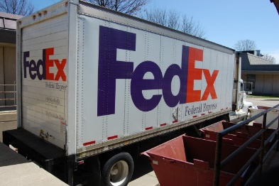
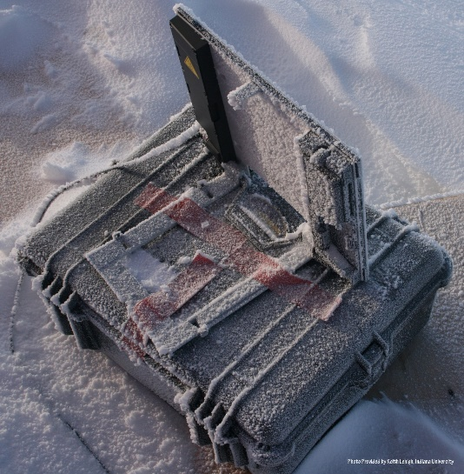

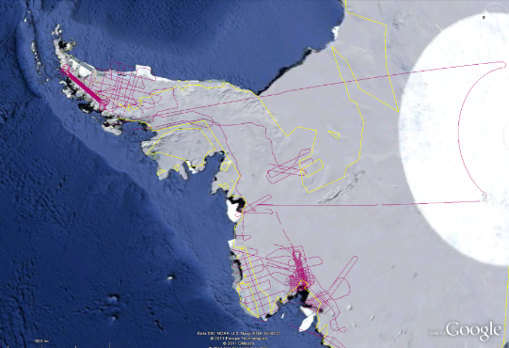
CReSIS Remote Sensing: Radar Surveys
Expeditions last 1-2 months and gather up to 100 TB data. Most is saved on removable disks and flown back to continental US at end. A sample is analyzed in field to check instrument

Slide 52
43: Radar Data Analysis for CReSIS Remote Sensing of Ice Sheets IV
Earth, Environmental and Polar Science
Typical CReSIS echogram with Detected Boundaries. The upper (green) boundary is between air and ice layer while the lower (red) boundary is between ice and terrain
PP, GIS
Streaming
Parallelism over Radar Images

Slide 53
Analytics Facet (kernels) of the Ogres

Slide 54
Core Analytics Ogres (microPattern) I
Map-Only
  Pleasingly parallel - Local Machine Learning
MapReduce: Search/Query/Index
  Summarizing statistics as in LHC Data analysis (histograms) (G1)
  Recommender Systems (Collaborative Filtering)
  Linear Classifiers (Bayes, Random Forests)
Alignment and Streaming (G7)
  Genomic Alignment, Incremental Classifiers
Global Analytics
Nonlinear Solvers (structure depends on objective function) (G5,G6)
  Stochastic Gradient Descent SGD
  (L-)BFGS approximation to Newton’s Method
  Levenberg-Marquardt solver

Slide 55
Core Analytics Ogres (microPattern) II
Map-Collective (See Mahout, MLlib) (G2,G4,G6)
  Often use matrix-matrix,-vector operations, solvers (conjugate gradient)
  Outlier Detection, Clustering (many methods),
  Mixture Models, LDA (Latent Dirichlet Allocation), PLSI (Probabilistic Latent Semantic Indexing)
  SVM and Logistic Regression
  PageRank, (find leading eigenvector of sparse matrix)
  SVD (Singular Value Decomposition)
  MDS (Multidimensional Scaling)
  Learning Neural Networks (Deep Learning)
  Hidden Markov Models

Slide 56
Core Analytics Ogres (microPattern) III
Global Analytics – Map-Communication (targets for Giraph) (G3)
  Graph Structure (Communities, subgraphs/motifs, diameter, maximal cliques, connected components)
  Network Dynamics - Graph simulation Algorithms (epidemiology)
Global Analytics – Asynchronous Shared Memory (may be distributed algorithms)
  Graph Structure (Betweenness centrality, shortest path) (G3)
  Linear/Quadratic Programming, Combinatorial Optimization, Branch and Bound (G5)

Slide 57
HPC-ABDS
Integrating High Performance Computing with Apache Big Data Stack
Shantenu Jha, Judy Qiu, Andre Luckow

Slide 58
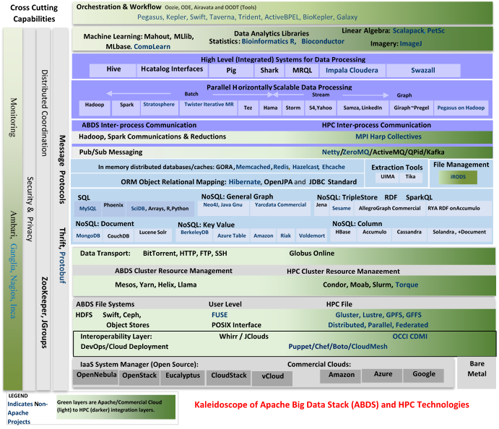

Slide 59
SPIDAL (Scalable Parallel Interoperable Data Analytics Library)
Getting High Performance on Data Analytics
Performance of HPC and Productivity/Sustainability of ABDS
On the systems side, we have two principles:
  The Apache Big Data Stack with ~120 projects has important broad functionality with a vital large support organization
  HPC including MPI has striking success in delivering high performance,
  however with a fragile sustainability model
There are key systems abstractions which are levels in HPC-ABDS software stack where Apache approach needs careful integration with HPC
  Resource management
  Storage
  Programming model -- horizontal scaling parallelism
  Collective and Point-to-Point communication
  Support of iteration
  Data interface (not just key-value)
In application areas, we define application abstractions to support:
  Graphs/network
  Geospatial
  Genes
  Images, etc.

Slide 60







HPC ABDS SYSTEM (Middleware)
120 Software Projects
System Abstraction/Standards
Data Format and Storage
HPC Yarn for Resource management
Horizontally scalable parallel
programming model
Collective and Point to Point Communication
Support for iteration (in memory processing)
HPC ABDS
Hourglass
Application Abstractions/Standards
Graphs, Networks, Images, Geospatial ..
Scalable Parallel Interoperable Data Analytics Library (SPIDAL)
High performance Mahout, R, Matlab …..
High Performance Applications

Slide 62
Maybe a Big Data Initiative would include
Workflow: Python or Kepler
Data Analytics: Mahout, R, ImageJ, Scalapack
High level Programming: Hive, Pig
Parallel Programming model: Hadoop, Spark, Giraph (Twister4Azure, Harp), MPI; Storm, Kapfka or RabbitMQ (Sensors)
In-memory: Memcached
Data Management: Hbase, MongoDB, MySQL or Derby
Distributed Coordination: Zookeeper
Cluster Management: Yarn, Slurm
File Systems: HDFS, Lustre
DevOps: Cloudmesh, Chef, Puppet, Docker, Cobbler
IaaS: Amazon, Azure, OpenStack, Libcloud
Monitoring: Inca, Ganglia, Nagios

Slide 63
Comparing Data Intensive and Simulation Problems

Slide 64
Comparison of Data Analytics with Simulation I
Pleasingly parallel often important in both
Both are often SPMD and BSP
  Non-iterative MapReduce is major big data paradigm
  not a common simulation paradigm except where “Reduce” summarizes pleasingly parallel execution
Big Data often has large collective communication
  Classic simulation has a lot of smallish point-to-point messages
Simulation dominantly sparse (nearest neighbor) data structures
  “Bag of words (users, rankings, images..)” algorithms are sparse, as is PageRank
  Important data analytics involves full matrix algorithms

Slide 65
Comparison of Data Analytics with Simulation II
There are similarities between some graph problems and particle simulations with a strange cutoff force.
  Both Map-Communication
Note many big data problems are “long range force” as all points are linked.
  Easiest to parallelize. Often full matrix algorithms
  e.g. in DNA sequence studies, distance δ(i, j) defined by BLAST, Smith-Waterman, etc., between all sequences i, j.
  Opportunity for “fast multipole” ideas in big data.
In image-based deep learning, neural network weights are block sparse (corresponding to links to pixel blocks) but can be formulated as full matrix operations on GPUs and MPI in blocks.
In HPC benchmarking, Linpack being challenged by a new sparse conjugate gradient benchmark HPCG, while I am diligently using non- sparse conjugate gradient solvers in clustering and Multi-dimensional scaling.

Slide 66


“Force Diagrams” for macromolecules and Facebook

Slide 67
Parallel Global Machine Learning Examples
Initial SPIDAL entries

Slide 68
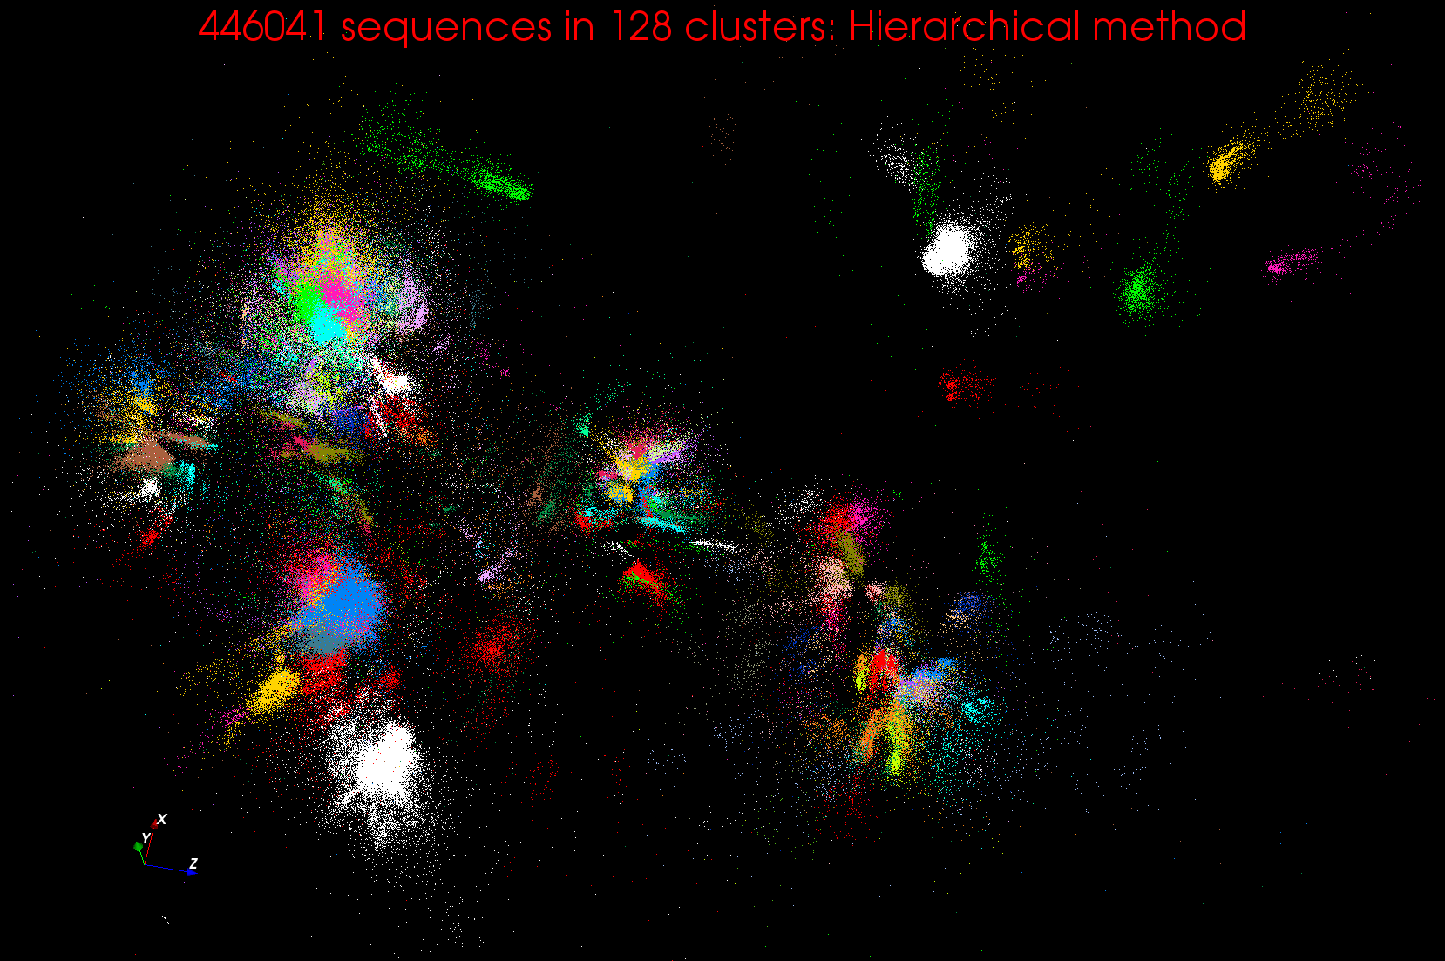
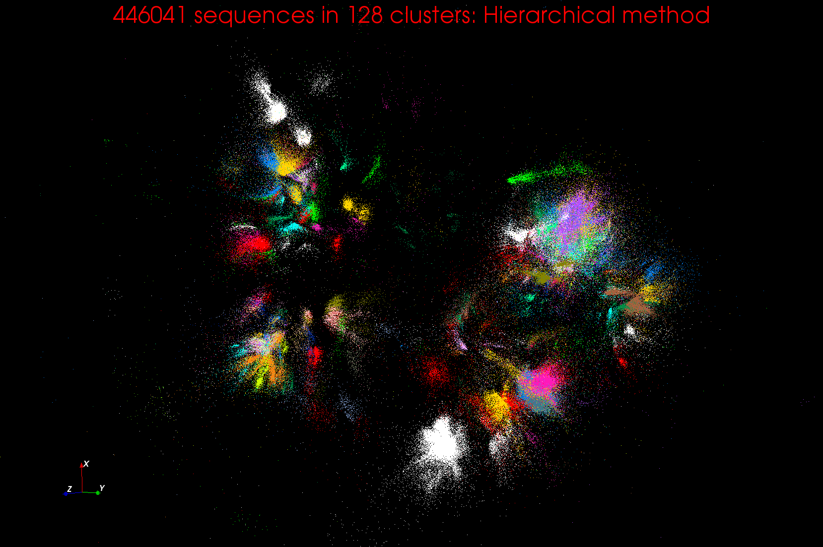
Clustering and MDS Large Scale O(N²) GML

Slide 69
Cluster Count v. Temperature for LC-MS Data Analysis
All start with one cluster at far left
T=1 special as measurement errors divided out
DA2D counts clusters with 1 member as clusters. DAVS(2) does not

Slide 70
Iterative MapReduce
Implementing HPC-ABDS
Judy Qiu, Bingjing Zhang, Dennis Gannon, Thilina Gunarathne

Slide 71
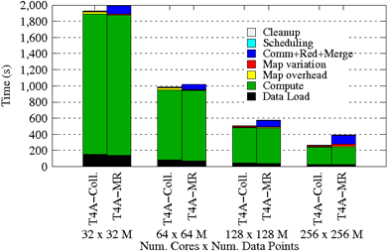
Using Optimal “Collective” Operations
Twister4Azure Iterative MapReduce with enhanced collectives
  Map-AllReduce primitive and MapReduce-MergeBroadcast
Strong Scaling on K-means for up to 256 cores on Azure

Slide 72
Kmeans and (Iterative) MapReduce
Shaded areas are computing only where Hadoop on HPC cluster is fastest
Areas above shading are overheads where T4A smallest and T4A with AllReduce collective have lowest overhead
Note even on Azure Java (Orange) faster than T4A C# for compute

Slide 73
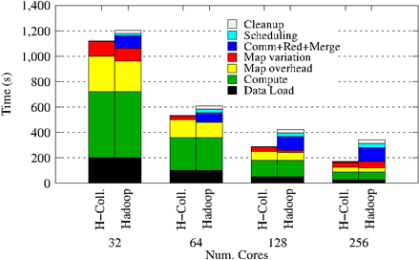
Collectives improve traditional MapReduce
Poly-algorithms choose the best collective implementation for machine and collective at hand
This is K-means running within basic Hadoop but with optimal AllReduce collective operations
Running on Infiniband Linux Cluster

Slide 74
Harp Design
Parallelism Model
Architecture
MapReduce Model
Map-Collective or Map-Communication Model
M
M
M
M
MapReduce Applications
Map-Collective
or Map-Communication Applications
M
M
M
M
Application
Shuffle
Harp
Optimal Communication
MapReduce V2
R
R
Framework
Resource Manager
YARN

Slide 75
Features of Harp Hadoop Plugin
Hadoop Plugin (on Hadoop 1.2.1 and Hadoop 2.2.0)
Hierarchical data abstraction on arrays, key-values and graphs for easy programming expressiveness.
Collective communication model to support various communication operations on the data abstractions (will extend to Point to Point)
Caching with buffer management for memory allocation required from computation and communication
BSP style parallelism
Fault tolerance with checkpointing

Slide 76
WDA SMACOF MDS (Multidimensional Scaling) using Harp on IU Big Red 2
Parallel Efficiency: on 100-300K sequences
Best available MDS (much better than that in R)
Java
Harp (Hadoop plugin)
Cores =32 #nodes
Conjugate Gradient (dominant time) and Matrix Multiplication

Slide 77
Increasing Communication
Identical Computation
Mahout and Hadoop MR – Slow due to MapReduce
Python slow as Scripting; MPI fastest
Spark Iterative MapReduce, non optimal communication
Harp Hadoop plug in with ~MPI collectives

Slide 78
Java Grande

Slide 79
Java Grande
We once tried to encourage use of Java in HPC with Java Grande Forum but Fortran, C and C++ remain central HPC languages.
  Not helped by .com and Sun collapse in 2000-2005
The pure Java CartaBlanca, a 2005 R&D100 award-winning project, was an early successful example of HPC use of Java in a simulation tool for non-linear physics on unstructured grids.
Of course Java is a major language in ABDS and as data analysis and simulation are naturally linked, should consider broader use of Java
Using Habanero Java (from Rice University) for Threads and mpiJava or FastMPJ for MPI, gathering collection of high performance parallel Java analytics
  Converted from C# and sequential Java faster than sequential C#
So will have either Hadoop+Harp or classic Threads/MPI versions in Java Grande version of Mahout

Slide 80
Performance of MPI Kernel Operations
Pure Java as in FastMPJ slower than Java interfacing to C version of MPI

Slide 81
Lessons / Insights
Proposed classification of Big Data applications with features and kernels for analytics
  Add other Ogres for workflow, data systems etc.
Integrate (don’t compete) HPC with “Commodity Big data” (Google to Amazon to Enterprise Data Analytics)
  i.e. improve Mahout; don’t compete with it
  Use Hadoop plug-ins rather than replacing Hadoop
Enhanced Apache Big Data Stack HPC-ABDS has ~120 members
Opportunities at Resource management, Data/File, Streaming, Programming, monitoring, workflow layers for HPC and ABDS integration
Data intensive algorithms do not have the well developed high performance libraries familiar from HPC
Global Machine Learning or (Exascale Global Optimization) particularly challenging
Strong case for high performance Java (Grande) run time supporting all forms of parallelism

