Slide 1
Clouds for Simulation and Data Enabled Scientific Discovery
Future Internet Technology Building,
Tsinghua University, Beijing, China
December 22 2011
Geoffrey Fox
gcf@indiana.edu
http://www.infomall.org http://www.salsahpc.org
Director, Digital Science Center, Pervasive Technology Institute
Associate Dean for Research and Graduate Studies, School of Informatics and Computing
Indiana University Bloomington
Work with Judy Qiu and several students

Slide 2
Topics Covered
Broad Overview: Data Deluge to Clouds
Clouds Grids and Supercomputers: Infrastructure and Applications
Internet of Things: Sensor Grids supported as pleasingly parallel applications on clouds
MapReduce and Iterative MapReduce for non trivial parallel applications on Clouds
MapReduce and Twister on Azure
Summary of Applications Suitable for Clouds
Architecture of Data-Intensive Clouds
Summary of Data-Intensive Applications on Clouds

Slide 3

Some Trends
  The Data Deluge is clear trend from Commercial (Amazon, e-commerce) , Community (Facebook, Search) and Scientific applications
  Light weight clients from smartphones, tablets to sensors
  Multicore reawakening parallel computing
  Exascale initiatives will continue drive to high end with a simulation orientation
  Clouds with cheaper, greener, easier to use IT for (some) applications
  New jobs associated with new curricula
    Clouds as a distributed system (classic CS courses)
    Data Analytics (Important theme at SC11)
    Network/Web Science

Slide 4
Some Data sizes
  ~40 10⁹ Web pages at ~300 kilobytes each = 10 Petabytes
  Youtube 48 hours video uploaded per minute;
    in 2 months in 2010, uploaded more than total NBC ABC CBS
    ~2.5 petabytes per year uploaded?
  LHC 15 petabytes per year
  Radiology 69 petabytes per year
  Square Kilometer Array Telescope will be 100 terabits/second
  Earth Observation becoming ~4 petabytes per year
  Earthquake Science – few terabytes total today
  PolarGrid – 100’s terabytes/year
  Exascale simulation data dumps – terabytes/second

Slide 5
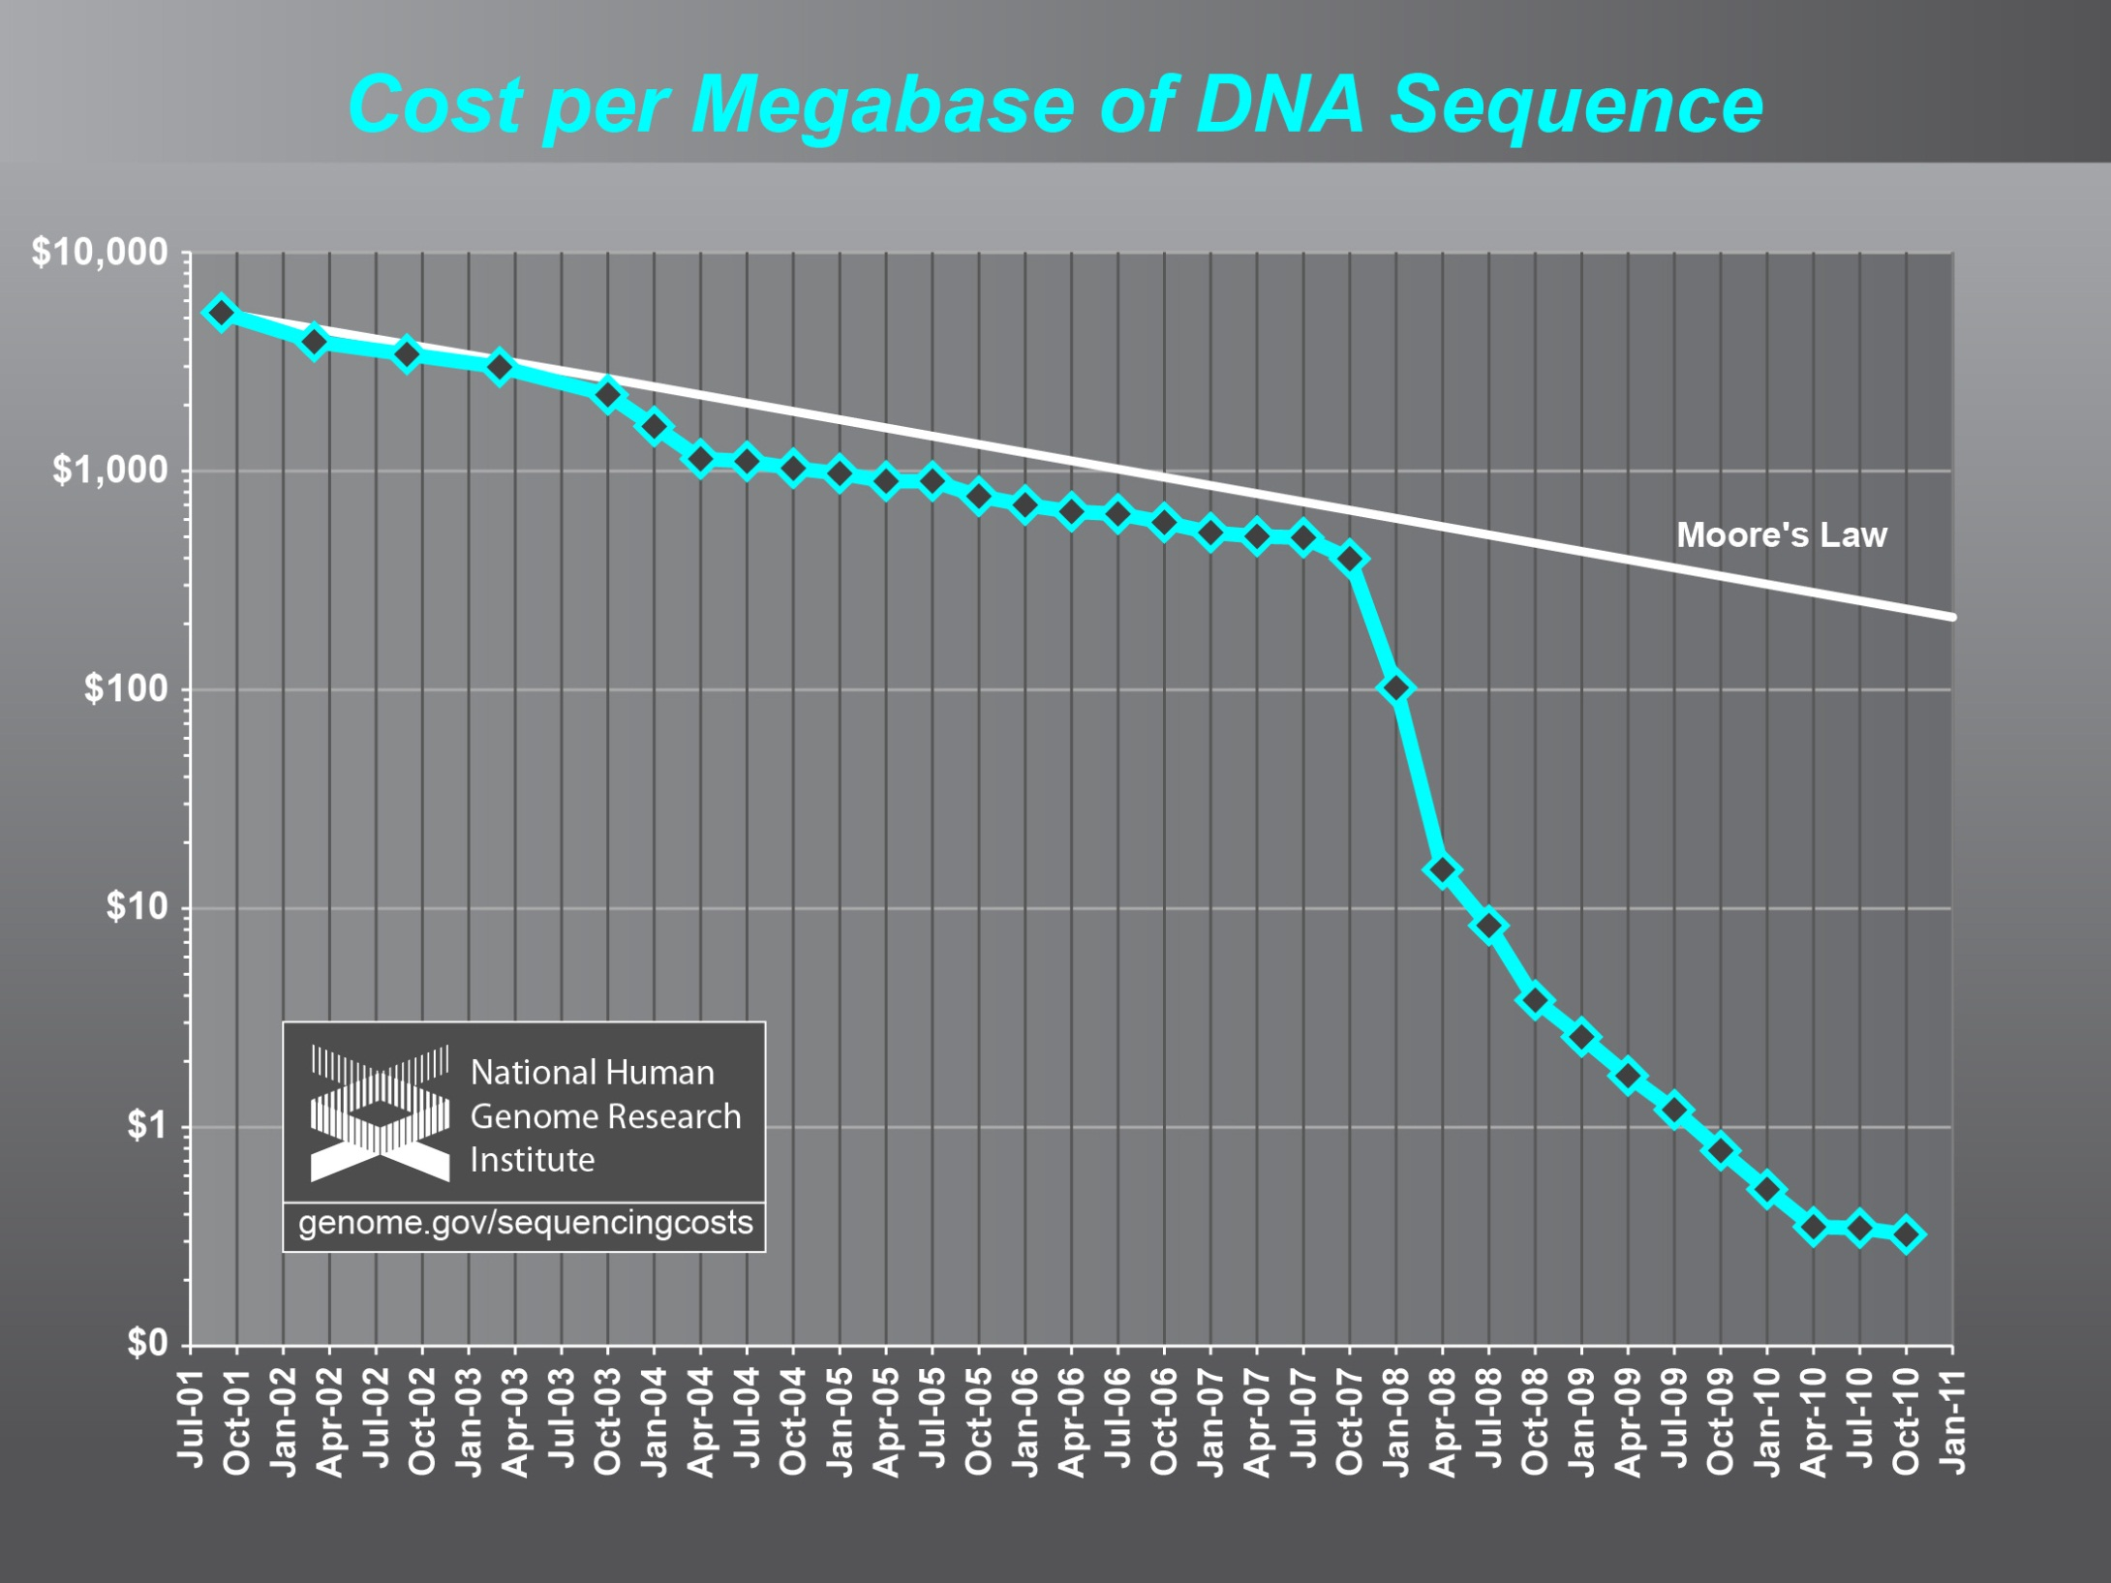
Why need cost effective
Computing!
(Note Public Clouds not allowed for human genomes)

Slide 6
Genomics in Personal Health
  Suppose you measured everybody’s genome every 2 years
    30 petabits of new gene data per day
    factor of 100 more for raw reads with coverage
  Data surely distributed
  1.5*10⁸ to 1.5*10¹⁰ continuously running present day cores to perform a simple Blast analysis on this data
    Amount depends on clever hashing and maybe Blast not good enough as field gets more sophisticated

Slide 7
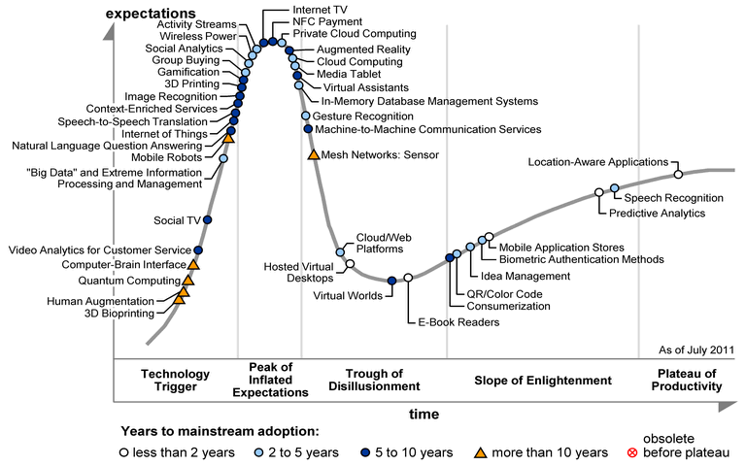

Slide 8
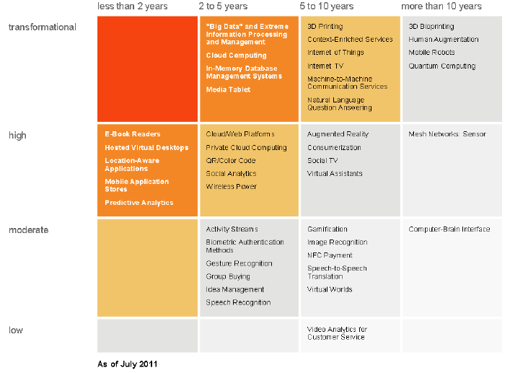
Transformational
High
Moderate
Low
“Big Data” and Extreme
Information Processing and Management
Cloud Computing
In-memory Database Management Systems
Media Tablet
3D Printing
Content enriched Services
Internet of Things
Internet TV
Machine to Machine Communication Services
Natural Language Question Answering
Cloud/Web Platforms
Private Cloud Computing
QR/Color Bar Code
Social Analytics
Wireless Power

Slide 9
Clouds Offer From different points of view
Features from NIST:
  On-demand service (elastic);
  Broad network access;
  Resource pooling;
  Flexible resource allocation;
  Measured service
Economies of scale in performance and electrical power (Green IT)
Powerful new software models
  Platform as a Service is not an alternative to Infrastructure as a Service – it is instead an incredible valued added
  Amazon is as much PaaS as Azure

Slide 10
2 Aspects of Cloud Computing:
Infrastructure and Runtimes
Cloud infrastructure: outsourcing of servers, computing, data, file space, utility computing, etc..
Cloud runtimes or Platform: tools to do data-parallel (and other) computations. Valid on Clouds and traditional clusters
  Apache Hadoop, Google MapReduce, Microsoft Dryad, Bigtable, Chubby and others
  MapReduce designed for information retrieval but is excellent for a wide range of science data analysis applications
  Can also do much traditional parallel computing for data-mining if extended to support iterative operations
  Data Parallel File system as in HDFS and Bigtable

Slide 11
Clouds Grids and Supercomputers: Infrastructure and Applications

Slide 12
What Applications work in Clouds
Workflow and Services
Pleasingly parallel applications of all sorts analyzing roughly independent data or spawning independent simulations including
  Long tail of science
  Integration of distributed sensor data
Science Gateways and portals
Commercial and Science Data analytics that can use MapReduce (some of such apps) or its iterative variants (most analytic apps)
Note Data Analysis requirements not well articulated in many fields – See http://www.delsall.org for life sciences

Slide 13
Clouds and Grids/HPC
Synchronization/communication Performance
Grids > Clouds > HPC Systems
Clouds appear to execute effectively Grid workloads but are not easily used for closely coupled HPC applications
Service Oriented Architectures and workflow appear to work similarly in both grids and clouds
Assume for immediate future, science supported by a mixture of
  Clouds – data analysis (and pleasingly parallel)
  Grids/High Throughput Systems (moving to clouds as convenient)
  Supercomputers (“MPI Engines”) going to exascale

Slide 14
Internet of Things: Sensor Grids supported as pleasingly parallel applications on clouds

Slide 15
  Internet of Things: Sensor Grids
  A pleasingly parallel example on Clouds
  A sensor (“Thing”) is any source or sink of time series
    In the thin client era, smart phones, Kindles, tablets, Kinects, web-cams are sensors
    Robots, distributed instruments such as environmental measures are sensors
    Web pages, Googledocs, Office 365, WebEx are sensors
    Ubiquitous Cities/Homes are full of sensors
    They have IP address on Internet
  Sensors – being intrinsically distributed are Grids
  However natural implementation uses clouds to consolidate and control and collaborate with sensors
  Sensors are typically “small” and have pleasingly parallel cloud implementations

Slide 16








Sensors as a Service
Output Sensor
Sensors as a Service
A larger sensor ………
Sensor Processing as a Service (MapReduce)

Slide 17
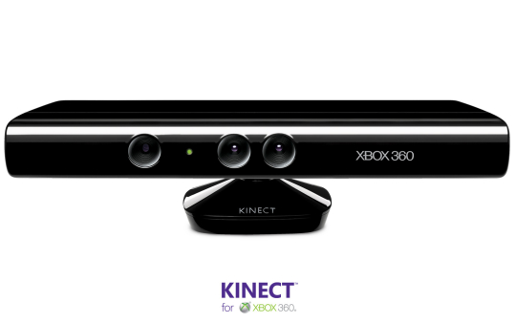
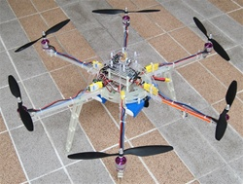



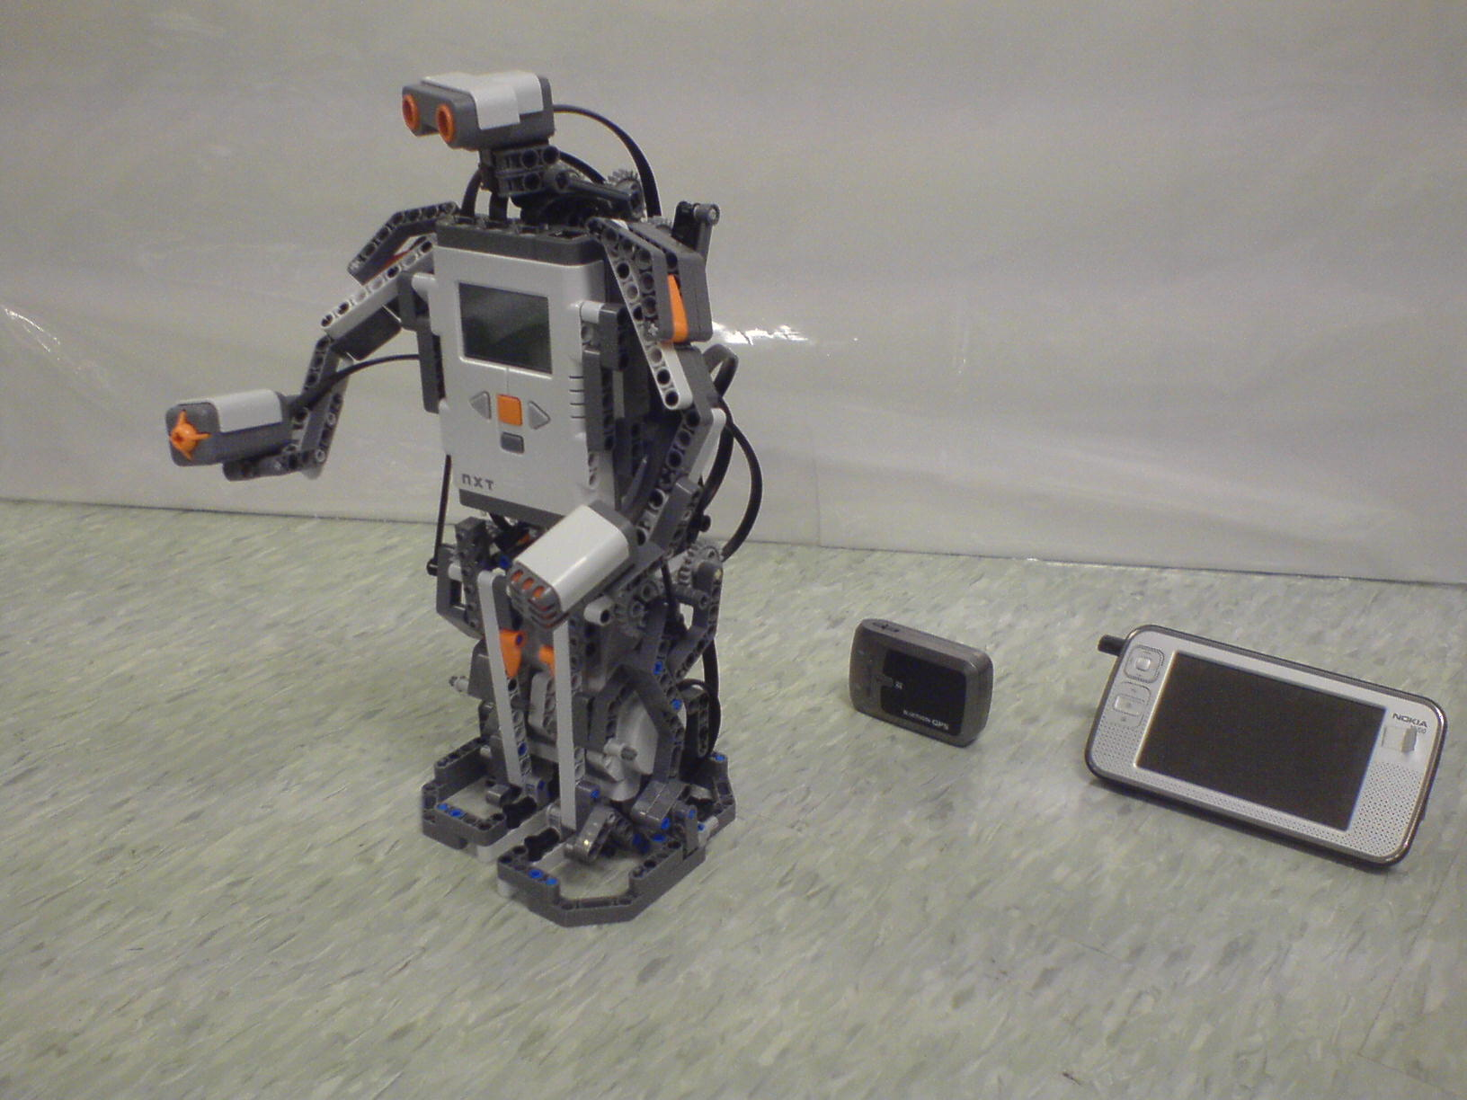
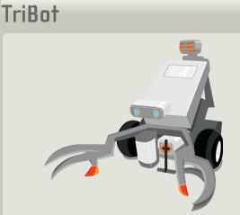

Some Sensors
Hexacopter
Laptop for PowerPoint
Surveillance Camera
RFID Reader
RFID Tag
Lego Robot GPS Nokia N800

Slide 18
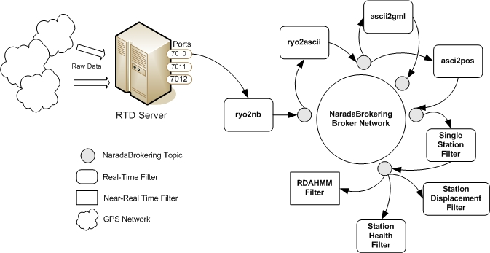
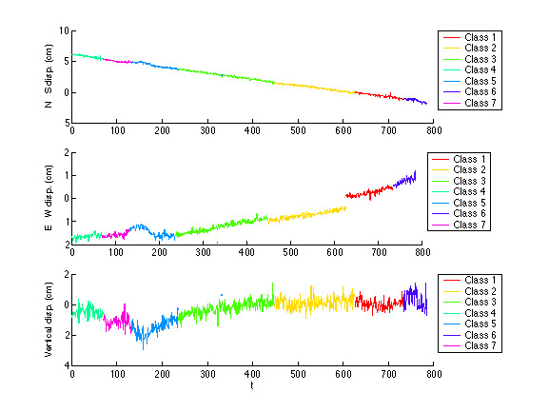
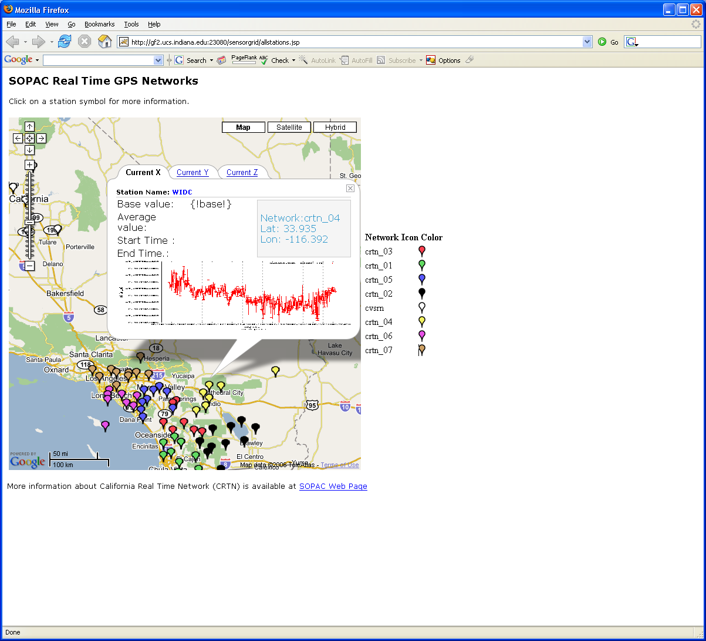
Real-Time GPS Sensor Data-Mining
Services process real time data from ~70 GPS Sensors in Southern California
Brokers and Services on Clouds – no major performance issues
CRTN GPS
Earthquake
Streaming Data
Support
Transformations
Data Checking
Archival
Hidden Markov
Datamining (JPL)
Display (GIS)
Real Time
18
Notes:
18

Slide 19
Performance of Pub-Sub Cloud Brokers
High end sensors equivalent to Kinect or MPEG4 TRENDnet TV-IP422WN camera at about 1.8Mbps per sensor instance
OpenStack hosted sensors and middleware

Slide 20
MapReduce and Iterative MapReduce for non trivial parallel applications on Clouds

Slide 21






MapReduce “File/Data Repository” Parallelism
Map = (data parallel) computation reading and writing data
Reduce = Collective/Consolidation phase e.g. forming multiple global sums as in histogram
Instruments
MPI or Iterative MapReduce
Map Reduce Map Reduce Map
Communication
Reduce
Portals
/Users
Disks
Map₁
Map₂
Map₃

Slide 22
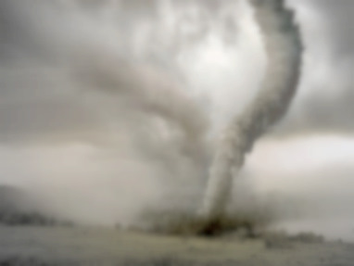
Twister v0.9
March 15, 2011
  New Interfaces for Iterative MapReduce Programming
  http://www.iterativemapreduce.org/
SALSA Group
Bingjing Zhang, Yang Ruan, Tak-Lon Wu, Judy Qiu, Adam Hughes, Geoffrey Fox, Applying Twister to Scientific Applications, Proceedings of IEEE CloudCom 2010 Conference, Indianapolis, November 30-December 3, 2010
Twister4Azure released May 2011
http://salsahpc.indiana.edu/twister4azure/
MapReduceRoles4Azure available for some time at
http://salsahpc.indiana.edu/mapreduceroles4azure/
Microsoft Daytona project July 2011 is Azure version

Slide 23

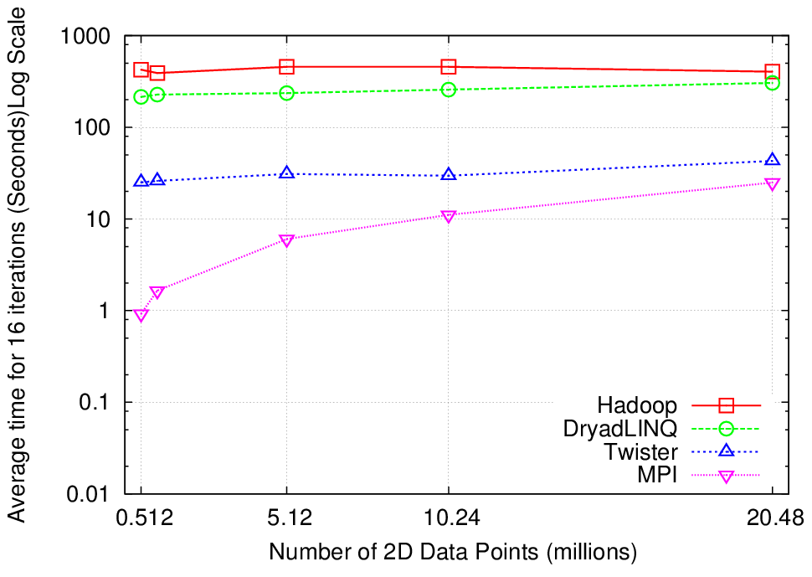
K-Means Clustering
Compute the distance to each data point from each cluster center and assign points to cluster centers
map
map
Time for 20 iterations
reduce
Compute new cluster
centers
User program
Compute new cluster centers
Iteratively refining operation
Typical MapReduce runtimes incur extremely high overheads
  New maps/reducers/vertices in every iteration
  File system based communication
Long running tasks and faster communication in Twister enables it to perform close to MPI

Slide 24


Twister
Pub/Sub Broker Network
Map Worker
M
Worker Nodes
R
Reduce Worker
Streaming based communication
Intermediate results are directly transferred from the map tasks to the reduce tasks – eliminates local files
Cacheable map/reduce tasks
  Static data remains in memory
Combine phase to combine reductions
User Program is the composer of MapReduce computations
Extends the MapReduce model to iterative computations
D
D
MR
Driver
User
Program
M
M
M
M
D
MRDeamon
R
R
R
R
Data Read/Write
Communication
Data Split
File System
Iterate
Static
data
Configure()
User Program
Map(Key, Value)
δ flow
Reduce (Key, List<Value>)
Combine (Key, List<Value>)
Different synchronization and intercommunication mechanisms used by the parallel runtimes
Close()

Slide 25
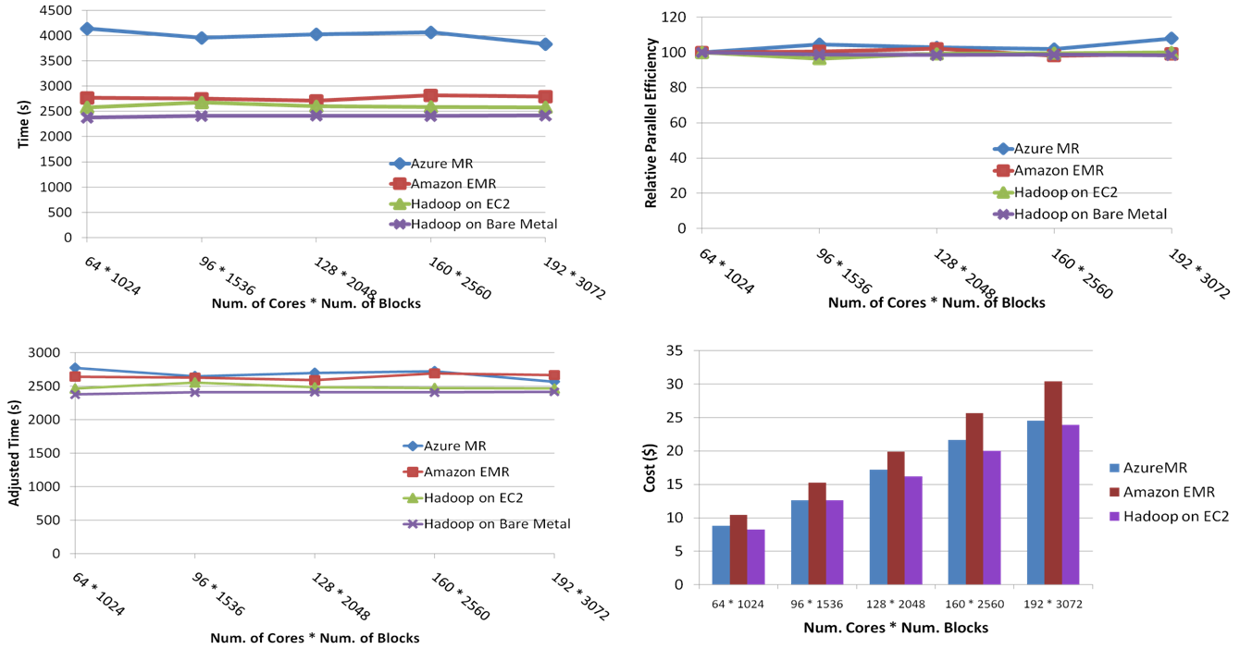
SWG Sequence Alignment Performance
Smith-Waterman-GOTOH to calculate all-pairs dissimilarity
Notes:
~123 million sequence alignments, for under 30$ with zero up front hardware cost,

Slide 26

Performance of Pagerank using
ClueWeb Data (Time for 20 iterations)
using 32 nodes (256 CPU cores) of Crevasse

Slide 27
Map Collective Model (Judy Qiu)
Combine MPI and MapReduce ideas
Implement collectives optimally on Infiniband, Azure, Amazon ……
Iterate
Input
map
Initial Collective Step
Network of Brokers
Generalized Reduce
Final Collective Step
Network of Brokers

Slide 28
MapReduce and Twister on Azure

Slide 29
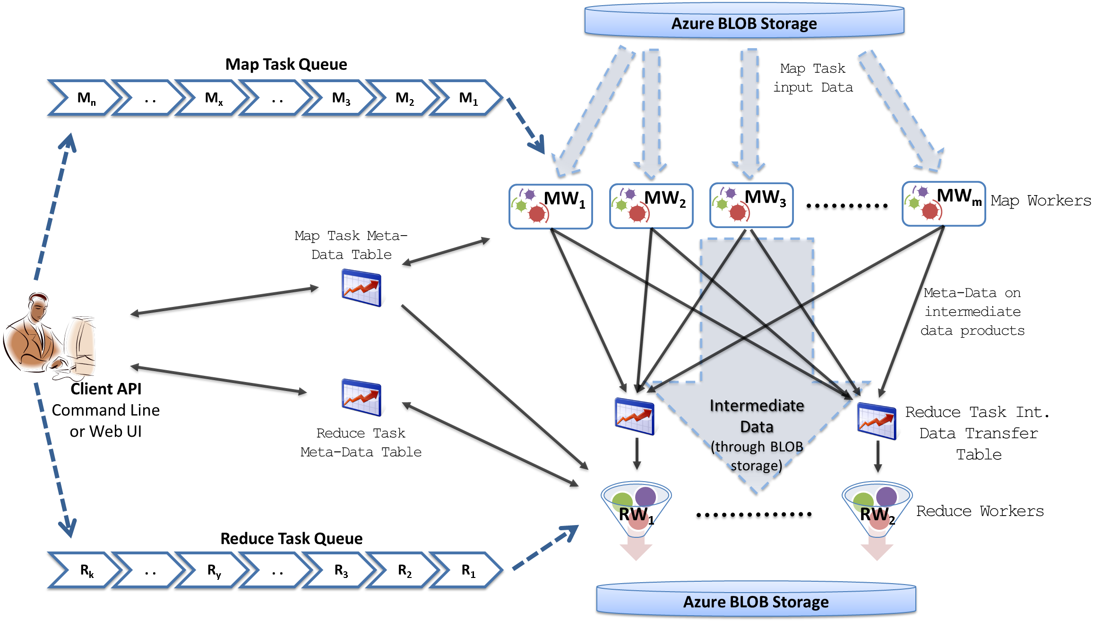
MapReduceRoles4Azure Architecture
Azure Queues for scheduling, Tables to store meta-data and monitoring data, Blobs for input/output/intermediate data storage.
Notes:
We use Azure Queues for scheduling, Tables to store meta-data and monitoring data, Blobs for input/output/intermediate data storage.

Slide 30
MapReduceRoles4Azure
Use distributed, highly scalable and highly available cloud services as the building blocks.
  Azure Queues for task scheduling.
  Azure Blob storage for input, output and intermediate data storage.
  Azure Tables for meta-data storage and monitoring
Utilize eventually-consistent , high-latency cloud services effectively to deliver performance comparable to traditional MapReduce runtimes.
Minimal management and maintenance overhead
Supports dynamically scaling up and down of the compute resources.
MapReduce fault tolerance
http://salsahpc.indiana.edu/mapreduceroles4azure/

Slide 31
High Level Flow Twister4Azure
Map
Combine
Job Start
Map
Reduce
Combine
Merge
Add Iteration?
Job Finish
Reduce
No
Map
Combine
Yes
Data Cache
Hybrid scheduling of the new iteration
Merge Step
In-Memory Caching of static data
Cache aware hybrid scheduling using Queues as well as using a bulletin board (special table)
Notes:
In our current work, we extend MR4Azure to support iterative mapreduce computations. We added an additional merge step to the programming model, where the computations decides whether to go for a new iteration or not. We also support in-memory caching of static data between iterations and we developed a hybrid scheduling strategy to perform cache aware scheduling.

Slide 32
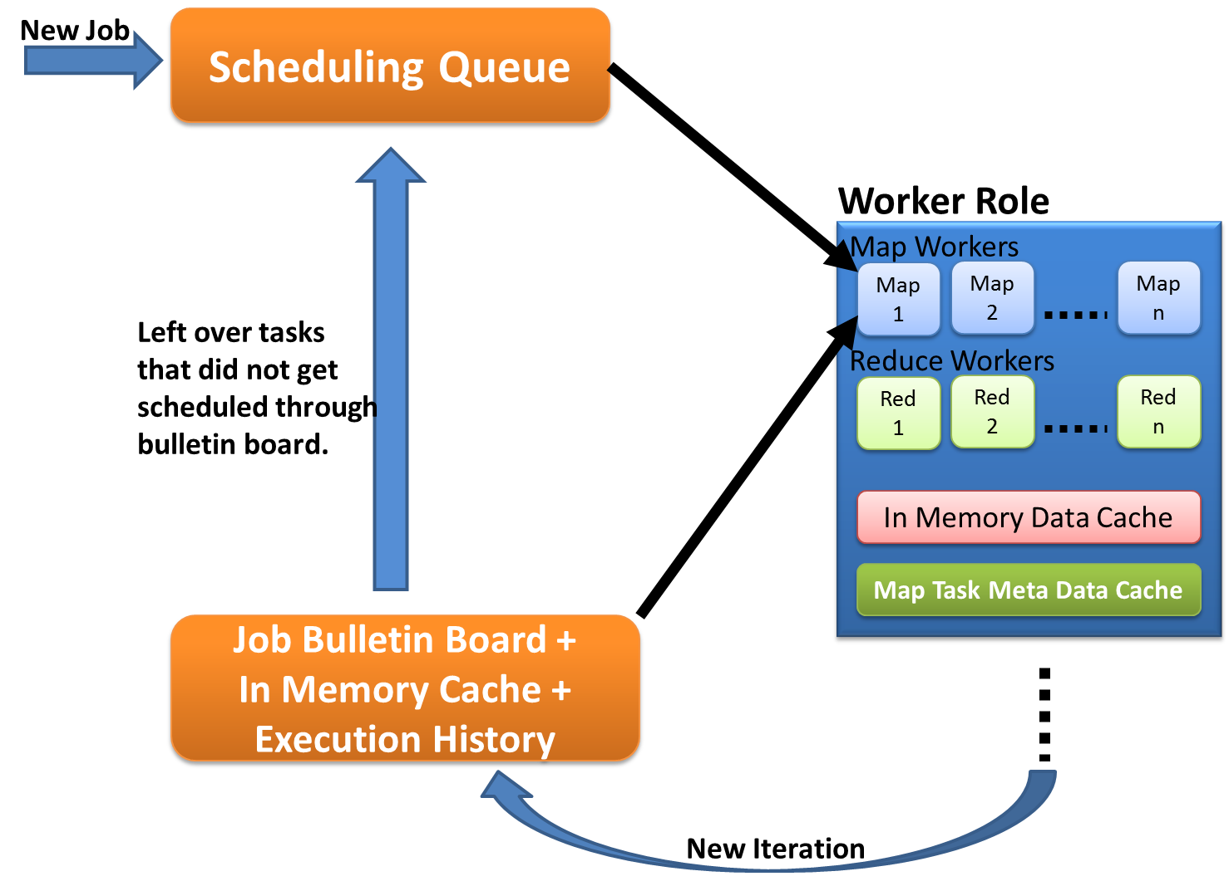
Cache aware scheduling
New Job (1st iteration)
  Through queues
New iteration
  Publish entry to Job Bulletin Board
  Workers pick tasks based on in-memory data cache and execution history (MapTask Meta-Data cache)
  Any tasks that do not get scheduled through the bulletin board will be added to the queue.

Slide 33
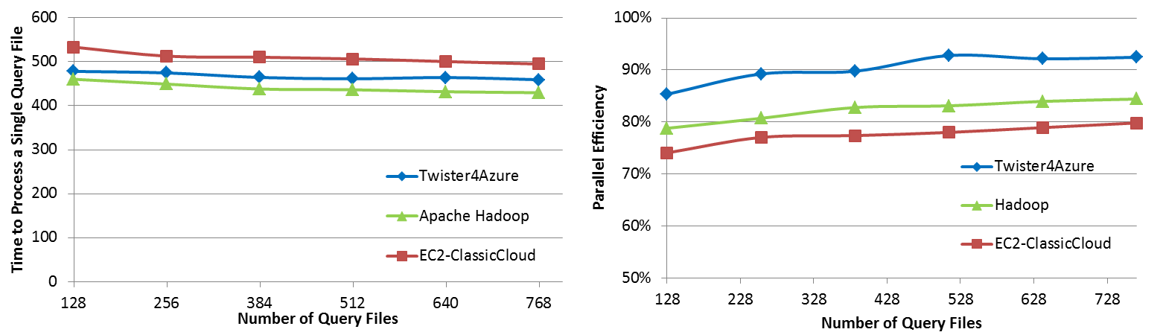

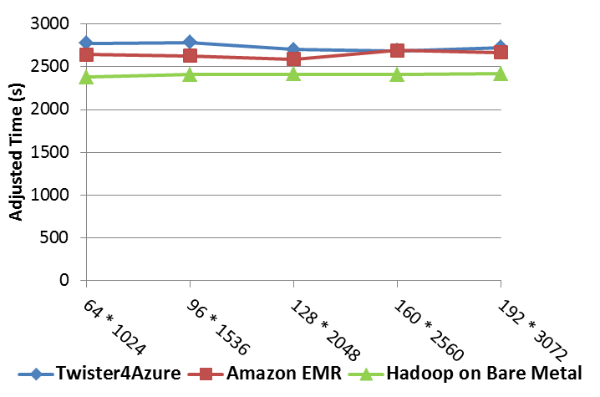
Performance Comparisons
BLAST Sequence Search
Smith Waterman Sequence Alignment
Cap3 Sequence Assembly

Slide 34

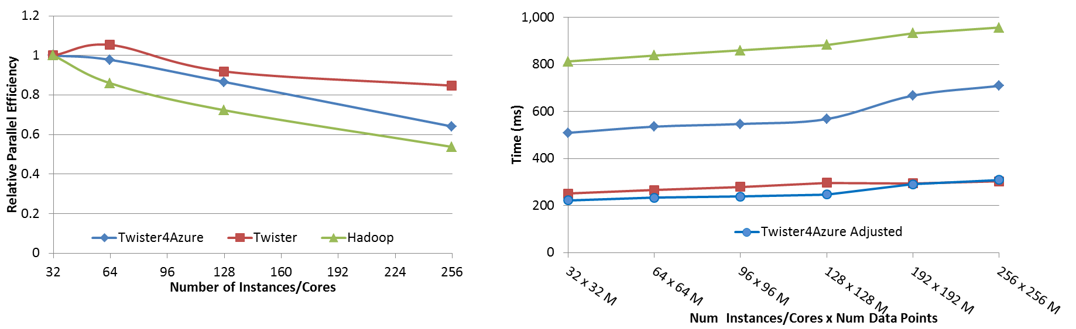
Performance – Kmeans Clustering
Task Execution Time Histogram
Number of Executing Map Task Histogram
Strong Scaling with 128M Data Points
Weak Scaling
Notes:
Right(c): Twister4Azure executing Map Task histogram for 128 million data points in 128 Azure small instances
Figure 5. KMeansClustering Scalability. Left(a): Relative parallel efficiency of strong scaling using 128 million data points.
Center(b): Weak scaling. Workload per core is kept constant (ideal is a straight horizontal line).

Slide 35
Kmeans Speedup from 32 cores

Slide 36
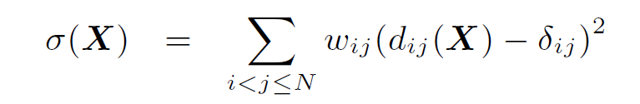
Look at one problem in detail
Visualizing Metagenomics where sequences are ~1000 dimensions
Map sequences to 3D so you can visualize
Minimize Stress
Improve with deterministic annealing (gives lower stress with less variation between random starts)
Need to iterate Expectation Maximization
N² dissimilarities (Smith Waterman, Needleman-Wunsch, Blast) δ_{i j}
Communicate N positions X between steps

Slide 37
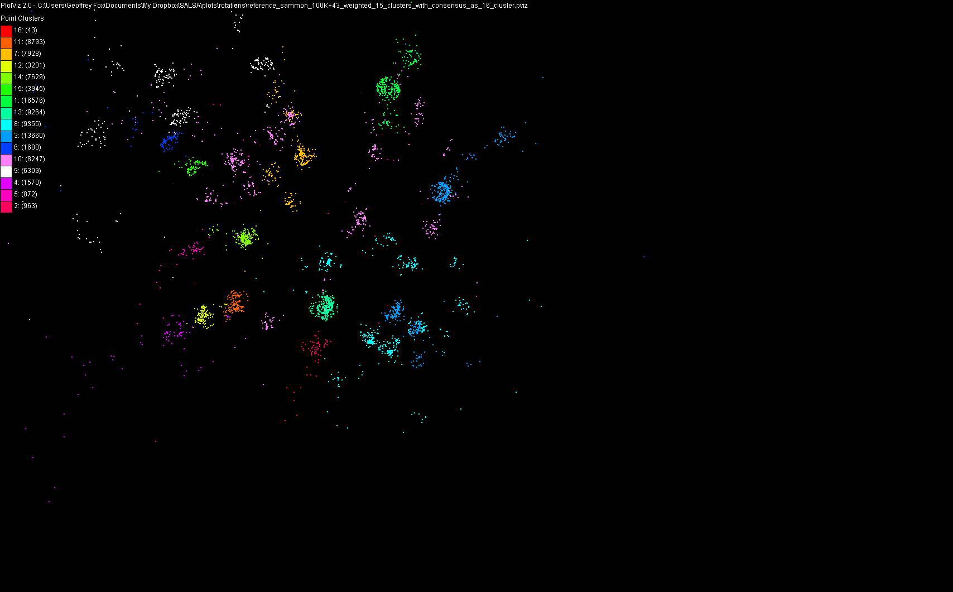
100,043 Metagenomics Sequences mapped to 3D

Slide 38
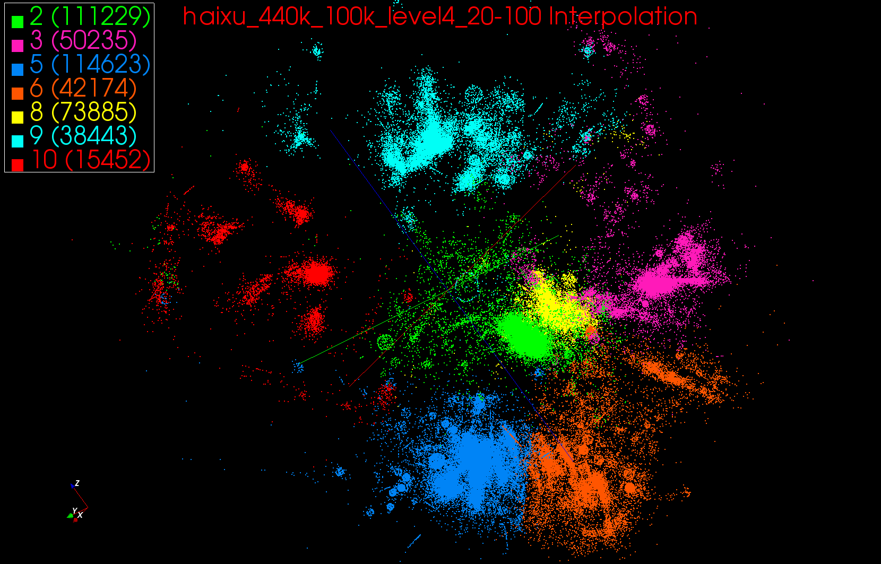
440K Interpolated

Slide 39
Multi-Dimensional-Scaling
Many iterations
Memory & Data intensive
3 Map Reduce jobs per iteration
X_{k} = invV * B(X_{(k-1)}) * X_{(k-1)}
2 matrix vector multiplications termed BC and X
BC: Calculate BX
X: Calculate invV (BX)
Calculate Stress
Map
Reduce
Merge
Map
Reduce
Merge
Map
Reduce
Merge
New Iteration

Slide 40
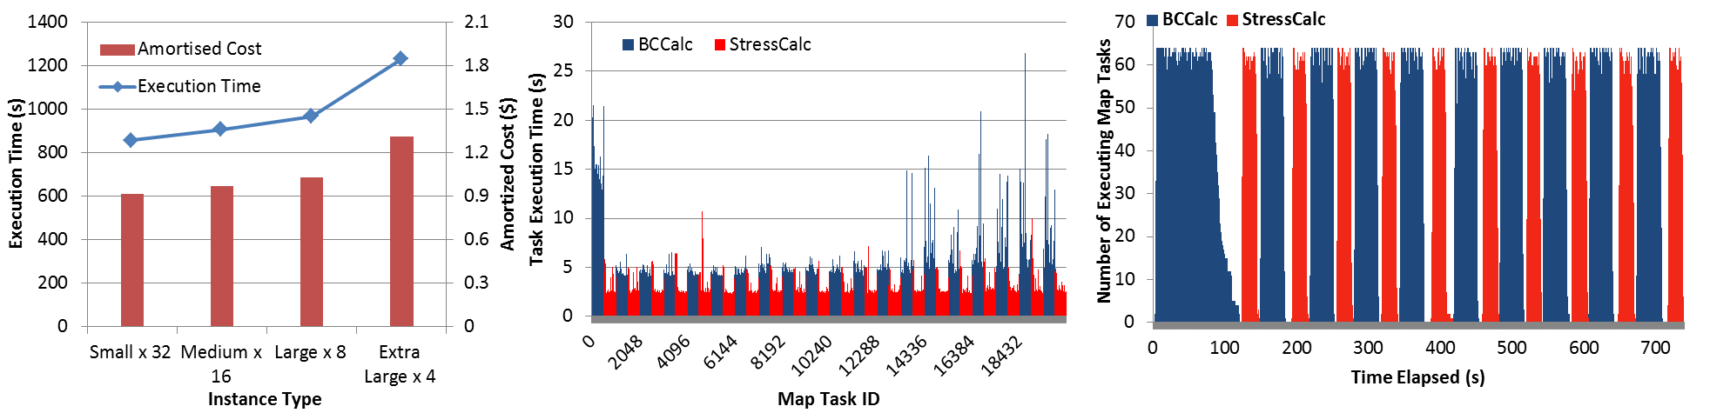
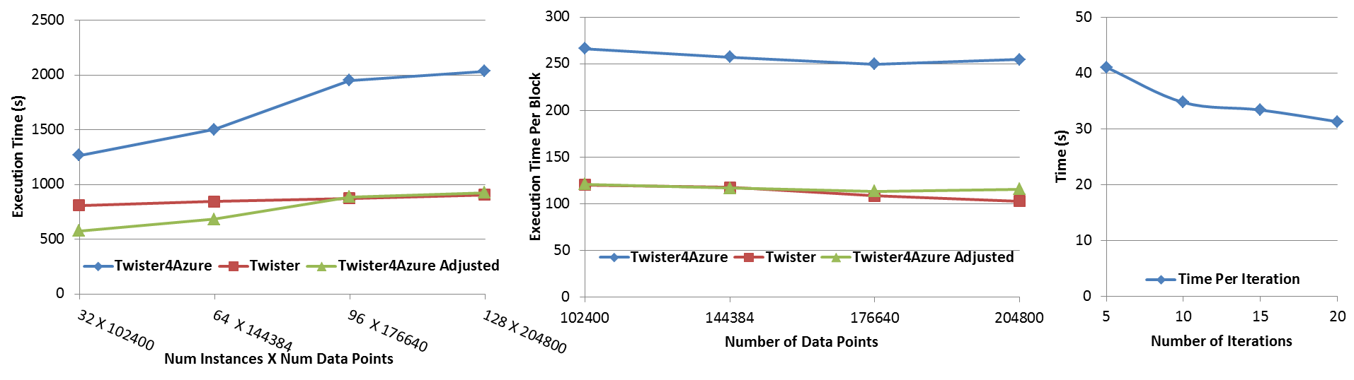




Performance – Multi Dimensional Scaling
Azure Instance Type Study
Task Execution Time Histogram
Number of Executing Map Task Histogram
Weak Scaling
Data Size Scaling
Increasing Number of Iterations
Performance with/without
data caching
Speedup gained using data cache
Scaling speedup
Increasing number of iterations
Notes:
Figure 6. Twister4Azure MDS performance Left: Instance type study using 76800 data points, 32 instances, 20 iterations. Center: Twister4Azure MDS individual task execution time histogram for 144384 x144384 distance matrix in 64 Azure small instances, 10 iterations Right: Twister4Azure executing Map Task histogram for 144384 x144384 distance matrix in 64 Azure small instances, 10 iterations
Figure 7. Left: Weak scaling where workload per core is ~constant. Ideal is a straight horizontal line. Center : Data size scaling with 128 Azure small instances/cores, 20 iterations. Right: Time per iteration with increasing number of iterations 30k x 30k distance matrix, 15 instances.

Slide 41
Twister4Azure Conclusions
Twister4Azure enables users to easily and efficiently perform large scale iterative data analysis and scientific computations on Azure cloud.
  Supports classic and iterative MapReduce
  Non pleasingly parallel use of Azure
Utilizes a hybrid scheduling mechanism to provide the caching of static data across iterations.
Should integrate with workflow systems
Plenty of testing and improvements needed!
Open source: Please use http://salsahpc.indiana.edu/twister4azure

Slide 42
Summary of
Applications Suitable for Clouds

Slide 43
Application Classification
(a) Map Only
(b) Classic MapReduce
(c) Iterative MapReduce
(d) Loosely Synchronous
Input
Input
Iterations
Input
map
map
map
P_{ij}
reduce
reduce
Output
BLAST Analysis
Smith-Waterman Distances
Parametric sweeps
PolarGrid Matlab data analysis
High Energy Physics (HEP) Histograms
Distributed search
Distributed sorting
Information retrieval
Expectation maximization clustering e.g. Kmeans
Linear Algebra
Multimensional Scaling
Page Rank
Many MPI scientific applications such as solving differential equations and particle dynamics
Domain of MapReduce and Iterative Extensions
MPI

Slide 44
What can we learn?
There are many pleasingly parallel data analysis algorithms which are super for clouds
  Remember SWG computation longer than other parts of analysis
There are interesting data mining algorithms needing iterative parallel run times
There are linear algebra algorithms with flaky compute/communication ratios
Expectation Maximization good for Iterative MapReduce

Slide 45
Research Issues for (Iterative) MapReduce
Quantify and Extend that Data analysis for Science seems to work well on Iterative MapReduce and clouds so far.
  Iterative MapReduce (Map Collective) spans all architectures as unifying idea
Performance and Fault Tolerance Trade-offs;
  Writing to disk each iteration (as in Hadoop) naturally lowers performance but increases fault-tolerance
  Integration of GPU’s
Security and Privacy technology and policy essential for use in many biomedical applications
Storage: multi-user data parallel file systems have scheduling and management
  NOSQL and SciDB on virtualized and HPC systems
Data parallel Data analysis languages: Sawzall and Pig Latin more successful than HPF?
Scheduling: How does research here fit into scheduling built into clouds and Iterative MapReduce (Hadoop)
  important load balancing issues for MapReduce for heterogeneous workloads

Slide 46
Architecture of Data-Intensive Clouds

Slide 47
Authentication and Authorization: Provide single sign in to All system architectures
Workflow: Support workflows that link job components between Grids and Clouds.
Provenance: Continues to be critical to record all processing and data sources
Data Transport: Transport data between job components on Grids and Commercial Clouds respecting custom storage patterns like Lustre v HDFS
Program Library: Store Images and other Program material
Blob: Basic storage concept similar to Azure Blob or Amazon S3
DPFS Data Parallel File System: Support of file systems like Google (MapReduce), HDFS (Hadoop) or Cosmos (dryad) with compute-data affinity optimized for data processing
Table: Support of Table Data structures modeled on Apache Hbase/CouchDB or Amazon SimpleDB/Azure Table. There is “Big” and “Little” tables – generally NOSQL
SQL: Relational Database
Queues: Publish Subscribe based queuing system
Worker Role: This concept is implicitly used in both Amazon and TeraGrid but was (first) introduced as a high level construct by Azure. Naturally support Elastic Utility Computing
MapReduce: Support MapReduce Programming model including Hadoop on Linux, Dryad on Windows HPCS and Twister on Windows and Linux. Need Iteration for Datamining
Software as a Service: This concept is shared between Clouds and Grids
Web Role: This is used in Azure to describe user interface and can be supported by portals in Grid or HPC systems
Components of a Scientific Computing Platform

Slide 48
Architecture of Data Repositories?
Traditionally governments set up repositories for data associated with particular missions
  For example EOSDIS, GenBank, NSIDC, IPAC for Earth Observation , Gene, Polar Science and Infrared astronomy
  LHC/OSG computing grids for particle physics
This is complicated by volume of data deluge, distributed instruments as in gene sequencers (maybe centralize?) and need for complicated intense computing

Slide 49
Clouds as Support for Data Repositories?
The data deluge needs cost effective computing
  Clouds are by definition cheapest
Shared resources essential (to be cost effective and large)
  Can’t have every scientists downloading petabytes to personal cluster
Need to reconcile distributed (initial source of ) data with shared computing
  Can move data to (disciple specific) clouds
  How do you deal with multi-disciplinary studies

Slide 50
Traditional File System?
S
Data
C
C
C
C
S
C
C
C
C
Archive
Data
S
C
C
C
C
Data
C
C
C
C
S
Data
Compute Cluster
Storage Nodes
Typically a shared file system (Lustre, NFS …) used to support high performance computing
Big advantages in flexible computing on shared data but doesn’t “bring computing to data”
Object stores similar to this?

Slide 51
Data Parallel File System?
Block1
Replicate each block
File1
Block2
……
Breakup
BlockN
C
C
C
C
Data
Data
Data
Data
C
C
C
C
Data
Data
Data
Data
C
C
C
C
Data
Data
Data
Data
C
C
C
C
Data
Data
Data
Data
Block1
File1
Block2
……
Breakup
Replicate each block
BlockN
No archival storage and computing brought to data

Slide 52
Summary of
Data-Intensive Applications on Clouds

Slide 53
Summarizing Guiding Principles
Clouds may not be suitable for everything but they are suitable for majority of data intensive applications
  Solving partial differential equations on 100,000 cores probably needs classic MPI engines
Cost effectiveness, elasticity and quality programming model will drive use of clouds in many areas such as genomics
Need to solve issues of
  Security-privacy-trust for sensitive data
  How to store data – “data parallel file systems” (HDFS), Object Stores, or classic HPC approach with shared file systems with Lustre etc.
Programming model which is likely to be MapReduce based
  Look at high level languages
  Compare with databases (SciDB?)
  Must support iteration to do “real parallel computing”
  Need Cloud-HPC Cluster Interoperability

