Slide 1

Scalable Parallel Computing on Clouds
Thilina Gunarathne (tgunarat@indiana.edu)
Advisor : Prof.Geoffrey Fox (gcf@indiana.edu)
Committee : Prof.Judy Qiu, Prof.Beth Plale, Prof.David Leake

Slide 2







Clouds for scientific computations
No upfront cost
Zero maintenance
Horizontal scalability
Compute, storage and other services
Loose service guarantees
Not trivial to utilize effectively ☹
Notes:
The utility computing model introduced by cloud computing combined with the rich set of cloud infrastructure services offers a very viable environment for the scientists to process massive amounts of data. Absence of upfront infrastructure spending and zero maintenance cost coupled with the ability to horizontally scale makes scientists very happy.
However, clouds offer unique reliability and sustained performance challenges for large scale parallel computations due to the
virtualization,
multi-tenancy,
non-dedicated commodity connectivity and etc..
Also the cloud services offer unique loose services guarantees such as eventual consistency.
This makes it necessary to have specialized distributed parallel computing frameworks build specifically for cloud characteristics to harness the power of clouds both easily and effectively.

Slide 3
Scalable Parallel Computing on Clouds
Programming Models
Scalability
Performance
Fault Tolerance
Monitoring
Notes:
My research focuses on creating scalable parallel programming frameworks specifically designed for cloud environments to support efficient, reliable and user friendly execution of data intensive iterative computations.
The goals of my work are designing suitable programming models,
achieving good scalability and good performance,
providing framework managed fault tolerance ensuring eventual completion of the computations and
having good monitoring tools to perform scalable parallel computing on clouds.

Slide 4
Pleasingly Parallel Frameworks
HDFS
Input Data Set
Cap3 Sequence Assembly
Data File
exe
exe
Map()
Map()
Executable
Optional
Reduce
Phase
Reduce
HDFS
Results
Classic Cloud Frameworks
Map Reduce
Notes:
Out first step was to build a pleasingly computing framework for cloud environments to process embarrassingly parallel applications. This would be similar to a simple job submission framework.
We implemented several applications including sequence assembly, Blast sequence search and couple of dimensional scaling interpolation algorithms . We were able to achieve comparable performance. This motivated us to go a step further and extend our work to MapReduce type applications..

Slide 5





Map Reduce
Programming Model
Moving Computation to Data
Scalable
Fault Tolerance
  Simple programming model
  Excellent fault tolerance
  Moving computations to data
  Works very well for data intensive pleasingly parallel applications
  Ideal for data intensive parallel applications
Notes:
MapReduce provides a easy to use programming model together with very good fault tolerance and scalability for large scale applications. MapReduce model is proving to be Ideal for data intensive pleasingly parallel applications in commodity hardware and in clouds.
In our current research, we improve and extend MapReduce programming model to support richer applications patterns efficiently.

Slide 6
MRRoles4Azure
First MapReduce framework for Azure Cloud
Use highly-available and scalable Azure cloud services
Hides the complexity of cloud & cloud services
Co-exist with eventual consistency & high latency of cloud services
Decentralized control
  avoids single point of failure
Azure Cloud Services
Highly-available and scalable
Decentralized
Avoids Single Point of Failure
Utilize eventually-consistent , high-latency cloud services effectively
Minimal maintenance and management overhead
Dynamically scale up/down
Global queue based dynamic scheduling
MapReduce
First pure MapReduce for Azure
Typical MapReduce fault tolerance
Notes:
We started by creating a decentralized MapReduce framework for Azure cloud utilizing the highly-available and scalable, Azure infrastructure services as the building blocks.
MRRoles4Azure hides the complexity of cloud services from the users and
is designed to co-exist with the eventual consistent nature of cloud services.
The decentralized architecture avoid the single point of failure and bottleneck, while global queue based dynamic scheduling achieves better load balancing.
We selected Azure platform, as at that time there weren’t any distributed data processing frameworks available for Azure. We performed the first public release of MRRoles4Azure in the 4th quarter of 2010 as the first pure MapReduce framework for Azure.

Slide 7
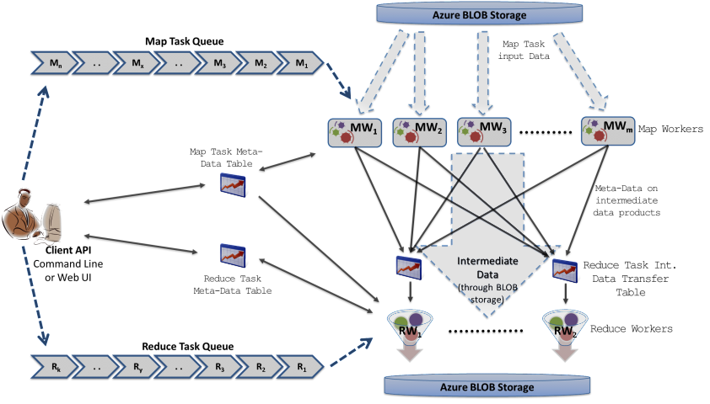
MRRoles4Azure
Azure Queues for scheduling, Tables to store meta-data and monitoring data, Blobs for input/output/intermediate data storage.
Notes:
Ability to dynamically scale up/down
Easy testing and deployment
Combiner step
Web based monitoring console

Slide 8
MRRoles4Azure
Global Barrier
Notes:
One major challenge we encountered is in implementing the global barrier before the reduce task processing. It became a challenge due to the eventual consistency nature of cloud services. We got through it by using special data structures to keep track of the number of reduce data products each map task generated for each reduce task

Slide 9
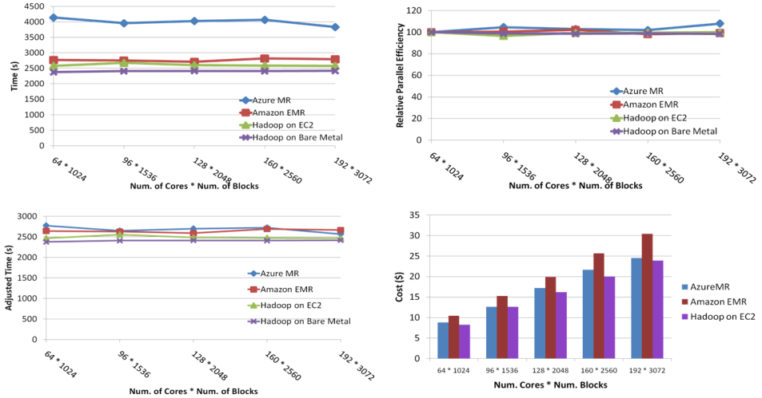
SWG Sequence Alignment
Performance comparable to Hadoop, EMR
Costs less than EMR
Smith-Waterman-GOTOH to calculate all-pairs dissimilarity
Notes:
~123 million sequence alignments, for under 30$ with zero up front hardware cost,
Add call-outs

Slide 10
Data Intensive Iterative Applications
Compute
Communication
Reduce/ barrier
Smaller Loop-Variant Data
Broadcast
New Iteration
Larger Loop-Invariant Data
Growing class of applications
  Clustering, data mining, machine learning & dimension reduction applications
  Driven by data deluge & emerging computation fields
Notes:
Iterative computations are at the core of the vast majority of data intensive scientific computations.
need to process massive amounts of data and the emergence of data intensive computational fields, such as bioinformatics, chemical informatics and web mining.
Most of these applications consists of iterative computation and communication steps where single iterations can easily be specified as MapReduce computations.
Large input data sizes which are loop-invariant and can be reused across iterations.
Loop-variant results.. Orders of magnitude smaller…

Slide 11

Extensions to support broadcast data
Iterative MapReduce for Azure Cloud
Merge step
In-Memory Caching of static data
Programming model extensions to support broadcast data
Merge Step
Hybrid intermediate data transfer
Hybrid intermediate data transfer
In-Memory/Disk caching of static data
http://salsahpc.indiana.edu/twister4azure
Notes:
additional merge step to the programming model, which would be the point where the computations decide whether to go for a new iteration or not.
Extensions to support broadcast data as an additional input to Map & reduce functions.
support in-memory caching of static loop-invariant data between iterations. We achieved this by having cacheable input formats, requiring no changes to the map reduce programming model.
The tasks of iterative computations are much finer grained and the intermediate data are relatively smaller than typical map reduce computations. We added support for hydrid transfer of intermediate data.
First iterative MR on Azure.. Released in early May 2011.

Slide 12
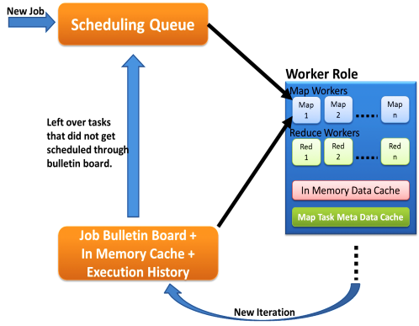
Hybrid Task Scheduling
First iteration through queues
Cache aware hybrid scheduling
Decentralized
Fault Tolerant
Multiple MapReduce applications within an iteration
Left over tasks
Data in cache + Task meta data history
New iteration in Job Bulleting Board
Notes:
No master with global knowledge of cached data products. Rather than pushing the workers pick tasks.
Multiple MapReduce applications within an iteration supporting much richer application patterns

Slide 13
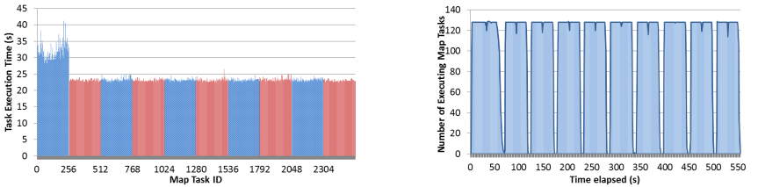
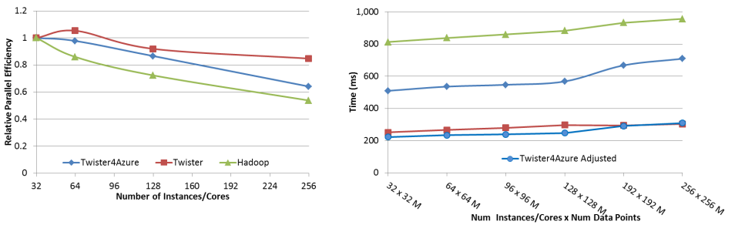




Performance – Kmeans Clustering
Overhead between iterations
First iteration performs the initial data fetch
Task Execution Time Histogram
Number of Executing Map Task Histogram
Scales better than Hadoop on bare metal
Strong Scaling with 128M Data Points
Weak Scaling
Performance with/without
data caching
Speedup gained using data cache
Scaling speedup
Increasing number of iterations
Notes:
Right(c): Twister4Azure executing Map Task histogram for 128 million data points in 128 Azure small instances
Figure 5. KMeansClustering Scalability. Left(a): Relative parallel efficiency of strong scaling using 128 million data points.
Center(b): Weak scaling. Workload per core is kept constant (ideal is a straight horizontal line).

Slide 14
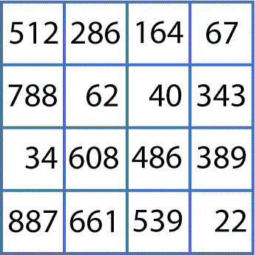
Applications
Bioinformatics pipeline
O(NxN)
Clustering
O(NxN)
Cluster Indices
Pairwise Alignment & Distance Calculation
Gene Sequences
Visualization
3D Plot
O(NxN)
Coordinates
Distance Matrix
Multi-Dimensional Scaling
http://salsahpc.indiana.edu/

Slide 15
Multi-Dimensional-Scaling
Many iterations
Memory & Data intensive
3 Map Reduce jobs per iteration
X_{k} = invV * B(X_{(k-1)}) * X_{(k-1)}
2 matrix vector multiplications termed BC and X
BC: Calculate BX
X: Calculate invV (BX)
Calculate Stress
Map
Reduce
Merge
Map
Reduce
Merge
Map
Reduce
Merge
New Iteration

Slide 16
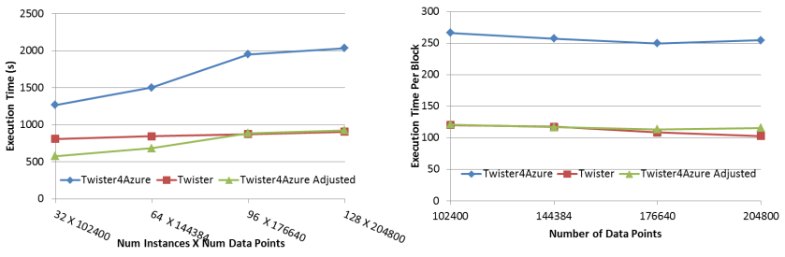
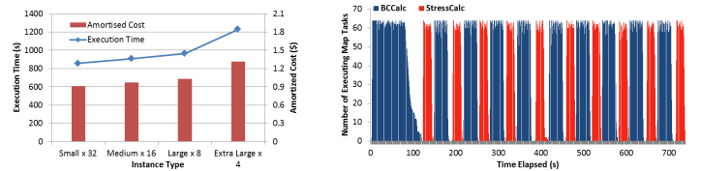
Performance – Multi Dimensional Scaling
Performance adjusted for sequential performance difference
First iteration performs the initial data fetch
Weak Scaling
Data Size Scaling
Azure Instance Type Study
Number of Executing Map Task Histogram
Task Execution Time Histogram
Performance with/without
data caching
Speedup gained using data cache
Scaling speedup
Increasing number of iterations
Notes:
Weak scaling where workload per core is ~constant. Ideal is a straight horizontal line. Center : Data size scaling with 128 Azure small instances/cores, 20 iterations.
Instance type study using 76800 data points, 32 instances, 20 iterations. Right: Twister4Azure executing Map Task histogram for 144384 x144384 distance matrix in 64 Azure small instances, 10 iterations

Slide 17

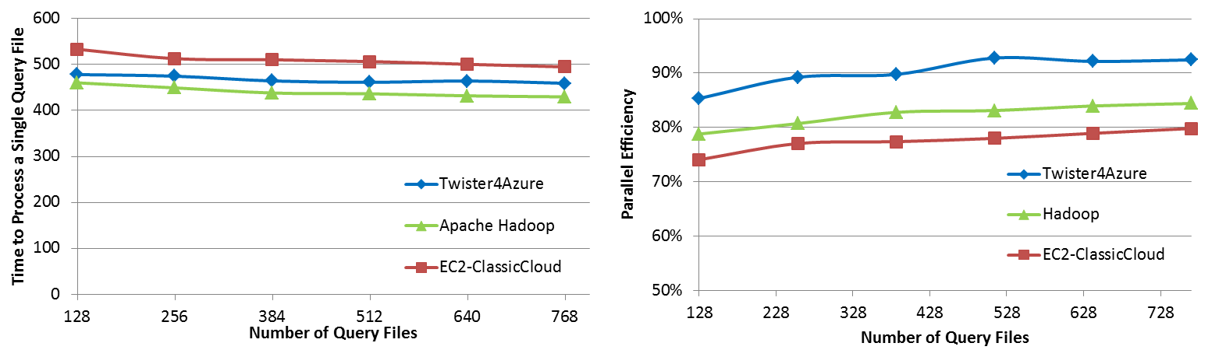
BLAST sequence search
BLAST Sequence Search
BLAST
Scales better than Hadoop & EC2-Classic Cloud

Slide 18
Current Research
Collective communication primitives
Exploring additional data communication and broadcasting mechanisms
  Fault tolerance
Twister4Cloud
  Twister4Azure architecture implementations for other cloud infrastructures

Slide 19
Contributions
Twister4Azure
  Decentralized iterative MapReduce architecture for clouds
  More natural Iterative programming model extensions to MapReduce model
  Leveraging eventual consistent cloud services for large scale coordinated computations
Performance comparison of applications in Clouds, VM environments and in bare metal
Exploration of the effect of data inhomogeneity for scientific MapReduce run times
Implementation of data mining and scientific applications for Azure cloud as well as using Hadoop/DryadLinq
GPU OpenCL implementation of iterative data analysis algorithms
Notes:
Include inhomogeneity and VM overhead results
GPU work as a contribution
Application implementation on Azure as a contribution

Slide 20
Acknowledgements
My PhD advisory committee
Present and past members of SALSA group – Indiana University
National Institutes of Health grant 5 RC2 HG005806-02.
FutureGrid
Microsoft Research
Amazon AWS

Slide 21
Selected Publications
Gunarathne, T., Wu, T.-L., Choi, J. Y., Bae, S.-H. and Qiu, J. Cloud computing paradigms for pleasingly parallel biomedical applications. Concurrency and Computation: Practice and Experience. doi: 10.1002/cpe.1780
Ekanayake, J.; Gunarathne, T.; Qiu, J.; , Cloud Technologies for Bioinformatics Applications, Parallel and Distributed Systems, IEEE Transactions on , vol.22, no.6, pp.998-1011, June 2011. doi: 10.1109/TPDS.2010.178
Thilina Gunarathne, BingJing Zang, Tak-Lon Wu and Judy Qiu. Portable Parallel Programming on Cloud and HPC: Scientific Applications of Twister4Azure. In Proceedings of the forth IEEE/ACM International Conference on Utility and Cloud Computing (UCC 2011) , Melbourne, Australia. 2011. To appear.
Gunarathne, T., J. Qiu, and G. Fox, Iterative MapReduce for Azure Cloud, Cloud Computing and Its Applications, Argonne National Laboratory, Argonne, IL, 04/12-13/2011.
Gunarathne, T.; Tak-Lon Wu; Qiu, J.; Fox, G.; MapReduce in the Clouds for Science, Cloud Computing Technology and Science (CloudCom), 2010 IEEE Second International Conference on , vol., no., pp.565-572, Nov. 30 2010-Dec. 3 2010. doi: 10.1109/CloudCom.2010.107
Thilina Gunarathne, Bimalee Salpitikorala, and Arun Chauhan. Optimizing OpenCL Kernels for Iterative Statistical Algorithms on GPUs. In Proceedings of the Second International Workshop on GPUs and Scientific Applications (GPUScA), Galveston Island, TX. 2011.
Gunarathne, T., C. Herath, E. Chinthaka, and S. Marru, Experience with Adapting a WS-BPEL Runtime for eScience Workflows. The International Conference for High Performance Computing, Networking, Storage and Analysis (SC'09), Portland, OR, ACM Press, pp. 7, 11/20/2009
Judy Qiu, Jaliya Ekanayake, Thilina Gunarathne, Jong Youl Choi, Seung-Hee Bae, Yang Ruan, Saliya Ekanayake, Stephen Wu, Scott Beason, Geoffrey Fox, Mina Rho, Haixu Tang. Data Intensive Computing for Bioinformatics, Data Intensive Distributed Computing, Tevik Kosar, Editor. 2011, IGI Publishers.

Slide 22
Questions?
Thank You!
http://salsahpc.indiana.edu/twister4azure
http://www.cs.indiana.edu/~tgunarat/

Slide 23
Background
  Web services
    Apache Axis2 committer, release manager, PMC member
  Workflow
    BPEL-Mora
    WSO2 Mashup server
    LEAD (Linked environments
  Cloud computing
    Hadoop, Twister, EMR

Slide 24
Broadcast Data
Loop invariant data (static data) – traditional MR key-value pairs
  Comparatively larger sized data
  Cached between iterations
Loop variant data (dynamic data) – broadcast to all the map tasks in beginning of the iteration
  Comparatively smaller sized data
  Map(Key, Value, List of KeyValue-Pairs(broadcast data) ,…)
Can be specified even for non-iterative MR jobs

Slide 25
In-Memory Data Cache
Caches the loop-invariant (static) data across iterations
  Data that are reused in subsequent iterations
Avoids the data download, loading and parsing cost between iterations
  Significant speedups for data-intensive iterative MapReduce applications
Cached data can be reused by any MR application within the job

Slide 26
Cache Aware Scheduling
Map tasks need to be scheduled with cache awareness
  Map task which process data ‘X’ needs to be scheduled to the worker with ‘X’ in the Cache
Nobody has global view of the data products cached in workers
  Decentralized architecture
  Impossible to do cache aware assigning of tasks to workers
Solution: workers pick tasks based on the data they have in the cache
  Job Bulletin Board : advertise the new iterations

Slide 27
Merge Step
Extension to the MapReduce programming model to support iterative applications
  Map -> Combine -> Shuffle -> Sort -> Reduce -> Merge
Receives all the Reduce outputs and the broadcast data for the current iteration
User can add a new iteration or schedule a new MR job from the Merge task.
  Serve as the “loop-test” in the decentralized architecture
    Number of iterations
    Comparison of result from previous iteration and current iteration
  Possible to make the output of merge the broadcast data of the next iteration

Slide 28
Multiple Applications per Deployment
Ability to deploy multiple Map Reduce applications in a single deployment
Possible to invoke different MR applications in a single job
Support for many application invocations in a workflow without redeployment

