Slide 1
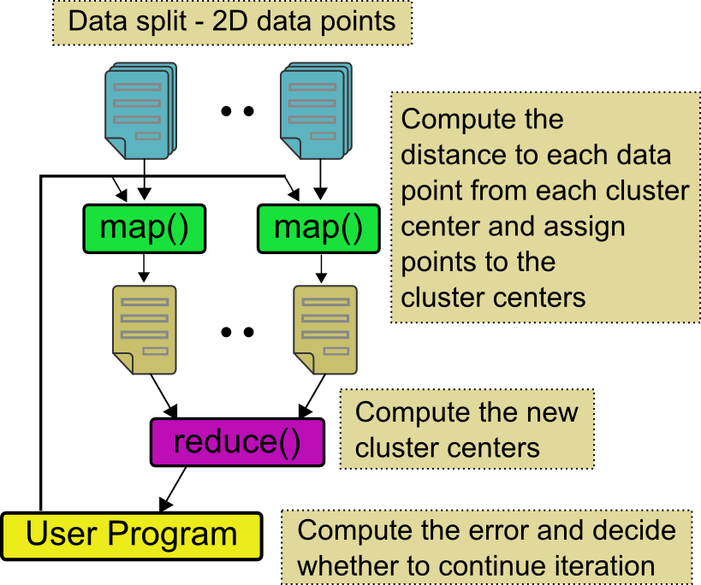
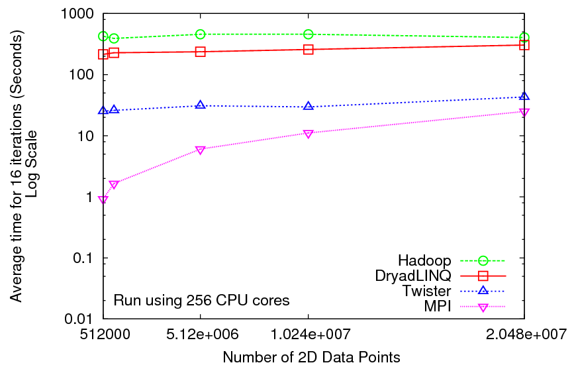
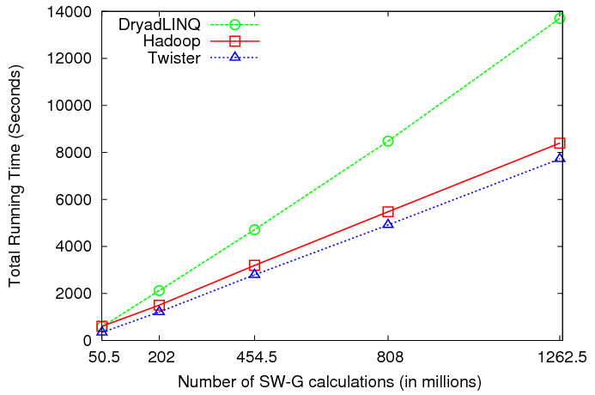
Iterative and non-Iterative Computations
K-means
Smith Waterman is a non iterative case and of course runs fine
Performance of K-Means

Slide 2
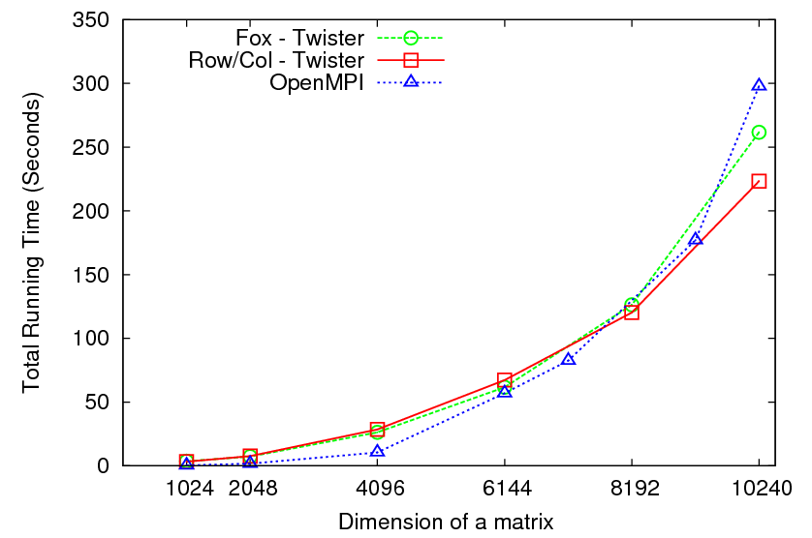
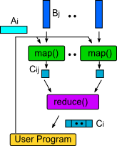
Matrix Multiplication 64 cores
Square blocks Twister
Row/Col decomp Twister
Square blocks OpenMPI

Slide 3
Overhead OpenMPI v Twister negative overhead due to cache

Slide 4
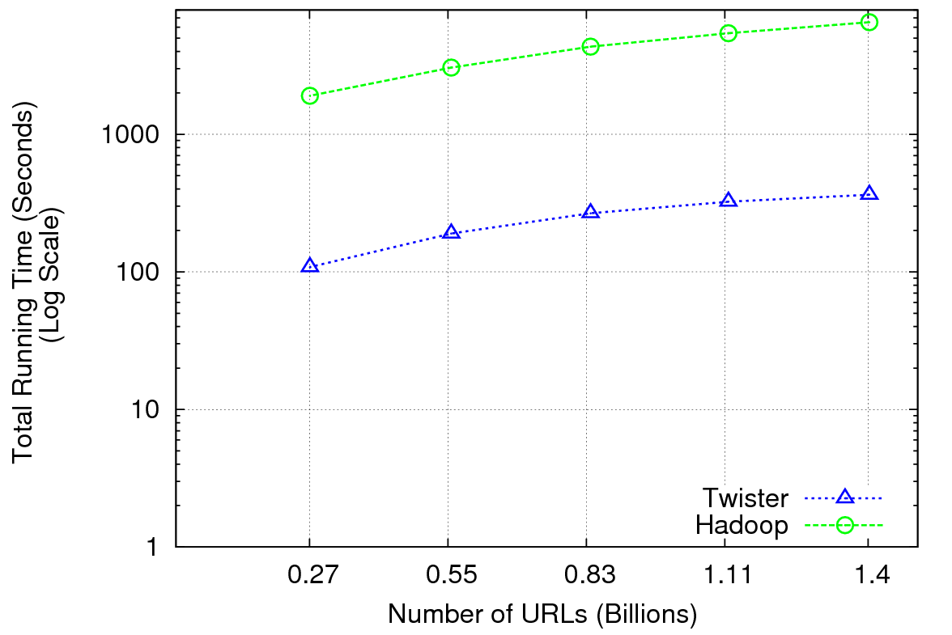
Performance of Pagerank using ClueWeb Data (Time for 20 iterations) using 32 nodes (256 CPU cores) of Crevasse

Slide 5
MPI & Iterative MapReduce papers
MapReduce on MPI Torsten Hoefler, Andrew Lumsdaine and Jack Dongarra, Towards Efficient MapReduce Using MPI, Recent Advances in Parallel Virtual Machine and Message Passing Interface Lecture Notes in Computer Science, 2009, Volume 5759/2009, 240-249
MPI with generalized MapReduce
Jaliya Ekanayake, Hui Li, Bingjing Zhang, Thilina Gunarathne, Seung-Hee Bae, Judy Qiu, Geoffrey Fox Twister: A Runtime for Iterative MapReduce, Proceedings of the First International Workshop on MapReduce and its Applications of ACM HPDC 2010 conference, Chicago, Illinois, June 20-25, 2010 http://grids.ucs.indiana.edu/ptliupages/publications/twister__hpdc_mapreduce.pdf http://www.iterativemapreduce.org/
Grzegorz Malewicz, Matthew H. Austern, Aart J. C. Bik, James C. Dehnert, Ilan Horn, Naty Leiser, and Grzegorz Czajkowski Pregel: A System for Large-Scale Graph Processing, Proceedings of the 2010 international conference on Management of data Indianapolis, Indiana, USA Pages: 135-146 2010
Yingyi Bu, Bill Howe, Magdalena Balazinska, Michael D. Ernst HaLoop: Efficient Iterative Data Processing on Large Clusters, Proceedings of the VLDB Endowment, Vol. 3, No. 1, The 36th International Conference on Very Large Data Bases, September 1317, 2010, Singapore.
Matei Zaharia, Mosharaf Chowdhury, Michael J. Franklin, Scott Shenker, Ion Stoica Spark: Cluster Computing with Working Sets poster at http://radlab.cs.berkeley.edu/w/upload/9/9c/Spark-retreat-poster-s10.pdf

